Slide 1
Streamflow Restoration Planning
Speaker’s name
WRIA 13 Watershed Restoration and Enhancement Plan
date

Slide 2
Streamflow Restoration law RCW 90.94
Clarifies how local governments can issue building permits for homes intending to use a permit-exempt well for their domestic water supply and offsets those impacts through a local watershed planning effort.
Ecology chaired the WRIA 13 Committee, composed of tribes, counties, cities, WDFW, municipal water purveyor, and interest groups. The committee met over the last two years to develop the Watershed Restoration and Enhancement Plan.
Notes:
This is Summary Slide 1. It can be used, along with the next slide, as very high level overviews of the law and plan components.

Slide 3
Watershed Restoration and Enhancement Plan Components
Planning Horizon
2018 - 2038
WRIA Subbasin Delineation
9 subbasins
Projected New Permit-Exempt Wells
2,616 Projected New Permit-Exempt Wells
Estimated Consumptive Use
435 acre-feet per year (0.6 cfs) – most likely estimate
513 acre-feet per year (0.7 cfs) – goal to achieve through adaptive management
Projects and Actions
to offset estimated consumptive use and meet Net Ecological Benefit (NEB)
Notes:
Summary Slide 2. This slide provides an overview of the planning requirements per the law (RCW 90.94). Ecology provided additional guidance and a policy interpretive statement to provide more direction to the committees.
WRIA – Watershed Resources Inventory Area
New permit-exempt wells focus on new wells for domestic use
Consumptive use: For the purposes described here, consumptive water use is considered water that is evaporated, transpired, consumed by humans, or otherwise removed from an immediate water environment due to the use of new permit-exempt domestic wells.
Net Ecological Benefit (NEB): The outcome that is anticipated to occur through implementation of projects and actions in a plan to yield offsets that exceed impacts within: a) the planning horizon; and, b) the relevant WRIA boundary.

Slide 4
Presentation Outline
Background
Streamflow Restoration Law
Role of the Committee
Elements of the Watershed Plan
Steps to Complete Plan
4
Notes:
Long Presentation Outline

Slide 5
What is a permit-exempt domestic well?
Serve single homes, small developments, irrigation of small lawns and gardens
Chapter 90.94 RCW establishes withdrawal limits for permit-exempt domestic well connections in this watershed
Notes:
Certain "small withdrawals" of groundwater are exempt from the permitting process. These uses are commonly referred to as "permit exempt."
Permit-exempt groundwater wells often provide water where a community supply is not available, serving single homes, small developments, irrigation of small lawns and gardens.
90.94 RCW applies to domestic and non-commercial lawn or garden irrigation uses.
90.94 RCW restricts new permit-exempt domestic withdrawals in this WRIA to a maximum annual average of 950 gallons per days per connection, subject to the 5000 gallons per day and ½-acre outdoor irrigation of non-commercial lawn/garden limits established in RCW 90.44.050.
[add any additional talking points relevant to your work in the watershed, such is how your entity works with PE wells, where they are located historically, etc]

Slide 6
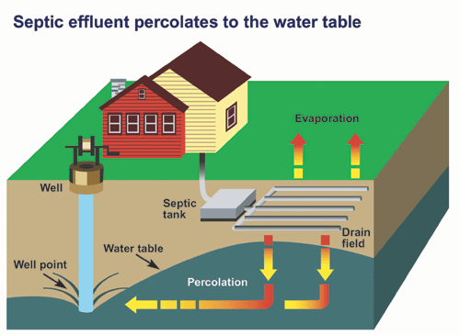
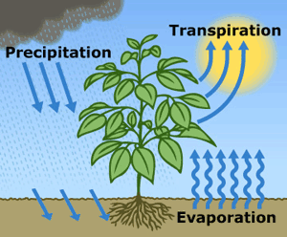
What is consumptive water use?
Water that is evaporated, transpired, consumed by humans, or otherwise removed from an immediate water environment due to the use of new permit-exempt domestic wells.
Indoor Consumptive Use
Outdoor Consumptive Use
10%
80%
90%
20%
Notes:
Source: NEB Guidance Page 5
For indoor water use most houses with domestic wells are connected to septic systems, so it is reasonable to assume that only about 10% is lost from groundwater system.
For outdoor water use a good assumption is that about 80% is lost, mainly due to evapotranspiration.

Slide 7
How are groundwater and streamflows connected?
Notes:
Most groundwater in Washington is hydraulically connected to nearby lakes and streams. In fact, during much of the year, groundwater discharge may make up most of the water in a stream. https://ecology.wa.gov/Water-Shorelines/Water-supply/Protecting-stream-flows

Slide 8
How do wells affect streamflows?
Notes:
When groundwater is pumped and water is put to use, this often leads to a decrease in streamflow. Many factors influence where and how much a groundwater use may affect a stream, such as the nature of the aquifer, the distance between the well and the stream, the well depth, and the type of water use (for example, lawn watering consumes much more water than in-house use that discharges to a septic system). However, at least some portion of the well water used in a home typically has a negative impact on nearby streams. https://ecology.wa.gov/Water-Shorelines/Water-supply/Protecting-stream-flows

Slide 9
Streamflow Restoration Law RCW 90.94
Clarifies how local governments can issue building permits for homes intending to use a permit-exempt well for their domestic water supply and offsets those impacts through a local watershed planning effort.
Notes:
The law, and consequently this watershed plan, is concerned with the identification of projects and actions intended to offset the anticipated impacts from new permit-exempt domestic groundwater withdrawals over the next 20 years and provide a net ecological benefit. In order to aid in project implementation, the law also authorized $300 million in capital funds over the next 15 years.
The local watershed planning effort began with the committee’s formation in each watershed called out in the law. There are 15 watersheds across the state undergoing planning efforts under this law; there are 7 other watersheds that are developing watershed restoration and enhancement plans like ours.

Slide 10
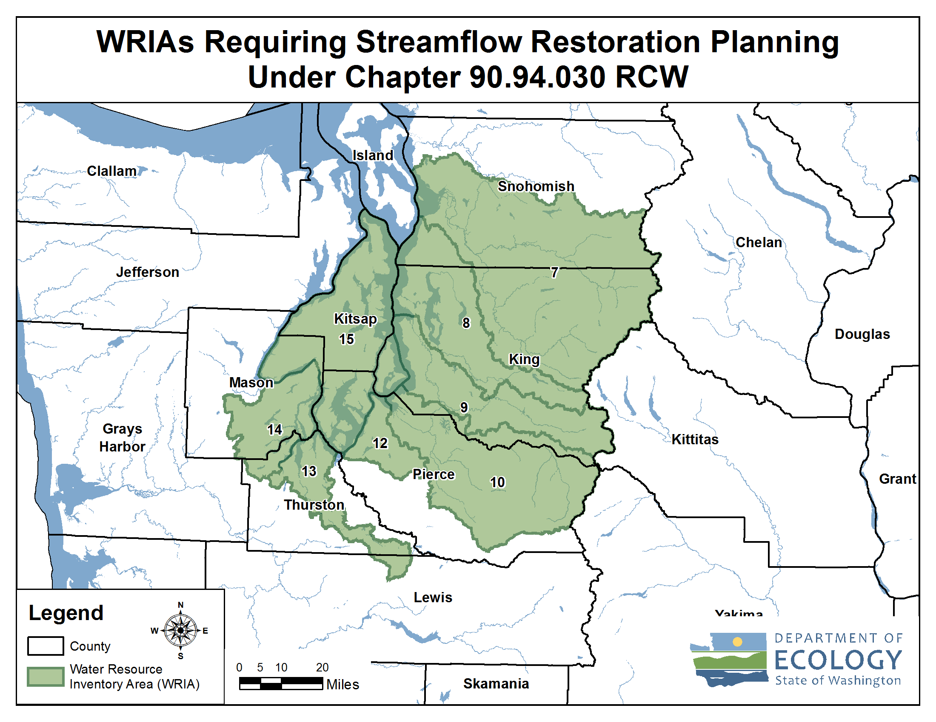
Streamflow Restoration Planning Map
Notes:
These are the watersheds that are developing Watershed Restoration and Enhancement Plans chaired by Ecology.
[Direct to “brochures” if questions about how these WRIAs were selected. Relates to whether instream flow rules addressed PE wells.]
WRIA 13 Committee brochure
https://fortress.wa.gov/ecy/publications/SummaryPages/2011073.html

Slide 11
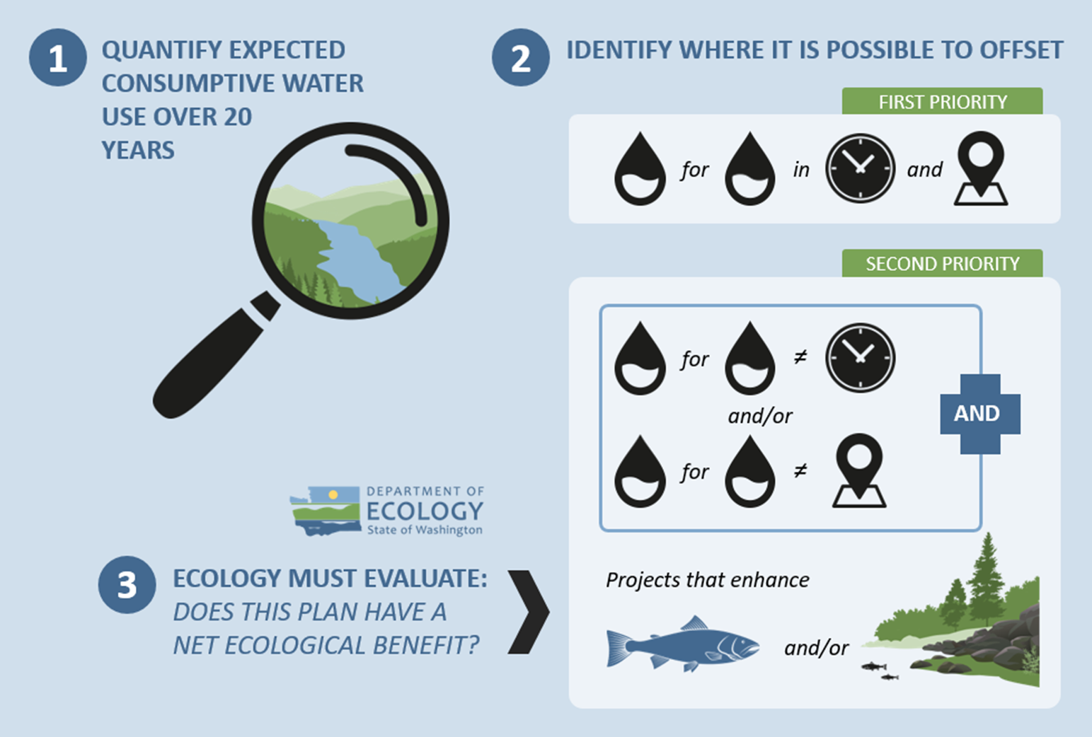
Overview of the Watershed Plan
Notes:
The major steps to complete the plan include:
1. Estimate the consumptive water use of new domestic permit-exempt wells through 2038;
2. Identify projects to offset consumptive use – we must identify projects that provide “water for water” offsets within the WRIA. Projects are not required to provide water offset in the same place or at the same time as well impacts. However, projects that offset water during the same time and in the same areas where wells are expected are a higher priority. The plan also includes projects that enhance habitat for fish.
3. Ecology is then required to evaluate the plan to make a determination of whether it achieves a net ecological benefit.

Slide 12
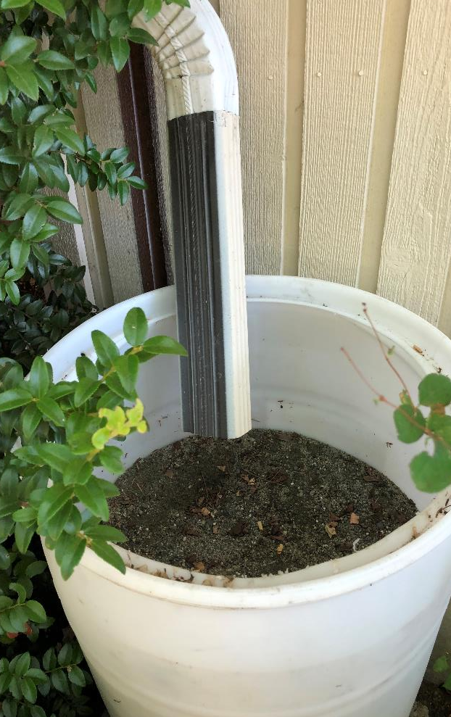
What is offset?
The anticipated ability of a project or action to counterbalance some amount of
the new consumptive water use over the next 20 years (2018-2038).

Slide 13
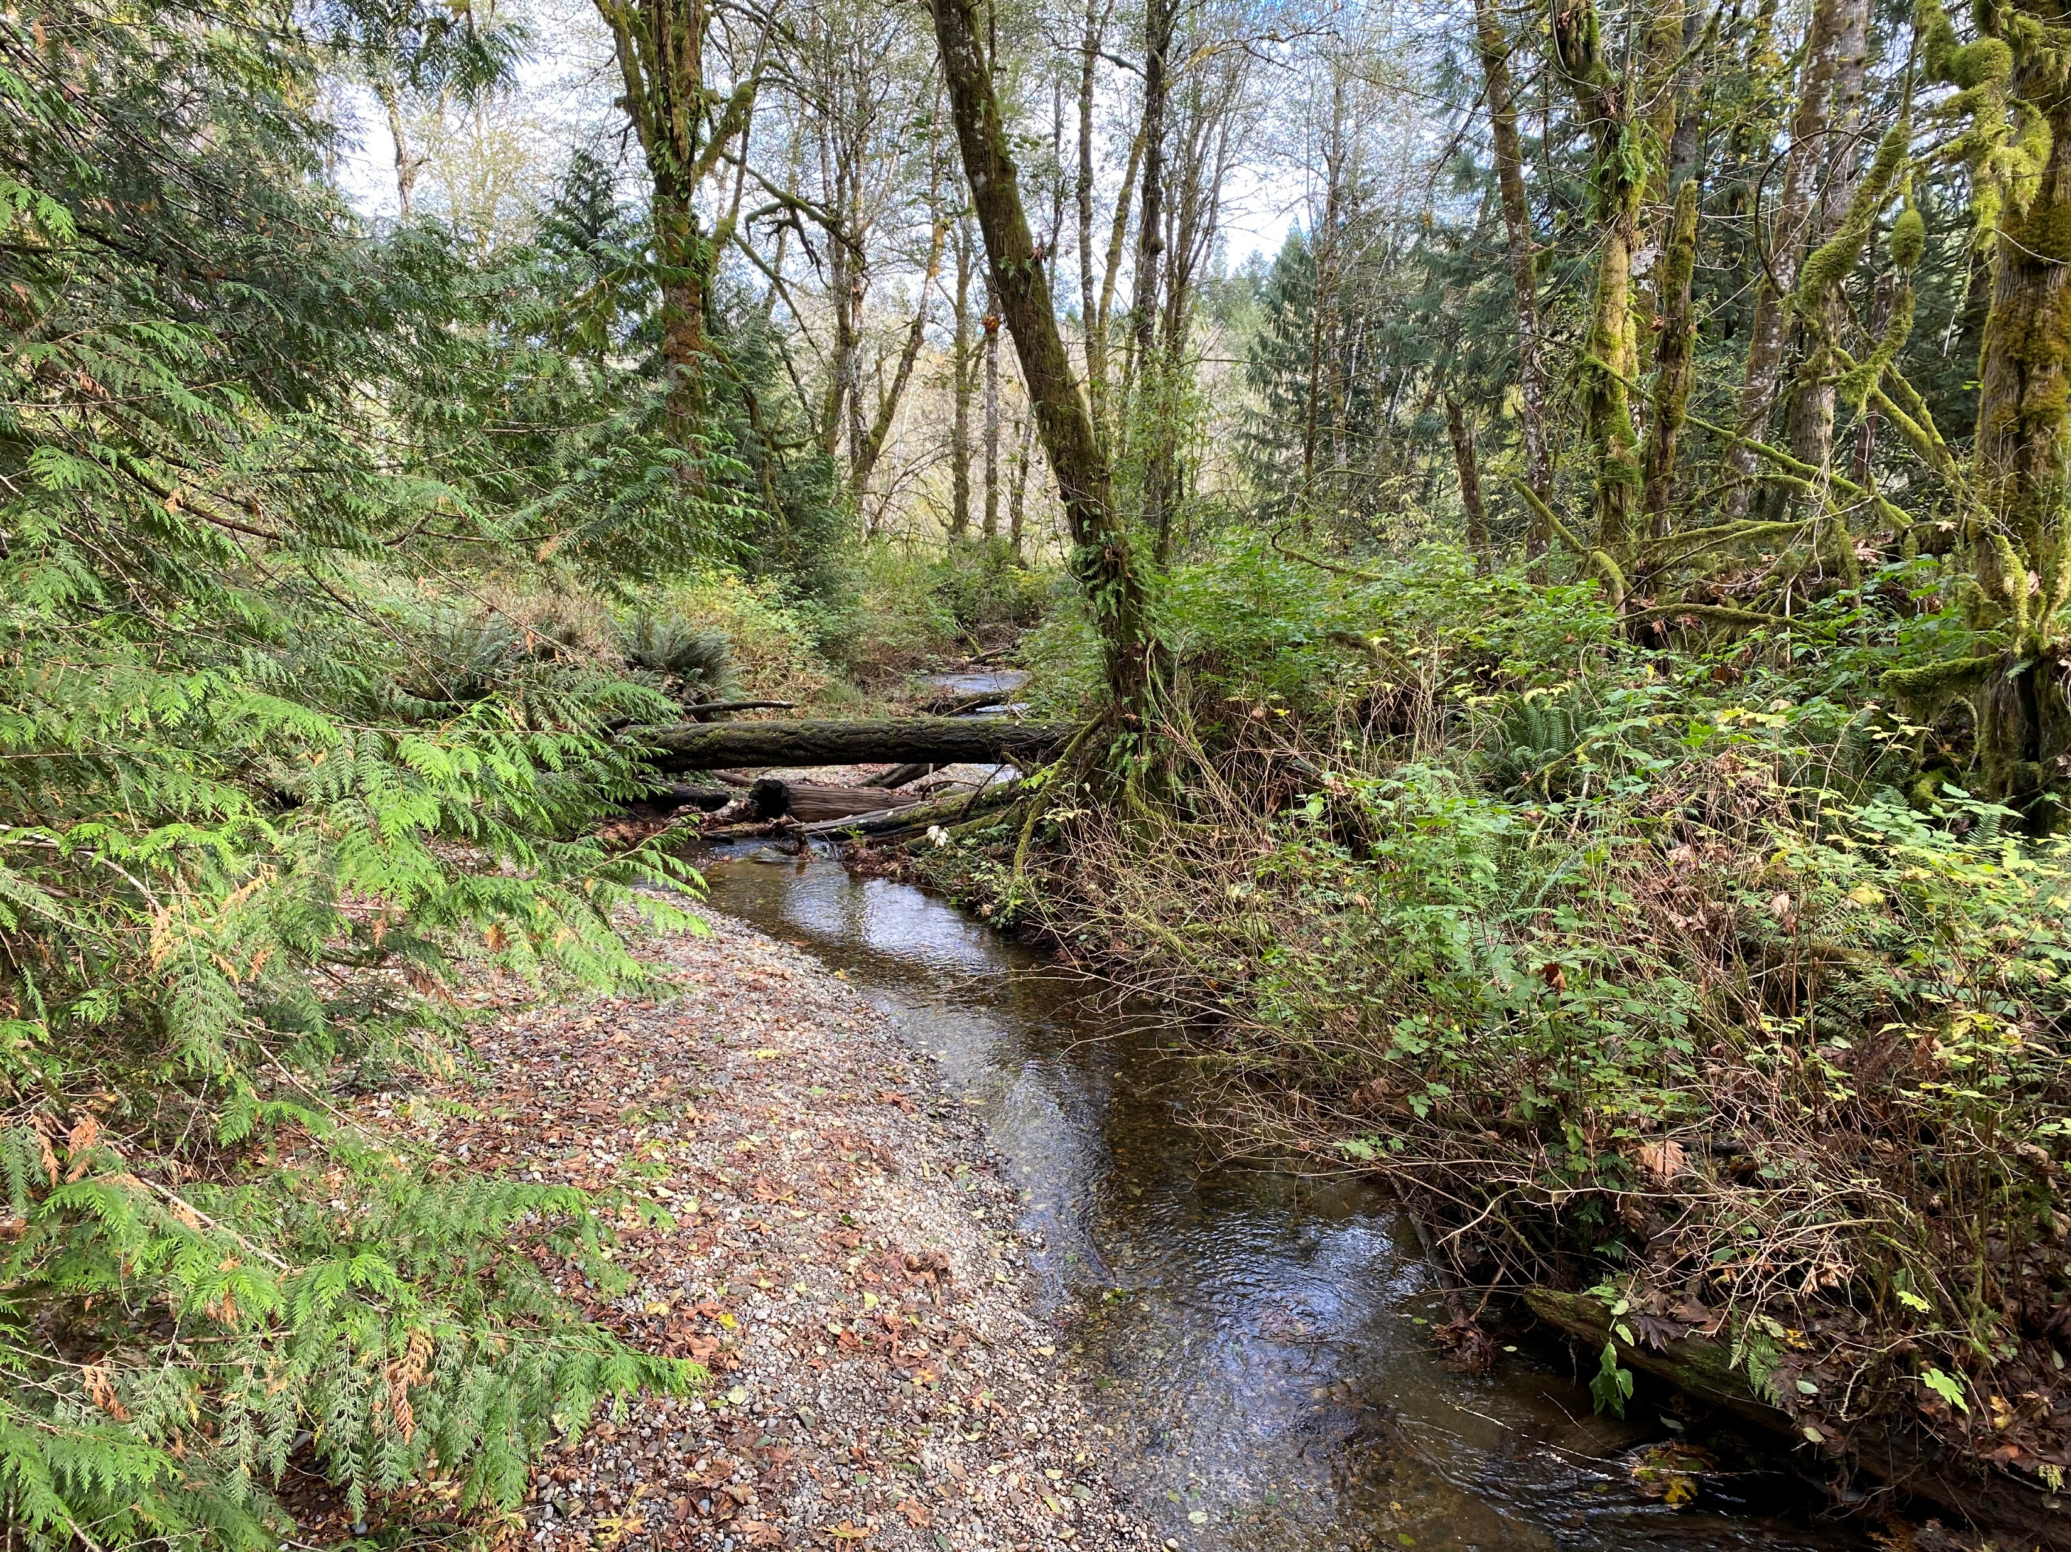
What is Net Ecological Benefit (NEB)?
From Ecology’s Final NEB Guidance
“…local planning groups are best situated, and will therefore determine the appropriate amount of benefits beyond the offsetting of projected impacts …”
Notes:
Ecology released Final NEB Guidance in July 2019 to support committees in their planning process.
NEB is the outcome that is anticipated to occur through implementation of projects in a plan to yield offsets that exceed impacts within the planning horizon and WRIA boundary.
[Prompt for speaker to make comments: Please reflect on the committee’s work regarding NEB (based on your view)
For example:
Through the committee discussions, meetings, and plan writing, it is our opinion that this plan meets NEB. The committee estimated a consumptive use of 435 acre-feet per year, and identified projects that provide a potential offset of 1,316 acre-feet. The plan includes additional projects that that provide habitat benefits to the WRIA. Through the combination of water offset and habitat projects, we anticipate that the plan achieves a net ecological benefit. ]

Slide 14
Watershed Restoration and Enhancement Committee
Entity Name | Representing
Squaxin Island Tribe | Tribal government
Lewis County | County government
Thurston County | County government
City of Lacey | City government
City of Olympia | City government
City of Tumwater | City government
Public Utility District No. 1 of Thurston County | Water utility
Washington Department of Fish and Wildlife | State agency
Washington Department of Ecology | State agency
Thurston Conservation District | Agricultural interests
Building Industry Association of Washington | Residential construction industry
Deschutes Estuary Restoration Team | Environmental interests
WRIA 13 Salmon Habitat Recovery Lead Entity | Ex-officio
LOTT Clean Water Alliance | Ex-officio
Nisqually Indian Tribe | Ex-officio
City of Yelm | Ex-officio
City of Tenino | Ex-officio

Slide 15
Roles of Committee and Ecology
Committee
Develops Watershed Plan
Approves Plan
Ecology
Determines NEB
Adopts Plan

Slide 16
Watershed Restoration and Enhancement Plan Components
Planning Horizon
2018 - 2038
WRIA Subbasin Delineation
9 subbasins
Projected New Permit-Exempt Wells
2,616 Projected New Permit-Exempt Wells
Estimated Consumptive Use
435 acre-feet per year (0.6 cfs) – most likely estimate
513 acre-feet per year (0.7 cfs) – goal to achieve through adaptive management
Projects and Actions
to offset estimated consumptive use and meet Net Ecological Benefit (NEB)
Policy and Adaptive Management
Recommendations that contribute to the goal of streamflow restoration

Slide 17
Delineate Subbasins
The WRIA 13 Committee divided WRIA 13 into 9 subbasins for the purposes of assessing consumptive use and project offsets.
Subbasins help describe the location and timing of projected new consumptive water use, the location and timing of impacts to instream resources, and the necessary scope, scale, and anticipated benefits of projects.
Notes:
Subbasin delineation was helpful in describing the location and timing of projected new consumptive water use, the location and timing of impacts to instream resources, and the necessary scope, scale, and anticipated benefits of projects. In some instances, subbasins may not correspond with hydrologic or geologic basin delineations (e.g. watershed divides)

Slide 18
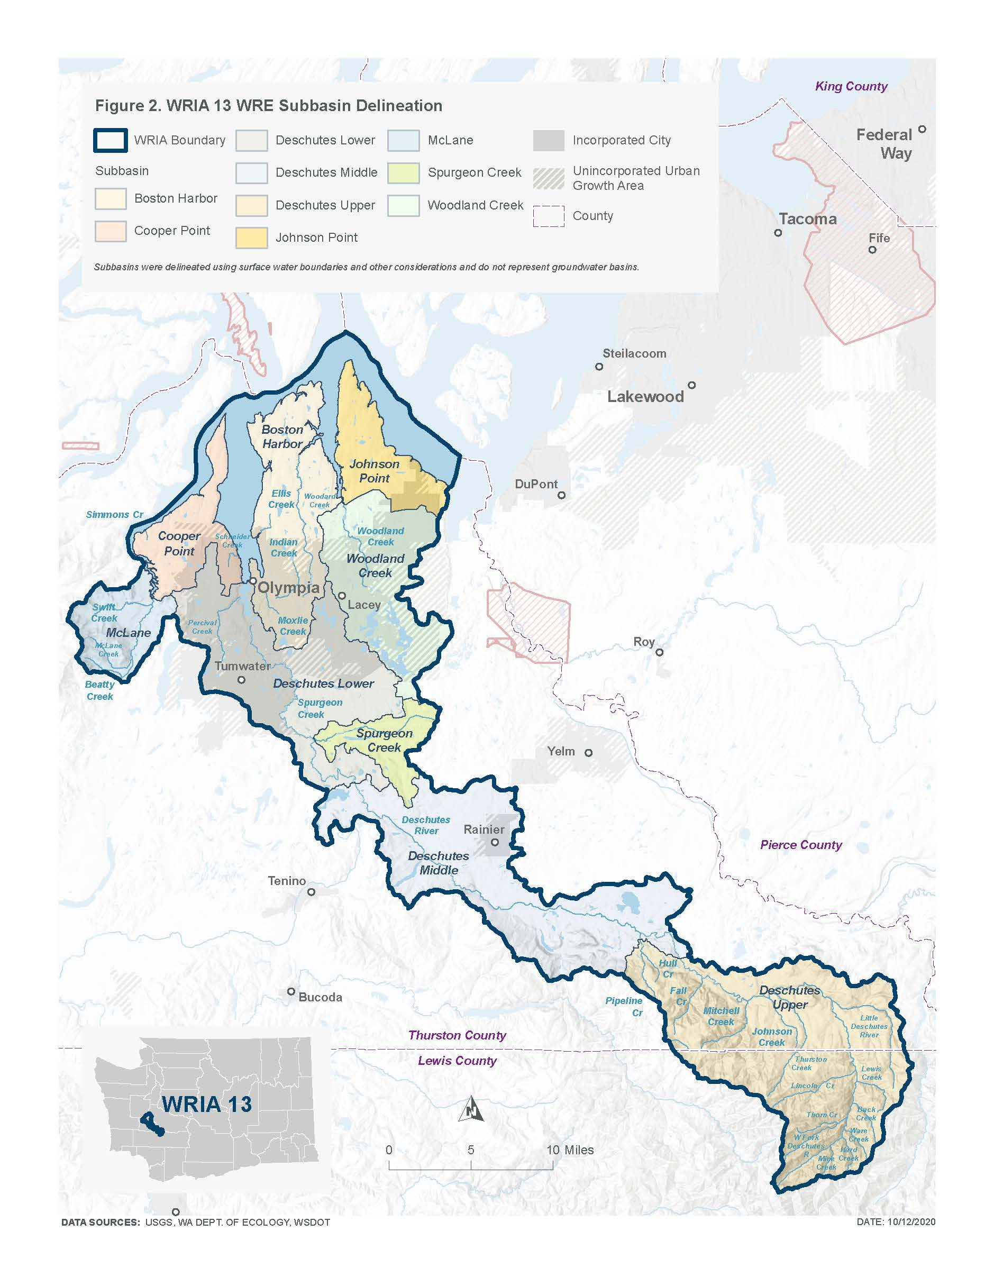
Subbasin Delineation

Slide 19
Project New Permit-Exempt Wells
The WRIA 13 Committee projects 2,616 new PE wells over the planning horizon. Note that Thurston County and Lewis County are both within WRIA 13; however, the Lewis County portion of WRIA 13 is entirely comprised of timberland and thus was not included in the projection for new PE wells.
Notes:
This Committee developed a method that they agreed was appropriate to project the number of new PE wells over the planning horizon in the WRIA, in order to estimate new consumptive water use. This method, referred to as the PE well projection method, is based on recommendations from Appendix A of Ecology’s Final NEB Guidance (Ecology 2019).
[add any specific talking points relevant to the method to project wells that is relevant to the audience, along with other important details]

Slide 20
Projected New Permit-Exempt Wells
Subbasin | Projected New PE Wells
Boston Harbor | 296
Cooper Point | 232
Deschutes Lower | 379
Deschutes Middle | 734
Deschutes Upper | 30
Johnson Point | 520
McLane | 165
Spurgeon Creek | 92
Woodland Creek | 168
Total | 2,616

Slide 21
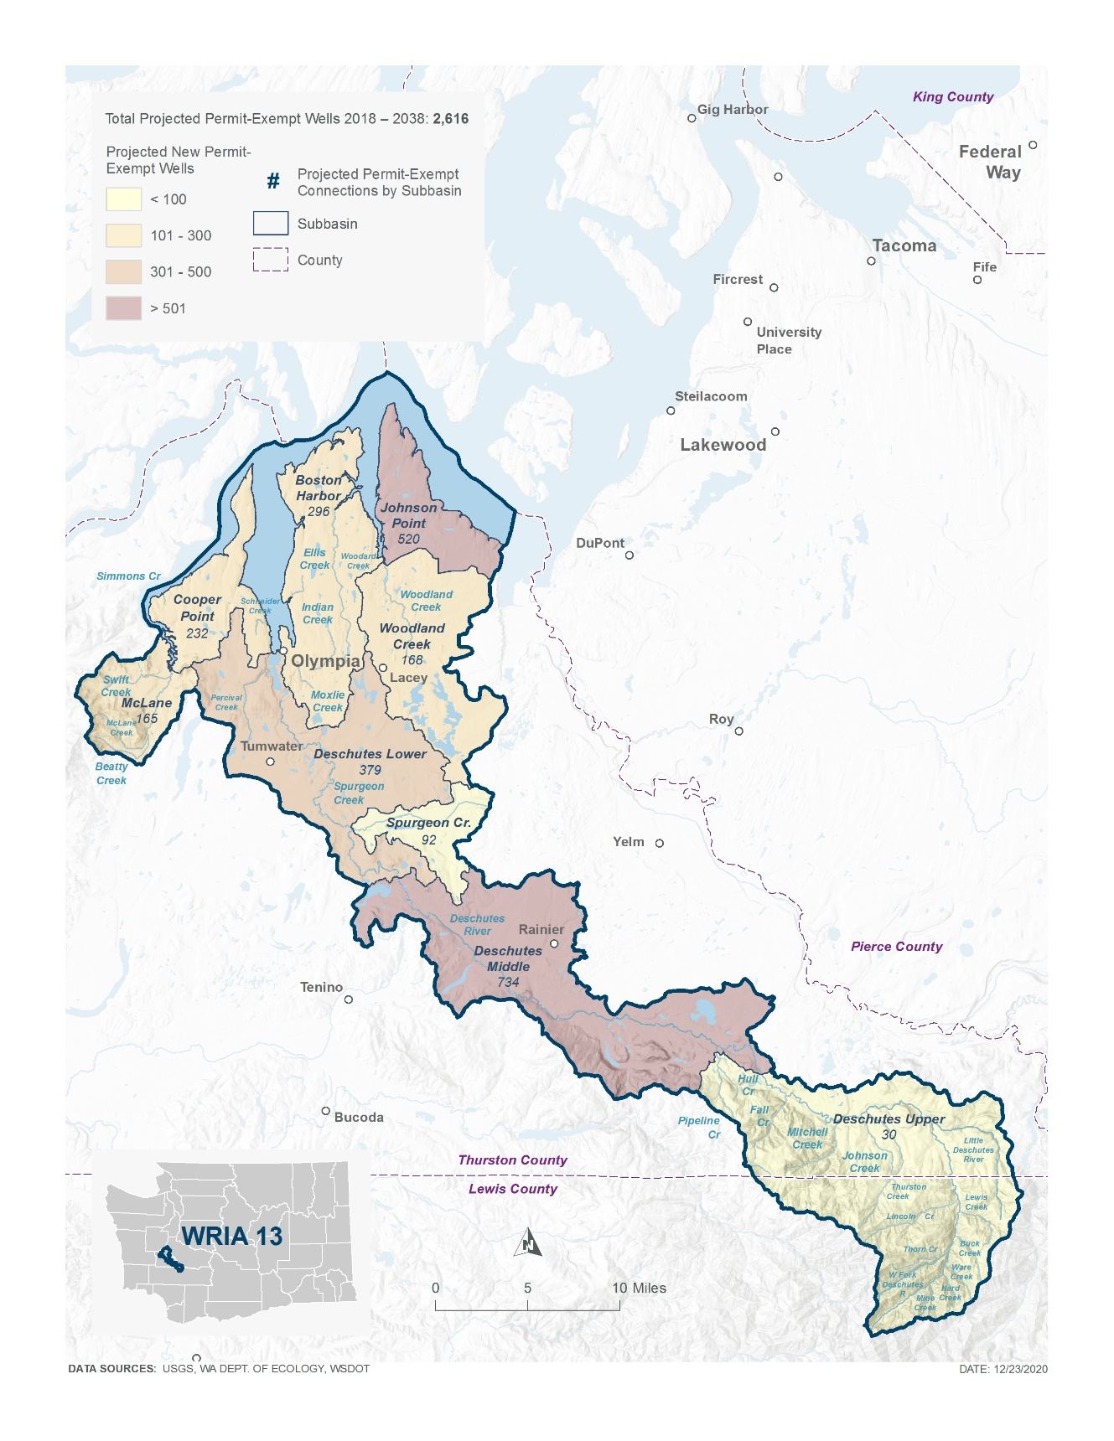
New Permit-Exempt Wells Map

Slide 22
Estimate New Consumptive Water Use
The WRIA 13 Committee agreed to a 20-year projection for WRIA 13 of 2,616 new PE wells to estimate the consumptive water use that this watershed plan must address and offset.
The WRIA 13 Committee estimates 435 afy (0.6 cfs) of new consumptive water use in WRIA 13 as the “most likely” estimate.
The Committee also included a higher consumptive use estimate to achieve through adaptive management of 513 afy (0.7 cfs).
Additional information is included in the plan for context showing the water use assuming the maximum outdoor watering limit of 0.5 acres, and the maximum legal withdrawal limit of 950 gallons per day.
Notes:
The Consumptive Use Estimates Technical Memorandum provides a more detailed description of the analysis and alternative scenarios considered (Appendix)
[add any specific talking points relevant to the method to estimate CU that is relevant to the audience, along with other important details]

Slide 23
Estimated New Consumptive Water Use
 |  |  | Assumed Irrigated Acreage of 0.10 Acre (“Most Likely” Estimate) |  | Assumed Irrigated Acreage of 0.12 Acre (Higher Adaptive Management Estimate) |  | Water System Data | Maximum Outdoor Watering Limit (0.5 acres) | Maximum Withdrawal Limit (950 gpd)
Subbasin | Projected new PE Wells | Indoor CU (AFY) | Outdoor CU (AFY) | Total CU/year (AFY) | Outdoor CU (AFY) | Total CU/year (AFY) | Total CU/year (AFY) | Total CU/year (AFY) | Total CU/year (AFY)
Boston Harbor | 296 | 5 | 44 | 49 | 53 | 58 | 52 | 226 | 217
Cooper Point | 232 | 4 | 35 | 39 | 42 | 45 | 41 | 177 | 170
Deschutes Lower | 379 | 6 | 57 | 63 | 68 | 74 | 67 | 289 | 278
Deschutes Middle | 734 | 12 | 110 | 122 | 132 | 144 | 129 | 560 | 539
Deschutes Upper | 30 | 1 | 4 | 5 | 5 | 6 | 5 | 23 | 22
Johnson Point | 520 | 9 | 78 | 86 | 93 | 102 | 92 | 397 | 382
McLane | 165 | 3 | 25 | 27 | 30 | 32 | 29 | 126 | 121
Spurgeon Creek | 92 | 2 | 14 | 15 | 16 | 18 | 16 | 70 | 68
Woodland Creek | 168 | 3 | 25 | 28 | 30 | 33 | 30 | 128 | 123
Total | 2,616 | 44 | 391 | 435 | 469 | 513 | 461 | 1,997 | 1,921

Slide 24
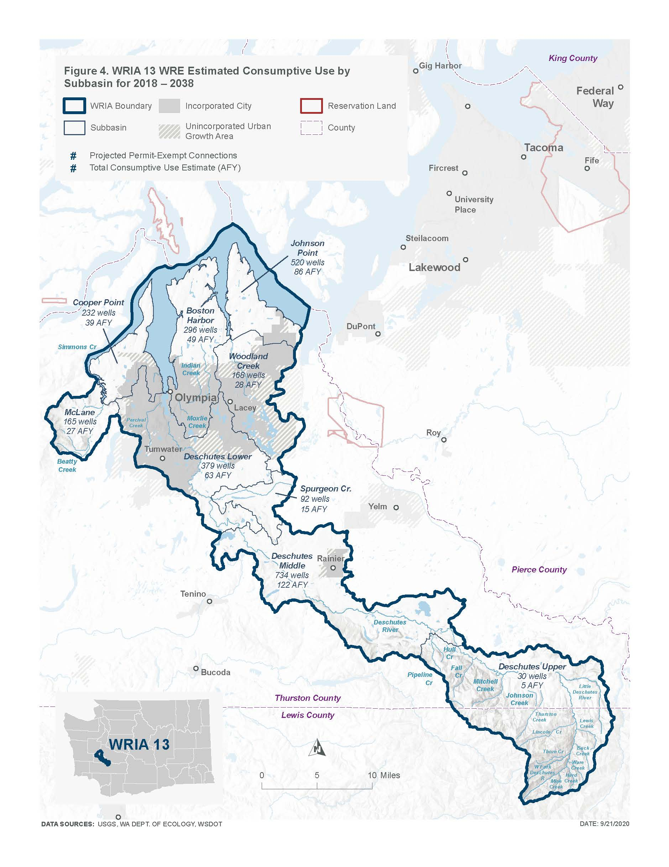
New Consumptive Water Use Map

Slide 25
Types of Projects & Actions
Non-Acquisition Water Offset Projects
Habitat and Other Related Projects
Notes:
The committee is finalizing project selection, developing project descriptions and evaluations, and writing an adaptive management component for the watershed plan.

Slide 26
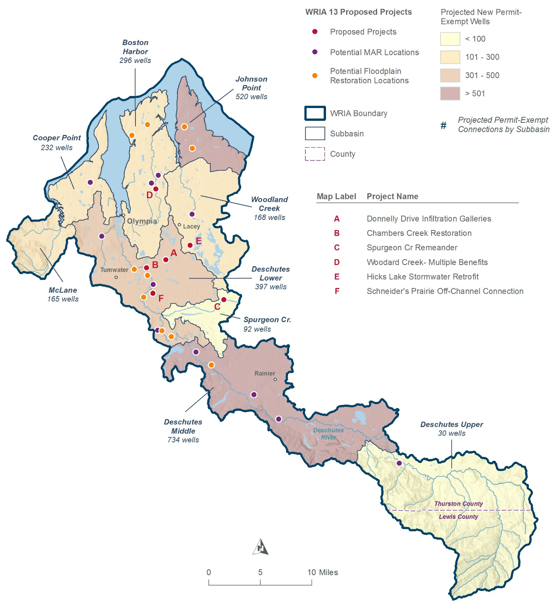
Projects Overview Map

Slide 27
Water Offset Projects
Schneider’s Prairie Off-Chanel Connection
Off-channel reconnection and infiltration
Subbasin: Lower Deschutes
Hicks Lake Stormwater Retrofit
Stormwater infiltration in series with existing stormwater treatment
Subbasin: Woodland
Donnelly Drive Infiltration Ponds
Improve neighborhood stormwater infiltration, avoiding surcharge and runoff to Chambers ditch
Subbasin: Lower Deschutes
Managed Aquifer Recharge
Categorical project that will include potential site locations in priority subbasins

Slide 28
WRIA 13 Water Offset Projects
Project Name | Project Type and Description | Subbasin | Estimated Water Offset (AFY) | Offset Claimed by WRIA 13 Committee (AFY)
Schneider's Prairie Off-Channel Connection | Off-channel reconnection and infiltration | Lower Deschutes | 681 | 681
Hicks Lake Stormwater Retrofit | Stormwater infiltration in series with existing stormwater treatment | Woodland | 296 | 296
Donnelly Drive Infiltration | Improve neighborhood stormwater infiltration, avoiding surcharge and runoff to Chambers ditch. | Lower Deschutes | 14 | 14
Deschutes/ Chambers MAR | Several candidate locations for MAR of diverted Deschutes River water from high flow periods, exceeding instream minimum flows or ecological flows. | Upper Deschutes Middle Deschutes Lower Deschutes Woodland Boston Harbor Cooper Point | 811 | 325
WRIA 13 Total Water Offset |  |  | 1,802 | 1,316
WRIA 13 Consumptive Use Estimate |  |  | 435
WRIA 13 Higher Adaptive Management Consumptive Use Estimate |  |  | 513

Slide 29
WRIA 13 Habitat/Non-offset Projects
Project Name | Description | Subbasin | Anticipated Ecological Benefit
Spurgeon Creek Re-meander | Channel re-alignment to increase channel length and sinuosity | Spurgeon | Floodplain connectivity; Instream habitat complexity
Chambers Creek | Channel re-alignment to increase channel length and sinuosity at the confluence with Chambers Ditch. | Lower Deschutes | Floodplain connectivity; Instream habitat complexity
Woodard Creek | Add LWD and riparian vegetation | Boston Harbor | Floodplain connectivity; Instream habitat complexity

Slide 30
WRIA 13 Prospective Projects
Water Right Opportunities/Efficiency Projects
Forest Stand Age
The committee is interested in voluntary projects that involve forest conservation, forest land acquisition, carbon sequestration that can be demonstrated to have a streamflow benefit.
Floodplain Restoration
The Committee is interested in restoring stream floodplain function, where appropriate.
Small-scale LID Project Development
The Committee is interested in a programmatic project to strategically concentrate small-scale LID retrofit work in urbanized settings, partnering with residential and commercial community members to redirect runoff away from stormwater conveyance systems and into green stormwater infiltration facilities.

Slide 31
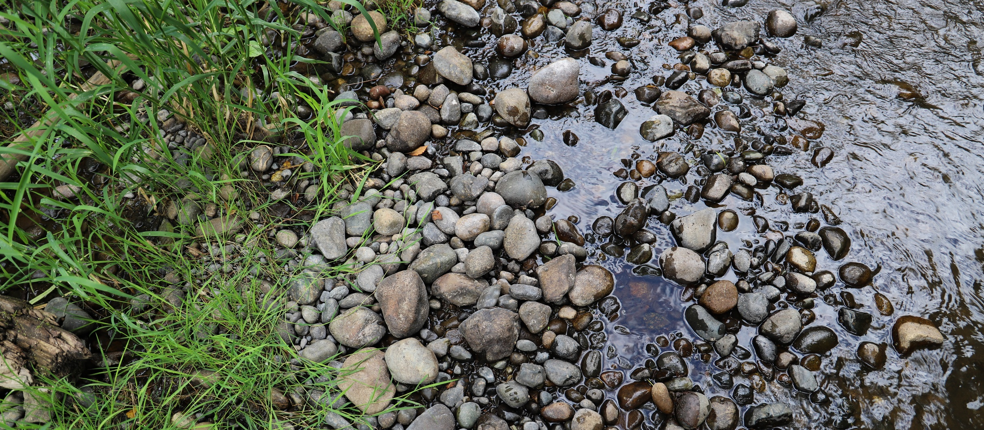
Policy and Adaptive Management Recommendations
As required by the NEB Guidance, the Committee prepared the watershed plan with implementation in mind. However, as articulated in the Streamflow Restoration Policy and Interpretive Statement (POL-2094), “RCW 90.94.020 and 90.94.030 do not create an obligation on any party to ensure that plans, or projects and actions in those plans or associated with rulemaking, are implemented."

Slide 32
WRIA 13 Policy Recommendations
Water Conservation and Drought Adaptation Education and Outreach
Drought Response Limits
County Policies to Promote Connections to Group A Systems
Revolving Loan & Grant Fund for Small Public Water Systems
South Sound Water Steward
Upgrade Well Reporting
Instream Flow Rules
Permit Exempt Well Withdrawal Limits
Salmon Recovery Portal Project Tracking
Deschutes Watershed Council (DWC)
County Planning Study – Streamflow Restoration Effectiveness
Water Supply Data for Comprehensive Water Planning
Rainwater Collection – Education and Incentives
Water Conservation Statewide Policy
Revise Thurston County Critical Areas Code Regarding Reclaimed Water use

Slide 33
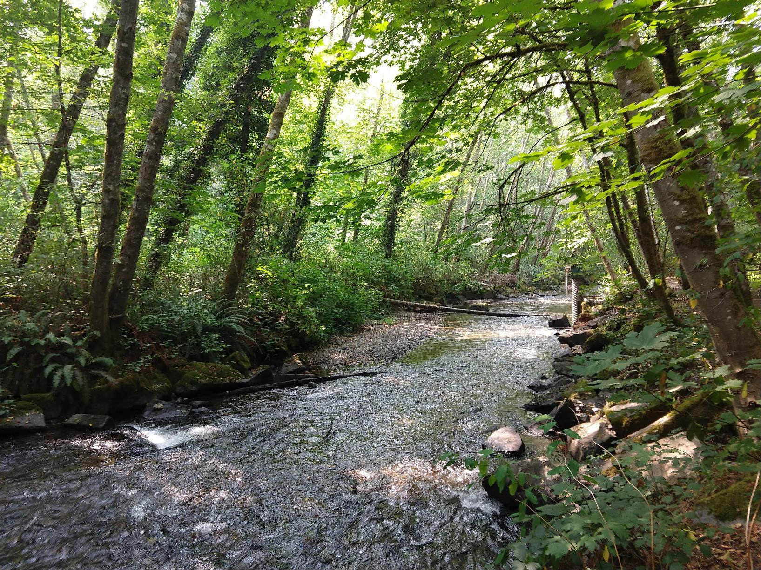
Plan Implementation and Adaptive Management
The WRIA 13 Committee supports an adaptive management process for implementation of the WRIA 13 Watershed Plan. Adaptive management will help address uncertainty and provide more reasonable assurance for plan implementation.

Slide 34
Plan Implementation and Adaptive Management Recommendations
Oversight
Project Tracking
Monitoring and Research
Funding
Legislative funding is requested for all policy recommendations except the Salmon Recovery Portal Project Tracking

Slide 35
Steps to Complete the Plan
Committee members meet (virtually) for the final vote on the plan in mid-April
If all members of the Committee approve the plan, the Committee chair will submit the plan to Ecology for review and NEB determination.
If the Committee does not approve the plan, Ecology will prepare the plan. Ecology will send the plan to the Salmon Recovery Funding Board for technical Review. Ecology will then finalize the plan and the Director shall initiate rulemaking.

Slide 36
Post Plan Submission to Ecology
SEPA public comment period
No changes to plan after submission
Ecology will review plan
Ecology will determine action by June 30, 2021

Slide 37
Thank you for your time!
Any questions?

Slide 38
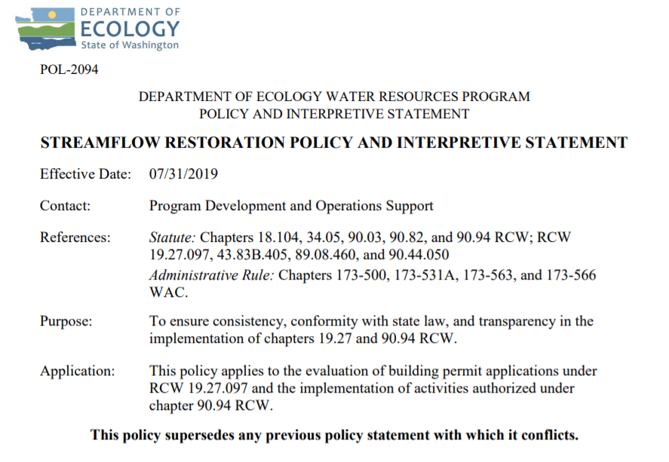
Ecology’s Policy Interpretation
More information on the Streamflow Restoration law can be found online
Notes:
RCW 90.94.030 adds to the management regime for new homes using domestic permit-exempt well withdrawals in this WRIA and elsewhere. For example, local governments must, among other responsibilities relating to new permit-exempt domestic wells, collect a $500 fee for each building permit and record withdrawal restrictions on the title of the affected properties. Additionally, this law restricts new permit-exempt domestic withdrawals in this WRIA to a maximum annual average of up to 950 gallons per days per connection, subject to the five thousand gallons per day and ½-acre outdoor irrigation of non-commercial lawn/garden limits established in RCW 90.44.050. Ecology has published its interpretation and implementation of RCW 19.27.097 and RCW 90.94 in Water Resources POL 2094.

Slide 39
Ecology’s NEB Guidance
More information on the Final Guidance for Determining Net Ecological Benefit can be found online
Notes:
After conducting a thorough scientific literature review, Ecology has determined that NEB is not a technical term that has been defined in the natural sciences. Instead, it is a creation of the Washington State Legislature. Therefore, Ecology has prepared this guidance for interpretation and application of this term. This guidance provides supplemental information, beyond that provided expressly in the law, for those groups engaged in the watershed planning work required by RCW 90.94.020 and RCW 90.94.030.

Slide 40
WRIA 13 Committee Brochure
More information on WRIA 13 Committee can be found online
Notes:
EDIT PER WRIA so there is a screenshot of the brochure and a link

Slide 41
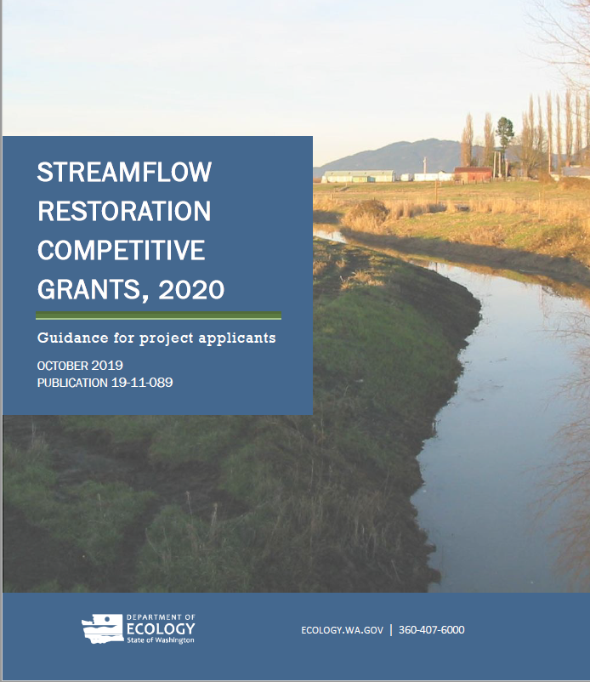
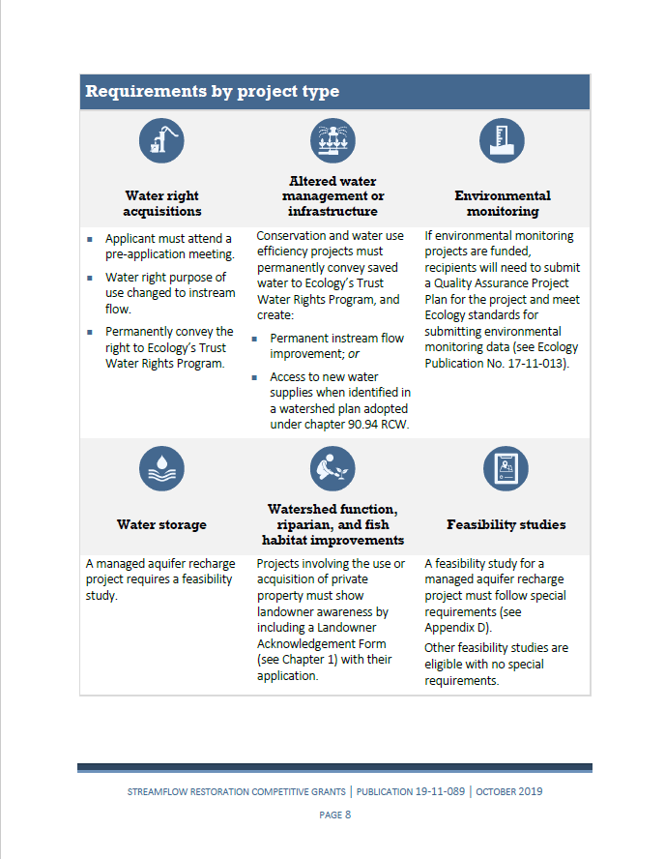
Grants Guidance Overview

