Slide 1
Streamflow Restoration Planning
Speakers name
WRIA 14 Watershed Restoration and Enhancement Plan
date

Slide 2
Streamflow Restoration law RCW 90.94
Clarifies how local governments can issue building permits for homes intending to use a permit-exempt well for their domestic water supply and offsets those impacts through a local watershed planning effort.
Ecology chaired the WRIA 14 Committee, composed of tribes, counties, cities, WDFW, municipal water purveyor, and interest groups. The committee met over the last two years to develop the Watershed Restoration and Enhancement Plan.
Notes:
This is Summary Slide 1. It can be used, along with the next slide, as very high level overviews of the law and plan components.

Slide 3
Watershed Restoration and Enhancement Plan Components
Planning Horizon
2018 - 2038
WRIA Subbasin Delineation
8 subbasins
Projected New Permit-Exempt Wells
4,294 Projected New Permit-Exempt Wells
Estimated Consumptive Use
759 acre-feet per year (1.04 cfs) – most likely estimate
1,034 acre-feet per year (1.43 cfs) – goal to achieve through adaptive management
Projects and Actions
to offset estimated consumptive use and meet Net Ecological Benefit (NEB)
Notes:
Summary Slide 2. This slide provides an overview of the planning requirements per the law (RCW 90.94). Ecology provided additional guidance and a policy interpretive statement to provide more direction to the committees.
WRIA – Watershed Resources Inventory Area
New permit-exempt wells focus on new wells for domestic use
Consumptive use: For the purposes described here, consumptive water use is considered water that is evaporated, transpired, consumed by humans, or otherwise removed from an immediate water environment due to the use of new permit-exempt domestic wells.
Net Ecological Benefit (NEB): The outcome that is anticipated to occur through implementation of projects and actions in a plan to yield offsets that exceed impacts within: a) the planning horizon; and, b) the relevant WRIA boundary.

Slide 4
Presentation Outline
Background
Streamflow Restoration Law
Role of the Committee
Elements of the Watershed Plan
Steps to complete Plan
4
Notes:
Long Presentation Outline

Slide 5
What is a permit-exempt domestic well?
Serve single homes, small developments, irrigation of small lawns and gardens
Chapter 90.94 RCW establishes withdrawal limits for permit-exempt domestic well connections in this watershed
Notes:
Certain "small withdrawals" of groundwater are exempt from the permitting process. These uses are commonly referred to as "permit exempt."
Permit-exempt groundwater wells often provide water where a community supply is not available, serving single homes, small developments, irrigation of small lawns and gardens.
90.94 RCW applies to domestic and non-commercial lawn or garden irrigation uses.
90.94 RCW restricts new permit-exempt domestic withdrawals in this WRIA to a maximum annual average of 950 gallons per days per connection, subject to the 5000 gallons per day and ½-acre outdoor irrigation of non-commercial lawn/garden limits established in RCW 90.44.050.
[add any additional talking points relevant to your work in the watershed, such is how your entity works with PE wells, where they are located historically, etc]

Slide 6
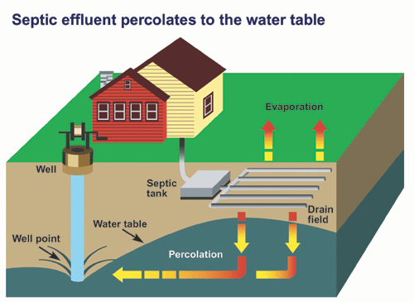
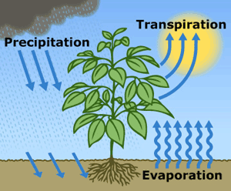
What is consumptive water use?
Water that is evaporated, transpired, consumed by humans, or otherwise removed from an immediate water environment due to the use of new permit-exempt domestic wells.
Indoor Consumptive Use
Outdoor Consumptive Use
10%
80%
90%
20%
Notes:
Source: NEB Guidance Page 5
For indoor water use most houses with domestic wells are connected to septic systems, so it is reasonable to assume that only about 10% is lost from groundwater system.
For outdoor water use a good assumption is that about 80% is lost, mainly due to evapotranspiration.

Slide 7
How are groundwater and streamflows connected?
Notes:
Most groundwater in Washington is hydraulically connected to nearby lakes and streams. In fact, during much of the year, groundwater discharge may make up most of the water in a stream. https://ecology.wa.gov/Water-Shorelines/Water-supply/Protecting-stream-flows

Slide 8
How do wells affect streamflows?
Notes:
When groundwater is pumped and water is put to use, this often leads to a decrease in streamflow. Many factors influence where and how much a groundwater use may affect a stream, such as the nature of the aquifer, the distance between the well and the stream, the well depth, and the type of water use (for example, lawn watering consumes much more water than in-house use that discharges to a septic system). However, at least some portion of the well water used in a home typically has a negative impact on nearby streams. https://ecology.wa.gov/Water-Shorelines/Water-supply/Protecting-stream-flows

Slide 9
Streamflow Restoration Law RCW 90.94
Clarifies how local governments can issue building permits for homes intending to use a permit-exempt well for their domestic water supply and offsets those impacts through a local watershed planning effort.
Notes:
The law, and consequently this watershed plan, is concerned with the identification of projects and actions intended to offset the anticipated impacts from new permit-exempt domestic groundwater withdrawals over the next 20 years and provide a net ecological benefit. In order to aid in project implementation, the law also authorized $300 million in capital funds over the next 15 years.
The local watershed planning effort began with the committee’s formation in each watershed called out in the law. There are 15 watersheds across the state undergoing planning efforts under this law; there are 7 other watersheds that are developing watershed restoration and enhancement plans like ours.

Slide 10
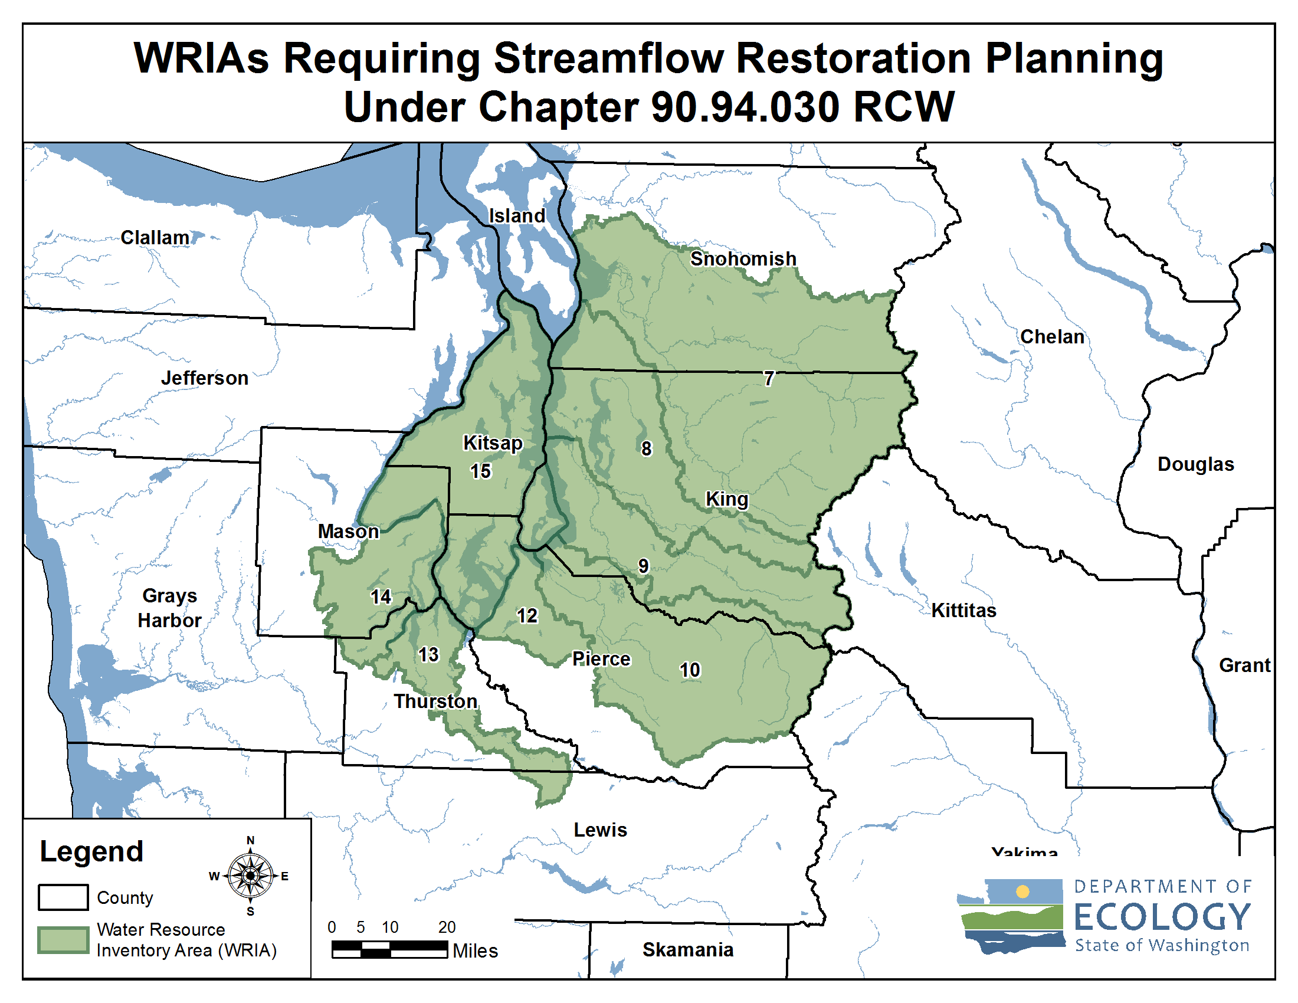
Streamflow Restoration Planning Map
Notes:
These are the watersheds that are developing Watershed Restoration and Enhancement Plans chaired by Ecology.
[Direct to “brochures” if questions about how these WRIAs were selected. Relates to whether instream flow rules addressed PE wells.]
WRIA 14 Committee brochure
https://fortress.wa.gov/ecy/publications/SummaryPages/2011074.html

Slide 11
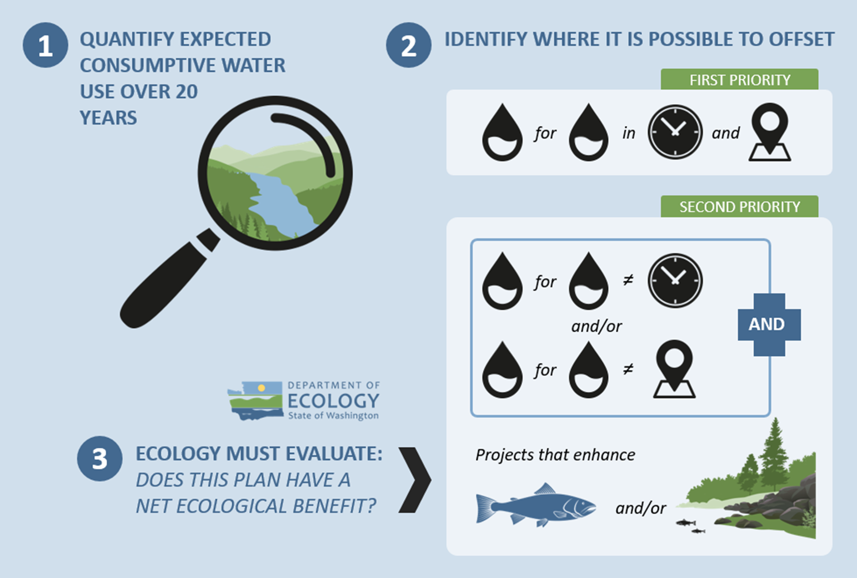
Overview of the Watershed Plan
Notes:
The major steps to complete the plan include:
1. Estimate the consumptive water use of new domestic permit-exempt wells through 2038;
2. Identify projects to offset consumptive use – we must identify projects that provide “water for water” offsets within the WRIA. Projects are not required to provide water offset in the same place or at the same time as well impacts. However, projects that offset water during the same time and in the same areas where wells are expected are a higher priority. The plan also includes projects that enhance habitat for fish.
3. Ecology is then required to evaluate the plan to make a determination of whether it achieves a net ecological benefit.

Slide 12
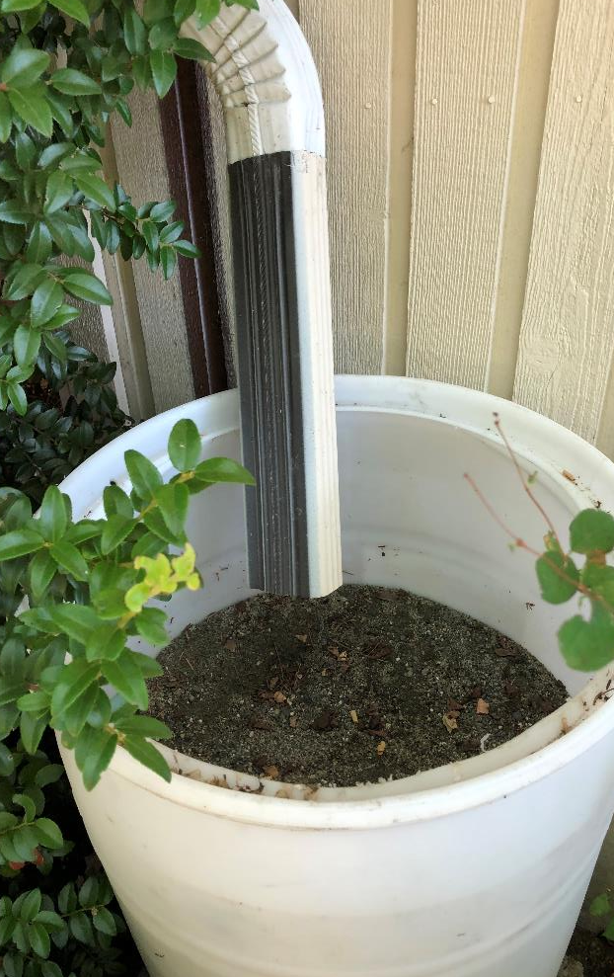
What is offset?
The anticipated ability of a project or action to counterbalance some amount of
the new consumptive water use over the next 20 years (2018-2038).

Slide 13
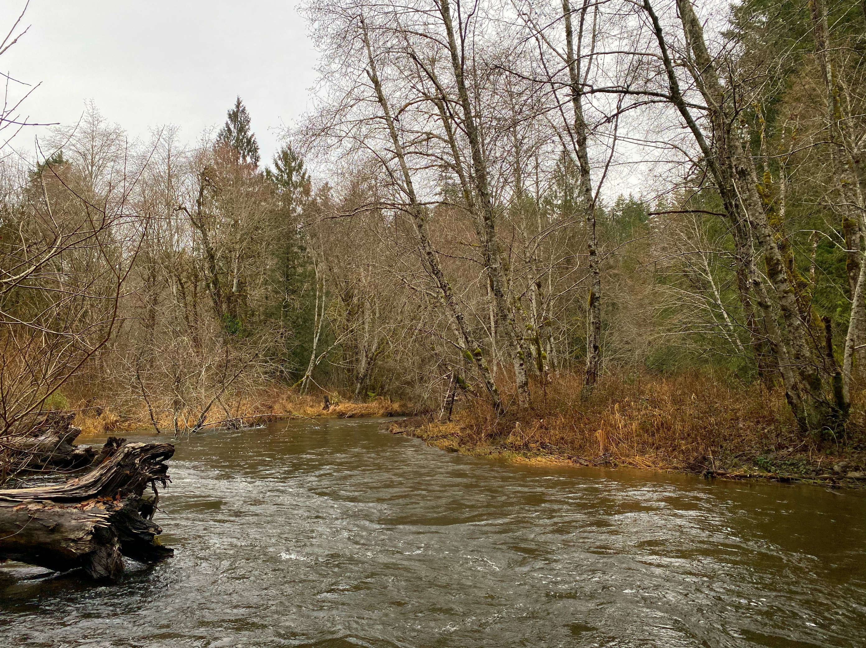
What is Net Ecological Benefit (NEB)?
From Ecology’s Final NEB Guidance
“…local planning groups are best situated, and will therefore determine the appropriate amount of benefits beyond the offsetting of projected impacts …”
Notes:
Ecology released Final NEB Guidance in July 2019 to support committees in their planning process.
NEB is the outcome that is anticipated to occur through implementation of projects in a plan to yield offsets that exceed impacts within the planning horizon and WRIA boundary.
[Prompt for speaker to make comments: Please reflect on the committee’s work regarding NEB (based on your view)
For example:
Through the committee discussions, meetings, and plan writing, it is our opinion that this plan meets NEB. The committee estimated a consumptive use of 965 acre-feet per year, and identified projects that provide a potential offset of XX acre-feet. The plan includes additional projects that that provide habitat benefits to the WRIA. Through the combination of water offset and habitat projects, we anticipate that the plan achieves a net ecological benefit. ]

Slide 14
Watershed Restoration and Enhancement Committee
Entity Name | Representing
Skokomish Tribe | Tribal government
Squaxin Island Tribe | Tribal government
Mason County | County government
Thurston County | County government
City of Shelton | City government
Mason County Public Utility District 1 | Water purveyor
Washington Department of Fish and Wildlife | State agency
Washington Department of Ecology | State agency
Building Industry Association of Washington | Residential construction industry
Washington State Chapter of the Sierra Club | Environmental interests
Mason-Kitsap Farm Bureau | Agricultural interests
Mason Conservation District | Ex-officio
Washington State Department of Health | Ex-officio
Green Diamond | Ex-officio

Slide 15
What is the Committee’s role?
Committee
Develops Watershed Plan
Approves Plan
Ecology
Determines NEB
Adopts Plan

Slide 16
Watershed Restoration and Enhancement Plan Components
Planning Horizon
2018 - 2038
WRIA Subbasin Delineation
8 subbasins
Projected New Permit-Exempt Wells
4,294 Projected New Permit-Exempt Wells
Estimated Consumptive Use
759 acre-feet per year (1.04 cfs) – most likely estimate
1,034 acre-feet per year (1.43 cfs) – goal to achieve through adaptive management
Projects and Actions
to offset estimated consumptive use and meet Net Ecological Benefit (NEB)
Policy and Adaptive Management
recommendations that contribute to the goal of streamflow restoration

Slide 17
Delineate Subbasins
The WRIA 14 Committee divided WRIA 14 into 8 subbasins for the purposes of assessing consumptive use and project offsets.
Notes:
Subbasin delineation was helpful in describing the location and timing of projected new consumptive water use, the location and timing of impacts to instream resources, and the necessary scope, scale, and anticipated benefits of projects. In some instances, subbasins may not correspond with hydrologic or geologic basin delineations (e.g. watershed divides)

Slide 18
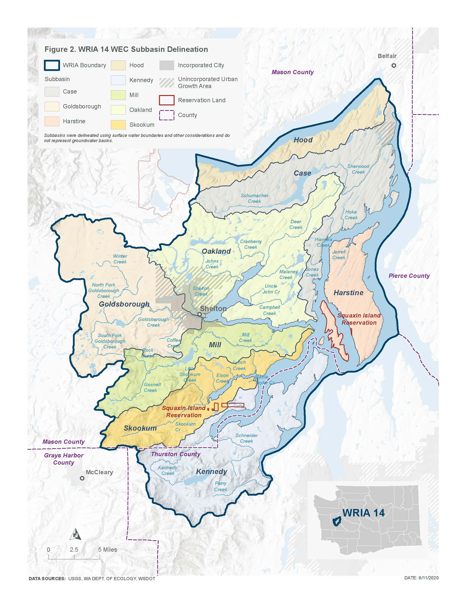
Subbasin Delineation Map

Slide 19
Project New Permit-Exempt Wells
The WRIA 14 Committee projects 4,294 PE wells over the planning horizon. The largest number of these wells are likely to be installed in the Oakland Bay subbasin.
Notes:
This Committee developed a method that they agreed was appropriate to project the number of new PE wells over the planning horizon in the WRIA, in order to estimate new consumptive water use. This method, referred to as the PE well projection method, is based on recommendations from Appendix A of Ecology’s Final NEB Guidance (Ecology 2019).
[add any specific talking points relevant to the method to project wells that is relevant to the audience, along with other important details]

Slide 20
Projected New Permit-Exempt Wells
Subbasin | Projected PE Wells
Case | 512
Goldsborough | 546
Harstine | 143
Hood | 117
Kennedy (Mason County) | 59
Kennedy (Thurston County) | 529
Mill | 466
Oakland | 1,559
Skookum | 363
Totals | 4,294

Slide 21
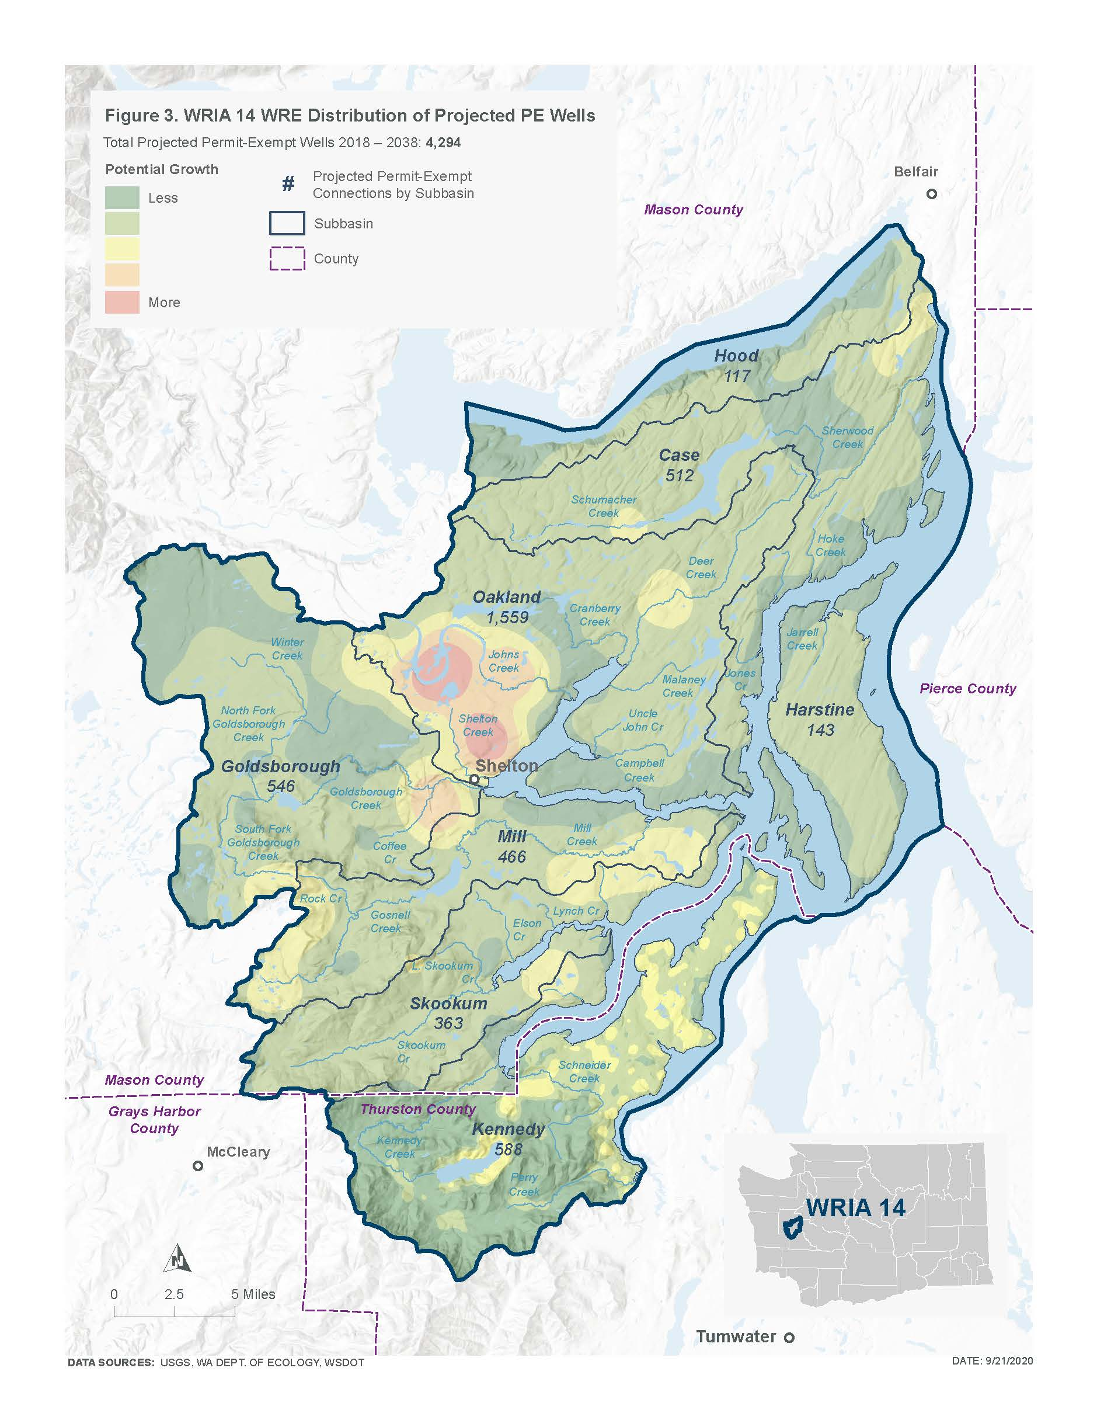
New Permit-Exempt Wells Map

Slide 22
Estimate New Consumptive Water Use
The WRIA 14 Committee used a 20-year projection for WRIA 14 of new PE wells to estimate the consumptive water use that this watershed plan must address and offset. The WRIA 14 Committee estimates 759 AF per year (1.04 cfs) of new consumptive water use in WRIA 14 as the “most likely” estimate.
The Committee also included a higher estimate to achieve through adaptive management of 1,034 AF per year (1.43 cfs)
Notes:
The Consumptive Use Estimates Technical Memorandum provides a more detailed description of the analysis and alternative scenarios considered (Appendix)
[add any specific talking points relevant to the method to estimate CU that is relevant to the audience, along with other important details]

Slide 23
Estimated New Consumptive Water Use
 |  |  | Assumed Irrigated Acreage of 0.10 Acre (Most Likely Estimate) |  | Assumed Irrigated Acreage of 0.14 Acre (Higher Adaptive Management Goal)
Subbasin | Projected PE wells | Indoor CU (AF/year) | Outdoor CU (AF/year) | Total CU/year (AF/year) in 2038 | Outdoor CU (AF/year) | Total CU/year (AF/year) in 2038
Case | 512 | 8.6 | 81.9 | 90.5 | 114.7 | 123.3
Goldsborough | 546 | 9.2 | 87.4 | 96.5 | 122.3 | 131.5
Harstine | 143 | 2.4 | 22.9 | 25.3 | 32.1 | 34.5
Hood | 117 | 2.0 | 18.7 | 20.7 | 26.2 | 28.2
Kennedy | 588 | 9.9 | 94.0 | 103.9 | 131.6 | 141.5
Mill | 466 | 7.8 | 74.6 | 82.4 | 104.4 | 112.2
Oakland | 1,559 | 26.2 | 249.4 | 275.6 | 349.2 | 375.4
Skookum | 363 | 6.1 | 58.1 | 64.2 | 81.3 | 87.4
TOTAL | 4,294 | 72 | 687 | 759.2 | 962 | 1,034.0

Slide 24
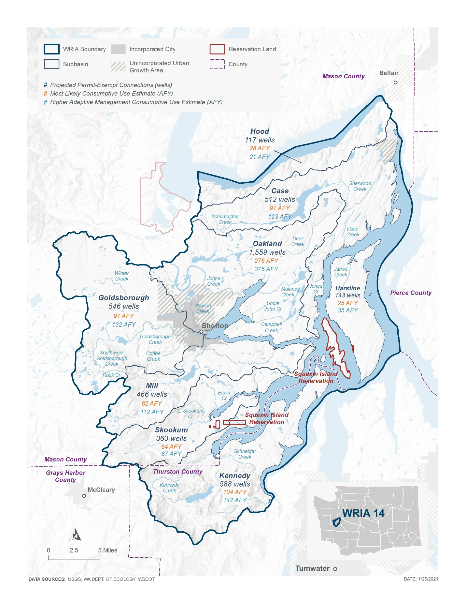
New Consumptive Water Use Map

Slide 25
Types of Projects & Actions
Water Right Acquisition Offset Projects
Non-Acquisition Water Offset Projects
Habitat and Other Related Projects
Regulatory Action Recommendations
Notes:
The committee is finalizing project selection, developing project descriptions and evaluations, and writing an adaptive management component for the watershed plan.

Slide 26
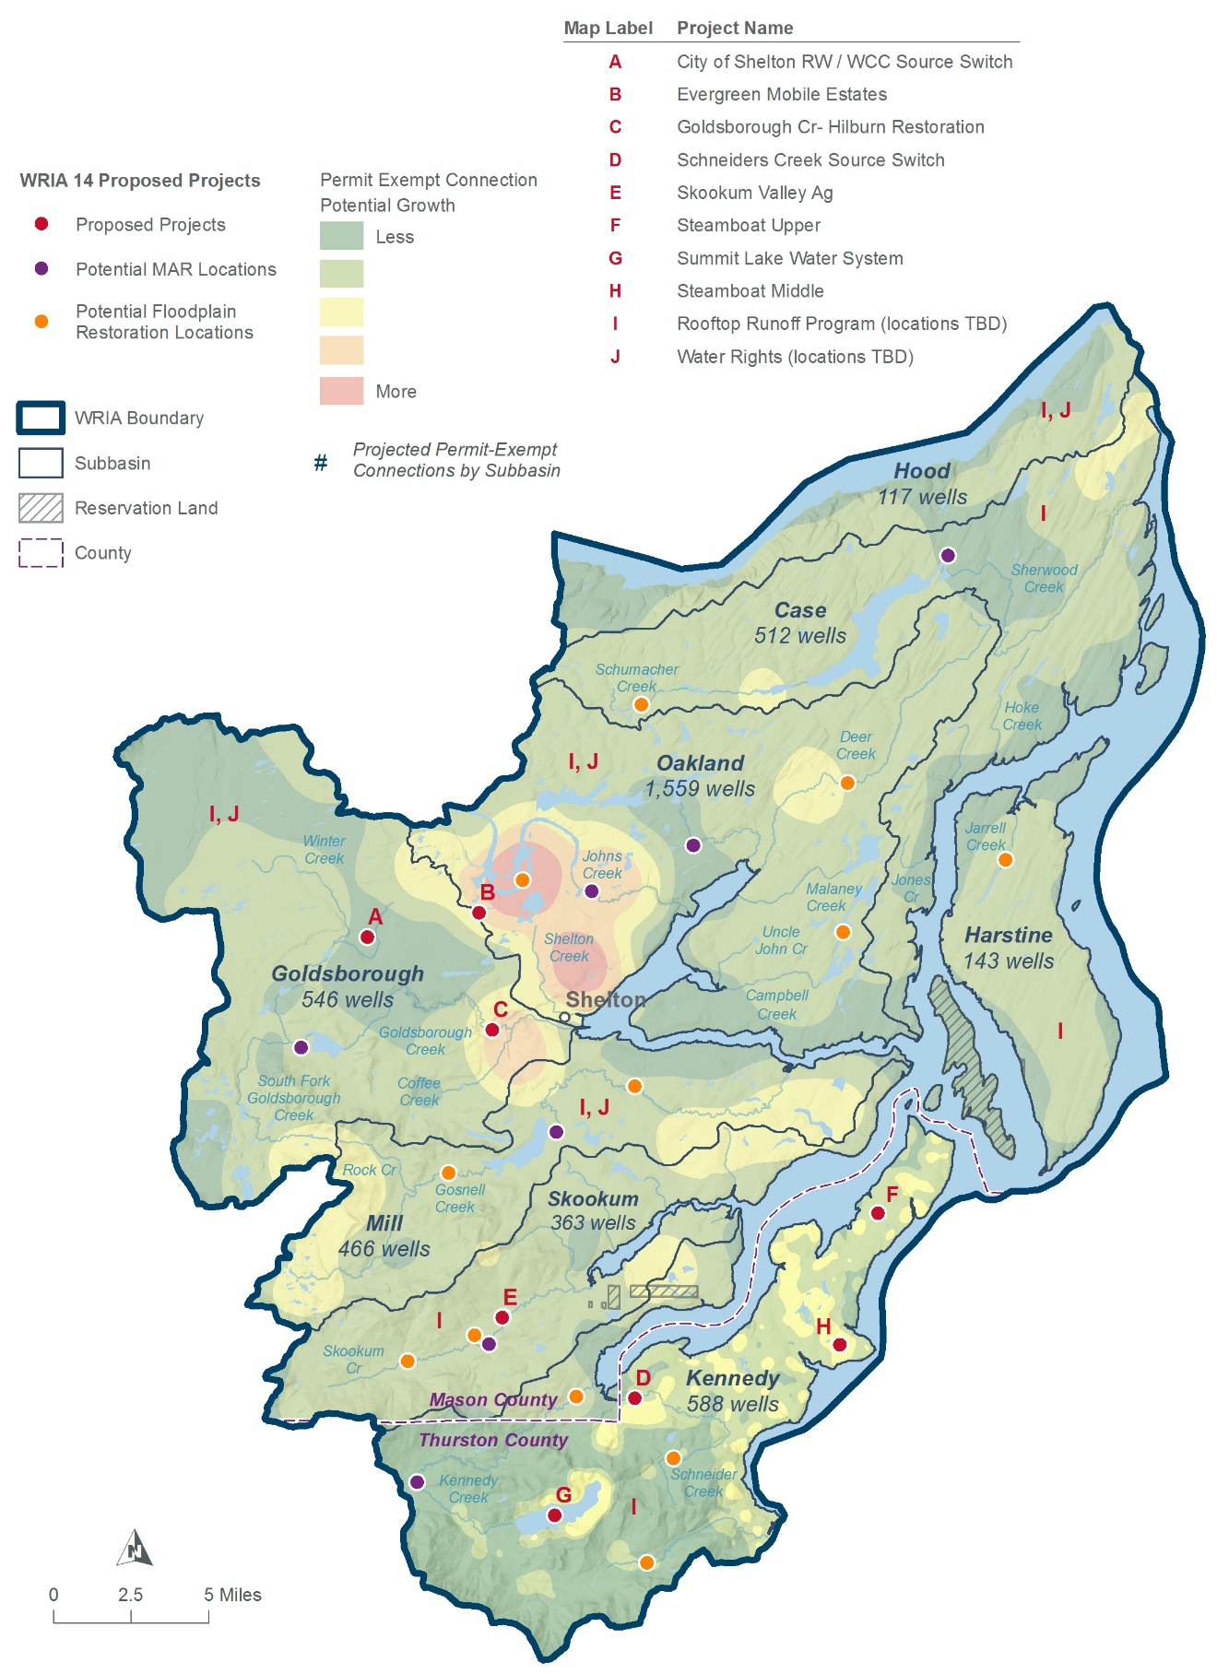
Projects Overview Map

Slide 27
WRIA 14 Water Offset Projects (Category I)
City of Shelton Reclaimed Water/ WCC Source Switch
Redirect North Shelton wastewater to WRP and infiltrate Class A reclaimed water at existing spray field near the WCC
Subbasin: Goldsborough
Evergreen Mobile Estates
Water system consolidation and water right acquisition
Subbasin: Oakland
Steamboat Middle
Expanded water storage in an existing wetland
Subbasin: Kennedy
Managed Aquifer Recharge
Categorical project that will include potential site locations in priority subbasins
Subbasins: Case, Mill, Kennedy, Goldsborough, Oakland, Skookum
Water Right Acquisition Opportunities
Categorical project that includes potential opportunities for water right acquisitions in priority subbasins
Subbasins: Goldsborough, Hood, Mill, Oakland

Slide 28
WRIA 14 Habitat/Non-offset Projects
Skookum Valley Ag
Channel re-alignment to increase channel length and sinuosity
Subbasin: Skookum
Skookum Valley Railroad Culvert Crossings
Restore fish passage at several existing barriers
Subbasin: Skookum
Goldsborough Creek-Hilburn Restoration
Priority project from Salmon Recovery 4YWP. Remove bank protection and channel fill, increase density of LWD.
Subbasin: Goldsborough
Steamboat Upper
Increase ponded storage on north end of the Steamboat Peninsula
Subbasin: Kennedy

Slide 29
WRIA 14 Prospective Projects
Other Water Right Opportunities and Efficiency Projects
Investigate opportunities throughout WRIA 14 for water right acquisition or efficiency projects.
Forest Stand Age
The committee is interested in voluntary projects throughout WRIA 14 that involve forest conservation, forest land acquisition, carbon sequestration that can be demonstrated to have a streamflow benefit.
Floodplain Restoration
The committee is interested in restoring stream floodplain function, where appropriate throughout WRIA 14.
Summit Lake Alternative Water Supply
This project in the Kennedy subbasin conceptually project involves determining alternative solutions for safe water supply to the Summit Lake community. There is a potential for water offset but the project is currently too conceptual.
Schneider Creek Source Switch
This project in the Kennedy subbasin would involve a source switch from surface water to groundwater. There is potential for water offset but the project currently conflicts with the Foster Supreme Court Decision and would only be implemented pending legislative changes to allow for such projects to move forward.
Mason County Rooftop Runoff Program
This project would implement a new county requirement WRIA-wide for new rural residential building to install LID BMPs that infiltrate over 95% of rooftop runoff. There is potential for water offset but Mason County is not moving forward with the project at this time due to regulatory constraints.

Slide 30
Water Offset Projects
Project Type | Project Name | Project Description | Subbasin | Estimated Water Offset (AFY) | Offset Claimed by WRIA 14 Committee (AFY)
Category I | City of Shelton RW/ WCC Source Switch | Re-direct North Shelton wastewater to WRP and infiltrate Class A reclaimed water at existing spray field near the WCC | Goldsborough | 486 | 486
Category I | Evergreen Mobile Estates | Water system consolidation and water right acquisition | Oakland Bay | 7 | 7
Category I | MAR | Install managed aquifer recharge facilities | Multiple | 910 | 273
Category I | Water Right Opportunities | A focused WRIA-wide analysis on potential WR efficiencies and acquisition for future studies and implementation | Goldsborough, Hood, Mill, Oakland | 1,112 | 111
Category I | Steamboat Middle | Surface water retention and infiltration | Kennedy | 14 | 14
Prospective | Schneider Creek Source Switch | Source switch from surface water ground water | Kennedy | 64 | 0
Prospective | Summit Lake Water System | Future potential source switch for local domestic water supply | Kennedy | 24-133 | 0
Prospective | Mason Co Rooftop Runoff | New county requirement for new rural residential building to install LID BMPs that infiltrate over 95% of rooftop runoff. | All | 249 | 0
 | WRIA 14 Total Water Offset for WRIA 14 Projects |  |  | 2,866-2,975 | 891
 | WRIA 14 Consumptive Use Estimate |  |  | 759
 | WRIA 14 Higher Adaptive Management Consumptive Use Goal |  |  | 1,034

Slide 31
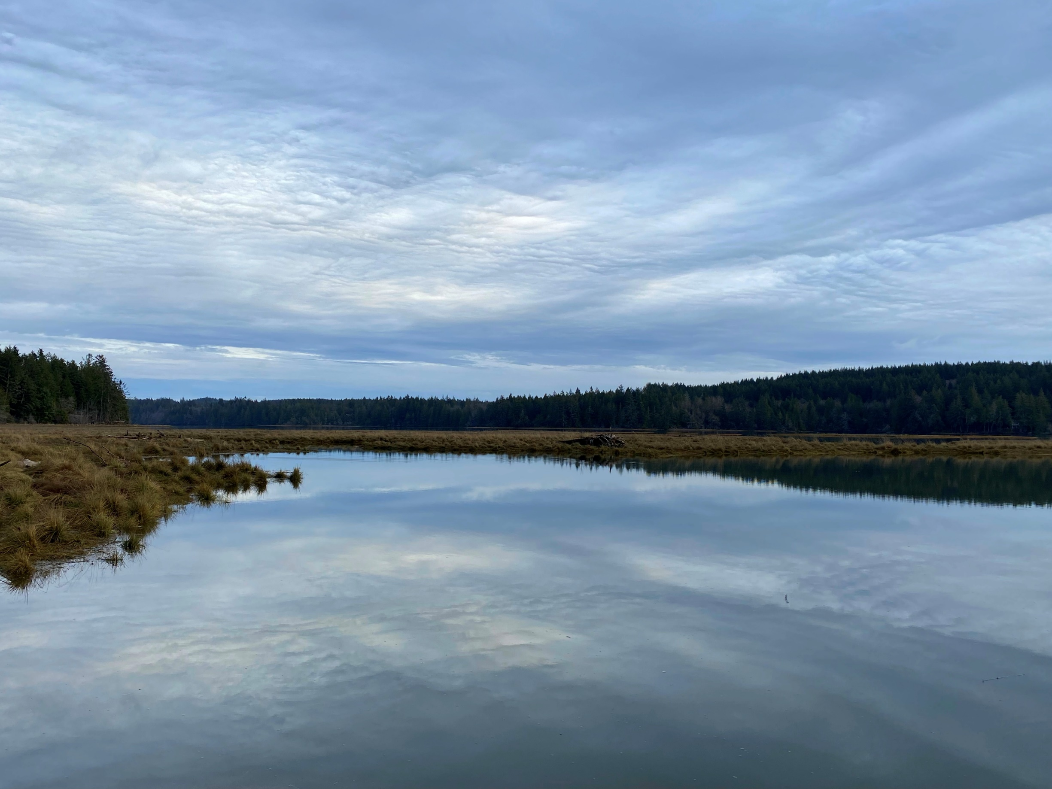
Policy and Adaptive Management Recommendations
As recommended by the NEB Guidance, the Committee prepared the watershed plan with implementation in mind. However, as articulated in the Streamflow Restoration Policy and Interpretive Statement (POL-2094), “RCW 90.94.020 and 90.94.030 do not create an obligation on any party to ensure that plans, or projects and actions in those plans or associated with rulemaking, are implemented."
Notes:
[Included caveat language – presenter should use this slide and speak to it as appropriate for the audience. This slide can also be moved before the recommendations slide]

Slide 32
WRIA 14 Policy and Regulatory Recommendations
Track the number and location of permit-exempt wells
Monitoring and Research
Revolving Loan and Grant Fund for Community Water Systems
Mason County-Wide Conservation Outreach Program
Water Supply Data for Comprehensive Water Planning
Sports Field Irrigation Conservation
Group A Water System Conservation through Infrastructure Improvements
Funding for Plan Implementation
Waterwise Landscaping

Slide 33
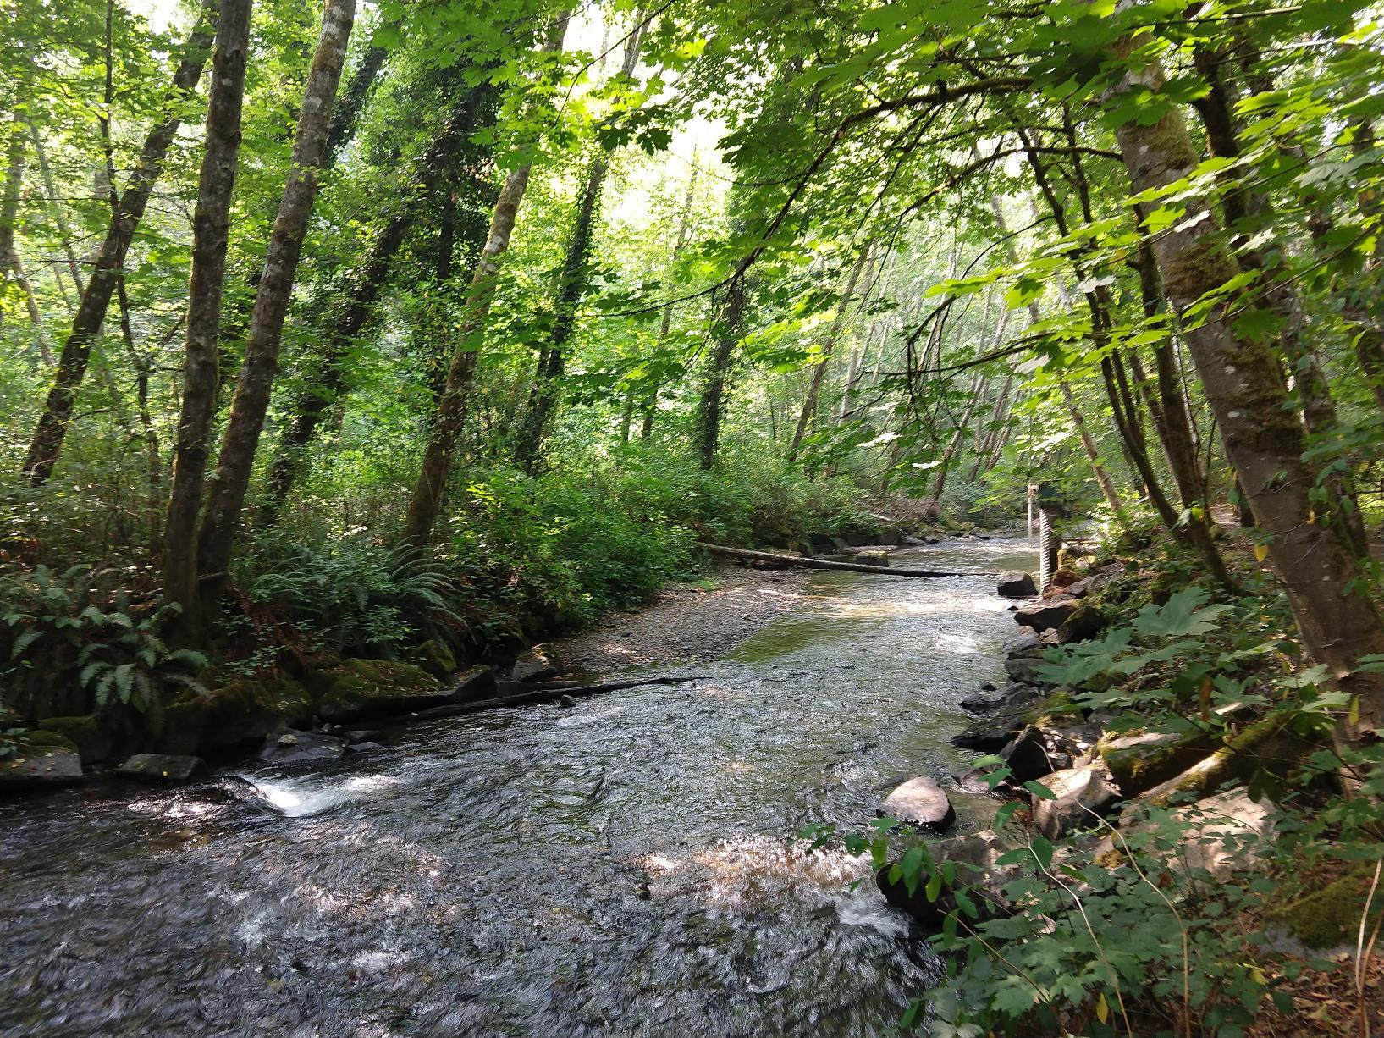
Plan Implementation and Adaptive Management
The WRIA 14 Committee supports an adaptive management process for implementation of the WRIA 14 Watershed Plan. Adaptive management will help address uncertainty and provide more reasonable assurance for plan implementation.

Slide 34
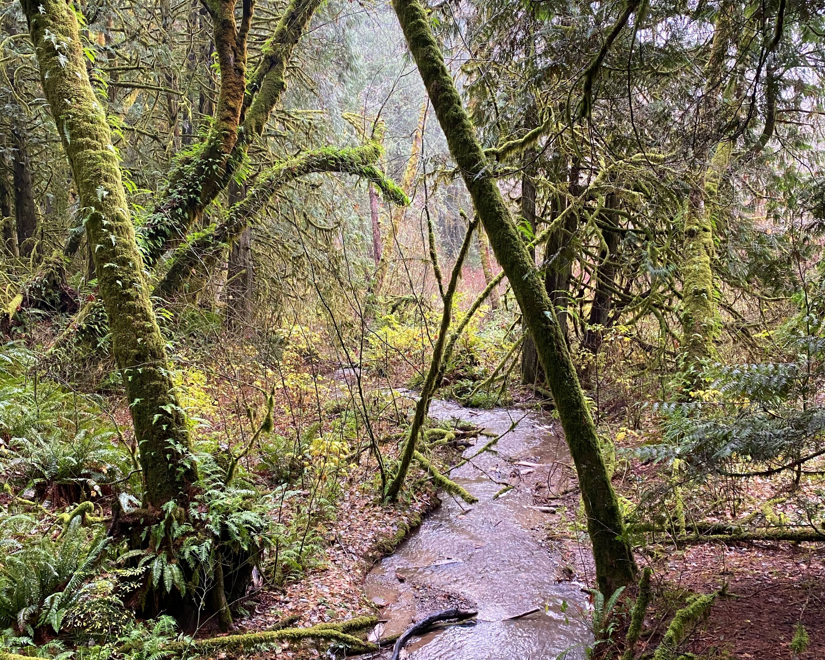
Plan Implementation and Adaptive Management Recommendations
Project, Policy and Permit-Exempt Well Tracking
Reporting and Adaptation
Funding

Slide 35
Steps to Complete the Plan
Committee members meet (virtually) for the final vote on the plan in mid-April.
If all members of the Committee approve the plan, the Committee chair will submit the plan to Ecology for review and NEB determination.
If the Committee does not approve the plan, Ecology will prepare the plan. Ecology will send the plan to the Salmon Recovery Funding Board for technical Review. Ecology will then finalize the plan and the Director shall initiate rulemaking.

Slide 36
Post Plan Submission
SEPA public comment period
No changes to plan after submission
Ecology will review plan
Ecology will determine action by June 30, 2021

Slide 37
Thank you for your time!
Any questions?

Slide 38
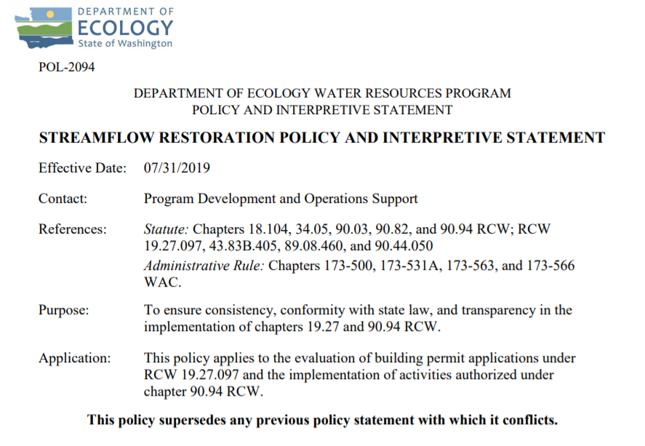
Ecology’s Policy Interpretation
More information on the Streamflow Restoration law can be found online
Notes:
RCW 90.94.030 adds to the management regime for new homes using domestic permit-exempt well withdrawals in this WRIA and elsewhere. For example, local governments must, among other responsibilities relating to new permit-exempt domestic wells, collect a $500 fee for each building permit and record withdrawal restrictions on the title of the affected properties. Additionally, this law restricts new permit-exempt domestic withdrawals in this WRIA to a maximum annual average of up to 950 gallons per days per connection, subject to the five thousand gallons per day and ½-acre outdoor irrigation of non-commercial lawn/garden limits established in RCW 90.44.050. Ecology has published its interpretation and implementation of RCW 19.27.097 and RCW 90.94 in Water Resources POL 2094.

Slide 39
Ecology’s NEB Guidance
More information on the Final Guidance for Determining Net Ecological Benefit can be found online
Notes:
After conducting a thorough scientific literature review, Ecology has determined that NEB is not a technical term that has been defined in the natural sciences. Instead, it is a creation of the Washington State Legislature. Therefore, Ecology has prepared this guidance for interpretation and application of this term. This guidance provides supplemental information, beyond that provided expressly in the law, for those groups engaged in the watershed planning work required by RCW 90.94.020 and RCW 90.94.030.

Slide 40
WRIA 14 Committee Brochure
More information on WRIA 14 Committee can be found online
Notes:
EDIT PER WRIA so there is a screenshot of the brochure and a link

Slide 41
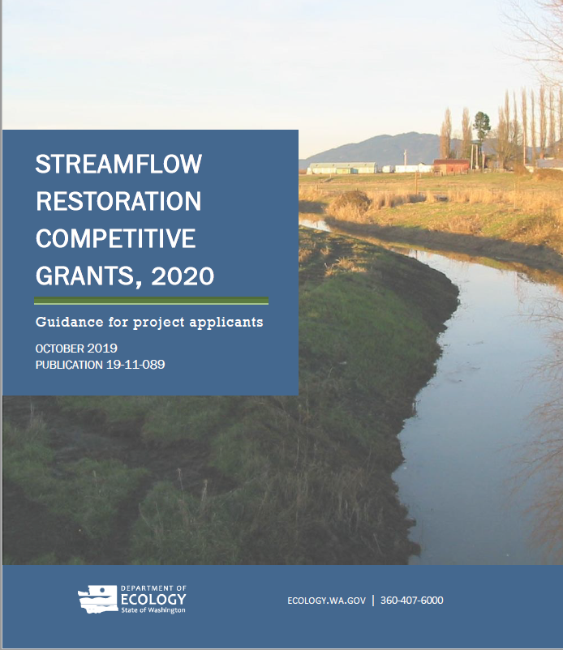
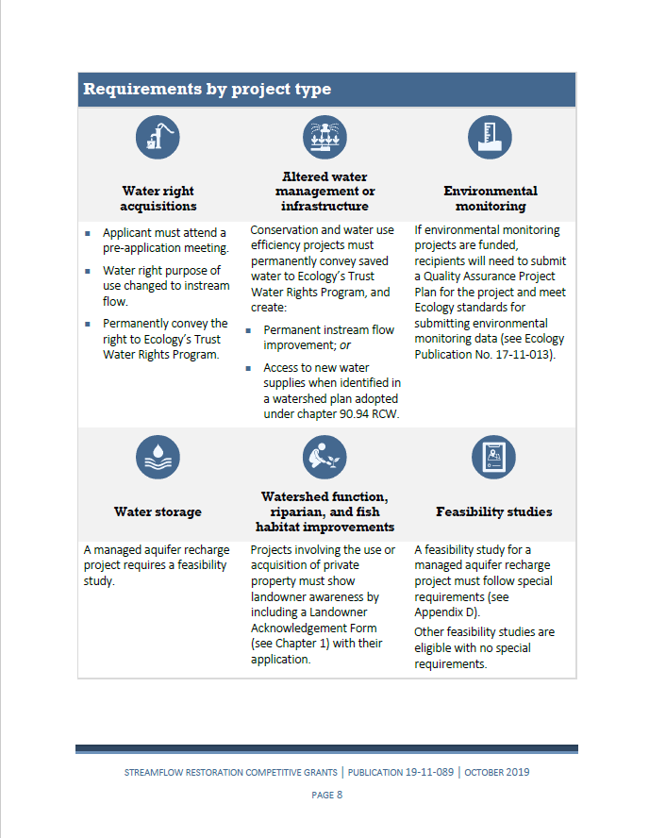
Grants Guidance Overview

