Slide 1

WRIA 15 Watershed Restoration and enhancement committee
March 7, 2019
Water Resources Program
Washington State Department of Ecology

Slide 2
Welcome and introductions | 9:30am
Approval of agenda and February meeting summary | 9:35am
Updates and Announcements | 9:40am
Workgroup Report | 9:50am
County and City Planning Panel | 10:00am
Proposed Summer and Fall 2019 Schedule | 12:10pm
Action Items and Next Steps | 12:15pm
Public Comment- limit to 3 minutes per person | 12:20pm
End | 12:30pm

Slide 3
Updated Committee Calendar

Slide 4
Workgroup Report
Subbasins
Data
Technical contractor scope of work
Up Next:
Subbasins
Growth projection scenarios and permit exempt wells
Consumption use options

Slide 5
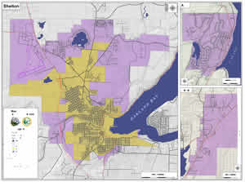


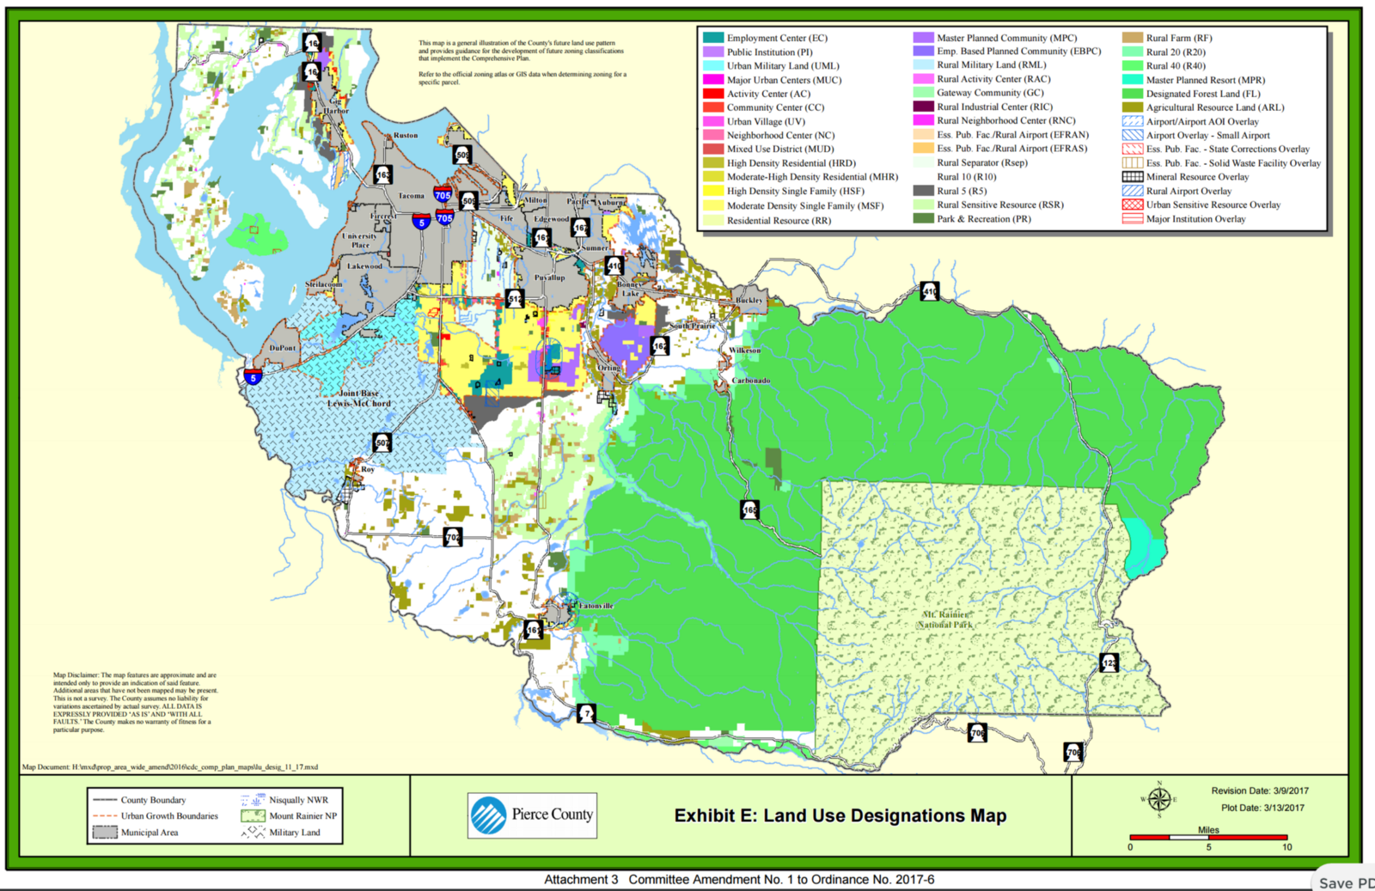
Planning Panel: Purpose
Inform upcoming decisions on growth projections and estimates for permit exempt wells.

Slide 6
Planning Panel: Objectives
Committee understands the role that county and city planners have in directing growth.
Committee understands how zoning and subdivision regulations work to protect resource lands and rural areas.
Committee understands the limits of planning and land use regulations.
Committee understands how county and city planning interacts with watershed restoration and enhancement plan.

Slide 7
Proposed 2019 Schedule
Regular Committee Meetings | Brief Committee Meetings/ Sample Project Site Visits | Workgroup Meetings
April | July or August (~1 hour meeting followed by site visits) | April (in person) – growth projections, subbasins, consumptive use approach
May | November or December (~1 hour meeting followed by site visits) | May (in person) – growth projections, subbasins, consumptive use approach
June |  | June (call) – consumptive use estimates
September |  | July (call) -consumptive use estimates
October |  | August (in person)- consumptive use recommendations
November or December |  | September (in person)- consumptive use recommendations, approach to project identification
 |  | October (call) – project identification
 |  | November or December (call)- project identification

Slide 8
2019 proposed meeting schedule
April
Committee Meeting
Workgroup Meeting
May
Committee Meeting
Workgroup Meeting
June
Committee Meeting
Workgroup Meeting
Jul/ Aug
Site Visits
Workgroup Meetings
Sept
Committee Meeting
Workgroup Meeting
Oct
Committee Meeting
Workgroup Meeting
Nov/ Dec
Committee Meeting
Workgroup Meetings
Site Visits
Growth projections Subbasins
Consumptive Use

Slide 9
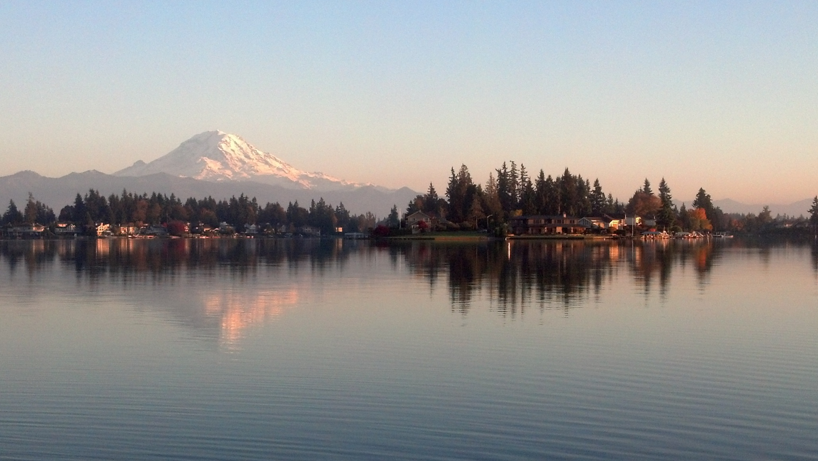

Department of Ecology
Water Resources Program
Notes:
STACY
Next steps:
Work with technical consultant and workgroup to begin teeing up ideas/options to bring back to the committee for input. Continue discussion next month, working towards decision in May.

