Slide 1
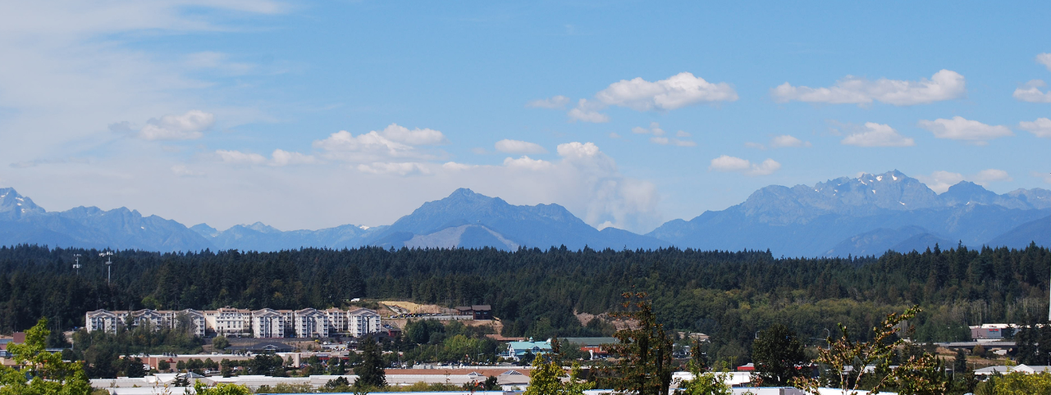

KITSAP COUNTY
Department of Community Development
Long-Range Planning & Environmental Programs

Slide 2
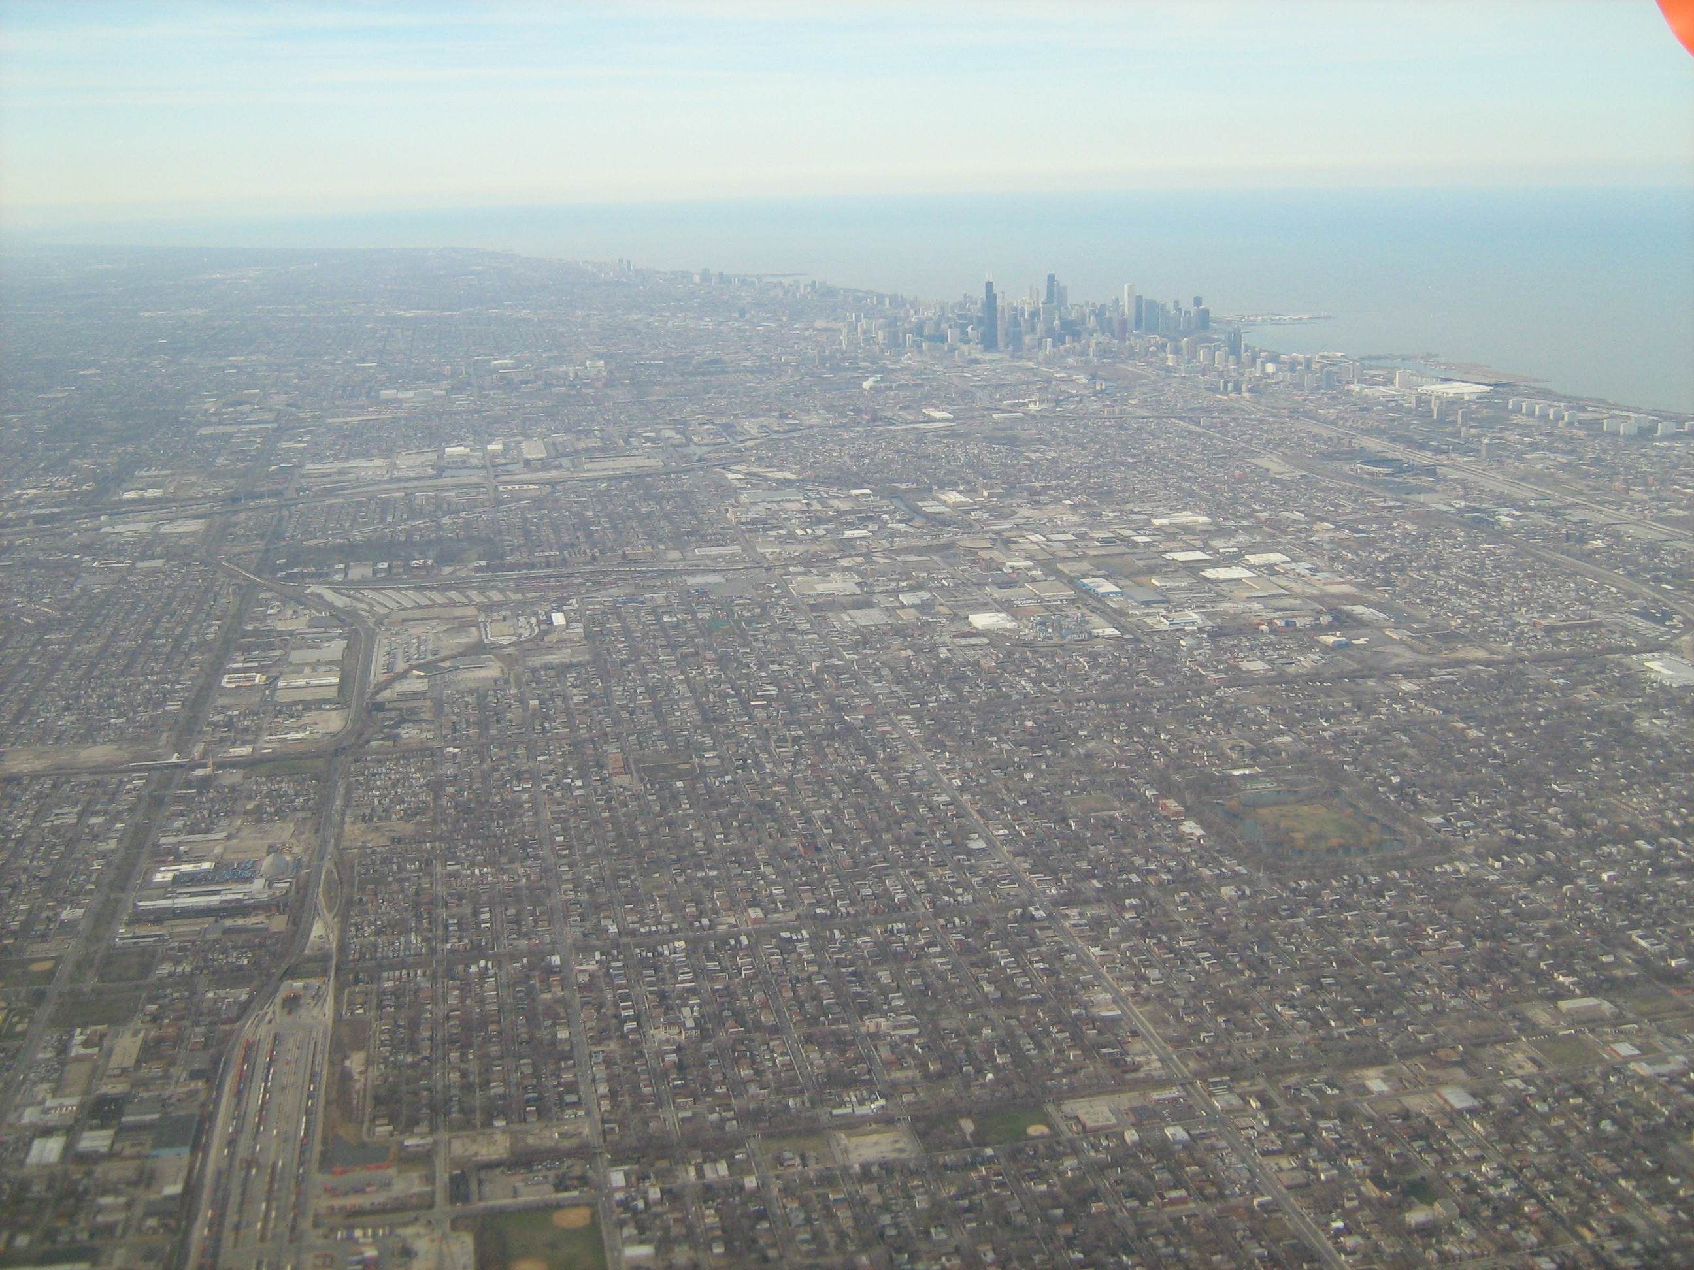

Slide 3
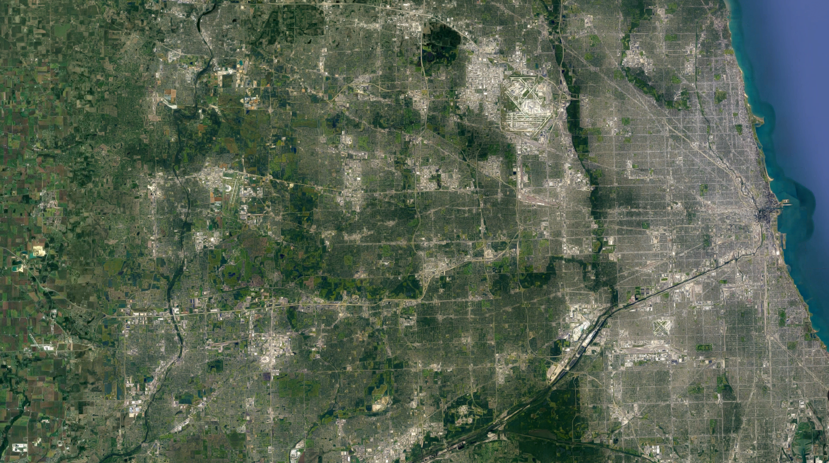
2010
1990
1960
50 miles

Slide 4
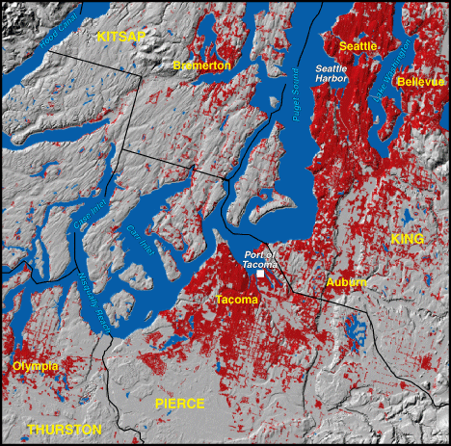
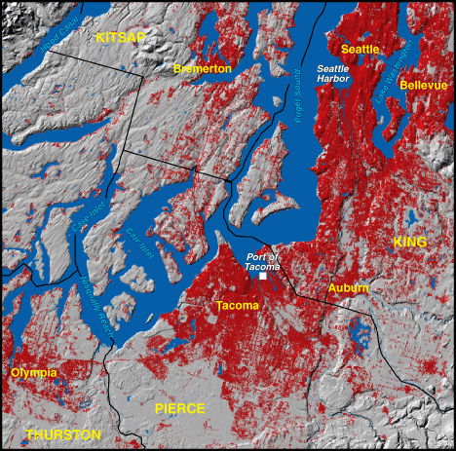
1970 King, Pierce, Thurston, Kitsap Population 1,750,000
1990 King, Pierce, Thurston, Kitsap Population 2,444,000
Source: USGS

Slide 5
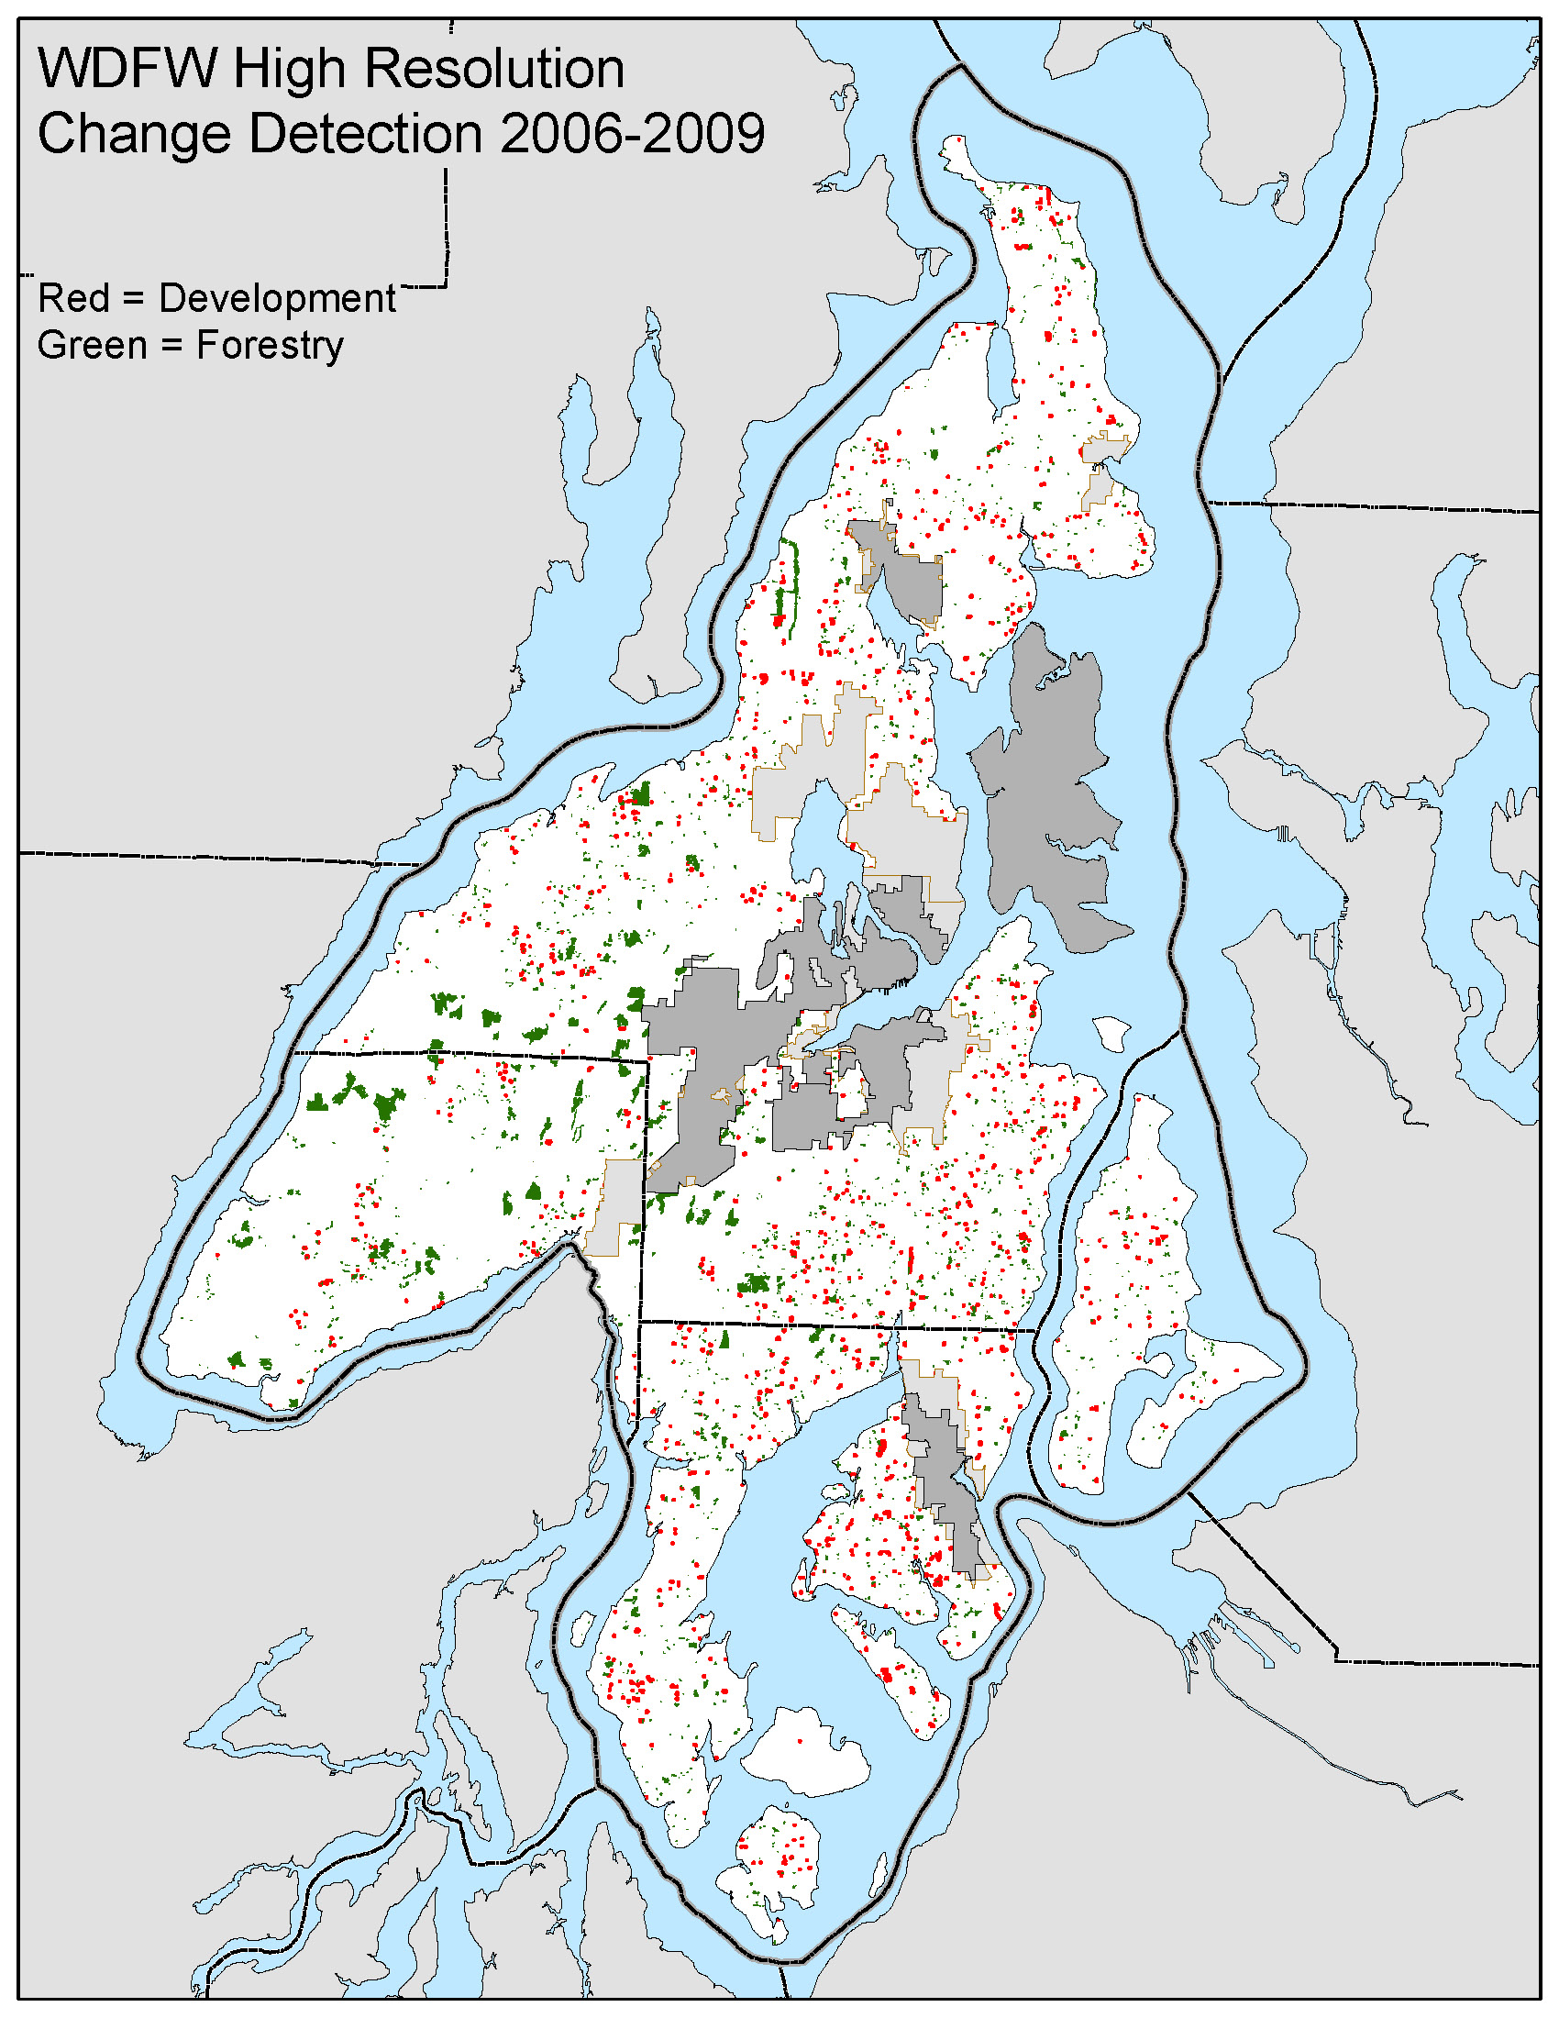
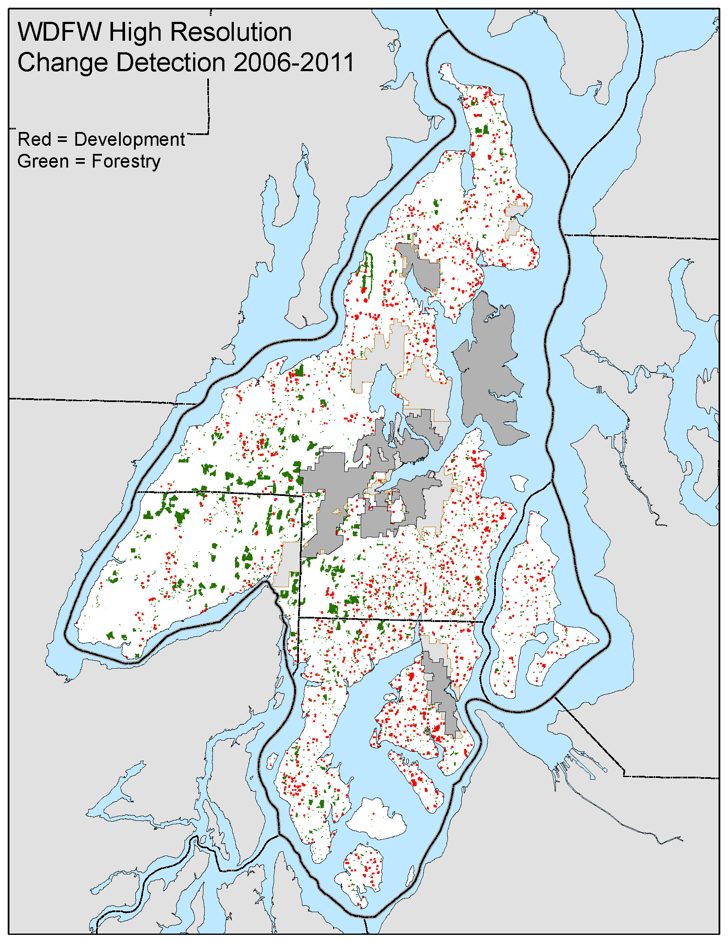
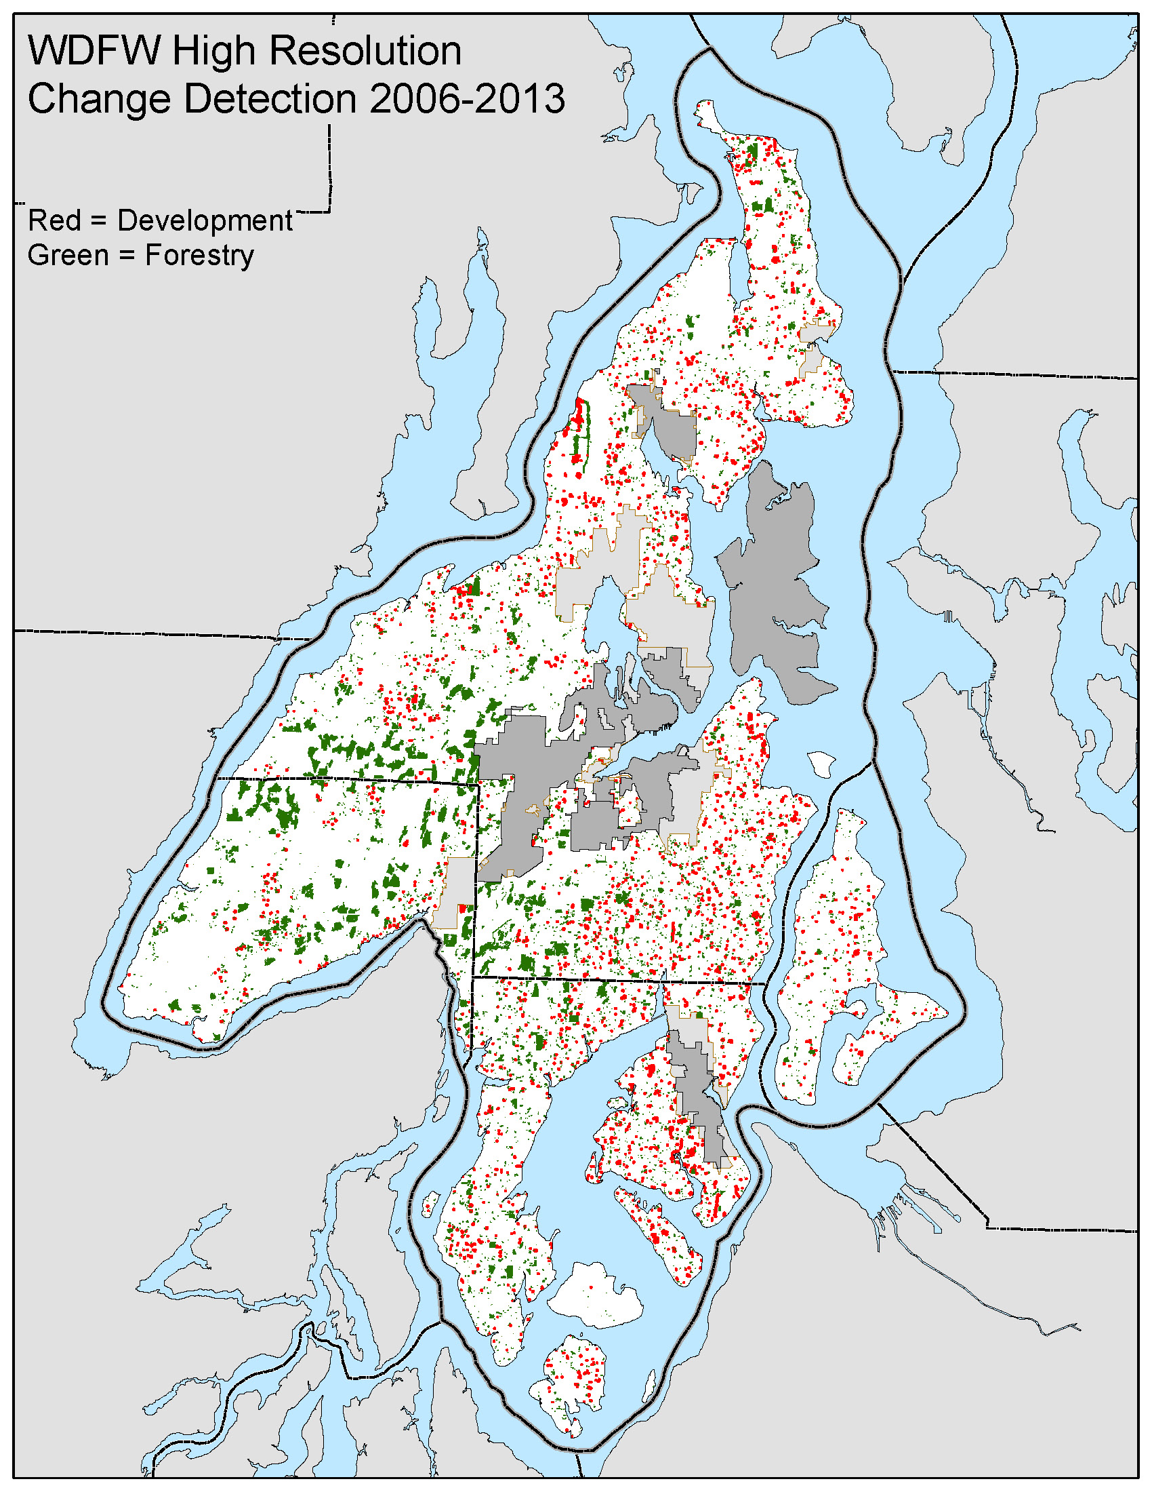

Slide 6
Growth Management Act - 1990
The legislature finds that uncoordinated and unplanned growth, together with a lack of common goals expressing the public's interest in the conservation and the wise use of our lands, pose a threat to the environment, sustainable economic development, and the health, safety, and high quality of life enjoyed by residents of this state.
It is in the public interest that citizens, communities, local governments, and the private sector cooperate and coordinate with one another in comprehensive land use planning …

Slide 7
50 miles

Slide 9
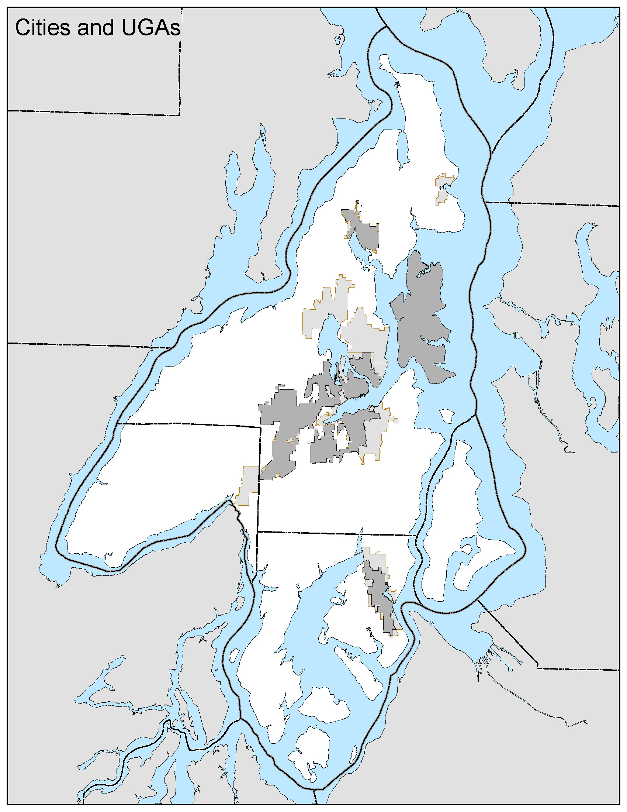

Slide 10
COMPREHENISVE PLANNING OVERVIEW
Enabling Law
  Planning Enabling Act, RCW 36.70 (1959)
  State Growth Management Act, RCW 36.70A (1990)
Regional Coordination
  Multi-County Planning Policies:
  Puget Sound Regional Council (Snohomish, King, Pierce, Kitsap)
  Kitsap Countywide Planning Policies:
  Kitsap Regional Coordinating Council (Kitsap, Bainbridge Island, Bremerton, Port Orchard, Poulsbo)
Local Planning
  Kitsap County Comprehensive Plan
Implementation
  Development regulations & programs
Notes:
GMA – common framework for planning in WA State
MPP/CPP – common framework for planning in Central Puget Sound and Kitsap County
Comp Plan – must be consistent with GMA, MPP, and CPP; next slide will cover the Comp Plan in more detail
Implementation – development regulations and programs must be consistent with the Comp Plan

Slide 11


COMPREHENSIVE PLAN 2016-2036
20-year vision for how our communities will grow
  Land use
  Economic development
  Environment
  Housing & human services
  Transportation
  Capital facilities & utilities
  Parks, recreation, & open space
  Subarea & neighborhood plans
Strategies, policies & investments
to achieve the vision
New Population
45%
34%
21%
Land Capacity Analysis

Slide 12
Review and Evaluation Program
a.k.a. Buildable Lands Program
(Clark, King, Kitsap, Pierce, Snohomish, Thurston, Whatcom)
Determine whether a county and its cities are achieving urban densities in urban growth areas
  by comparing growth and development assumptions, targets, and objectives in countywide planning policies and comprehensive plans
  with actual growth and development.
Identify reasonable measures, other than adjusting urban growth areas, to reduce the difference.

Slide 13
Mandated Activities
Not Mandated but Necessary
GMA Related:
  Comprehensive Plan 8-year update - 2016, 2024
  Comprehensive Plan 4-year review - 2020
  Subarea planning and implementation
  Comp Plan implementation/ coordination/monitoring
  Land capacity analysis, monitoring
  2021 Buildable Lands Report
  Countywide Planning Policies update
  Mandatory public involvement for code and Comp Plan
Critical areas regulations
Shoreline Master Program update – 2020
Municipal annexation review
Water & sewer system plan review
Comprehensive Plan annual docket of amendments
Comprehensive Plan appeals
Regional planning – e.g., Puget Sound Regional Council
Ongoing development code updates & maintenance
Climate change resiliency planning
Lead Entity process for salmon recovery
Local Integrating Organization for Puget Sound recovery
Watershed Restoration and Enhancement Committee

Slide 14
Mandated Activities - Long-Term Cycle
(Primary Drivers)
Today
Notes:
5 supervisors
70 at full complement

Slide 15
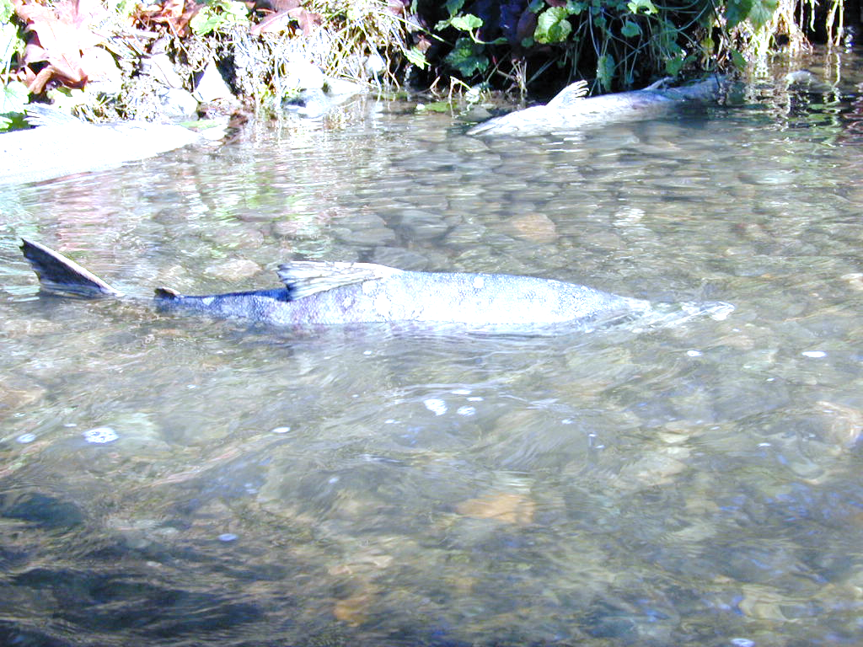
RESOURCE PLANNING
Convening to action, coordinating with others, prioritizing actions
Salmon Recovery
Puget Sound
Ecosystem Recovery
“Lead Entity”
West Sound Watersheds Council
Hood Canal Coordinating Council
“Local Integrating Organization”
West Central LIO
Hood Canal Coordinating Council
New in 2018:
Streamflow Restoration Act
Chum salmon spawning

Slide 16
Lead Entities and Local Integrating Organizations
Local, watershed-based organizations that:
Develop local recovery strategies
Mobilize organizations to implement the strategies
Recovery Strategies
Make smart investments
Make sure only the top priority projects are funded
Combine science, local knowledge, and social values to guide projects
Involve the community

Slide 17
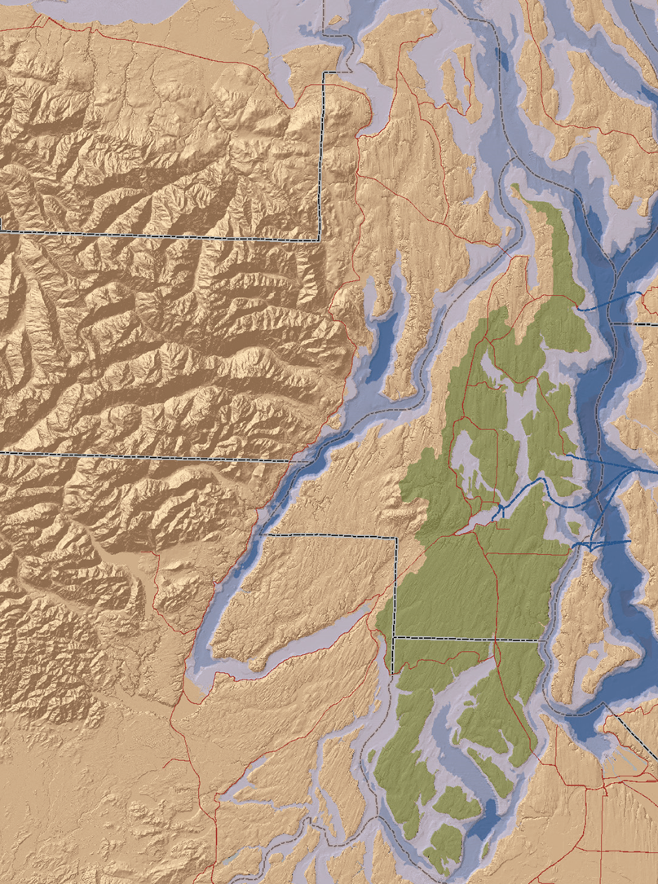
Salmon Recovery “Lead Entity”
West Sound Watersheds Council
One of 25 Lead Entities statewide
Lead Entities consist of:
  A local technical advisory committee
  A local citizen advisory committee
Members
Kitsap County
Pierce County
City of Gig Harbor
City of Bremerton
City of Poulsbo
City of Bainbridge Island
City of Port Orchard
Suquamish Tribe
Squaxin Island Tribe
Special districts
State/federal agencies
Businesses
Landowners
Community organizations
Regional Fisheries Enhancement Groups
Notes:
21 participating members currently
19 vetted projects on 2018 Habitat Work Schedule

Slide 18
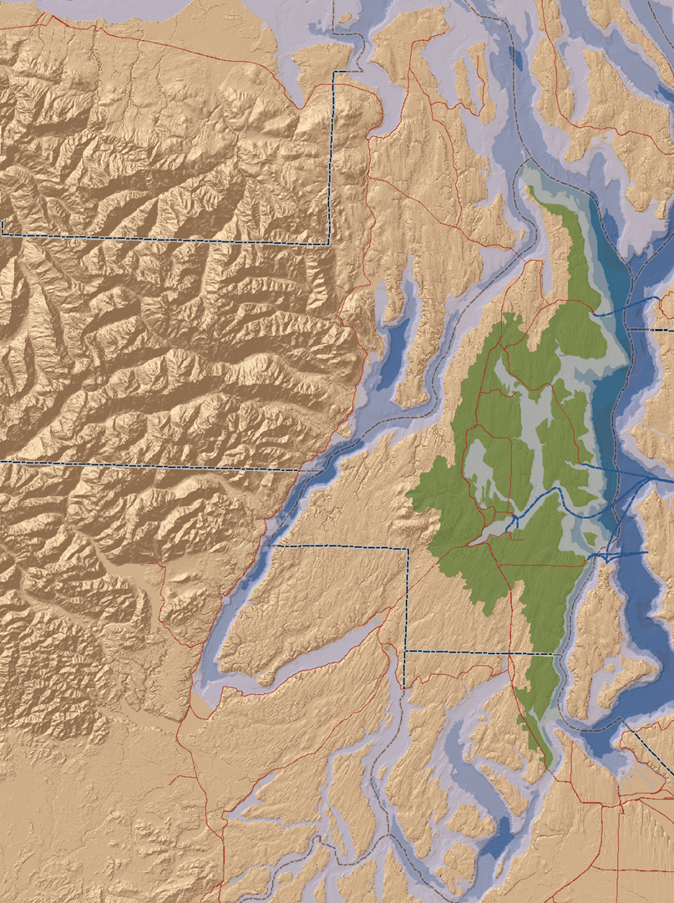
Puget Sound Recovery
“Local Integrating Organization”
West Central Local Integrating Organization
One of 9 LIOs in the Puget Sound region
Technical Working Group
Executive Committee
Kitsap County
Pierce County
City of Gig Harbor
City of Bremerton
City of Poulsbo
City of Bainbridge Island
City of Port Orchard
Suquamish Tribe
Port Gamble S’Klallam Tribe
Notes:
17 participating members currently
37 vetted projects in 2018 (Near-Term Actions)
16 Kitsap Co projects (12 DCD, 4 PW)

Slide 19
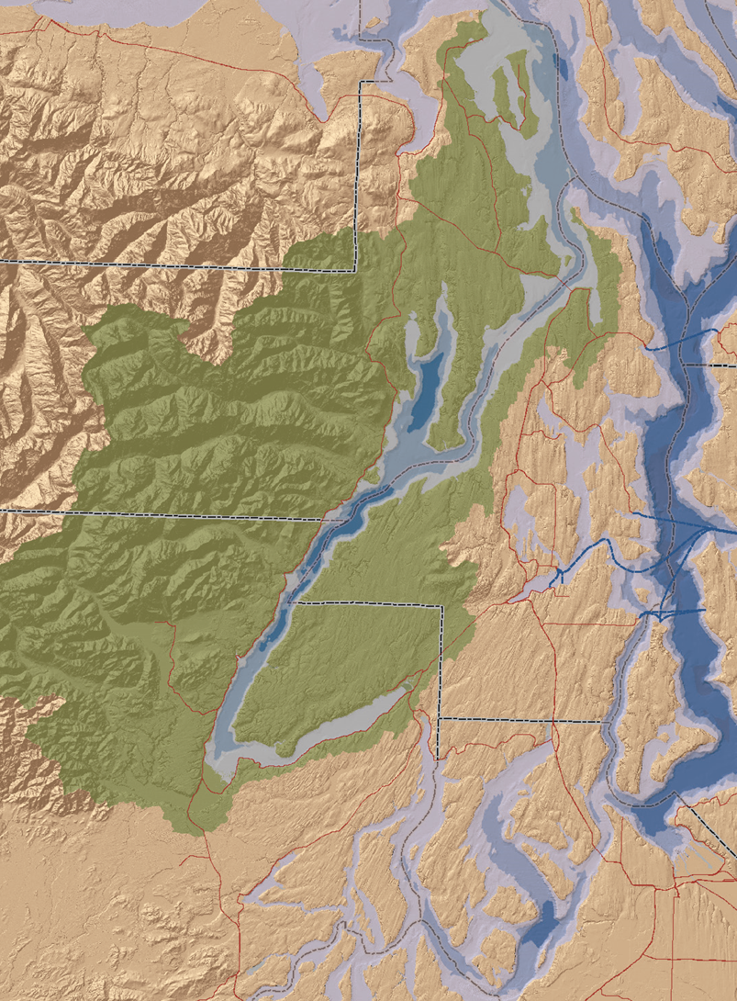
“Local Integrating Organization”
and
“Lead Entity”
Hood Canal Coordinating Council
Local technical advisory committee
Local citizen advisory committee
Board of Directors
Kitsap County
Jefferson County
Mason County
Port Gamble S’Klallam Tribe
Skokomish Tribe

Slide 20
Definitions (unofficial)
Subdivision: The division of land into smaller units.
Short Subdivision: In UGAs, division of land into 9 or fewer units.
Outside UGAs, the division of land into 4 or fewer units.
Plat: A map showing the division of land.
Lot: A unit of land generally presumed to meet dimensional requirements for zoning, setbacks, etc. for development purposes.
Parcel: A unit of land with a tax account number.
Tract: A unit of land set aside for a specific purpose, such as open space, common area, stormwater facility, etc.
Legacy Lot: A legally formed lot, which may not meet current zoning, but can still be developed.

Slide 21
Land Use versus Zoning
Land Use: Land use designation is about the future. It is comprehensive planning term to describe generally how land will be used looking forward.
Zoning: Zoning is about what is allowed today. A zone determines how land may be used and what can be built today. Zoning may also determine other things like density, setbacks, and lot sizes.
Allowed Uses: Allowed uses are categories of uses that are permitted or conditionally permitted for each zone.
For example, dwelling, hotel/motel, brew pub, kennel, slaughterhouse, or fish processing facility.
The Comprehensive Plan’s Land Use Map and the Zoning Map are like a leader and follower. The land use map is the leading map and the zone map is the following map.

Slide 22
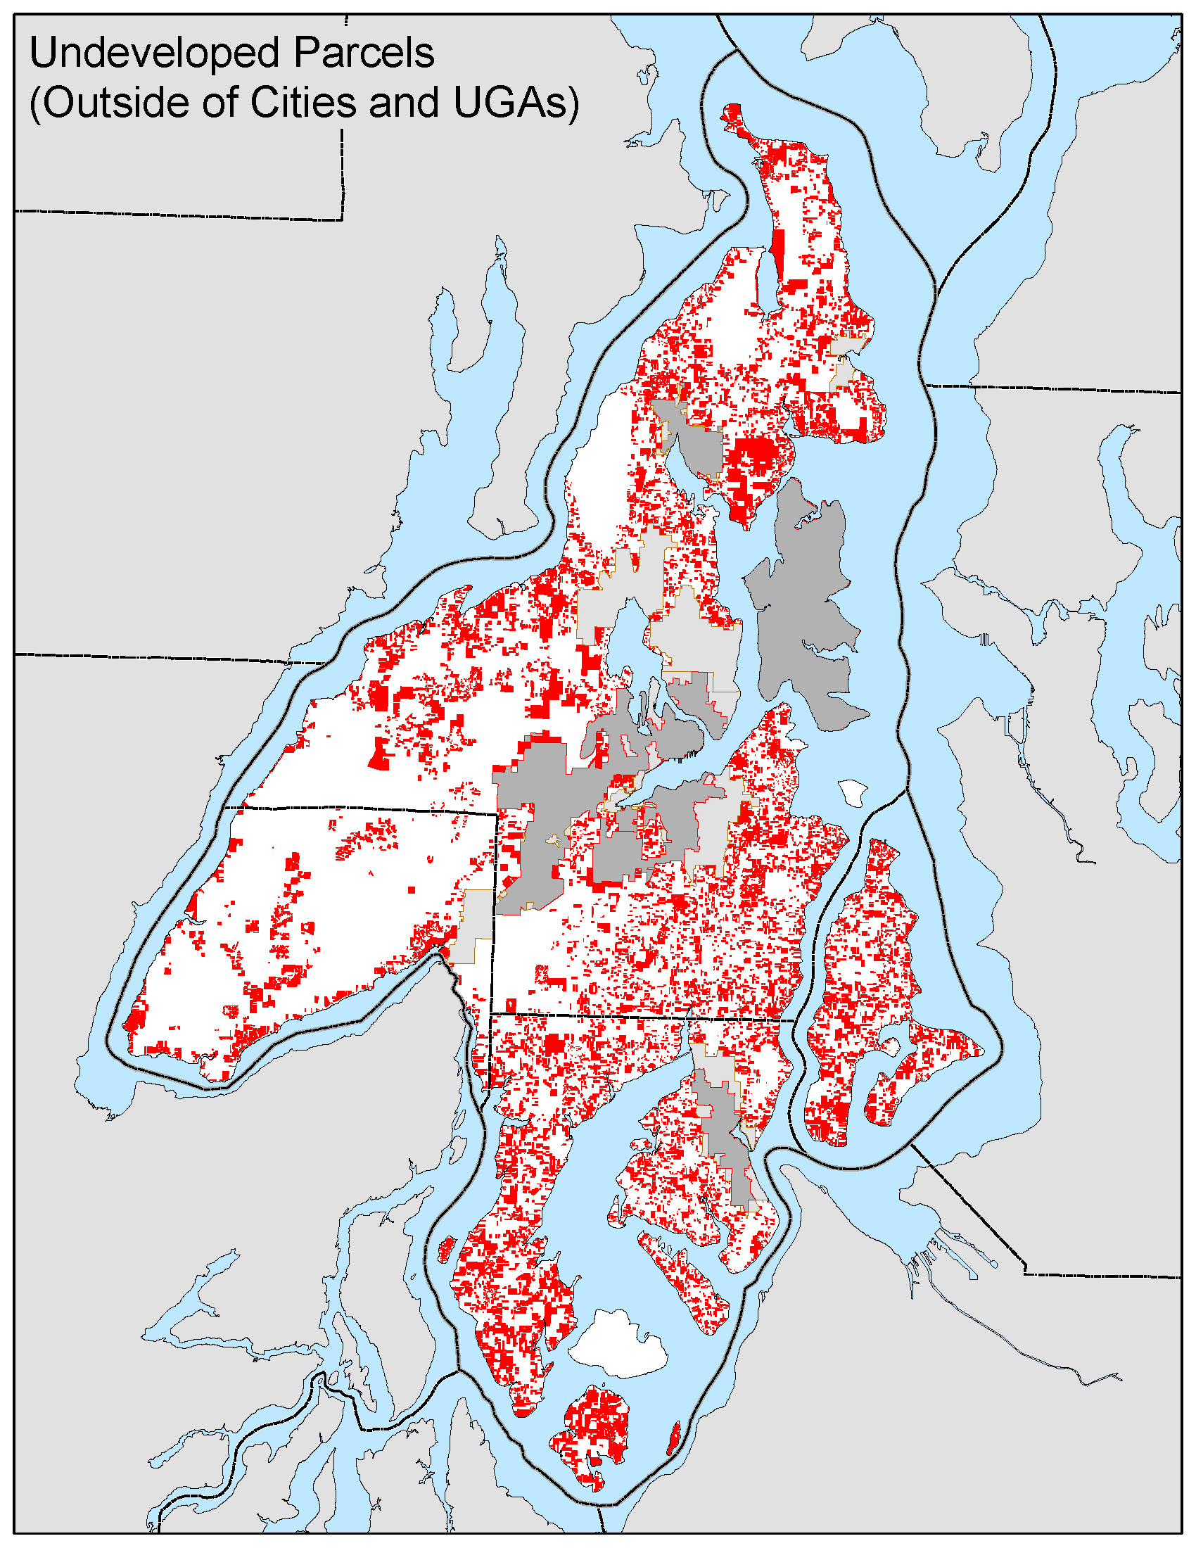

Slide 23
ISSUES FOR WREC PLANNING
Forecasting rural growth: full buildout, partial buildout
Legacy lots, rural non-conforming lots (80%+)
Policy, regulatory, or programmatic approaches
in addition to project approaches
Relationship to municipal stormwater permits
Relationship to Kitsap County’s “Water as a Resource Policy”
Role for Natural Resources Asset Management

