Slide 1
WRIA #15 – Kitsap
Dan Cardwell
Pierce County Planning & Public Works
March 7, 2019 Watershed Restoration and Enhancement Committee

Slide 2
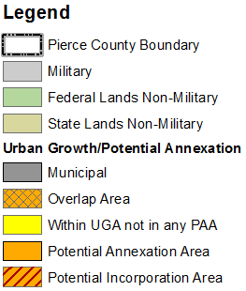
Growth Management Planning
Notes:
U/R map – countywide level
Table of growth patterns
Comment on how GMA has shifted growth toward urban

Slide 3
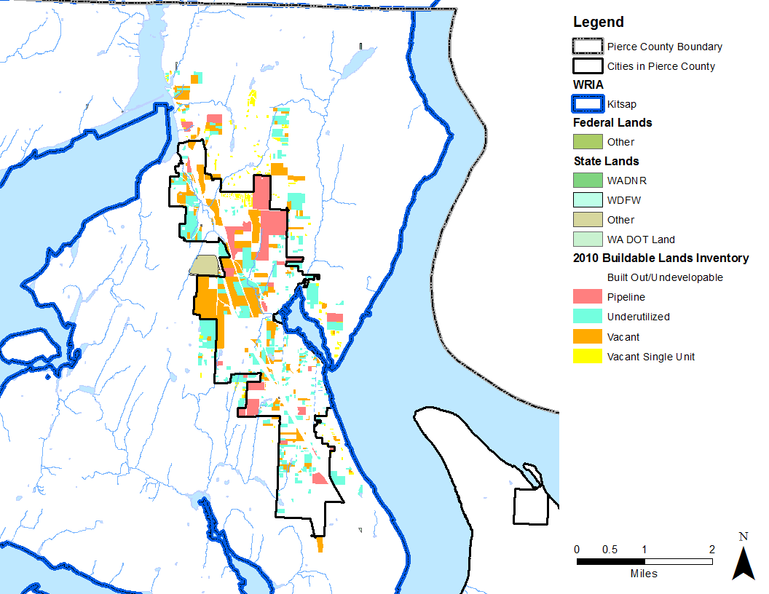
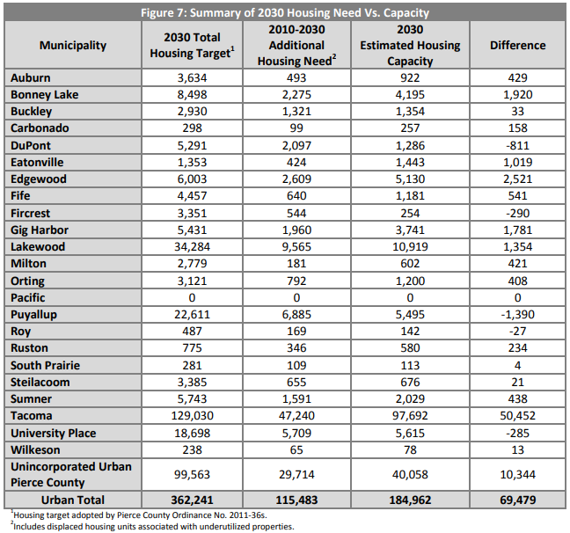
Buildable Lands
Whole jurisdiction within WRIA
Part of jurisdiction within WRIA

Slide 4
Unincorporated Pierce County GMA Trends
39%
31%
60%
30%
28%
40%
69%
61%
72%
70%

Slide 5
WRIA #15 Kitsap
Total Population | 2010 Census | 2018 (ESRI Est.)
Total: | 98,123 | 105,597
Pierce County: | 64,194 | 70,579
Unincorporated: | 56,976 | 60,519
Land Base | Acres
Total: | 144,956
Pierce County: | 81,499
Urban: | 6,804
Rural: | 74,695
Not within Group A Water Service Area: | 34,744

Slide 6
Unincorporated Development Regulations
Zoning Type |  | Minimum Density | Maximum Density
URBAN | Multifamily/ Mixed Use | 6 units per acre | 25 units per acre*
 | Single Family | 4 units per acre | 6 units per acre (sewer)
RURAL | Single Family | 1 unit per 10 acres | 1 unit per 2.5 acres
 | Forest Land/ Large Lot | 1 unit per 80 acres | 1 unit per 10 acres
Highest Density
Lowest Density
*Current proposal may increase maximum urban density

Slide 7
Land Characteristics
 | Parcels | Average Parcel Size | Vacant Parcels
Total: | 56,484 | 2.6
Pierce County (PC): | 39,681 70% of total | 1.8 | 7,929 14% of PC
Unincorporated: | 34,510 61.1% of total 87% of PC | 2.0 | 7,452 22% of PC Unincorporated
Not within Group A Water Service Area: | 7,829 20% of PC | 4.2 | 2,300 29% those not within Group A

Slide 8
WRIA #15 (Pierce): Housing Development Trends

Slide 9
Pierce County Policy
Pierce County policy: no new individual wells in Group A Water Systems
Building permits proposing permit-exempt wells in the #10 Puyallup-White, #12 Chambers-Clover, and #15 Kitsap WRIAs:
Limited to 950 gallons per day
Fee of $500 ($350 to Ecology, $150 to County for reporting requirements)
Record restrictions on title (additional recording fee)
Tacoma Pierce County Health Department reviews well applications.

Slide 10
Tacoma-Pierce County Health Dept. Requirements
Tacoma-Pierce County Health Department (TPCHD) regulates the drilling of new individual wells
TPCHD policy: individual wells prohibited in the Urban Growth Area or Group A Water Service Area
Except when related to timely and reasonable service
Restrictions/well siting and setbacks
Saltwater intrusion areas
Landfill setbacks
Impact to nearby wells or the source

Slide 11
Water Purveyor Coordination
Water availability letters
Water purveyors grant approval for proposed permit-exempt wells within their service areas
Only occurs when they are unable to provide timely and reasonable service
Permit-exempt well could be temporary until system expands and can take over
Other option may be for a neighbor system to adjust boundaries and provide service
Updating Coordinated Water System Plan
Required by State law to coordinate process
Review plans for consistency with local government growth plans

Slide 12
Questions?
Dan Cardwell
(253)798-7039 or dan.cardwell@piercecountywa.gov

