Slide 1

Adopted
February 28, 2017

Slide 2
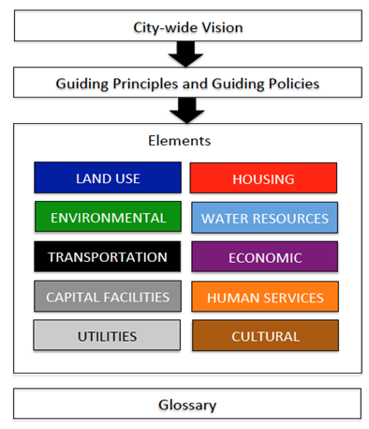

Slide 3
GUIDING PRINCIPLES
Guiding Principle #1
Preserve the special character of the Island, which includes downtown Winslow’s small town atmosphere and function, historic buildings, extensive forested areas, meadows, farms, marine views and access, and scenic and winding roads supporting all forms of transportation.
Guiding Policy 1.1 Develop an island-wide conservation strategy to identify and apply effective methods to preserve the natural and scenic qualities that make the Island a special place, including better protection for the shoreline, trees, soils, native plants, and farms.
Guiding Policy 1.2 Accommodate new growth in designated centers that meet the Island’s identified needs for housing, goods, services and jobs while respecting conservation and environmental protection priorities.

Slide 4
GUIDING PRINCIPLES
Guiding Principle #2 Manage the water resources of the Island to protect, restore and maintain their ecological and hydrological functions and to ensure clean and sufficient groundwater for future generations.
Guiding Principle #3 Foster diversity with a holistic approach to meeting the needs of the Island and the human needs of its residents consistent with the stewardship of our finite environmental resources.
Guiding Principle #4 Consider the costs and benefits to Island residents and property owners in making land use decisions.
Guiding Principle #5 The use of land on the Island should be based on the principle that the Island’s environmental resources are finite and must be maintained at a sustainable level.

Slide 5
GUIDING PRINCIPLES
Guiding Principle #6
Nurture Bainbridge Island as a sustainable community by meeting the needs of the present without compromising the ability of future generations to meet their own needs.
Guiding Principle #7
Reduce greenhouse gas emissions and increase the Island’s climate resilience.
Guiding Principle #8
Support the Island’s Guiding Principles and Policies through the City’s organizational and operating budget decisions.

Slide 6


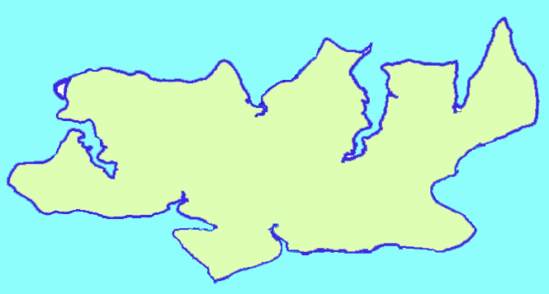



Fig. LU-3. Island-wide
Land Use Concept
Day Road
Shorelines
Gateways
305 Corridor
Rolling
Bay
Designated Centers
Winslow Lynwood Center
Rolling Bay Island Center
Industrial Centers
Day Road Sportsman Triangle
Conservation Area
Sportsman
Triangle
Island
Center
Winslow
Lynwood Center

Slide 7
Bainbridge Island
17,430 ACRES
Conservation Areas
91%
15,841 ACRES
Designated
Centers
9%
1,589 ACRES

Slide 8
DESIGNATED CENTERS
WINSLOW
MIXED USE TOWN CENTER/
HIGH SCHOOL ROAD &
RESIDENTIAL DISTRICTS
NEIGHBORHOOD CENTERS
INDUSTRIAL CENTERS
Lynwood
Center
Island
Center
Day Road
Sportsman Triangle
Rolling
Bay

Slide 9
ACTIONS BY ELEMENT
LU Action #1 Complete a thorough review of all Bainbridge Island codes to ensure that they implement and are consistent with the Comprehensive Plan.
LU Action #5 Adopt a multi-year planning work program for adopting the subarea plans for Island Center, Rolling Bay, Sportsman Triangle and Day Road.
EC Action #1 Adopt and maintain an Economic Development Strategy to coordinate public and private efforts to grow and sustain a healthy economy on the Island.
EN Action #3 Consider climate change in all relevant City decisions, including capital projects, budgeting, staffing, and program creation.

