Slide 1
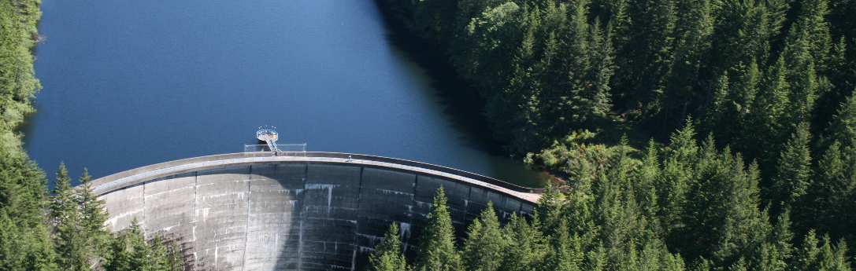
WRIA 15 Watershed Restoration and Enhancement Committee
April 4, 2019
Photo from KPUD

Slide 2
AGENDA
Welcome and Introductions
Meeting Agenda and March Summary
Updates and Announcements
Ex Officio Nominations
  Mason-Kitsap Farm Bureau
  Washington Water Service
Groundwater Models
Water Purveyor Panel
Public Comment
Debrief and Recommendations

Slide 3
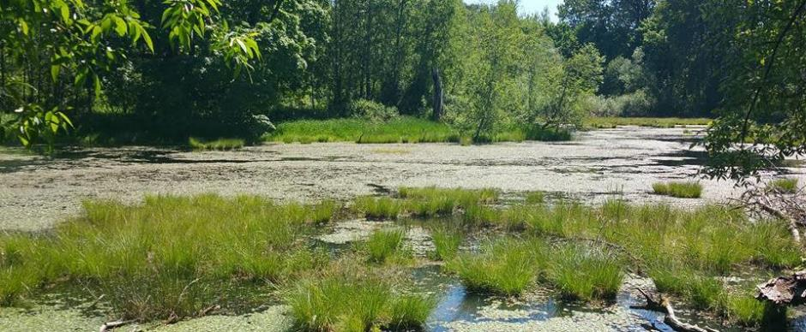
Updates and Announcements
Operating Principles
Committee Support
NEB Guidance

Slide 4
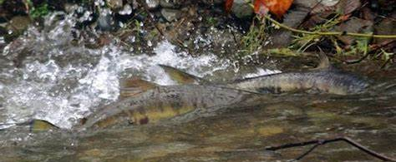
Ex Officio Decision
Mason-Kitsap Farm Bureau
Washington Water Service

Slide 5
Groundwater Model Presentations

Slide 6
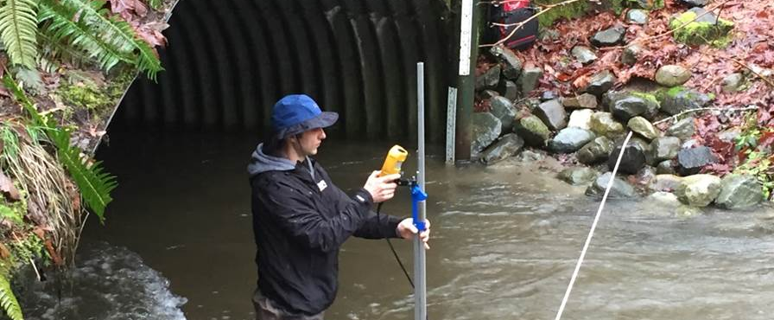
Water Purveyor Panel
How do you engage with cities or counties for permit-exempt well requests?
How do you track growth and are there areas where you anticipate not being able to meet the service need at the rate of growth?
Are there areas within your service area where you expect wells to be drilled – or that have already been drilled- between Jan 2018 and 2038?
Are there ongoing planning efforts or any potential changes that could impact the committee’s work and recommendations? Photo from KPUD

Slide 7
Presentations
December
Geography
January
Instream Flows
February
Hydrogeology, Subbasins
March
County and City Planning, Lessons Learned
April
Modeling, Water Purveyors

Slide 8
WORKGROUP AGENDA
DISCUSSION AND WORKING SESSION ON SUBBASIN DELINEATION
GUIDANCE FOR CONSULTANT ON GROWTH PROJECTIONS
NEXT STEPS AND ACTION ITEMS

Slide 9
Technical Workgroup Formation
Process
  Operating principles refers to the formation of workgroups
  Membership may change over time, depending on the focus topics
  Not necessarily mean a two-year commitment.
Transparency
  Doodle poll went to those who expressed interest in the workgroup.
  Any member of the Committee is welcome to join
  Others with relevant expertise to offer are also welcome to join.
Purpose
  The purpose is to support the efforts of the Committee.
  Initial focus will be subbasin delineations and data gaps related to population projections for permit-exempt wells.

Slide 10
Work Flow Overview for Elements of Watershed Restoration and Enhancement Plans
Overview presentation by Ecology or Consultant and initial Committee discussions and recommendations.
Technical consultants develop draft product and provide to Ecology before Committee meeting or technical workgroup meeting.*
Technical workgroup discuss recommended approach and provides feedback to consultants.
Technical consultants present draft products to Committee. Committee discussions and recommendations.
Technical workgroup meets and provides feedback to consultants.
Technical consultants on point
Technical workgroup on point
*In some cases, draft product provided to technical workgroup for review prior to Committee meeting. There may be more than one round of feedback from the technical workgroup and/or Committee for certain elements of the Plan (esp. consumptive use and project list development).
Consultants make revisions, develop final product to Ecology and present revised products to Committee.**
**The Committee is the decision-making body which will approve final decisions on subbasin delineations, growth projections, consumptive use estimates, and offset project list.

Slide 12
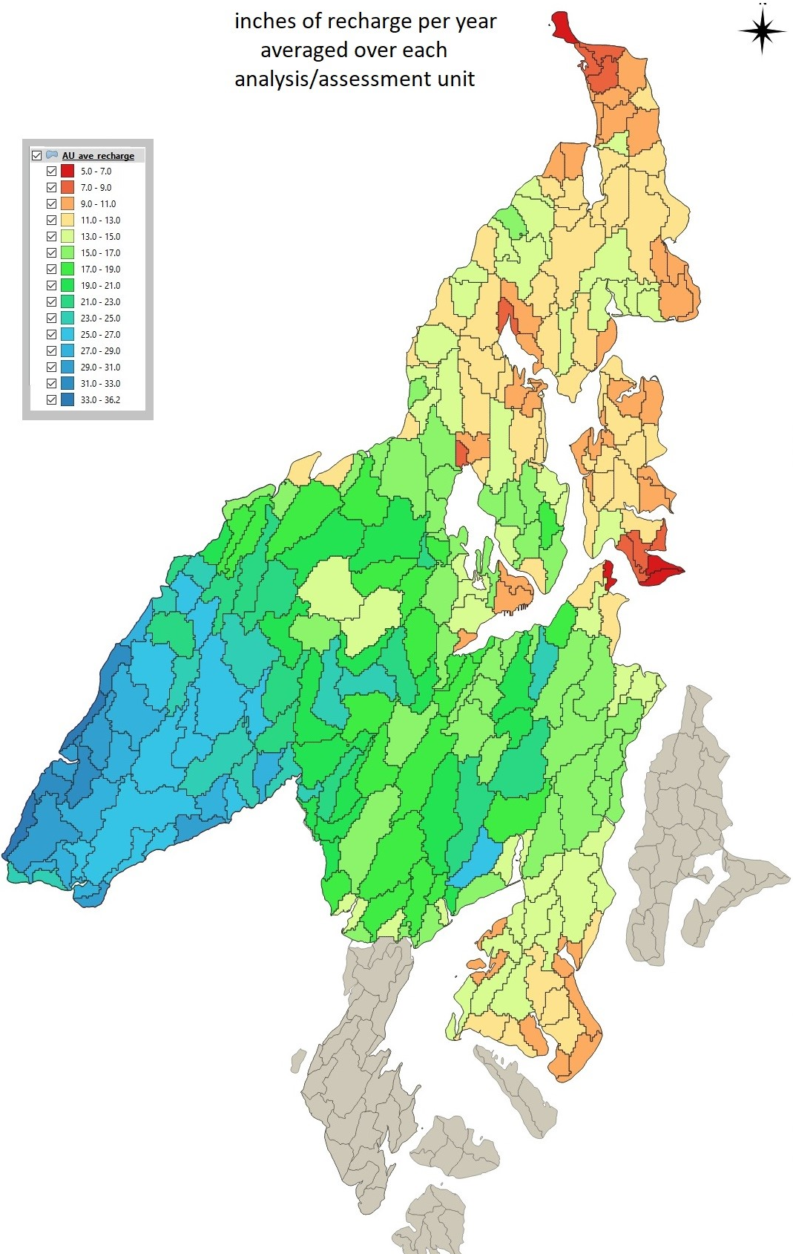
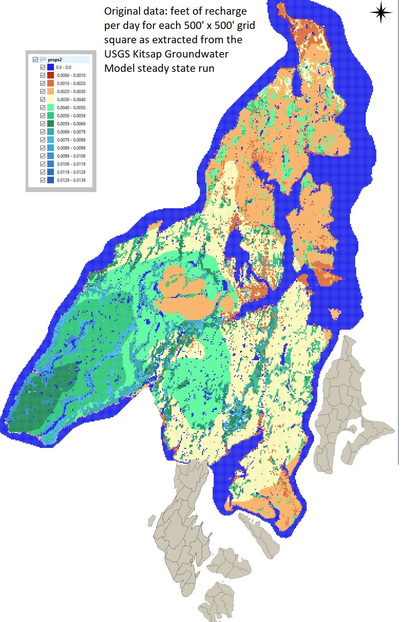

Slide 13
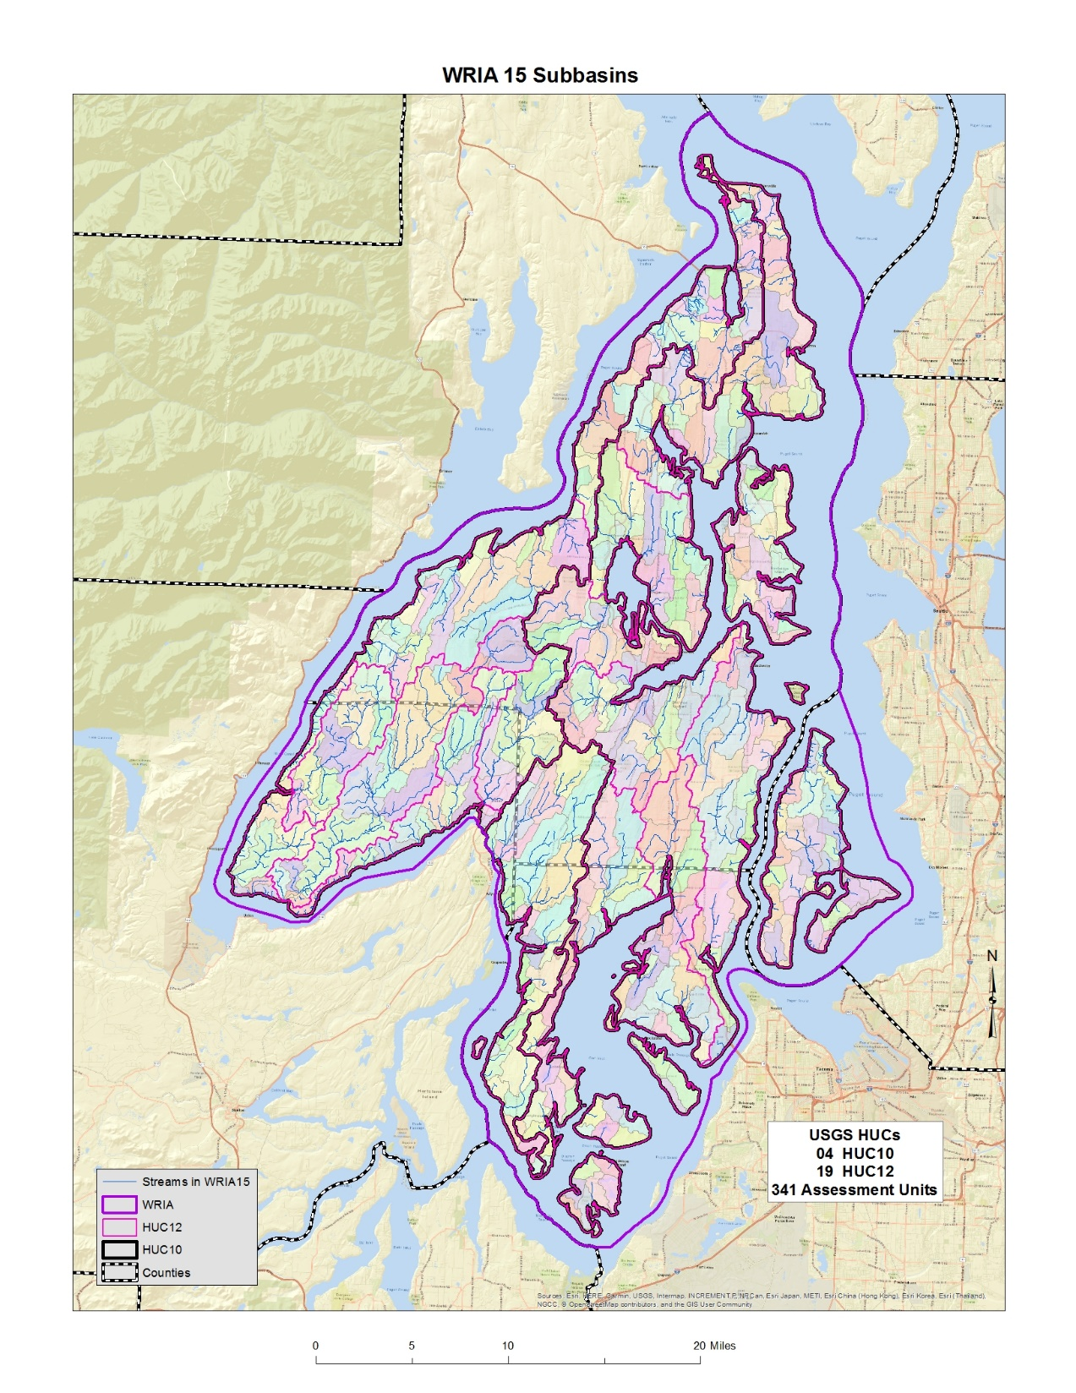

Too few of subbasins reduces our understanding of the relationships between where pumping effects will be and where benefits of offset projects will occur.
Too many subbasins can make it unwieldly to evaluate all of the offset projects needed to achieve a net ecological benefit for the WRIA.
Notes:
I took the USGS HUC (Hydrologic Unit Codes) are various scales which are shown in this image: HUC08-subbasin; HUC10-watershed; HUC12-subwatersheds and overlaid them for WRIA 15. I also added even smaller Assessment Units that Ecology had developed several years ago.
There are four HUC10s; and nineteen HUC12s. There are 341 AUs as well. While at some level all 341 drainages deserve some attention, it is important to keep in mind the purpose of this delineation process, which is to support estimating the consumptive impacts of new domestic exempt well uses in the WRIA. If no new wells are going to be constructed in a specific drainage, then there won’t be new impacts caused by new domestic wells in that area.

Slide 14
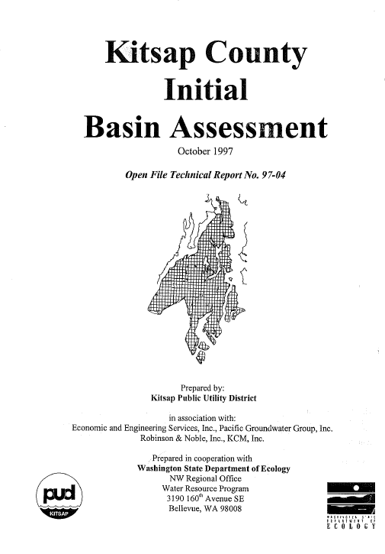
1997 Work broke the Kitsap County portion of the basin into 18 subbasins
Notes:
1997 Work broke the Kitsap County portion of the basin into 18 subbasins as seen on the map. This report was developed to support the efforts of Ecology at the beginning of Watershed Planning under RCW 90.82.

Slide 15
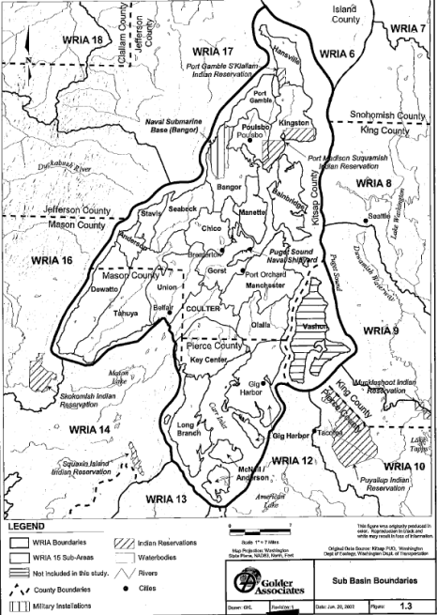
2002 Work broke the WRIA into 24 subbasins
Notes:
2002 Work broke the WRIA into 24 subbasins which are shown on this map

Slide 16
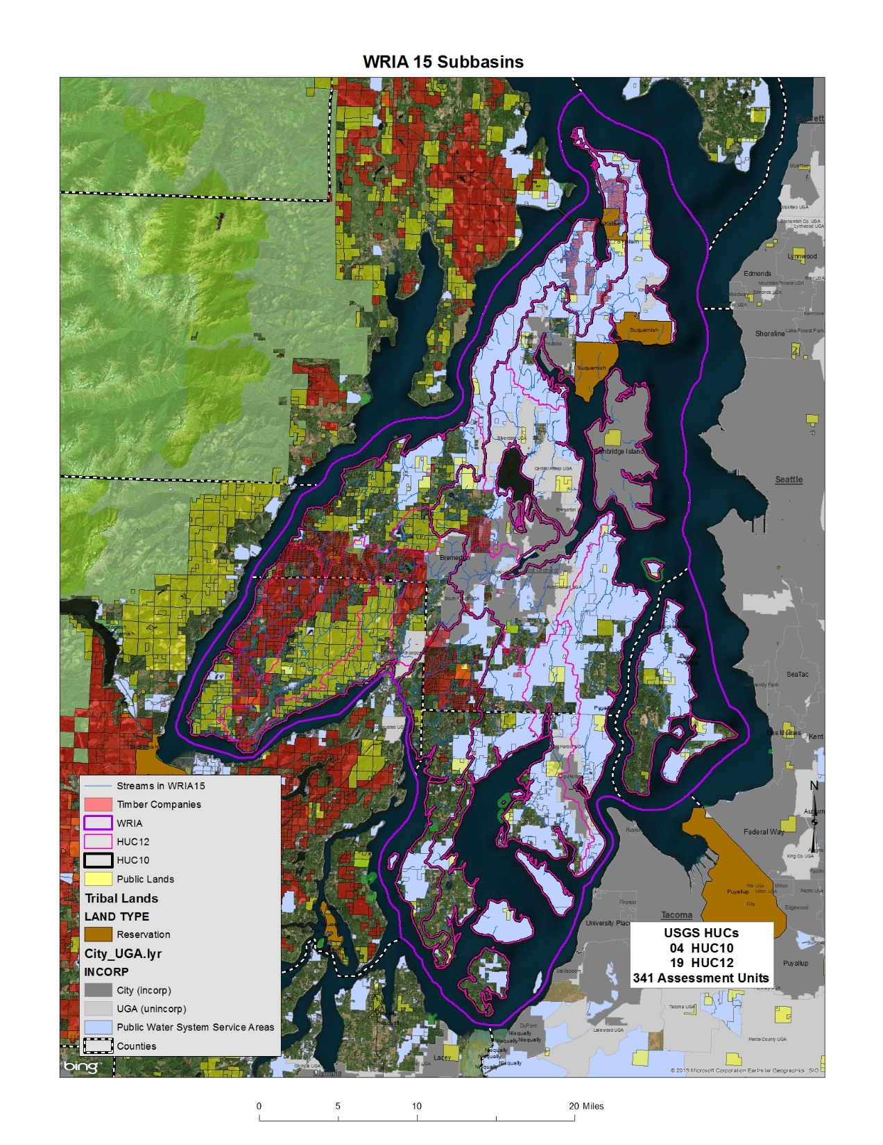
Where can new domestic exempt wells be drilled in the WRIA?
Notes:
Where can new domestic exempt wells be drilled in the WRIA?
Then I overlaid major public lands owned by various levels of government. I also grabbed parcels obviously owned by major timber companies (missing all the smaller ones). I then added the water system service area maps and the incorporated/UGA boundaries. Since we are focusing on rural, domestic, exempt uses coming in the next twenty years, I figured most of the polygons I added preclude domestic well new uses going into those areas either because the land isn’t privately owned or is in commercial timber.
What this map shows is that much of the WRIA isn’t likely to experience much new domestic exempt use in the coming decades. There just isn’t that much real estate that isn’t either inside a water service area, or public land, or timber property. I have no idea if the water service areas have the capacity to serve new uses in the ‘blue’ areas on this map. Just because a parcel is located inside a blue polygon doesn’t mean that the purveyor can serve water to it. Just one of the many things I don’t know about WRIA15.

Slide 17
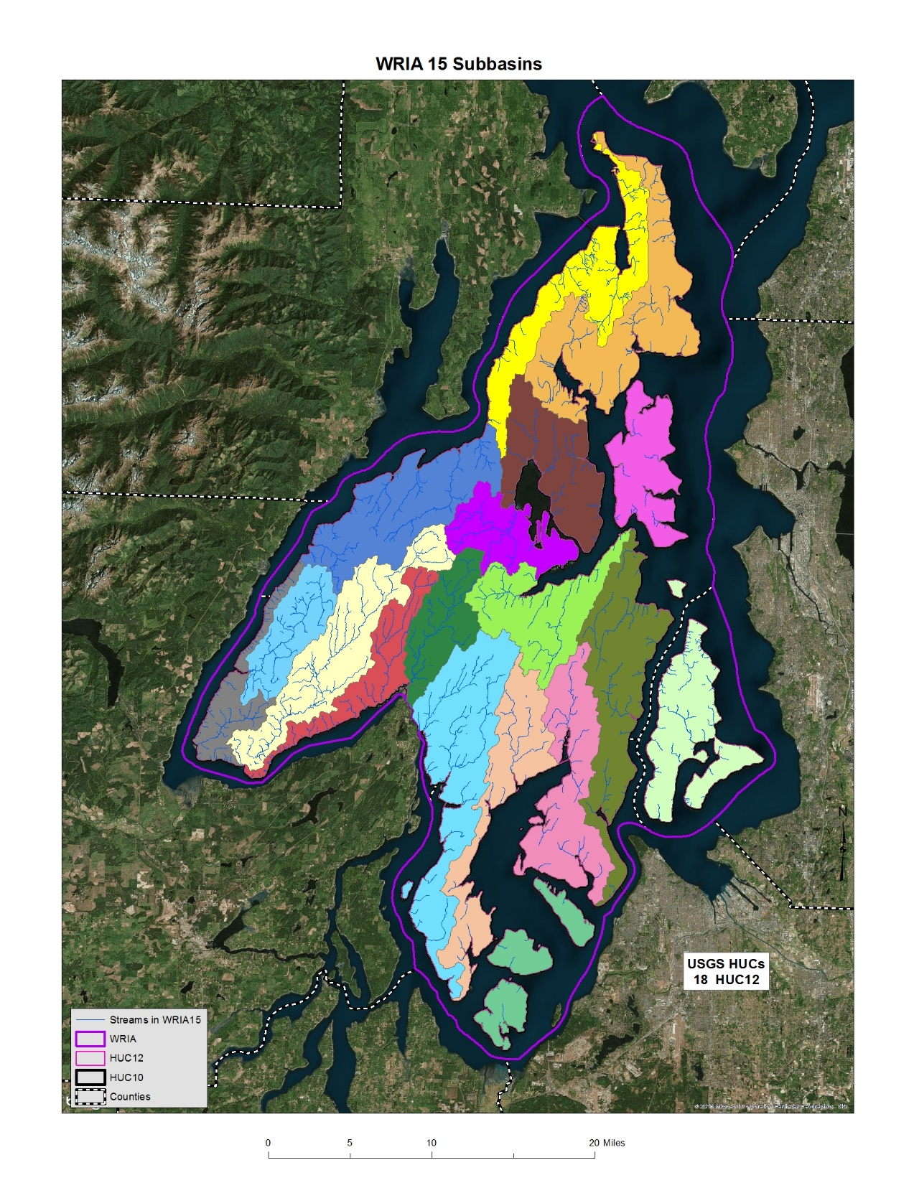
John mapped 18 subbasins
Notes:
From looking at the first two maps, I combined the HUC12s together to arrive at 18 subbasins to consider for the watershed planning process as presented in this map.

Slide 18
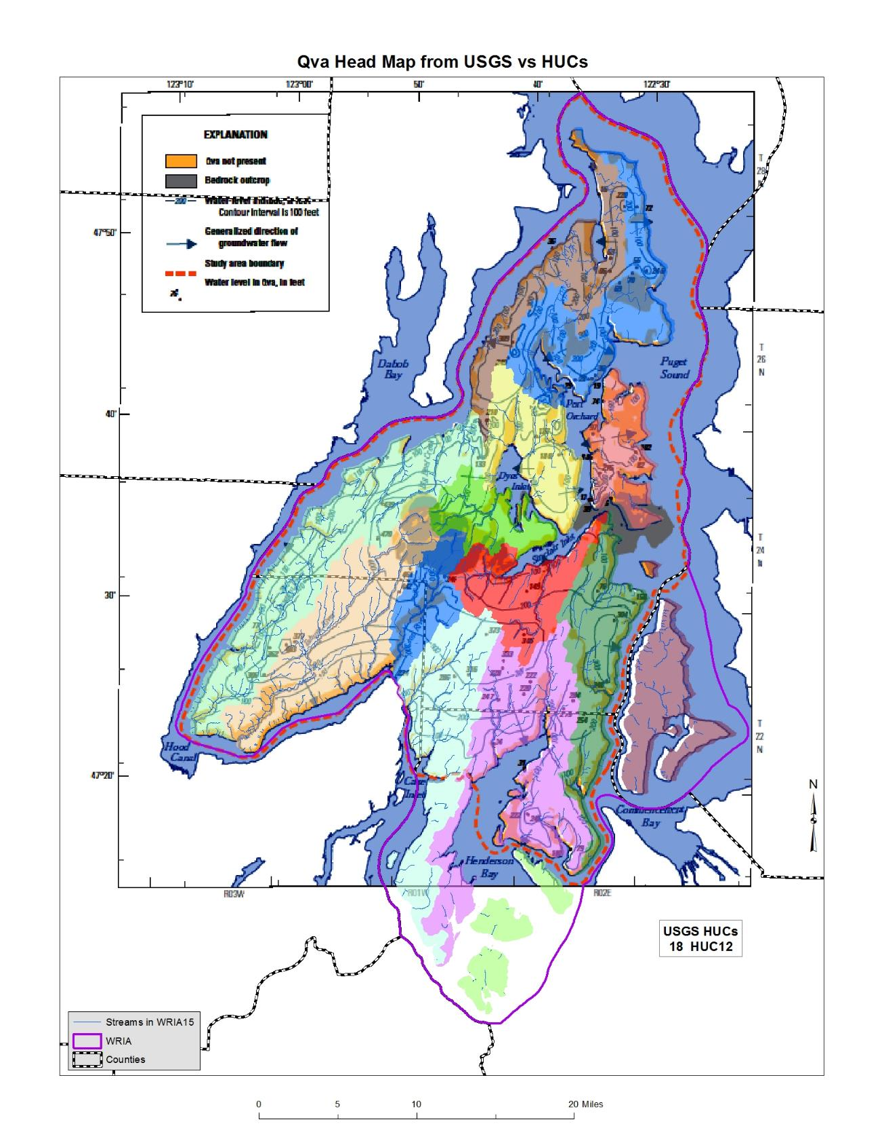
Overlaid USGS Qva Head Map with HUC subbasin map, allowing me to combine multiple HUCs and end up with 14 subbasins
Notes:
This map shows that I have overlaid USGS Qva Head Map with HUC subbasin map, allowing me to combine multiple HUCs and end up with 14 subbasins

Slide 19
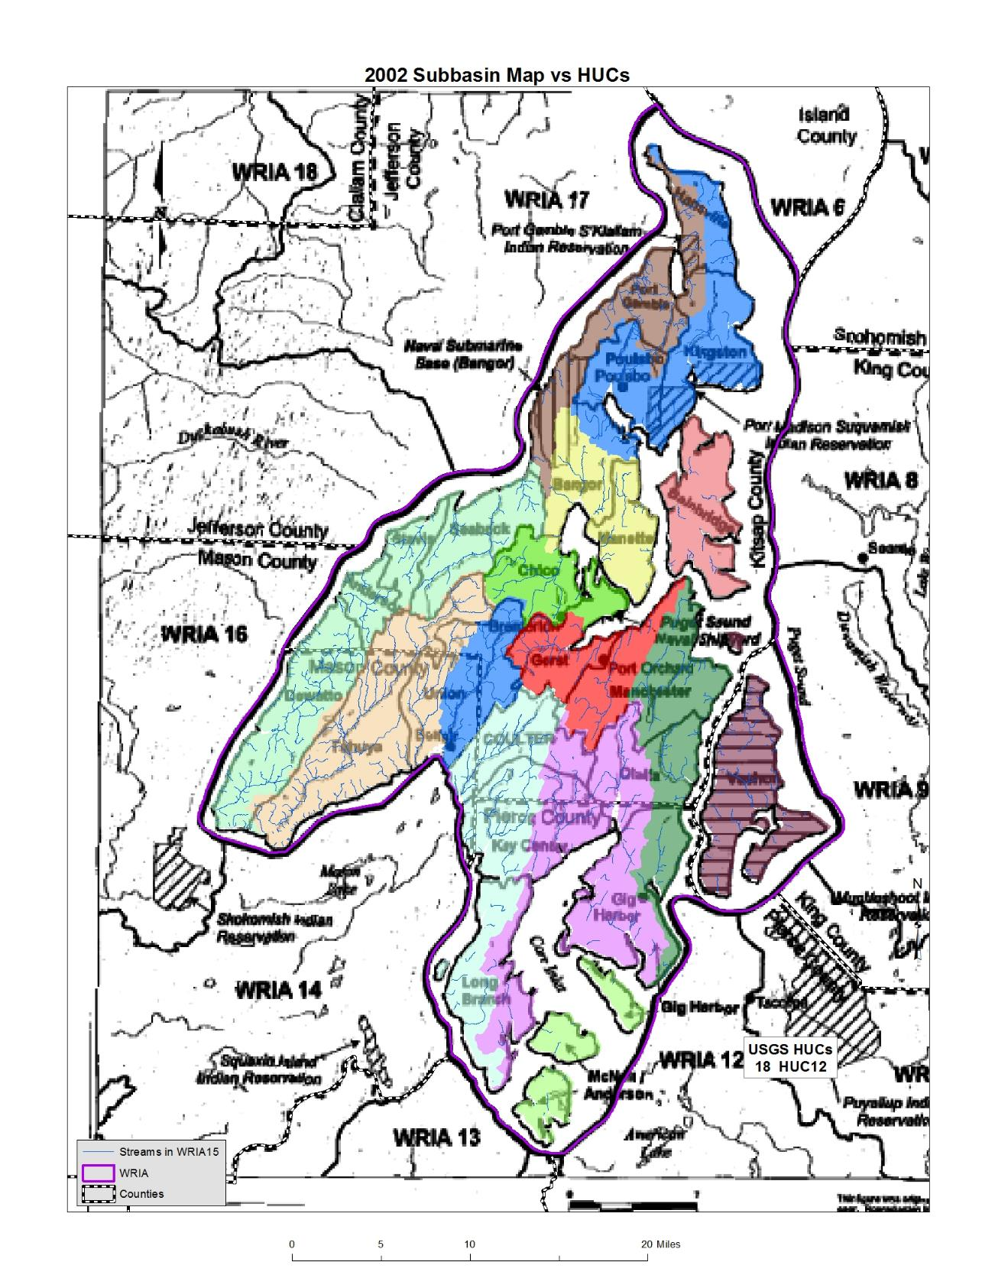
Notes:
I looked at the combined HUCs in comparison to some of the older maps that were developed two decades ago and found very little relationship, which is shown in this map.

Slide 20
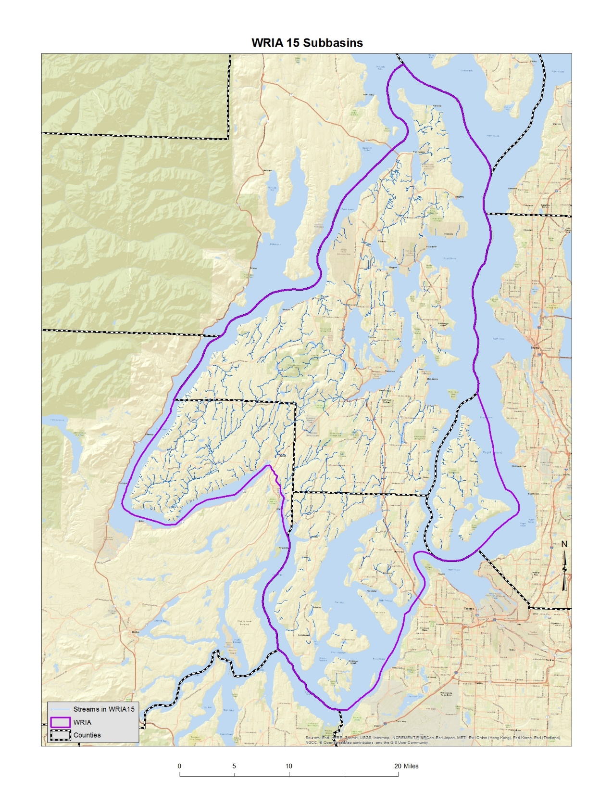
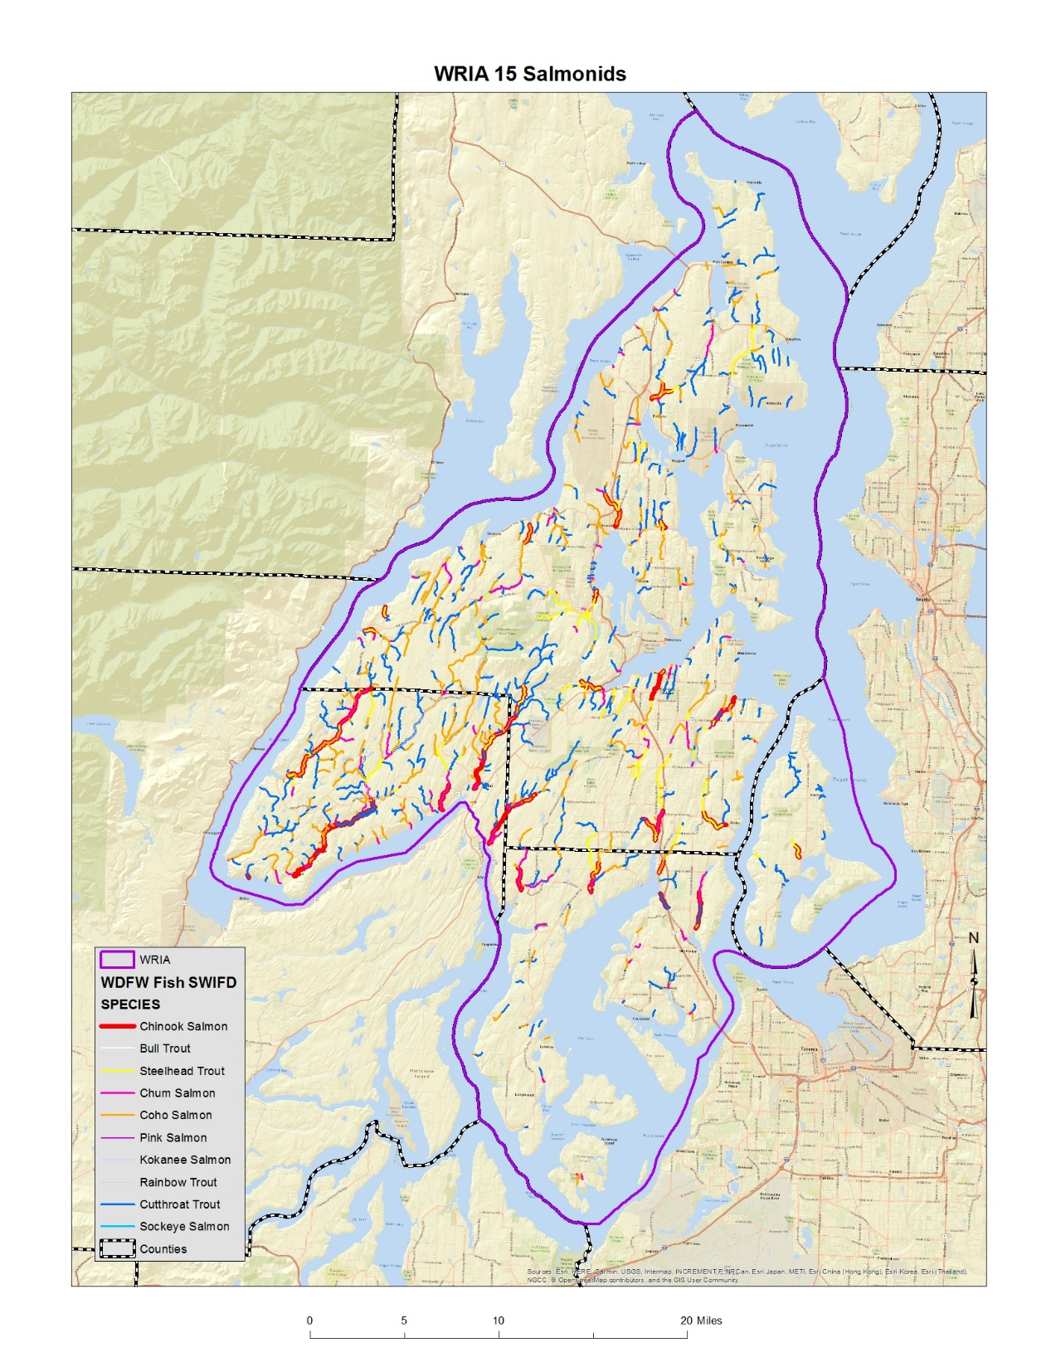
Notes:
This map shows distribution of fish from WDFW in WRIA 15. Fish distribution may be another consideration for identifying subbasins.

