Slide 1
WATER AVAILABILITY AND PERMITTING STUDY
Response to King County Ordinance 18427
Steve Hirschey
King County

Slide 2
WATER AVAILABILITY AND PERMITTING STUDY
Hirst case in October of 2016
Unknowns created by the Supreme Court decision
King County was in the process of updating the Comprehensive Plan
December of 2016 adoption of Comprehensive Plan
  Workplan Action 13 Water Availability & Permitting Study
December of 2017 interim report
January of 2018 new law created by ESSB 6091
December of 2018 final report

Slide 3
History of County Interest in Groundwater Protection
Groundwater is used by approximately 30 percent of the population in the County and is the primary supply in the rural area
Policies in the Comprehensive Plan and code in Titles 9 and 13
A hierarchy of water service with preference for first the large Group A system, other Group A systems then Group B, and as a last resort, a new system or private well
Four Coordinated Water System Planning areas

Slide 4
The Report
Outlines King County’s response to Hirst based on the changes in state law enacted by ESSB 6091
Potential policy changes ~ protect rural water resources
Code changes ~ fee, gallons per day, and drought limitation
Implementation issues

Slide 5
Report Outcomes
A short report ~ 10 pages
Service Requirements Flow Chart ~ the hierarchy of service as outlined in the Comprehensive Plan Policies
Map of Water Service Agency Areas ~ guide the applicant to the appropriate Group A water purveyor for water service
Map of Estimated Number of Parcels with Potential for Permit Exempt Wells

Slide 6
Assumptions used for excluding or including parcels
Parcels in the unincorporated area (either urban or rural)
Parcels not in public ownership
Parcels with on-site improvements of less than $10K
Parcels not less than one acre in size. One acre was determined as a size where siting septic, well site and a dwelling was too crowded to comply with all the siting regulations

Slide 7
Assumptions used for excluding or including parcels -continued
No parcels in the Agricultural Production District
No parcels in the Forest Production District
No parcels with conservation easement
No parcels in the Farmland Preservation Program

Slide 8
Assumptions used for excluding or including parcels-continued
Parcels not located within the service area of an existing large Group A water purveyor obligated to provide service assuming the RCW 43.20.260
No parcels that are within the Transfer Development Right Program sending site properties
No parcels within the 100 year flood plain
No parcels in the Severe Channel migration zone with less than one acre outside the zone

Slide 9
Assumptions continued
Zoning/subdivision– base zoning divided by parcel size
Annexations – not considered
Assumptions reflect policy and code framework

Slide 10
Report Outcomes
Interest in how potential development is characterized
  County directs growth to the Urban Area
Implementation is key
  Mapping of water utility service areas for County permit-counter staff use
Better understanding of whether or not public water systems can expand

Slide 11
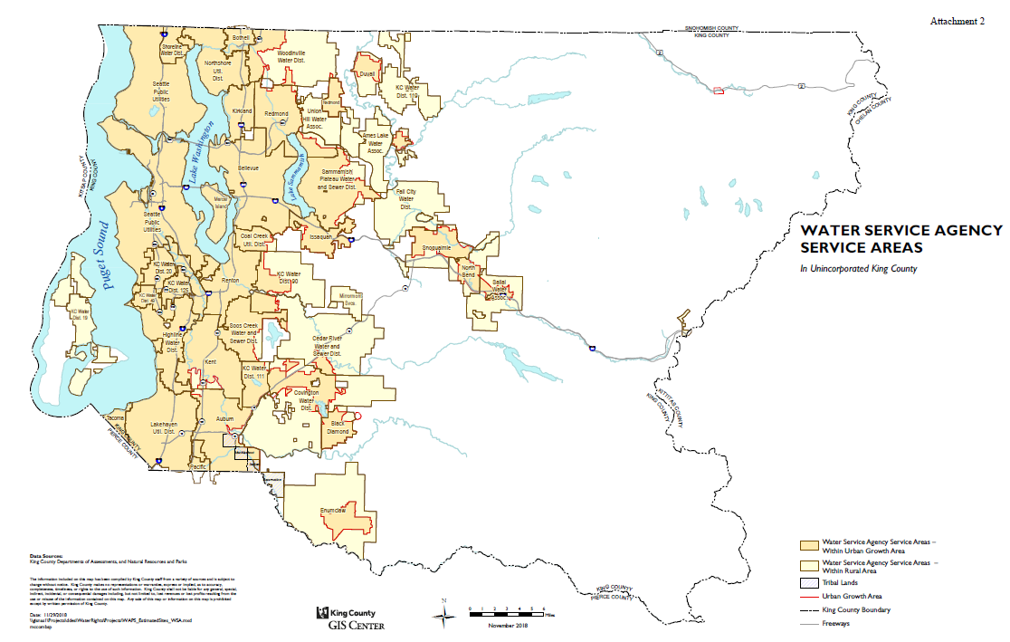

Slide 12
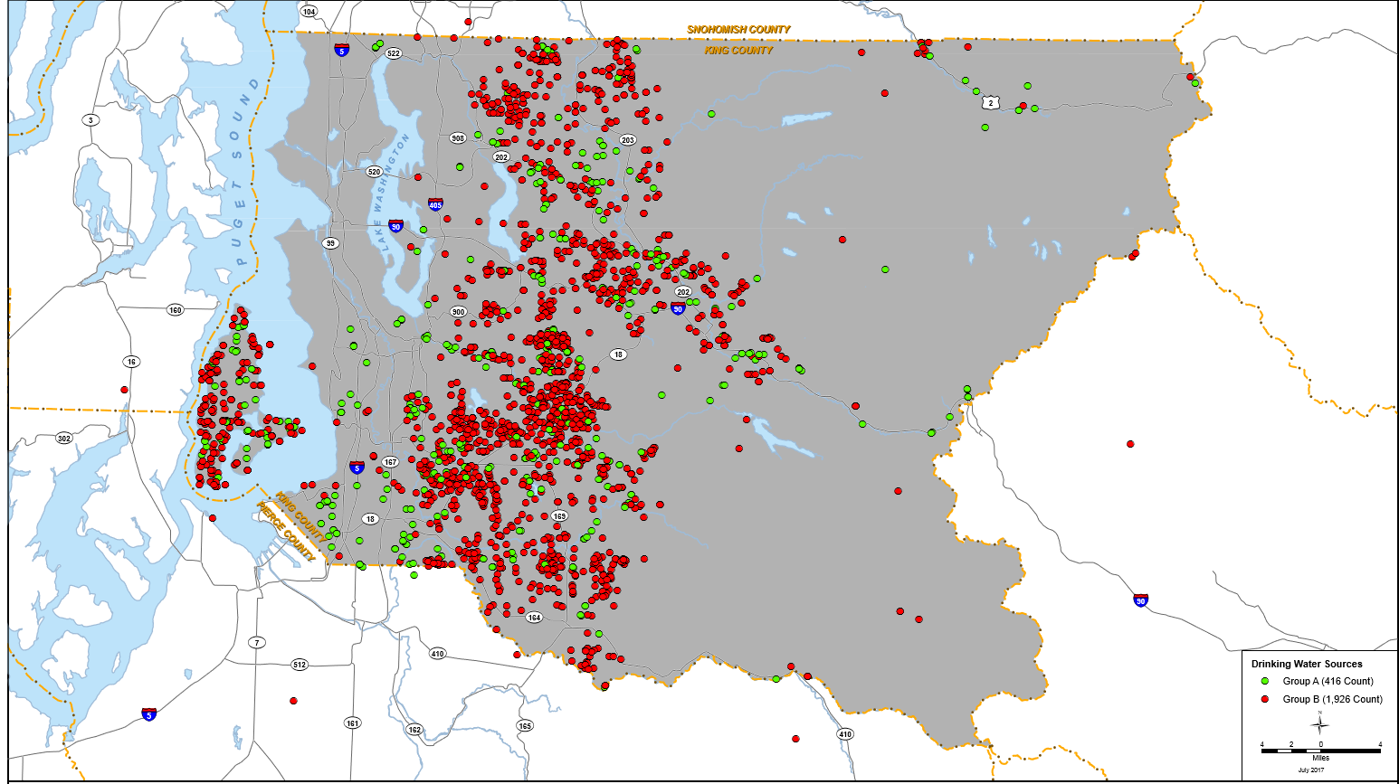

Slide 13
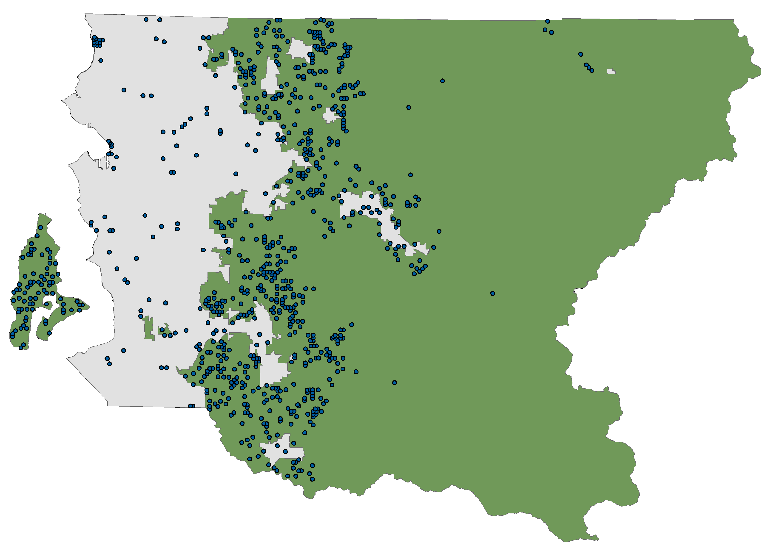
Water wells (2007-17)
Non-dewatering wells [1206]
299 – Urban
907 – Rural

Slide 14
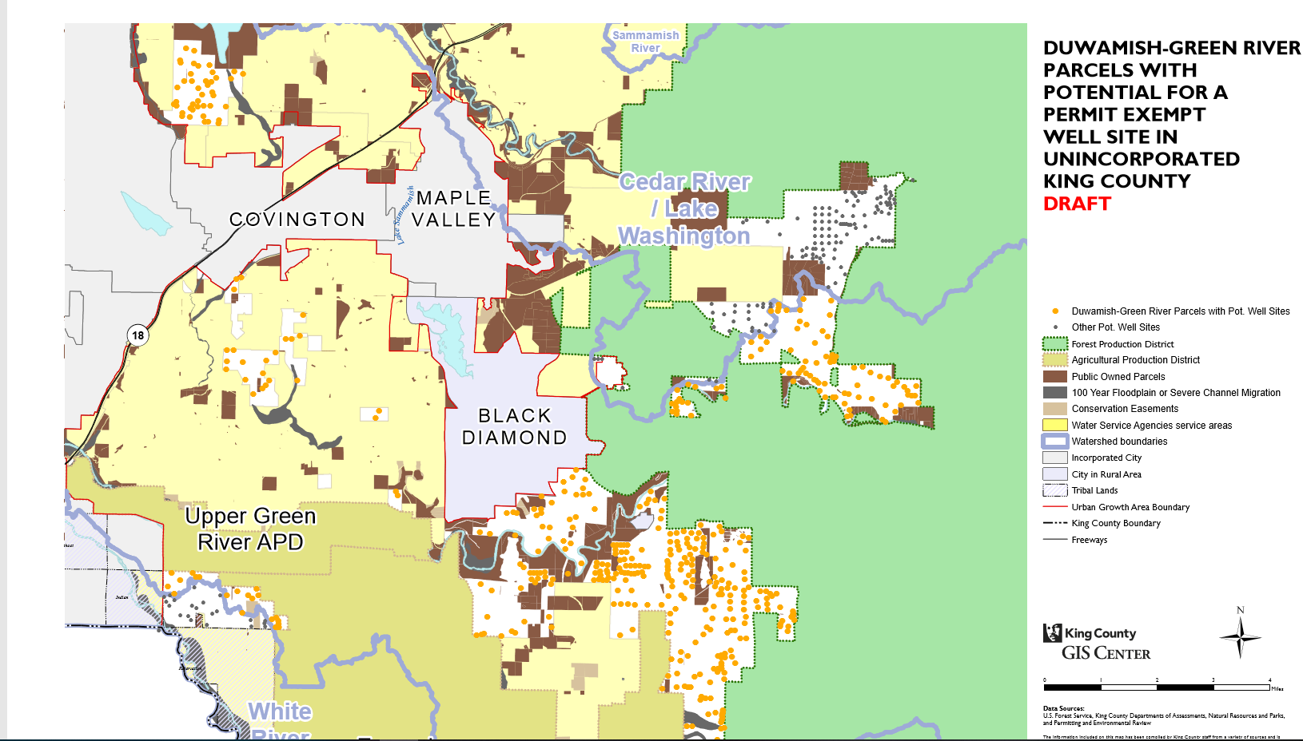
Example Map

Slide 15
Questions
The Report can be downloaded here
https://mkcclegisearch.kingcounty.gov/LegislationDetail.aspx?ID=3823498&GUID=2B07BB69-BB8A-4E0C-8A8D-C1C36D5CDB79&Options=Advanced&Search

