Slide 1
Overview of Groundwater Models of the Kitsap Peninsula and Bainbridge Island
Summary of results presented by:
Lonna Frans, U. S. Geological Survey Washington Water Science Center
April 4, 2019

Slide 2
Typical Modeling Project Objectives
Characterize GW flow system and interaction with SW features
Construct a computerized flow model to assist water resource managers and stakeholders in the evaluation of management options
Generate model predictions of impacts for potential water use and climate scenarios

Slide 3
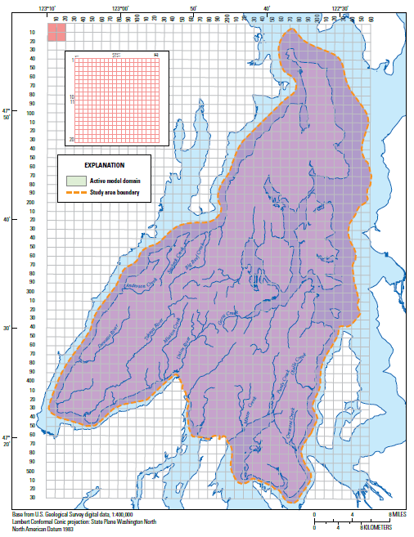
Numerical model development
500 feet square cells
14 layers
Freshwater recharge
Interaction with streams and marine waters
Groundwater withdrawals and return flows

Slide 4
Cross-sectional view of the Kitsap Peninsula

Slide 5
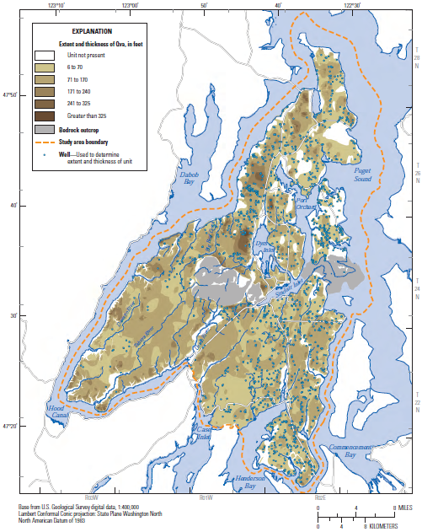
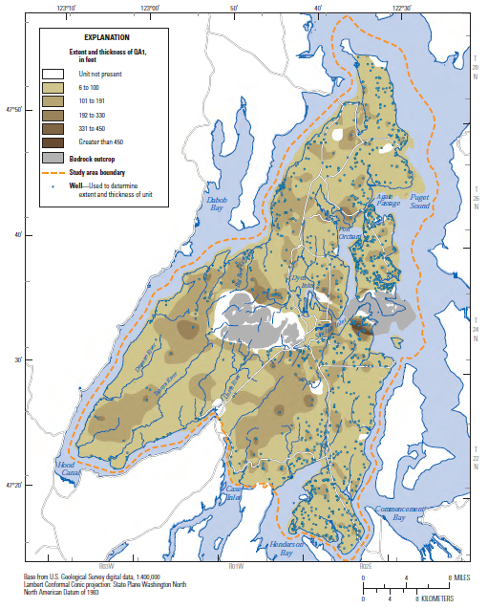
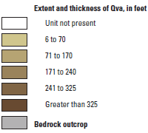
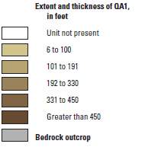
Extents and thicknesses of selected aquifers
Vashon advance aquifer (Qva)
Sea-level aquifer (QA1)
Notes:
Bigger fonts

Slide 6
What kinds of questions can groundwater models address?
How will saltwater intrusion affect coastal wells?
How are surface streams likely to respond in the future? Which streams are most likely to go dry?
How much drawdown can be expected in the water table with changes in pumping or recharge?
How will all of these variables be affected by seasonal variability?

Slide 7
What kind of questions can the model not address?
What will happen to my well?
What is the best growth scenario?
Where can we put new wells?
Which aquifers can we pump freely?

Slide 8
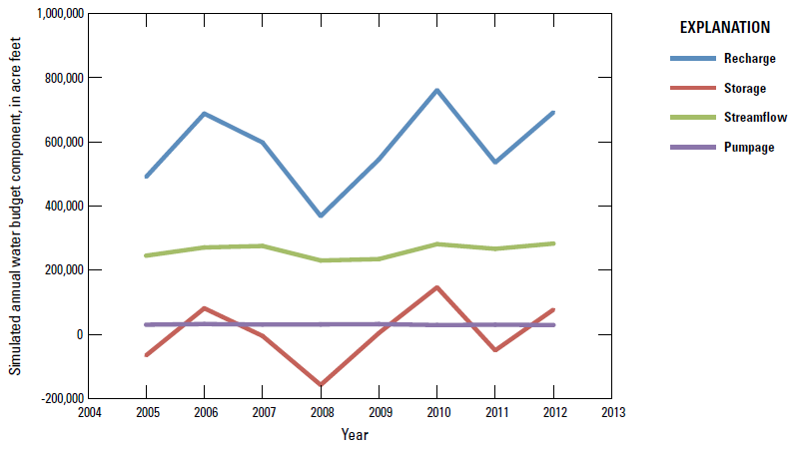
What can the model’s water budget tell us?
Notes:
Bigger picture

Slide 9
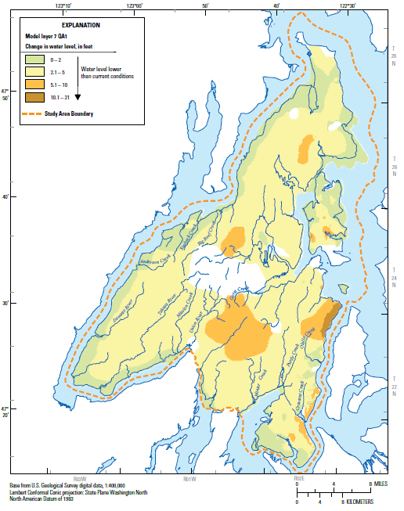
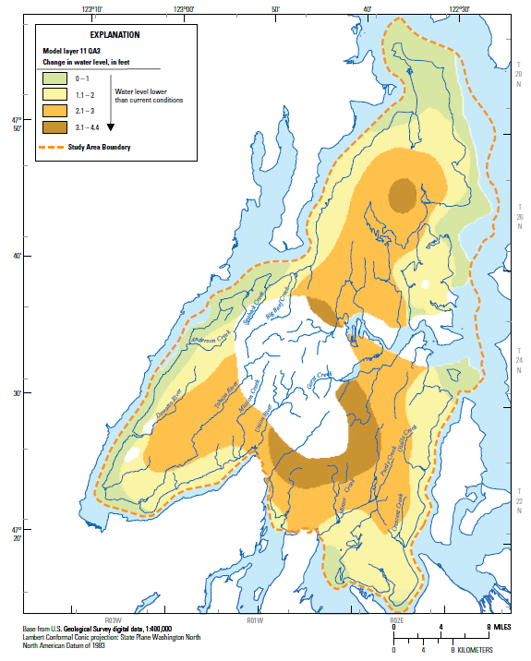
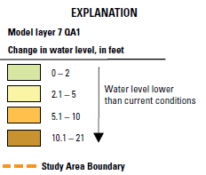
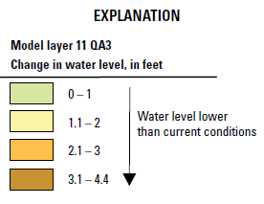
Recharge decreased by 15%
Sea-level aquifer
Deep aquifer

Slide 10
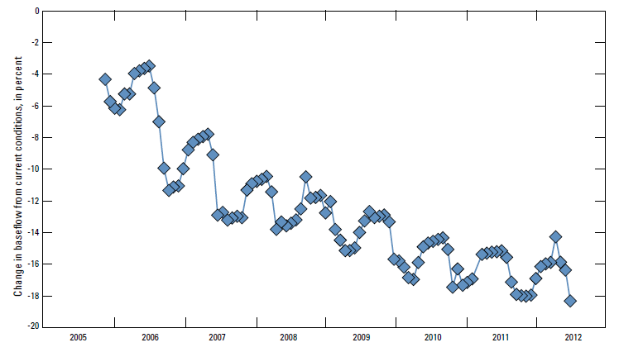
Recharge decreased by 15%
% change in streamflow
Notes:
Changed y axis to be readable

Slide 11
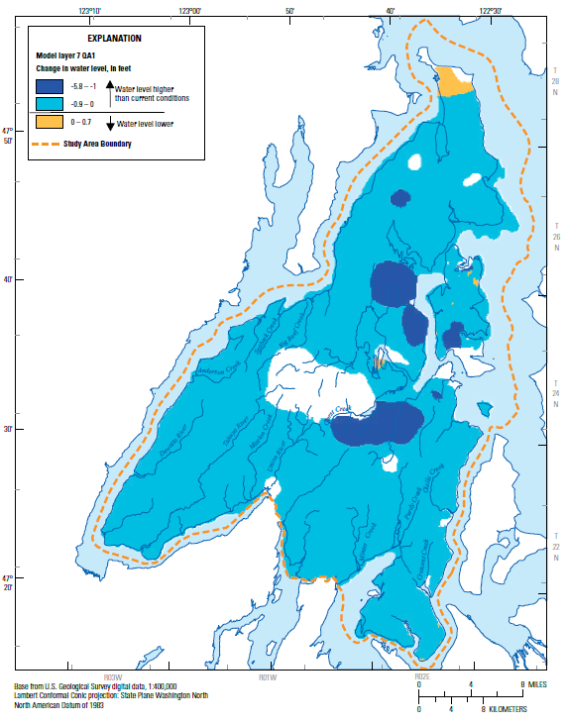
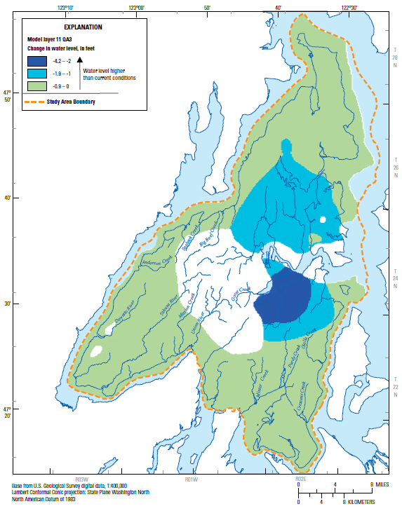
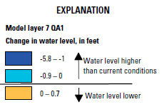
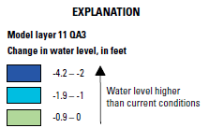
Reduce outdoor water use by 80% during the summer
Sea-level aquifer
Deep aquifer

Slide 12
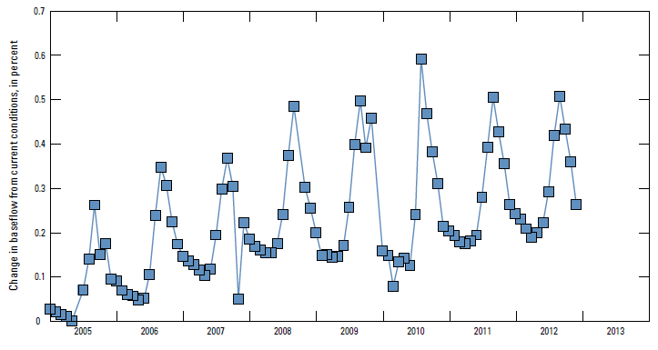
Reduce outdoor water use by 80% during the summer

Slide 13
Modeling effects of projected population growth and climate change
Projected population growth
Notes:
Bigger fonts

Slide 14
Projected recharge amounts
Notes:
Bigger fonts added

Slide 15
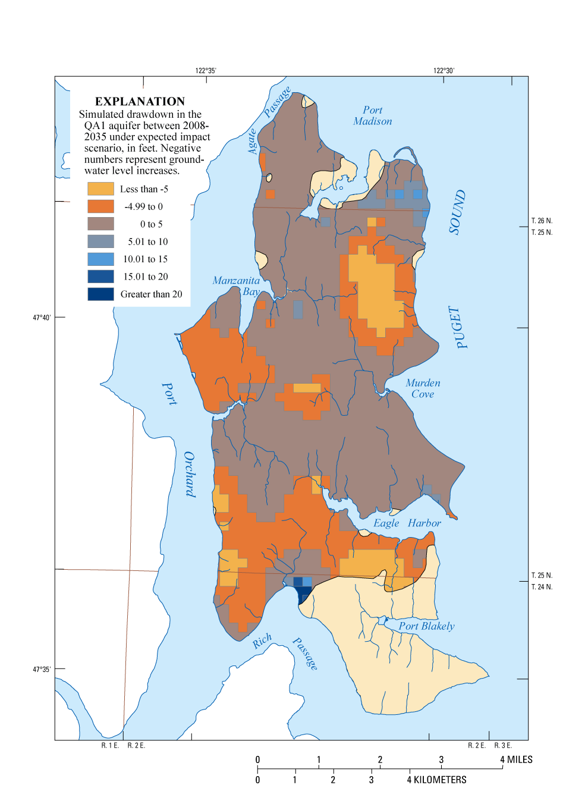
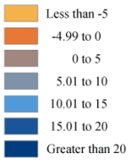
Expected conditions in 2035
Sea-level
aquifer
Notes:
Made legend bigger

Slide 16
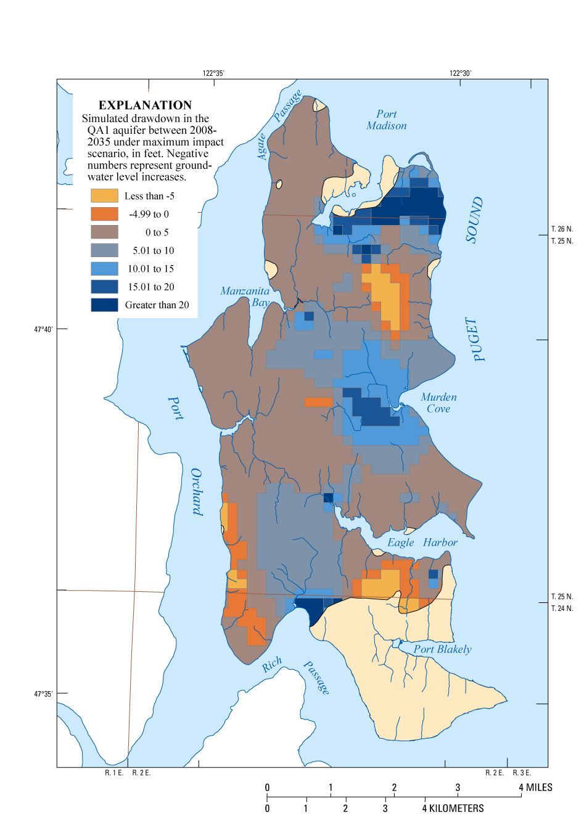
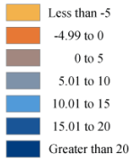
Maximum impact conditions in 2035
Sea-level
aquifer
Notes:
Made legend larger

Slide 17
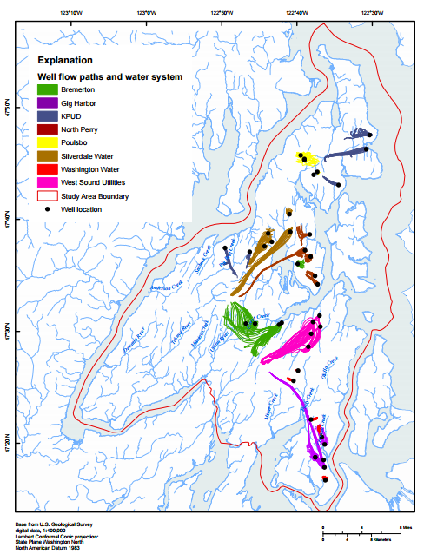
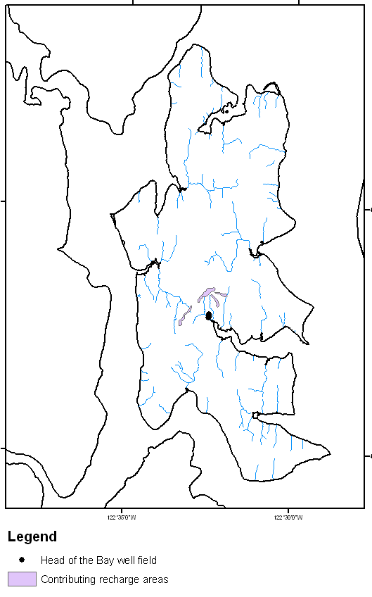
Determining recharge areas
Notes:
Cropped and resized pictures

Slide 18
Summary
Models are useful tools to help make informed decisions about groundwater management
Recharge amounts have the largest impact on baseflow discharge and groundwater levels
Models can be used to assess effects of changes in pumping, land use, and climate
Models can be used to delineate recharge areas and travel times to wells
Notes:
I tweaked the wording on these and added “land use” to third bullet

Slide 19
Questions?
Lonna Frans
(253) 552-1694
lmfrans@usgs.gov

