Slide 1


Growth Projections &
Consumptive Water Use Estimates for RCW 90.94
May 2019
John Covert
Washington State Department of Ecology
john.covert@ecy.wa.gov

Slide 2
Committee Task
Project number of new domestic permit exempt wells in the next 20 years.
Estimate the amount of indoor and outdoor water used by the domestic permit-exempt wells.
Calculate consumptive water use.
Develop projects and actions to offset the amount of water calculated in #3 and meet NEB.
Notes:
These are the steps that the committee, technical workgroup, and technical consultant will be working on over the next year.
Over the next few months we will focus on what we need to do to determine how much water we will need to offset, steps 1-3.
Each of these steps requires us to make a number of assumptions.
No one can accurately predict the future, we don’t where homes will be built, we don’t know how much water each individual well user will actually use, and we don’t have the actual plant and soil conditions on each parcel to know how much water actually ends up being consumptive rather than returned to the ground or to a stream. We’ll have to be comfortable with the unknowns, but also make assumptions that are defensible and justifiable.
The technical workgroup will develop methods or options for each step, based on different assumptions, and provide the committee the options and their assumptions, benefits, and drawbacks. The committee will decide which direction to take.
Lessons learned from WRIAs 1 and 11: if they did this again, would spent less time on steps 1-3 so they could focus more on project identification and development.
We have limited time and resources for this process. The more Committee meeting time, technical workgroup time, and consultant time we spend on the earlier steps, means less time and resources to use later.

Slide 3
Why Estimate Consumptive Water Use?
ESSB 6091 Sec.203(3)(b) says “At a minimum, the plan must include those actions that the committee determines to be necessary to offset potential impacts to instream flows associated with permit-exempt domestic water use.”
ESSB 6091 Sec.203(3)(e) says we “must include estimates of the cumulative consumptive water use impacts over the subsequent 20 years”
Ultimately, watershed plans will be judged by two tests:
  Offsets total potential impacts of new domestic wells, and
  Achieves a “net ecological benefit” (NEB).

Slide 4
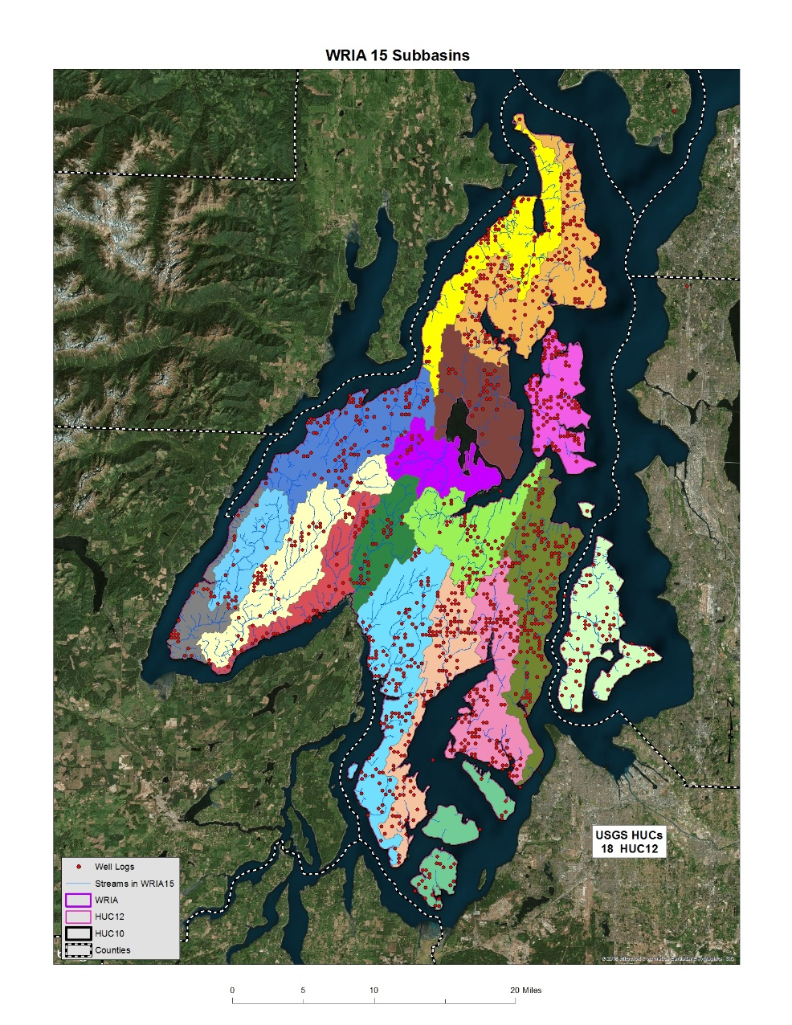
Subbasins and Growth Projections
Notes:
Useful to come up with subbasin delineation early, before get too far on consumptive use estimates
We might not have data that is spatial, so we will use assumptions to create subbasin level estimates of number of new wells and consumptive use
For outdoor use, we might gather data on outdoor watering to create subbasin level estimates
Data that is not spatial will require more work to recalculate if subbasin boundaries change.

Slide 5
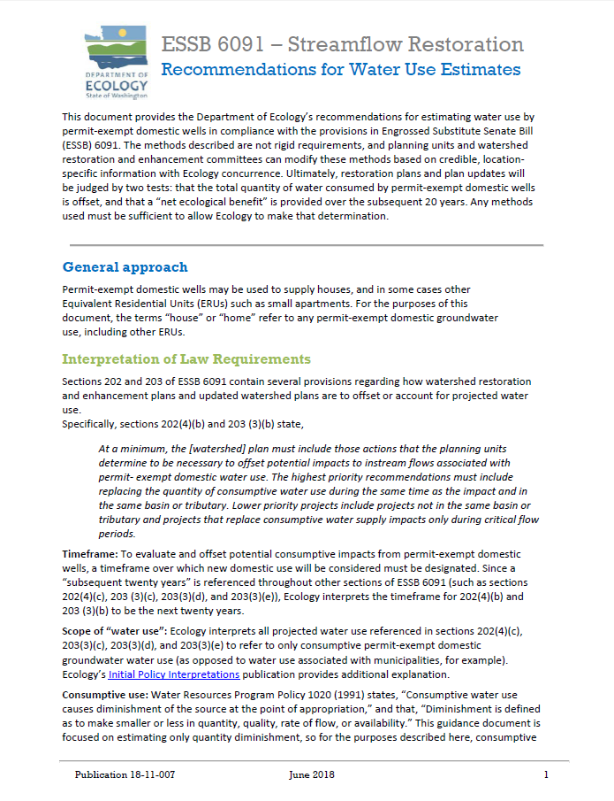
Ecology published recommendations for estimating water use by permit-exempt domestic wells in compliance with RCW 90.94.
The methods described here are described in that document.
Notes:
Ecology published recommendations for estimating water use, which I asked you to read before today’s meeting.
Today we will review the methods for estimating the number of future permit-exempt domestic wells.

Slide 6
Methods for Estimating Number of Future Permit-Exempt Domestic Wells
Building permits: Conduct GIS analysis of county building permits over time, zoning, and parcel information.
Population forecasts: Use population data available from counties and/or WA Office of Financial Management (OFM).
Wells: Use Ecology well log data.
Developable land: Conduct GIS analysis of parcels available for future development, e.g. King County study
Notes:
The recommendations include 3 methods for estimating the number of future PE wells. Possible to use a combination of methods, or different methods for different parts of the basin based on county boundaries.
I added the method used in the King County Water Availability and Permitting study that you heard about last month as 4

Slide 7
1. Building Permits
GIS analysis of building permits, zoning, and parcel information.
Segregate data by WRIA and/or subbasins
Estimate number of single-family building permits issued over some previous time period (e.g. past 10 years)
Use results to predict permit-exempt domestic wells over subsequent 20- year period
Assumptions: rate of increase for new building permits, number/percent of permits that rely on wells, zoning restrictions, undeveloped parcels, etc.

Slide 8
2. Population Forecasts: Option 1
Look at populations for 2 different years (e.g. 2008 and 2018), then use rates of increase to predict future populations.
Upon request, OFM can prepare 2000-2017 small area estimates for a basin or subbasins.
Assumptions: rate of increase, % of population using municipal/ community water system, average number of people per household, etc.
WRIA Name | Estimated Occupied Housing Units 2010 | Estimated Occupied Housing Units 2011 | Estimated Occupied Housing Units 2012 | Estimated Occupied Housing Units 2013 | Estimated Occupied Housing Units 2014 | Estimated Occupied Housing Units 2015 | Estimated Occupied Housing Units 2016 | Estimated Occupied Housing Units 2017 | Estimated Occupied Housing Units 2018 | Numeric Change in Occupied Housing Units 2010 to 2018 | Percent Change in Occupied Housing Units 2010 to 2018
Kitsap | 129,776 | 130,411 | 130,825 | 131,483 | 132,220 | 132,892 | 134,321 | 135,396 | 137,112 | 7,336 | 5.65

Slide 9
2. Population Forecasts: Option 2
Rely on current county or OFM population estimates for a given basin or subbasin, then increase that number based on available population projections.
Assumptions: rate of increase, population per basin/subbasins that span municipal boundaries, population using municipal/community water system, average number of people per household, etc.

Slide 10
2. Population Forecasts: Option 3
Use growth projections from County Comprehensive Plans.
Assumptions: rate of increase, population per basin/subbasins that span municipal boundaries, population using municipal/community water system, average number of people per household, etc.

Slide 11
3. Well logs
Segregate data into sub-basins.
Evaluate data to estimate number of permit-exempt wells drilled over some previous time period (e.g. past 10 years).
Use results to predict permit-exempt domestic wells over subsequent 20-year period.
Assumptions: wells in database are permit-exempt, wells in water service areas, rate of increase, average number of people per household, etc.

Slide 12
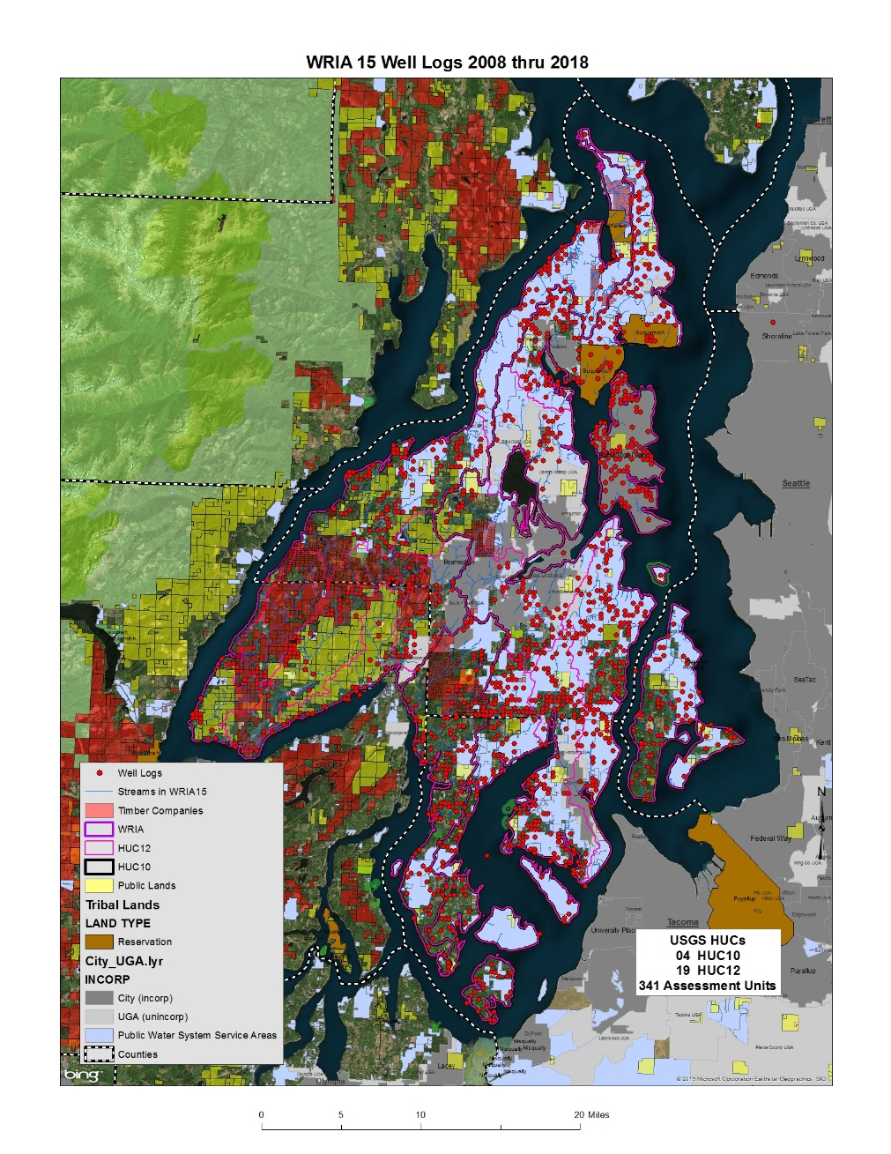
Example: Well Logs
Cannot filter to show only permit-exempt wells
Information in the database is provided by the driller
Location of wells is on the quarter-quarter section
Notes:
cannot filter ecology database to show only permit-exempt wells
Information in the database is provided by the driller and is not always correct, sometimes fields are missing
Location of wells is on the quarter quarter section
The map shows water wells and excludes dewatering wells
We filtered for wells 6-8 inches in diameter, and deeper than 30 feet, as a proxy for domestic wells

Slide 13
4. Developable Lands (King County study)
Use GIS data to identify buildable/developable land.
Overlay zoning information to capture residential density potential.
Remove areas with municipal/community water systems.
Determine likelihood of development in the next 20 years based on growth rates.
  Or, calculate for “full buildout” conditions.
Assumptions: 20 year rate of development, parcels to exclude, connections in water service areas, etc.

Slide 14
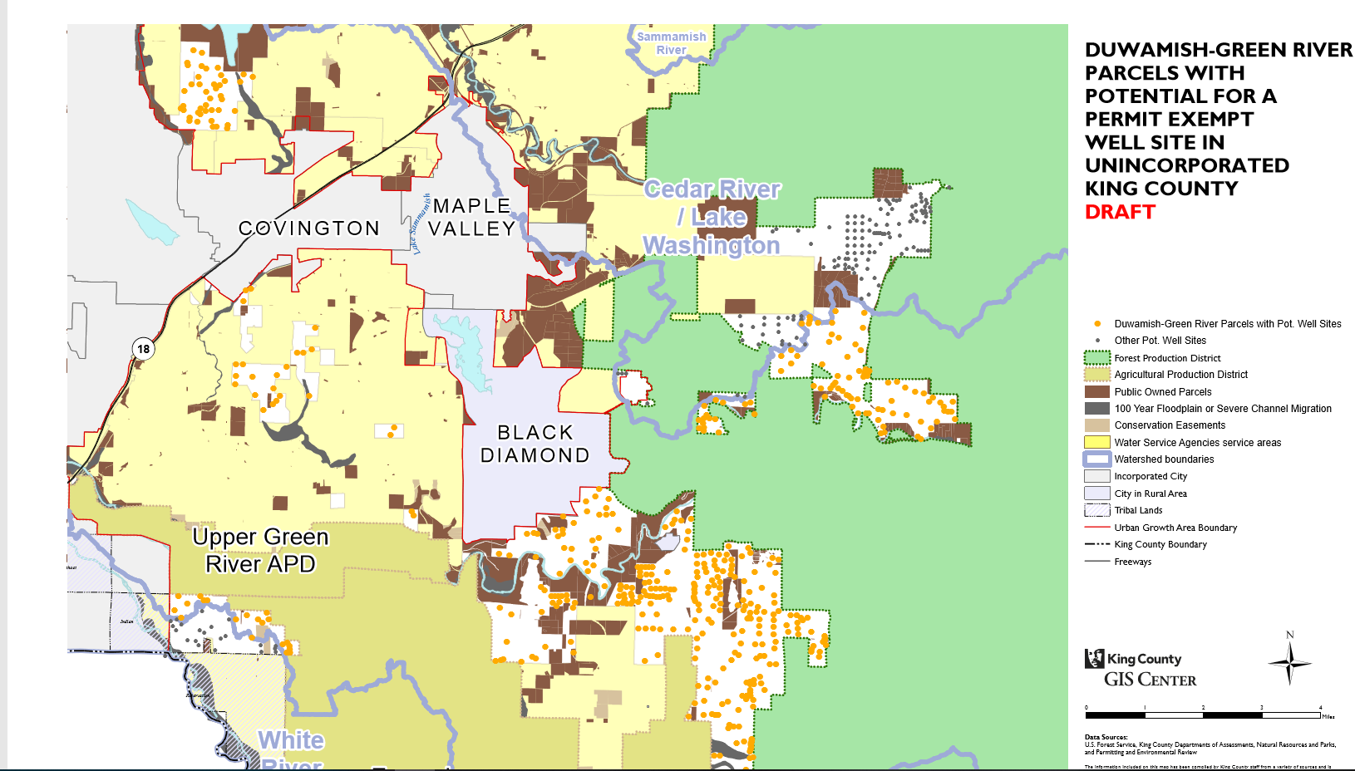
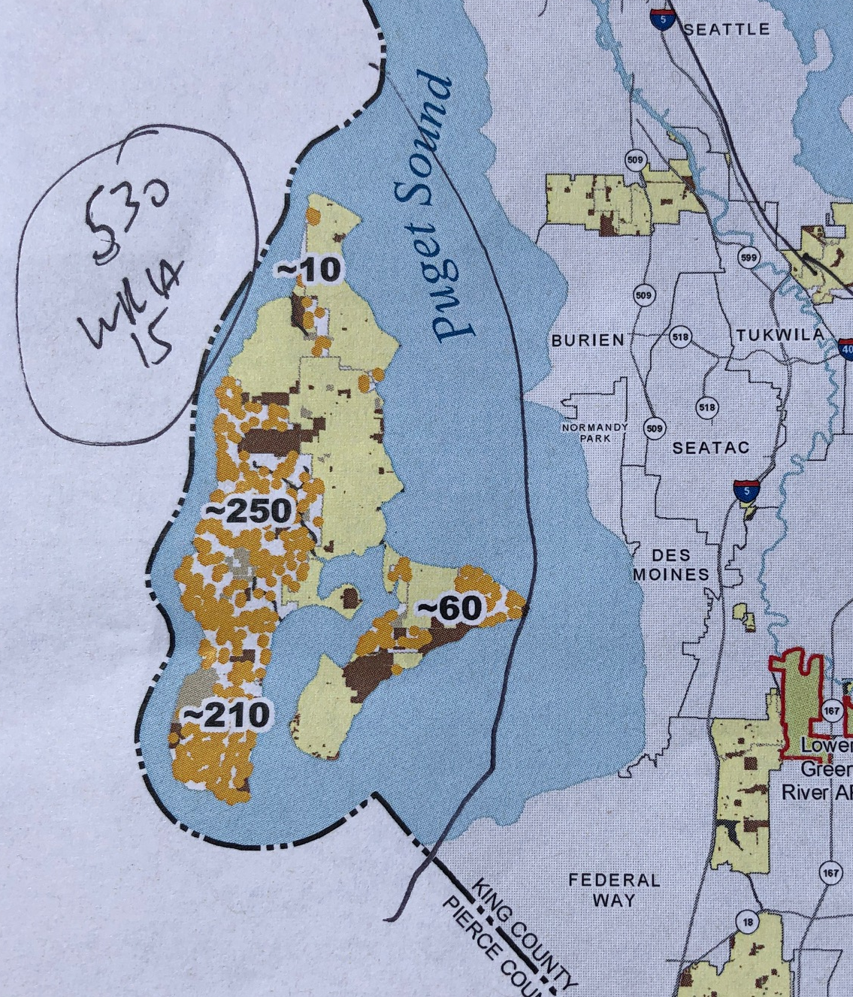
Example: Developable Lands
~530 parcels in WRIA15 portion of King County

Slide 15
Examples from other WRIAs

Slide 16
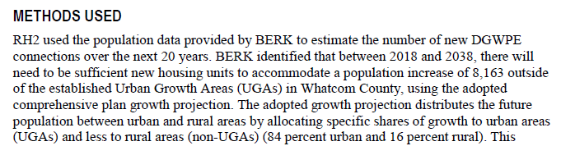
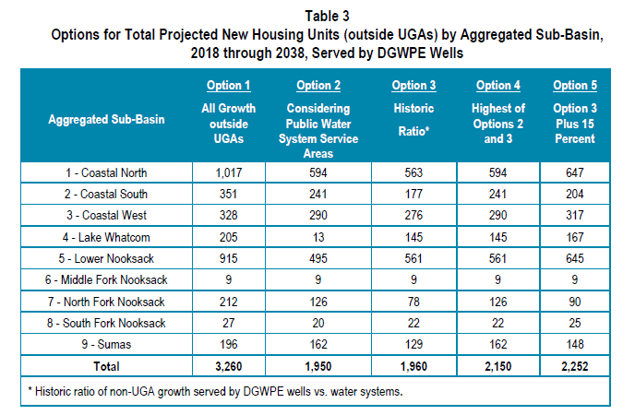
WRIA 1: Population Forecast
Comprehensive plan growth projections for rural growth outside of UGA’s
Adjustments for public water system capacity.
Estimated 2,150 new homes served by wells 2018-2038
Notes:
Population forecasts from the County’s most recent Comprehensive Plan used to develop rural population estimates by subbasin
These forecasts predict a population increase of 8,163 outside of the established Urban Growth Areas (UGAs) in Whatcom County.
assumed 2.56 average number of people per single-family home
numbers per subbasin were adjusted to account for the likely number of homes that will be constructed outside of Urban Growth Areas (UGAs), but can still hook up to water purveyors with capacity and infrastructure to serve additional customers

Slide 17
WRIA 1 Estimates
Consumptive use from new domestic uses over 20-year horizon will likely be about 647 AF/year (~0.9 cfs)
Apportioned out by subbasin based on expected new well locations

Slide 18
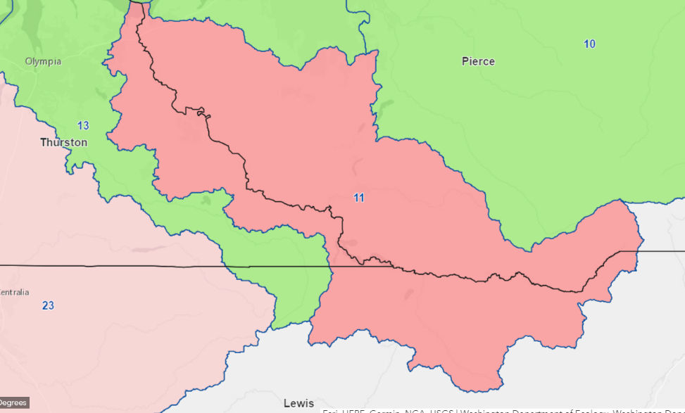
WRIA 11 Estimates
3 counties. Each county used a different method to estimate number of new well connections.
Estimated ~3,000 new well connections 2018-2040.
Consumptive use estimated at
747 Acre Feet/year or 1.03 cfs.
Notes:
Forecast growth to 2040 to match comp plan timeframe
New well connections estimated at about 3,000, using high growth scenarios from the three counties.
Forecasted average annual water use by permit-exempt wells in all of WRIA 11 is expected to range between 318 and 747 AF/Year or 0.44 and 1.03 cfs based on the two methods used for estimating outdoor consumptive water use

Slide 19
WRIA 11: Thurston County
Population Forecast
Thurston Regional Planning Council population forecasts
Urban areas: assumed all growth in cities would connect to water service. Estimated wells in UGAs based on past trends.
Rural areas: subtracted available connections within water service area.
Notes:
calculated the change in population and dwelling units between 2018 and 2040 using estimates developed by Thurston Regional Planning Council (TRPC).
Estimate number of new households likely to rely on permit-exempt water connection
Within incorporated city boundaries: Thurston County assumed that all future growth will be served by a municipal water utility
development that relies on permit-exempt wells is allowed in the UGAs, if applicant demonstrate that a public utility is not available
Within UGA: % likely to use wells, based on past development patterns
Rural areas, outside UGAs: likely to rely on wells unless within boundary of water service area with available connections. Subtracted number of available connections to existing larger Group A and B water systems from the estimated number of new households
Thurston County estimated 2,147 new permit-exempt connections in the Nisqually watershed through 2040

Slide 20
WRIA 11: Lewis County
Population Forecast
Compared three population projections:
Thurston Regional Planning Council Transportation Model to 2040
Two straight-line projections that used historic growth trends to estimate potential growth
Assumed all new growth on permit-exempt wells because of limited water system capacity and large lot sizes
Notes:
Lewis County compared three different projections for the growth of the area:
the TRPC Transportation Model to 2040 (TRPC, 2017)
two straight-line projections that used historic growth trends to estimate potential growth. 2000-2008 (high growth) and 2008-2018 (slow growth). TRPC fell between these two.
138 (slow growth), 145 (TRPC), and 181 (high growth) new housing units
Lewis County assumed that the growth would fall somewhere within the range of the three projections.
A safety factor of 11% was also added to consider any potential mapping errors
Based on the limited amount of capacity available on existing community water systems and the relatively large lots required, Lewis County assumed that all the new residential development within the sub-basin would occur on permit-exempt wells.

Slide 21
WRIA 11: Pierce County
Combination
Combination of population projections, building permit data, and county well data
Notes:
Combination of population projections, building permit data, and county well data
estimated: a) individual permit exempt well connections; and b) Group B permit-exempt well connections
Group B well connections based on existing data
Low and high projection for individual well connections, based on historic trends
Low estimate based on population projections:
2018 population for each subbasin estimated based on 2010 census data. Growth rate estimated from 2010 census data and 2030 population targets adopted by Pierce County through Vision 2030. Multiplied estimated annual growth by 22 to get growth rate for 2018-2040 and then used that to determine population growth for each subbasin.
Used 2.5 people/household to estimate number of new single family residential units (SFR).
Estimated number of new wells based on historic development data: compared the number of new individual permit-exempt well connections to the total number of building permits in each of the sub-basins between 1991 and 2016 to estimate the percentage of single-family residential (SFR) permit-exempt wells per total building permits for each of the sub-basins
That percentage used to forecast number of domestic permit-exempt wells 2018-2040
High estimate based on county permit exempt well data: 10 years of county permit exempt well data from 2007-2016. Calculated annual year growth rate and projected new wells for 2018-2040.
rural population growth will account for almost all of the new permit-exempt wells, but a few additional permit-exempt wells were added for the rare case they may be utilized within a municipal service area.
The low projection for total permit-exempt well connections within the Pierce County portion of the Nisqually River Basin was 559.7 versus the high projection of 659.4.

Slide 22
WRIA 59: County Well Data
Calculated building permits that rely on wells 2001-2017 and assumed same rate for 2018-2038
Looked at well impacts to aquifers, based on groundwater model
Notes:
Stevens County tracks permit-exempt domestic wells
They calculated the number of domestic exempt building permits issued by subbasin over the period of 2001 thru 2017.
They used this ratio to estimate the number of new anticipated domestic wells for the coming 20 years by subbasin
They also estimated the aquifer type for each of the 950 wells.
They also evaluated parcels that are unlikely to be developed.

Slide 23
WRIA 59 Estimates
Projected 1,118 new homes relying on wells
Estimated consumptive use impacts at ~430 AF/year by the end of the 20 year horizon
Apportioned those impacts by subbasin and aquifer type based on expected new well locations.

Slide 24
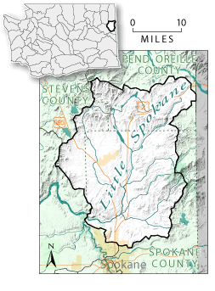
WRIA 55 Estimates
3 counties
Each county used different methods to project number of Single Family Units (SFUs) that would rely on wells.
Estimated ~1,650 acre feet/year or 2.3 cfs
Notes:
3 counties: Each county developed growth projections on a subbasin level for single family residential units (SFUs) relying on exempt wells on the mandated 20-year horizon.

Slide 25
WRIA 55: Spokane County
Population Forecast
Spokane Regional Transportation Council Horizon 2040 projected increase in single family units (SFUs)
  GIS analysis to allocate SFUs to subbasins and then between areas served by public water and areas served by wells, based on current distribution from County assessors data
  Compared to 2001-2017 historical growth data from county assessor
Estimated 1602 new homes using wells
Notes:
Spokane Regional Transportation Council (SRTC) Horizon 2040 projected increase in SFUs
GIS analysis to allocate the distribution of the projected increase in SFUs and within each TAZ into each subbasin, followed by allocations between areas served by public water supplies and areas served by permit exempt wells in proportion to the distribution of existing SFUs derived from Spokane County Assessor data
Comparison to Historical Growth Data Based on Spokane County Assessor data, 1923 new SFUs relying on exempt wells were built between 2001 and 2017.
Estimated 1602 new homes relying on permit exempt wells 2018-2038

Slide 26
WRIA 55: Stevens County
County Well Data
Building permits 2001-2017 that rely “private water supply”
Assumed same growth rate for 2018-2038
Estimated 246 new homes using wells
Notes:
Stevens County reviewed the number of building permits issued from 2001 - 2017 for new homes using a private water supply.
GIS methods were used to filter the data to include only parcels within both WRIA 55 and Stevens County.
Between 2001 and 2017 there were 209 new residences that rely on permit exempt wells in Stevens County’s portion of WRIA 55.
average growth rate of 12.3 homes per year.
rate was used to extrapolate growth over the next 20 years
estimated 246 new homes relying on permit exempt wells built within WRIA 55 in Stevens County in the next 20 years

Slide 27
WRIA 55: Pend Oreille County
Building permits 2011-2017 that were outside public water districts
Assumed same growth rate for 2018-2038
Estimated 332 new homes using wells
Notes:
GIS methods were used to filter residential building permit data for the period 2011- 2017 to include only permits that were in WRIA 55, but outside public water districts, indicating use of an exempt well.
The average annual growth rate of 16.6 homes was used to extrapolate growth on a 20-year horizon.
Estimated 332 new homes relying on permit exempt wells built within WRIA 55 in Pend Oreille County in the next 20 years

Slide 28
Lessons Learned from WRIA 1 & 11
Don’t spend a lot of time on consumptive use estimate alternatives
Use scenarios and conservative assumptions to deal with uncertainty and data gaps
Make sure everyone is comfortable with assumptions
Can use different methods, or combination of methods for different parts of the watershed
If using multiple methods, make sure end up with same unit, e.g. “new connections”
Notes:
all the projections are guesses with a bunch of assumptions
Can use adaptation management to deal with that
One thing is certain: will not look like we project. Build in flexibility

Slide 30

Total Water Use vs. Consumptive Water Use
Estimates of water use by future permit-exempt domestic wells must account for portion of water consumptively used.
  For indoor water use most houses on permit-exempt domestic wells are connected to septic systems, so a reasonable assumption is that only about 10% is lost from the groundwater system.
  For outdoor water use a good assumption is that about 80% is lost, mainly due to evapotranspiration.
Planning groups can use assumptions other than 10% and 80% if justification is provided.

Slide 31

Indoor Water Use
The Water Research Foundation (DeOreo, et al., 2016) evaluated water use in homes provided by municipal water in 23 areas across U.S. and Canada (ave = 59 gpd per capita). A sampling of homes supplied by Tacoma Water averaged 51 gpd per capita indoor water use (in this study).
Since homes supplied municipal water are more likely to be fitted with water saving appliances, an assumption of 60 gpd per capita is reasonable for indoor water use.

Slide 32
Household Consumptive Indoor Water Use
Average household size estimates are available from OFM.
Assuming 2.5 people per household, 60 gpd per capita water use, and 10% of indoor water use consumption, household consumptive indoor water use (HCIWU) equals :
60 gpd X 2.5 people/house X 365 days X 3.07 (10⁻⁶)AF/gal. X 10%
= 0.017 AF/YR

Slide 33
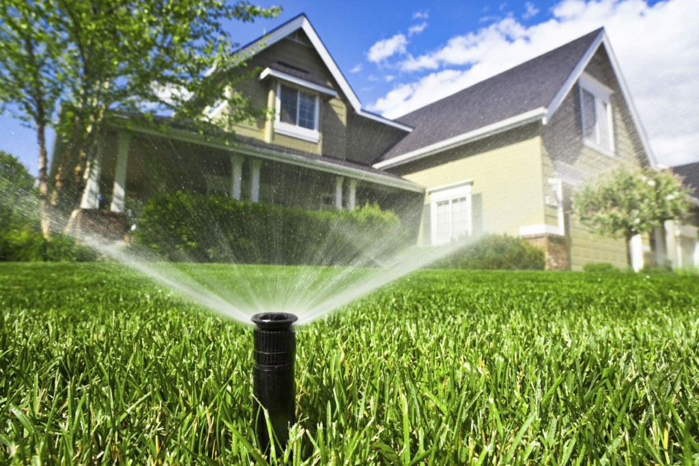
Outdoor Water Use
Irrigation requirements are available in Appendix A of the Washington Irrigation Guide (WAIG) (USDA, 1997).

Slide 34

Household Consumptive Outdoor Water Use
For example, if there is a 0.4 acre outdoor watering area and you’re near Sedro Woolley and the net irrigation requirement for pasture/turf is 11.11 inches (page 254 of 323 Appendix A):
Irrig. Req. (in.) = 11.11 in./12 in./ft. X 0.4 acres = 0.37 AF/YR
Assuming 75% efficiency for residential pop-up sprinkler system (to account for water lost during water application process):
0.37 acre-feet ÷ 75% application efficiency = 0.49 acre-feet per year
Assuming 80% outdoor water use consumptive loss, total Household Consumptive Outdoor Water Use (HCOWU) per house would be:
0.49 acre-feet x 80% consumed (i.e. 20% return flow) = 0.39 acre-feet per year
indoor use + outside use
For our example, total consumptive household use = 0.017 + 0.39 = 0.407 AF/yr (96% outside use!)

Slide 35
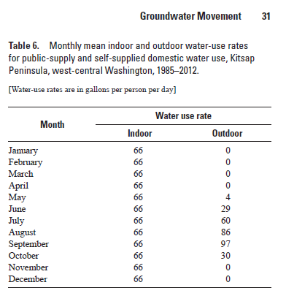
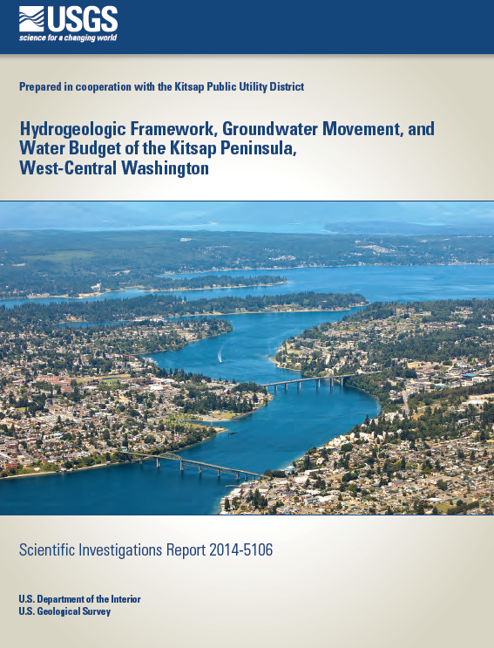
9360 gallons per summer per capita
*2.5=23,400 gallons per home
If we use Ecology’s method, folks are irrigating < 0.07 acres (or a 54’ x 54’ irrigation footprint) which is smaller than other Puget Sound WRIAs

Slide 36


When & Where Consumptive Use
Impacts Will Occur
ESSB 6091 requires high priority offset projects to replace 20-year water use in-time and in same subbasin.
Estimating timing of groundwater impacts on streams is complicated due to lags between when a well is pumped and when those impacts propagate to a stream.
If shallow well pumps an unconfined aquifer adjacent to a stream, pumping effects can be almost instantaneous. However, if well pumps aquifer farther from stream, smaller effects can occur over longer periods.

Slide 37
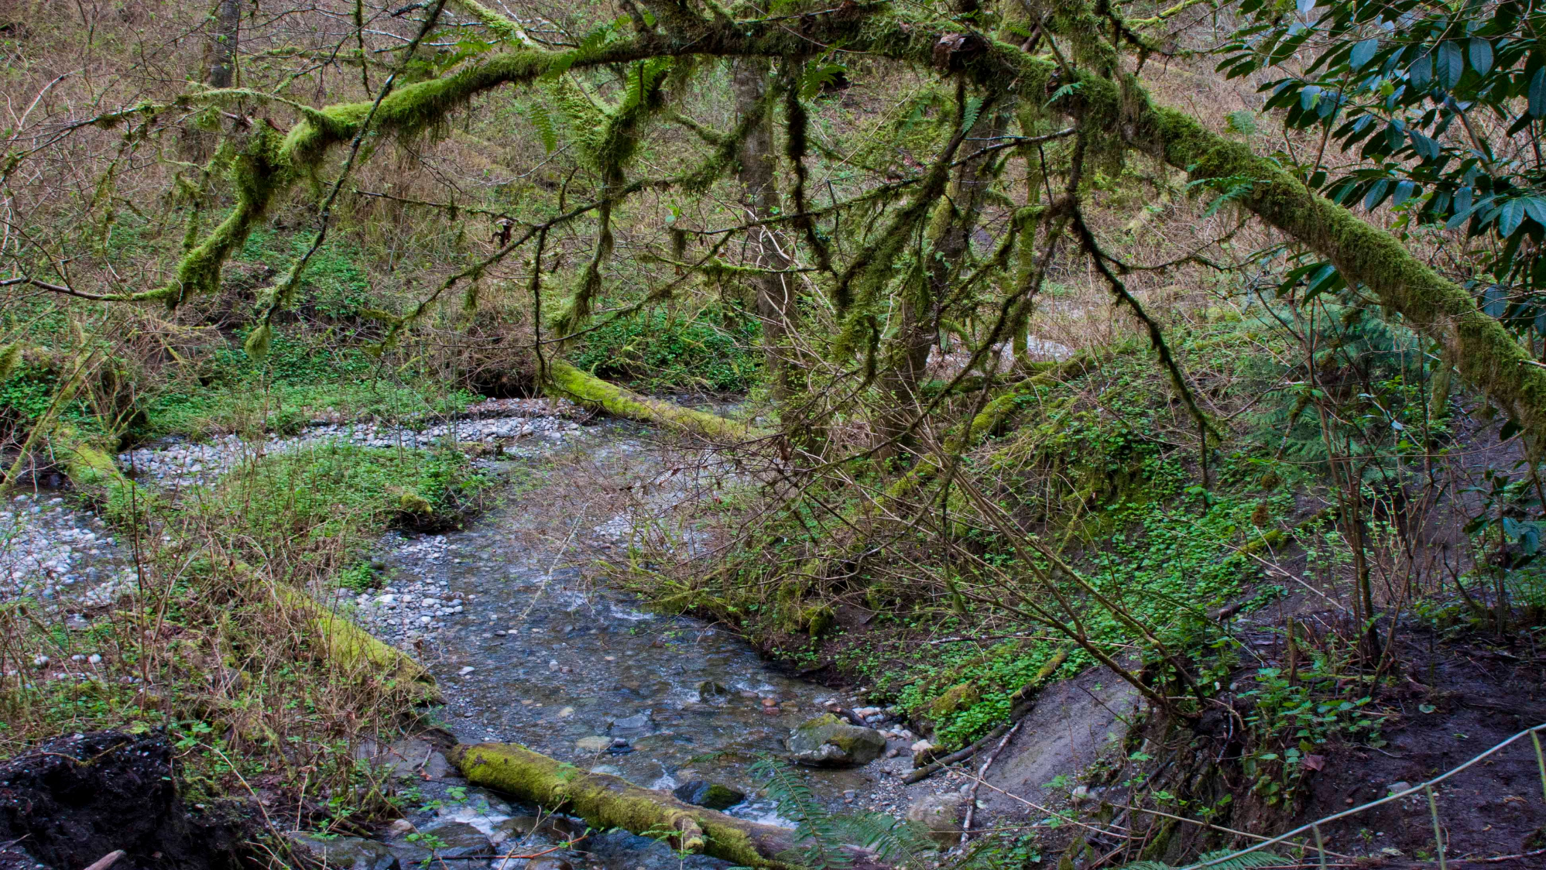
Questions
and
Discussion

