Slide 1

Intro to subbasins- Wria 15
Streamflow Restoration
Water Resources Program
Washington State Department of Ecology

Slide 2
Why do we need subbasins for this process?
In RCW 90.94.030: The highest priority recommendations must include replacing the quantity of consumptive water use during the same time as the impact and in the same basin or tributary.
Population projection scenarios
Project identification and development
Notes:
RCW 90.94.030(3)(b) says plans must include actions to offset new consumptive use impacts in either 1) the same subbasin (higher priority projects) or 2) not in the same subbasin or only during critical flow periods (lower priority projects).
The fewer the number of subbasins, the more likely you’ll have more higher priority projects.
Key for NEB evaluation- highest priority given to water for water projects in the same place as the projected water use. We can include other projects, but will need to justify why a project in another part of the watershed should be counted towards offsetting water use on a stream in another part of the watershed.
Will support organization of population projections and scenarios and project ID

Slide 3
Timeline for Decision
February-April 2019: Discussion with committee to identify options and seek input
February-May 2019: Workgroup discusses subbasins and proposes options and recommendations
May 2019: Committee decision on initial subbasins
Fall 2019-Spring 2020: Revisit initial subbasin delineation to revise as necessary to align with project proposals
Notes:
Revisiting the handout from last meeting
Consultants and workgroup to support, but options will come to this committee for a decision

Slide 4
Options and Recommendations
Develop initial subbasin delineation now (as begin growth projections)
Revisit as develop projects to refine as necessary
Identify a manageable number of subbasins
Support from technical consultant, ECY technical staff, workgroup
No right answer
Notes:
Too many subbasins will make project identification difficult

Slide 5
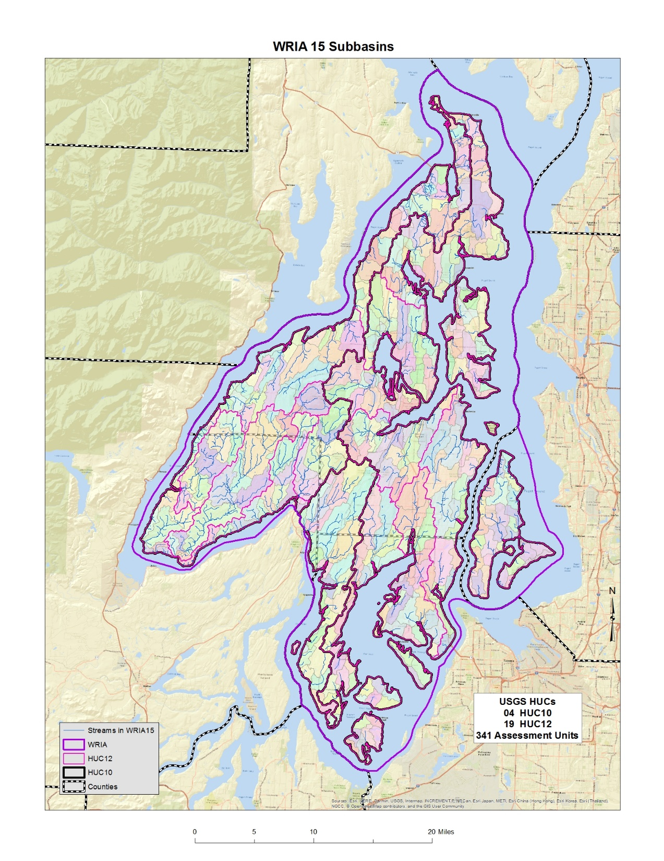

Too few of subbasins reduces our understanding of the relationships between where pumping effects will be and where benefits of offset projects will occur.
Too many subbasins can make it unwieldly to evaluate all of the offset projects needed to achieve a net ecological benefit for the WRIA.
Notes:
I took the USGS HUC (Hydrologic Unit Codes) are various scales which are shown in this image: HUC08-subbasin; HUC10-watershed; HUC12-subwatersheds and overlaid them for WRIA 15. I also added even smaller Assessment Units that Ecology had developed several years ago.
There are four HUC10s; and nineteen HUC12s. There are 341 AUs as well. While at some level all 341 drainages deserve some attention, it is important to keep in mind the purpose of this delineation process, which is to support estimating the consumptive impacts of new domestic exempt well uses in the WRIA. If no new wells are going to be constructed in a specific drainage, then there won’t be new impacts caused by new domestic wells in that area.

Slide 6
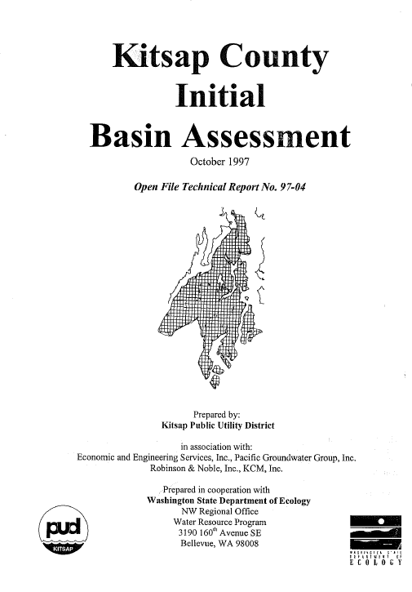
1997 Work broke the Kitsap County portion of the basin into 18 subbasins
Notes:
1997 Work broke the Kitsap County portion of the basin into 18 subbasins as seen on the map. This report was developed to support the efforts of Ecology at the beginning of Watershed Planning under RCW 90.82.

Slide 7
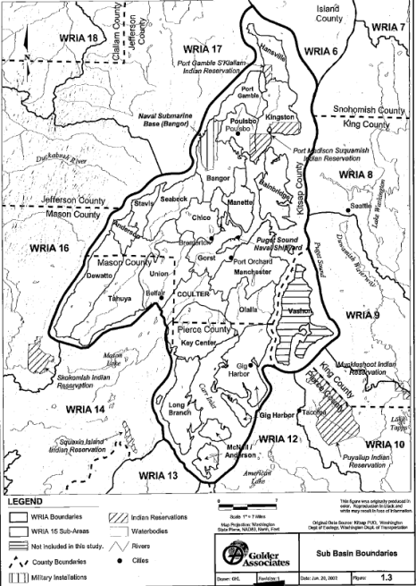
2002 Work broke the WRIA into 24 subbasins
Notes:
2002 Work broke the WRIA into 24 subbasins which are shown on this map

Slide 8
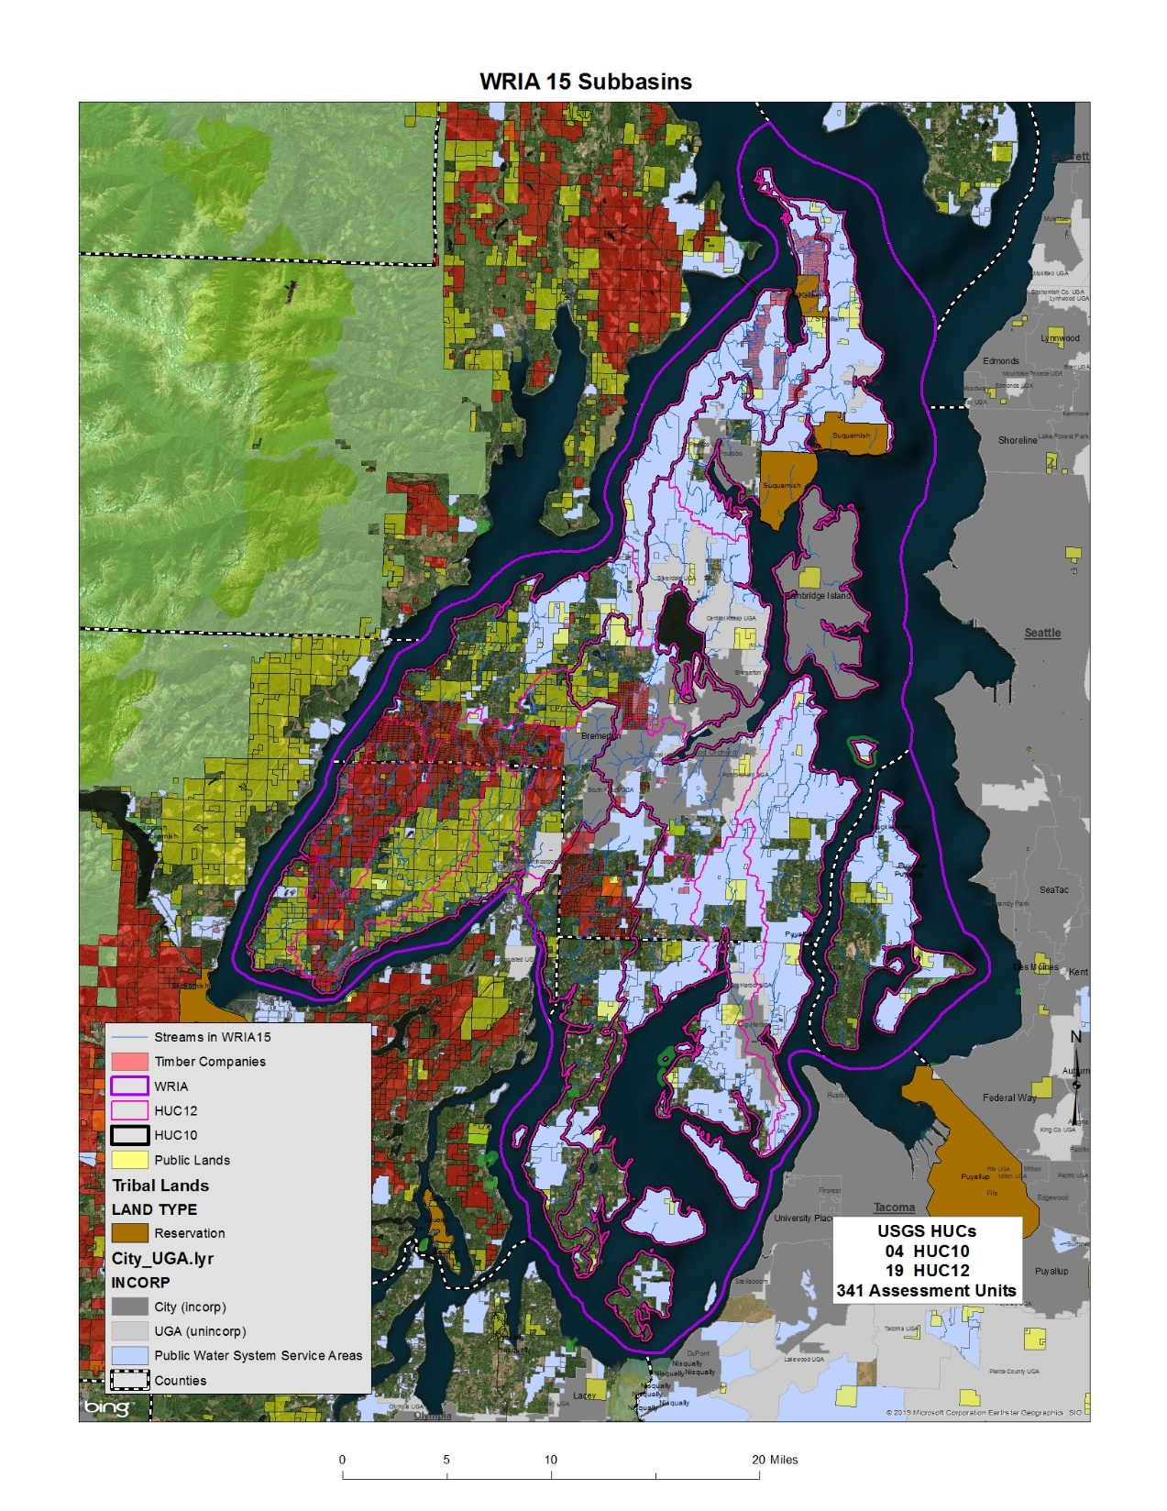
Where can new domestic exempt wells be drilled in the WRIA?
Notes:
Where can new domestic exempt wells be drilled in the WRIA?
Then I overlaid major public lands owned by various levels of government. I also grabbed parcels obviously owned by major timber companies (missing all the smaller ones). I then added the water system service area maps and the incorporated/UGA boundaries. Since we are focusing on rural, domestic, exempt uses coming in the next twenty years, I figured most of the polygons I added preclude domestic well new uses going into those areas either because the land isn’t privately owned or is in commercial timber.
What this map shows is that much of the WRIA isn’t likely to experience much new domestic exempt use in the coming decades. There just isn’t that much real estate that isn’t either inside a water service area, or public land, or timber property. I have no idea if the water service areas have the capacity to serve new uses in the ‘blue’ areas on this map. Just because a parcel is located inside a blue polygon doesn’t mean that the purveyor can serve water to it. Just one of the many things I don’t know about WRIA15.

Slide 9
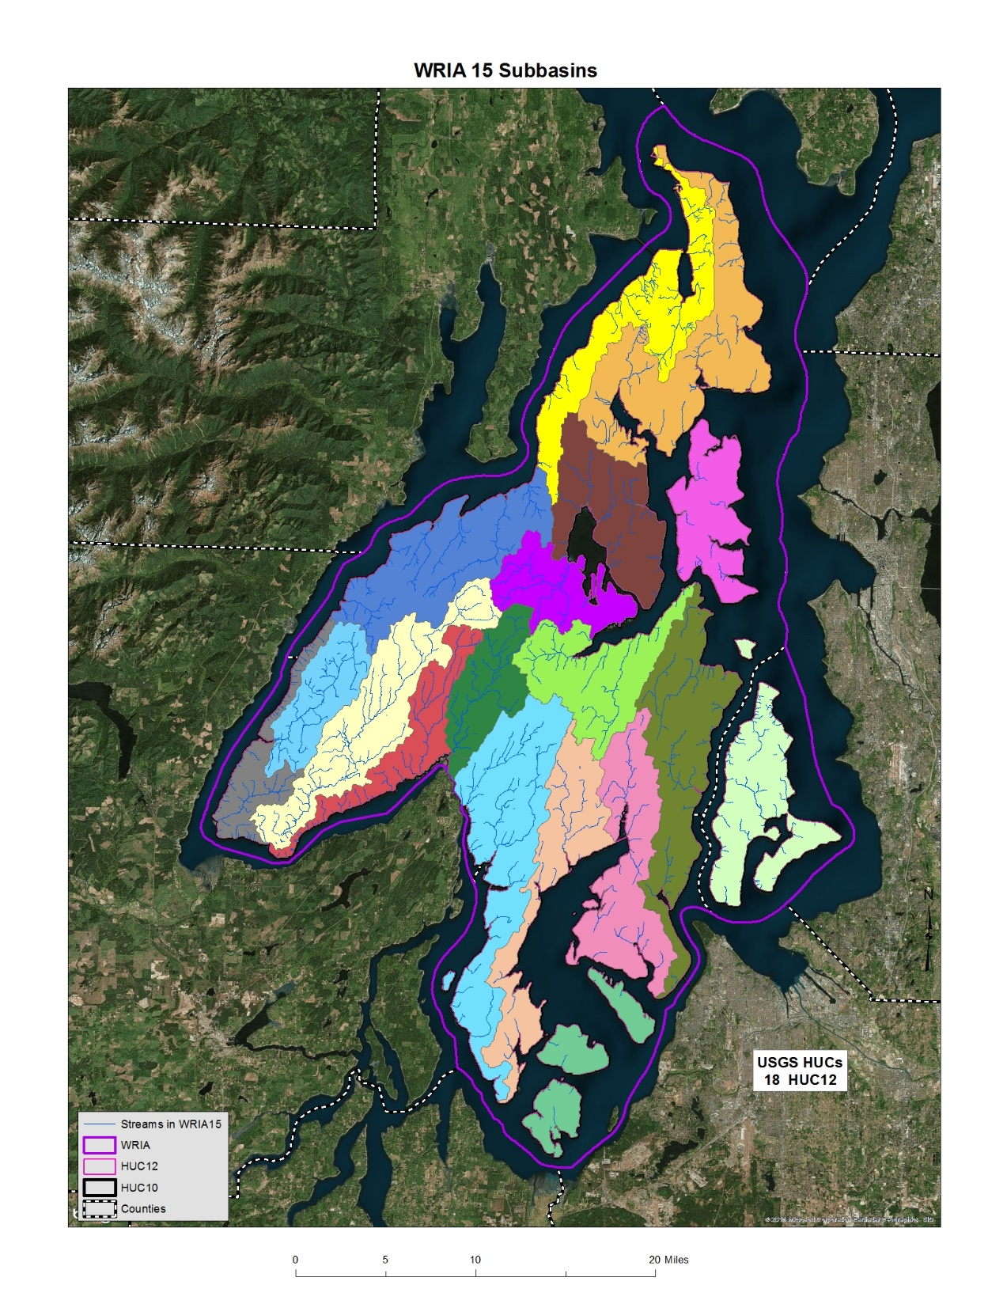
John mapped 18 subbasins
Notes:
From looking at the first two maps, I combined the HUC12s together to arrive at 18 subbasins to consider for the watershed planning process as presented in this map.

Slide 10
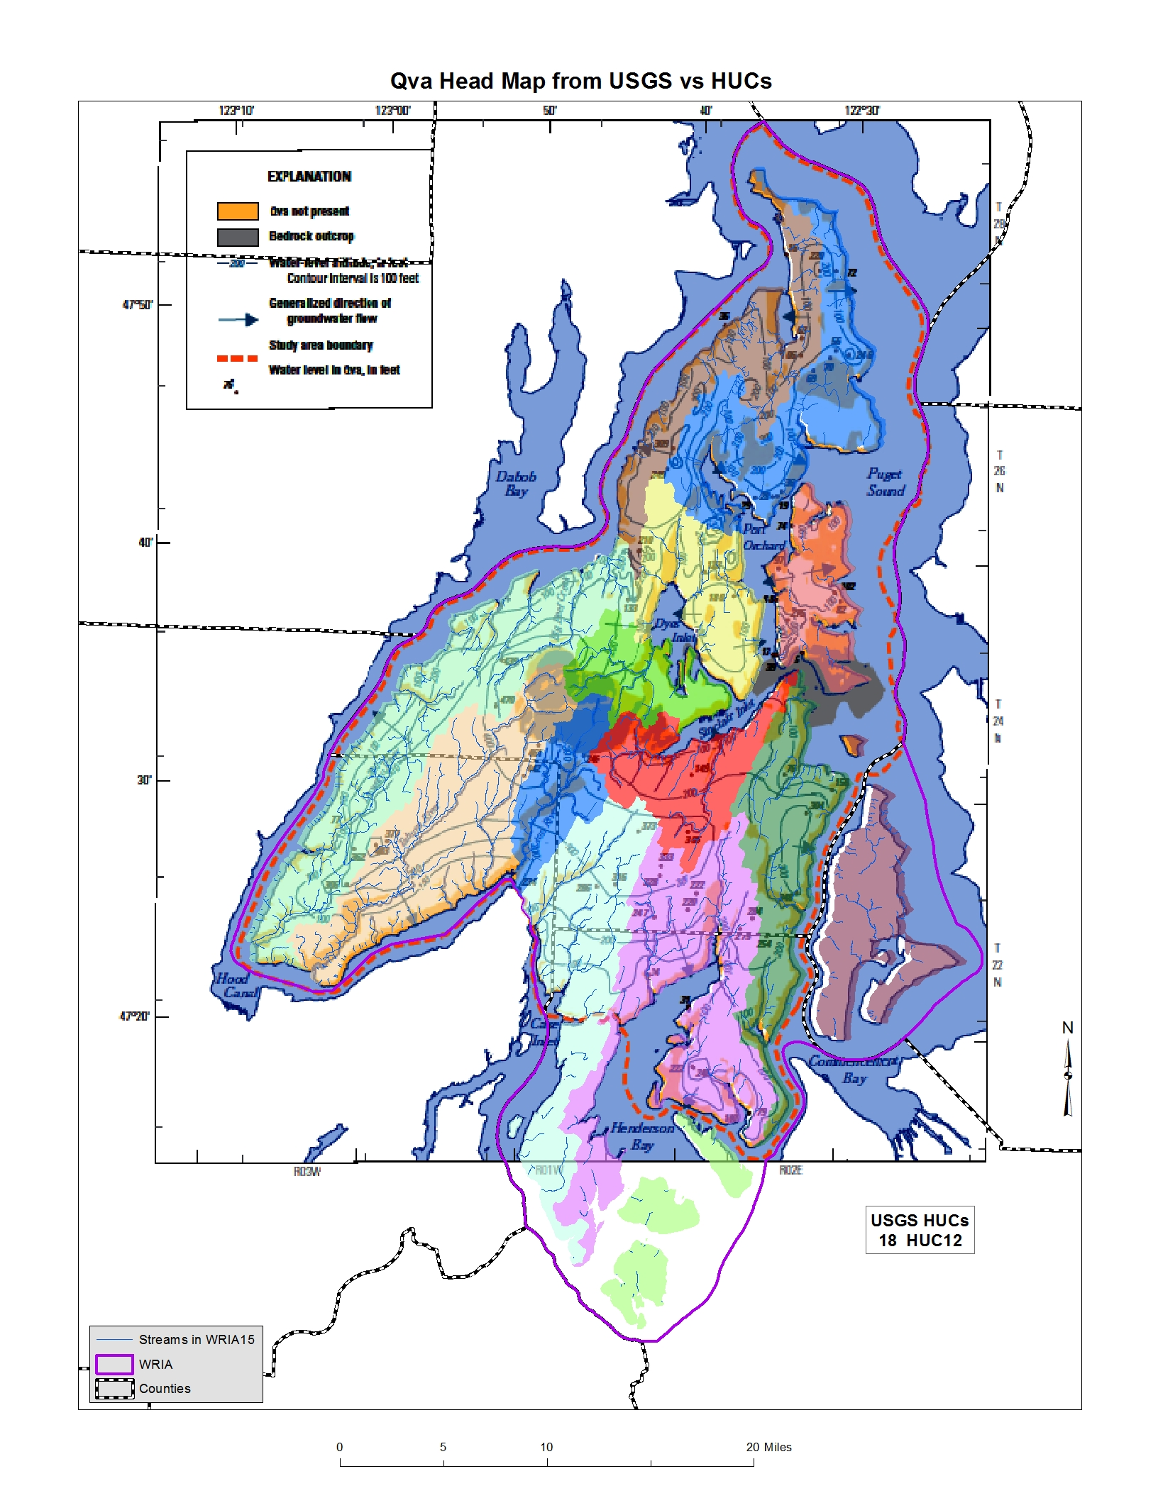
Overlaid USGS Qva Head Map with HUC subbasin map, allowing me to combine multiple HUCs and end up with 14 subbasins
Notes:
This map shows that I have overlaid USGS Qva Head Map with HUC subbasin map, allowing me to combine multiple HUCs and end up with 14 subbasins

Slide 11
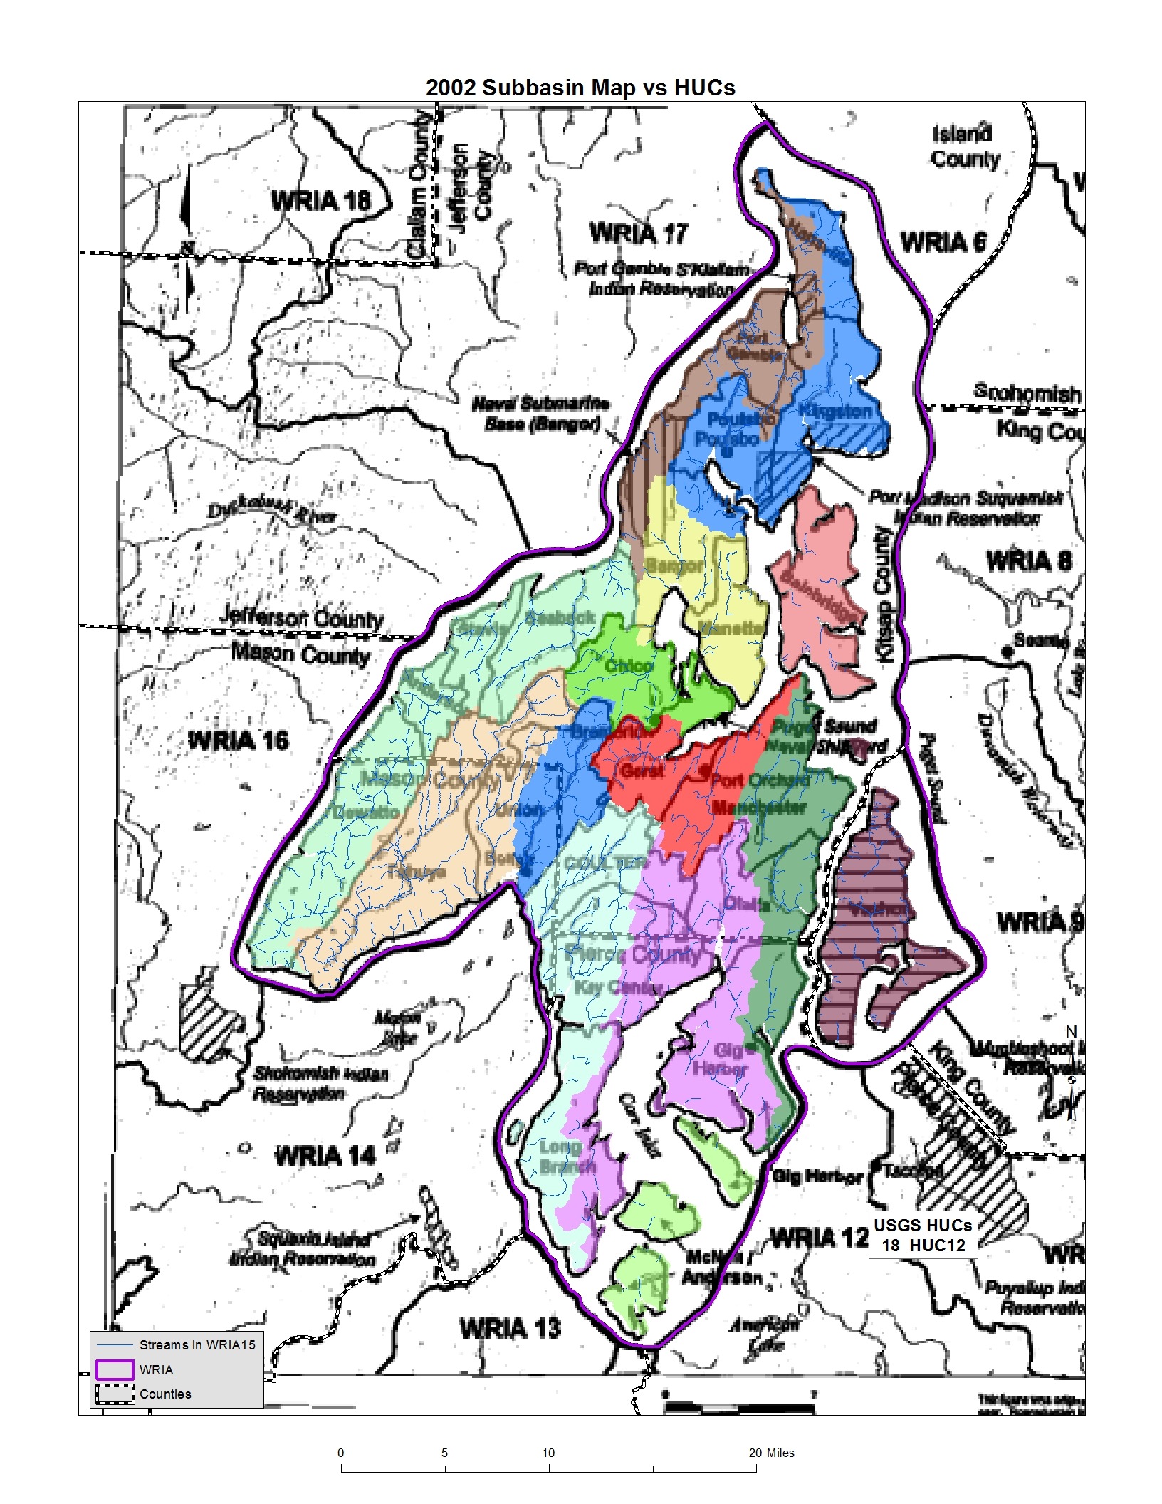
Notes:
I looked at the combined HUCs in comparison to some of the older maps that were developed two decades ago and found very little relationship, which is shown in this map.

Slide 12
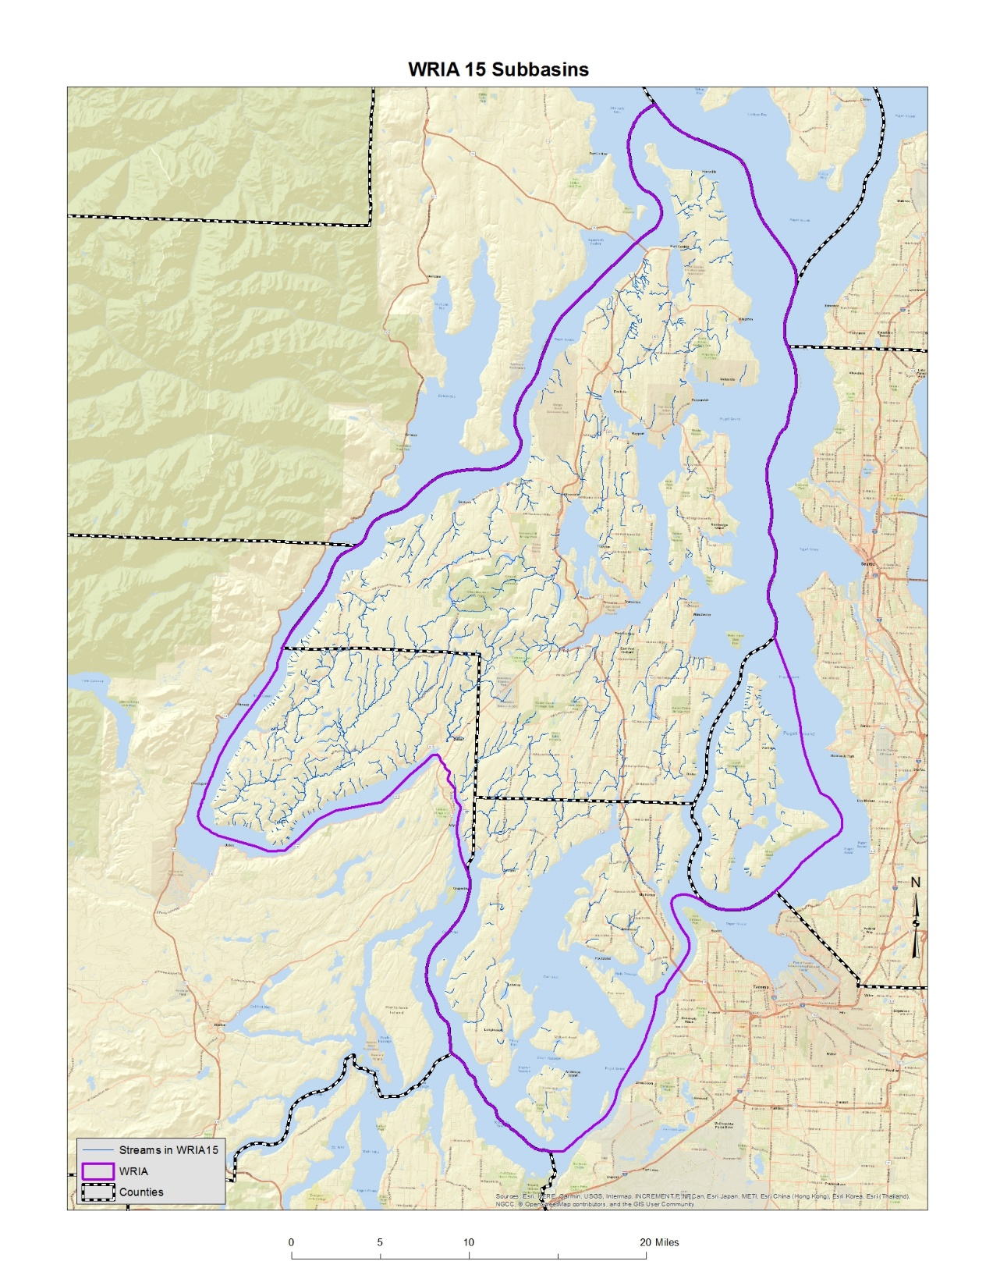
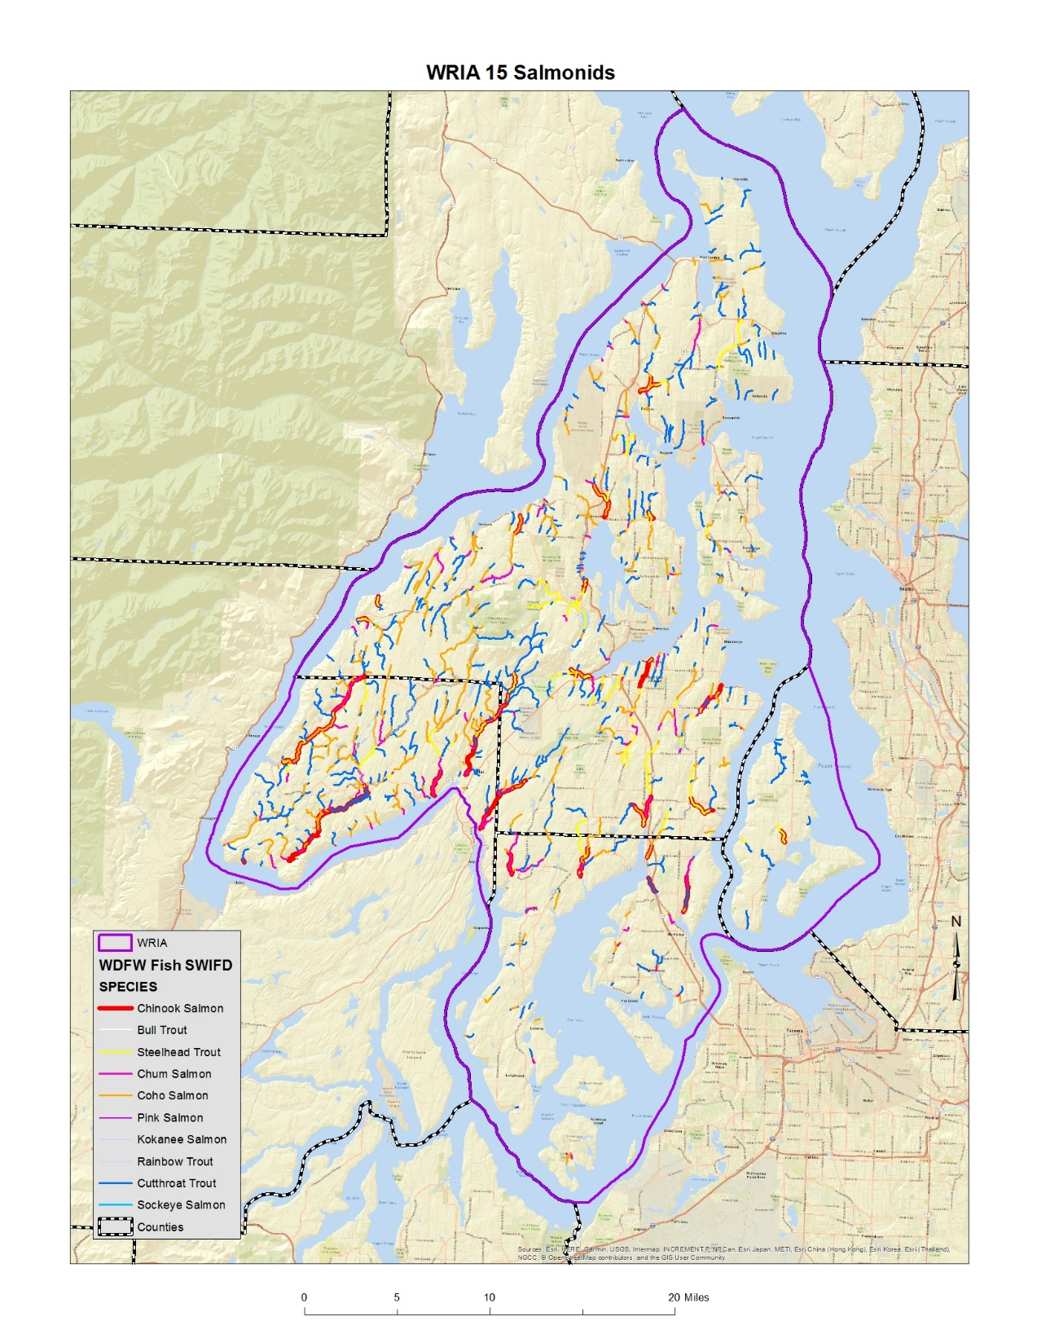
Notes:
This map shows distribution of fish from WDFW in WRIA 15. Fish distribution may be another consideration for identifying subbasins.

Slide 13

Notes:
You all can identify your own approach to subbasins! We will look for some reasoning for how you break up the WRIA, but it is essentially a blank slate.

Slide 14
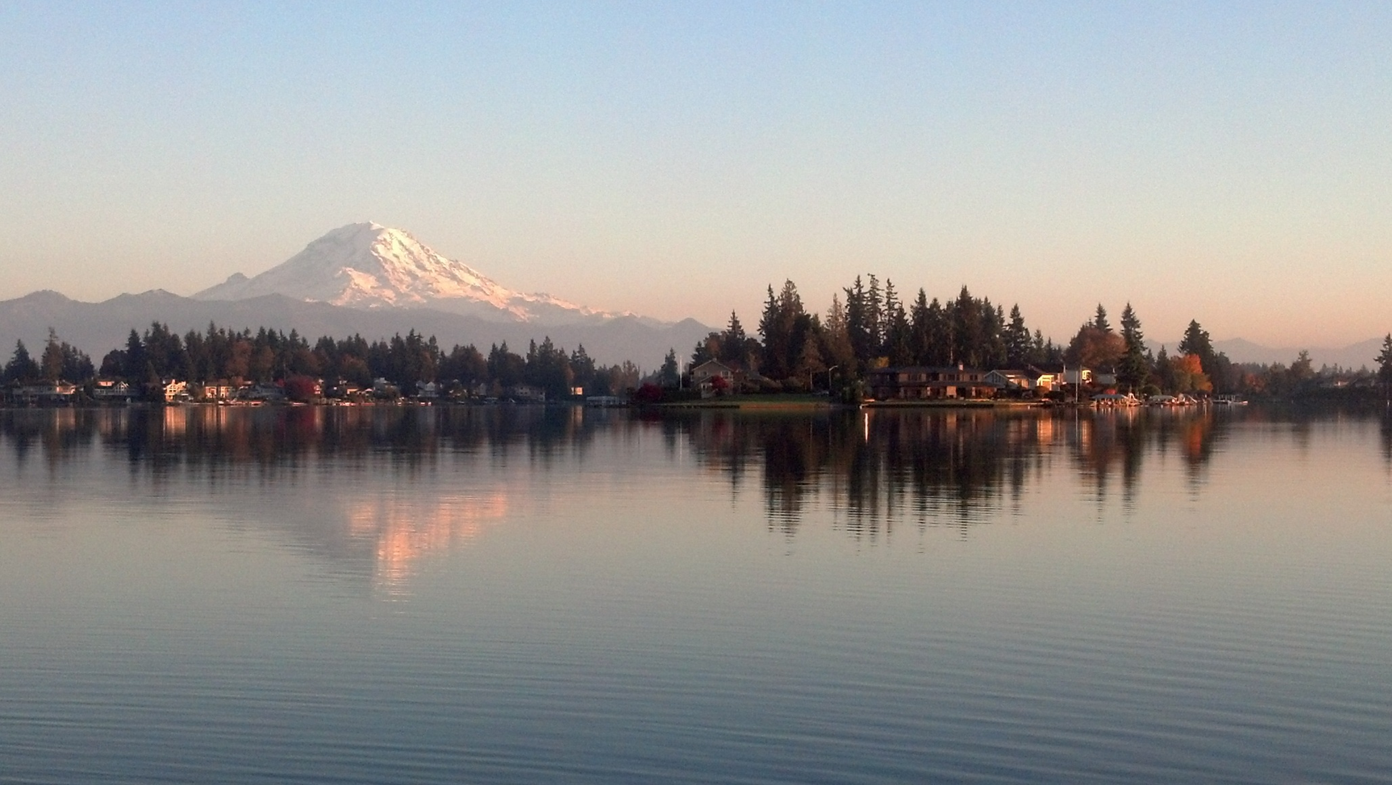

Department of Ecology
Water Resources Program
Notes:
STACY
Next steps:
Work with technical consultant and workgroup to begin teeing up ideas/options to bring back to the committee for input. Continue discussion next month, working towards decision in May.

