Slide 1
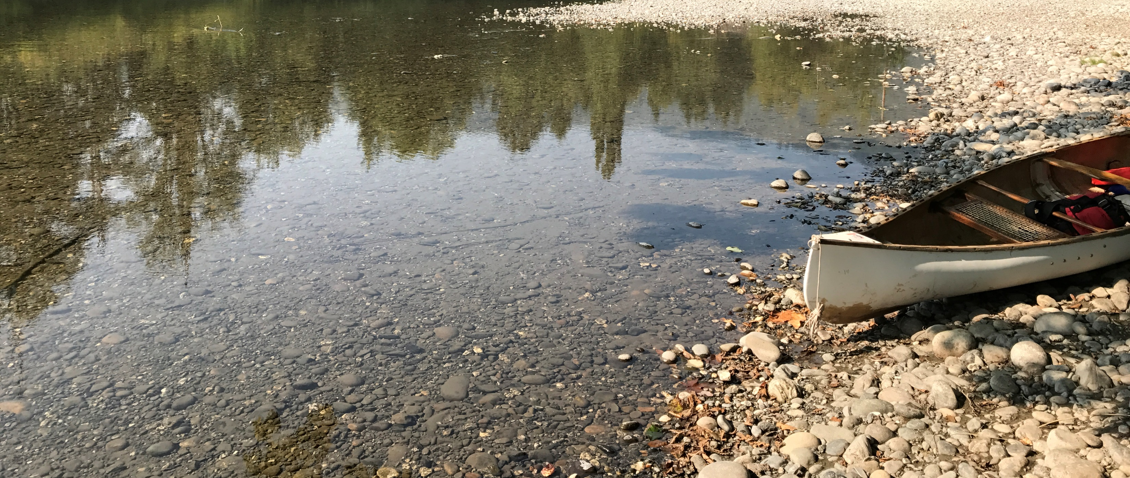
Streamflow Restoration Planning
[Speakers name]
WRIA 15 Watershed Restoration and Enhancement Plan
[date]

Slide 2
Streamflow Restoration law
RCW 90.94
Clarifies how local governments can issue building permits for homes intending to use a permit-exempt well for their domestic water supply and offsets those impacts through a local watershed planning effort.
Ecology chaired the WRIA 15 Committee, composed of tribes, counties, cities, WDFW, municipal water purveyor, irrigation district, and interest groups. The committee met over the last two years to develop the Watershed Restoration and Enhancement Plan.
Notes:
This is Summary Slide 1. It can be used, along with the next slide, as very high level overviews of the law and plan components.

Slide 3
Watershed Restoration and Enhancement Plan Components
Planning Horizon
2018 - 2038
WRIA Subbasin Delineation
Seven subbasins
Projected New Permit-Exempt Wells
5,568 projected new permit-exempt wells
Estimated Consumptive Use
766.4 acre-feet per year, with a higher goal of offsetting 1218 acre-feet per year through project implementation to benefit streams.
Projects and Actions
to offset estimated consumptive use and meet Net Ecological Benefit (NEB)
Notes:
Summary Slide 2. This slide provides an overview of the planning requirements per the law (RCW 90.94). Ecology provided additional guidance and a policy interpretive statement to provide more direction to the committees.
WRIA – Watershed Resources Inventory Area
New permit-exempt wells focus on new wells for domestic use
Consumptive use: For the purposes described here, consumptive water use is considered water that is evaporated, transpired, consumed by humans, or otherwise removed from an immediate water environment due to the use of new permit-exempt domestic wells.
Net Ecological Benefit (NEB): The outcome that is anticipated to occur through implementation of projects and actions in a plan to yield offsets that exceed impacts within: a) the planning horizon; and, b) the relevant WRIA boundary.

Slide 4
Presentation Outline
Background
Streamflow Restoration law
Role of the Committee
Elements of the Watershed Plan
Steps to complete plan
4
Notes:
Long Presentation Outline

Slide 5
What is a permit-exempt domestic well?
Serve single homes, small developments, irrigation of small lawns and gardens.
Chapter 90.94 RCW establishes withdrawal limits for permit-exempt domestic well connections in this watershed.
Notes:
Certain withdrawals of groundwater are exempt from the permitting process. These uses are commonly referred to as "permit exempt."
Permit-exempt groundwater wells often provide water where a community supply is not available, serving single homes, small developments, irrigation of small lawns and gardens.
90.94 RCW applies to domestic and non-commercial lawn or garden irrigation uses.
90.94 RCW restricts new permit-exempt domestic withdrawals in this WRIA to a maximum annual average of 950 gallons per days per connection, subject to the 5000 gallons per day and ½-acre outdoor irrigation of non-commercial lawn/garden limits established in RCW 90.44.050.
[add any additional talking points relevant to your work in the watershed, such is how your entity works with PE wells, where they are located historically, etc]

Slide 6
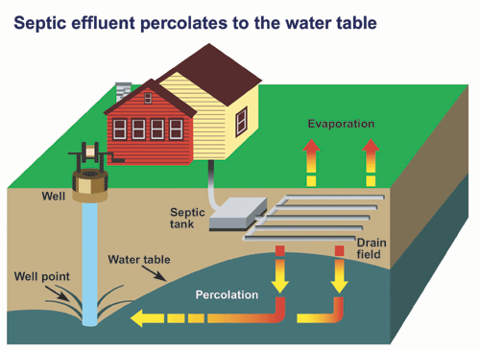
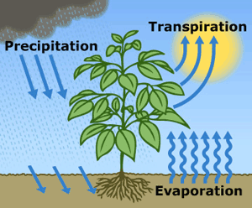
What is consumptive water use?
Water that is evaporated, transpired, consumed by humans, or otherwise removed from an immediate water environment due to the use of new permit-exempt domestic wells.
Indoor Consumptive Use
Outdoor Consumptive Use
10%
80%
90%
20%
Notes:
Source: NEB Guidance Page 5
For indoor water use most houses with domestic wells are connected to septic systems, so it is reasonable to assume that only about 10% is lost from groundwater system.
For outdoor water use a good assumption is that about 80% is lost, mainly due to evapotranspiration.

Slide 7
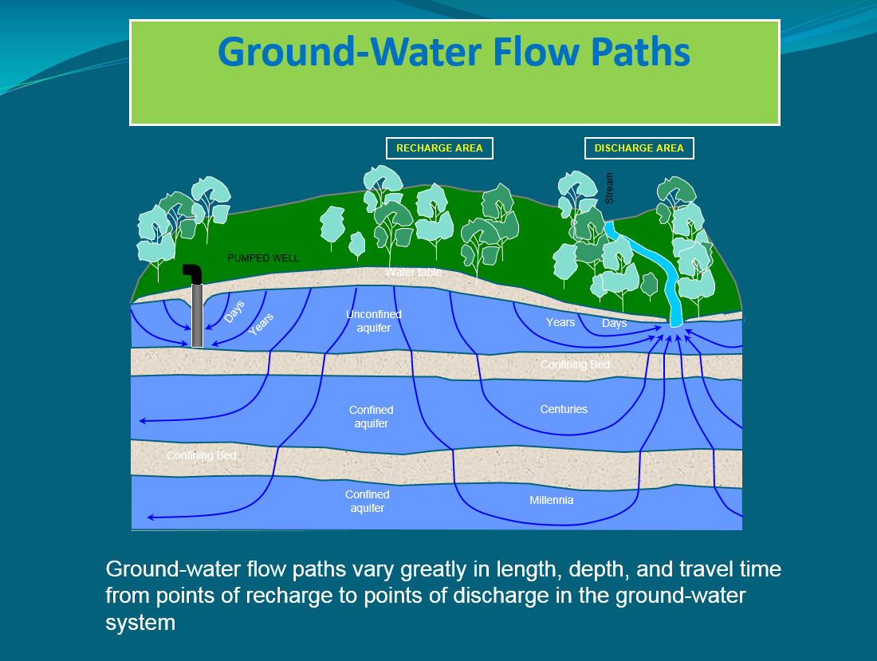
How are groundwater and streamflows connected?
Notes:
Most groundwater in Washington is hydraulically connected to nearby lakes and streams. In fact, during much of the year, groundwater discharge may make up most of the water in a stream. https://ecology.wa.gov/Water-Shorelines/Water-supply/Protecting-stream-flows

Slide 8
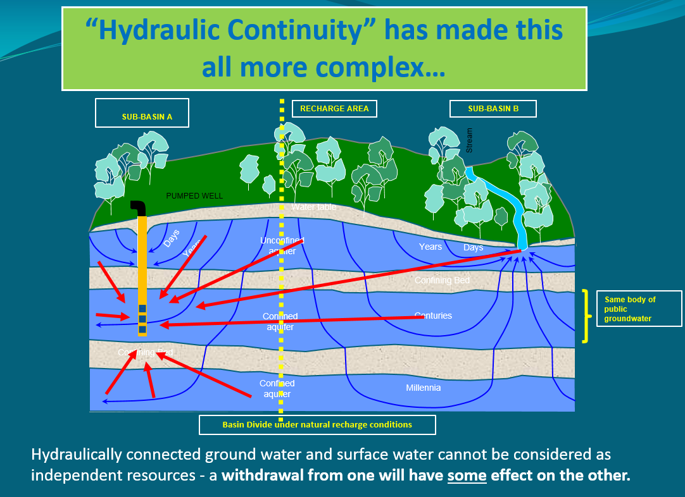
How do wells affect streamflows?
Notes:
When groundwater is pumped and water is put to use, this often leads to a decrease in streamflow. Many factors influence where and how much a groundwater use may affect a stream, such as the nature of the aquifer, the distance between the well and the stream, the well depth, and the type of water use (for example, lawn watering consumes much more water than in-house use that discharges to a septic system). However, at least some portion of the well water used in a home typically has a negative impact on nearby streams. https://ecology.wa.gov/Water-Shorelines/Water-supply/Protecting-stream-flows

Slide 9
Streamflow Restoration law
RCW 90.94
  Clarifies how local governments can issue building permits for homes intending to use a permit-exempt well for their domestic water supply and offsets those impacts through a local watershed planning effort.
Notes:
The law, and consequently this watershed plan, is concerned with the identification of projects and actions intended to offset the anticipated impacts from new permit-exempt domestic groundwater withdrawals over the next 20 years and provide a net ecological benefit. In order to aid in project implementation, the law also authorized $300 million in capital funds over the next 15 years.
The local watershed planning effort began with the committee’s formation in each watershed called out in the law. There are 15 watersheds across the state undergoing planning efforts under this law; there are 7 other watersheds in Puget Sound that are developing watershed restoration and enhancement plans like ours.

Slide 10
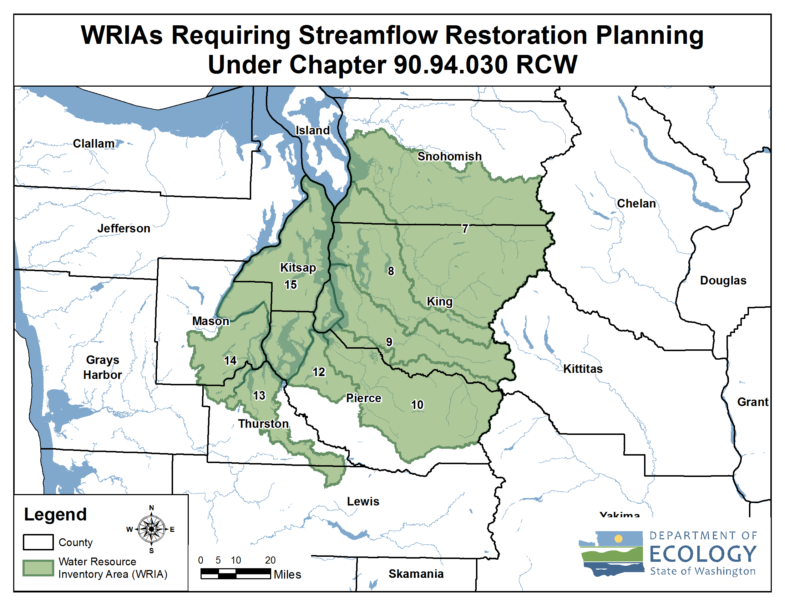
Streamflow Restoration Planning Map
Notes:
These are the watersheds that are developing Watershed Restoration and Enhancement Plans chaired by Ecology.
[Direct to “brochures” if questions about how these WRIAs were selected. Relates to whether instream flow rules addressed PE wells.]
WRIA 15 Committee brochure
WRIA 15: https://fortress.wa.gov/ecy/publications/SummaryPages/2011075.html

Slide 11
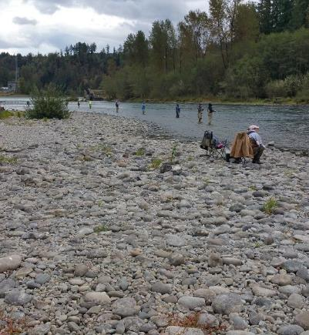
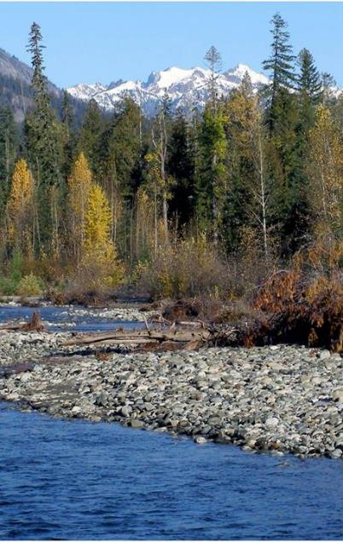
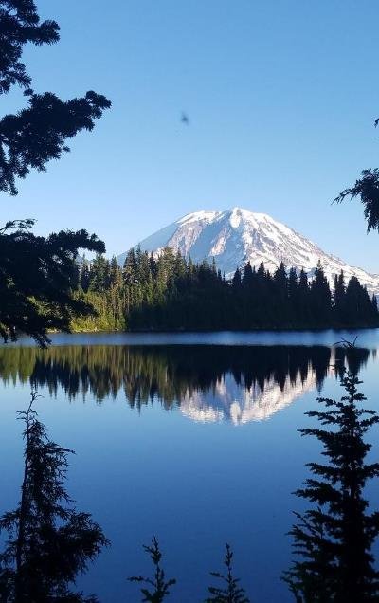
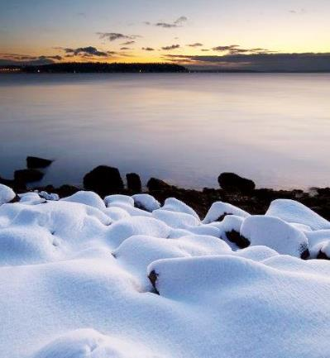
Streamflow Restoration Funding Program Overview
15 Year Competitive Grant Program - $300 million
Pilot Round (2018/2019)
Current Round (2020)
Statewide
Funding Rule
Chapter 173-566 WAC
Funding Guidance
Publication 19-11-089
Notes:
How is Ecology supporting implementation of the watershed plans?
The legislature has given Ecology $300 over the course of 15 years to restore and enhance streamflows, and meet the requirements of the Chapter 90.94 RCW. Grant funding will help incentivize state and local agencies, tribal governments, and non-profit organizations to implement local watershed plans and projects.
It is important to note that local project needs developed through the watershed planning process are greater than available statewide funds. The grant process is competitive and other sources of funding beyond these grants is needed to implement all projects within the watershed restoration and enhancement plan.

Slide 12
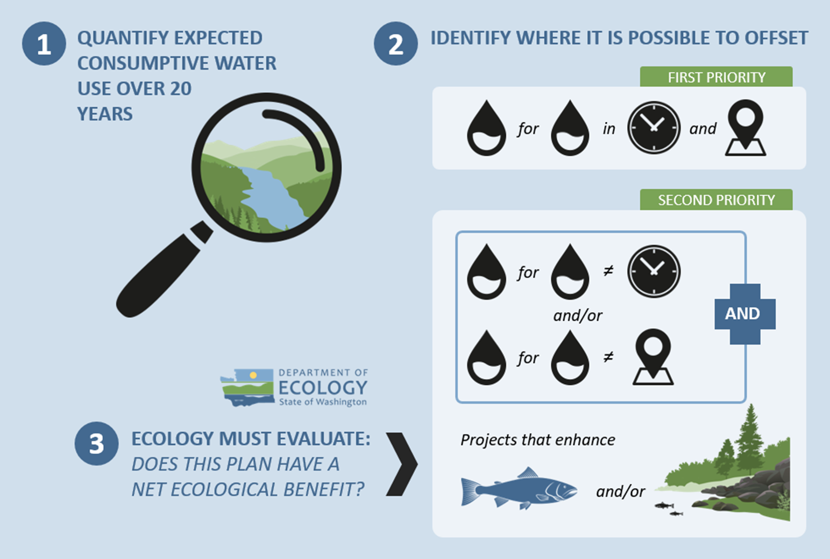
Overview of the Watershed Plan
Notes:
The major steps to complete the plan include:
1. Estimate the consumptive water use of new domestic permit-exempt wells through 2038;
2. Identify projects to offset consumptive use – we must identify projects that provide “water for water” offsets within the WRIA. Projects are not required to provide water offset in the same place or at the same time as well impacts. However, projects that offset water during the same time and in the same areas where wells are expected are a higher priority. The plan also includes projects that enhance habitat for fish.
3. Ecology is then required to evaluate the plan to make a determination of whether it achieves a net ecological benefit.

Slide 13
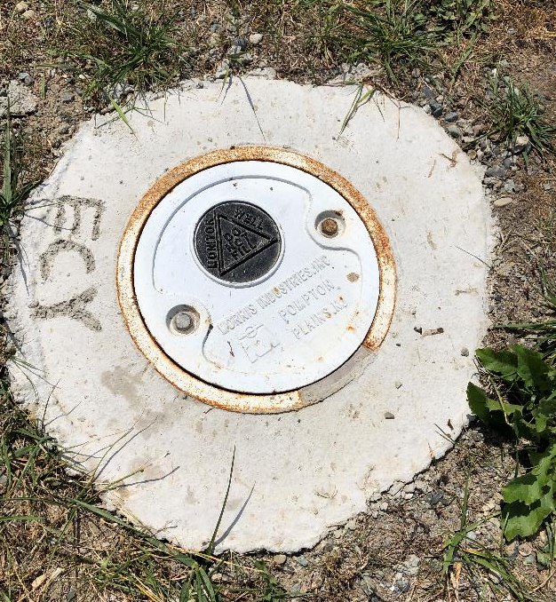
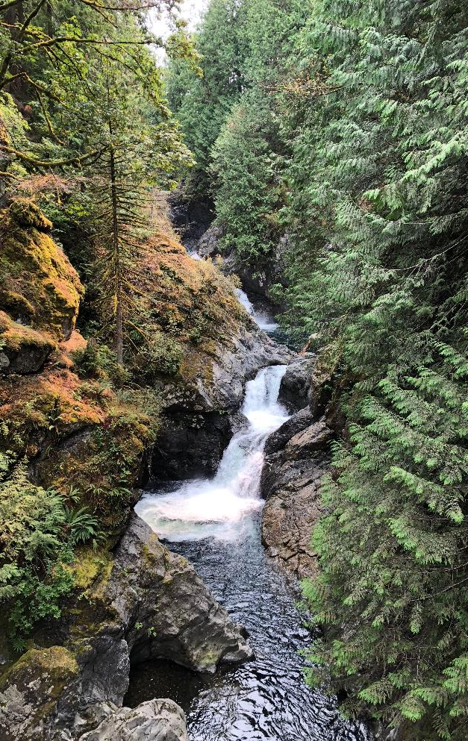
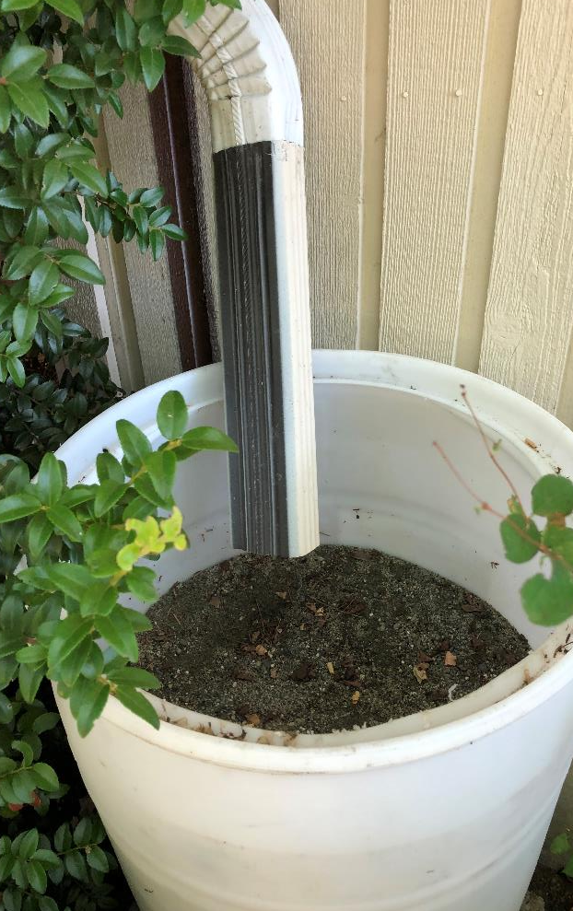
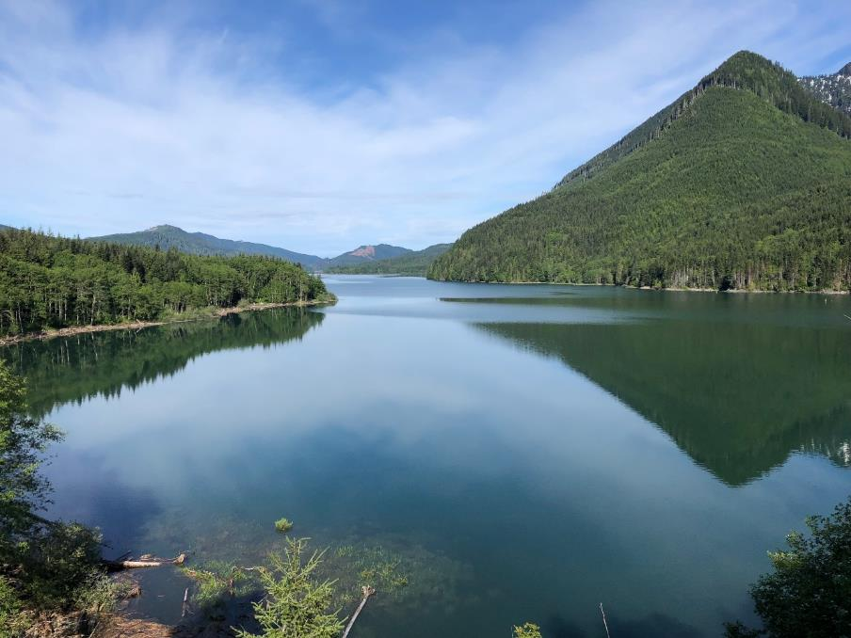
What is offset?
The anticipated ability of a project or action to counterbalance some amount of the new consumptive water use over the next 20 years (2018-2038).

Slide 14
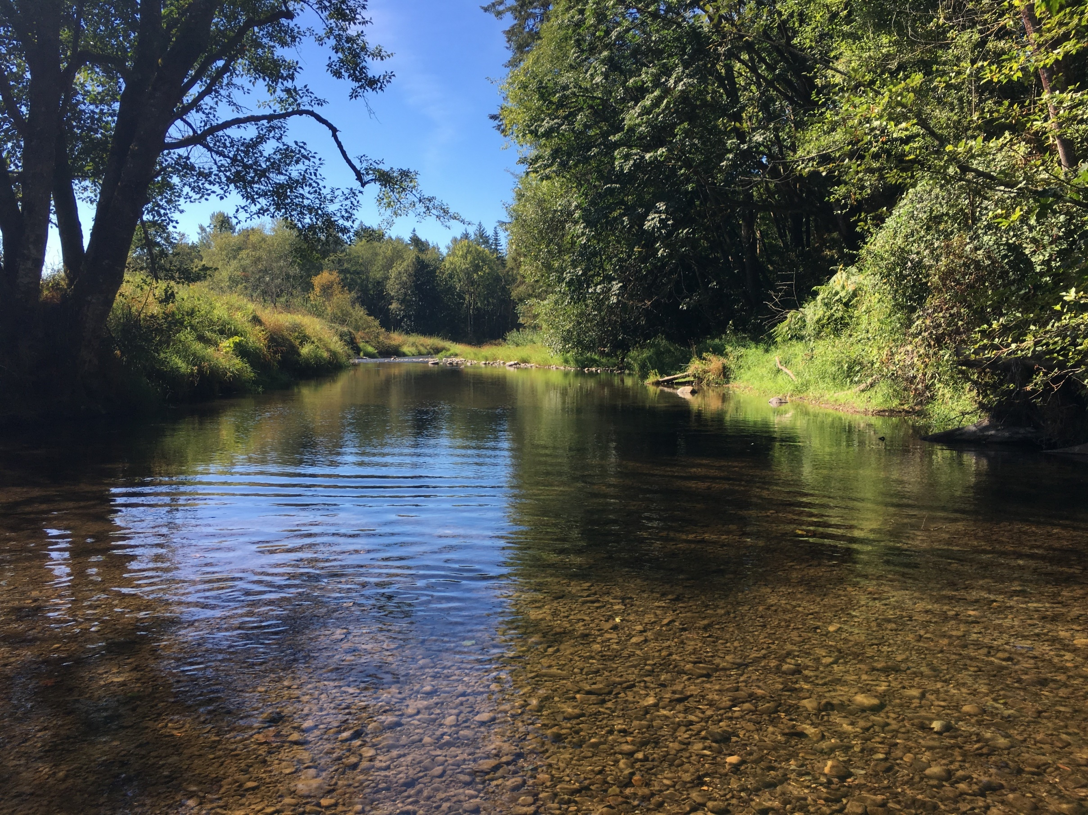
What is Net Ecological Benefit (NEB)?
From Ecology’s Final NEB Guidance
“…local planning groups are best situated, and will therefore determine the appropriate amount of benefits beyond the offsetting of projected impacts …”
Notes:
Ecology released Final NEB Guidance in July 2019 to support committees in their planning process.
NEB is the outcome that is anticipated to occur through implementation of projects in a plan to yield offsets that exceed impacts within the planning horizon and WRIA boundary.
[Prompt for speaker to make comments: Please reflect on the committee’s work regarding NEB (based on your view)
For example:
Through the committee discussions, meetings, and plan writing, it is our opinion that this plan meets NEB. The committee estimated a consumptive use of 766.4 acre-feet per year, and identified projects that provide a potential offset of XX acre-feet. The plan includes additional projects that that provide habitat benefits to the WRIA. Through the combination of water offset and habitat projects, we anticipate that the plan achieves a net ecological benefit.

Slide 15
Watershed Restoration and Enhancement Committee
Puyallup Tribe
Skokomish Tribe
Squaxin Island Tribe
Suquamish Tribe
Port Gamble S'Klallam Tribe
City of Port Orchard
City of Bremerton
City of Gig Harbor
City of Bainbridge
City of Poulsbo*
Washington Water Service - ex officio
*Withdrew from Committee in October 2020
Kitsap County
King County
Mason County
Pierce County
Kitsap Public Utility District
Department of Fish and Wildlife
Department of Ecology
Kitsap Building Association
Kitsap Conservation District
Great Peninsula Conservancy
Mason-Kitsap Farm Bureau - ex officio

Slide 16
What is the Committee’s role?
Committee
Develops Watershed Plan
Approves Plan
Ecology
Determines NEB
Adopts Plan

Slide 17
Watershed Restoration and Enhancement Plan Components
Planning Horizon
2018 - 2038
WRIA Subbasin Delineation
Seven subbasins
Projected New Permit-Exempt Wells
5,568 projected new permit-exempt wells
Estimated Consumptive Use
766.4 acre-feet per year, with a higher goal of offsetting 1218 acre-feet per year through project implementation to benefit streams.
Projects and Actions
to offset estimated consumptive use and meet Net Ecological Benefit (NEB)

Slide 18
Delineate Subbasins
The WRIA 15 Committee divided WRIA 15 into 7 suitably sized subbasins for the purposes of assessing consumptive use and project offsets.
Notes:
Subbasin delineation was helpful in describing the location and timing of projected new consumptive water use, the location and timing of impacts to instream resources, and the necessary scope, scale, and anticipated benefits of projects. In some instances, subbasins may not correspond with hydrologic or geologic basin delineations (e.g. watershed divides)

Slide 19
Subbasin Delineation
Notes:
Higher resolution map can be found within plan.

Slide 20
Project New Permit-Exempt Wells
The WRIA 15 Committee projects 5,568 PE wells over the planning horizon.
Notes:
This Committee developed a method that they agreed was appropriate to project the number of new PE wells over the planning horizon in the WRIA, in order to estimate new consumptive water use. This method, referred to as the PE well projection method, is based on recommendations from Appendix A of Ecology’s Final NEB Guidance (Ecology 2019).
[add any specific talking points relevant to the method to project wells that is relevant to the audience, along with other important details]

Slide 21
Projected New Permit-Exempt Wells
Subbasin | Medium Growth
 | Kitsap | Pierce | Mason | King | Total
West Sound | 1,336 |  |  |  | 1,336
North Hood Canal | 656 |  |  |  | 656
South Hood Canal | 49 |  | 1,077 |  | 1126
Bainbridge Island | 491 |  |  |  | 491
South Sound | 389 | 940 | 224 |  | 1,553
Vashon-Maury Island |  |  |  | 368 | 368
McNeil Island, Anderson Island, Ketron Island |  | 38 |  |  | 38
Total | 2,921 | 978 | 1,301 | 368 | 5,568

Slide 22
Estimate New Consumptive Water Use
The WRIA 15 Committee used the 20-year projection of new PE wells for WRIA 15 (5,568) to estimate the consumptive water use that this watershed plan must address and offset.
The WRIA 15 Committee estimates 766.4 acre-feet per year of new consumptive water use in WRIA 15.
The WRIA 15 Committee set a higher offset goal of 1218 for project implementation to benefit streams.
The WRIA 15 Committee set a goal of meeting the offset need by subbasin.
Notes:
The Consumptive Use Estimates Technical Memorandum provides a more detailed description of the analysis and alternative scenarios considered (Appendix)
[add any specific talking points relevant to the method to estimate CU that is relevant to the audience, along with other important details]

Slide 23
Estimated New Consumptive Water Use
Subbasin | Projected PE wells | Indoor CU (AF/yr) | Outdoor CU (AF/yr) | Total CU (AF/yr) in 2038
West Sound | 1,336 | 22.4 | 161.4 | 183.9
North Hood Canal | 656 | 11.0 | 79.3 | 90.3
South Hood Canal | 1,126 | 18.9 | 136.1 | 155.0
Bainbridge Island | 491 | 8.3 | 59.3 | 67.6
South Sound | 1,553 | 26.1 | 187.7 | 213.8
Vashon-Maury Island | 368 | 6.2 | 44.5 | 50.7
McNeil Island, Anderson Island, Ketron Island | 38 | 0.6 | 4.6 | 5.2
Total | 5,568 | 93.6 | 672.8 | 766.4

Slide 24
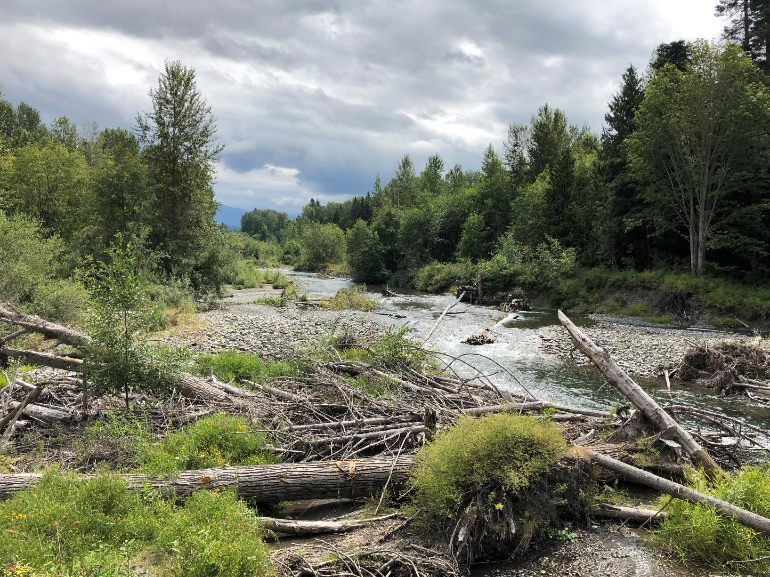
Types of Projects & Actions
Water Right Acquisition Offset Projects
Non-Acquisition Water Offset Projects
Habitat and Other Related Projects
Other Recommendations
Notes:
The committee is finalizing project selection, developing project descriptions and evaluations, and writing an adaptive management component for the watershed plan.

Slide 25
Projects Overview
Managed Aquifer Recharge
Water Right Acquisitions
Community Forest Protection
Raingarden and Low Impact Development Applications
Habitat Restoration and Protection Projects
Notes:
[provide examples of projects in the plan that may be of interest to the audience]
[add total cost once available]
Committee provided a conservative approach to estimating offset value of each projects, lowering benefits based on their feasibility of implementation and time to implementation.

Slide 26
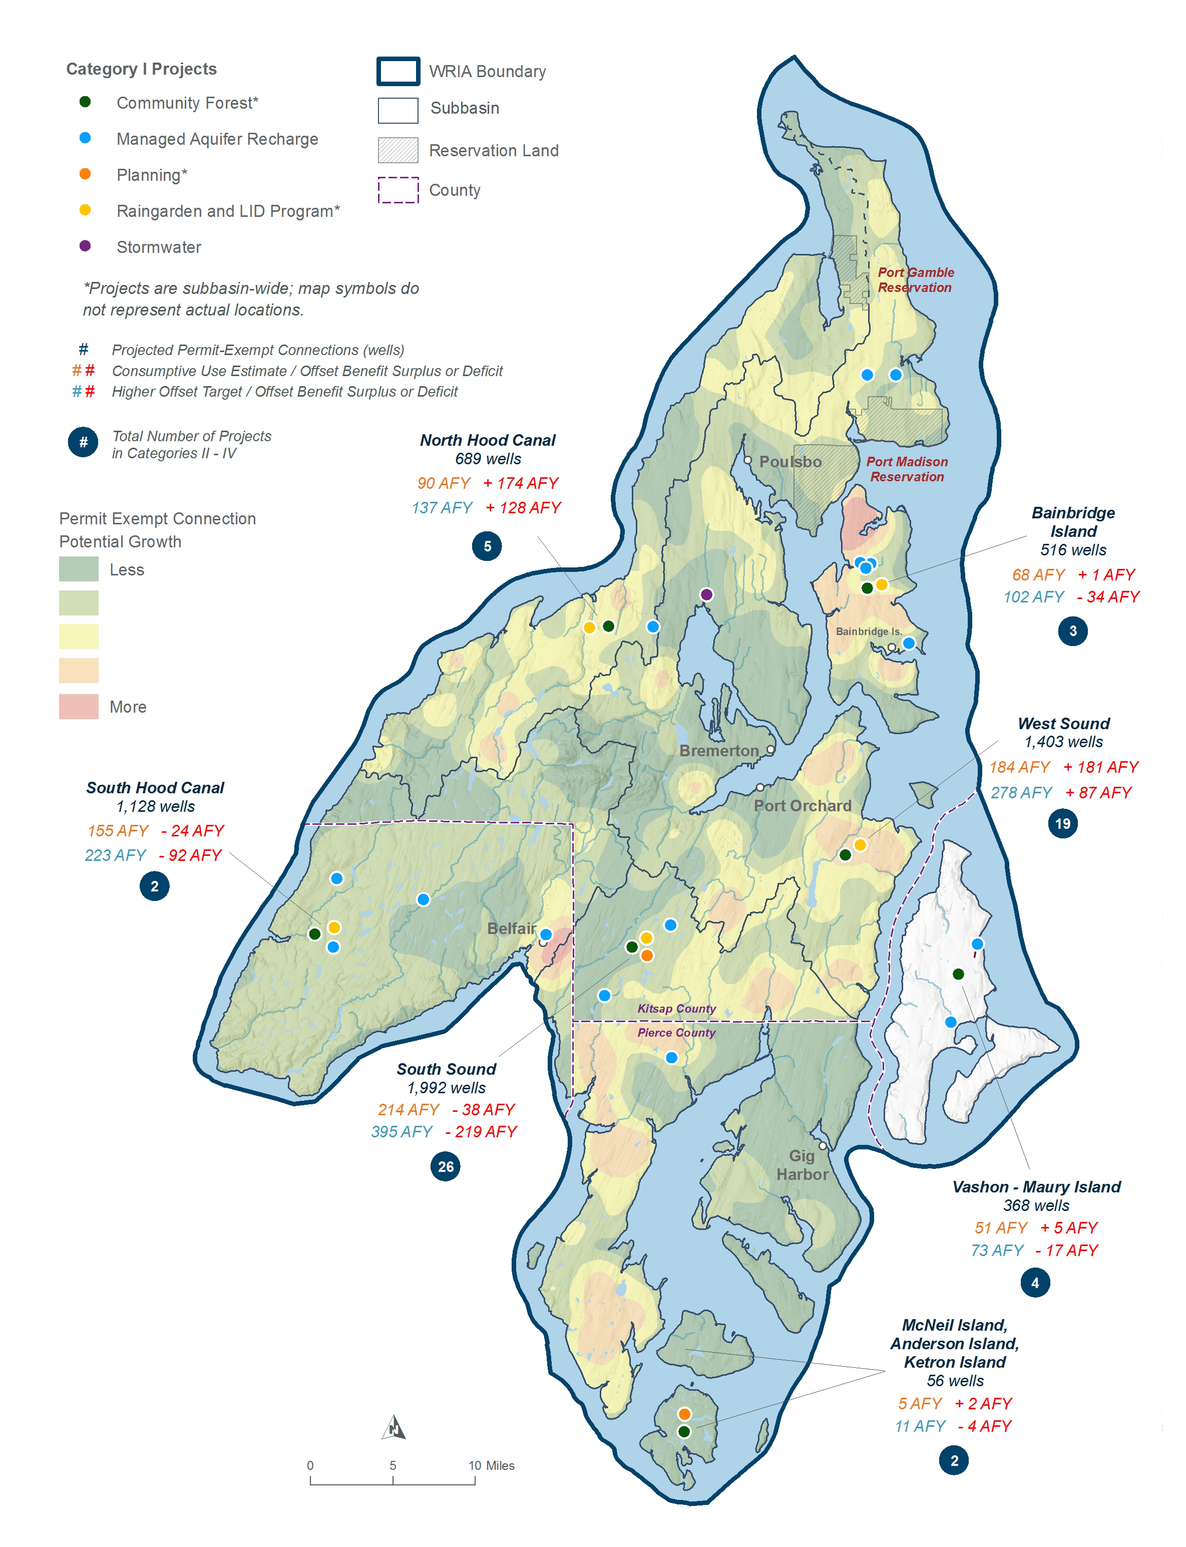

Slide 27
Insert final table that shows surplus/deficits by subbasin
Subbasin | Offset Project Totals (AF/YR) | Consumptive Use Estimate (AF/YR)¹ | CU Estimate Surplus/ Deficit (AF/YR) ³ | Higher Offset Target (AF/YR) ² | Higher Target Surplus/ Deficit (AF/YR)³ | County
Bainbridge Island | 68.2 | 67.6 | +0.6 | 102.2 | -34 | Kitsap
South Sound Islands | 7 | 5.2 | +1.8 | 11.1 | -4.1 | Pierce
North Hood Canal | 264 | 90.3 | +173.7 | 136.5 | +127.5 | Kitsap
South Hood Canal | 131 | 155.0 | -24 | 223.4 | -92.4 | Kitsap and Mason
South Sound | 175.5 | 213.8 | -38.3 | 394.6 | -219.1 | Pierce and Kitsap
Vashon - Maury Island | 56 | 50.7 | +5.3 | 72.9 | -16.9 | King
West Sound | 365 | 183.9 | +181.1 | 277.9 | 87.1 | Kitsap
WRIA 15 Total | 1066.7 | 766.4 | +300.3 | 1218.7 | -152
Notes:
This table shows the CU estimate, the higher offset target for projects, the total benefit expected from project implementation and a surplus/deficit from the CU estimate and Offset Target.

Slide 28
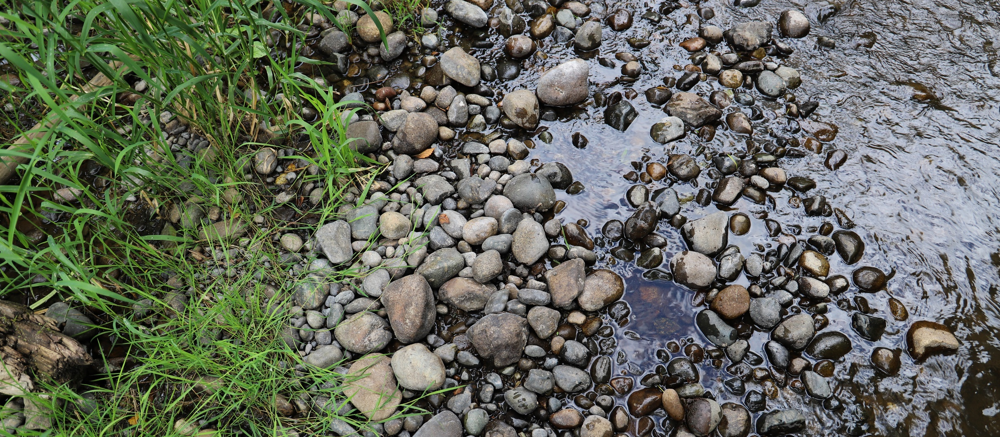
Policy and Regulatory Recommendations
As required by the NEB Guidance, the Committee prepared the watershed plan with implementation in mind. However, as articulated in the Streamflow Restoration Policy and Interpretive Statement (POL-2094), “RCW 90.94.020 and 90.94.030 do not create an obligation on any party to ensure that plans, or projects and actions in those plans or associated with rulemaking, are implemented."
Notes:
[Included caveat language – presenter should use this slide and speak to it as appropriate for the audience. This slide can also be moved before the recommendations slide]

Slide 29
Policy and Adaptive Management Recommendations
The WRIA 15 Watershed Plan includes additional recommendations, including improvements to the well tracking database, outreach and education around beavers, monitoring, project implementation and adaptive management.
Recommendation to have the Committee reconvene, voluntarily, to assess progress and for Ecology to generate reports annually and every five years.
Notes:
[insert more details on specific policies that may be of interest to the audience]

Slide 30
Steps to complete plan
Committee members meet (virtually) to vote on plan. Meeting anticipated in April 15th.
If all members of the Committee approve the plan, the Committee chair will submit the plan to Ecology for review and NEB determination. The Director must adopt the plan by June 30, 2021.
If the Committee does not approve the plan, Ecology will prepare the plan. Ecology will send the plan to the Salmon Recovery Funding Board for technical review. Ecology will then finalize the plan and the Director shall initiate rulemaking.

Slide 31
Your role to complete plan
Review the plan.
Provide direction to the committee representative on whether to approve the plan.
Notes:
[optional]: the committee member can include his/her recommendation in the briefing.

Slide 32
Post Plan Submission
SEPA public comment period.
No changes to plan after submission.
Ecology will review plan.
Ecology will determine action by June 30, 2021.
If achieves NEB, adopt plan.

Slide 33
Thank you for your time!
Any questions?

Slide 34
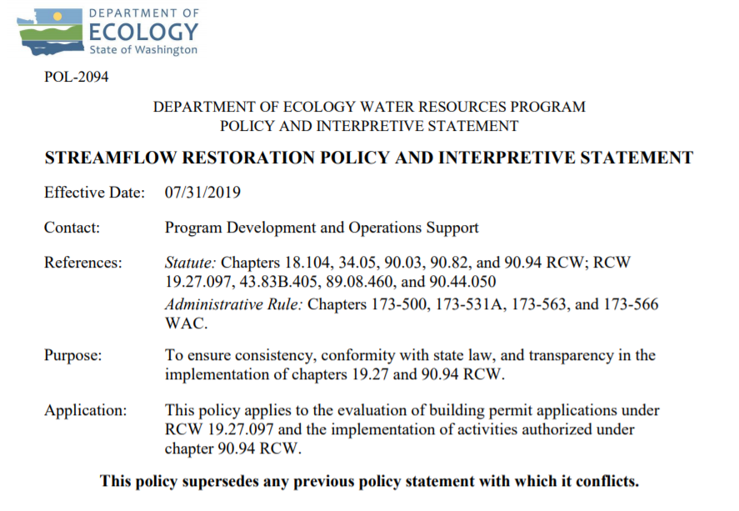
Ecology’s Policy Interpretation
More information on the Streamflow Restoration law can be found online
Notes:
RCW 90.94.030 adds to the management regime for new homes using domestic permit-exempt well withdrawals in this WRIA and elsewhere. For example, local governments must, among other responsibilities relating to new permit-exempt domestic wells, collect a $500 fee for each building permit and record withdrawal restrictions on the title of the affected properties. Additionally, this law restricts new permit-exempt domestic withdrawals in this WRIA to a maximum annual average of up to 950 gallons per days per connection, subject to the five thousand gallons per day and ½-acre outdoor irrigation of non-commercial lawn/garden limits established in RCW 90.44.050. Ecology has published its interpretation and implementation of RCW 19.27.097 and RCW 90.94 in Water Resources POL 2094.

Slide 35
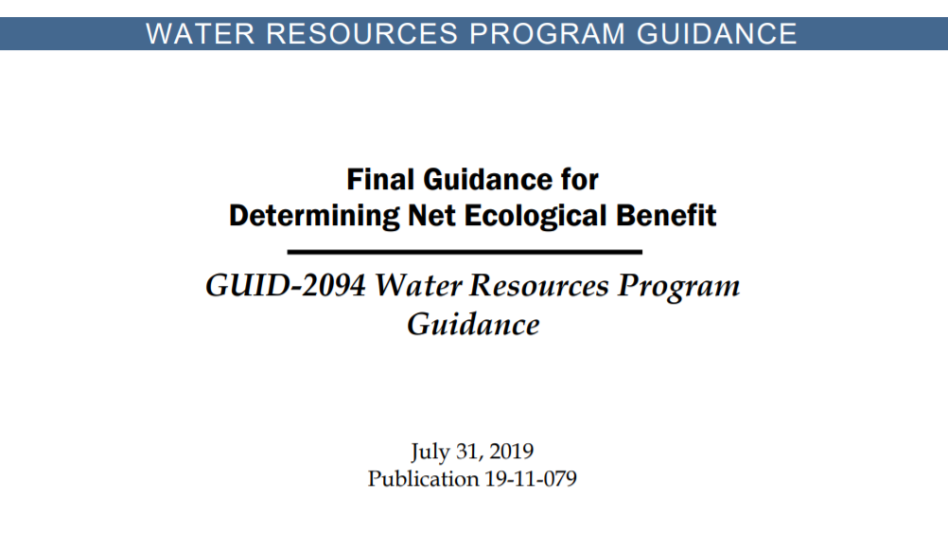
Ecology’s NEB Guidance
More information on the Final Guidance for Determining Net Ecological Benefit can be found online
Notes:
After conducting a thorough scientific literature review, Ecology has determined that NEB is not a technical term that has been defined in the natural sciences. Instead, it is a creation of the Washington State Legislature. Therefore, Ecology has prepared this guidance for interpretation and application of this term. This guidance provides supplemental information, beyond that provided expressly in the law, for those groups engaged in the watershed planning work required by RCW 90.94.020 and RCW 90.94.030.

Slide 36
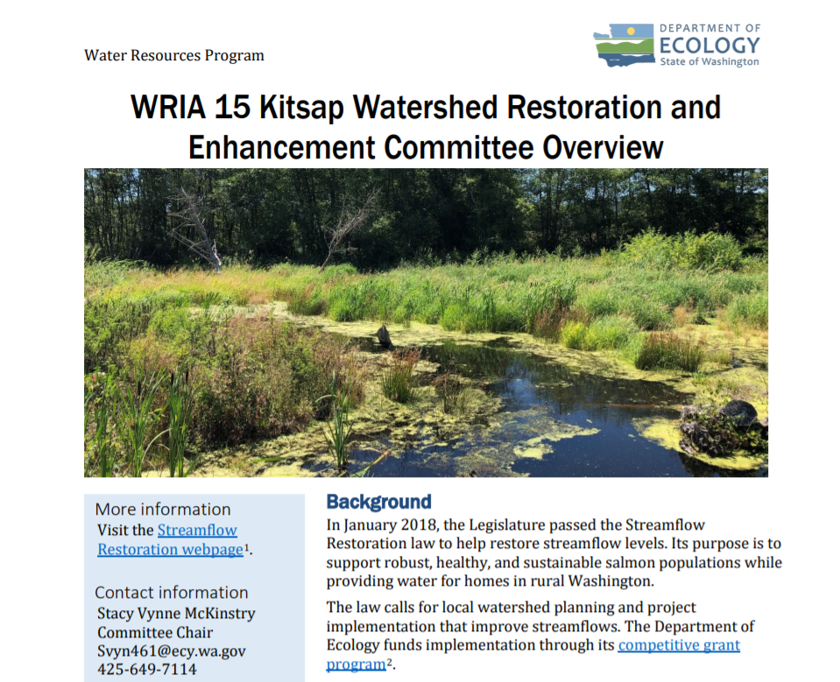
WRIA 15 Committee Brochure
More information on WRIA 15 Committee can be found online

