Slide 1
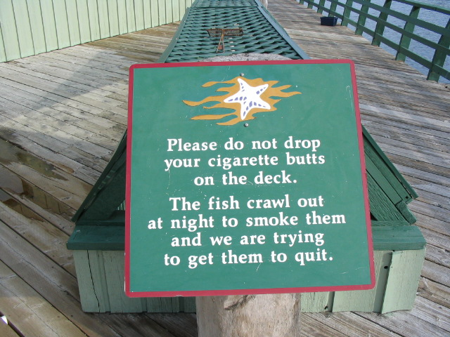
SOCIAL MARKETING
    What is Social Marketing?
    What are Principles for Success?
    How PSP Supports a Social Marketing Approach
Notes:
In the next 90 minutes we’ll cover these 4 topics.
We have a couple of handouts for you that will capture these major points.

Slide 2

DEFINITIONS
FORMAL:
“A process that applies marketing principles and techniques to influence target audience behaviors that benefit society as well as the target audience.”

Slide 3
DEFINITIONS: INFORMAL
Influencing Public Behaviors for Good

Slide 4

IT’S ALL ABOUT BEHAVIORS
Eat 5 fruits and vegetables a day.
Replace half of your lawn with native plants.
Exercise 30 minutes, 5X a week.
Don’t idle more than 10 seconds, except in traffic.
Pick up after your pet and place in trash.
Wash cars at a commercial car wash.
Notes:
What you should notice about these is how specific they are.
It doesn’t say “eat healthy”. It says “Eat 5 a Day”.
You want the target audience to know exactly what to do.
And you want to be able to measure whether or not they have done it.

Slide 5

AND IT’S ALL ABOUT THE EXCHANGE THEORY
In order for Exchange to happen
Benefits must equal Costs
Notes:
This is the fundamental marketing theory.
And your job as a social marketer is to increase benefits and decrease costs so that costs equal benefits.

Slide 6
TYPICAL APPLICATIONS
IMPROVING HEALTH
PREVENTING INJURIES
PROTECTING THE ENVIRONMENT
INVOLVING THE COMMUNITY
Notes:
Distinguished more than 40 years ago by Philip Kotler and initially focused on improving health and preventing injuries.
In past couple of decades, used to influence behaviors to protect the environment

Slide 8
HOW DIFFERS
Commercial Sector Marketing
  Typically goods and services
  For a profit
  Benefit of shareholders
Non-Profit Marketing
  Promoting services of the organization
  Supporting fundraising
Social Marketing
  Benefit society and the target audience

Slide 9
HOW DIFFERS
From Education:
  Education typically just informs
  Social Marketing is intent on influencing behavior change
From Advertising and Social Media:
  Advertising and social media are only two of the many communication options (Promotion Tool) for influencing behaviors
  There are 3 other powerful tools: Product, Price and Place
Notes:
Education is something social marketers might use, but it is rarely enough to change behaviors since it takes more than words and knowledge to remove barriers and provide benefits.

Slide 10
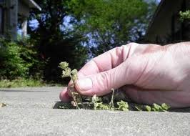
WHY IT’S SO HARD
We ask people to . . .
Be uncomfortable
Risk rejection
Reduce pleasure
Give up looking good
Be embarrassed
Go out of their way
Spend more time
Spend more money

Slide 11
PRINCIPLES FOR SUCCESS
A Clear Target Audience is Identified
A Single, Simple Desired Behavior is Selected
Audience Barriers & Benefits are Understood
All 4Ps in the Marketing Toolbox are Considered
Changes in Behavior are Measured and Reported

Slide 12
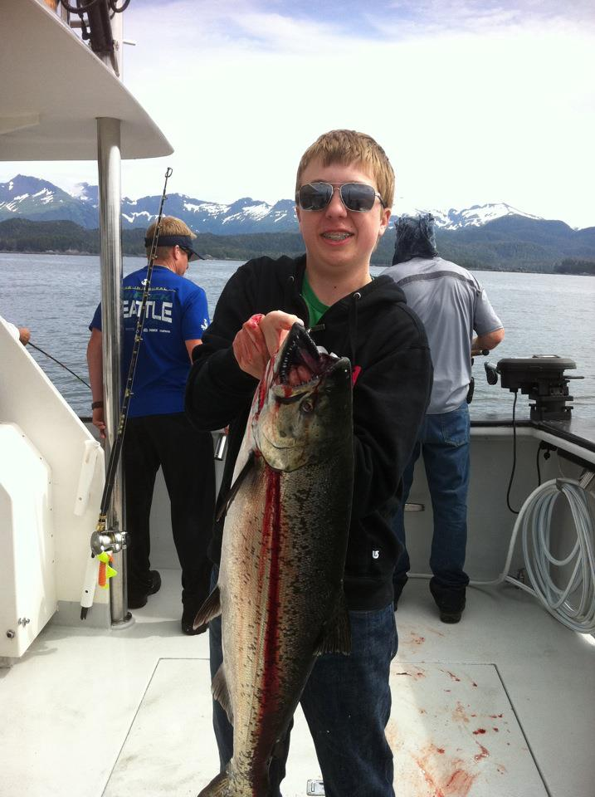
#1 A CLEAR TARGET AUDIENCE IS
IDENTIFIED
Helps Develop Strategies
Increased Effectiveness
Increased Efficiencies, Return on Investment
Notes:
So if you want to catch a crab you’ll need to use the bait they want, put the trap down where they hang out and when they are hungry.
If you do, you’ll get more crab (than starfish) and in a shorter period of time.

Slide 13
#1 A CLEAR TARGET AUDIENCE IS
IDENTIFIED
Spring 2000
King County DNRP
  Results of $1.5 million ad campaign
    Leave grass clippings on the lawn
    Not to use pesticides
40% awareness
Little/no behavior change

Slide 14
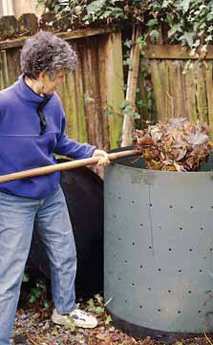
#1 A CLEAR TARGET AUDIENCE IS
IDENTIFIED
2000 Piloted new strategy
Targeting “One Neighborhood at a
Time” vs. 500,000 home gardeners
24 Desired Behaviors:
  Building healthy soils
  Practicing natural lawn care
  Choosing the best/right plants for the site
  Controlling pests and diseases w/o pesticides
  Water deeply and less frequently

Slide 15
#1 A CLEAR TARGET AUDIENCE IS
IDENTIFIED
Formative Research with 400 households
Barriers to Natural Gardening:
  Not knowing ideal practices
  Not knowing how to do
  Concern lawn won’t look as good
  Natural pesticides don’t work
  Don’t believe pesticides a real problem
  Perception natural products more costly
  Natural ways take more time
Benefit/Motivator: Neighbor’s success

Slide 16
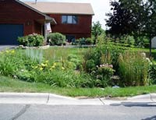
PRODUCT
PRICE
PLACE
PROMOTION
2-hour neighborhood workshops
First 7 years, 5 practices
2008, added garden design

Slide 17
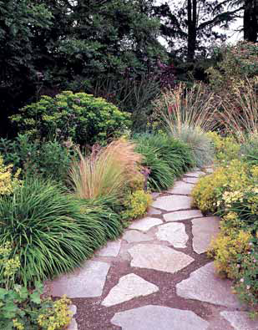
PRODUCT
PRICE
PLACE
PROMOTION
Free
Door prizes like mulch mowers
  Attending all 3 sessions increases likelihood)
Free information kit valued at $15
Extra materials to give to neighbors (Diffusion)

Slide 18
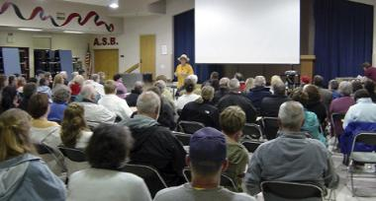
PRODUCT
PRICE
PLACE
PROMOTION
2 hour workshop
Weekday evenings (7pm – 9pm)
Spring and fall
Familiar location with free parking
  Schools, churches, community centers
Register by phone or email or at door

Slide 19

PRODUCT
PRICE
PLACE
PROMOTION
Fun, informative and free
Direct mail, door-to-door calls
Email reminders (Prompt)

Slide 20
#1 A CLEAR TARGET AUDIENCE IS
IDENTIFIED
Behavior Change Research (18 months later):
  99% mower at 2 inches
  99% avoiding pesticides
  58% choosing native plants
  45% watering deeply/infrequently
  43% using organic or slow-release fertilizers
  39% planted drought-tolerant plants
  39% applying organic layer of mulch
  26% called the garden hotline
Attendees shared workshop and tips w/ 5 others
Average cost to reach a gardener and friends ($17)
Notes:
Research was conducted with over 300 workshop attendees

Slide 21
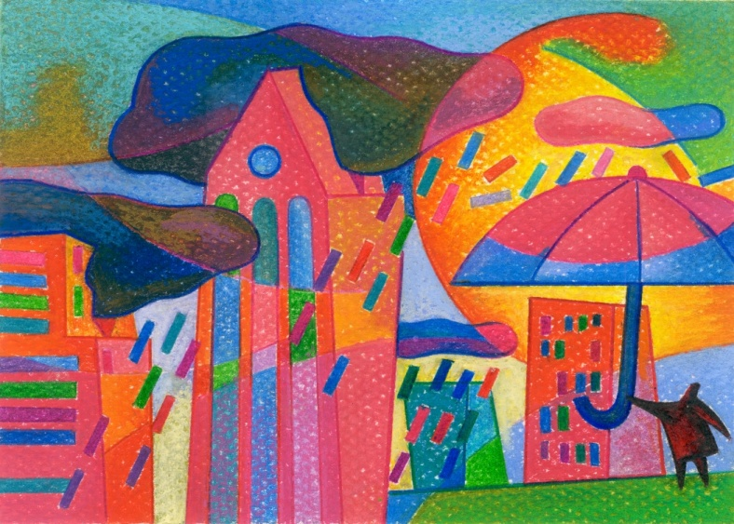
#2 A SINGLE, DESIRED BEHAVIOR
IS SELECTED
Year 2000. Metro Regional Government
Perfect storm in Portland Oregon:
  180,000 tons food disposed annually in solid waste system
  Oregon Food Bank struggling

Slide 22

#2 A SINGLE, DESIRED BEHAVIOR
IS SELECTED
Food Rescue Program
Partners: Restaurant Association, Chef’s, Food Bank, 3 Counties, 25 cities, Food Alliance
Provide food business a safe and convenient way to donate their perishable and surplus prepared foods to agencies that serve the hungry

Slide 23
#2 A SINGLE, DESIRED BEHAVIOR
IS SELECTED
Restaurant Barriers/Concerns:
  How do we get involved?
  How do we get the food to you?
  Can we select the agency closest to us?

Slide 24
#2 A SINGLE, DESIRED BEHAVIOR
IS SELECTED
Response of Fork it Over:
  Online registration
  Online selection of agency
  Picked up at scheduled time

Slide 25
#2 A SINGLE, DESIRED BEHAVIOR
IS SELECTED
Making a difference:
  1999 -2005, 18 million pounds forked over
  Spent $700,000 to administer program
  Saved $647,650 in disposal costs
  Food worth $17 million
  Every dollar invested, $31 benefit

Slide 26
#3 BARRIERS ARE UNDERSTOOD
May be Internal or External
Real or Perceived:
  Knowledge
  Belief
  Skills
  Infrastructure
  Technology
  Economic status
  Cultural
Costs, objections, reasons don’t want to or don’t think can do the behavior
A GIFT!

Slide 27
#3 BARRIERS ARE UNDERSTOOD
Scooping the Poop in Snohomish County 2006-08
157,000 dogs
25 tons in BACKYARDS alone every day
Target Audience:
  Urban and Suburban dog owners who do not regularly pick up in their yards and dispose of it properly
  About 41% of all dog-owning households

Slide 28
#3 BARRIERS ARE UNDERSTOOD
Behavior Objective
  Regularly pick up dog waste in their yards and dispose of it in the trash
  ONE OF YOUR POSTERS HERE
Notes:
Desired Behavior was to Scoop the Poop. Bag It. And Place It In the Trash.

Slide 29
#3 BARRIERS ARE UNDERSTOOD
Barriers to Scooping in the Backyard:
  Self admitted laziness
  It’s gross
  Can’t find it in the dark in winter
  It’s raining
  Can’t find it in the bushes
  Believing “one little” pile can’t be a problem
  It’ll wash away anyway
Notes:
Watch what they did to overcome these barriers

Slide 30
#3 BARRIERS ARE UNDERSTOOD
Barriers to Disposal in Trash:
  Concern about plastic bags in landfill
  Concern about the garbage man
  Belief that it’s not allowed
  Concern about landfill volume
Notes:
Watch what they did to overcome these barriers

Slide 31

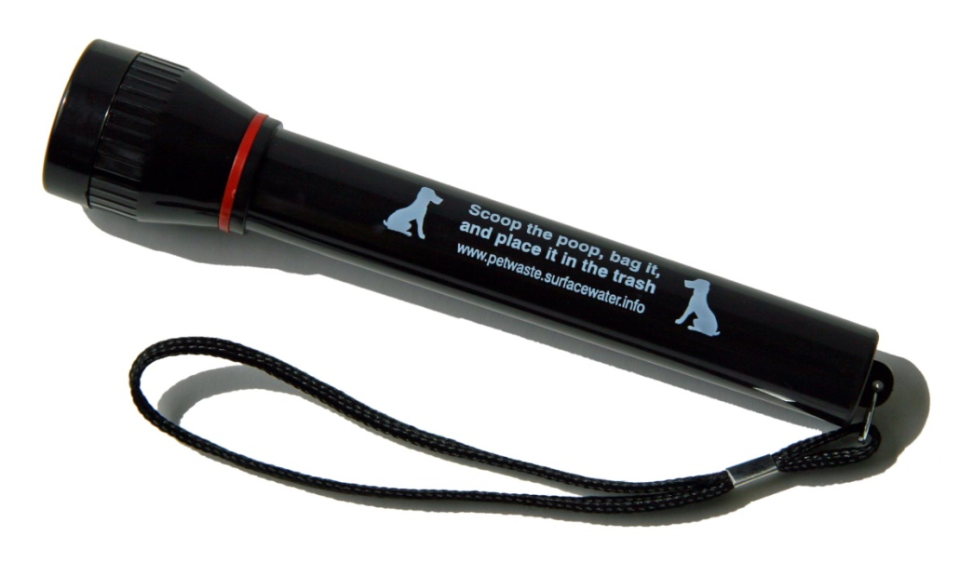
PRODUCT
PRICE
PLACE
PROMOTION
Branded Flashlights
Trash can stickers to “warn the garbage man” AND create norms

Slide 32
PRODUCT
PRICE
PLACE
PROMOTION
  Flashlights were free
  Photo contest (Recognition)
  Highlighted in pet waste calendar

Slide 33
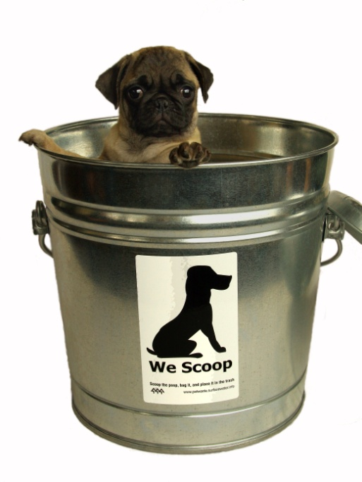
PRODUCT
PRICE
PLACE
PROMOTION
  Flashlights, trash can stickers, water bottles, pens and calendars mailed to homes or delivered door to door on select holidays

Slide 34
PRODUCT
PRICE
PLACE
PROMOTION
At Vet Clinics
Notes:
They held a press conference in a park .
The pile in the back is the estimated amount of pet waste each day.
(It’s dirt, though)

Slide 35
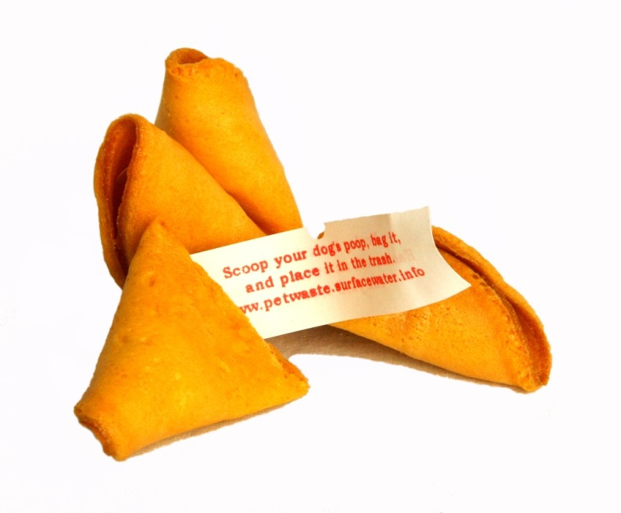
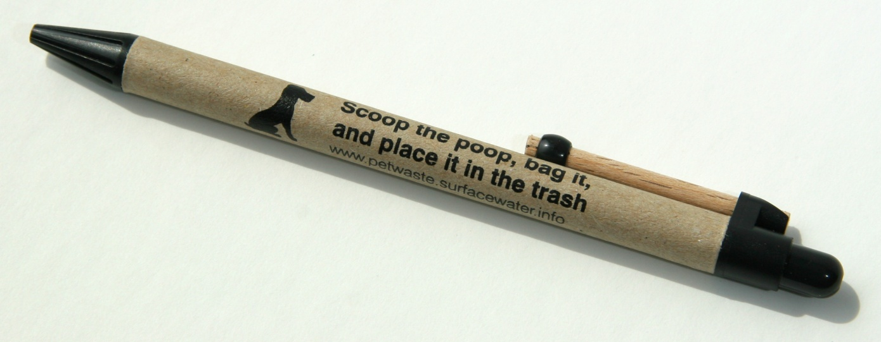
PRODUCT
PRICE
PLACE
PROMOTION
  Promotional Items
Notes:
They held a press conference in a park .
The pile in the back is the estimated amount of pet waste each day.
(It’s dirt, though)

Slide 36
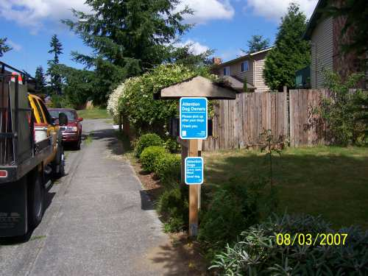
PRODUCT
PRICE
PLACE
PROMOTION
  Yard signs
  Locations where dogs were walked
  An intern mapped them!
Notes:
They held a press conference in a park .
The pile in the back is the estimated amount of pet waste each day.
(It’s dirt, though)

Slide 37
PRODUCT
PRICE
PLACE
PROMOTION
  Utility Insert
  Notice overcoming a barrier
Notes:
They held a press conference in a park .
The pile in the back is the estimated amount of pet waste each day.
(It’s dirt, though)

Slide 38
#3 BARRIERS ARE UNDERSTOOD
OUTCOMES
  50% of target audience households made some form of personal response to the campaign (e.g., talked to the vet)
  48% increase in number of households scooping the poop and placing it in the trash
Notes:
Imagine if you on Austin’s City Council.
Wouldn’t this data give you sound reason to continue funding the project?

Slide 39
#3 BENEFITS ARE UNDERSTOOD
BENEFITS
  What your target audience wants or needs that the behavior could provide
Some are Intrinsic
  Pride, Belonging, Looking Good
Some are Extrinsic
  Save Time, Save Money

Slide 40
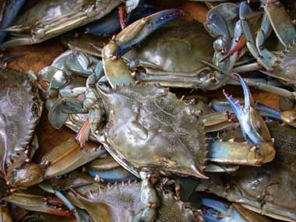
#3 BENEFITS ARE UNDERSTOOD
Background
  2003 Chesapeake Bay
  Concern with declining blue crabs
  From 78 million pounds/year to 50 million

Slide 41
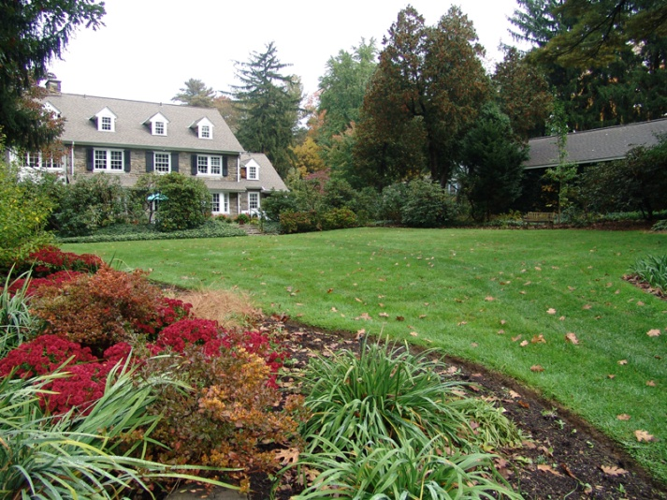
#3 BENEFITS ARE UNDERSTOOD
Target Audience
  Commercial Practices
  Industry Regulation
  Residential Gardening
Rationale:
  Larger audience
  Not focused on in past

Slide 42

#3 BENEFITS ARE UNDERSTOOD
Behavior
  Skip the spring lawn fertilizer
  Wait until Fall
Positioning
  Reframing the problem of a polluted bay as a culinary, not an environmental, problem
Notes:
In other words, they figured out What’s In it for Me to do this behavior?

Slide 43

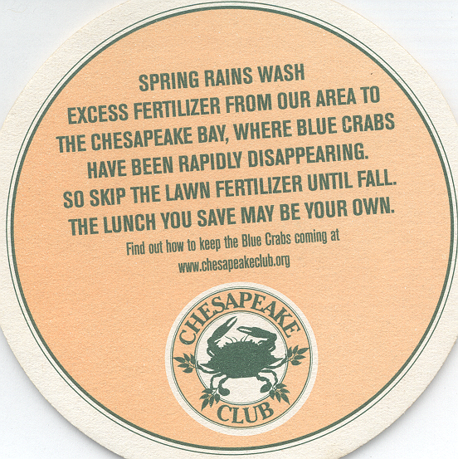
#3 BENEFITS ARE UNDERSTOOD
Notes:
Bar Coasters for Restaurants and Bars

Slide 44



http://www.youtube.com/watch?v=AMOBPQ55zKw
Notes:
For videos, you may need to download to your desktop in environments that have intermittent or no Internet access.

Slide 45



Slide 46
#3 BENEFITS ARE UNDERSTOOD
  BEHAVIOR CHANGE OUTCOMES
    Before campaign:
      52% planning to fertilize in spring
    After 2 weeks of campaign:
      39% planning to fertilize in spring (25% improvement)
Notes:
Telephone Survey to measure behavior change intent.
(Too soon to measure actual behavior change)

Slide 47
#4: ALL 4Ps IN THE MARKETING TOOLBOX
ARE CONSIDERED
To Overcome Barriers & Provide Benefits
Product
Price
Place
Promotion
Notes:
These are the Intervention Tools.
Most of the time we need all 4Ps to remove barriers & provide benefits.

Slide 48
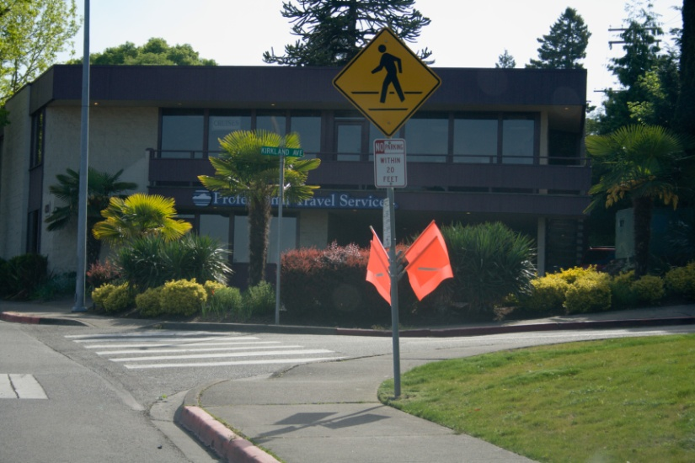
#4: ALL 4Ps IN THE MARKETING TOOLBOX
ARE CONSIDERED
Situation: City of Kirkland
  Orange pedestrian flags since 1996
Target Audience:
  Workers, shoppers
Behavior:
  Use a flag every time

Slide 49
#4: ALL 4Ps IN THE MARKETING
TOOLBOX ARE CONSIDERED
What are they for?
No flags on my side.
Holder hard to use.
I feel safe.

Slide 50
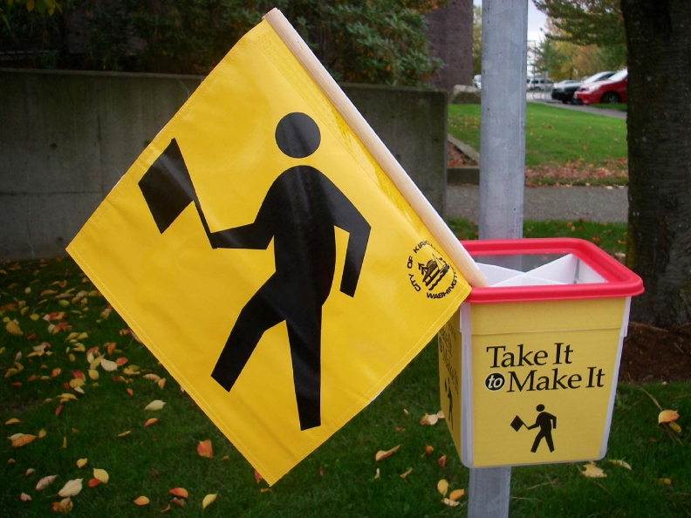
PRODUCT
PRICE
PLACE
PROMOTION
Old Design
New Design

Slide 51
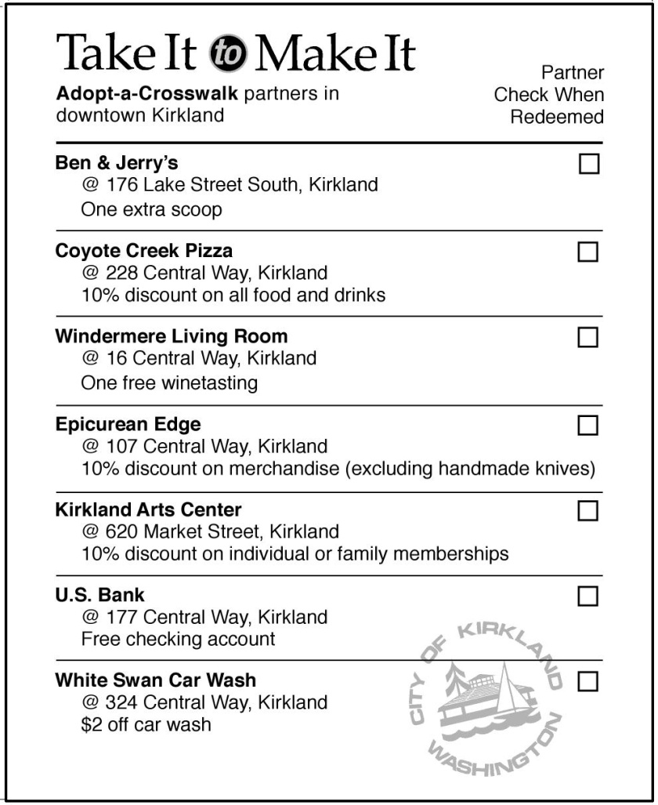

PRODUCT
PRICE
PLACE
PROMOTION
Adopt a Crosswalk Partners

Slide 52
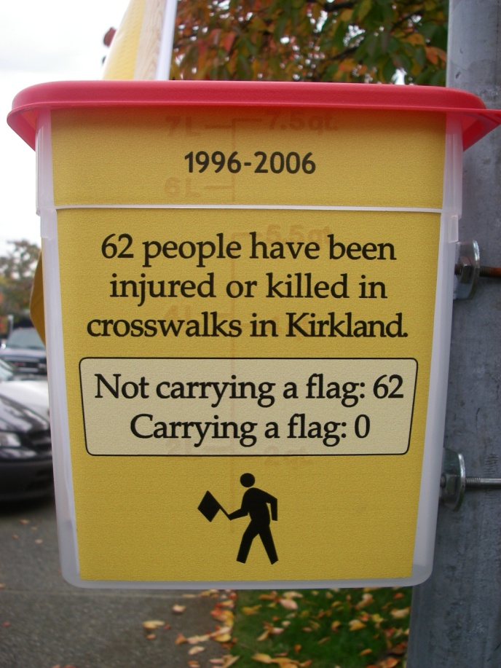
PRODUCT
PRICE
PLACE
PROMOTION
Improving Access

Slide 53
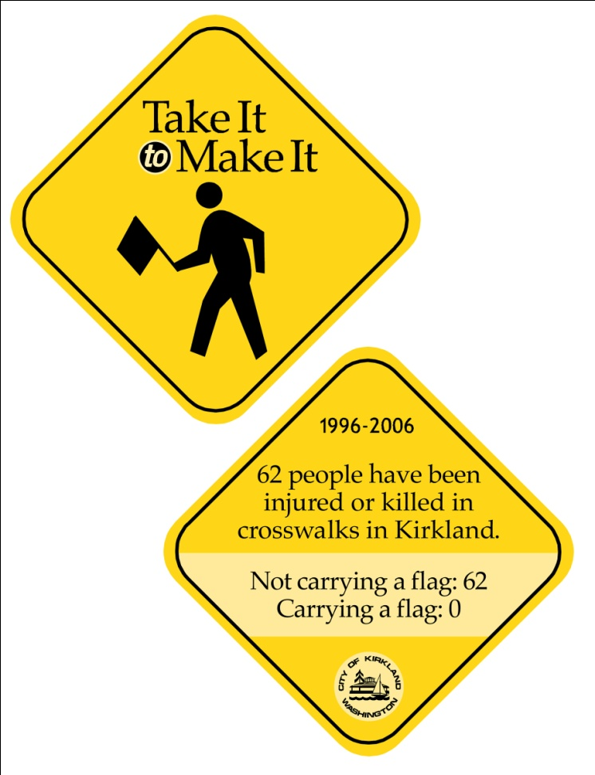

PRODUCT
PRICE
PLACE
PROMOTION
Drink Coasters
Posters

Slide 54
RESULTS: 5 MONTHS LATER
 | 2007 | 2008 | % CHANGE
# People/ Groups | 2426 | 2363 | 3% Decrease
# Flags | 267 | 438 | 64% Increase

Slide 55
#5 CHANGES IN BEHAVIOR ARE
MEASURED & REPORTED
Input Measures
  How much money was spent?
Output Measures
  What was the money spent on?
Outcome Measures
  How many people changed their behaviors?

Slide 56

#5 CHANGES IN BEHAVIOR ARE
MEASURED & REPORTED
Shore Stewards Program
Started in early 2000
Engage Shoreline landowners in Puget Sound Friendly behaviors
Currently in 8 counties
Coordinated by WSU Extension
Partnership with Marine Resources Committees and WSU Beach Watchers

Slide 57

#5 CHANGES IN BEHAVIOR ARE
MEASURED & REPORTED
Inputs:
  County coordinators
  Grant funding
Outputs:
  3000+ landowners
  Guide for Shoreline Living,
  Metal Signs, DVD
  Promotional Mailers
  Site Visits, Assessments, Free Native Plants

Slide 58
#5 CHANGES IN BEHAVIOR ARE
MEASURED & REPORTED
BEHAVIOR | BEFORE 2007 | AFTER 2011 | % CHANGE
Fertilize Safely | 58% | 69% | +19%
Preserve eelgrass & spawning habitats | 33% | 57% | +73%
Manage water runoff | 41% | 73% | +78%
Use soft armoring techniques | 20% | 32% | +60%

Slide 59
THE 5 BIG QUESTIONS TO ASK
To Assure A Social Marketing Approach
1. Have you selected a clear target audience?
2. Are you encouraging a single, simple desired
  behavior?
  Have you identified audience barriers and
  desired benefits?
  Have you considered all 4Ps?
  Will you report on levels of behavior change?

Slide 61
WHAT PSP IS DOING TO SUPPORT SOCIAL MARKETING
Immersion Trainings
Train the Trainer
Diffusion Stewardship Grants
ECO Net Social Marketing Grants
BMP Support
Sustainability via Web/My Puget Sound
Infrastructure for Program Implementation

