Slide 1
Advisory Committee Meeting Building Green Cities Input on Literature Summary, Interviews, and Study Participants
June 28, 2018

Slide 2
today's agenda
Time | Topic
1:00 – 1:10 pm | Welcome
1:10 – 1:20 pm | Recap of Building Green Cities Project
1:20 – 1:30 pm | High-level Summary of Literature Review Findings
1:30 – 2:00 pm | Selection Criteria for Interview Guide
2:00 – 2:45 pm | Topic Areas for Interview Guide and Preliminary Interview Questions
2:45 – 3:00 pm | Next Steps and Adjourn
OPTIONAL
3:00 – 3:30 pm | Continued Discussion about Preliminary Interview Questions

Slide 3
Recap of building green cities program

Slide 4
Literature Review
Preliminary Findings

Slide 5
Methodology
Document List
Document Review
Initial source documents provided by Commerce
Herrera helped to prioritize Commerce list and add others
Conducted additional research
Assessed relevancy to both literature review and subsequent interview objectives
Assessed recency
Prepared document review template
Completed document review template for each document
Aggregated and coded document review data
Identified themes

Slide 6
Barriers to ADOPTION OF Low impact development
Barrier | Example(s)
Customer Demand | Lack of public awareness. Provide outreach to general public, developers, and elected officials. Lack of consumer appreciation for LID aesthetic. Uncertainty regarding ongoing maintenance causes hesitation.
Costs | Permit applications are cumbersome and time-consuming. Uncertainty regarding costs. Lack of adequate funding sources for LID projects.
Technical Knowledge | Need for more long-term performance data. Need for more support to build developer expertise, e.g., demonstration projects, technical assistance with site-specific designs, toolkits, information sharing across jurisdictions.
Policy | LID is difficult to implement via land use codes; separate out LID. Codes and standards inconsistent across jurisdictions: improve coordination.
Notes:
KOM:
“Developers respond to benefits that influence their bottom line.” Examples cited include:
Increased sale price or rental price,
reduced time to sale,
improved appearance or market appeal (specific examples included bioswales and other vegetative stormwater controls)
Help them meet stronger stormwater controls while minimizing costs
Also: “the primary motivation for developers to use LID/GSI is the opportunity to market properties as green.”
Therefore: Anything we can do to promote customer demand will - by extension – improve developer adoption.
To that end: Several articles cited the need for more public education regarding the benefits of LID in order to 1) increase their understanding of the connection to protecting salmon and responding to climate change, and 2) increase their appreciation of the aesthetics of LID.

Slide 7
Incentives and Strategies
to Address Barriers and increase adoption
Reduce Developer COSTS
Materials discounts
Tax rebates
Grants
Offer incentives to increase LID adoption specifically in redevelopment projects
Public-private partnerships
Reduce Developer RISKS
Expedited, or “fast-track”, permitting
Clearly defined guidelines
Common rating system for LID (similar to LEED)
Free technical assistance
LID education outreach
Increase Developer REVENUE
Increase consumer demand
Awards and recognition
Density bonuses
Zoning variance
Reduced fees

Slide 8
Examples
Of Incentive & Strategies
“Developers are supportive of incentives that offset costs and ease the transition to stronger stormwater standards.” ~ ECONorthwest, 2011
City | Strategy
Auburn, WA | Point-based incentive program to encourage developers to go above and beyond requirements, including LID.
Chicago, IL | Chicago’s Green Permit Program reviews permits much faster for projects that meet certain LEED criteria. Chicago’s Green Roof Grants helped add over 2.5 million square feet of green roofs across the City.
Portland, OR | Portland’s Ecoroof Floor Area Ratio Bonus increases a building’s allowable area in exchange for adding an ecoroof. Has seen over $225 million in additional private development and has added more than 120 ecoroofs to the City.
Santa Monica, CA | Gives $160,000 per year in Landscape Grants to property owners that use native landscaping to reduce water consumption and absorb runoff.
Notes:
Maybe reference 10,000 rain gardens – movement started in Kansas City, MO but has spread???
The City of Auburn’s current code lays out a point-based incentive program for alternative development techniques to encourage developers to go “above and beyond” the requirements. LID/GSI are each worth 5 points, and water quality, habitat, and natural vegetation also provide points. Development projects that have 100 points can have:
• Alternate lot dimensions (required setbacks, frontages)
• Alternate parking lot landscaping
• Alternate engineering design
• Expedited permitting process
• Increased density
• Other bonuses including increased impervious and increased maximum height.
More info:
www.codepublishing.com/WA/Auburn/?auburn18/auburn1849.html

Slide 9
Developer Interviews
Selection Criteria and Preliminary Questions
Notes:
Review topic areas during meeting
Ask for feedback and take notes on flip chart
Ask for volunteers/commitment to review interview guide document in July.
Post via Google Docs for collaborative editing.

Slide 10
Interview Overview
30-minute in-depth interviews with 20 to 25 developers working in urban and suburban areas of Puget Sound
Interview guide informed by:
Literature review summary
Interviews with 5 municipal planning staff
Testing of draft interview guide with 3 developers

Slide 11
“Go above and Beyond” Code
What, specifically, do we want developers to do?
Use LID when project is otherwise under size thresholds
Use BMPs that Ecology exempts as infeasible
Use optional BMPs (vegetated roofs, rainwater harvesting, minimal excavation foundations)
Use bioretention or permeable pavement in a drainage basin that is flow control exempt (e.g., Puget Sound)
Notes:
Which of these are we focusing on? They affect which developers we interview and what we ask them.
Relatedly, this project is focusing on “urban centers,” so where is that on a map?

Slide 12
Proposed Developer Selection Criteria
Selection Criteria | Seek mix of | Do not interview if
Role | Land developer | Building developer | Development consultant | Only other roles
Experience | Prefer 5+ years | <3 years
Neighborhood | Urban | Suburban | Only rural or small towns
Building type(s) | Commercial Mixed-use (subsidized) | Mixed-use (market rate) Multifamily (subsidized) | Multifamily (market rate) | Only single-family or other types
Project size(s) | Large | Medium | Small
Site constraints | Flow control required or inside regional growth areas No constraints
Land type(s) | Redevelopment | New development
Company type | Multi-state corporation | Washington corporation Individual or local business | Non-profit
Notes:
Questions
How are we defining an “urban center”
Are these your top selection criteria? If not, which criteria would you replace? Are any criteria not essential?
Let’s talk about site constraints:
How do you envision the site constraints affecting developers?
How do we ask about this?
Within each criterion:
Are these the right categories to include and exclude from interviews?
Should we focus on certain categories more than others, or seek to distribute interviews roughly evenly?
How would you define large, medium, and small projects? By land area or by project budget? Or by whether they were required to implement MR

Slide 13
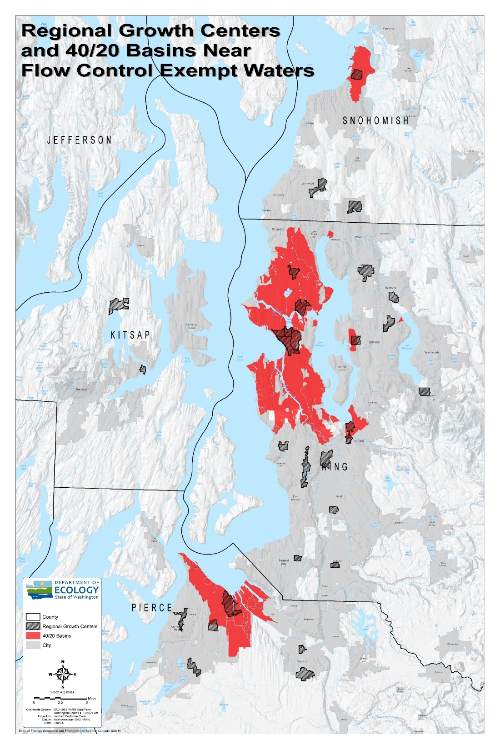
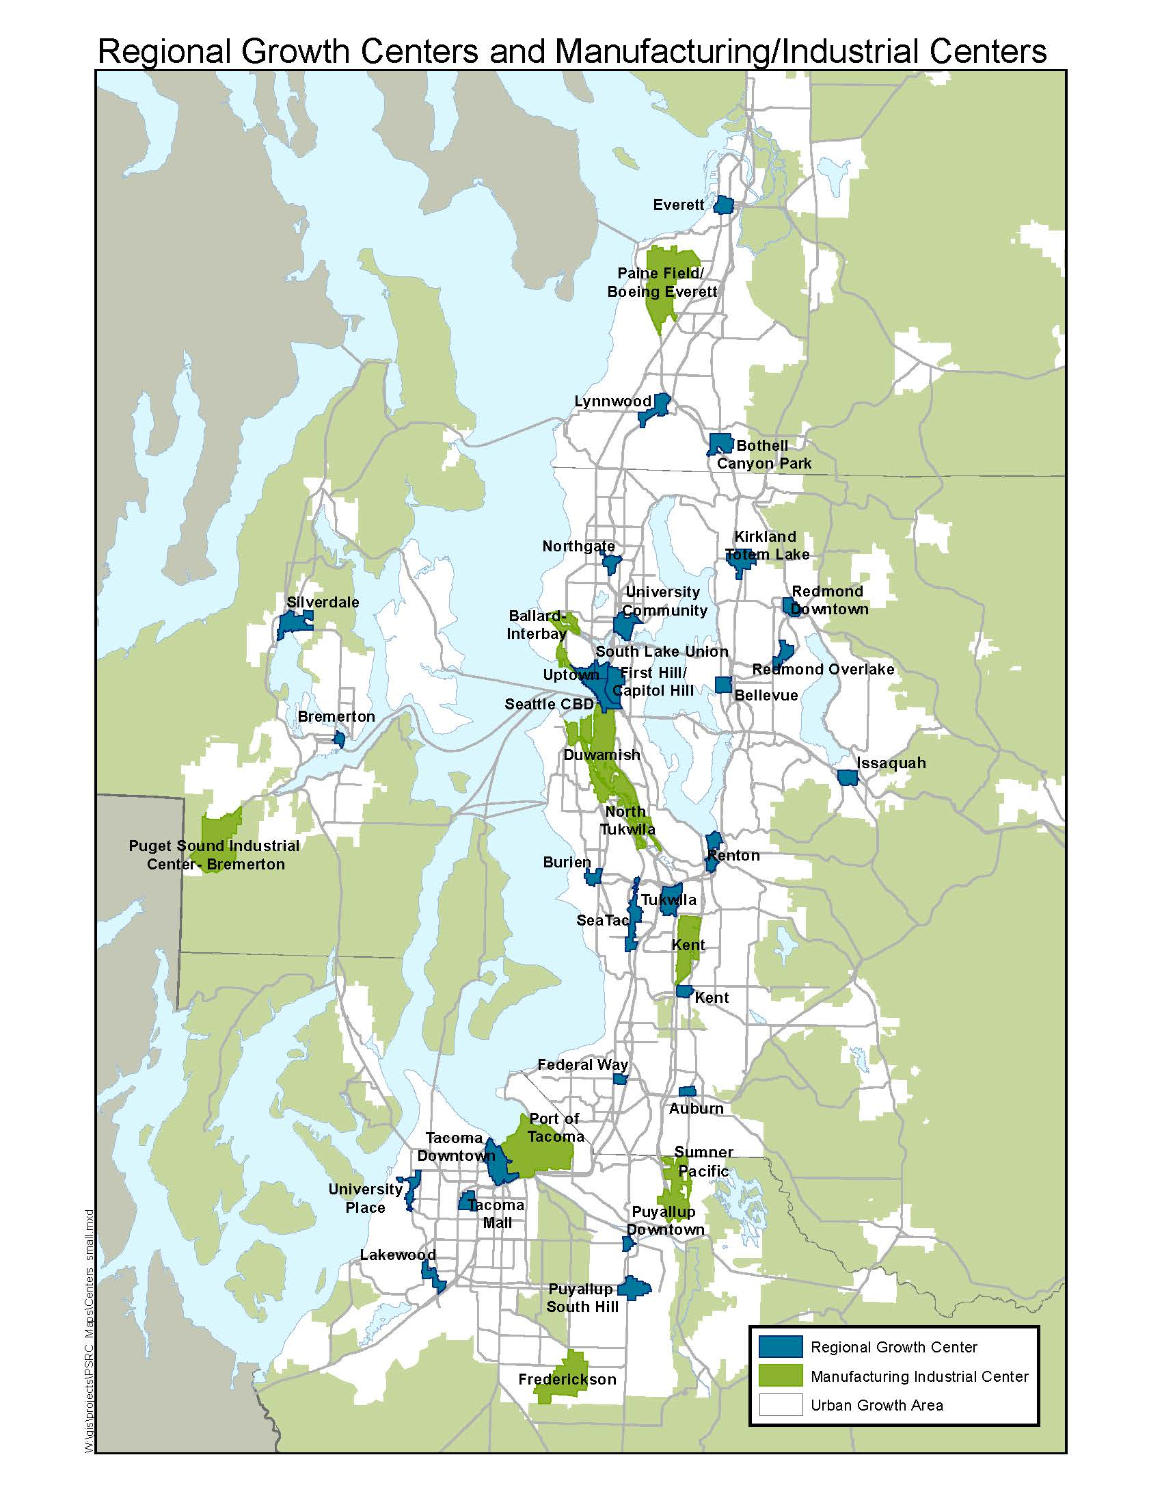

Slide 14
Developer Selection Criteria
The development company owner or a project manager who is responsible for making decisions regarding to what extent low impact development features will be incorporated in to the properties the company develops.
What job titles or responsibilities should we ask about when looking for the right person to talk to?
Notes:
What job titles or responsibilities should we use when looking for the right person to talk to?

Slide 15
Questions: Current Use and Experience
What are the most important factors you consider when choosing among stormwater management methods?
To what extent do you currently use LID on your projects?
On what types of projects are you most likely to use LID methods?

Slide 16
Questions: Changes and Motivators
New regulations require projects to use LID when feasible. How, if at all, did this change how you approached stormwater management on your projects?
When you use LID to manage all or almost all of a site’s stormwater, why do you make that choice?

Slide 17
Questions: Barriers
What are your biggest barriers to using LID methods for managing all or almost all stormwater on your projects?
What would help you overcome your barriers to LID?

Slide 18
Questions: Incentives (part 1)
What incentives/programs for LID have you participated in? What worked and didn’t work?
What incentives or programs would motivate you to use LID to manage almost all stormwater on your projects?

Slide 19
Questions: Incentives (Part 2)
Here’s a list of potential incentive/program types that cities and counties may consider.
Which types are most attractive to you, and why?
For the incentives that are attractive to you, can you describe how
Notes:
Are there specific incentive formats that you are more or less interested in probing about?
Are there any non-starters?

Slide 20
Municipal Staff Interviews
What incentives/strategies to promote LID to developers has your municipality tried? What worked and what didn’t?
What incentives/strategies has your municipality tried to promote other voluntary changes (such as LEED)? What worked and what didn’t?
What are your ideas for strategies to increase use of LID?
What type of guidance documents would be most useful?
Notes:
The contractor shall interview one staff member each at five local governments identified by Commerce regarding their past experience and new ideas regarding incentives and strategies for developers as well as their suggestions for the guidance documents (developed in Task 4).
Commerce will identify the 5 municipalities.

Slide 21
Developer Recruitment List
Currently sources:
BIAW and
Puget Sound Business Journal listings
LinkedIn and Shapr
What are your suggestions for:
Developers to interview
People or organizations that can connect us to developers
Municipalities to interview
Notes:
GOAL: solicit ideas for individuals/entities to invite for developer interviews and local government interviews
Solicit input from Advisory Committee on organizations or individuals to contact, with reference to the selection criteria
Discuss next steps

Slide 22
Thank you!

