Slide 1
Lakewood Station District Subarea Plan (LSDS)
Commerce Grantees Webinar
September 15, 2020

Slide 2
Lakewood Station District Subarea
Terminus of the Sounder
Approximately ½ -1 miles from Downtown
Transit Oriented Development
Affordable housing

Slide 3
Vision
New high-density employment and residential district
Walkable district with employment, health, housing, shopping
Multi-modal commuter hub
Enhanced connections to Downtown
Housing affordable to moderate incomes – including ownership

Slide 4
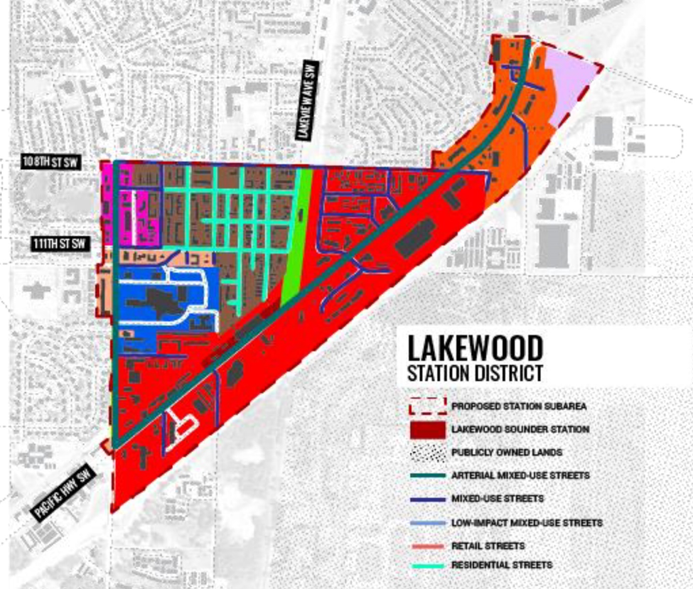
Hybrid Form Based Code
Overlay superimposes the FBC over zoning
Densities already in place
Street typologies drive standards
Transit and commercial corridors identified for mixed use
Supportive of missing middle in residential area

Slide 5
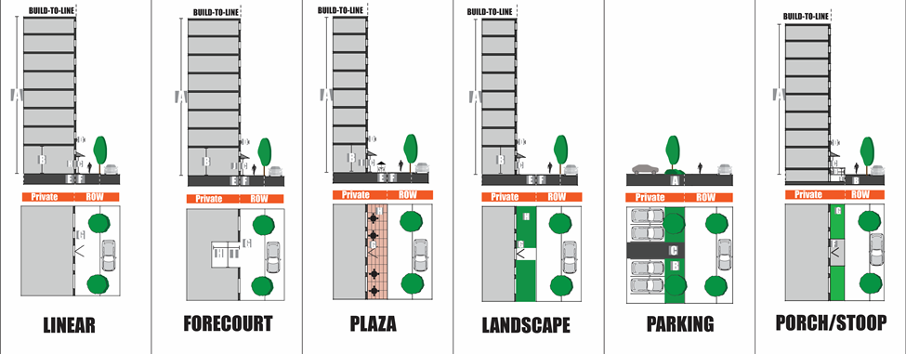
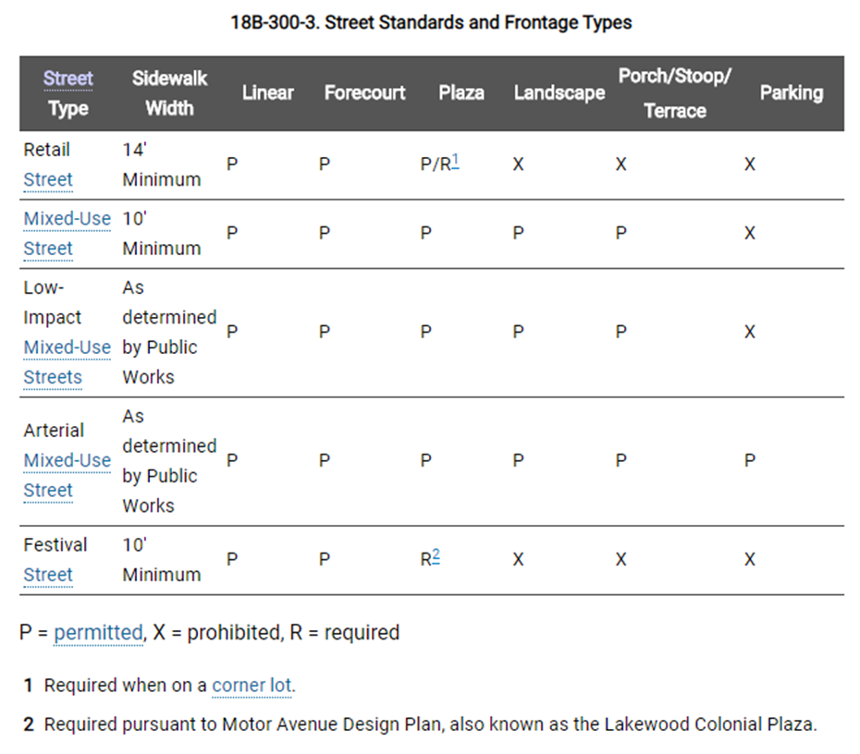
Customizing the Form Based Code
Draws on the FBC for Downtown - developed and vetted with thorough engagement
New residential street type addresses rowhouse development
Addresses public input on the desire to maintain ground-related outdoor space
City is vacating unused ROW
Planned Action

