Slide 1
Tools for Housing Affordability
FOR WASHINGTON STATE COMMUNITIES
Anne Fritzel Emily Grossman Steve Zetz
Senior Planner Housing Policy lead CITY OF PROSSER

Slide 2
Housing Needs and the Capital Stack
Emily Grossman
Policy and strategy advisor
05/12/2020

Slide 3
Purpose of the Presentation
Communicate about the drivers of the housing crisis
Share the framework for housing policy in Washington State
Inspire local leaders with possibilities for housing diversity and affordability
Share local approaches
Not intended to address homelessness, nor tenant protections

Slide 4

Washington’s Housing Policy Act
It is the goal of the state of Washington to coordinate, encourage, and direct, when necessary, the efforts of the public and private sectors of the state and to cooperate and participate, when necessary, in the attainment of a decent home in a healthy, safe environment for every resident of the state. The legislature declares that attainment of that goal is a state priority. RCW 43.185B.007 (1993)

Slide 5

Our Shared Vision for Housing
Most households can find an affordable place to live
Subsidized housing is available for those who need it
Low income households live in high opportunity areas
Broad opportunities for homeownership
Affordable units are not lost

Slide 6
Analyzing Housing Needs

Slide 7
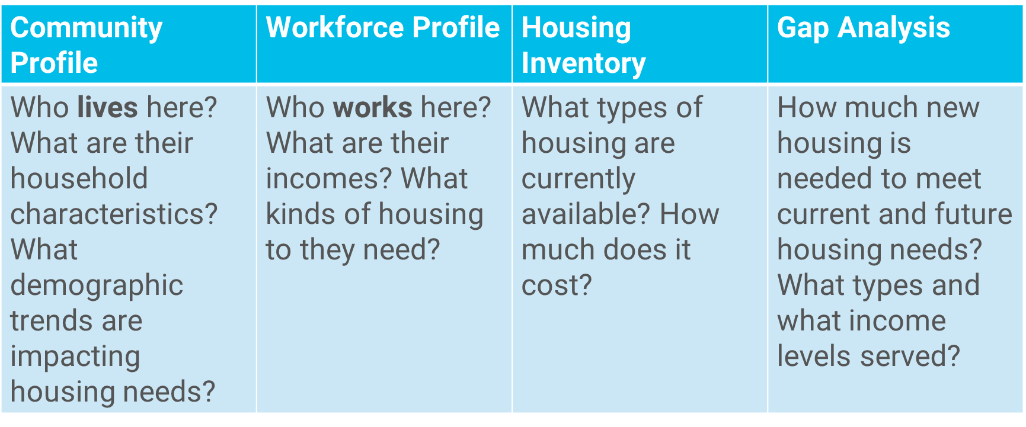
Your Housing Needs Assessment

Slide 8
Measuring Affordability
Housing is considered “Affordable” if the household is paying no more than 30% of their income for housing costs (rent or mortgage plus utilities).
A household is “Cost Burdened” if they are paying more than 30% of their income on housing costs.
Area Median Income is the middle of the income range. 50% of people earn above, and 50% below. Provided by the US Department of Housing and Urban Development (HUD) at the county and metro level, adjusted by household size.
Notes:
Median Multiple rates affordability of housing by dividing the median house price by gross (before tax) annual median household income. affordable housing challenges requires understanding trends and disparities in income and wealth

Slide 9
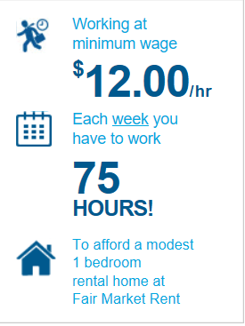
Household income is the primary factor in affordability
Food Prep Workers – $12.40
Cashiers – $12.95
Waiters and Waitresses – $13.52
Personal Care Aids – $13.96
Retail Sales Persons – $14.16
MEAN RENTER WAGE $12.46
Top Five Occupations
Source: NLIHA Out of Reach Report 2019
Notes:
Income is the primary factor, not price or availability. You use an affordability index: this one is housing wage. HAI is another one. Cost burden is the most typically used: housing-expenditure-to-income-ratio

Slide 10
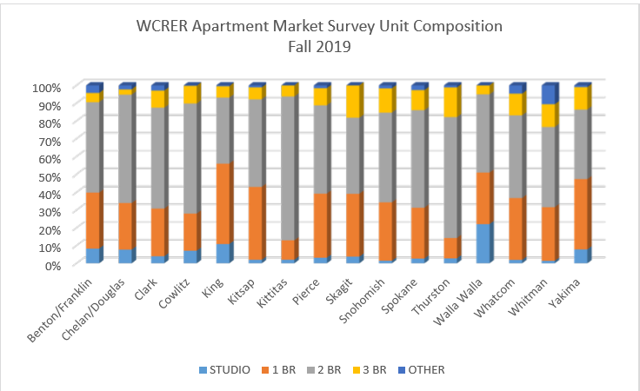
Housing Inventory/Unit Composition
Source: WCRER Fall 2019 Apartment Market Survey

Slide 11
Cost Drivers
Shifting Demographics
Supply and Demand
Changing economic policies and financial instruments
Public Policy
Source: American Community Survey 2018 5-Year Estimates; Median Income in Past 12

Slide 12
Affordable Housing Basics

Slide 13
Subsidized (Government-Assisted) Housing
Rent subsidies are payments made directly to a private market landlord (including non-profit housing agencies) on behalf of an income-qualified tenant.
Non-profit housing is owned and operated by a private, not for profit, agency.
Public Housing is owned and operated by government (typically a Housing Authority) and subsidized to below-market rates through grants from the Department of Housing and Urban Development (HUD).
Notes:
A generic term covering all federal, state or local government programs that reduce the cost of housing for low- and moderate-income residents. Housing can be subsidized in numerous ways—giving tenants a rent voucher, helping homebuyers with down payment assistance, reducing the interest on a mortgage, providing deferred loans to help developers acquire and develop property, giving tax credits to encourage investment in low- and moderate-income housing, authorizing tax-exempt bond authority to finance the housing and/or providing ongoing assistance to reduce the operating costs of housing and others.

Slide 14
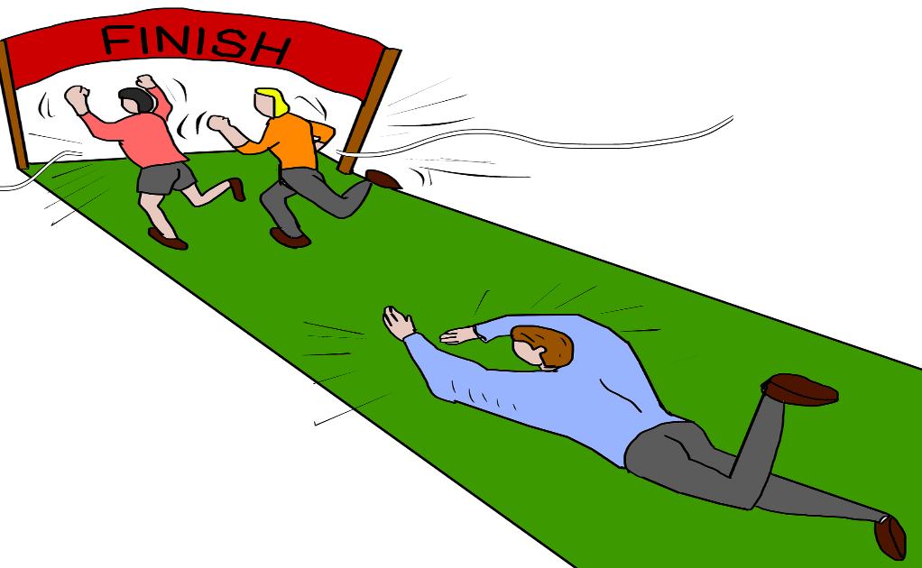
How we subsidize housing
Loans
Grants
Tax Credits
Private Activity Bonds
Operating Subsidies
Rent Subsidies
Energy Subsidies
Donations of Real Estate
Development Costs + Cash Flow
= Feasibility

Slide 15




Major Funders of Subsidized Housing

Slide 16
Legal Overview:
Housing Planning in Washington State
Growth Management Act
Growth Management Hearings Board cases
Local authority
Special consideration for the “poor and infirm”

Slide 17
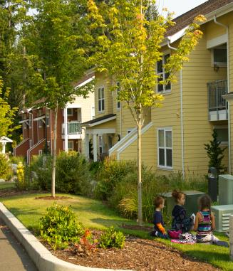
Growth Management Act housing goal
Encourage the availability of affordable housing to all economic segments of the population of this state,
Promote a variety of residential densities and housing types, and
Encourage preservation of existing housing stock.
RCW 36.70A.030(4)

Slide 18
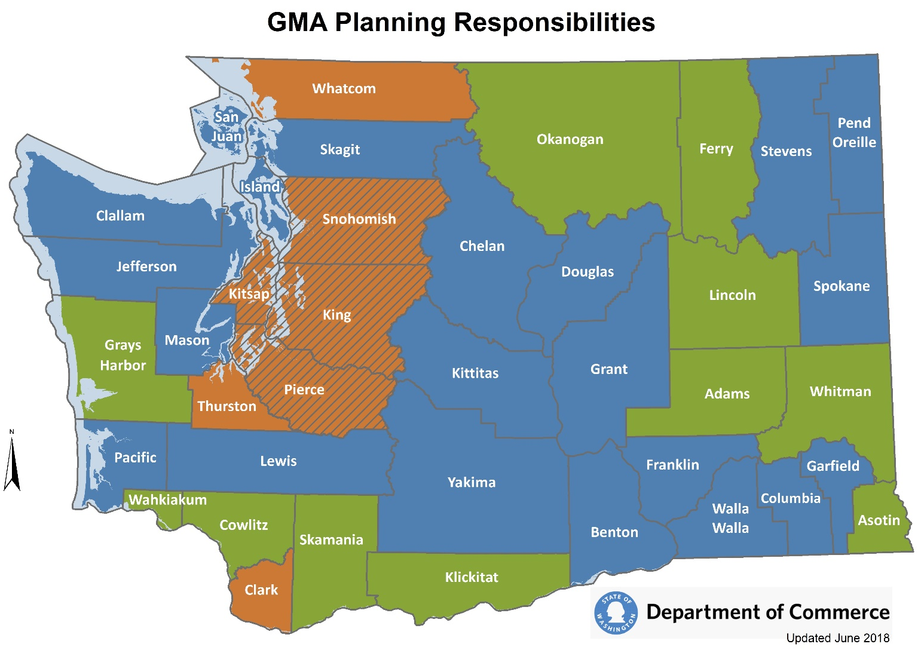
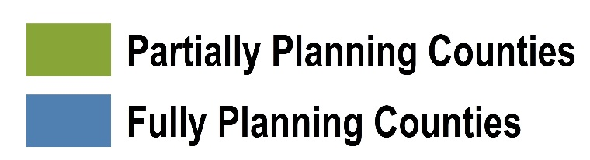
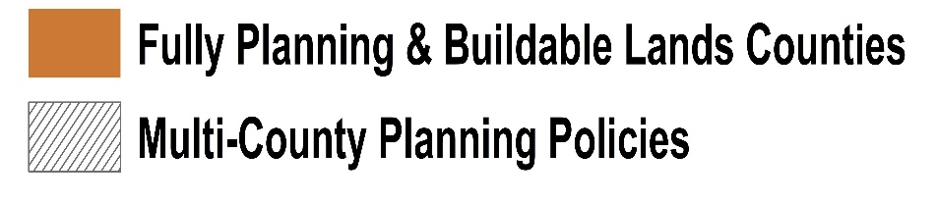
Countywide planning policies (CPPs), at a minimum, shall address:
Policies that consider the need for affordable housing, such as housing for all economic segments of the population and parameters for its distribution.
RCW 36.70A.210 (3)(e)

Slide 19
Counties and cities must develop a housing element ….
…ensuring vitality and character of established residential neighborhoods. It must contain at least:
An inventory and analysis of projected housing needs.
Goals, policies, and objectives for the preservation, improvement, and development of housing, including single-family residences.
Identification of sufficient land for housing, including, but not limited to, government-assisted housing, housing for low-income families, manufactured housing, multifamily housing, group homes. and foster care facilities.
Adequate provisions for existing and projected housing needs of all economic segments of the community. RCW 36.70A.070(4)

Slide 20
Growth Management Hearings Board
Paul Stickney and Richard Birgh v. City of Sammamish
GMHB Case No. 15-3-0017 (2017)
King County Countywide Planning Policies (CPPs) required each jurisdiction to include in its comprehensive plan an inventory of existing housing stock and an analysis of existing and projected housing needs.
Analysis must consider local and countywide housing needs and each city is responsible for addressing its share of countywide need.
  Three Income ranges:
  Moderate Income (50-80% of AMI) 16% total housing
  Low Income (below 50% of AMI) 12% total housing
  Very Low Income (below 30% of AMI) 12% total housing
              King County CPP H-1

Slide 21
Paul Stickney and Richard Birgh v. City of Sammamish
GMHB Case No. 15-3-0017 (2017)
  Petitioners: Affordable housing stock severely lacking
  Moderate Income: 4% of housing stock
  Low Income: 1% of housing stock
  Very low income: 0% of housing stock
  Yet 13% of households are moderate to very low income range.
  GMHB:
  Simply identifying total number of housing units needed to manage projected growth was insufficient.
  King County CPPs require each city to accommodate its share of countywide affordable housing for moderate, low, and very-low income households.
  Needs analysis should have been by income category.

Slide 22
Futurewise v. City of Bothell
GMHB Case No. 07-3-0014
  Futurewise argued:
  City had not provided sufficient land for low income housing.
  Density of 15 du/acre needed to make SF detached housing affordable.
  City should have adopted mandatory incentive programs for affordable housing.
  GMHB:
  Record demonstrated sufficient land to accommodate affordable housing.
  Other housing types could be part of planned accommodation (i.e., need not be all detached SFDUs).
  GMA does not require that Bothell include mandatory incentive programs for affordable housing.

Slide 23
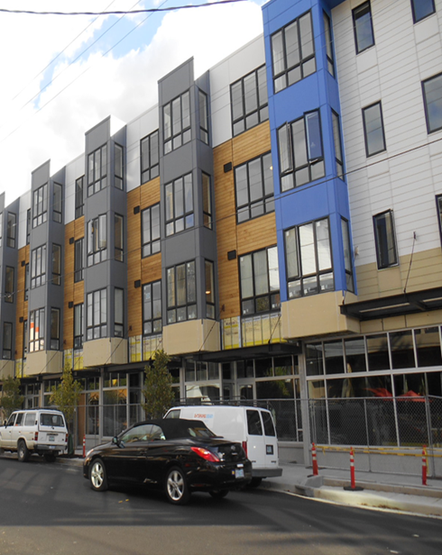
RCW 36.70A.540: Affordable housing incentive programs encouraged
Affordability for 50 years to 80% AMI for ownership and 50% AMI for rental (adjustable)
Optional or mandatory programs using tools such as:
  Density bonuses in UGAs
  Height/bulk bonuses
  Fee waivers or exemptions
  Parking reductions
  Expedited permitting
  Inclusionary zoning
Cities with programs:
Redmond
Kirkland
Issaquah
Sammamish
Seattle
Monroe
Newcastle
Bainbridge Island

Slide 24
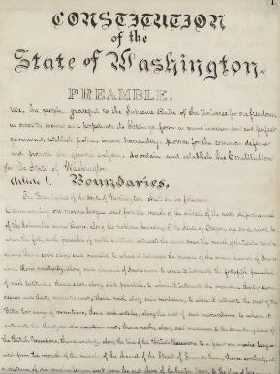
Gift of public funds?
Article 8, Section 7
“No county, city, town or other municipal corporation shall hereafter give any money, or property, or loan its money, or credit to or in aid of any individual, association, company or corporation, except for the necessary support of the poor and infirm. . . .”
Washington State Constitution

Slide 25

Provisions for housing the homeless . . .
  Cities issuing “homelessness state of emergency” in order to build more housing. Also public health emergency.
  Homelessness encampments:
  If homeless encampments are hosted by a church, protected by Federal “Religious Land Use and Institutionalized Persons Act” (RLUIPA).
  RCW 36.01.290 authorizes religious institutions to host temporary encampments for homeless persons on property owned or controlled by a religious organization. HB 1754 (2020)
  Resources: Low Income Housing Institute lihi.org

Slide 26
Local Government Tools for Housing Affordability
  Make it easier and faster to develop
  Encourage the development of more affordable forms of housing
  Help subsidized housing to be even more affordable
  Preserve existing affordable housing

Slide 27
Make it easier, faster, & cheaper to develop housing

Slide 28
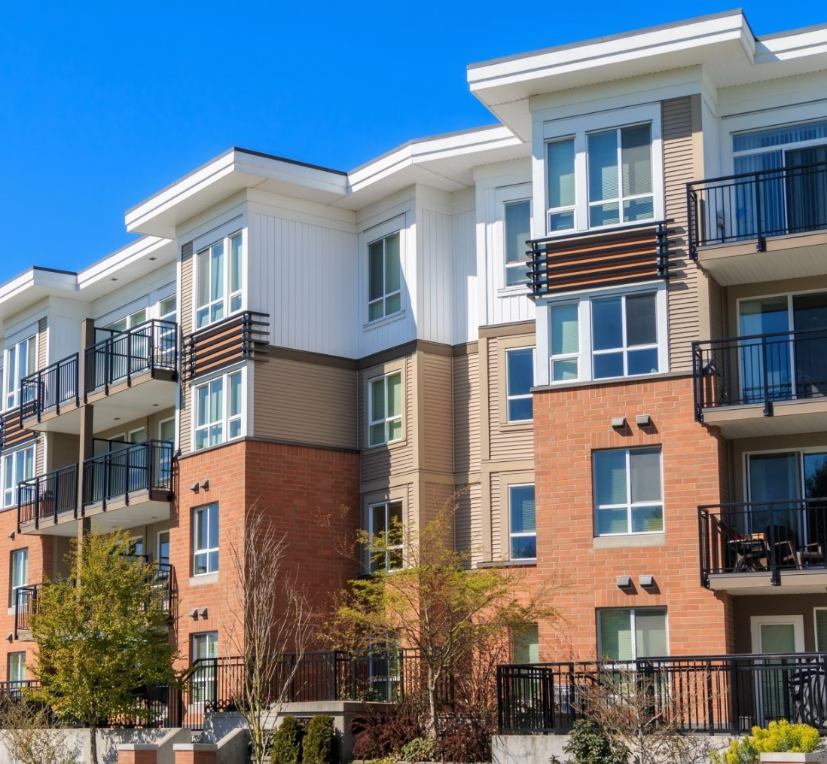
Increase housing production
  Allow more units
  Increase density, require minimum density, form-based code
  Flexible development standards (review street standards, setbacks, open space, and parking requirements for impact on number of dwelling units allowed)
  Decrease carrying cost of the project
  Invest in infrastructure to support new housing
  If collecting impact fees , must allow later payment of first 20 single family units per developer. (RCW 82.02.050(3))

Slide 29
Make the development process easier
  Development review
Reduce number of land use designations and zones
  Streamline and expedite the development review process
Subdivision process
  Expand short plats definition to nine lots (RCW 58.17.020(6))
  Delegate final plat approval to planning commission or staff (RCW 58.17.100)

Slide 30
Reduce SEPA review & risk
PLANNED ACTIONS
Mountlake Terrace Town Center
Shoreline Aurora Square
Puyallup Downtown
Edmonds and Everett Highway 99
Spokane Valley
Lake Stevens Downtown
Lakewood Downtown
Olympia Downtown
Tumwater Brewery area
Burien Infill Ordinance
Expand categorical exemptions to 30 SF or 60 MF (WAC 187-11-800)
A planned action is a subarea plan where environmental impacts have been addressed before individual projects are proposed (RCW 43.21C.440)
Infill exemption for residential, mixed use or commercial development within an urban growth area (RCW 43.21C.229)

Slide 31
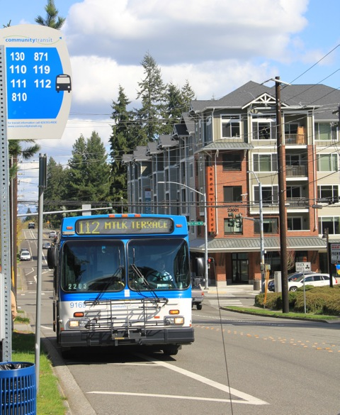
Increase housing production summary
  Focus on opportunity areas, such as high quality amenity with high quality transit, if you have it.
  Allow more units, bonus densities, or use inclusionary zoning
  Require a minimum density, or use a form-based code
  Consider SEPA infill exemption or planned action.
  Check in with developers to be sure it will “pencil”

Slide 32
Allow and encourage more affordable forms of housing

Slide 33
Missing middle housing is less costly to build

Slide 34
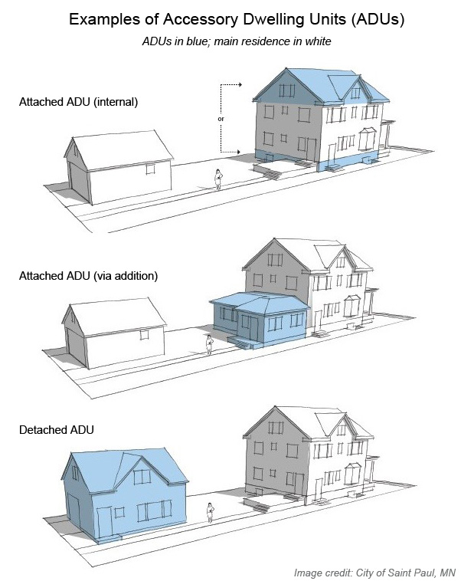
Accessory Dwelling Unit (ADU)
A small, self-contained residential unit located on the same lot as an existing single family home, may be attached to or detached from the primary home.
Issues to consider
  Attached, detached
  Limit on size, height
  Owner-occupancy requirement
  Parking
  Sewer / water connection fees
  Permit fees (can be tied to affordability)
  Pre-approved plans? Manufactured units?
  Assistance identifying a lender

Slide 35
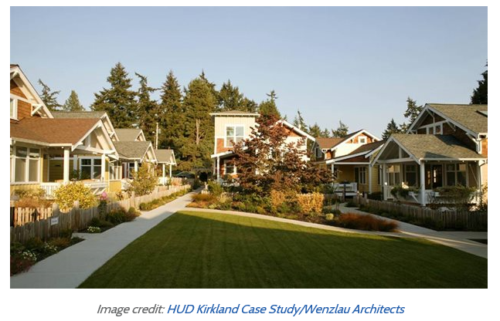
Cottage Housing
Grouping of small single family dwelling units clustered around a common area, may have shared amenities. Cottage housing allowed by:
Kirkland
Federal Way
Marysville
Mukilteo
Port Townsend
Lakewood
Langley
Redmond
Seattle

Slide 36
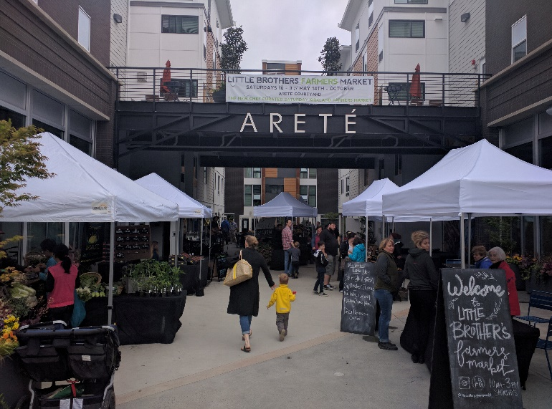
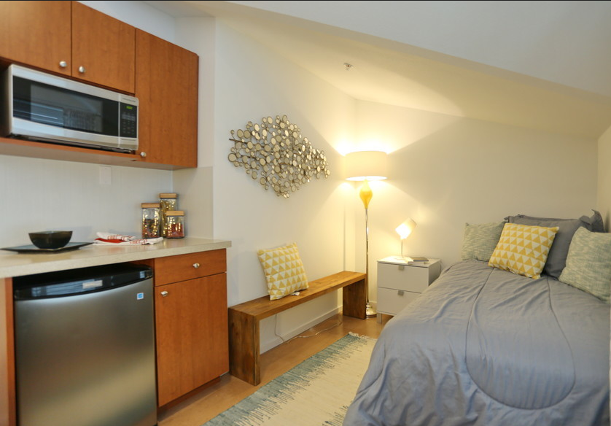
Micro-housing:
Residential Suites or “studios”
Examples:
Kirkland Arete: rent set at 80% of AMI
Seattle Apodments
Redmond “Tudor Manor”
Of note:
Private developer
LEED platinum
Parking is extra

Slide 37
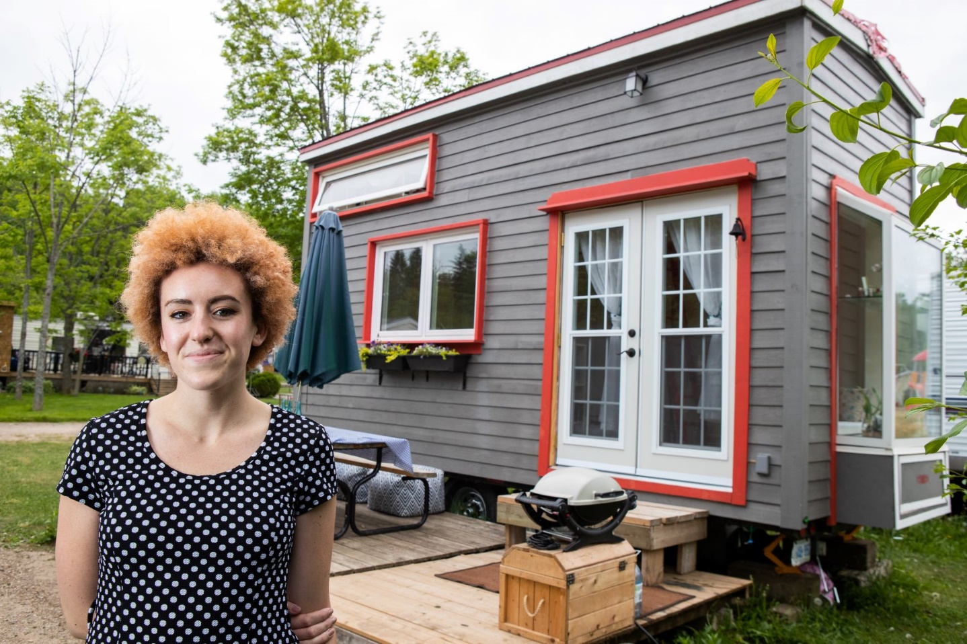
Tiny Homes on Wheels
  New Appendix Q to International Building Code for regulating “tiny houses.”
  Maybe be permitted as “factory built housing.” L&I inspects.
  Local government must inspect the siting: “foundation;” connection to sewer, water, electric; etc.
  Legal in manufactured home parks. RCW 35.21.684 & 35A.21.312

Slide 38
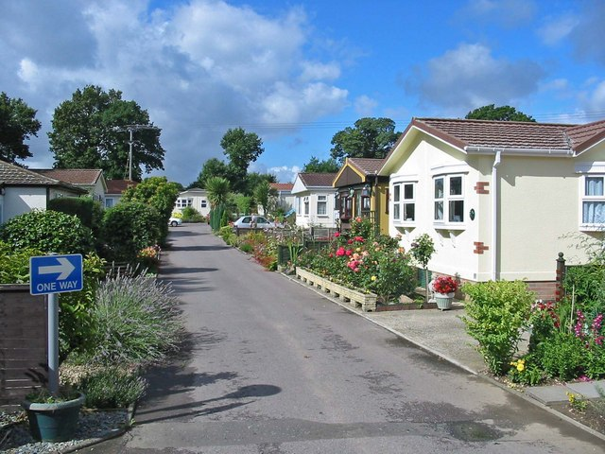
Manufactured home parks as affordable housing
1,250 MH parks in Washington; 65,000 spaces for rent.
RVs and tiny homes now allowed as permanent dwellings in mobile home parks if sanitation is available.
Parks are closing as property values rise, where to move the home?

Slide 39
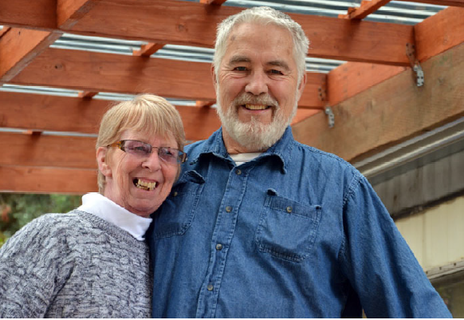
What to do if the MH park may close?
Can be zoned “manufactured home park”
Funding available for purchase by residents
Community land trust, co-housing

Slide 40
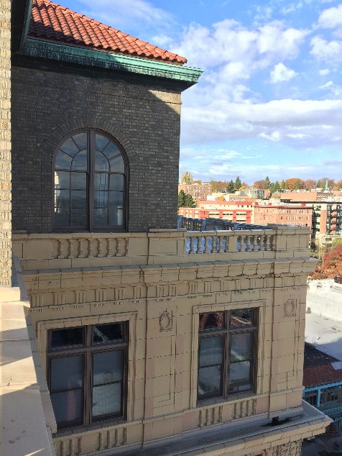
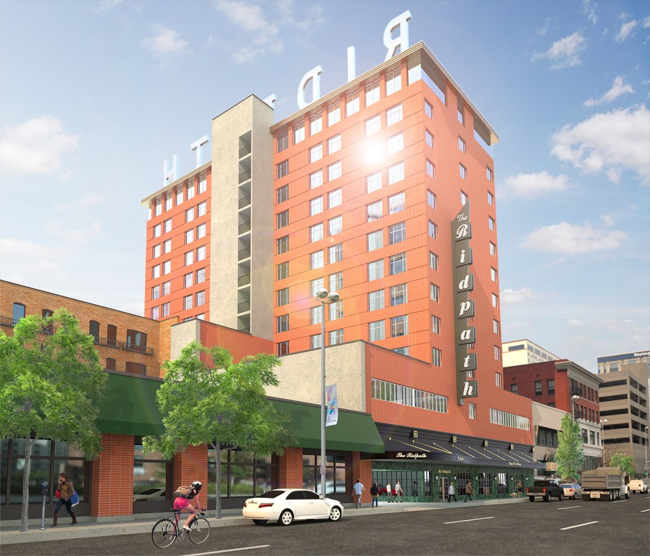
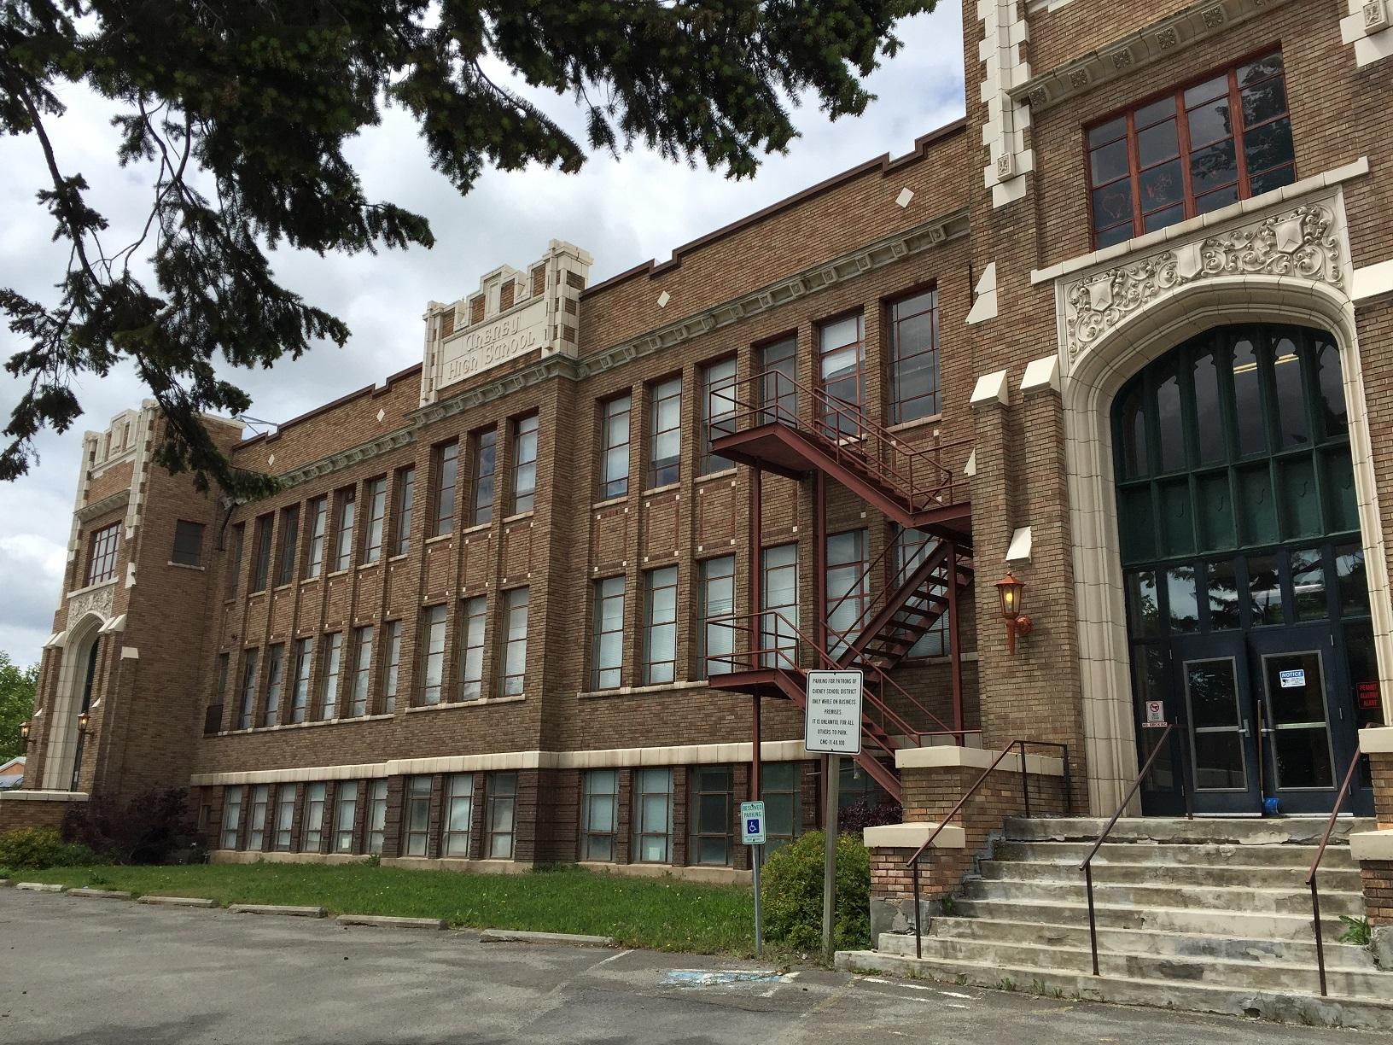
Adaptive re-use
Historic tax credits
Ridpath Club Apartments (Spokane)
Winthrop Hotel (Tacoma)
Schoolhouse Lofts (Cheney)

Slide 41
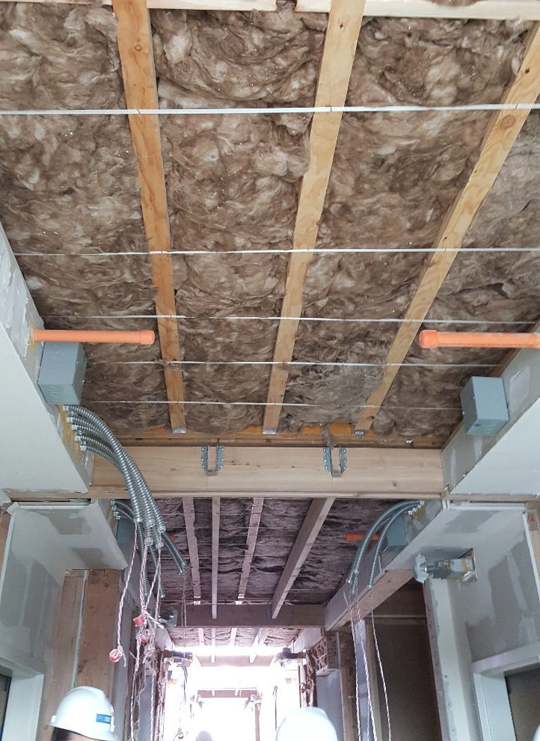
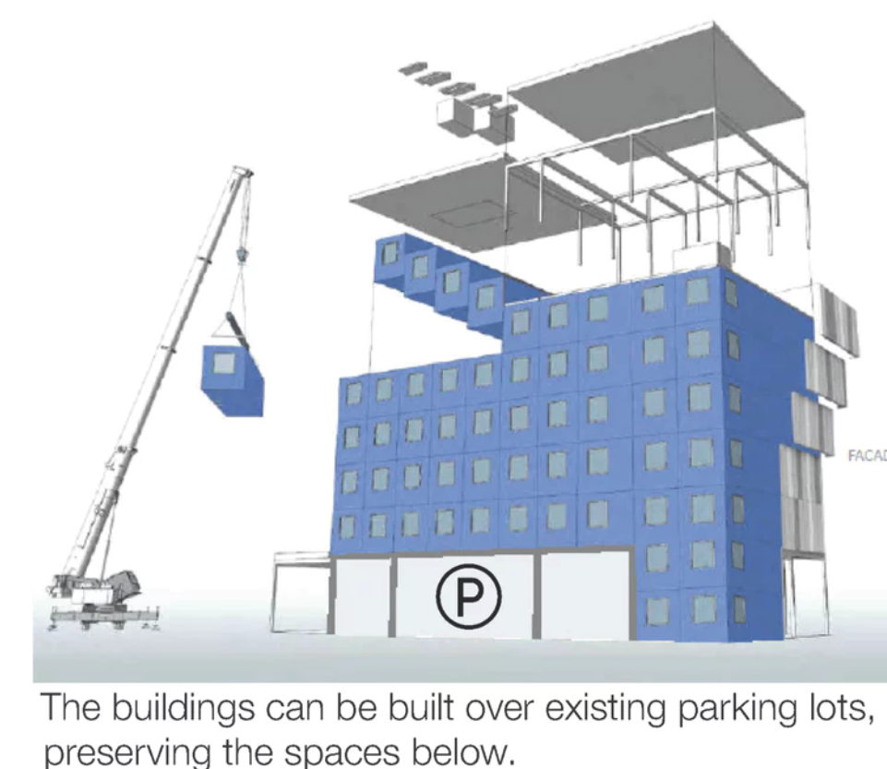
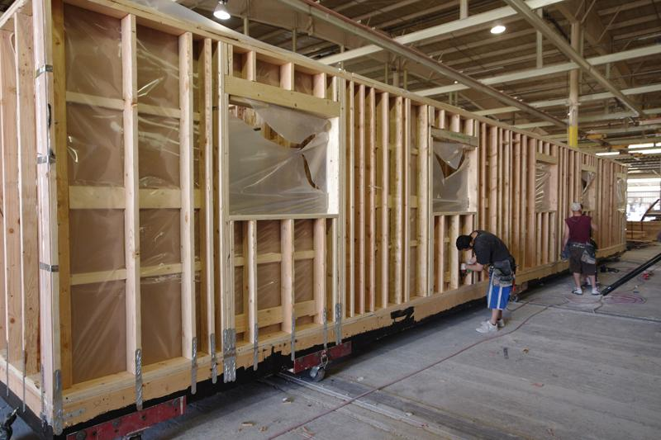
Off-site construction
Modules constructed off site
    Steady jobs for labor
    Environment controlled
    With scale, could provide significant savings

Slide 42
More affordable housing summary
Once more affordable forms of housing are allowed by code, how to incentivize?
  Size-based utility connection and permit fees?
  Expedited permitting for smaller units?
  Inclusionary housing vs. density bonuses?
  Parking, flexibility of standards

Slide 43
3. Consider tools to help subsidized housing

Slide 44
Cheaper to provide housing!
Source: Skagit County Corrections, Skagit Regional Health, Skagit County Public Health

Slide 45
Exception for “poor and infirm”
  A [city, town, or county] may assist in the development or preservation of publicly or privately owned housing for persons of low income by providing loans or grants of general municipal funds to the owners or developers of the housing. The loans or grants shall be authorized by the legislative authority of the city or town. They may be made to finance all or a portion of the cost of construction, reconstruction, acquisition, or rehabilitation of housing that will be occupied by a person or family of low income.
  RCW 35.21.685 and RCW 36.32.415
  Use of REET tax revenues to subsidize housing
  (RCW 82.46.075; AGO 2006, No. 12)

Slide 46
Multifamily Tax Exemption (MFTE) for new and rehabilitated multifamily development (RCW 84.14)
Anacortes
Auburn
Bellevue
Bremerton
Burien
Ellensburg
Everett
Federal Way
Issaquah
Kenmore
Kent
Kirkland
Lakewood
Longview
Lynwood
Moses Lake
Mountlake Terrace
Newcastle
Normandy Park
Olympia
Port Angeles
Puyallup
Renton
SeaTac
Seattle
Shoreline
Spokane
Tacoma
University Place
Vancouver
Walla Walla
Wenatchee
  An option if population over 15,000, or 5,000 in a buildable land county, or largest city in a GMA county.
  Tax exemption on the improvements only
  Must define “residential targeted area”
  Allows:
  8-year property tax exemption on market rate 4 + units, or
  12 years for 20% affordable housing units for low and moderate incomes

Slide 47
Bonus densities, or require affordable. . .
Local governments authorized to provide bonus densities in exchange for public benefit (such as affordable housing)
Bellingham: 50% bonus density if 100% of units are permanent owner-occupied affordable housing (BMC 20.27.030)
Marysville: 1.5 bonus units for each permanently low-income rental unit (MMC 22C.090.030)
Poulsbo: Max of 25% bonus density if 15% affordable (PMC18.70.070(B))
Counties too, within unincorporated UGAs
----------------------
Redmond: Development over 10 units in certain areas must provide affordable and then may build bonus units
Kirkland: Developments over 4 units in certain zones must provide affordable units
Federal Way: Multi-family projects over 25 units must provide affordable and then may build bonus units (FWMC 19.110.010)

Slide 48

Gift or discount public land
Public agencies (local government or utility) can discount or gift land they own for “public benefit” defined as affordable housing.
(up to 80% AMI) Must adopt rules to regulate transfer
RCW 39.33.015 (2018)
Other ideas for affordable housing
State or other publicly-owned land
Churches, service clubs
Mall transformation
Derelict buildings
Community facilities

Slide 49
Fee waivers
Local governments authorized to waive sewer/water connection fees, impact fees, and permit fees for affordable housing.
Ephrata Water and sewer connection fee waivers (RCW 35.92.380)
Puyallup Waiver of building permit fees
Everett Waiver of planning fees
Port Townsend Offers system-development charge deferrals
Kirkland Includes dimensional standards modification, reduced fees for road and/or park impact, and reduced fees for eligible planning, building, plumbing, mechanical, and electrical permits

Slide 50
Vote for local housing funds
Sales and use tax for affordable housing (up to 0.1% per dollar spent) <60% AMI per RCW 82.14.530 (2015)
Ellensburg (2017), Olympia (2017)
Affordable housing property tax levy (up to $0.50 per $1,000 assessed value) <50% AMI per RCW 84.52.105 (1993)
Bellingham (2012), Vancouver (2016), Jefferson County (2017), Seattle (multiple)

Slide 51
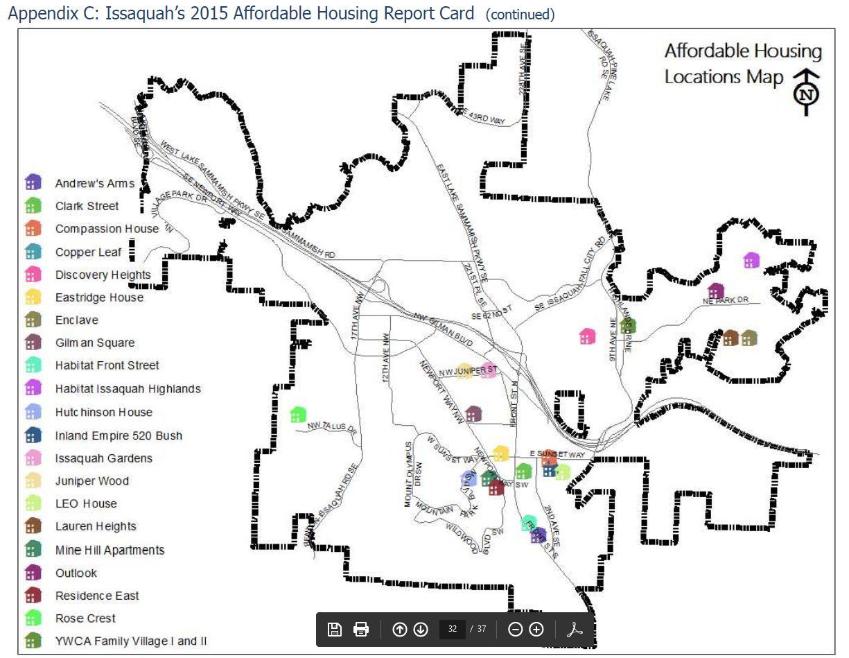
Preserve existing affordable housing stock
    Re-invest in older apartments to extend their life
    Acquire existing buildings, hotels, and other for sites for affordable housing
    Adaptive reuse of existing buildings for housing
    Weatherization and repair programs for low-income home owners
    Protect existing mobile and manufactured home parks

Slide 52
Conclusion
”

Slide 53
Some messaging to take home
The Mantra: “We need more homes, of all shapes and sizes, for all our neighbors.”
Talk up balance, variety, and options: Our lives, our families, and our incomes come in all shapes and sizes, and so do our housing needs.
Tell people’s stories: Give examples of affordable choices making the city work for all kinds of families and communities.
Connect affordability to opportunity: Where we live shapes our lives and long term success.

Slide 54

Some challenges and opportunities
Despite our current uncertainty, our state is likely to continue to attract more population and capital
“Zombie”, vacation rental and second homes remove housing from the market.
Next update to GMA plans is in 2024-2027
Nimbys to yimbys

Slide 55
Housing affordability resources
Commerce
Guidance for Developing a Housing Needs Assessment
Housing Action Plan and Housing Element Guidebooks coming in 2020
  www.commerce.wa.gov/serving-communities/growth-management/planning-for-housing
Housing resource web site:
www.ezview.wa.gov/ → Affordable Housing: Resources for Planning
MRSC: Many pages on Affordable Housing www.mrsc.org
Puget Sound Regional Council (PSRC) www.psrc.org
Housing Innovations Program Tool Kit (2017)
Regional Housing Needs Assessment (2021)

Slide 56
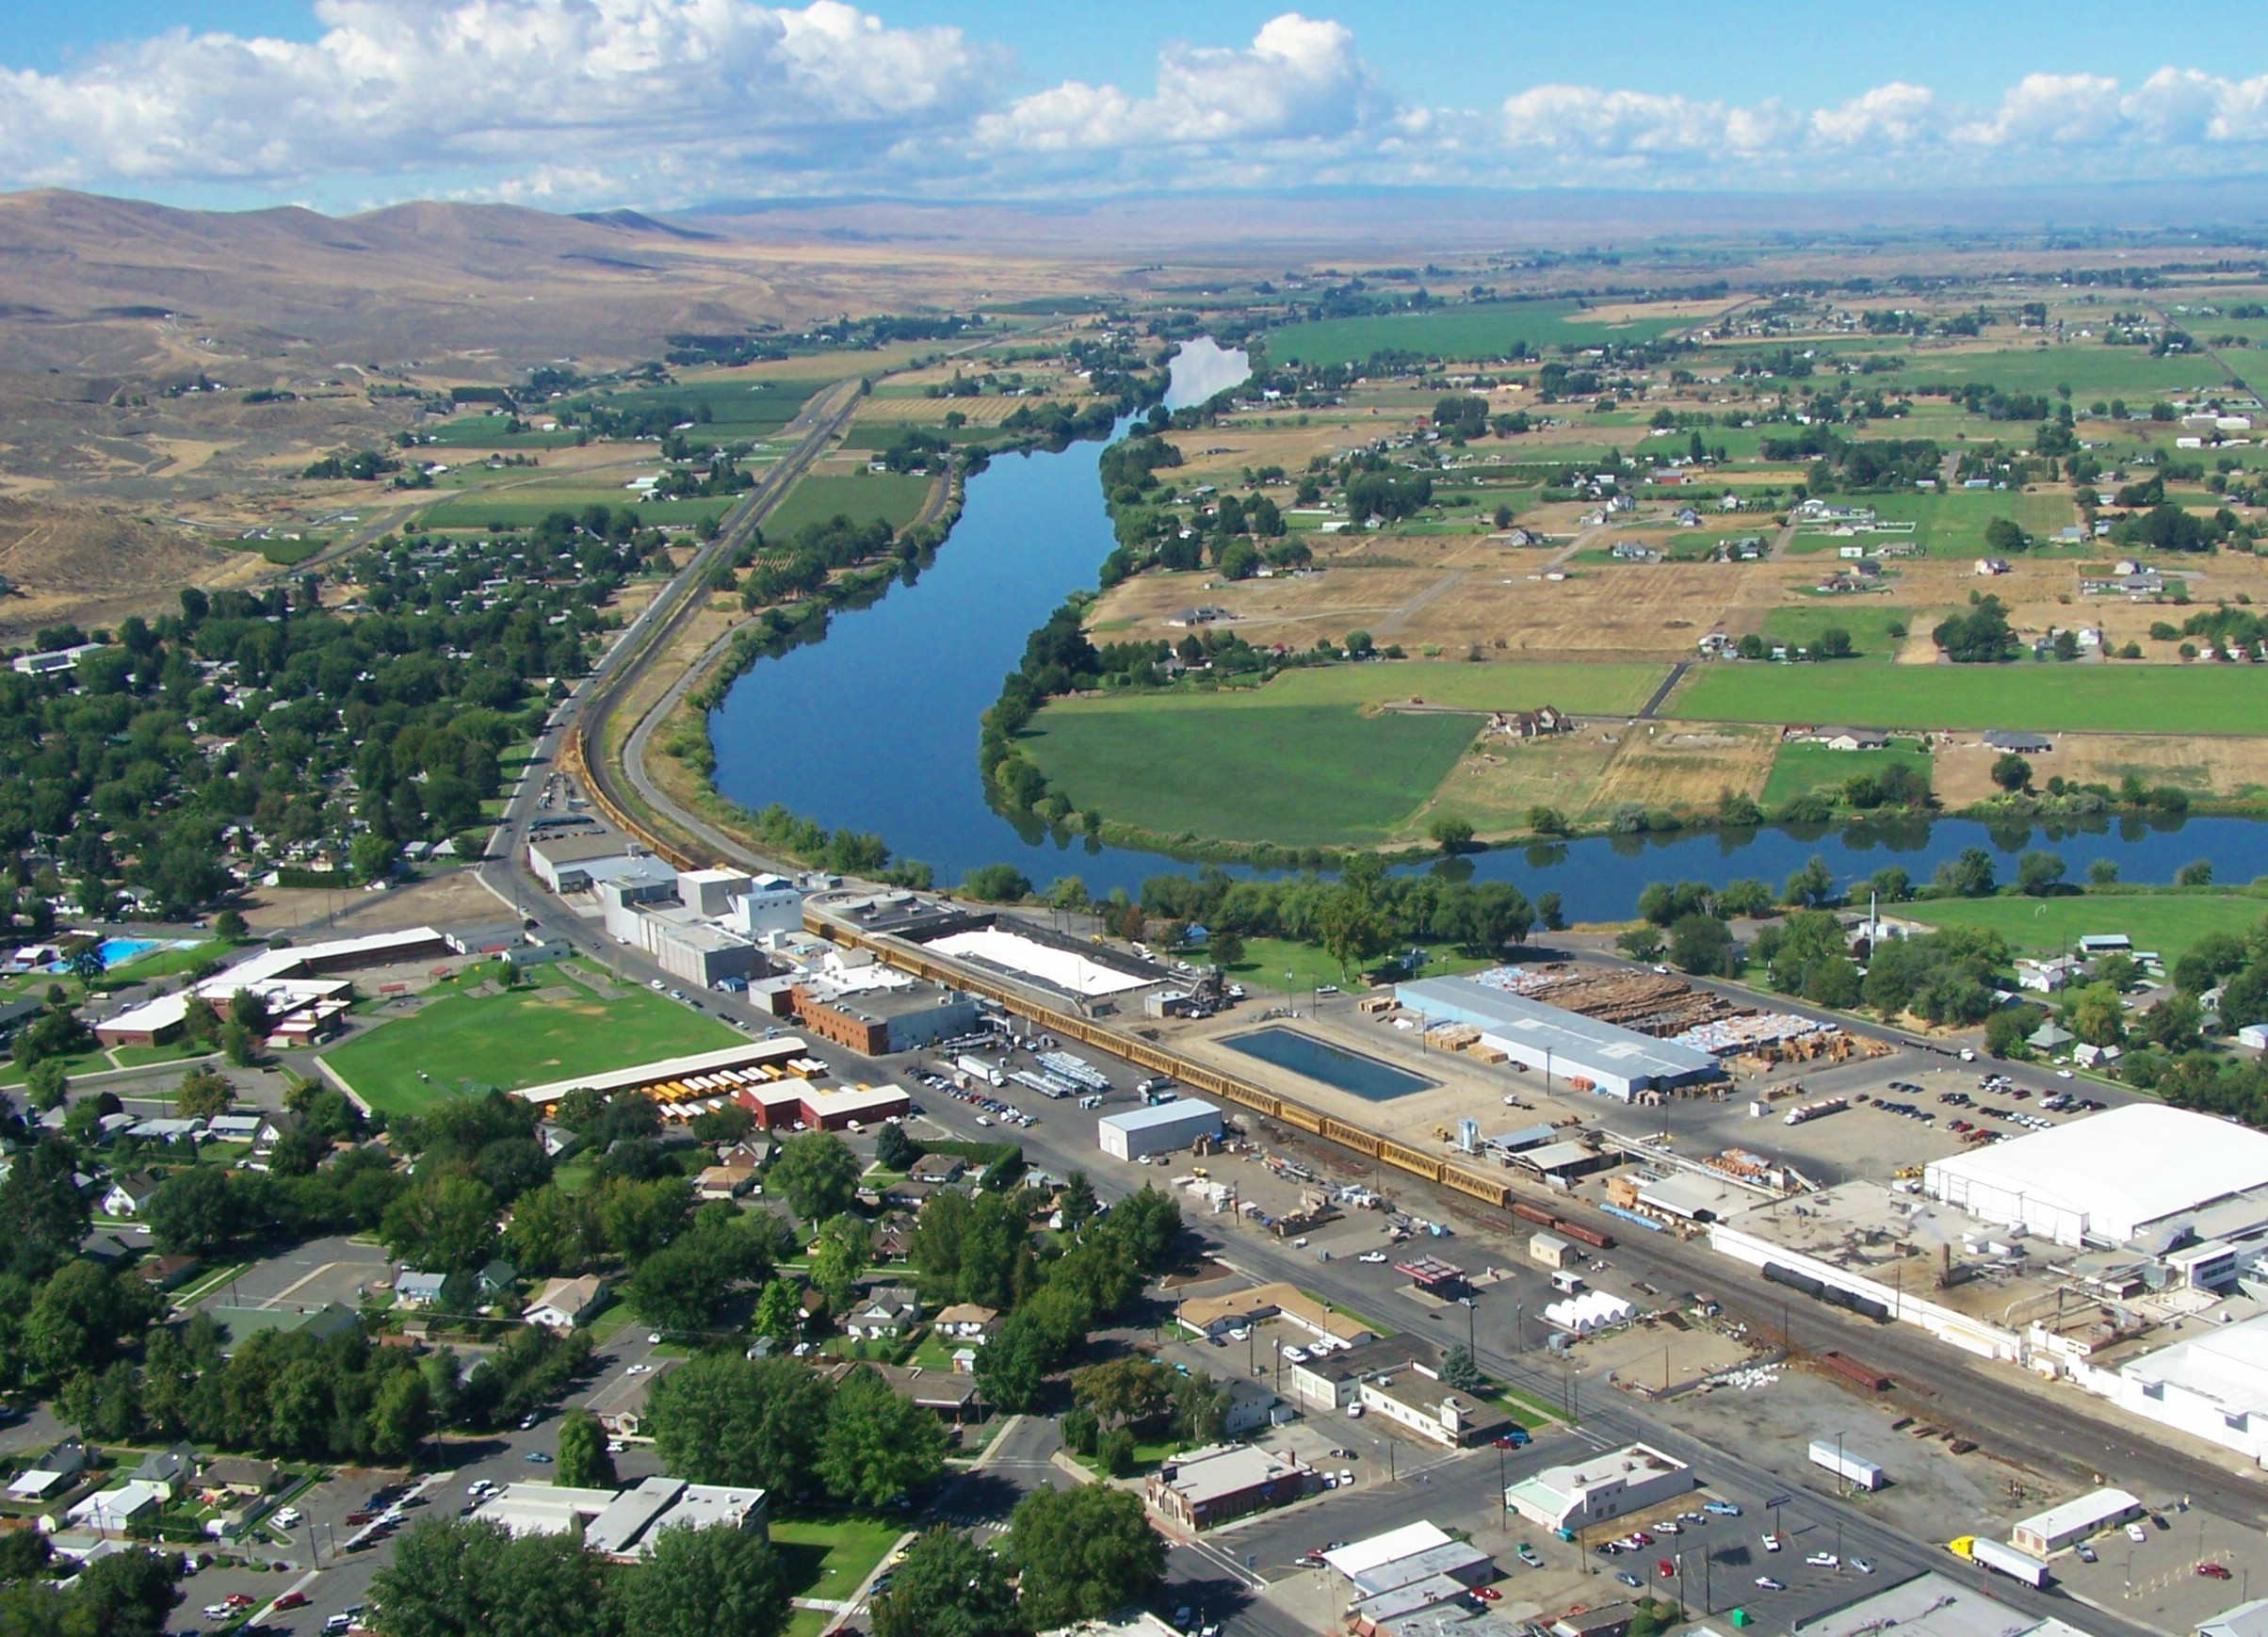
City of Prosser
Housing Incentive & Inclusionary Program

Slide 57
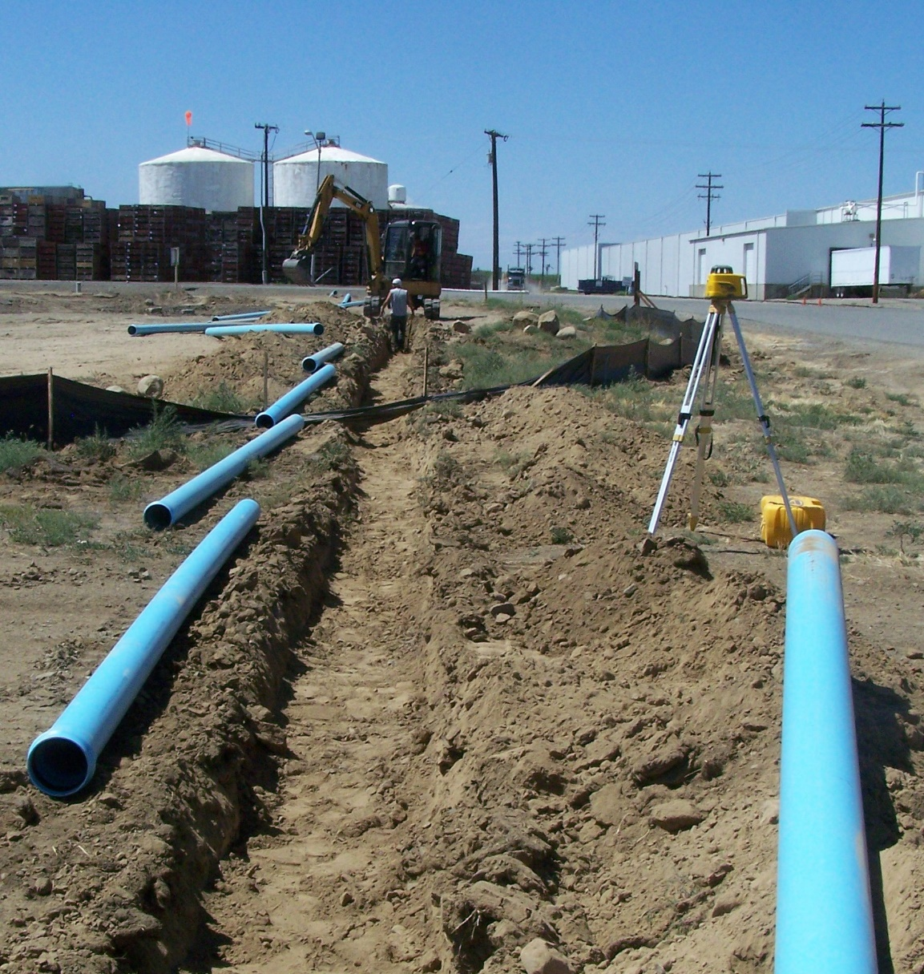
The Ugly Truth
Low Income Housing Formula
Low Income = Government Project = NIMBY

Slide 58
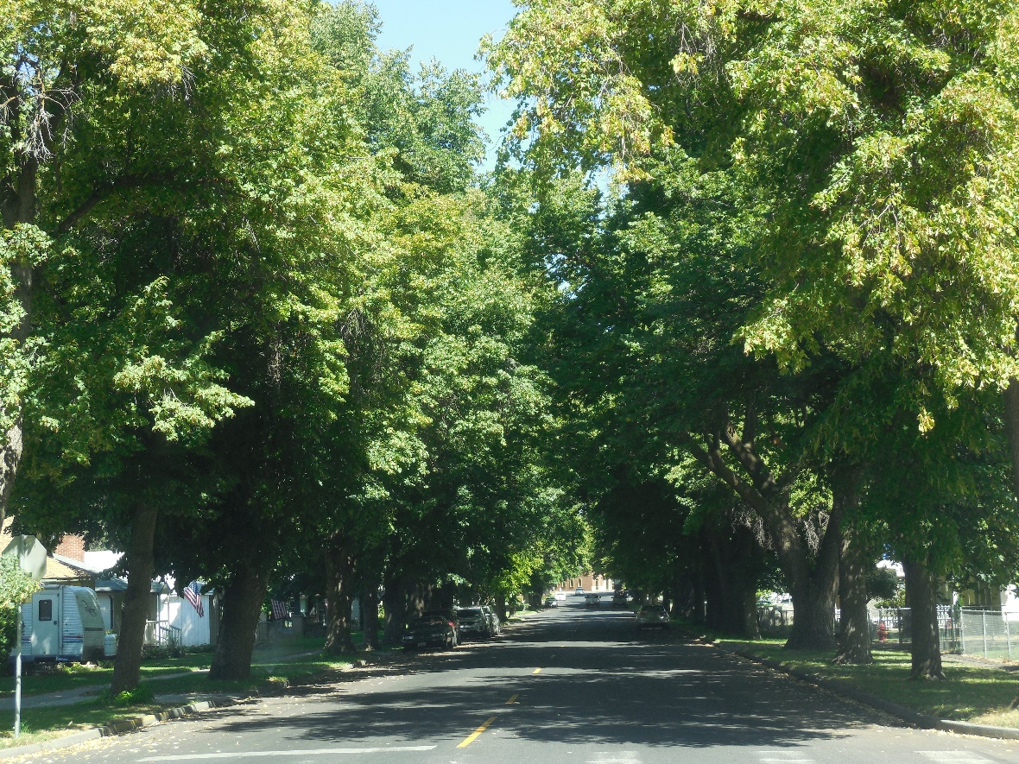
Identifying the Problem
What is it that people dislike?
Concentrated Poverty
Poor Design
Loss of identity (nostalgia)
Perceptions and Myths
How did we address it?
Find a model that disburses
Change design to foster a sense of ownership, Individual driveways, delineated spaces
Focus on what is not changing, making new memories
Studies & Data are helpful but not the answer, find the flaw in the myth and make it toxic to embrace.

Slide 59
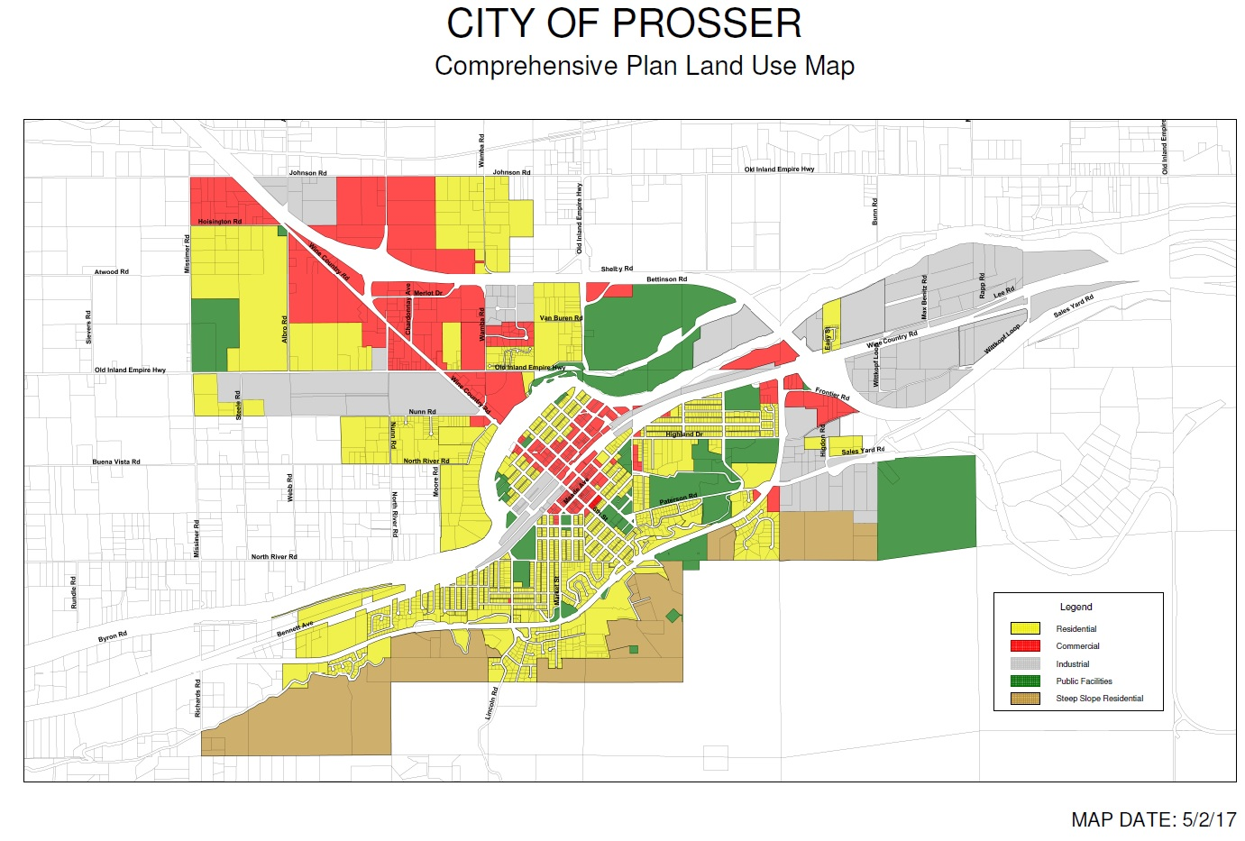
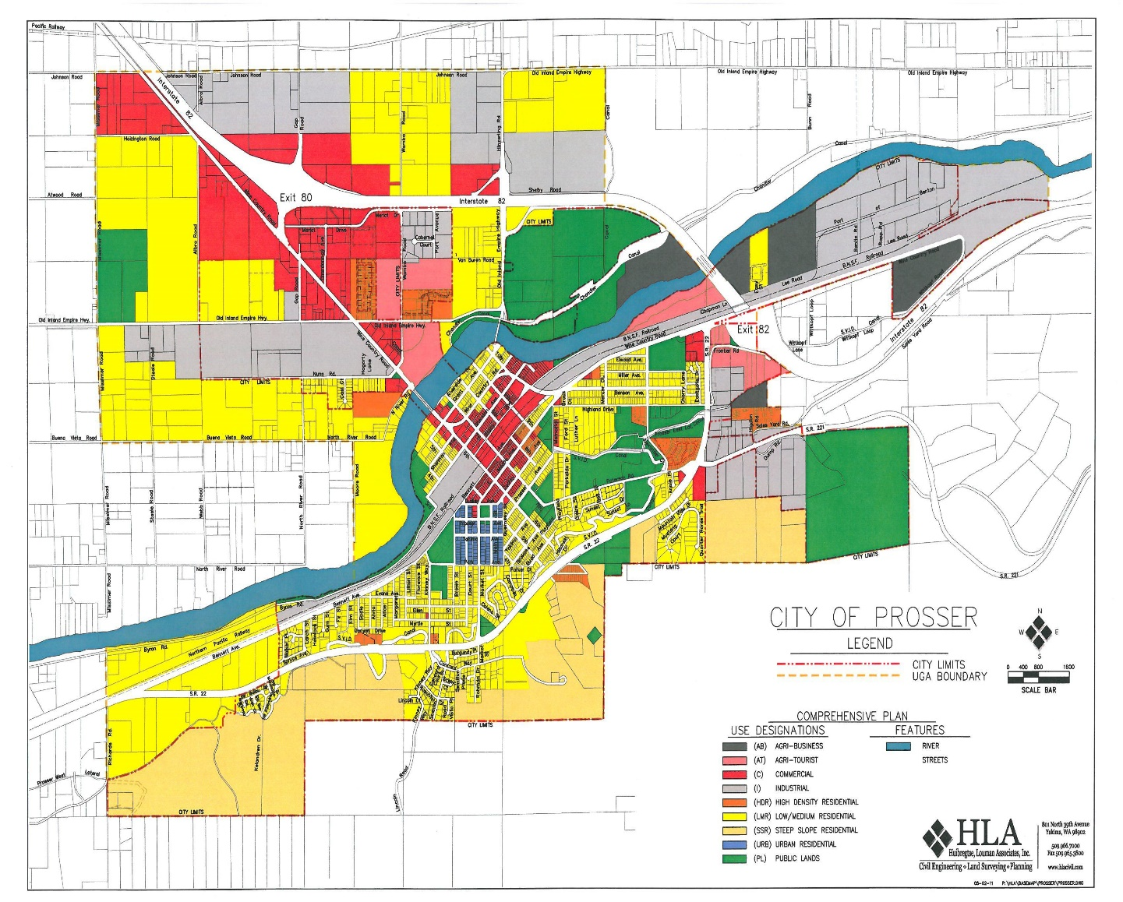
What Prosser Did
Removed barriers to High Density Housing by removing High Density as a land use designation.
After
Before

Slide 60


Follow-Up
Rewrite zoning codes to reflect new Comprehensive Plan Policies.
As part of the 2018 Comprehensive Plan update, we worked in class with the Prosser High School students and during the course of a week we identified policies and goals that were important to the students.
Overwhelmingly, Prosser High School students indicated their desire to see a variety of affordable housing options for both single-family and multi-family units.

Slide 61

Inclusionary Housing
How do you get private for profit developers to the table?
Reduce deed restriction to 20 years
Increased Density
PM 18.95.030 - Earned increased density of up to twenty percent over the otherwise allowable density in the applicable residential zone may be granted to a project if ten percent of dwelling units in the project are provided and retained as affordable owner-occupied homes or affordable rental units for not less than twenty years after the date of the certificate of occupancy is issued for the dwelling unit or project, subject to the following eligibility requirements……
10 single family Units
12 single family Units

Slide 62
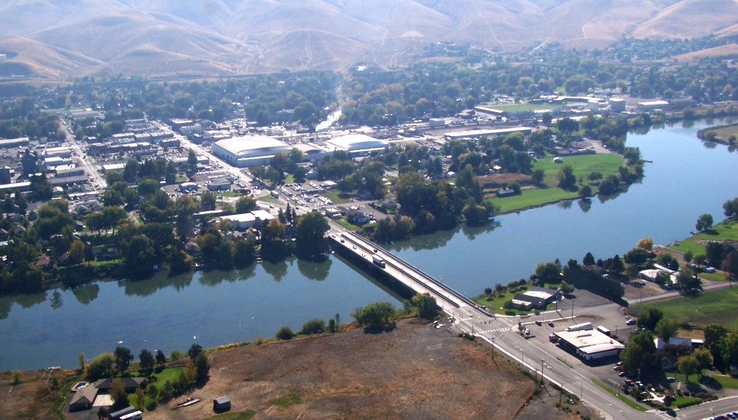
Finally
What we achieved
As of May 2020 we have 3 high density rezones that would not have been possible under the traditional model of high density land use designations.
First application for private development of affordable housing unit (pending).
Changing hearts and minds of the citizens.
What we hope to achieve in the next 24 months
Mixed Development – Both multi-family and multi-income
Address housing affordability through private for profit developments
End poverty concentrations
A true One Community approach to housing.

