Slide 1
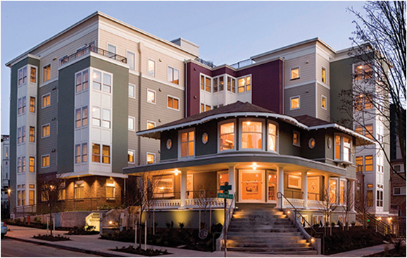
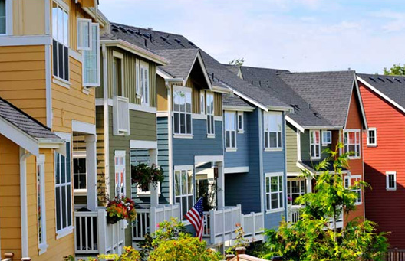
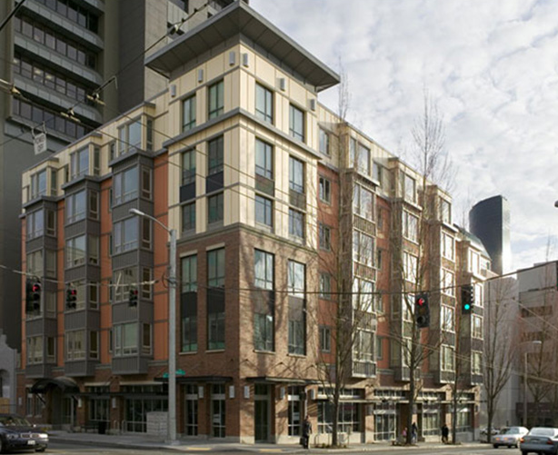
Seattle Housing Strategy

Slide 2
A Growing City
Notes:
After 2-3 below average years for development activity, the current permitting pipeline suggests that the coming 2-3 years will be characterized by above average development. The development market is likely to remain volatile, however, and we’re unlikely to hit the unprecedented highs of 2009 due to a number of factors (lending , markets, etc). That said, certain neighborhoods will see substantial new development. In fact, places like capitol hill, the U district and ballard are already seeing rapid growth.

Slide 3
A Mix of Housing Types

Slide 4
Half the City’s Households are Renters
Source: HUD Consolidated Housing Affordability Strategy Analysis, based on data from the 2005-09 American Community Survey.
Notes:
In Seattle, just over half of our households are renters – we have about 140,000 renter households
About a quarter of those renters have extremely low incomes, as defined by HUD – here in Seattle, less than $18,200 for a single person or $23,400 for a family of 3 (Blue).
The remaining three-quarters of our renters are evenly divided between folks that make more than $48,600 per year for a single person (green),
and this orange slice – people with incomes that fall right in the middle, earning between $18,200 and $48,600 for a single person.

Slide 5
Many Households Pay Too Much
54,000 cost burdened households

Slide 7
Seattle Housing Strategy
1. Optimize investments in affordable housing
2. Make publicly owned land available for housing
3. Reduce the cost of developing new housing
4. Foster an adequate and diverse supply of housing

Slide 8
1. Optimize Investments in Affordable Housing
What we’ve done
Seattle Housing Levy: an essential tool serving primarily extremely low-income households. From 2005-2012 the levy provided $157M for 3,671 rental units and $31M to assist 620 first-time homebuyers.
Strategy
Continue direct investment by renewing the Seattle Housing Levy in 2016
Strengthen the Multi-Family Tax Exemption program
Revise the affordable housing zoning incentives city-wide, including adjusting the fee-in-lieu formula

Slide 9
2. Make Publicly Owned Land Available for Housing
What we’ve done
12th Avenue Arts: Capitol Hill Housing will transform a parking lot into a mixed-use building integrating affordable housing, arts and performance space, retail and nonprofit offices under one roof.
Strategy
Continue to identify opportunities to use City-owned properties for affordable housing, engaging neighboring communities early in the development process.
Work with partner agencies to utilize other public property for housing, including transit oriented development work with Sound Transit.

Slide 10
3. Reduce the Cost of Developing New Housing
What we’ve done
Regulatory Reform Legislation: streamlines regulatory requirements and adds flexibility for developers, home owners, and small business entrepreneurs.
Strategy
Continue further improvements to the permitting process by better aligning processes across departments
Encourage more sustainable housing development that qualifies for the Priority Green Expedited or Facilitated review and permitting processes and expand this program to include upgrades to existing housing
Identify strategies to reduce or eliminate redundant or unnecessary processes or requirements

Slide 11
4. Foster an Adequate and Diverse Supply of Housing
What we’ve done
Enabled and encouraged the creation of affordable infill housing with over 500 mother-in-law apartments and backyard cottages built since 2005 and more than 1,000 rooms built or permitted as a part of 24 micro-housing projects since 2008.
Strategy
Encourage compact development near frequent transit as we work with neighborhoods to consider station area plans, urban design frameworks and zoning proposals
Explore options for encouraging a wider variety of housing types, particularly to address affordability and family housing

