Slide 1
Accessory Dwelling Units
Requirements and Recommendations
Cities and Other Urban Areas
Notes:
Commerce has new guidance for local jurisdictions across the state, the purpose of which is to:
address the need for more housing across the different income spectrum, and
encourage the development of small-scale infill housing in existing neighborhoods across the state.
A lot has changed in 30 years.
WA state is now experiencing a serious housing crisis – housing is increasingly financially out of reach for many households.
There is also a lack of mix of housing types to meet the needs of a diverse growing population.
A recent housing survey, conducted by the Puget Sound Regional Council and the Department of Commerce found that 79% of residents in the central Puget sound are directly impacted by high housing costs and lack of availability.
Recent, Increased Focus on ADUs – Especially given the current affordable housing crisis; (a) one method for increasing housing supply; and (b) may be more affordable to build than other types of AH, esp. AADUs.
ADUs are one opportunity, along with multifamily housing options such as townhomes, cottage housing duplexes and triplexes, that can alleviate the pressure on local governments and communities to address housing availability.

Slide 2
Overview
Introduction & Overview about Accessory Dwelling Units (ADUs)
ADD other bulleted items, as determined by person making the final ADU presentation
Notes:
NOTE TO PRESENTER: ADD more bullet points to suit your particular presentation and identify the key categories you will be covering.

Slide 3
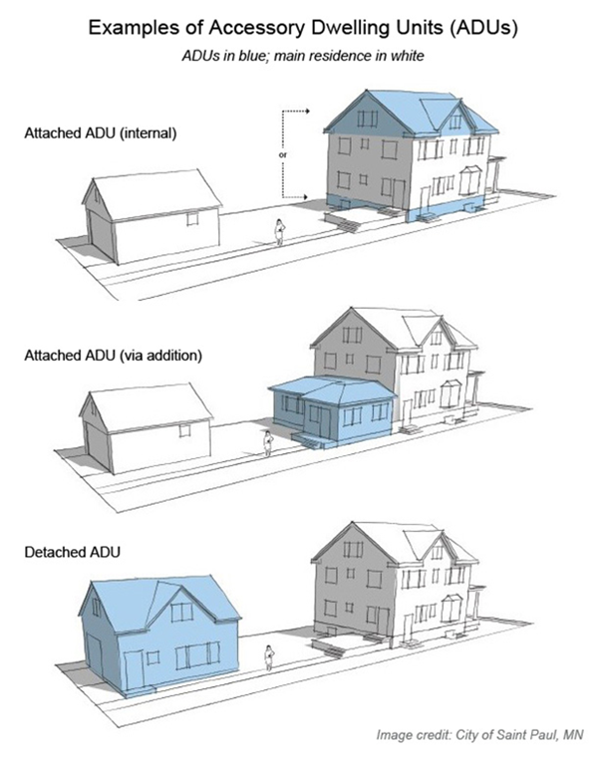
Definition of an Accessory Dwelling Unit
What is an ADU?
A small, self-contained residential unit located on the same lot as an existing single-family home. An ADU has all the basic facilities needed for day-to-day living, such as a kitchen, sleeping area, and a bathroom.
Types of Accessory Dwelling Units
Attached ADU (AADU)
Detached ADU (DADU)
Notes:
Basic Definition
An accessory dwelling unit (ADU) is a small, self-contained residential unit located on the same lot as an existing single-family home. An ADU has all the basic facilities needed for day-to-day living, such as a kitchen, sleeping area, and a bathroom.
Basic Types
Attached ADU (AADU)
Within existing residential structure (e.g., existing basement, attic, or attached garage OR A new addition to an existing residence)
Detached ADU (DADU)
Lots of different names – Backyard Cottage, etc.

Slide 4
ADUs are One Strategy to Allow More Housing
Allow moderate density housing and ADUs in existing neighborhoods
Leverage high-capacity transit with more intense development within walking distance
Rezone strip commercial to also allow more housing
Provide incentives for affordable housing, home sharing, etc.
Notes:
ADUs are one type of housing that can address the need for increasing the amount and affordability of housing, in addition to many other strategies such as…Read bullets 2-4
The benefits of encouraging the construction of new ADUs includes:
Adding to the diversity of housing options, alongside middle housing options such as duplexes, stacked flats, triplexes fourplexes and townhouses.
Providing a housing type that blends in well with existing single-family residential neighborhoods.
Catering to our state’s changing demographics, such as more seniors and smaller household sizes.
Providing housing that is typically more affordable than traditional single-family homes.
Adding housing units without expanding urban growth areas.
Correcting historic economic and racial exclusion by opening up single-family neighborhoods to more diverse housing and household types.
Reducing climate impacts because an ADU tends to be smaller and use less energy than a traditional single-family home.

Slide 5
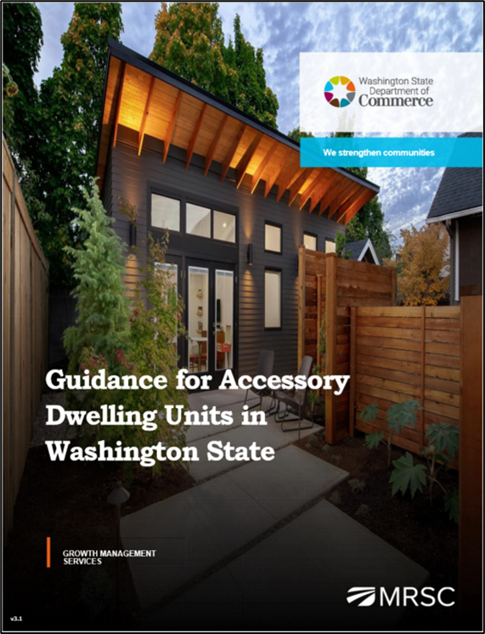
New Commerce ADU Guidance (June ‘23)
New Requirements for Cities/Growth Areas
Recommendations & Key Considerations
Other Programmatic Elements to Consider
Recorded Webinars
PowerPoint Slides
Guidance for Accessory Dwelling Units in Washington State
Notes:
In developing the new guidance, and working on the ADU project, Commerce reviewed all related GMA amendments since 1994, reviewed existing case law, pulled together a task force, sent multiple drafts out for review, assembled a large collection of current best practices, and conducted direct interviews and consultation with cities and counties across the state.
The new guidance is structured under the following categories:
Requirements for cities and other urban areas – cities with a population greater than 20,000, counties with a population greater than 125,000, and counties required to plan under the GMA.
Recommendations for cities and other urban areas – not requirements but suggestions for expanding the options for ADUs in towns, cities, and other urban areas including unincorporated urban growth areas and limited areas of more intensive development. These recommendations include allowing manufactured or prefabricated units, streamlining ADU permitting processes, and offering incentives to encourage ADUs that are affordable to lower-income households.
Key considerations for counties (rural and resource lands) – ADU provisions in rural and resource areas must be accompanied by measures to protect rural character, conserve resource lands, and limit density and sprawl.
Other programmatic elements to consider – such as address the use of ADUs as short-term rentals, provide information on landlord-tenant laws for prospective ADU owners and tenants, and creating programs to encourage the legalization of unpermitted ADUs.
Also, for local governments Commerce is recording ADU webinars such as this one for cities and urban areas, and for counties and rural areas, and developing PowerPoint slides to assist in discussion and briefings on the value and importance of this housing type.

Slide 6
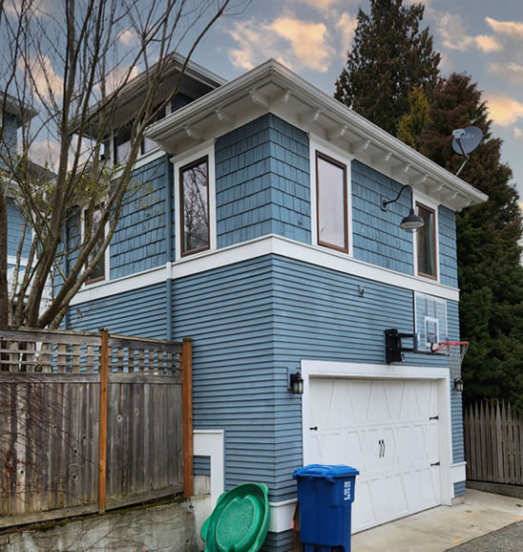
HB 1337 (2023) Accessory Dwelling Units
Local governments must, 6 months after the periodic update due date:
Allow at least two ADUs per lot in all GMA urban growth areas
May not require the owner to occupy the property
Allow the sale of ADUs as independent units
Allow an ADU of at least 1,000 square feet and must adjust zoning to be consistent with HB 1337
Set consistent parking requirements based on distance from transit and lot size
Notes:
Much of what has come to pass in HB 1337 came from a larger body of work known as the Collaborative Roadmap Phase III project – over a period of two years the task force presented findings, concepts and recommendations to the Washington State Legislature about proposed reforms to the state’s growth policy framework. Accessory dwelling units were a top contender in a list of housing types to be required or incentivized.
For starters, HB 1337, requires jurisdictions to, within 6 months after their periodic update due date:
Allow two ADUs per lot in all GMA urban growth areas – effectively allowing 3 units in all urban areas – the principal unit, plus two ADUs.
May not require owner occupancy for any unit on the property – the rationale for this requirement has been historically based on apprehensions about noise and other negative impacts that might be caused by unsupervised renters, and perhaps perceptions of conflicts around undefined shared space. But other local code provisions relating to those types of nuisance concerns can be adopted and applied to residential properties occupied by either owners or renters.
Must allow sale as condominiums – jurisdictions may not prohibit the sale or other conveyance of a condominium unit independently of a principal unit solely on the grounds that the condominium unit was originally built as an accessory dwelling unit.
Must allow at least 1,000 square feet size units – defined in gross floor area which means the interior habitable area of a dwelling unit including basements and attics but not including a garage or accessory structure.
Cannot require parking if within ½ mile of a major transit stop – Many lots in established areas aren’t large enough to support both an ADU and off-street parking, effectively prohibiting ADU development. This means that ADUs are often limited to larger lots that can accommodate parking and other site features. Removing off-street parking requirements for ADUs can help to open up possibilities for placing ADUs, especially in urban areas with transportation options.

Slide 7
HB 1337 (2023) Accessory Dwelling Units
May not charge more than 50% of impact fees charged for the principal unit
Allow ADUs on any lot that meets the minimum lot size required for the principal unit
May not require design review standards that are more restrictive than those for the principal unit
The new state law does not require ADUs to be allowed on lots with critical areas or their buffers
The new state law addresses covenants and restrictions, protecting any local government if they issue a permit for an ADU on a lot with a covenant restricting an ADU, from civil liability
Applies to all cities and their urban growth areas (UGAs)
Notes:
Impact fees are limited to 50% of the principal unit – ADUs are generally smaller than standard single-family homes, they typically have fewer people living in them, and cause fewer impacts on transportation, parks and schools.
Allow two ADUs on all lots that meet minimum lot size in zoning districts that allow for single-family homes – the ADUs may be:
Two attached accessory dwelling units (ADUs) such as unit in a basement, attic, or garage.
One attached accessory dwelling unit and one detached accessory dwelling unit (DADU), or
Two detached accessory dwelling units, which may be comprised of either one or two detached structures.
A conversion of an existing structure, such as a detached garage.
May not impose setback requirements, yard coverage limits, tree retention mandates, restrictions on entry door location, aesthetic requirements or design review standards that are more restrictive than those for the principal unit.
May not requirement street improvements as a condition of permitting accessory dwelling units.
The bill addresses covenants and restrictions, protecting any local government from civil liability if they issue a permit for an ADU on a lot with a covenant restricting an ADU – restricting covenants from actively or effectively prohibiting ADUs within a UGA.

Slide 8
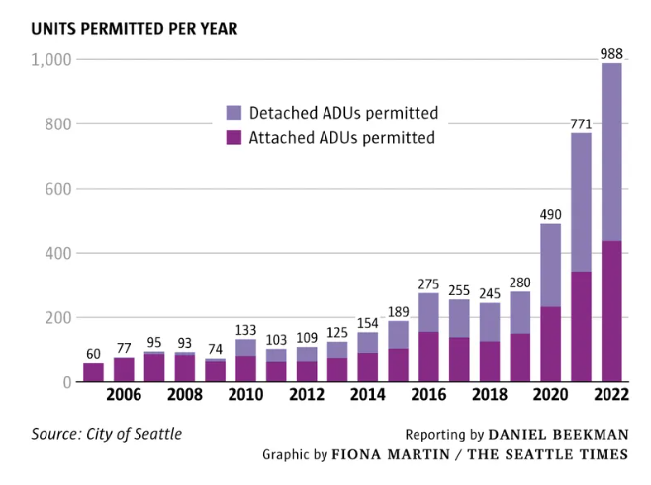
Expect Incremental Development
Notes:
In 1994 the construction of ADUs was stagnant, and has been, up until more recently. Some cities and counties have reported that newer development regulations have led to an increase in the production of ADUs, and we know that there is more construction underway.
Seattle, for example, had almost 1,000 ADUs permitted in 2022, which is up from 280 in 2019 – representing a 250% increase in construction of ADUs. Other cities such as Olympia, Burien, Tacoma and Kirkland have also seen increases in the permitting and production of ADUs.
We expect to see the production of ADUs increase across the state, in jurisdictions of all sizes – based on the high demand for housing and affordable housing, and housing reform.
As more and more people move to urban areas, ADUs will provide an additional housing option for seniors, students, teachers, health care workers, individuals with disabilities, and moderate-income renters and homeowners.

Slide 9
Requirements for Cities & Urban Growth Areas
SUMMARY
Allow at least two ADUs per lot
Do not require owner-occupancy
Allow separate sale of ADUs
Revise off-street parking requirements for ADUs
Set maximum size limits at no less than 1,000 sq. ft.
Reduce barriers from setbacks and other related regulations
Limit use of design standards
Reduce or waive permit application fees, impact fees, system development charges, and other ADU-related fees where applicable

Slide 10
A. Requirements for Cities & Urban Growth Areas
1. Allow at least two ADUs per lot
Two ADUs on a legal lot, which must be allowed to be any combination of:
One attached and one detached;
Two attached ADUs; or
Two detached ADUs
Duplexes, triplexes, townhouses, and multifamily structures may have ADUs (RCW 36.70A.696)
Notes:
1. Allow two ADUs per lot
At least two ADUs on a legal lot in all zoning districts within an urban growth area that allow for single-family homes.
One attached and one detached;
Two attached ADUs; or
Two detached ADUs
Must allow ADUs on parcels that meet the minimum lot size required for the principal unit.
May impose a limit of two ADUs, in addition t the principal unit, on a residential lot of < 2,000 sq. ft.
Duplexes, triplexes, multifamily structures may have ADUs (RCW 36.70A.696) – https://app.leg.wa.gov/Rcw/default.aspx?cite=36.70A.696
Ex. of Kirkland

Slide 11
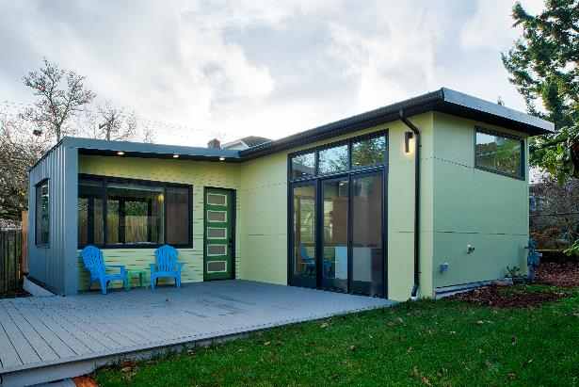
A. Requirements for Cities & Urban Growth Areas
2. May not require owner occupancy
The primary residence owner cannot be required to live on-site (i.e., neither in the primary residence nor an accessory dwelling unit)
Smith Gillman Cottage converted garage. Credit: CAST architecture.
Notes:
2. May not require owner occupancy
The primary residence owner is not required to live on-site (i.e., neither in the primary residence nor the accessory dwelling unit).

Slide 12
A. Requirements for Cities & Urban Growth Areas
3. Allow separate sale of ADUs
This allows for a new way to promote home ownership, since an ADU is usually a lower-cost housing option than a single-family residence
A few local governments in Washington State have allowed ADUs to be sold as condominiums for several years (before the passage of EHB 1337), including:
Seattle
Spokane
Kirkland
Notes:
3. Allow separate sale of ADUs
Must allow the separate sale of ADUs, either as condominiums or another form of “for sale” ownership – jurisdictions may not prohibit the sale or other conveyance of a condominium unit independently of a principal unit solely on the grounds that the condominium unit was originally built as an accessory dwelling unit.
This allows for a new way to promote home ownership, since an ADU is usually a lower-cost option than a single-family residence.
A few local governments in Washington State have allowed ADUs to be sold as condominiums for several years (before the passage of EHB 1337).

Slide 13
A. Requirements for Cities & Urban Growth Areas
4. Revise off-street parking standards for ADUs in specified locations (per EHB 1337)
May not require any off-street parking for ADUs within ½ mile walking distance of a major transit stop
May not require >one off-street parking space/unit on lots smaller than 6,000 sq. ft.
May not require >two off-street parking spaces/unit on lots greater than 6,000 sq. ft.
A local government can ask to increase its ADU parking standards – request must be supported by an empirical study and submitted to Commerce
Consider reducing parking requirements for ADUs beyond the statutory standards
Notes:
4. Revise off-street parking standards for ADUs in specified locations (per EHB 1337)
May not require any off-street parking for ADUs within ½ mile walking distance of a major transit stop
May not require >one off-street parking space/unit on lots smaller than 6,000 sq. ft.
May not require >two off-street parking spaces/unit on lots greater than 6,000 sq. ft.
A local government can ask to increase its ADU parking standards – request must be supported by an empirical study and submitted to Commerce.
Rationale must be related to a safety need or a “consistency with detached housing’s parking standards” claim.
Consider reducing parking requirements for ADUs beyond the statutory standards, except in the cases where there is truly:
No on-street parking available; or
Unique site conditions require it, such as areas not well served by public transit.

Slide 14
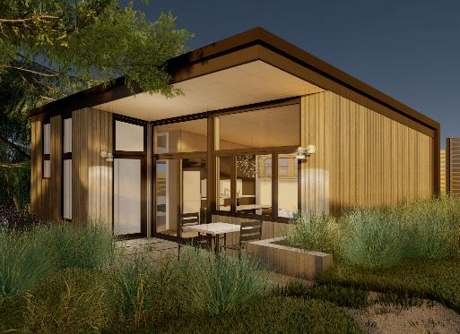
A. Requirements for Cities & Urban Growth Areas
5. Set maximum size limits at no less than 1,000 sq. ft.
ADUs are, by definition, “accessory” to the primary residence, so will often be smaller in size than the primary housing unit.
Cedar Cottage Seattle ADU Pre-Approved Plan. Credit: CAST Architecture.
Notes:
5. Must allow at least 1,000 square feet size units – defined in gross floor area, which means the interior habitable area of a dwelling unit including basements and attics but does not include a garage or any other accessory structure on a lot.

Slide 15
A. Requirements for Cities & Urban Growth Areas
6. Reduce barriers from setbacks and other related regulations
May not impose may not stricter standards for ADUs than those imposed on the principal units for:
Setbacks (including no rear setbacks for ADUs on lots with alleys)
Yard coverage
Tree retention mandates
Minimum roof height of 24 feet
Must allow ADU conversions of existing structures, including detached garages (even if they violate current setback or lot coverage requirements)
Notes:
6. Reduce barriers from setbacks and other ADU regulations
May not impose requirements that that are more restrictive than those for the principal unit:
setback requirements,
yard coverage limits,
tree retention mandates,
Minimum roof height of 24 feet (unless a lesser height is imposed on the primary residence).
Allow ADU conversions of existing structures (including conversion of both attached and detached garages).

Slide 16
A. Requirements for Cities & Urban Growth Areas
7. Limit use of design standards
May not impose stricter standards for ADUs than those imposed on the principal units regarding:
Restrictions on entry door location
Aesthetic requirements
Design review requirements
Notes:
7. Limit use of design standards
ONLY IF needed to enhance local support of ADUs
IF NEEDED, focus on a small set of design issues that are likely to enhance local support of ADUs
IF NEEDED, limit design review to proportionality of primary residence and proximity of neighboring homes (e.g., location of ADU entries & windows)
Administrative design review with building permit application (vs. (CUP)
Don’t require the design of an ADU to be compatible with the existing primary residence
“Careful about what you wish for, you might just get it”

Slide 17
A. Requirements for Cities & Urban Growth Areas
8. Reduce or waive ADU-related fees and charges
Statutory Limitation:
Impact fees – limited to 50% imposed on a principal unit (Note: may be reduced further, if there is an adequate policy basis)
Other Non-Statutory Options to Consider:
Additional impact fee reductions/waivers
Application fees
System development charges (aka “utility connection fees”)
Other ADU-related fees, where applicable
Notes:
8. Reduce or waive fees and charges
Statutory Limit:
Impact fees are limited to 50% of the principal unit.
Other Non-statutory Options:
Impact fees may be further reduced or even waived, if there is an adequate policy basis. Rationale: ADUs are generally smaller than standard single- family homes and typically have fewer people living in them, resulting in fewer impacts on transportation, parks and schools.
Application fees
Based on police power and if the local decision is made to prioritize new ADU construction
System development charges (aka “utility connection fees”)
Especially compelling, if the ADU doesn’t need a new line and/or separate meter
Other fees, if there are any others imposed by your community

Slide 18
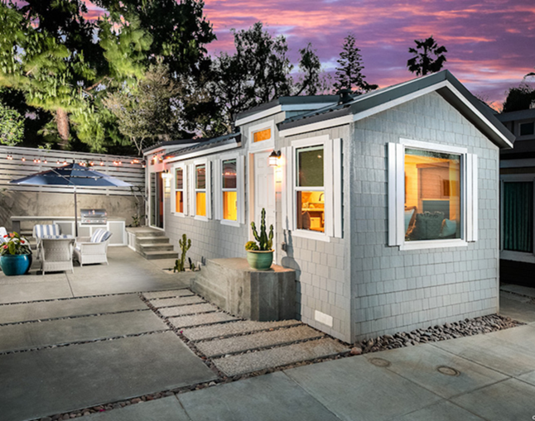
Recommendations for Cities & Other Urban Areas
SUMMARY
Allow pre-fabricated ADUs
Streamline ADU permitting processes
Offer incentives to encourage ADUs that are affordable to lower-income households
Credit: Eddie Bojorquez/Crest Backyard Homes.
Notes:
Note: The photo on this slide is an example of a prefabricated ADU.

Slide 19
B. Recommendations for Cities & Urban Areas
1. Allow prefabricated ADUs
Prefabricated units can be:
Less expensive and faster than ADUS built on-site
More sustainable, due to less waste generated by factory-built units
Less impact on neighboring properties during “construction”
State law about manufactured homes may come into play
Factory-built ADUs must be inspected by L&I at the factory
Home-made tiny homes on wheels are not currently allowed as ADUs on a residential lot
Notes:
Allow prefabricated ADUs
Prefabricated units can be:
less expensive than ADUS built on-site More sustainable, due to less waste generated by factory-built units.
Take less time to install than on-site construction.
Less impacts on neighboring properties during “construction” (such as less noise and on-street parking conflicts).
State law re: manufactured homes may come into play, such as adherence to L&I standards.

Slide 20
B. Recommendations for Cities & Urban Areas
2. Streamline ADU permitting processes
Allow ADUs ‘by-right’ (permitted use) with administrative review; no discretionary review or public hearing/public meeting
Consider an expedited permit process
Notes:
2. Streamline ADU permitting processes
Allow ADUs ‘by-right’ (permitted use) without discretionary review or public hearing
Consider an expedited permit process

Slide 21
B. Recommendations for Cities & Urban Areas
3. Offer incentives to encourage ADUs that are affordable to lower-income households
ADUs are usually more affordable than single-family, primary residences, but usually not affordable to lower-income households
In most cases, AADUs are less costly to produce than DADUs
Some local government programs provide incentives when:
80% or less of average median income (AMI)
Guaranteed to be affordable for a long period of time
Explore partnering with local nonprofits, including Community Land Trusts
Notes:
3. Offer incentives to encourage ADUs that are affordable to lower-income households
ADUs are usually more affordable than single-family, primary residences, but not in most cases, affordable to lower-income households
In most cases, Attached ADUs are less costly to produce than Detached ADUs
Some local government programs provide incentives when:
80% or less of average median income (AMI)
Guaranteed to be affordable for a long period of time
Explore partnering with local nonprofits, including Community Land Trusts
Unlikely to be used in rural areas, which is why it is in the second category of “Just for Cities and Urban Areas”

Slide 22
Other Programmatic Elements to Consider
SUMMARY
Address the use of ADUs as short-term rentals
Provide user-friendly communication materials
Provide information on landlord-tenant laws for prospective ADU owners and ADU tenants
Provide information on ADU financing and funding programs
Create a program to encourage legalization of unpermitted ADUs
Provide pre-approved ADU plans

Slide 23
D. Other Programmatic Elements to Consider
1. Address the use of ADUs as short-term rentals
In general, short-term rentals (STRs) remove housing units from the local housing stock
If maintaining an ample housing supply for residents is a local priority, local government regulations should fall into one of two categories:
ADUs not allowed to be used at all as STRs
Limited use of ADUs as STRs
Notes:
Address the use of ADUs as short-term rentals
Short-term rentals (STRs) do not add to the local housing stock (and actually remove a unit from the housing market)
STRs are really a commercial/hospitality operation, and not a residential use.
Local government regulations generally fall into one of three categories
ADUs not allowed to be used as STRs
Limited use of ADUs as STRs

Slide 24
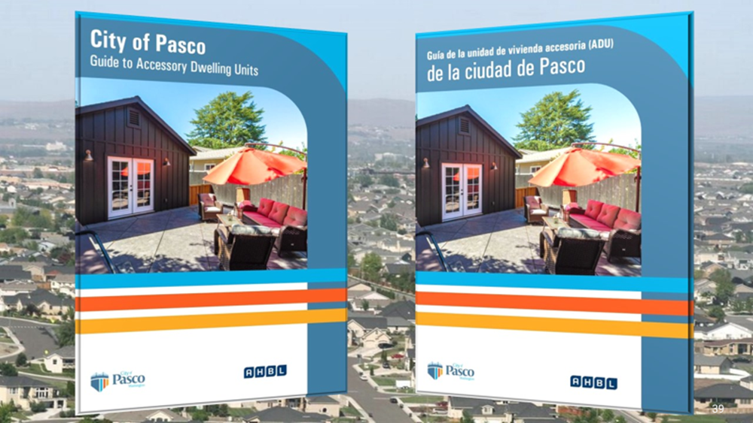
D. Other Programmatic Elements to Consider
2. Provide user-friendly communication materials
There are several good examples from Washington local governments:
ADU websites/webpages
One-two page handouts
Guidebooks
Credit: City of Pasco, WA.
Notes:
2. Provide user-friendly communication materials
There are several good examples from Washington local governments:
ADU websites/webpages
One-two page handouts
Guidebooks
The example shown on this slide is from Pasco and has been translated into Spanish.
Note: The Commerce ADU Guidance document contains some example you can cite.

Slide 25
D. Other Programmatic Elements to Consider
3. Provide information on landlord-tenant laws for prospective ADU owners and ADU tenants
There is lots of good information about Landlord-Tenant rights and requirements, both at the State and local levels
None of this information pertains solely to ADU owners or tenants
Notes:
3. Provide information on landlord-tenant laws for prospective ADU owners and ADU tenants
There is lots of good examples of information about Landlord-Tenant rights and requirements, provided at both the State and local levels
Very little of this information pertains solely to ADU owners or tenants.

Slide 26
D. Other Programmatic Elements to Consider
4. Provide information on ADU financing and funding programs
Limitations in Washington State on how local governments can provide financial assistance to people
One option for local governments: Be a resource/clearinghouse of information related to:
Financing options available to people wanting to rent out an existing ADU or construct a new ADU
Potential tax benefits of renting out an ADU
Notes:
4. Provide information on ADU financing and funding programs
Olympia’s OlyFed Bank has developed specialized lending products that support ADU construction. OlyFed claims to be one of the only financial institutions in the area with a dedicated plan for funding ADUs.
Potential idea:
Be a clearinghouse that provides homeowners interested in building an ADU with existing financial institutions
Other?
In addition, the Washington State Legislature has expanded an existing three-year property tax exemption for any improvements to a single-family dwelling in RCW 84.36.400 to include the construction of ADUs. The program was initiated through 2SSB 6231 (Chapter 204, Laws of 2020) and stipulates that dwelling units may be either attached to or within the single-family dwelling or a detached unit located on the same real property.

Slide 27
D. Other Programmatic Elements to Consider
5. Create a program to encourage legalization of unpermitted ADUs
There are many unpermitted accessory units in communities throughout our State
Goal: Allow existing unpermitted ADUs to get approval as legal ADUs, subject to applicable requirements
For example, fire and health/safety standards must be addressed before legalization is allowed to occur
Notes:
5. Create a program to encourage legalization of unpermitted ADUs
It is believed that there are many unpermitted in communities throughout our State.
Existing permitted nonconforming ADUs may be approved, subject to applicable requirements
Health/safety standards must be addressed before legalization can occur.
Allow for an increase in the size of an attached ADU for more efficient use of floor area (e.g., an existing garage or basement being used as an ADU)
Note: The Commerce ADU Guidance document contains some example you can cite.

Slide 28
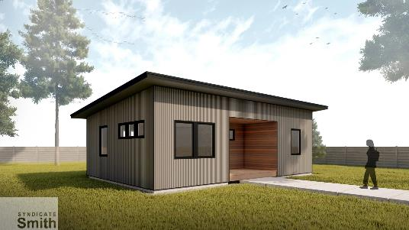
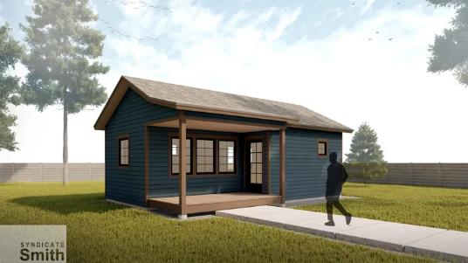
D. Other Programmatic Elements to Consider
6. Provide pre-approved ADU plans
Reduces the time needed to review plans, since they have already been “pre-approved”
An increasingly popular approach
Some issues to consider:
Need architects willing to participate in such a program
Even small changes to a pre-approved plan may result in the need for an individual review of the revised ADU plan (reducing the savings in review time)
Credit: Syndicate Smith Architect.
Notes:
6. Provide pre-approved ADU plans
An increasingly popular approach that:
Reduces design costs to applicants
Reduces the time needed to review plans, since they have already been “pre-approved”
Some issues to consider:
Need access to architects willing to participate in such a program
Even small changes to a pre-approved plan may result in the need for an individual review of the revised ADU plan (negating the time savings)
Notes:
The images on this slide are pre-approved ADU options from the city of Leavenworth.
The Commerce ADU Guidance document contains some example you can cite.

Slide 29
Comments and Questions

Slide 30
For more information:
Commerce Team
Anne Fritzel, AICP - anne.fritzel@commerce.wa.gov
Catherine McCoy - catherine.mccoy@commerce.wa.gov
Other Resources
Guidance for Accessory Dwelling Units in Washington State
Notes:
Commerce Team
Anne Fritzel, AICP - anne.fritzel@commerce.wa.gov
Catherine McCoy - catherine.mccoy@commerce.wa.gov
Other Resources
Guidance for Accessory Dwelling Units in Washington State
NOTE TO PRESENTER: Add other resources as you feel is appropriate.

Slide 31
