Slide 1
Accessory Dwelling Units
Requirements and Recommendations
Counties – Urban Growth Areas, LAMIRDs, Rural Lands, and Designated Natural Resource Lands
Notes:
A lot has changed in 30 years.
WA state is now experiencing a serious housing crisis – housing is increasingly financially out of reach for many households.
There is also a lack of mix of housing types to meet the needs of a diverse growing population.
WA state wants most of this housing growth to happen in urban areas.
ADUs are one opportunity, along with multifamily housing options such as townhomes, cottage housing duplexes and triplexes, that can alleviate the pressure on local governments and communities to address housing availability.

Slide 2
Overview
Overview about Accessory Dwelling Units (ADUs) in Washington State
County Approaches for:
Unincorporated urban growth areas
LAMIRDs
Rural lands
Designated natural resource lands
ADD more agenda items to this slide, as needed by your own presentation
Notes:
Note: ADD more agenda items to this slide, as needed by your own presentation

Slide 3
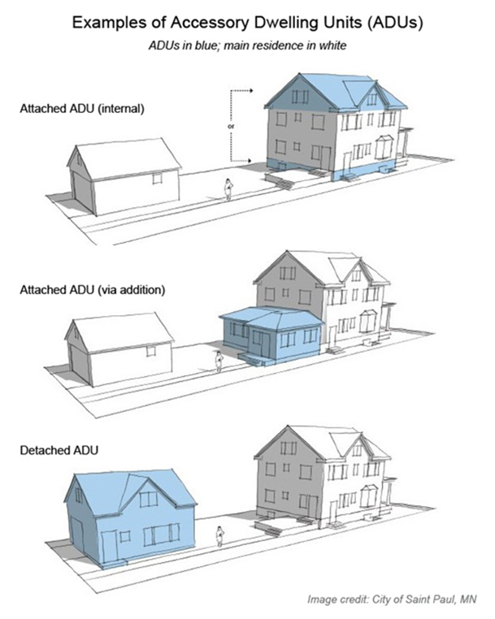
Definitions: RCW 36.70A.696
Dwelling unit: a residential living unit that provides complete independent living facilities for one or more persons and that includes permanent provisions for living, sleeping, eating, cooking, and sanitation.
Accessory dwelling unit (ADU): a dwelling unit located on the same lot as a single-family housing unit, duplex, triplex, townhome, or other housing unit.
Detached accessory dwelling unit (DADU): an accessory dwelling unit that consists partly or entirely of a building that is separate and detached from the principal unit.
Notes:
First - What is an ADU? Well, it is a dwelling unit, which means it has complete independent living facilities for one or more persons with provisions for living, eating, cooking, and sanitation. It does not refer to sleeping cabins or tiny homes on wheels, but it could be a unit manufactured somewhere else and installed on the property connected to sewer and water, or other utilities.
ADUs may be attached or detached. Detached means free standing, and attached means either within in a home, such a basement or attic unit, or beside the home. Note: Refer to the graphic on the slide..
An ADU is also accessory to the primary unit, meaning it is generally smaller and may be dependent on the primary unit for access or utilities. It is not a duplex, where the two units are equal. ADUs are often rented to friends and family, where it may be considered affordable, or it may be rented on the private market, where it is generally not considered affordable.

Slide 4
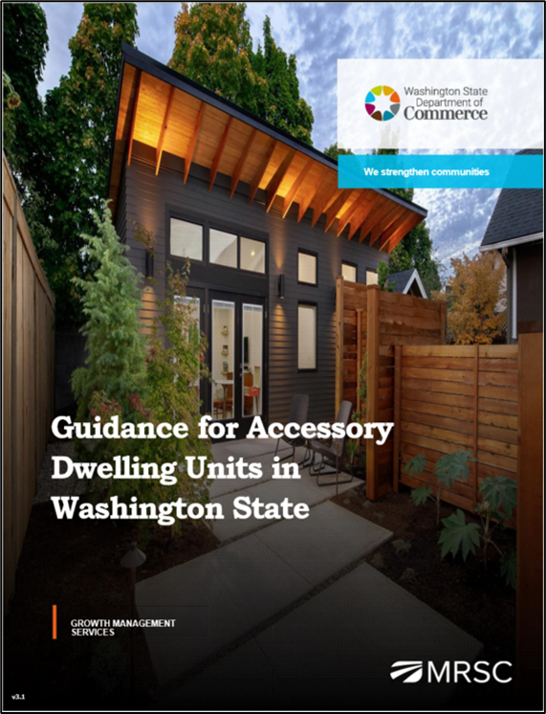
New Commerce ADU Guidance (June ‘23)
New Requirements for Cities/Growth Areas
Recommendations & Key Considerations
Other Programmatic Elements to Consider
Recorded Webinars
PowerPoint Slides
Guidance for Accessory Dwelling Units in Washington State
Notes:
In developing the new guidance, and working on the ADU project, Commerce reviewed all related GMA amendments since 1994, reviewed existing case law, pulled together a task force, sent multiple drafts out for review, assembled a large collection of current best practices, and conducted direct interviews and consultation with cities and counties across the state.
The new guidance is structured under the following categories:
Requirements for cities and other urban areas – cities with a population greater than 20,000, counties with a population greater than 125,000, and counties required to plan under the GMA.
Recommendations for cities and other urban areas – not requirements but suggestions for expanding the options for ADUs in towns, cities, and other urban areas including unincorporated urban growth areas and limited areas of more intensive development. These recommendations include allowing manufactured or prefabricated units, streamlining ADU permitting processes, and offering incentives to encourage ADUs that are affordable to lower-income households.
Key considerations for counties (rural and resource lands) – ADU provisions in rural and resource areas must be accompanied by measures to protect rural character, conserve resource lands, and limit density and sprawl.
Other programmatic elements to consider – such as address the use of ADUs as short-term rentals, provide information on landlord-tenant laws for prospective ADU owners and tenants, and creating programs to encourage the legalization of unpermitted ADUs.
Also, for local governments Commerce is recording ADU webinars such as this one for cities and urban areas, and for counties and rural areas, and developing PowerPoint slides to assist in discussion and briefings on the value and importance of this housing type.

Slide 5
ADUs for Counties
GMA-planning counties must plan and provide regulatory frameworks for four land use categories in decreasing order of intensity:
Unincorporated urban growth areas
Limited areas of more intense rural development (LAMIRDs)
Rural lands
Designated natural resource lands
Notes:
GMA-planning counties must plan and provide regulatory frameworks for four land use categories in decreasing order of intensity:
Unincorporated urban growth areas
Limited areas of More Intense Rural Development (LAMIRDs)
Rural lands
Designated natural resource lands

Slide 6
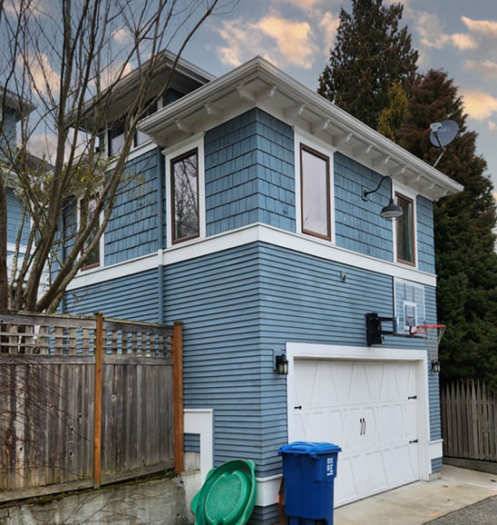
In Unincorporated Urban Growth Areas, HB 1337 (2023) Applies
Local governments must, 6 months after the periodic update due date:
Allow at least two ADUs per lot in all GMA urban growth areas
May not require the owner to occupy the property
Allow the sale of ADUs as independent units
Allow an ADU of at least 1,000 square feet and must adjust zoning to be consistent with HB 1337
Set consistent parking requirements based on distance from transit and lot size
Notes:
Much of what has come to pass in HB 1337 came from a larger body of work known as the Collaborative Roadmap Phase III project – over a period of two years the task force presented findings, concepts and recommendations to the Washington State Legislature about proposed reforms to the state’s growth policy framework. Accessory dwelling units were a top contender in a list of housing types to be required or incentivized.
For starters, HB 1337, requires jurisdictions to, within 6 months after their periodic update due date:
Allow two ADUs per lot in all GMA urban growth areas – effectively allowing 3 units in all urban areas – the principal unit, plus two ADUs.
May not require owner occupancy for any unit on the property – the rationale for this requirement has been historically based on apprehensions about noise and other negative impacts that might be caused by unsupervised renters, and perhaps perceptions of conflicts around undefined shared space. But other local code provisions relating to those types of nuisance concerns can be adopted and applied to residential properties occupied by either owners or renters.
Must allow sale as condominiums – jurisdictions may not prohibit the sale or other conveyance of a condominium unit independently of a principal unit solely on the grounds that the condominium unit was originally built as an accessory dwelling unit.
Must allow at least 1,000 square feet size units – defined in gross floor area which means the interior habitable area of a dwelling unit including basements and attics but not including a garage or accessory structure.
Cannot require parking if within ½ mile of a major transit stop – Many lots in established areas aren’t large enough to support both an ADU and off-street parking, effectively prohibiting ADU development. This means that ADUs are often limited to larger lots that can accommodate parking and other site features. Removing off-street parking requirements for ADUs can help to open up possibilities for placing ADUs, especially in urban areas with transportation options.

Slide 7
In Unincorporated Urban Growth Areas, HB 1337 (2023) Applies (continued)
May not charge more than 50% of impact fees charged for the principal unit
Allow ADUs on any lot that meets the minimum lot size required for the principal unit
May not require design review standards that are more restrictive than those for the principal unit
The new state law does not require ADUs to be allowed on lots with critical areas or their buffers
The new state law addresses covenants and restrictions, protecting any local government if they issue a permit for an ADU on a lot with a covenant restricting an ADU, from civil liability
Applies to all cities and their urban growth areas (UGAs)
Notes:
Impact fees are limited to 50% of the principal unit – ADUs are generally smaller than standard single-family homes, they typically have fewer people living in them, and cause fewer impacts on transportation, parks and schools.
Allow two ADUs on all lots that meet minimum lot size in zoning districts that allow for single-family homes – the ADUs may be:
Two attached accessory dwelling units (ADUs) such as unit in a basement, attic, or garage.
One attached accessory dwelling unit and one detached accessory dwelling unit (DADU), or
Two detached accessory dwelling units, which may be comprised of either one or two detached structures.
A conversion of an existing structure, such as a detached garage.
May not impose setback requirements, yard coverage limits, tree retention mandates, restrictions on entry door location, aesthetic requirements or design review standards that are more restrictive than those for the principal unit.
May not requirement street improvements as a condition of permitting accessory dwelling units.
Also, the new state law addresses covenants and restrictions, protecting any local government from civil liability if they issue a permit for an ADU on a lot with a covenant restricting an ADU – restricting covenants from actively or effectively prohibiting ADUs within a UGA.

Slide 8
Benefits of Urban ADUs: Not the Same in Rural Areas
Reducing climate impacts because an ADU tends to be smaller and use less energy than a traditional single-family home, and closer to
If sold separately, can provide housing that is typically more affordable than traditional single-family homes
Adding housing units without expanding urban growth areas
Correcting historic economic and racial exclusion by opening up single-family neighborhoods to more diverse housing and household types
Notes:
Here are some reasons why we encourage ADUs in our urban communities:
A more sustainable house is one that is smaller and closer to services and activity centers, so that a trip to get groceries, or pick up a child after school has less impact. That is not going to be a benefit of rural ADUs. In fact, when you look at homes in rural areas, some of the savings from buying further out is eaten up in transportation costs, because every trip requires a personal automobile.
ADUs can provide more affordable housing, but generally does not provide affordable to housing for lowest income segments unless tenants are friends or family. HB 1337 intended the potential for separate sale of ADUs. Given that rural densities require lots of at least 5 acres, separate sale is not possible.
Creating and serving an urban growth area with sewer, water, roads, parks, and other services is expensive. A benefit of urban ADUs is that we can absorb more people without have to expand the urban growth area. This is not the case is rural areas.
The final point here is that ADUs can open up exclusive neighborhoods and allow more diverse households. This is not applicable in rural areas.

Slide 9
Concerns About ADUs in Rural Context
Increased demand for emergency and other services
Increased traffic on county roads, and increase in emissions, decrease in safety
More housing and increased population in areas potentially prone to wildfires or other natural hazards
Impact on limited water supplies
Conflict with or decrease in land available for agriculture or other natural resource industries
The Growth Management Hearings Boards (GMHBs) have ruled against rural ADUs where they do not include specific criteria to curtail density
Notes:
Increased demand on emergency and other services, more households means more 911 calls in rural , where response times may be lower than urban areas, and more deliveries, which increases traffic on rural roads.
Again, each trip demands a private automobile with its own emission.
More housing in areas prone to wildfire means more risk, and greater losses if a fire occurs. Now, we know there are ways to plan against fire by creating clear areas, and keeping a green lawn, which can increase demands for water, which are limited in this state.
Also, increased ADUs means there is more pressure on rural industries which may be incompatible with residential uses. The GMA requires notice on the plat of any housing that is near resource industries.
Finally, the hearings board have ruled against rural ADUs when county regulations did not include specific criteria to curtail density in rural areas.

Slide 10
ADUs in Limited Areas of More Intense Rural Development (LAMIRDS)
Okay to add ADUs in a LAMIRD
A LAMIRD is confined to pre-1990 rural development
A LAMIRD cannot be expanded beyond the original boundary but can be infilled upon confirmation that existing providers of public facilities and services have sufficient capacity to serve new or additional development. (RCW 36.70A.070 (5)(d)(i)(C))
The requirements of HB 1337 does not apply as a LAMIRD is not within a UGA
Notes:
First of all, let’s talk about LAMIRDs.
The GMA framework is that urban development belongs in urban areas, and rural development is expected to be at significantly lower levels of intensity with a variety of rural densities.
But when the GMA was adopted in 1990, there were already pockets of urban development in rural areas, such as manufactured home parks, or small unincorporated villages. The solution was to draw a line around those areas and, though they can’t expand under the GMA, they can fill in over time.
This was recently clarified in 2022, with Senate Bill 5275.
For ADUs, they are clearly allowed, and encouraged to add additional housing options in a rural area. They may allow people to age in place in their community.
HB 1337 is not required, but encouraged to be followed in LAMIRDs.

Slide 11
Considerations Outside Urban Growth Areas
Rural element must control rural development
Containing or otherwise controlling rural development
Assuring visual compatibility of rural development with the surrounding rural area
Reducing the inappropriate conversion of undeveloped land into sprawling, low-density development in the rural area
Protecting against conflicts with the use of agricultural, forest, and mineral resource lands and discourage incompatible uses
RCW 36.70A.070(5)
Notes:
What does the GMA say about ADU development outside urban areas?
It says nothing, and so we have carefully drawn direction from the GMA, from case law, and county practices.
So, let’s get started, with the next slide.

Slide 12
ADUs in Rural Areas
"Rural character“ patterns of land use and development relating to open space, natural landscapes, reducing sprawl, no urban services
"Rural development" can consist of a variety of uses and residential densities, including clustered residential development, at levels that are consistent with the preservation of rural character
"Rural governmental services" include public services and facilities may include domestic water systems, fire and police protection services, transportation and public transit services, not including storm or sanitary sewers
The new State law is silent on ADUs in rural areas, however, which suggests that attached ADUs are okay, but to proceed with caution with detached ADUs
Notes:
HB 1337 allowed liberal use of ADUs within urban growth areas, but even in “the year of housing” in 2023, there were no provisions to allow ADUs in rural areas, so we recommend a cautious approach.
The guidance for rural areas is found in the requirements for the rural element –
Development must be consistent with rural character; clustered development may be allowed. Rural densities have been found to be one unit per five, ten, or twenty acres. But not one unit for one or two acres, which is considered a sprawl density.
Rural character focuses on natural landscapes, open space, and compatibility with wildlife.
Rural areas do not have sewer service, which is how additional ADUs are supported in urban areas. There may be public transit services, although not likely because the potential for riders is generally low with rural densities.
So what is the legal direction for rural areas? A variety of hearings board and court cases suggest that attached ADUs are likely okay, and that detached ADUs in rural areas is the same as increasing rural densities.
23) "Rural character" refers to the patterns of land use and development established by a county in the rural element of its comprehensive plan:
(a) In which open space, the natural landscape, and vegetation predominate over the built environment;
(b) That foster traditional rural lifestyles, rural-based economies, and opportunities to both live and work in rural areas;
(c) That provide visual landscapes that are traditionally found in rural areas and communities;
(d) That are compatible with the use of the land by wildlife and for fish and wildlife habitat;
(e) That reduce the inappropriate conversion of undeveloped land into sprawling, low-density development;
(f) That generally do not require the extension of urban governmental services; and
(g) That are consistent with the protection of natural surface water flows and groundwater and surface water recharge and discharge areas.
(24) "Rural development" refers to development outside the urban growth area and outside agricultural, forest, and mineral resource lands designated pursuant to RCW 36.70A.170. Rural development can consist of a variety of uses and residential densities, including clustered residential development, at levels that are consistent with the preservation of rural character and the requirements of the rural element. Rural development does not refer to agriculture or forestry activities that may be conducted in rural areas.
(25) "Rural governmental services" or "rural services" include those public services and public facilities historically and typically delivered at an intensity usually found in rural areas, and may include domestic water systems, fire and police protection services, transportation and public transit services, and other public utilities associated with rural development and normally not associated with urban areas. Rural services do not include storm or sanitary sewers, except as otherwise authorized by RCW 36.70A.110(4).

Slide 13
ADUs in Natural Resource Lands
Nonagricultural accessory uses and activities, including new buildings, parking, or supportive uses, shall not be located outside the general area already developed for buildings and residential uses and shall not otherwise convert more than one acre of agricultural land to nonagricultural uses.
Attached ADUs may be permissible
Other development of ADUs requires caution and must not interfere with resource use
Notes:
In Natural Resource lands, there are pretty strict rules around what accessory development may be allowed. There is an understanding that farming is hard work, with unreliable incomes, so there an allowance for agricultural accessory uses, to allow onsite processing of crops, for example, but limited allowances for non-agricultural accessory uses.
We see that attached ADUs may be allowed on agricultural lands. This can allow succession, so that multigenerational households can stay on the farm. However, detached ADUs may be seen as adding to density or interfering with agriculture, and Commerce recommends caution in allowing detached ADUs.

Slide 14
Options for Rural and Resource Lands
ATTACHED ADU: Allow one attached ADU with a single-family dwelling
Must be located on a conforming legal lot of record with no more than one established family dwelling unit
Attached ADUs generally not counted toward the maximum allowed residential density
DETACHED ADU: Count as a dwelling unit when calculating density
DADUs should be ‘dependent’ upon the principal residence and share common elements with the principal structure (e.g., road access, parking, water system, septic system, utility meters, yard)
Notes:
Relevant Hearings Board decisions:
Pierce County case 95-1-0010
San Juan County case 03-2-0003
(Case Law) Vashon-Maury v. King County
Rural character has a functional and visual component – the visual character of the rural landscape should not be disrupted or altered by the proposed use.

Slide 15
Comments and Questions

Slide 16
For more information:
Commerce Team
Anne Fritzel, AICP - anne.fritzel@commerce.wa.gov
Catherine McCoy - catherine.mccoy@commerce.wa.gov
Other Resources
Guidance for Accessory Dwelling Units in Washington State
Notes:
Commerce Team
Anne Fritzel, AICP - anne.fritzel@commerce.wa.gov
Catherine McCoy - catherine.mccoy@commerce.wa.gov
Other Resources
Guidance for Accessory Dwelling Units in Washington State
NOTE TO PRESENTER: Add other resources as you feel is appropriate.

Slide 17
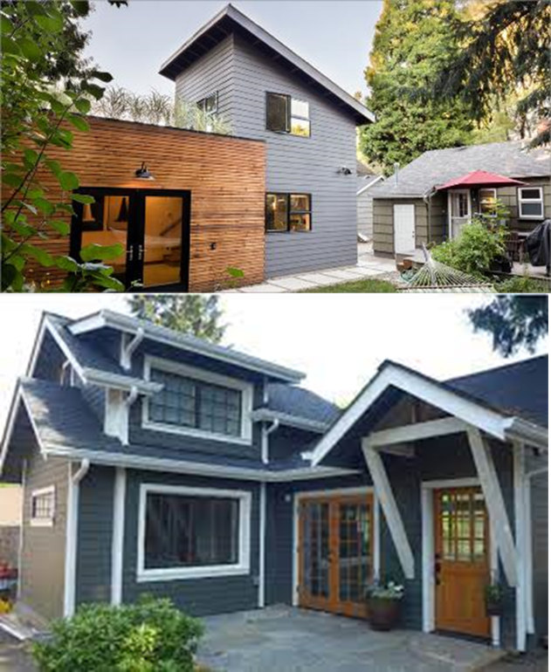

Slide 18
More Slides with Details about:
EHB 1337 Requirements for Urban Growth Areas
and
Recommendations for Urban Growth Areas
and
Other Programmatic Elements to Consider
Notes:
Note to Presenter: Use these detailed slides as necessary for your specific presentation

Slide 19
Requirements for Urban Growth Areas
SUMMARY
Allow at least two ADUs per lot
Do not require owner-occupancy
Allow separate sale of ADUs
Revise off-street parking requirements for ADUs
Set maximum size limits at no less than 1,000 sq. ft.
Reduce barriers from setbacks and other related regulations
Limit use of design standards
Reduce or waive permit application fees, impact fees, system development charges, and other ADU-related fees where applicable

Slide 20
A. Requirements for Urban Growth Areas
1. Allow at least two ADUs per lot
Two ADUs on a legal lot, which must be allowed to be any combination of:
One attached and one detached;
Two attached ADUs; or
Two detached ADUs
Duplexes, triplexes, townhouses, and multifamily structures may have ADUs (RCW 36.70A.696)
Notes:
1. Allow two ADUs per lot
At least two ADUs on a legal lot in all zoning districts within an urban growth area that allow for single-family homes.
One attached and one detached;
Two attached ADUs; or
Two detached ADUs
Must allow ADUs on parcels that meet the minimum lot size required for the principal unit.
May impose a limit of two ADUs, in addition t the principal unit, on a residential lot of < 2,000 sq. ft.
Duplexes, triplexes, multifamily structures may have ADUs (RCW 36.70A.696) – https://app.leg.wa.gov/Rcw/default.aspx?cite=36.70A.696
Ex. of Kirkland
Note: The letter “A” in the title references the Commerce “Guidance for ADUs in Washington State” document’s headings.

Slide 21
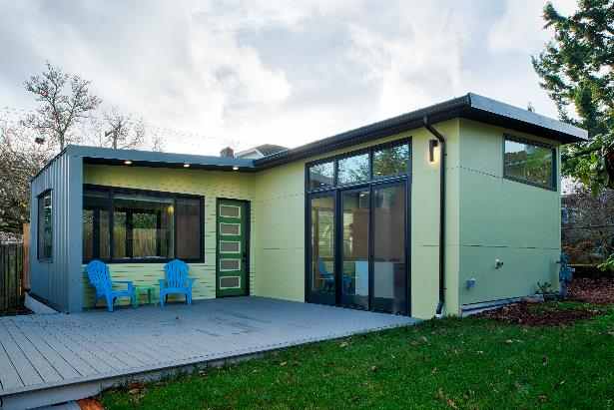
A. Requirements for Urban Growth Areas
2. May not require owner occupancy
The primary residence owner cannot be required to live on-site (i.e., neither in the primary residence nor an accessory dwelling unit)
Smith Gillman Cottage converted garage. Credit: CAST architecture.
Notes:
2. May not require owner occupancy
The primary residence owner is not required to live on-site (i.e., neither in the primary residence nor the accessory dwelling unit).

Slide 22
A. Requirements for Urban Growth Areas
3. Allow separate sale of ADUs
This allows for a new way to promote home ownership, since an ADU is usually a lower-cost housing option than a single-family residence
A few local governments in Washington State have allowed ADUs to be sold as condominiums for several years (before the passage of EHB 1337), including:
Seattle
Spokane
Kirkland
Notes:
3. Allow separate sale of ADUs
Must allow the separate sale of ADUs, either as condominiums or another form of “for sale” ownership – jurisdictions may not prohibit the sale or other conveyance of a condominium unit independently of a principal unit solely on the grounds that the condominium unit was originally built as an accessory dwelling unit.
This allows for a new way to promote home ownership, since an ADU is usually a lower-cost option than a single-family residence.
A few local governments in Washington State have allowed ADUs to be sold as condominiums for several years (before the passage of EHB 1337).

Slide 23
A. Requirements for Urban Growth Areas
4. Revise off-street parking standards for ADUs in specified locations (per EHB 1337)
May not require any off-street parking for ADUs within ½ mile walking distance of a major transit stop
May not require >one off-street parking space/unit on lots smaller than 6,000 sq. ft.
May not require >two off-street parking spaces/unit on lots greater than 6,000 sq. ft.
A local government can ask to increase its ADU parking standards – request must be supported by an empirical study and submitted to Commerce
Consider reducing parking requirements for ADUs beyond the statutory standards
Notes:
4. Revise off-street parking standards for ADUs in specified locations (per EHB 1337)
May not require any off-street parking for ADUs within ½ mile walking distance of a major transit stop
May not require >one off-street parking space/unit on lots smaller than 6,000 sq. ft.
May not require >two off-street parking spaces/unit on lots greater than 6,000 sq. ft.
A local government can ask to increase its ADU parking standards – request must be supported by an empirical study and submitted to Commerce.
Rationale must be related to a safety need or a “consistency with detached housing’s parking standards” claim.
Consider reducing parking requirements for ADUs beyond the statutory standards, except in the cases where there is truly:
No on-street parking available; or
Unique site conditions require it, such as areas not well served by public transit.

Slide 24
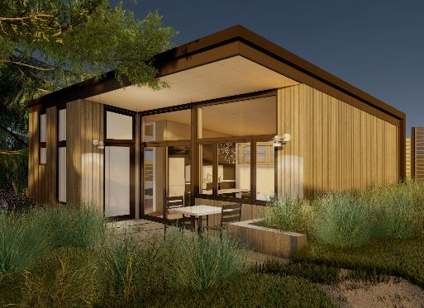
A. Requirements for Urban Growth Areas
5. Set maximum size limits at no less than 1,000 sq. ft.
ADUs are, by definition, “accessory” to the primary residence, so will often be smaller in size than the primary housing unit.
Cedar Cottage Seattle ADU Pre-Approved Plan. Credit: CAST Architecture.
Notes:
5. Must allow at least 1,000 square feet size units – defined in gross floor area, which means the interior habitable area of a dwelling unit including basements and attics but does not include a garage or any other accessory structure on a lot.

Slide 25
A. Requirements for Urban Growth Areas
6. Reduce barriers from setbacks and other related regulations
May not impose may not stricter standards for ADUs than those imposed on the principal units for:
Setbacks (including no rear setbacks for ADUs on lots with alleys)
Yard coverage
Tree retention mandates
Minimum roof height of 24 feet
Must allow ADU conversions of existing structures, including detached garages (even if they violate current setback or lot coverage requirements)
Notes:
6. Reduce barriers from setbacks and other ADU regulations
May not impose requirements that that are more restrictive than those for the principal unit:
setback requirements,
yard coverage limits,
tree retention mandates,
Minimum roof height of 24 feet (unless a lesser height is imposed on the primary residence).
Allow ADU conversions of existing structures (including conversion of both attached and detached garages).

Slide 26
A. Requirements for Urban Growth Areas
7. Limit use of design standards
May not impose stricter standards for ADUs than those imposed on the principal units regarding:
Restrictions on entry door location
Aesthetic requirements
Design review requirements
Notes:
7. Limit use of design standards
ONLY IF needed to enhance local support of ADUs
IF NEEDED, focus on a small set of design issues that are likely to enhance local support of ADUs
IF NEEDED, limit design review to proportionality of primary residence and proximity of neighboring homes (e.g., location of ADU entries & windows)
Administrative design review with building permit application (vs. (CUP)
Don’t require the design of an ADU to be compatible with the existing primary residence
“Careful about what you wish for, you might just get it”

Slide 27
A. Requirements for Urban Growth Areas
8. Reduce or waive ADU-related fees and charges
Statutory Limitation:
Impact fees – limited to 50% imposed on a principal unit (Note: may be reduced further, if there is an adequate policy basis)
Other Non-Statutory Options to Consider:
Additional impact fee reductions/waivers
Application fees
System development charges (aka “utility connection fees”)
Other ADU-related fees, where applicable
Notes:
8. Reduce or waive fees and charges
Statutory Limit:
Impact fees are limited to 50% of the principal unit.
Other Non-statutory Options:
Impact fees may be further reduced or even waived, if there is an adequate policy basis. Rationale: ADUs are generally smaller than standard single- family homes and typically have fewer people living in them, resulting in fewer impacts on transportation, parks and schools.
Application fees
Based on police power and if the local decision is made to prioritize new ADU construction
System development charges (aka “utility connection fees”)
Especially compelling, if the ADU doesn’t need a new line and/or separate meter
Other fees, if there are any others imposed by your community

Slide 28
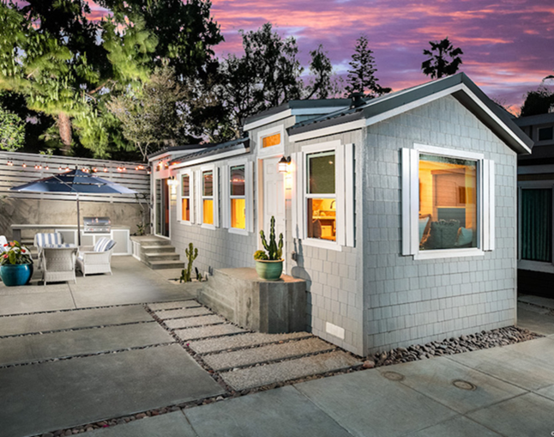
Recommendations for Urban Growth Areas
SUMMARY
Allow pre-fabricated ADUs
Streamline ADU permitting processes
Offer incentives to encourage ADUs that are affordable to lower-income households
Credit: Eddie Bojorquez/Crest Backyard Homes.
Notes:
Note: The photo on this slide is an example of a prefabricated ADU.

Slide 29
B. Recommendations for Urban Growth Areas
1. Allow prefabricated ADUs
Prefabricated units can be:
Less expensive and faster than ADUS built on-site
More sustainable, due to less waste generated by factory-built units
Less impact on neighboring properties during “construction”
State law about manufactured homes may come into play
Factory-built ADUs must be inspected by L&I at the factory
Home-made tiny homes on wheels are not currently allowed as ADUs on a residential lot
Notes:
Allow prefabricated ADUs
Prefabricated units can be:
less expensive than ADUS built on-site More sustainable, due to less waste generated by factory-built units.
Take less time to install than on-site construction.
Less impacts on neighboring properties during “construction” (such as less noise and on-street parking conflicts).
State law re: manufactured homes may come into play, such as adherence to L&I standards.
Note: The letter “B” in the title references the Commerce “Guidance for ADUs in Washington State” document’s headings.

Slide 30
B. Recommendations for Urban Growth Areas
2. Streamline ADU permitting processes
Allow ADUs ‘by-right’ (permitted use) with administrative review; no discretionary review or public hearing/public meeting
Consider an expedited permit process
Notes:
2. Streamline ADU permitting processes
Allow ADUs ‘by-right’ (permitted use) without discretionary review or public hearing
Consider an expedited permit process

Slide 31
B. Recommendations for Urban Growth Areas
3. Offer incentives to encourage ADUs that are affordable to lower-income households
ADUs are usually more affordable than single-family, primary residences, but usually not affordable to lower-income households
In most cases, AADUs are less costly to produce than DADUs
Some local government programs provide incentives when:
80% or less of average median income (AMI)
Guaranteed to be affordable for a long period of time
Explore partnering with local nonprofits, including Community Land Trusts
Notes:
3. Offer incentives to encourage ADUs that are affordable to lower-income households
ADUs are usually more affordable than single-family, primary residences, but not in most cases, affordable to lower-income households
In most cases, Attached ADUs are less costly to produce than Detached ADUs
Some local government programs provide incentives when:
80% or less of average median income (AMI)
Guaranteed to be affordable for a long period of time
Explore partnering with local nonprofits, including Community Land Trusts
Unlikely to be used in rural areas, which is why it is in the second category of “Just for Cities and Urban Areas”

Slide 32
Other Programmatic Elements to Consider
SUMMARY
Address the use of ADUs as short-term rentals
Provide user-friendly communication materials
Provide information on landlord-tenant laws for prospective ADU owners and ADU tenants
Provide information on ADU financing and funding programs
Create a program to encourage legalization of unpermitted ADUs
Provide pre-approved ADU plans

Slide 33
D. Other Programmatic Elements to Consider
1. Address the use of ADUs as short-term rentals
In general, short-term rentals (STRs) remove housing units from the local housing stock
If maintaining an ample housing supply for residents is a local priority, local government regulations should fall into one of two categories:
ADUs not allowed to be used at all as STRs
Limited use of ADUs as STRs
Notes:
Address the use of ADUs as short-term rentals
Short-term rentals (STRs) do not add to the local housing stock (and actually remove a unit from the housing market)
STRs are really a commercial/hospitality operation, and not a residential use.
Local government regulations generally fall into one of three categories
ADUs not allowed to be used as STRs
Limited use of ADUs as STRs
Note: The letter “D” in the title references the Commerce “Guidance for ADUs in Washington State” document’s headings.

Slide 34
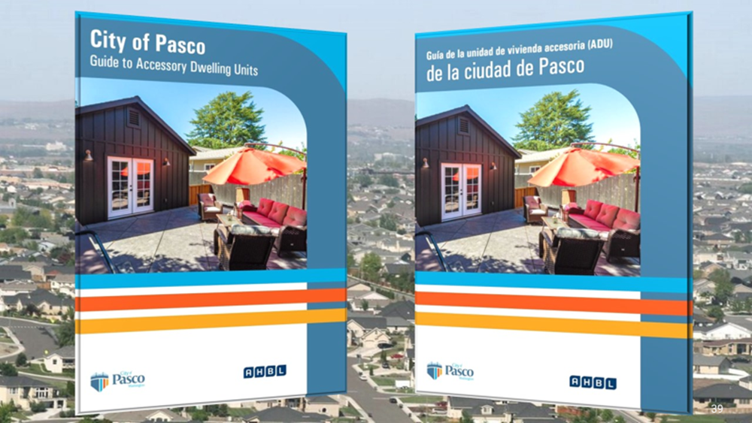
D. Other Programmatic Elements to Consider
2. Provide user-friendly communication materials
There are several good examples from Washington local governments:
ADU websites/webpages
One-two page handouts
Guidebooks
Credit: City of Pasco, WA.
Notes:
2. Provide user-friendly communication materials
There are several good examples from Washington local governments:
ADU websites/webpages
One-two page handouts
Guidebooks
The example shown on this slide is from Pasco and has been translated into Spanish.
Note: The Commerce ADU Guidance document contains some example you can cite.

Slide 35
D. Other Programmatic Elements to Consider
3. Provide information on landlord-tenant laws for prospective ADU owners and ADU tenants
There is lots of good information about Landlord-Tenant rights and requirements, both at the State and local levels
None of this information pertains solely to ADU owners or tenants
Notes:
3. Provide information on landlord-tenant laws for prospective ADU owners and ADU tenants
There is lots of good examples of information about Landlord-Tenant rights and requirements, provided at both the State and local levels
Very little of this information pertains solely to ADU owners or tenants.

Slide 36
D. Other Programmatic Elements to Consider
4. Provide information on ADU financing and funding programs
Limitations in Washington State on how local governments can provide financial assistance to people
One option for local governments: Be a resource/clearinghouse of information related to:
Financing options available to people wanting to rent out an existing ADU or construct a new ADU
Potential tax benefits of renting out an ADU
Notes:
4. Provide information on ADU financing and funding programs
Olympia’s OlyFed Bank has developed specialized lending products that support ADU construction. OlyFed claims to be one of the only financial institutions in the area with a dedicated plan for funding ADUs.
Potential idea:
Be a clearinghouse that provides homeowners interested in building an ADU with existing financial institutions
Other?
In addition, the Washington State Legislature has expanded an existing three-year property tax exemption for any improvements to a single-family dwelling in RCW 84.36.400 to include the construction of ADUs. The program was initiated through 2SSB 6231 (Chapter 204, Laws of 2020) and stipulates that dwelling units may be either attached to or within the single-family dwelling or a detached unit located on the same real property.

Slide 37
D. Other Programmatic Elements to Consider
5. Create a program to encourage legalization of unpermitted ADUs
There are many unpermitted accessory units in communities throughout our State
Goal: Allow existing unpermitted ADUs to get approval as legal ADUs, subject to applicable requirements
For example, fire and health/safety standards must be addressed before legalization is allowed to occur
Notes:
5. Create a program to encourage legalization of unpermitted ADUs
It is believed that there are many unpermitted in communities throughout our State.
Existing permitted nonconforming ADUs may be approved, subject to applicable requirements
Health/safety standards must be addressed before legalization can occur.
Allow for an increase in the size of an attached ADU for more efficient use of floor area (e.g., an existing garage or basement being used as an ADU)
Note: The Commerce ADU Guidance document contains some example you can cite.

Slide 38
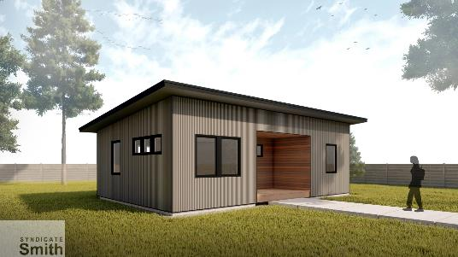
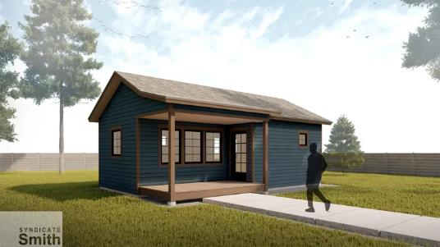
D. Other Programmatic Elements to Consider
6. Provide pre-approved ADU plans
Reduces the time needed to review plans, since they have already been “pre-approved”
An increasingly popular approach
Some issues to consider:
Need architects willing to participate in such a program
Even small changes to a pre-approved plan may result in the need for an individual review of the revised ADU plan (reducing the savings in review time)
Credit: Syndicate Smith Architect.
Notes:
6. Provide pre-approved ADU plans
An increasingly popular approach that:
Reduces design costs to applicants
Reduces the time needed to review plans, since they have already been “pre-approved”
Some issues to consider:
Need access to architects willing to participate in such a program
Even small changes to a pre-approved plan may result in the need for an individual review of the revised ADU plan (negating the time savings)
Notes:
The images on this slide are pre-approved ADU options from the city of Leavenworth.
The Commerce ADU Guidance document contains some example you can cite.

