Slide 1
Stakeholder & Tribal Advisory Group (STAG)
Disproportional Cost Analysis (DCA) in Remedy Selection
The DCA: Webinar for STAG Members
July 22, 2020
Clint Stanovsky, MTCA Cleanup Rulemaking Lead
Michael Feldcamp, Senior Legislative and Policy Analyst
Washington State Department of Ecology
Toxics Cleanup Program
Policy & Technical Support Unit

Slide 2
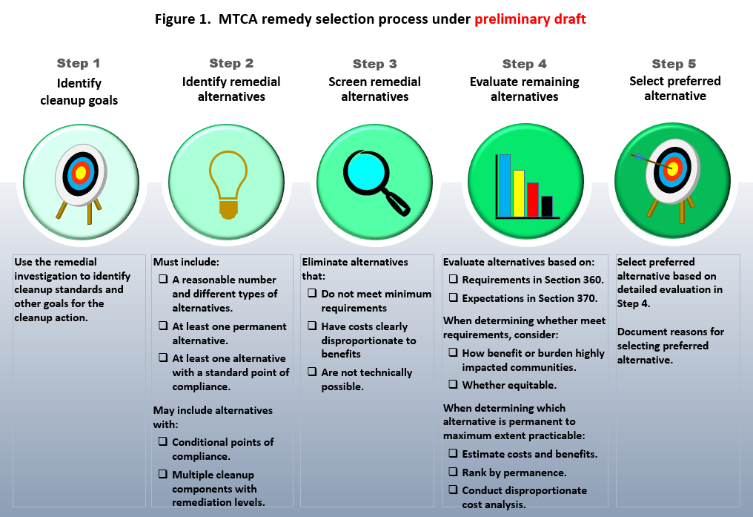
Preliminary Rule Update the Remedy Selection Process
Notes:
Mention that the goal is not to change but to clarify and reflect established practice in the rule.

Slide 3
Why do I need to conduct a DCA?
The Model Toxics Control Act says: “In conducting, providing for, or requiring remedial action, the department shall give preference to permanent solutions to the maximum extent practicable ….”
RCW 70.105D.030(1)(b)
Notes:
RCW 70.105D.030(1)(b)
This is the statutory requirement underlying the entire remedy selection process.
Disproportionate Cost Analysis (DCA) is defined in the MTCA Rule to carry out this key statutory requirement.
The terms “permanent solution” and “practicable” are defined in the rule.

Slide 4
How does DCA differ from a simple Cost-Benefit Analysis?
DCA doesn’t simply seek the most “cost-effective” solution.
Instead, DCA seeks the most permanent solution that is cost effective (maximum feasible permanence).
DCA proceeds by repeating pairwise comparisons of more-permanent with less-permanent alternatives,
Rejecting more-permanent alternatives for which incremental costs are greater than incremental benefits.
Stopping after identifying the first feasible more-permanent alternative.

Slide 5
How does DCA differ from a simple Cost-Benefit Analysis?
Benefits and costs cannot all be “quantified” and compared directly using the same units.
(Cost $ / Benefit $) < 1 doesn’t work.
Instead, for each pair of alternatives, we must compare:
Differences in quantified estimates of costs, with …
Differences in qualitative estimates of degree of benefits.
Qualitative estimates rely on “best professional judgement.” These must be:
Reasoned, consistent, and clearly documented.

Slide 6
How do I conduct a DCA?
Step 1: Estimate costs and benefits of each alternative.
Use seven specified criteria to estimate.
Estimates may be quantitative, but will often be qualitative and require the use of best professional judgment. Qualitative benefits may be weighted.
Estimates must reflect benefits and burdens on highly impacted communities.
Reference: WAC 173-340-360(5)(c)(i) and (3)(d) in preliminary draft.
Notes:
When estimating the benefits and costs of an alternative, identify and document:
How the alternative may benefit a highly impacted community by eliminating or mitigating the impacts of the site, and the degree to which benefits are equitably distributed.
How the alternative may burden a highly impacted community during the cleanup process, and the degree to which burdens are equitably distributed. This may include consideration of cumulative impacts.

Slide 7
How do I conduct a DCA?
Step 2: Rank alternatives by degree of permanence.
Determine whether alternative is “permanent” based on definition in WAC 173-340-200.
Determine relative degree of permanence based on criteria in WAC 173-340-360(5)(d)(ii).
Reference: WAC 173-340-360(5)(c)(ii) in preliminary draft.

Slide 8
How do I conduct a DCA?
Step 3: Identify the initial baseline alternative for the DCA.
If only 1 permanent alternative remains, use that alternative.
If more than 1 permanent alternative remains, use most practicable alternative.
If no permanent alternative remains, use alternative with the highest degree of permanence.
Reference: WAC 173-340-360(5)(c)(iii) in preliminary draft.

Slide 9
How do I conduct a DCA?
Step 4: Conduct a DCA of the ranked list of alternatives.
Compare costs and benefits of baseline alternative with next most permanent alternative.
Determine whether incremental cost substantially exceeds incremental degree of benefit.
If no, stop DCA. The baseline alternative is permanent to the maximum extent practicable.
If yes, eliminate baseline alternative and continue DCA using next most permanent alternative as baseline.
Reference: WAC 173-340-360(5)(c)(iv) in preliminary draft.

Slide 10
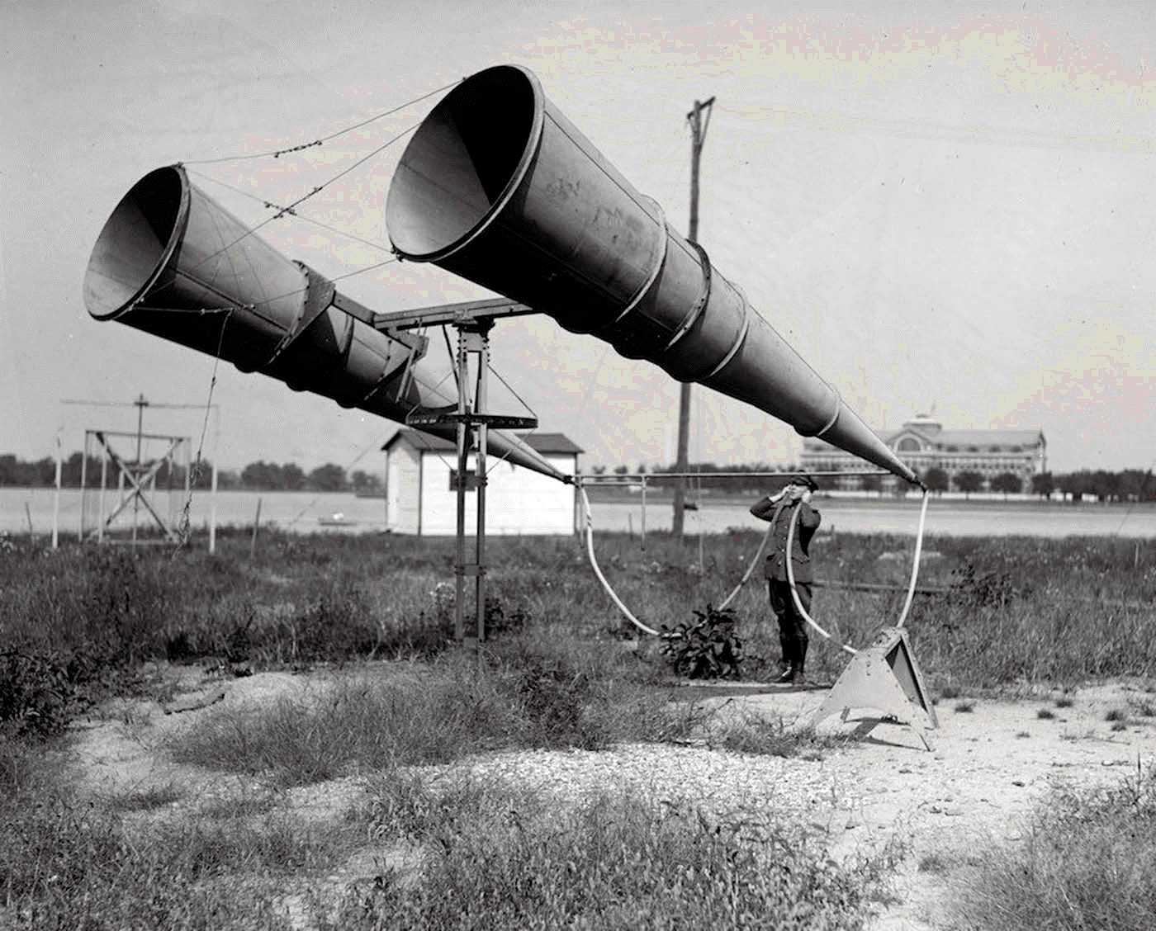
Questions or comments?

Slide 11
For more information…
Visit Ecology’s web page: https://ecology.wa.gov
Search for “Chapter 173-340 WAC” and select the link
From the Chapter 173-340 WAC rulemaking web page, follow links to:
Subscribe to e-mail notifications http://listserv.ecology.wa.gov/scripts/wa-ECOLOGY.exe?SUBED1=MTCA-SMS-RULE-UPDATE&A=1
Stakeholder and Tribal Advisory Group web page https://www.ezview.wa.gov/site/alias__1988/37514/default.aspx
Notes:
Currently, the rulemaking web page (just the citation that you searched for) appears as the third search result.

Slide 12
Thanks!
Clint Stanovsky MS, MPA
Regulatory Analyst | Policy and Technical Support Unit
Toxics Cleanup Program
Washington Department of Ecology
clinton.stanovsky@ecy.wa.gov
office: (360) 407-7193
cell: (360) 742-9703

Slide 13
Extra slides for Q & A
Notes:
Currently, the rulemaking web page (just the citation that you searched for) appears as the third search result.

Slide 14
Do I need to consider environmental justice in the DCA?
YES
EJ must be considered when evaluating whether an alternative meets cleanup action requirements.
This includes when conducting a DCA to determine which cleanup action alternative is permanent to maximum extent practicable.
Reference: WAC 173-340-360(3)(d) in preliminary draft.

Slide 15
How do I consider environmental justice in the DCA?
When estimating the benefits and costs of an alternative, identify and document:
How the alternative may benefit a highly impacted community by eliminating or mitigating the impacts of the site, and the degree to which benefits are equitably distributed.
How the alternative may burden a highly impacted community during the cleanup process, and the degree to which burdens are equitably distributed. This may include consideration of cumulative impacts.
Reference: WAC 173-340-360(3)(d) in preliminary draft.

