Slide 1
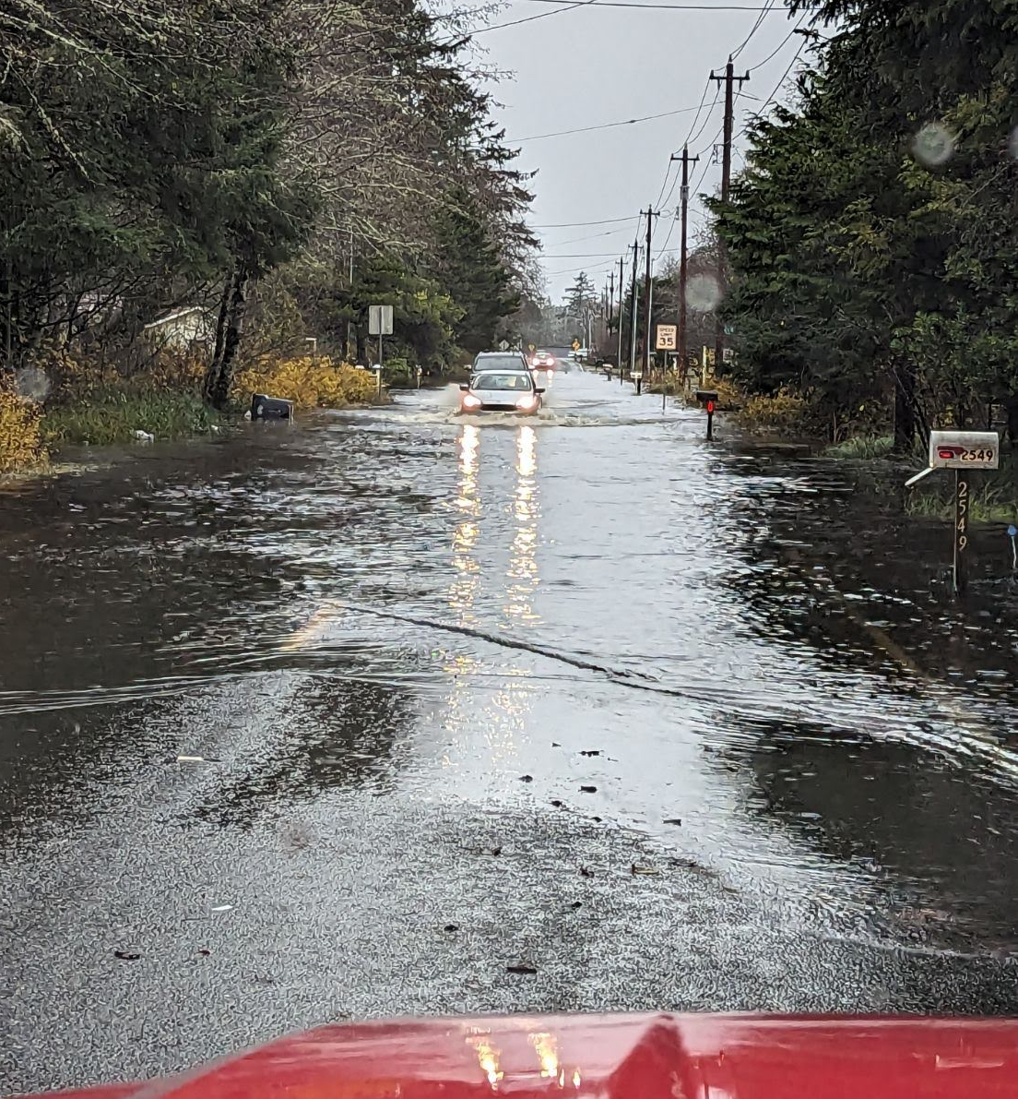
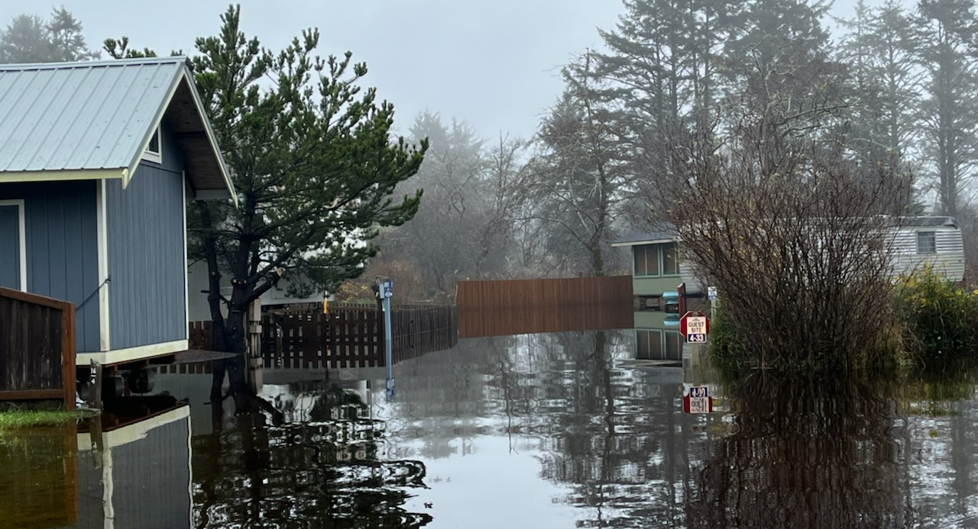


Connor Creek Flooding
Community Meeting
Ocean Shores Outdoor Recreation Club
January 18, 2024 -- 6:00 PM
← 12-05-2023
12-06-2023 →

Slide 2
Today’s Presentation
Provide update on activities since last meeting (9-28-2023).
Discuss/set next steps.
Leave you with additional resources.
Link to this presentation:
Connor Creek Community Meeting 1-18-2024
Scott Boettcher
SBGH-Partners
360/480-6600
scottb@sbgh-partners.com

Slide 3
A. Activities Since Last Meeting
Held conversations with many people.
Collected and reviewed much information.
Generated a list of ideas/possible solutions.
Problem . . .
“Connor Creek presents a chronic, complex, and historically unaddressed flooding problem adversely affecting North Beach residents, visitors, businesses, and emergency responders alike.”

Slide 4
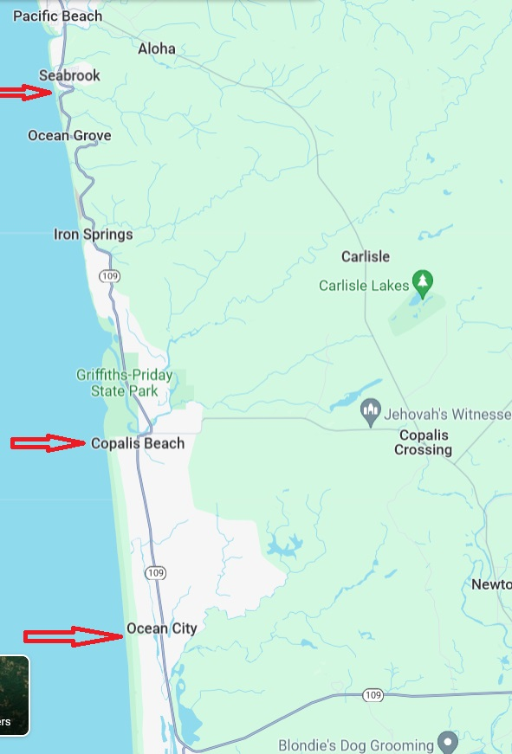
1. Conversations
Major themes/topics from 17 meetings.
Drainage/Conveyance
Emergency Response
Infrastructure
SR109
Past Planning/Studies
North Beach Future
Documentation

Slide 5
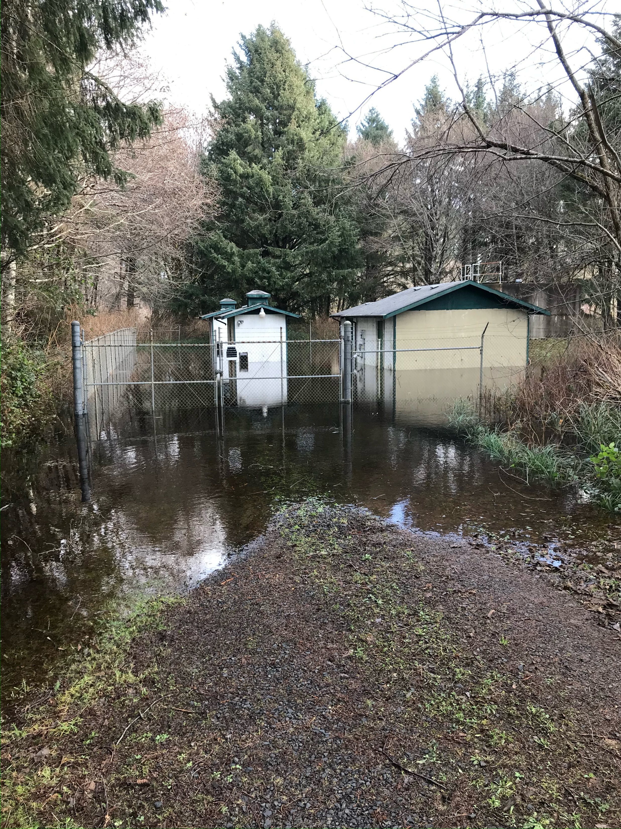
2. Information
Collected and reviewed much information.
Flooding
Plans/Studies
Mapping
Photo/Drone/Imagery
Other Documentation
Grays Harbor County Utilities Department
Water Well, 1-07-2022

Slide 6
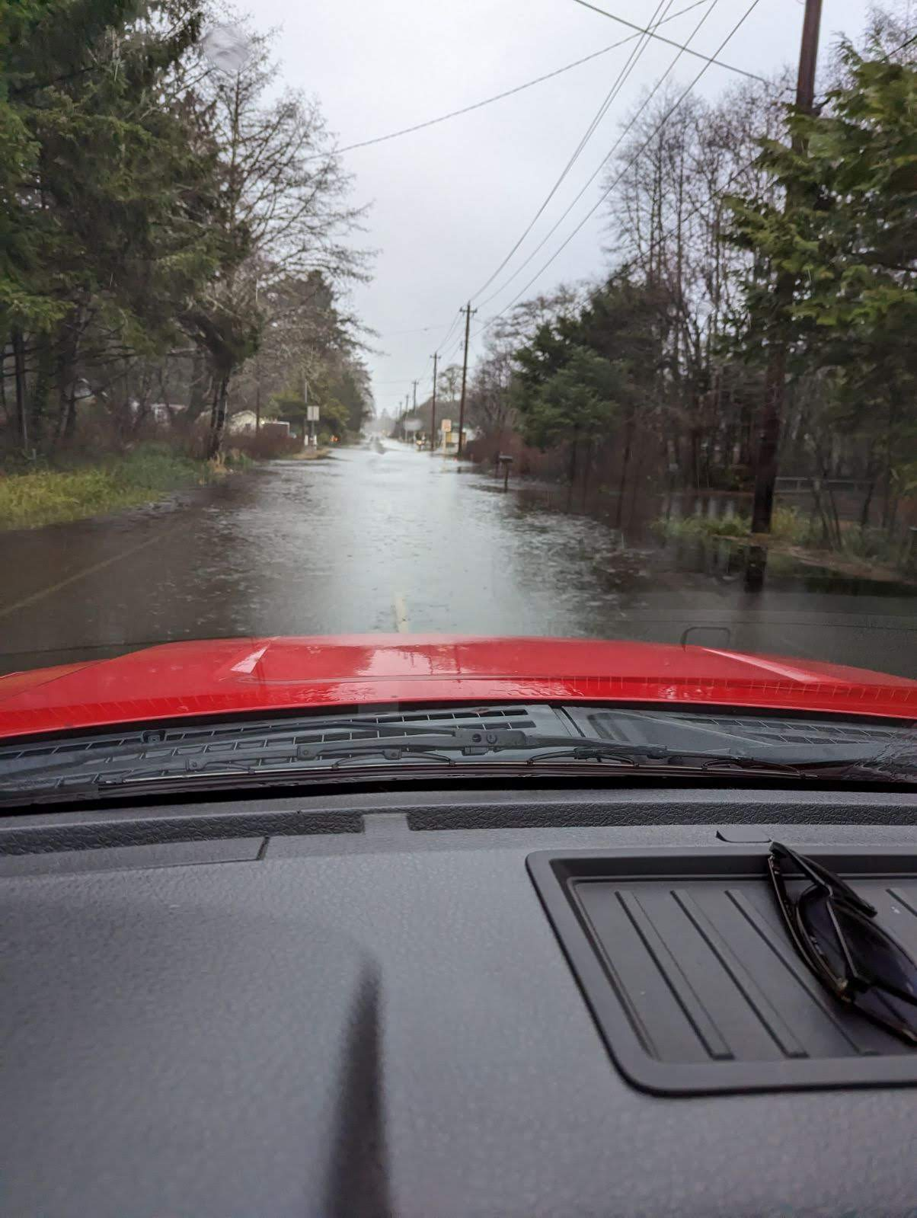
2. Information (Flooding)
Five “King Tide” events (10.4 ft and greater) since last community meeting (9/28/2023).
Two additional “Tides of Concern” events (9.5 ft and greater).
Seven events totalling 75 out of 121 days (62% of those days)!
8% of all tides annually are 9.5 ft and greater (Westport Station).
12-27-2022 →

Slide 7
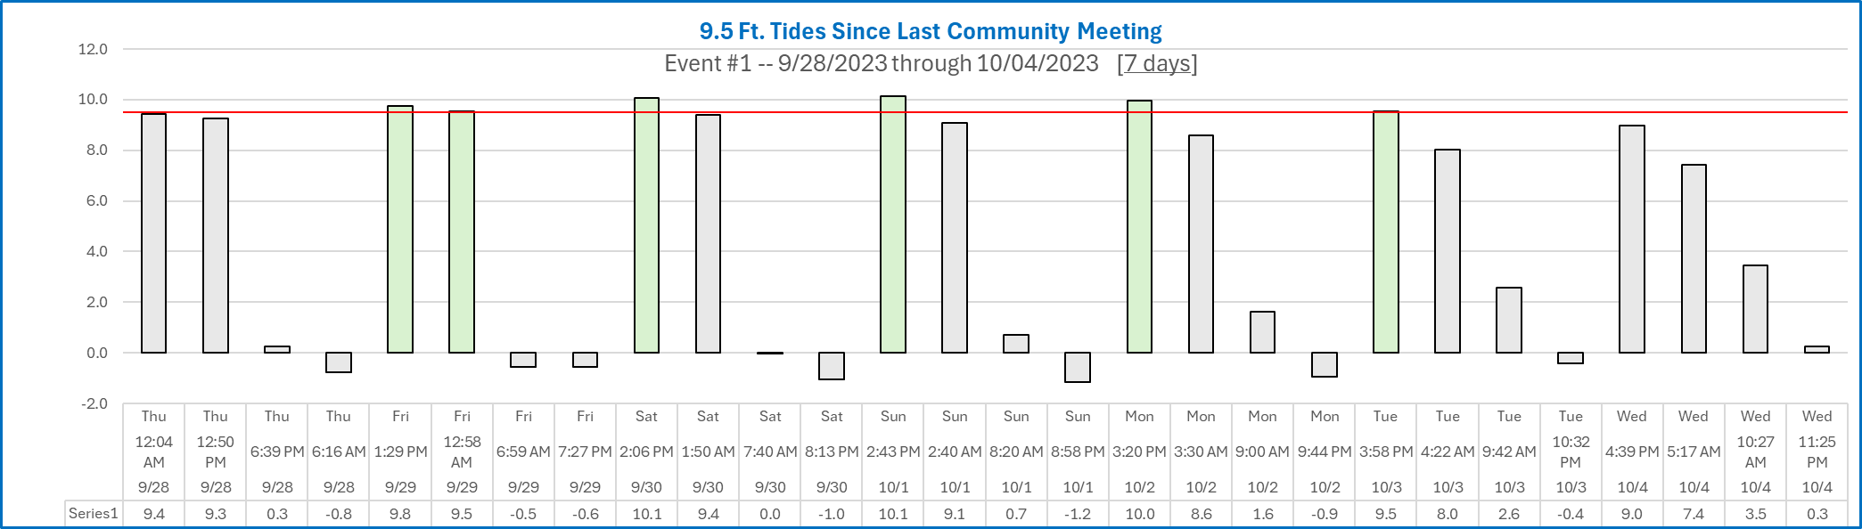
2. Information (Flooding)
Event #1

Slide 8
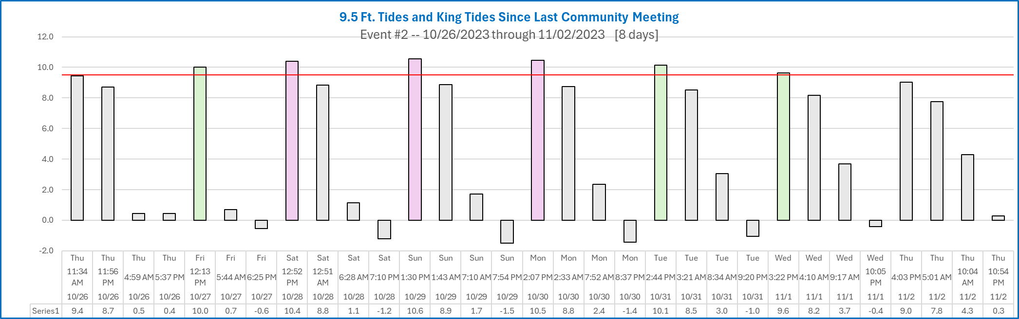
2. Information (Flooding)
Event #2

Slide 9
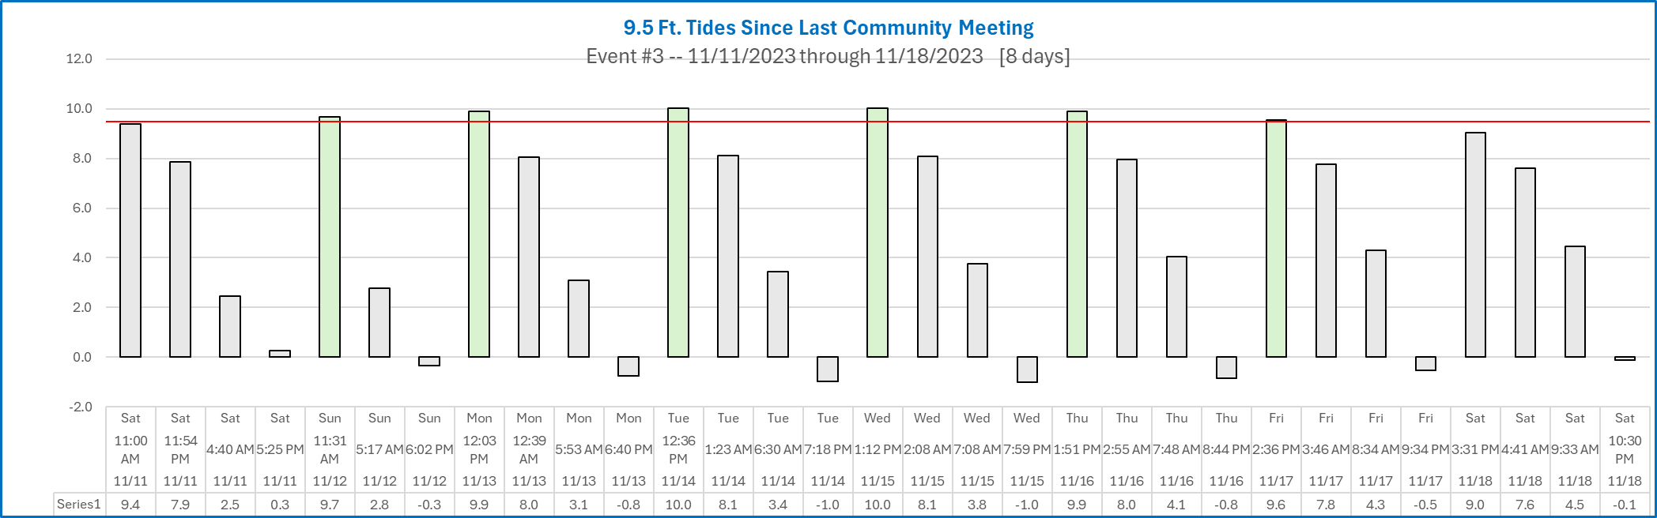
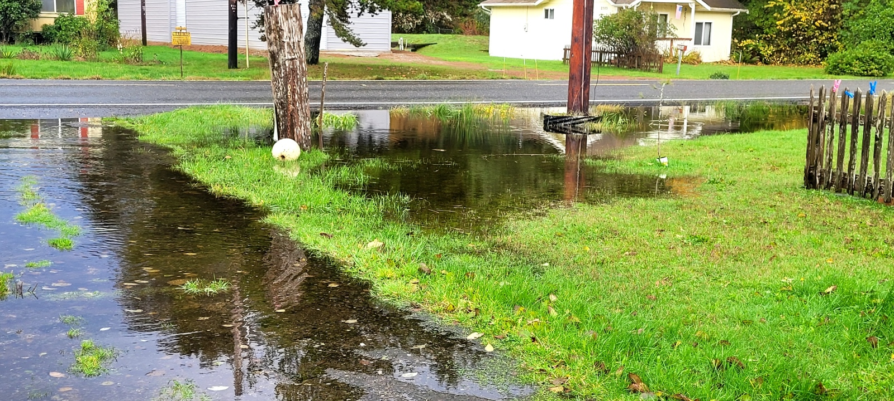
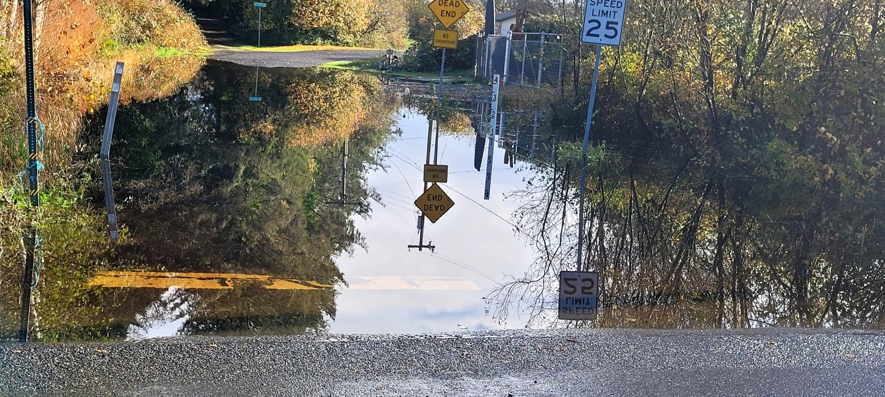
2. Information (Flooding)
Event #3
11-11-2023 →
← 11-16-2023

Slide 10
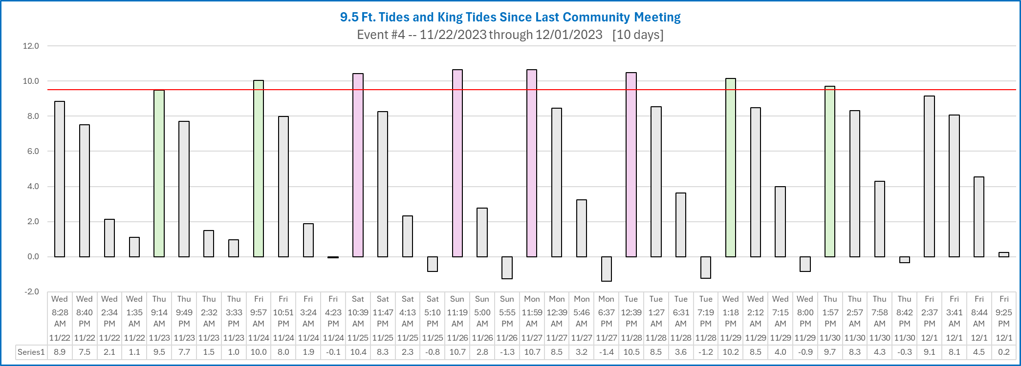
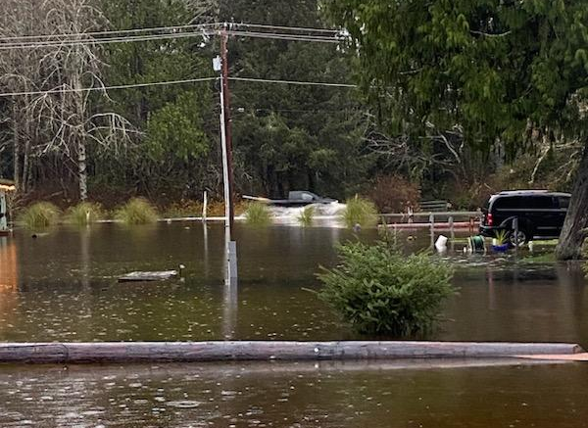
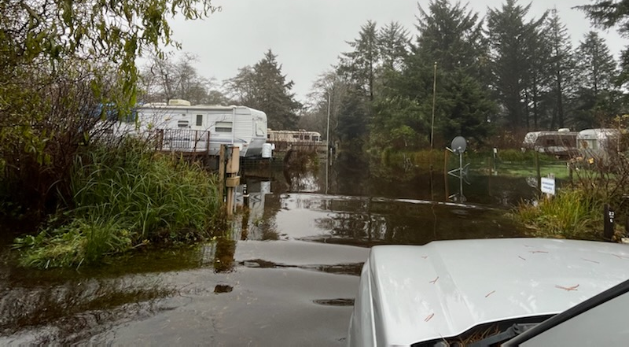
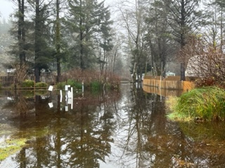
2. Information (Flooding)
Event #4
12-05-2023 →
← 12-06-2023 →

Slide 11
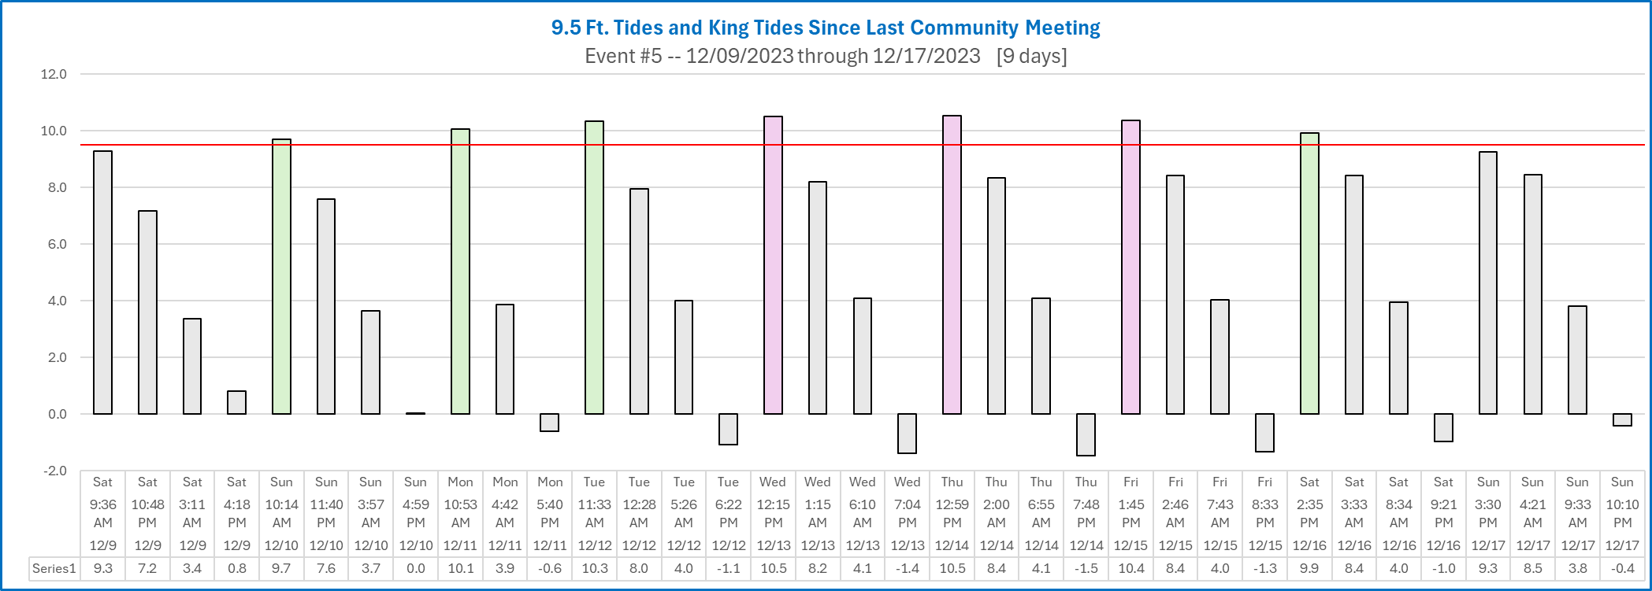
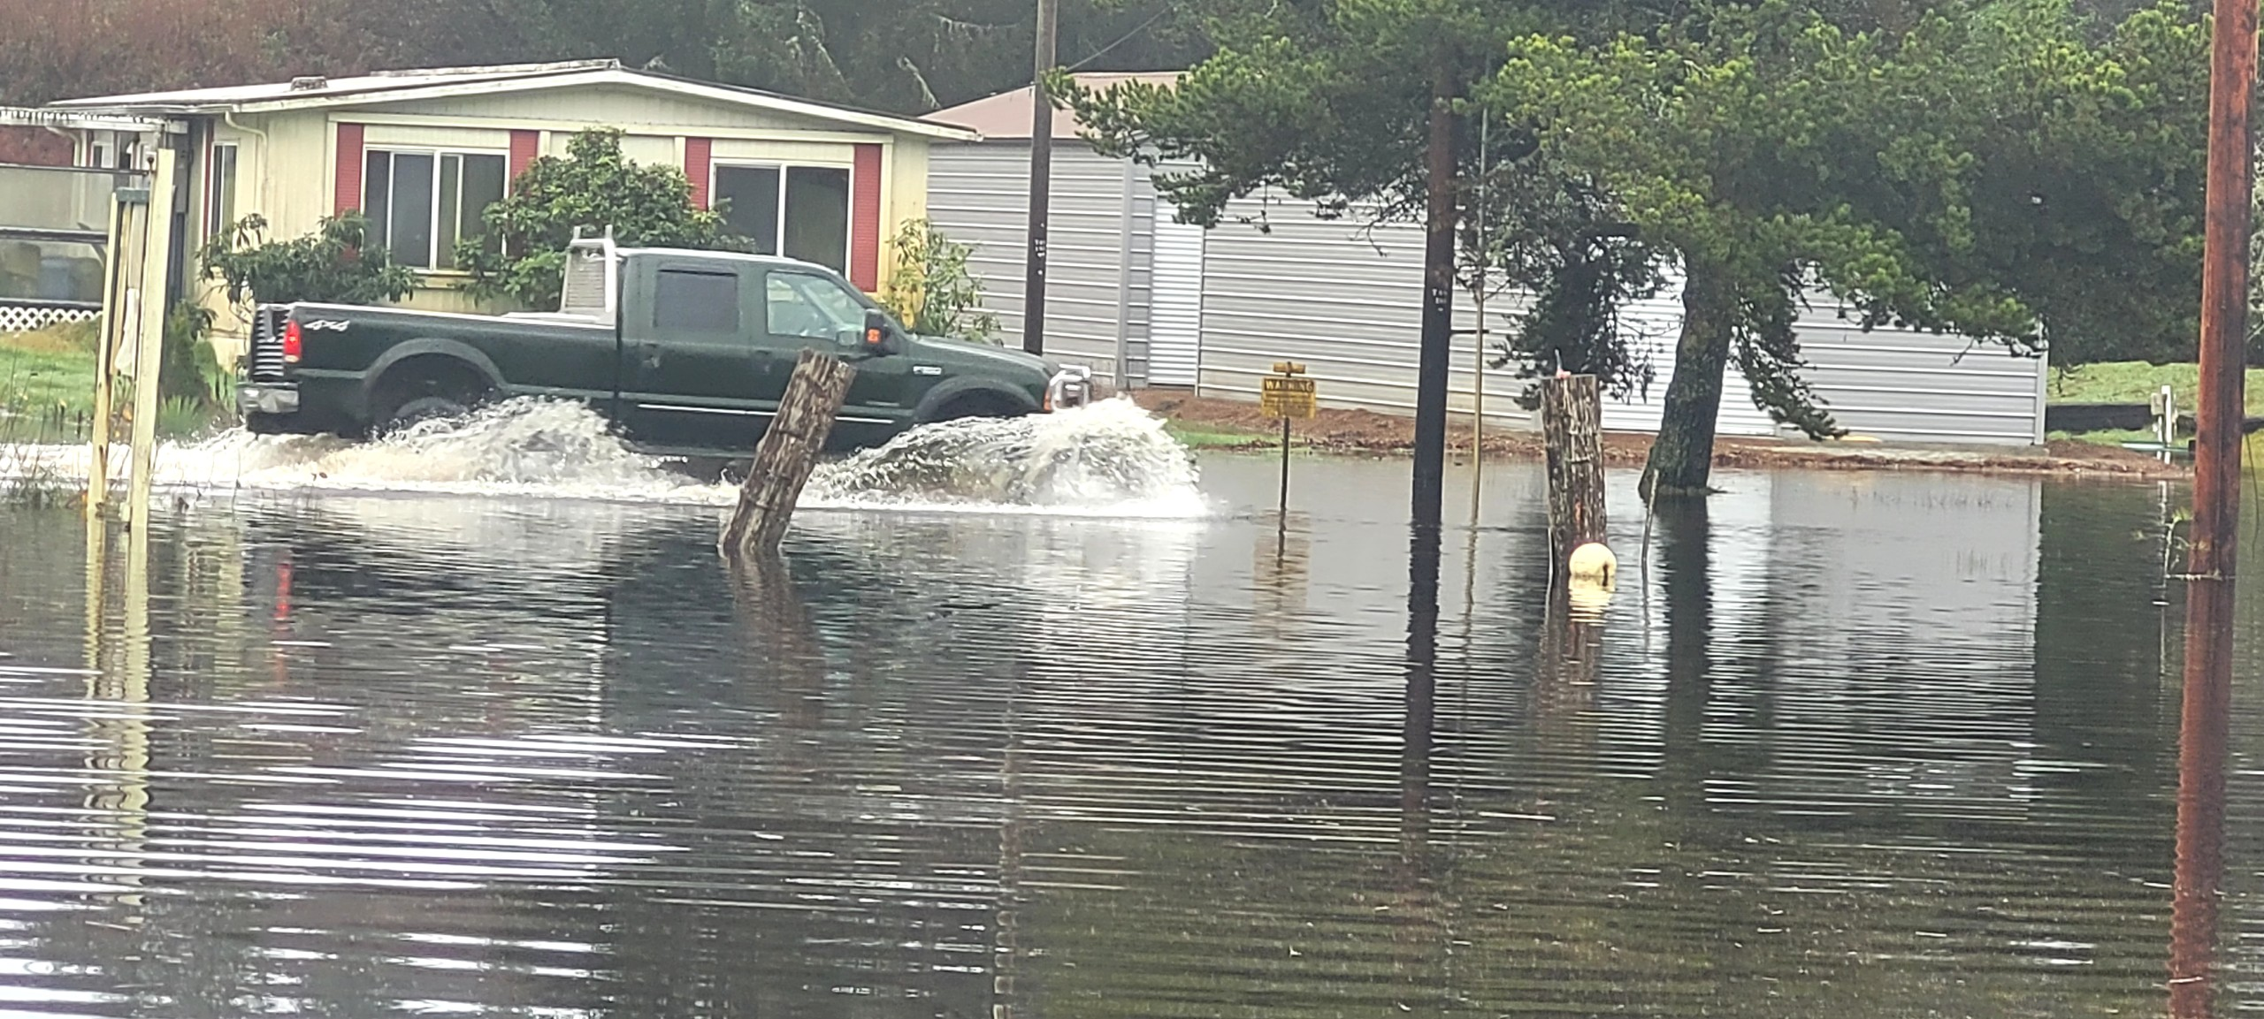
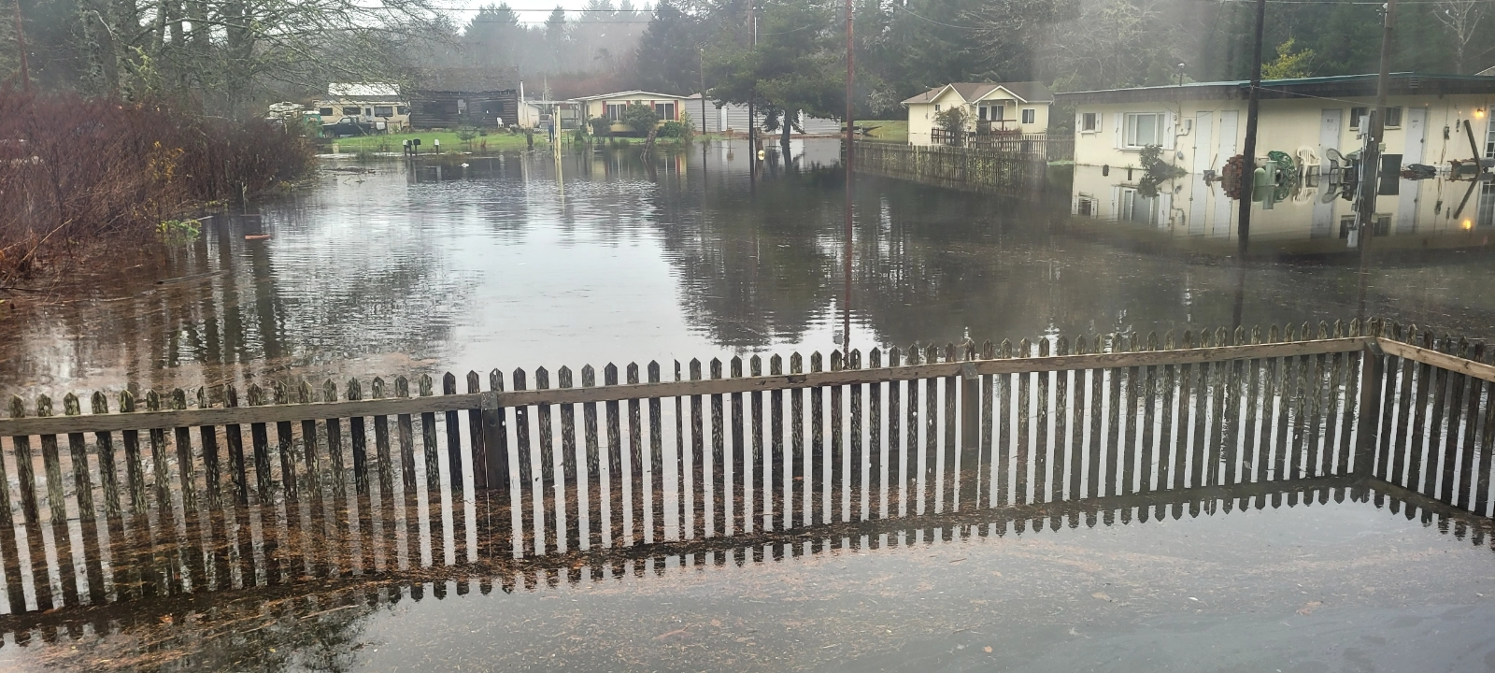
2. Information (Flooding)
Event #5
← 12-10-2023 →

Slide 12
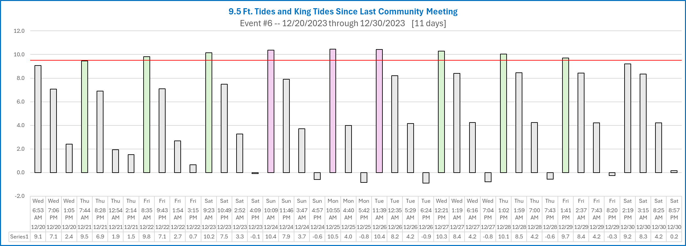
2. Information (Flooding)
Event #6

Slide 13
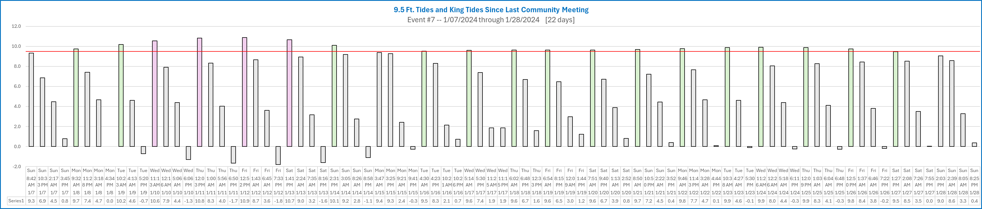
2. Information (Flooding)
Event #7

Slide 14
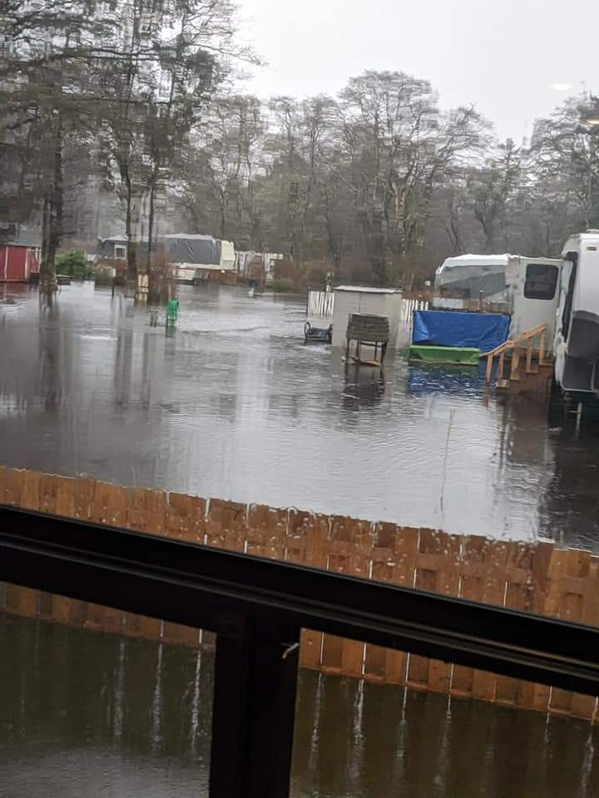
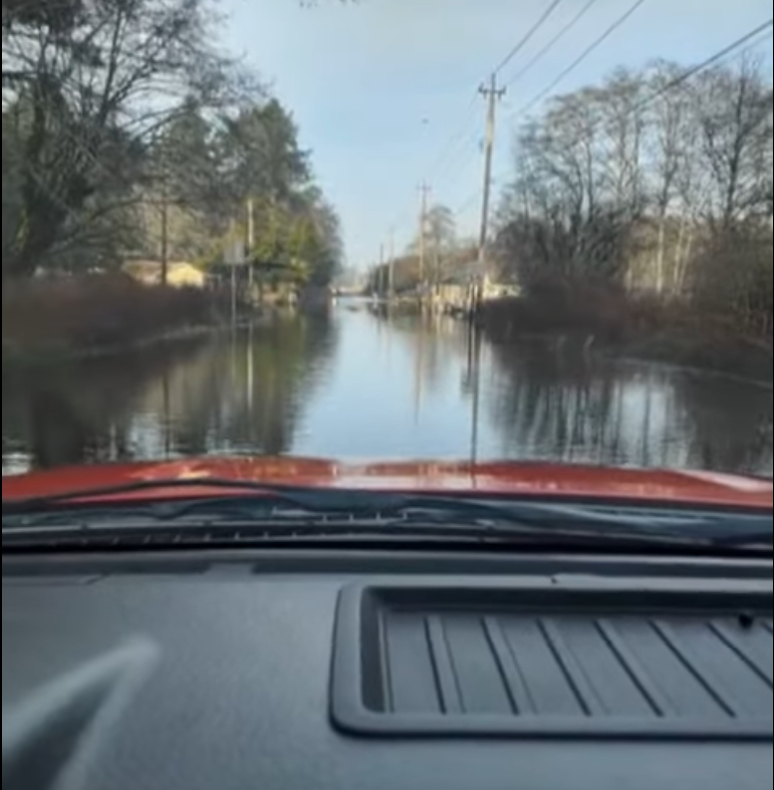
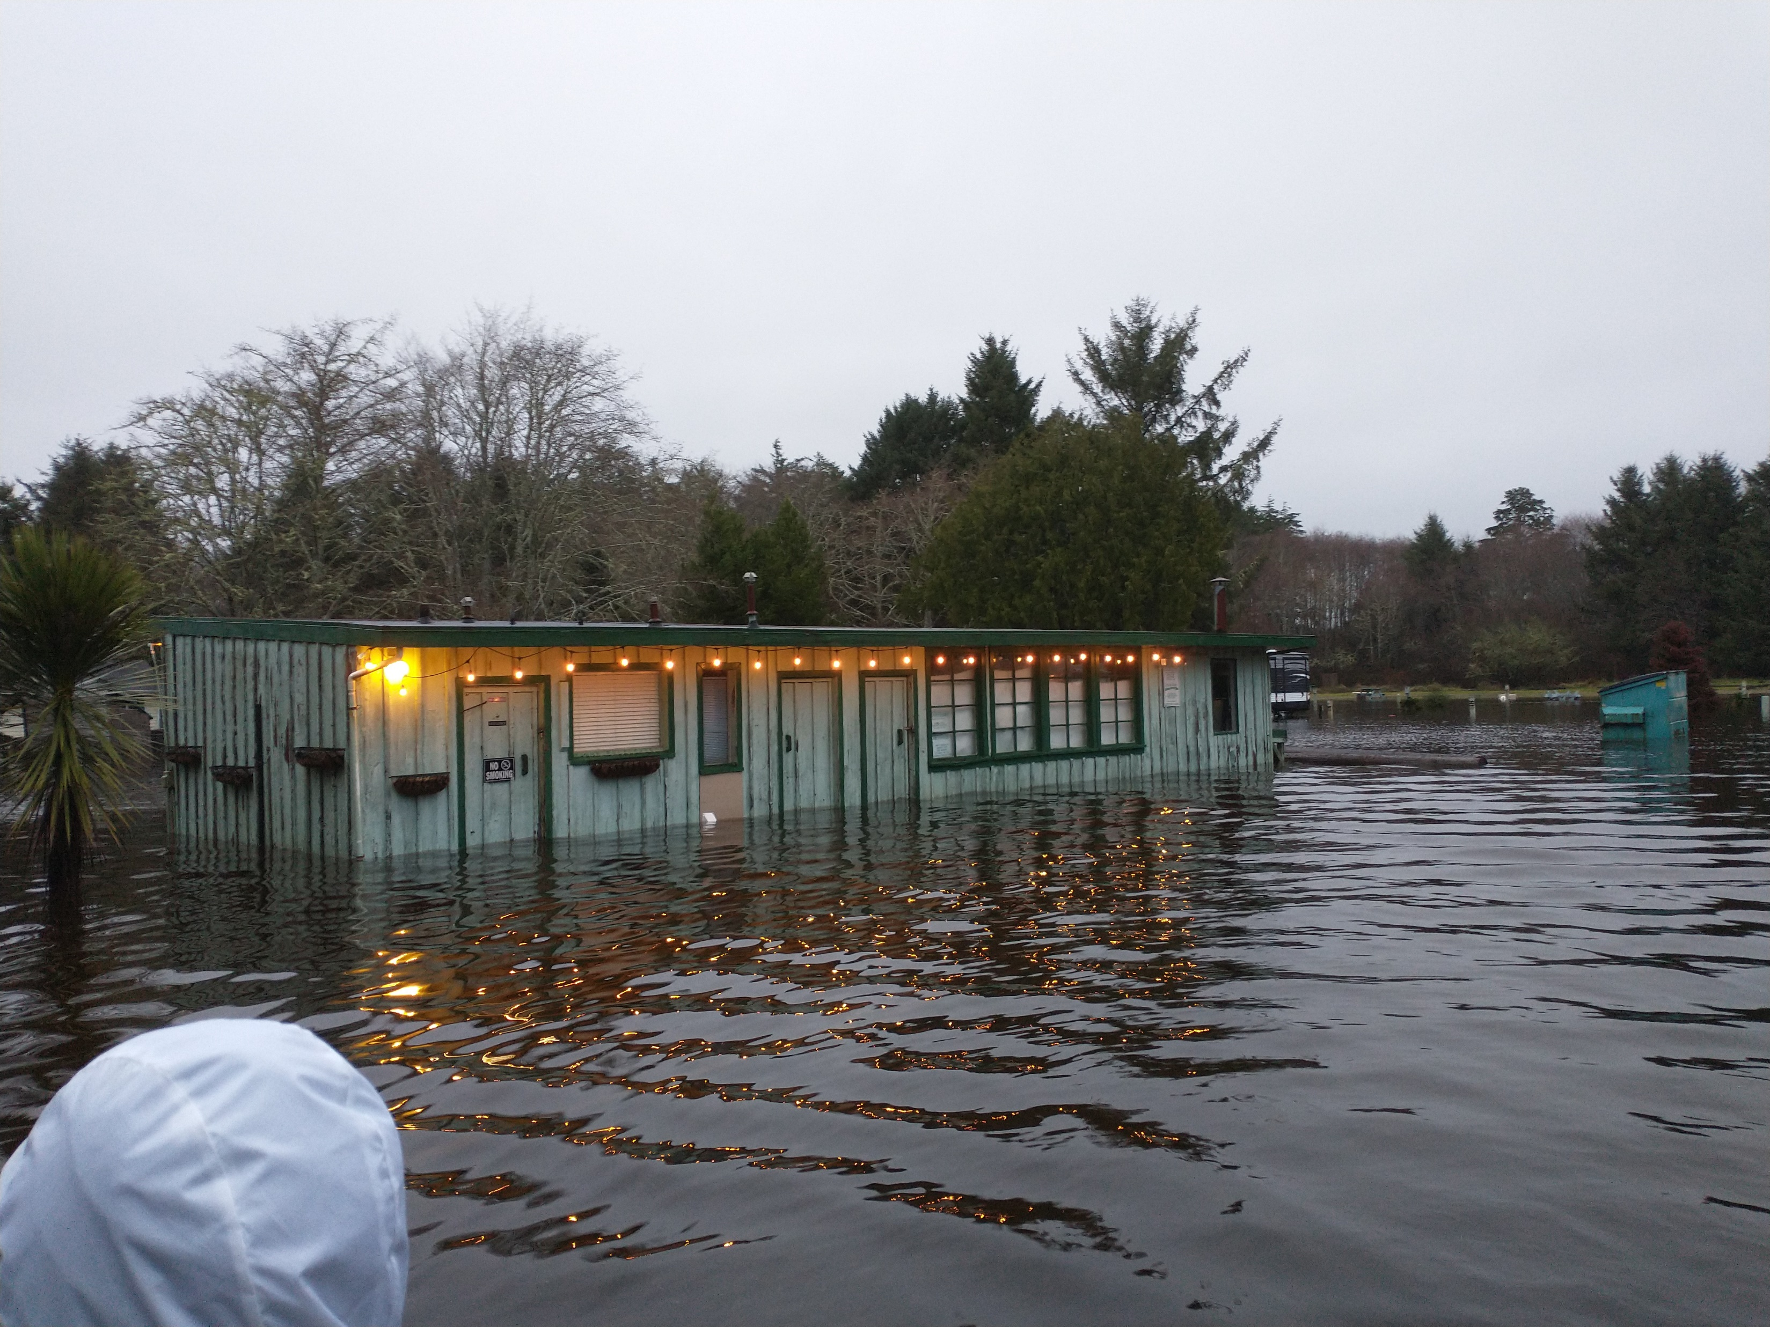
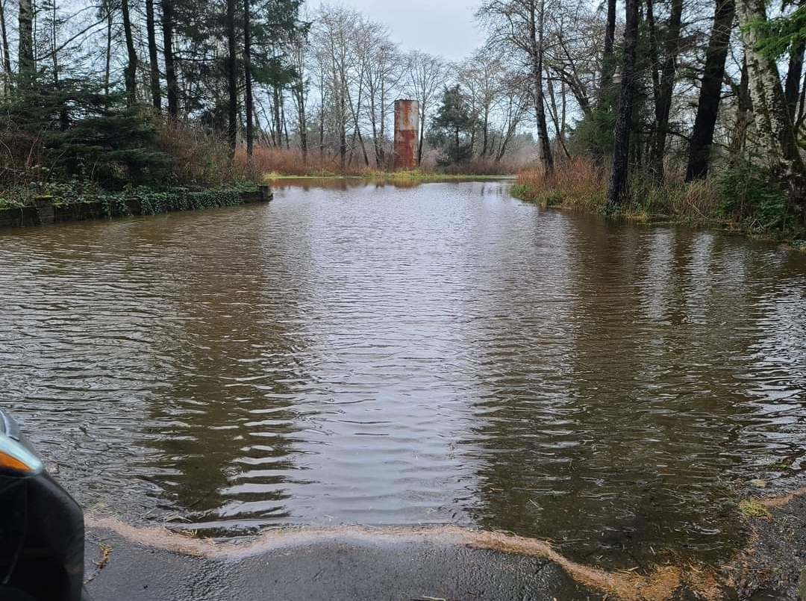
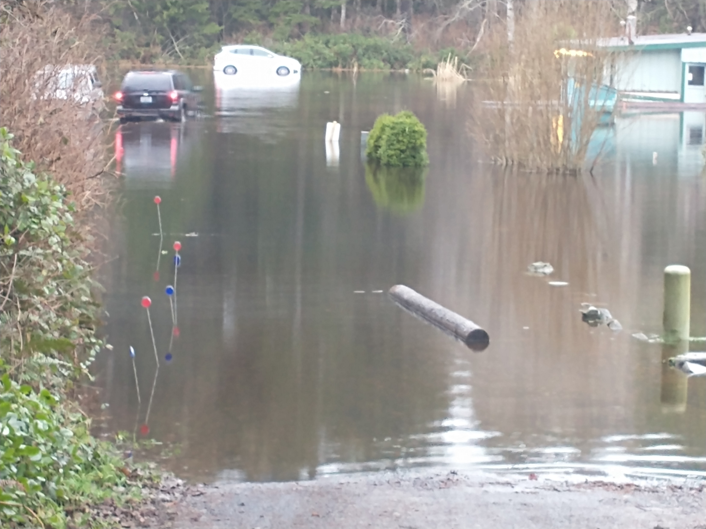
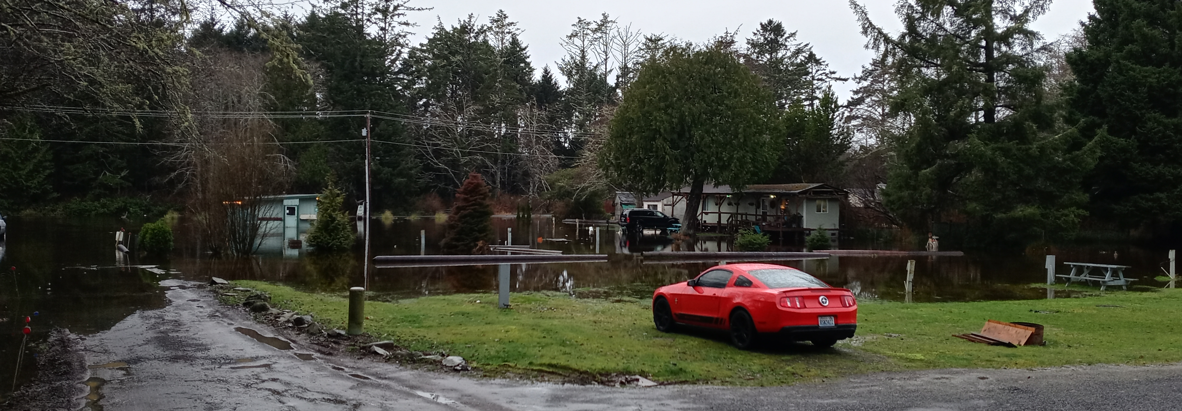
2. Information (Flooding)
← 1-03-2021
12-28-2022 →
1-07-2022 →
← 1-05-2021
1-07-2022 →
1-13-2023 →

Slide 15
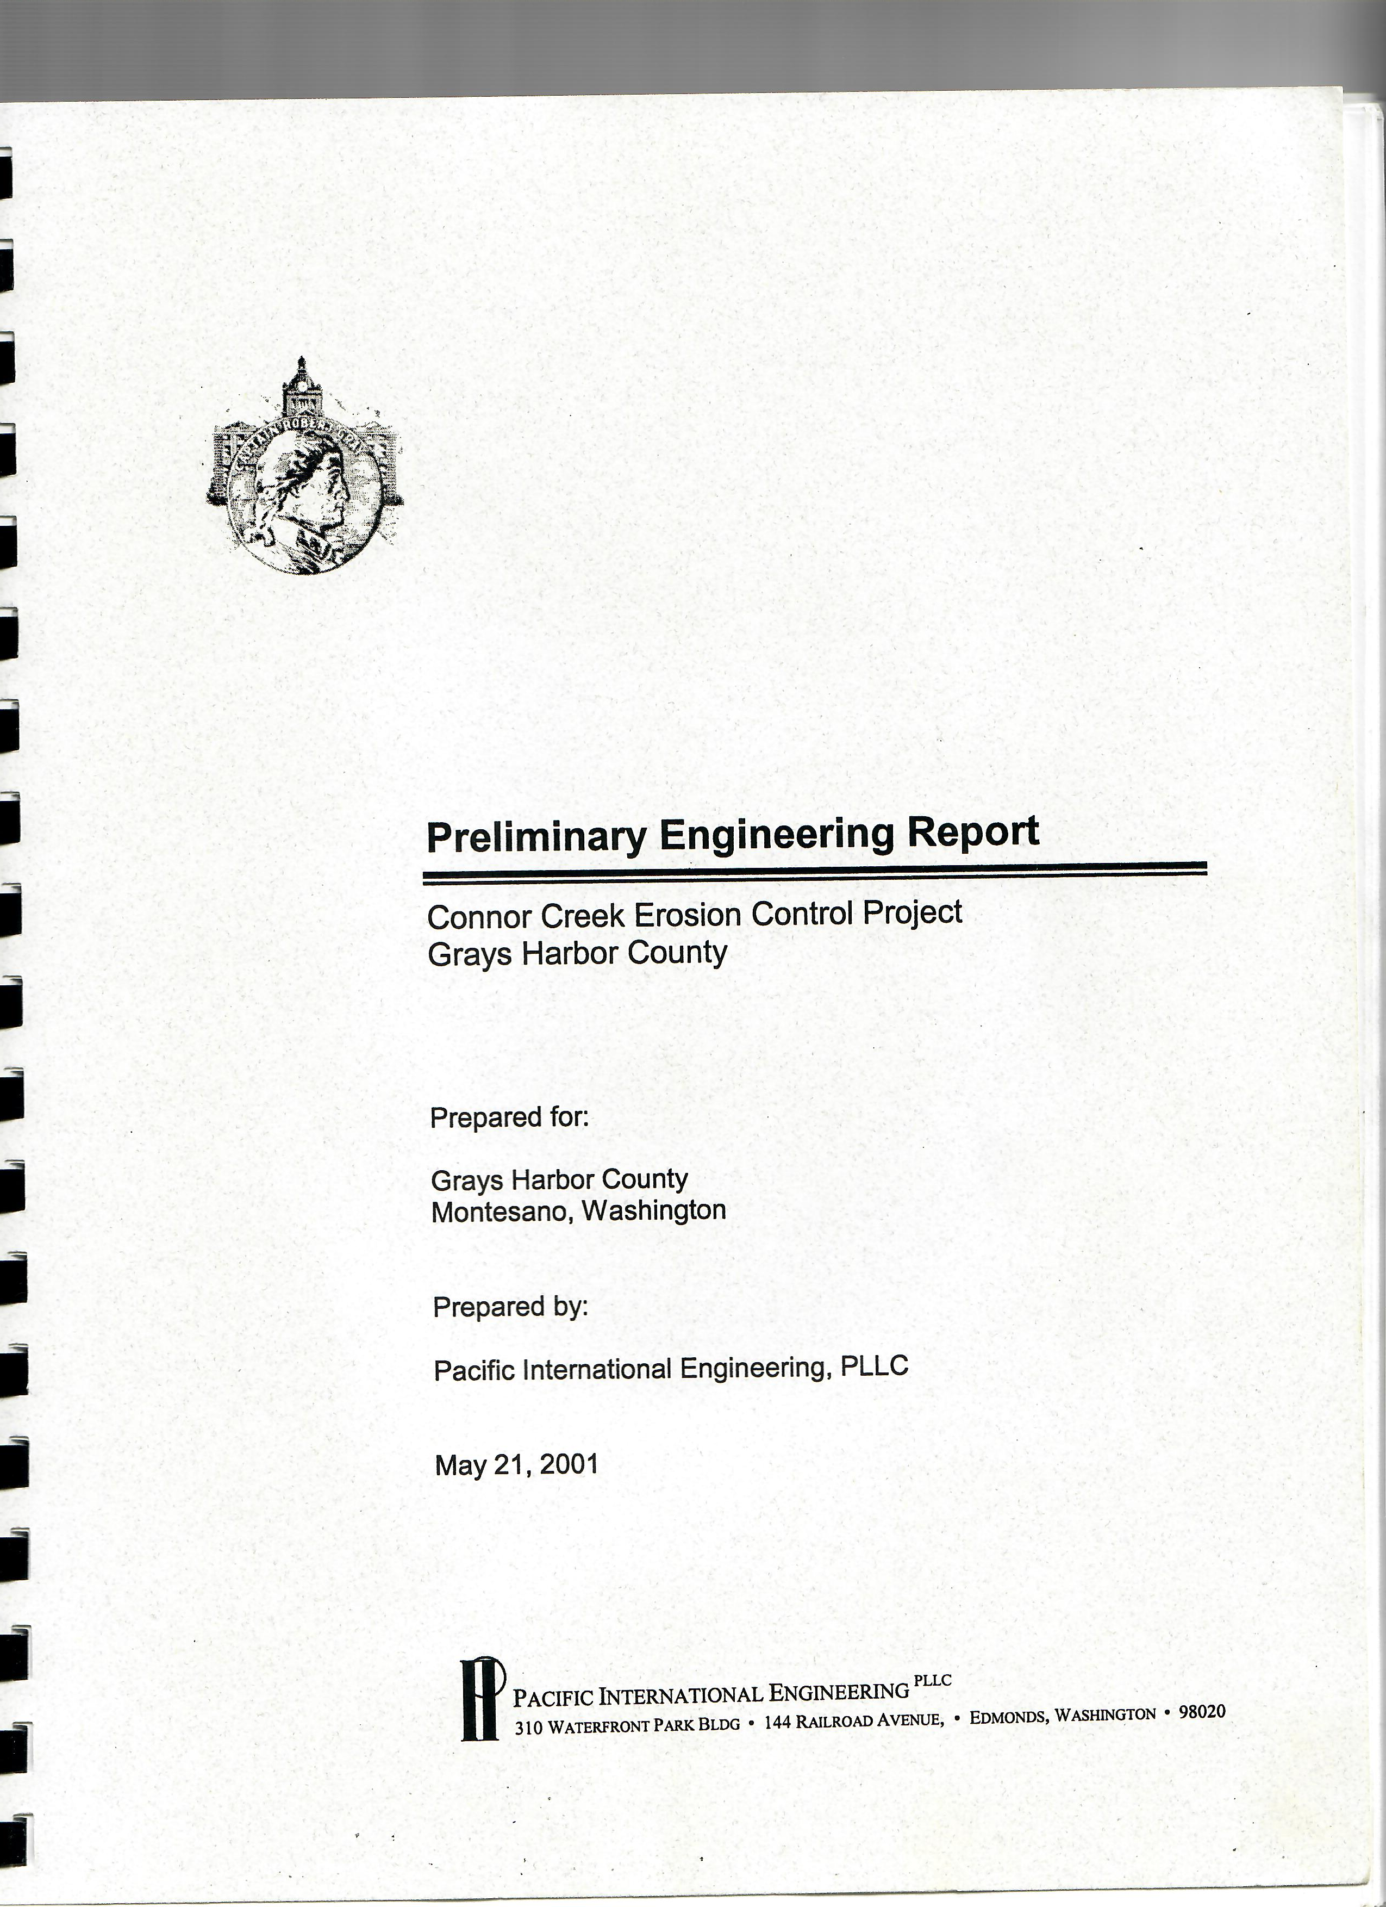
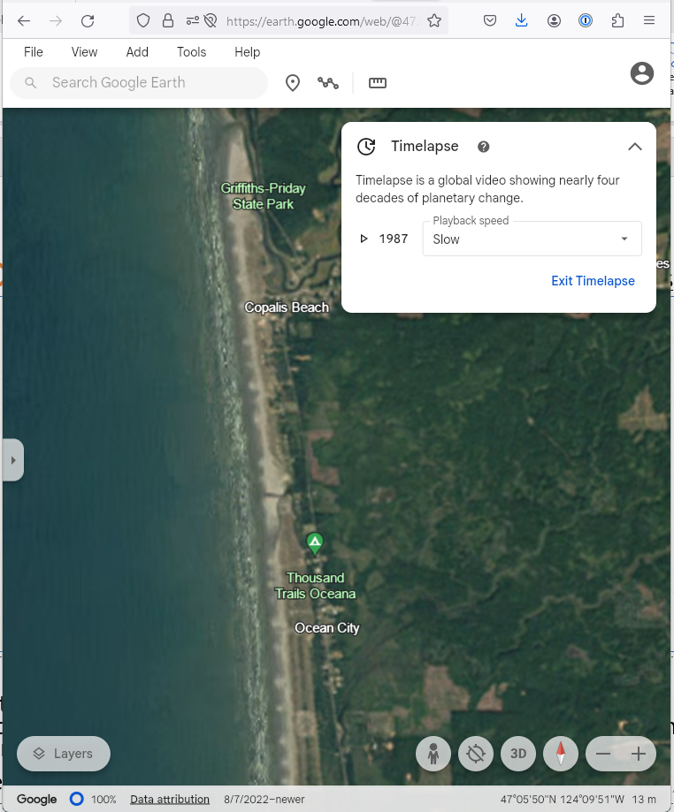
2. Information (Plans/Studies)
Issued May 2001.
Evaluated 9 alternatives to control migration of Connor Creek mouth.
Recommended “Composite Migration Corridor” (alt. 6) to install sand filled geotextile containers to contain mouth to 1987 location (Chabot Rd).
Alternative not implemented.
Did not address chronic flooding.
Activate Timelapse here or here.

Slide 16

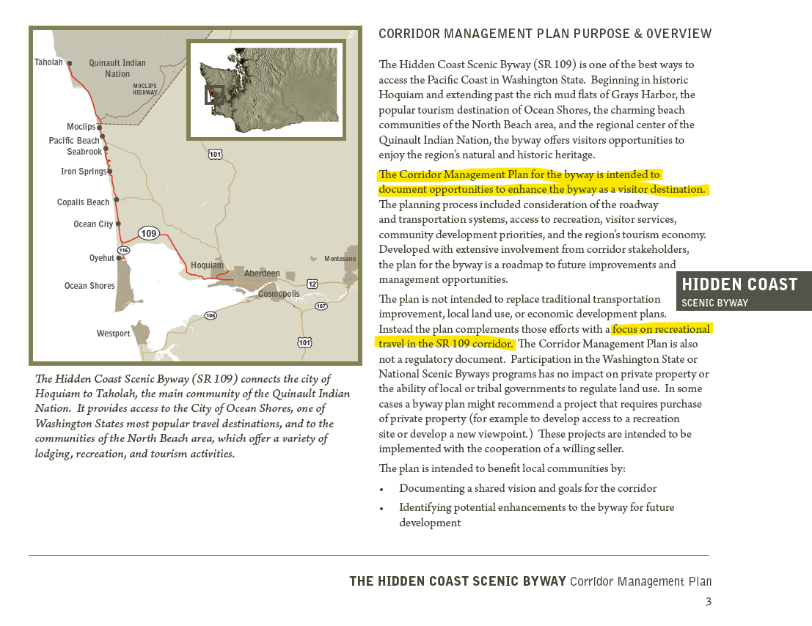
2. Information (Plans/Studies)
Issued June 2011 (see here).
Sets usage and travel vision for Hoquiam to Tahola.
Did not address chronic flooding.

Slide 17
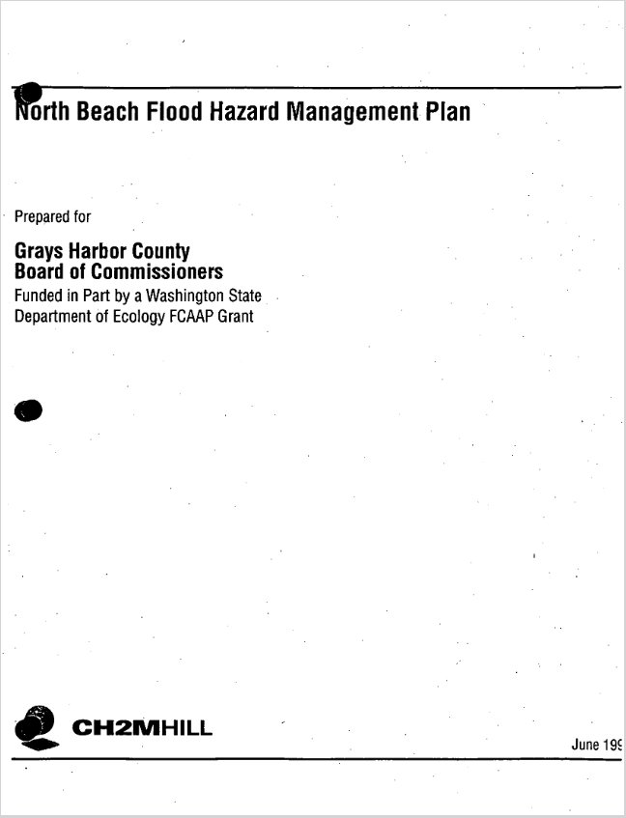
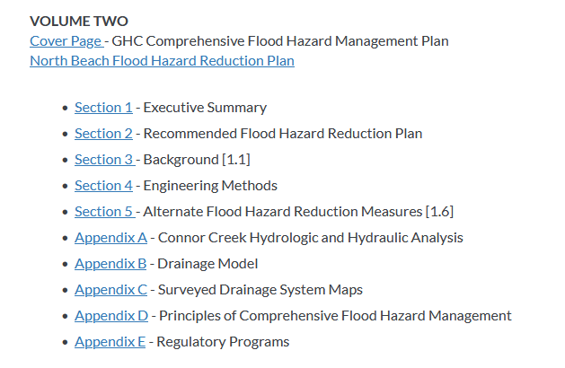
2. Information (Plans/Studies)
Issued July 1999 (see here).
Provides a baseline.
Out-of-date.

Slide 18
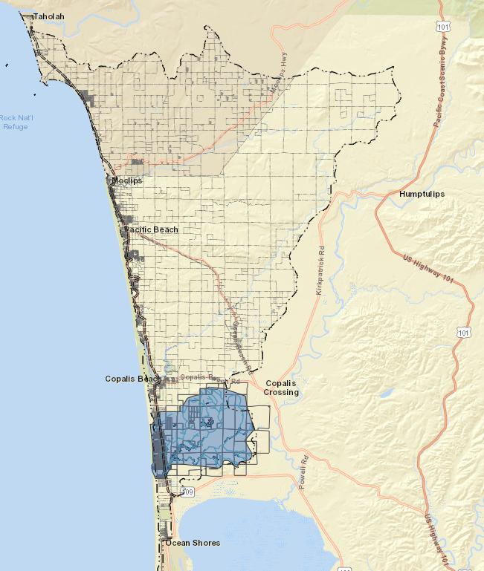
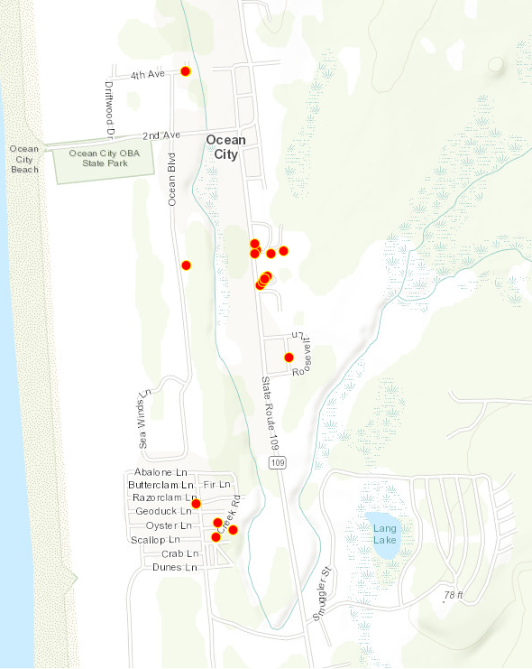
2. Information (Mapping)
Grays Harbor County web-based map with zoomable on/off layers.
See https://arcg.is/0eaKb1.
Layers:
  Parcels.
  Infrastructure (wells,
  bridges, roads).
  Water (wetlands, streams).
  Tsunami.
  Conner Creek watershed.
  Citizen photo uploads.
See instructions here.

Slide 19
2. Information (Photo/Drone/Imagery)
Video
1/03/2021 Video (GHFD#7) -- here
2021 or 2022 Video (Grays Harbor Public Utilities) -- here
12/05/2023 Video (Wendy) -- here
12/10/2023 Video (Wendy) -- here
Drone Footage
11/15/2023 Drone (Jim Weber) -- here 1 and here 2
Photo Footage
Photo -- here

Slide 20
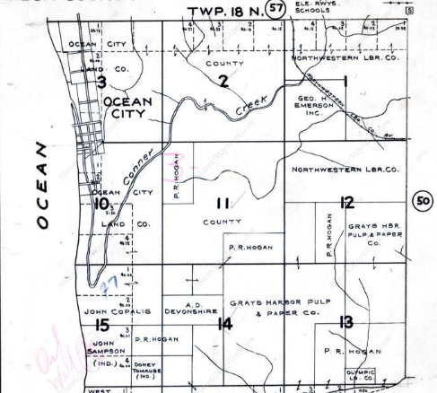
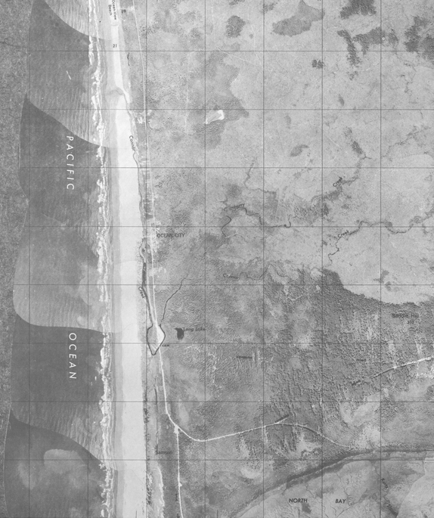
2. Information (Photo/Drone/Imagery)
← 1935 (org. 1927)
1944 →

Slide 21
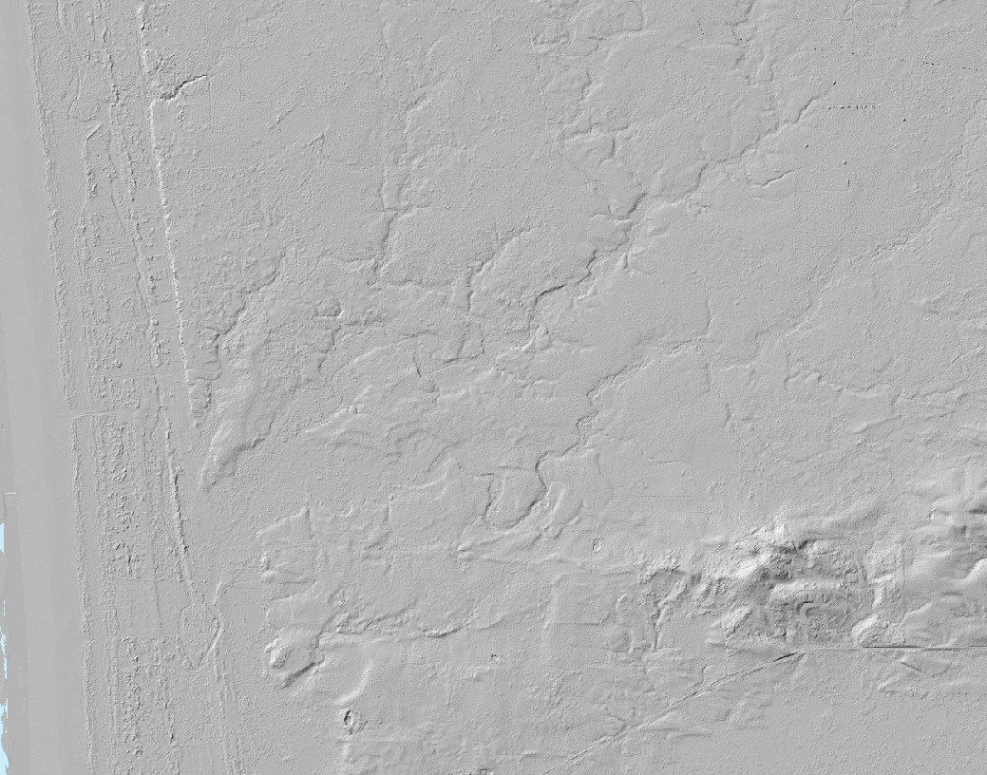
2. Information (Photo/Drone/Imagery)
https://lidarportal.dnr.wa.gov/#47.07366:-124.13392:14

Slide 22
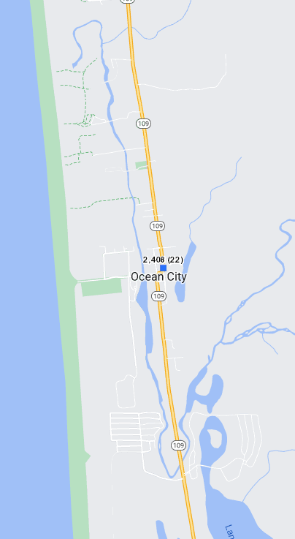
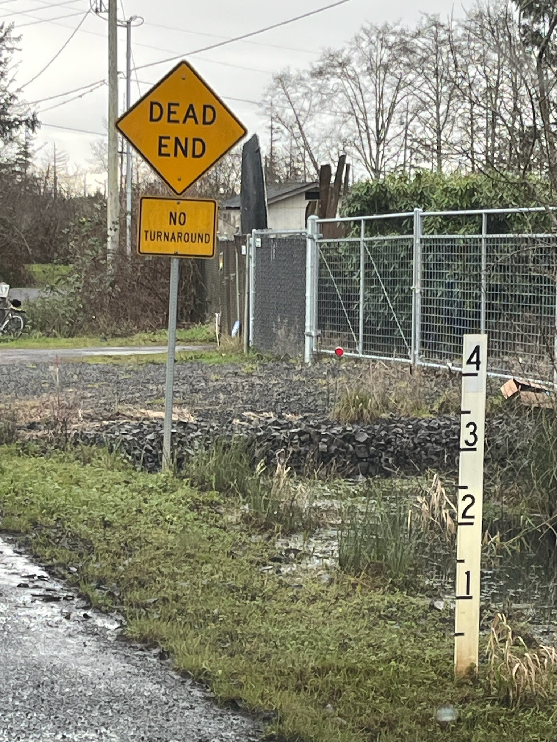
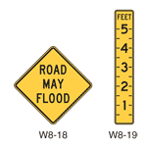
2. Information (Other Documentation)
2,408 two-way daily vehicle trips in 2022 (Location ID CS07522) →
← WSDOT will soon install flood warning and flood depth signs on SR109

Slide 23
3. Ideas/Possible Solutions
Implementation Ideas | Planning Ideas
1. Drainage/Conveyance -- Develop Connor Creek drainage plan. Locate/evaluate existing drainage infrastructure (public/private). Determine drainage volumes and needs (today/future). Factor in tidal effects. Determine alignments, rights-of-way, property acquisition needs. Develop DRAFT and FINAL plan. | 5. North Beach Future -- Assess the importance of flood hazard reduction to the future of North Beach and evaluate the extent to which current flooding hinders that vision. 6. Past Planning/Studies – Review/update existing plans, e.g., 1999 North Beach Flood Hazard Management Plan.
2. Drainage/Conveyance -- Consider formation of drainage district. Review operations/history/experience of GH Drainage District #1. Review formation process. Determine scope (regular drainage system maintenance). Evaluate benefits vs. costs, e.g., entities have longevity, can apply for grants. | 7. Documentation -- Correlate/document/map flooding frequency/duration with weather/creek conditions to better “tell the story.”
3. Emergency Response -- Investigate first responder needs (equipment, signage, flood tracking and warning, etc.). | 8. Funding – Identify funding programs. Seek input/perspective from GHCOG, GHCD, OCB, FEMA.
4. Infrastructure (Gaging) -- Install stream and weather station gages to document and inform about flooding conditions. | 9. Flood Warning -- Explore neighboring Chehalis River Basin Flood Warning System and consider partnerships.

Slide 24
B. Discuss Next Steps
Need Two Groups – Implementation Group and Planning Group.
Next Meeting – March 21, 2024 (6-8 PM, OSORC and Zoom)
  Updates from Implementation Group and Planning Group
  Update from WSDOT regarding SR109 Closures/Detours Summer 2024 (read more here)
Implementation Group:
Ground truth implementation ideas.
Cost-out, prioritize/sequence for next meeting.
3-4 meetings.
Planning Group:
Ground truth planning ideas.
Cost-out, prioritize/sequence for next meeting.
3-4 meetings.

Slide 25
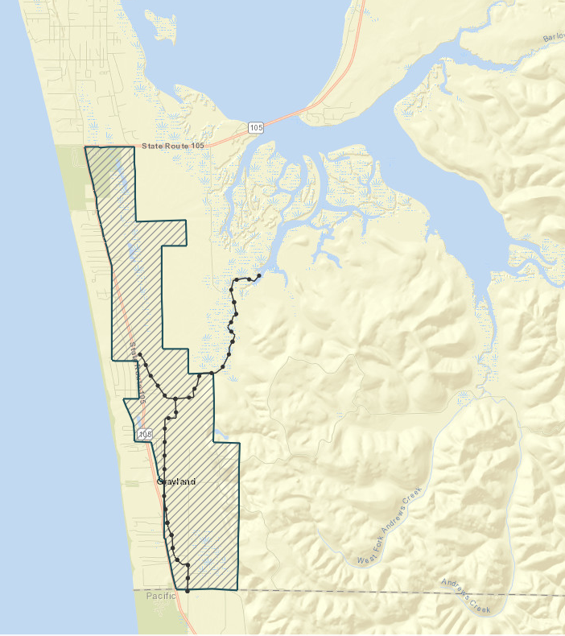
C. Additional Resources
Westport Tidal Predictions – here
King Tides Calendar -- here
WSDOT SR109 Traffic Counts (enter Location ID CS07522) -- here
GHC Ocean Beach Rd. Traffic Counts -- here
GHC Conner Creek Project Web Map:
  Map -- here
  Instructions -- here
Connor Creek Migration Imagery (Google Timelapse) -- here
Funding Opportunities (8-30-2023) – here
Drone Footage following Event #3 (Jim Weber, 11-15-2023) -- here 1 and here 2
Grays Harbor Drainage District #1

Slide 26
Attachment A – Meetings/Conversations
Date | Who | Major Discussion Themes/Topics
10/05/2023 | Luke Crooks (OSORC) | Drainage/Conveyance
10/16/2023 | Chris Talevich, Kyle Scott (GH County Utilities) | Infrastructure (protection/access)
10/16/2023 | Mike Wichers (Homeowner) | Drainage/Conveyance
10/16/2023 | Vladimir Shepsis (Applied Ocean Energy Co.) | Past Planning/Studies (coastal geomorphology)
10/16/2023 | Stan Sturgeon (Sturgeon Trailer Harbor) | Drainage/Conveyance
11/15/2023 | Bill Scott, Tricia Sorenson (WSDOT Maintenance) | Drainage/Conveyance, SR109 (travel, maintenance)
11/21/2023 | Brandon Carman, Amy Spoon (WDFW) | Drainage/Conveyance
12/01/2023 | Lynette Buffington (Greater Grays Harbor) | North Beach Future
12/06/2023 | Jim Weber (OSORC, Drone enthusiast) | Documentation (flooding pictures/drone)
12/07/2023 | Matt Reichenberger (GH Drainage District 1) | Drainage/Conveyance (managing, operating drainage district)
12/08/2023 | Stan Sturgeon (Sturgeon Trailer Harbor) | Drainage/Conveyance
12/13/2023 | Chief Stephanie Selin (GHFD#7) | Emergency Response
12/13/2023 | Lisa McElliot (Pacific Beach Business Owner) | SR109 (travel)
12/21/2023 | Stephen Poulakos (Seabrook) | North Beach Future, Past Planning/Studies
12/26/2023 | LJ Robinson (Kiewit Project Manager) | SR109 (Summer 2024 fish passage projects)
1/10/2024 | Mike Nordin (Grays Harbor Conservation District) | Drainage/Conveyance
1/17/2024 | Vicki Cummings (Grays Harbor Council of Governments) | North Beach Future, Past Planning/Studies

