Slide 1
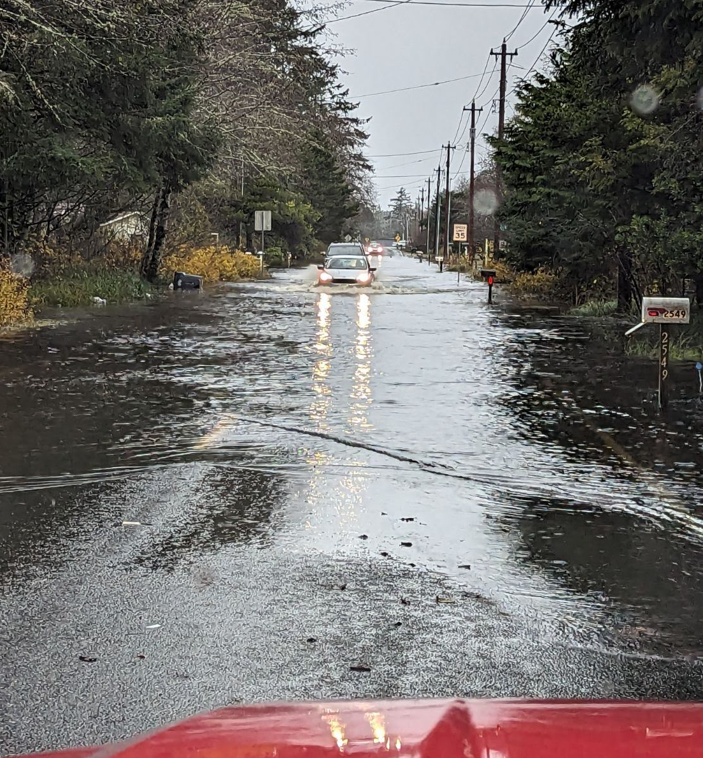
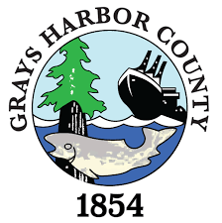
Connor Creek Flooding
Community Meeting
Ocean Shores Outdoor Recreation Club
March 21, 2024 -- 6:00 PM
← 12-05-2023
2-13-2024 →
Thank you WSDOT!

Slide 2
Today’s Presentation
Provide update on activities since last meeting (1-18-2024).
Discuss Connor Creek Implementation Group perspective on formation of a drainage district.
Discuss schedule and next steps.
Link to this presentation:
Connor Creek Community Meeting 3-21-2024
Scott Boettcher
SBGH-Partners
360/480-6600
scottb@sbgh-partners.com

Slide 3
A. Activities Since Last Meeting
Updated Problem statement . . .
“Connor Creek presents a chronic, complex, and historically unaddressed flooding problem adversely affecting North Beach residents, visitors, businesses, and emergency responders alike that has steadily gotten worse since about 1987.”

Slide 4
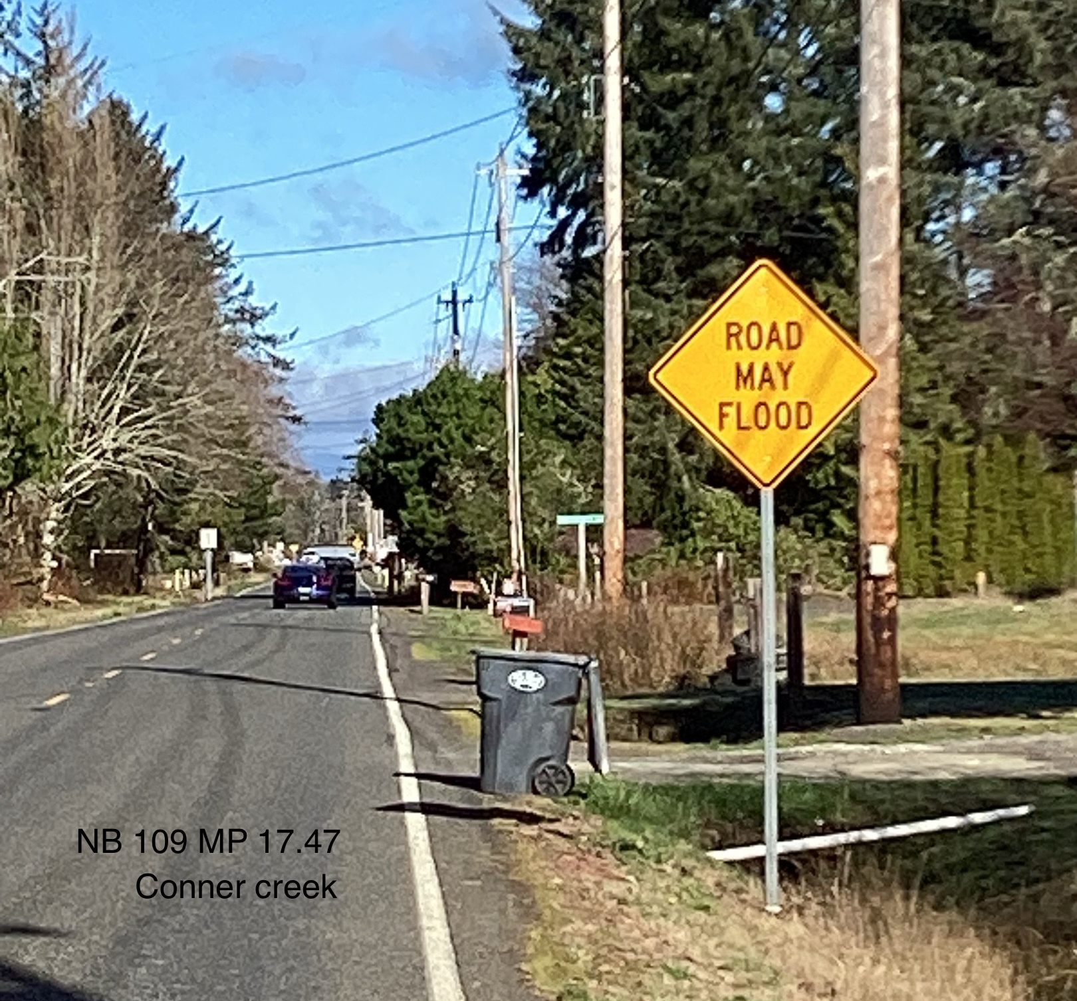
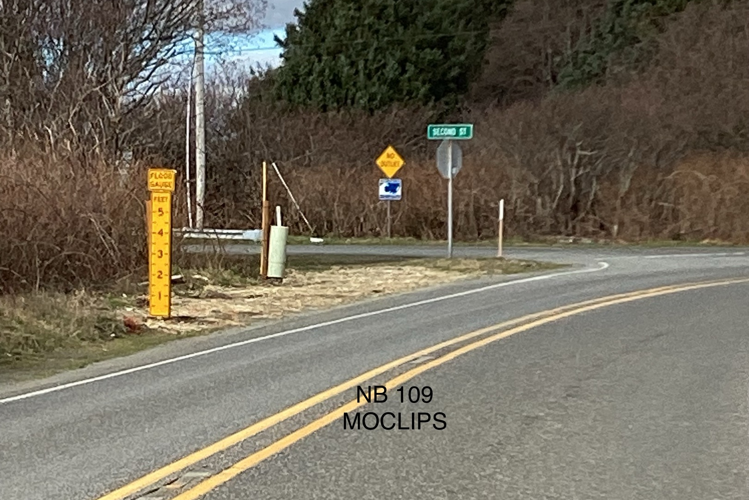
A1. Flood Signs
Thank you WSDOT!
2-23-2024

Slide 5
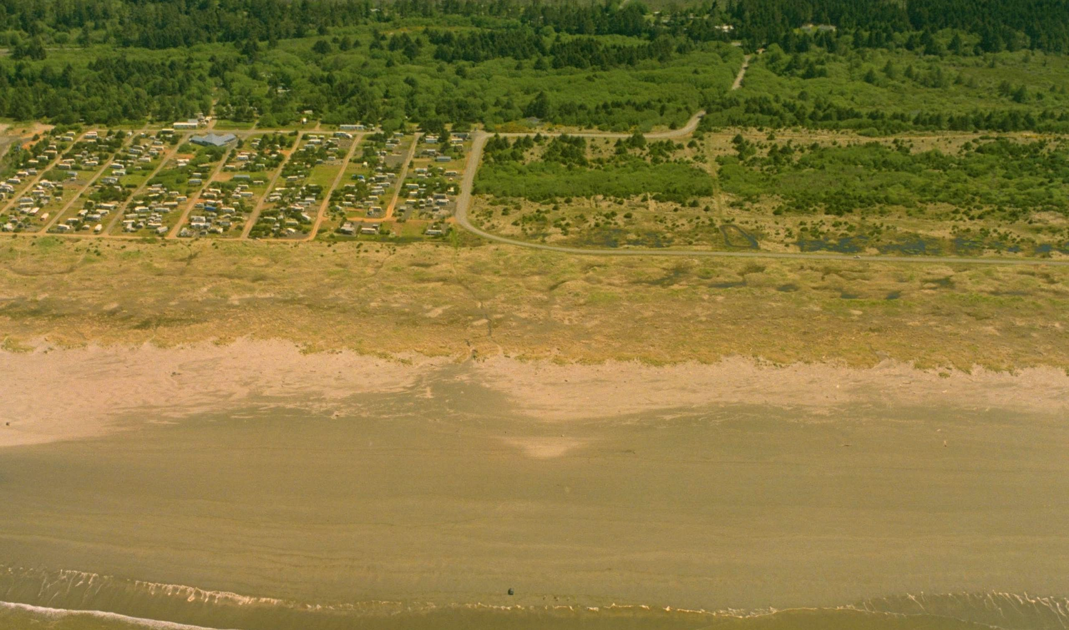
A2. Drainage Through The Dunes
1-24-2024:
Walked old, high-flow drainage course south of OCORC with several community members.
Walked Dunes Estate mitigation site.
Observed drainage pipe between OCORC and mitigation site
Collected mitigation plans and documents.
Mitigation Plan, here.
Mitigation Design, here.
Monitoring Report, here.
Ocean Shores Outdoor Recreation Club (OCORC) 5-10-1997

Slide 6
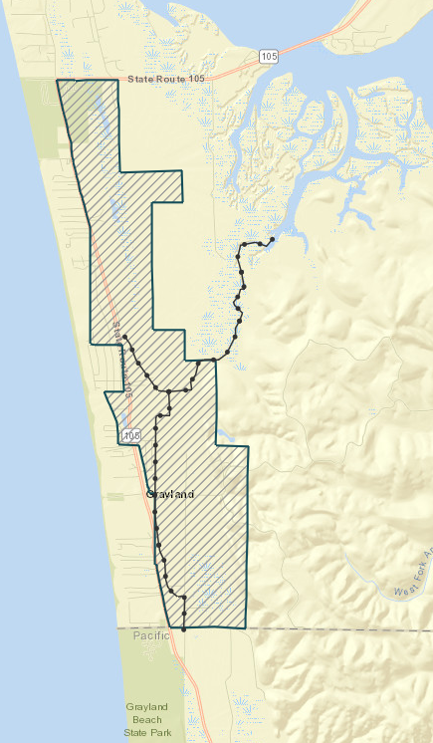
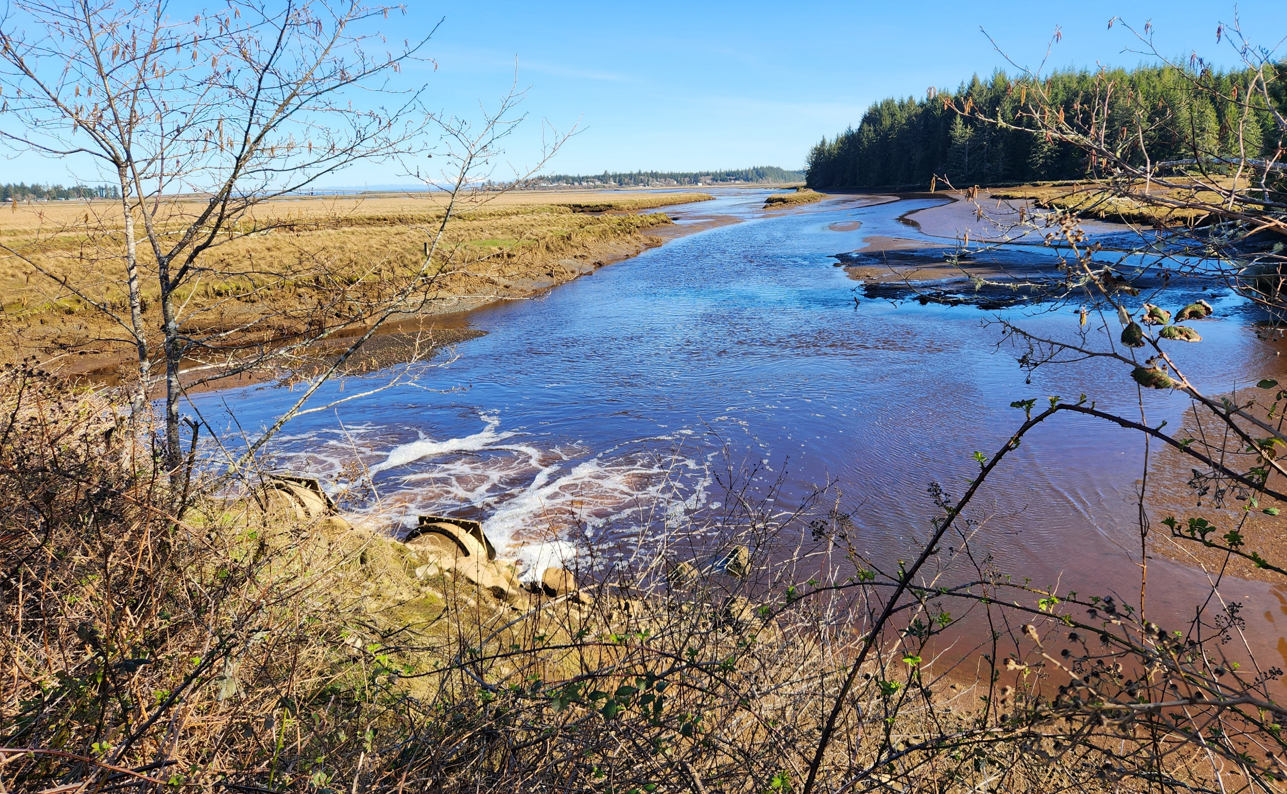
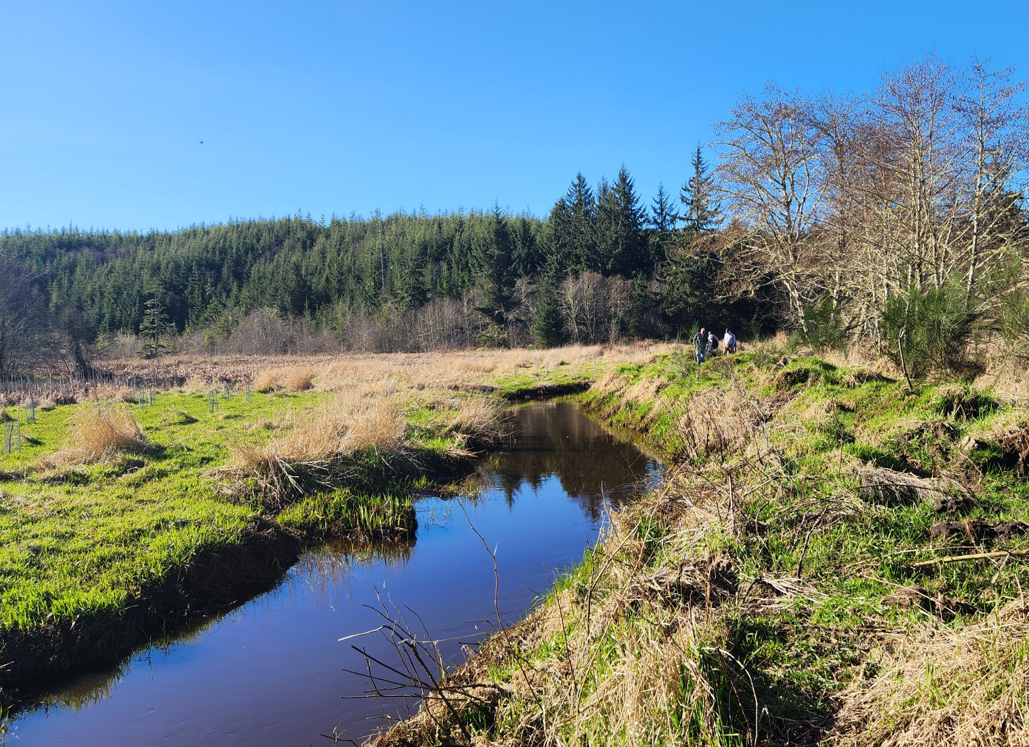
A3. Connor Creek Implementation Group
Meeting #1 -- 2/15/2024: Met at OSORC with Matthew Reichenberger (DD No. 1 Commissioner) to learn ins/outs, pros/cons of operating/maintaining DD No. 1.
Meeting #2 – 3/16/2024: Made site visit of DD No. 1 (Grayland) and walked maintained ditch out to tide gates at Elk river estuary.
Meeting #3 – 3/19/2024: Held virtual follow-up meeting with team.
Thank you, Stan & Vicki Hutton, Michelle Wiley,
Stan Sturgeon, Matthew Reichenberger!

Slide 7
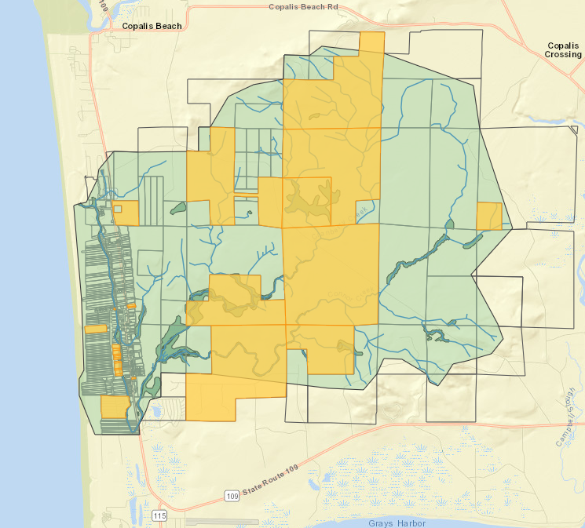
A4. Public Parcels, Connor Creek Watershed
PARCEL # | OWNER
788000100000 | FIRE DISTRICT #7
788000200001 | FIRE DISTRICT #7
181201000000 | G H COUNTY
181202310000 | G H COUNTY
181211100000 | G H COUNTY
181212120000 | G H COUNTY
191132330000 | G H COUNTY
191225110000 | G H COUNTY
191234340020 | G H COUNTY
191235210000 | G H COUNTY
191236100000 | G H COUNTY
730502300000 | G H COUNTY
787501700000 | G H COUNTY
787501800000 | G H COUNTY
787502000000 | G H COUNTY
787502100000 | G H COUNTY
787502400000 | G H COUNTY
787502600000 | G H COUNTY
787502700000 | G H COUNTY
787502800000 | G H COUNTY
787503000000 | G H COUNTY
787503100000 | G H COUNTY
181210330010 | OCEAN SHORES OUTDOOR REC CLUB
181210210010 | STATE OF WASHINGTON
191236300000 | STATE OF WASHINGTON
View interactive map here.
[Note: Add public ROW next.]

Slide 8
B. Perspective on Formation of a Drainage District
Pro | Con
It’s a legal, public “entity” (eligible to apply for public funding, empowered to implement its charge, etc.). It works (DD No. 1 has operated since 1930s). Assessments are low (or at least can be). DD No. 1 is a good analog (low lying coastal environment). | There’s an administrative burden (for Commissioners). There’s a personal responsibility burden (for Commissioners). Assessments are always unpopular. It takes time to set-up and efficiently operate/maintain.

Slide 9
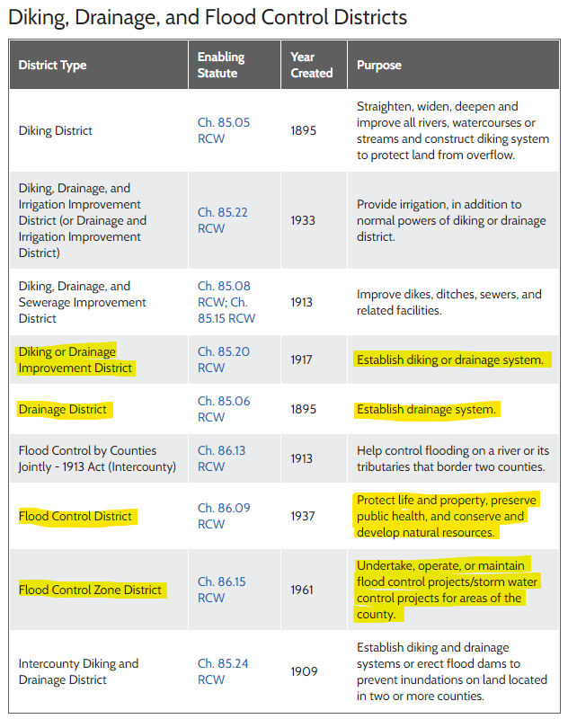
B. Perspective on Formation of a Drainage District
RCW 85.05
RCW 85.06
RCW 85.08
RCW 85.15
RCW 85.20
RCW 85.22
RCW 85.24
RCW 86.09
RCW 86.13
RCW 86.15
Which type drainage/flood district?
Source: MSRC here

Slide 10
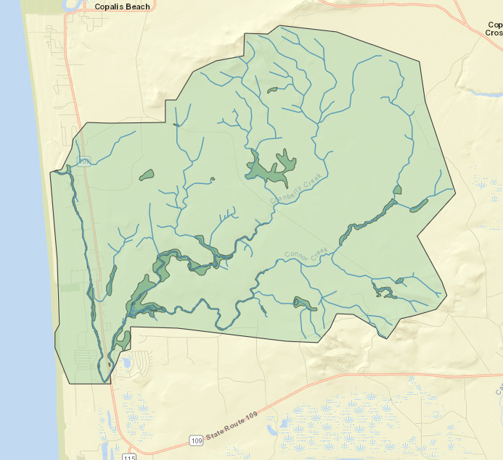
B. Perspective on Formation of a Drainage District
Possible Goals by Solution Area
Uplands: Slow, moderate, and/or reduce/redirect flow.
SR109 Corridor: Improve conveyance, evacuation (via public parcels, ROW).
Through the Dunes: Reinstate high-flow, overflow.
Mitigation Site: Enhance wetland water storage (hotter summers).
King Tides: Evacuate high-flows at historic overflow points.
View interactive map here.

Slide 11
C. Schedule and Next Steps
5/16/2024 (Community meeting): Recommend preferred district type and service area.
7/18/2024 (Community meeting): Present outreach and partnership building materials.
Aug-Dec 2024: Formation of district.
Aug-Dec 2024: Outreach and partnership building.
Aug-Dec 2024: Formation and submittal of legislative and grant funding requests.
Jan-May 2025: Legislative session.
July-Dec 2025: Hire expertise; Develop flood/drainage plan; Secure permits/funding for Phase I projects.
Confirm public ROW.
Secure rain gages and stream gage.
Confirm status of 1997 Flood Control Zone District (reference here).
With Implementation Group, evaluate preferred drainage/flood district type and service area/boundary.
Refine schedule.
Identify funding opportunities (e.g., 3/20/2024 Public Works Board announcement, here).

