Slide 1
Connor Creek Implementation Team
Flood Control Zone District Considerations
Grays Harbor County
Commissioner Vickie Raines
4-09-2024 (2:15 PM to 3:00 PM)
-- Implementation Team --
Stan Sturgeon
Vicki Hutton
Stan Hutton
Michelle Wiley
Gary Clarke

Slide 2
Today’s Presentation/Discussion
Status of 1996 FCZD reported at Last Community Meeting (3-21-2024)
Implementation Group’s Current Perspective on Preferred Type of “Entity”
Options and Next Steps
Scott Boettcher
SBGH-Partners
360/480-6600
scottb@sbgh-partners.com

Slide 3
Connor Creek Flooding Problem Statement
Updated Problem statement (3-21-2024 Community Meeting). . .
“Connor Creek presents a chronic, complex, and historically unaddressed flooding problem adversely affecting North Beach residents, visitors, businesses, and emergency responders alike that has steadily gotten worse since about 1987.”

Slide 4
A. Status of 1996 FCZD
BOCC established local FCZD in July 1996 in response to a local petition.
1996 FCZD served a corridor immediately north of the Connor Creek watershed focused on Connor Creek migration.
1996 FCZD was “active” up until early 2000s (2002??, 2003??).
1996 FCZD does not appear to have been dissolved and is assumed to still be “on-the-books.”

Slide 5
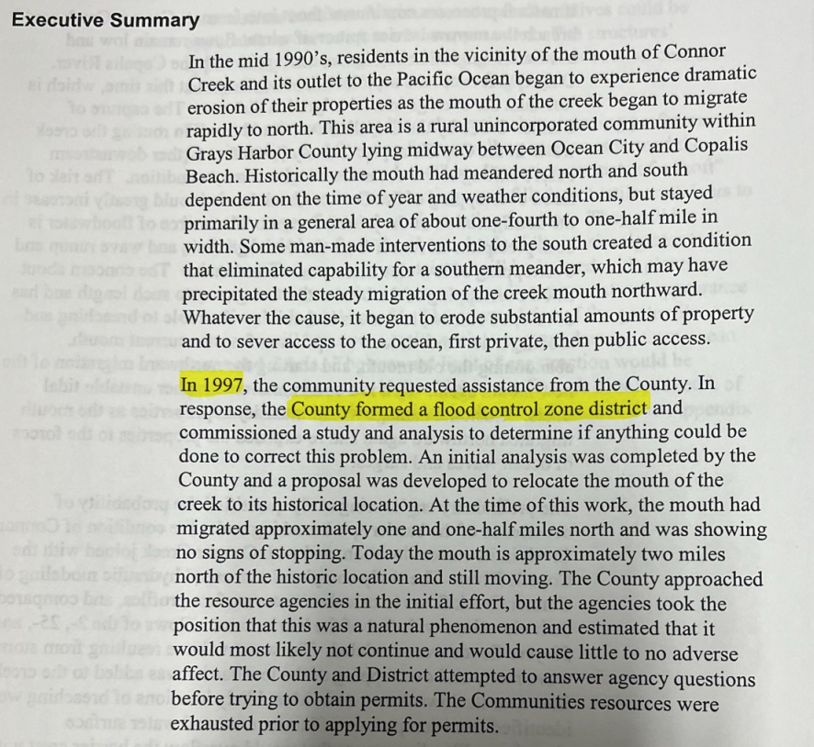
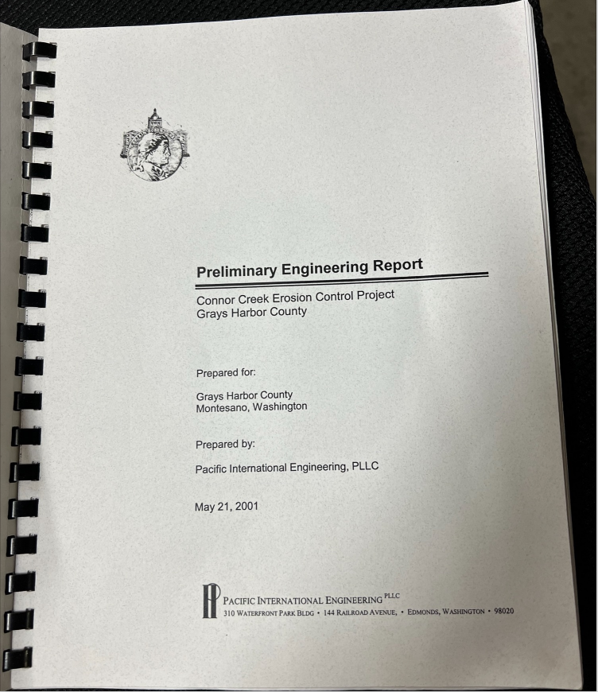
A1. Original Reference
https://www.ezview.wa.gov/Portals/_2006/Documents/Documents/1997%20FCZD%20Ref%203-21-2024.pdf

Slide 6
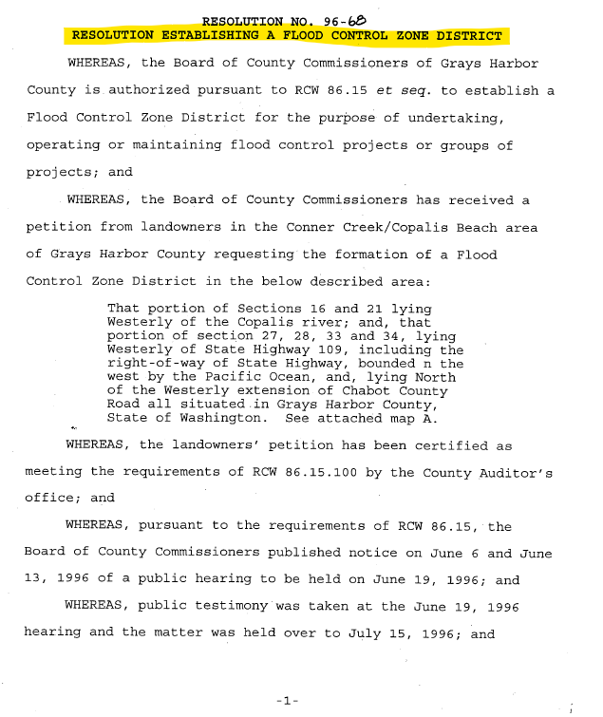
A2. 1996 Resolution

Slide 7
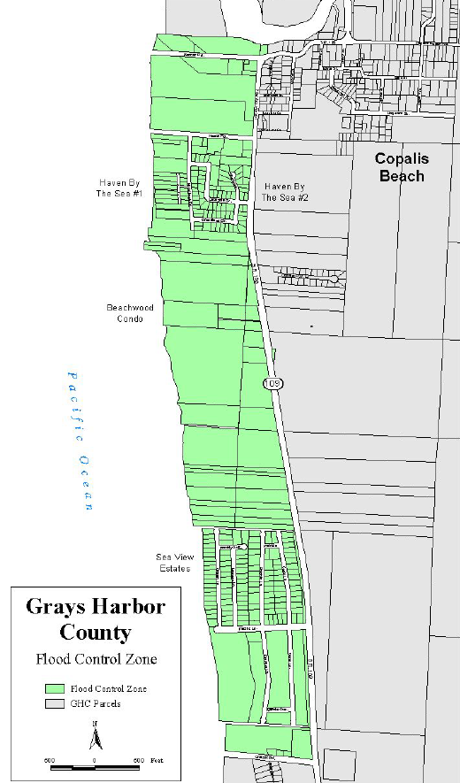
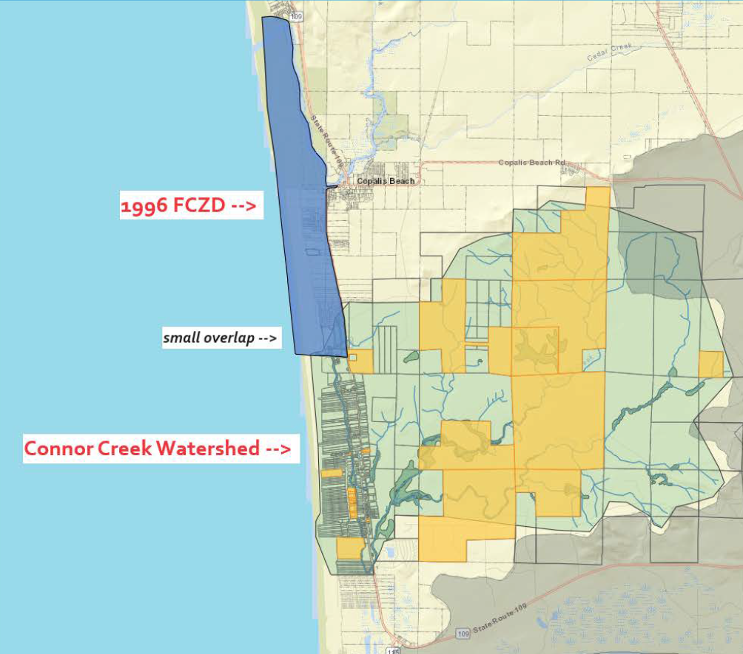
A3. 1996 FCZD Boundary
View interactive map here.

Slide 8
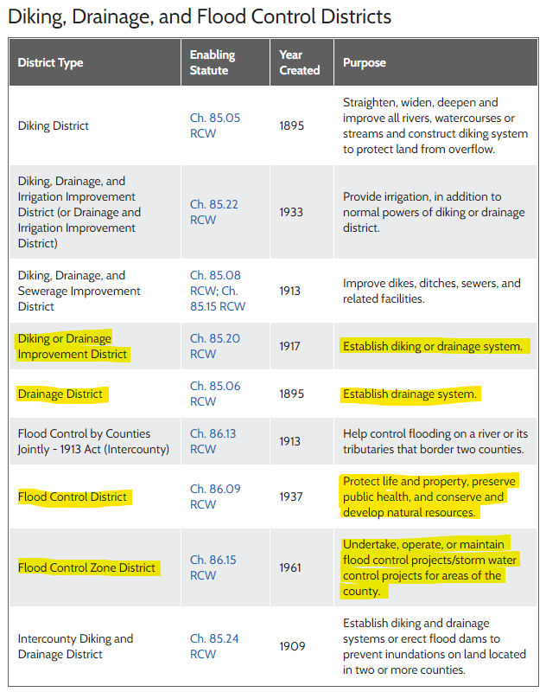
B. Perspective on Preferred Type of “Entity”
RCW 85.05
RCW 85.06
RCW 85.08
RCW 85.15
RCW 85.20
RCW 85.22
RCW 85.24
RCW 86.09
RCW 86.13
RCW 86.15
??????
???
Which type drainage/flood district?
Source: MSRC here

Slide 9
B1. Preferred Entity = Expanded FCZD (for now)
For Now . . .
Seems most expedient (and logical) given 1996 FCZD is still “on-the-books.”
Expanded FCZD would result in an entity with “standing” sooner than forming new entity (e.g., drainage district).
Implementation structure already exists (BOCC = supervisors; County engineer = lead; Contracting, advisory committee, funding, administrative implementation mechanisms already exist).
Several FCZDs are active in Western WA (including Pacific County) making a “community of peers.”
Counties with FCZDs:
Chelan
Columbia
Cowlitz
Jefferson
Lewis
Mason
Pacific
Pierce
Skagit
Spokane
Walla Walla
Whatcom
Yakima
https://app.leg.wa.gov/RCW/default.aspx?cite=86.15.020

Slide 10
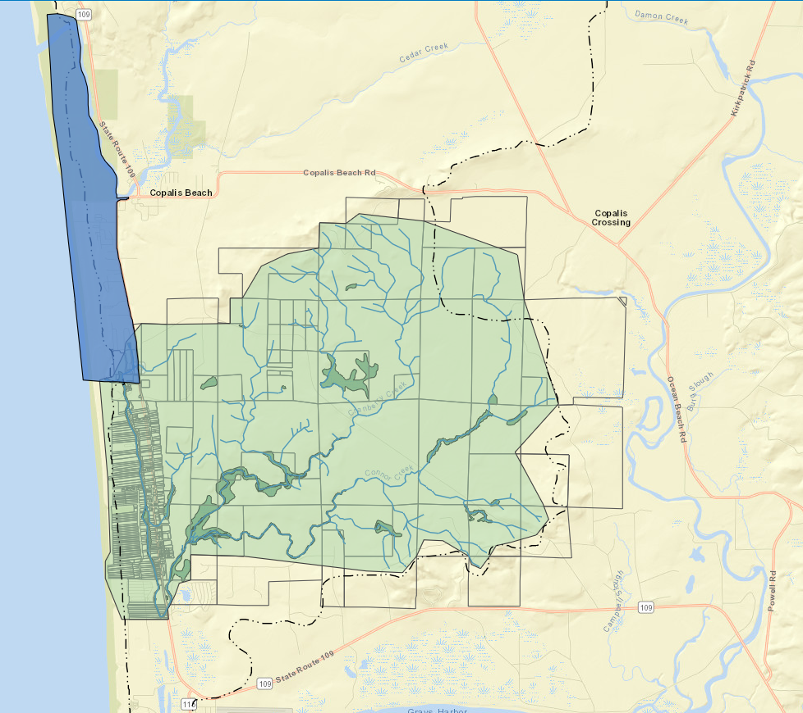
B2. Expanded FCZD Boundary (scale . . . )
Initial Expanded FCZD:
Existing FCZD
Connor Creek Watershed
Dunes Estates

Slide 11
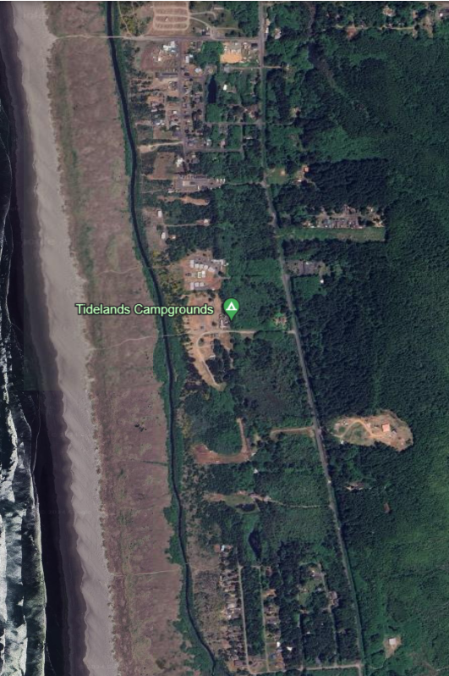
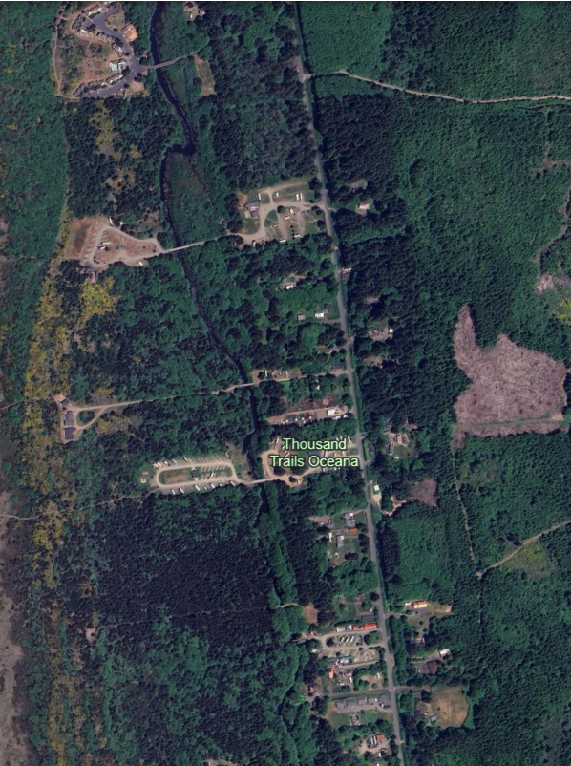
B2. Expanded FCZD Boundary (bridges . . . )
https://earth.google.com/web/@47.11579408,-124.1763912,3.41779126a,4125.29784153d,35y,0h,0t,0r

Slide 12
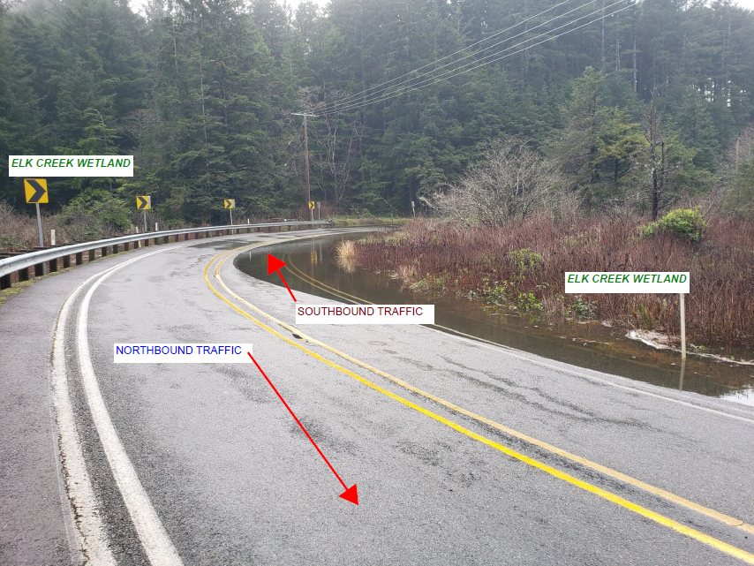
B3. Longer-Term (further expand)
Longer-Term:
Expand further northward to Seabrook or Pacific Beach.
Convert county-led and administered FCZD to locally-led and administered Flood Control District or Drainage District.
From Stephen Poulakas (Seabrook), 3/25/2024
Source: MSRC here

Slide 13
C. Options/Next Steps – Expanded FCZD
Option A -- “Motion of the Board”
Step 1 – BOCC initiates creation (expansion) of FCZD by resolution.
Step 2 – Done.
Option B -- “Petition of Electors”
Step 1 – Secure petition format from County Auditor.
Step 2 – Secure signatures from 25% of electors in Expanded FCZD.
1996 FCZD = 145 total voters (37 voters = 25%)
Connor Creek Watershed = 281 total voters (70 voters = 25%)
Dunes Estates = ?? Total voters (?? voters = 25%)
Step 3 – Deliver signed petition to County Auditor.
Step 4 – Auditor has 45 days to certify petition and deliver to BOCC.
Step 5 – BOCC has 40 days to act on resolution creating (expanding) FCZD as brought by petition.
Step 6 – Done.
-- Immediate GOAL --
Funding ASAP for:
Comprehensive watershed flood mitigation investment plan
SR109 drainage ditch maintenance

