Slide 1
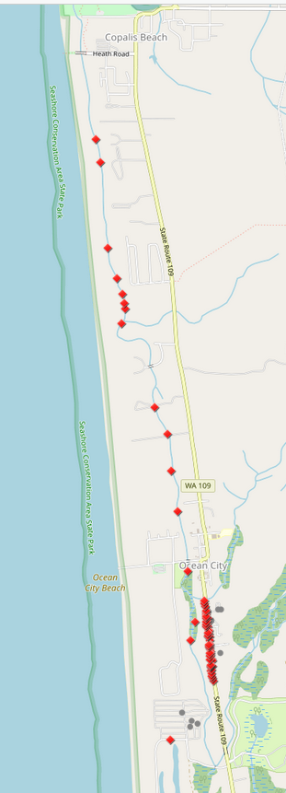
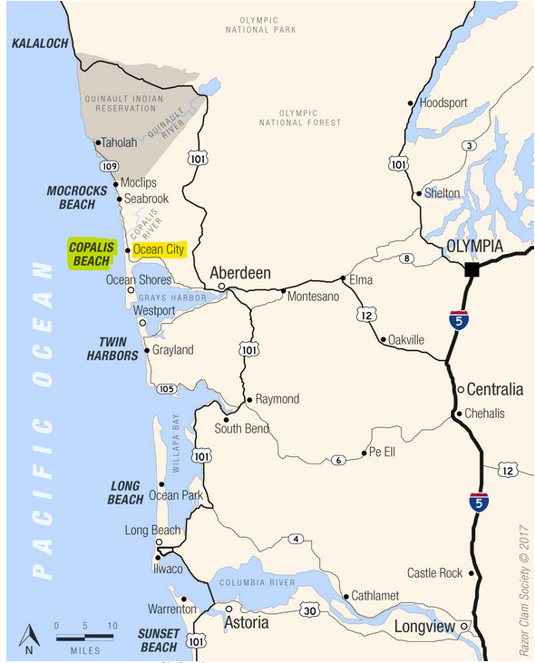
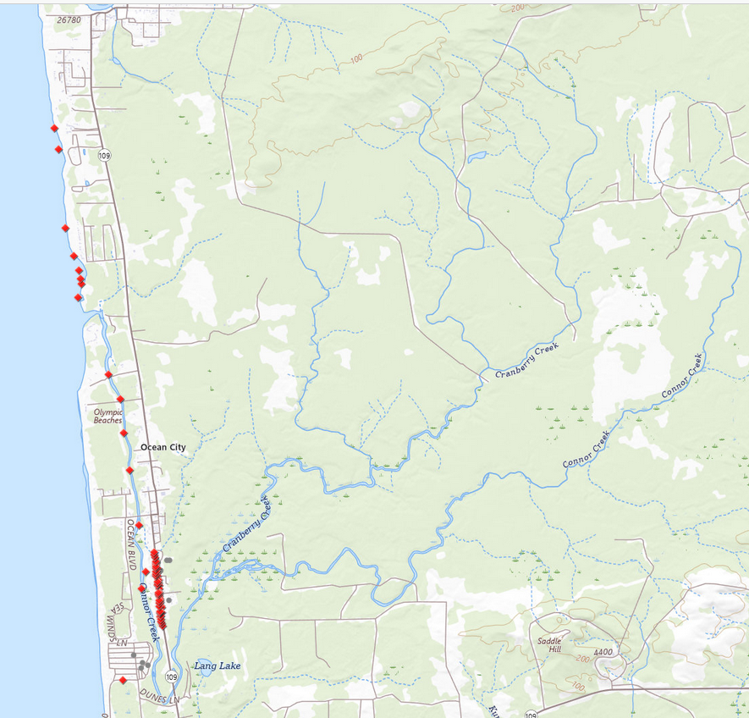
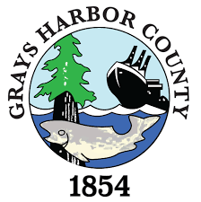
North Beach Flood Control Funding Request
Phase II – “Implement Drainage Improvements”
Click here to access web map.

Slide 2
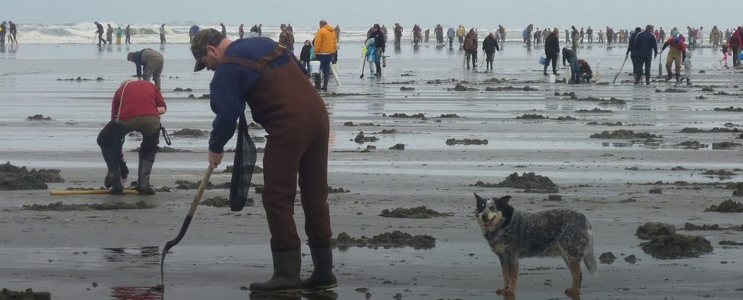
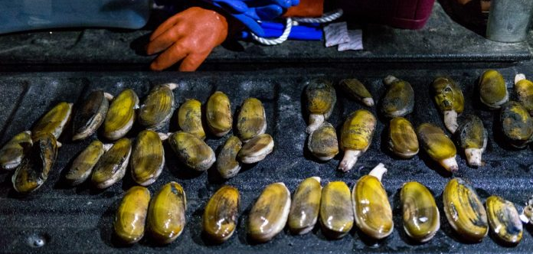
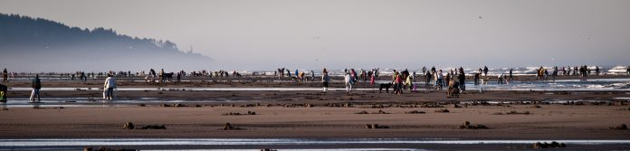
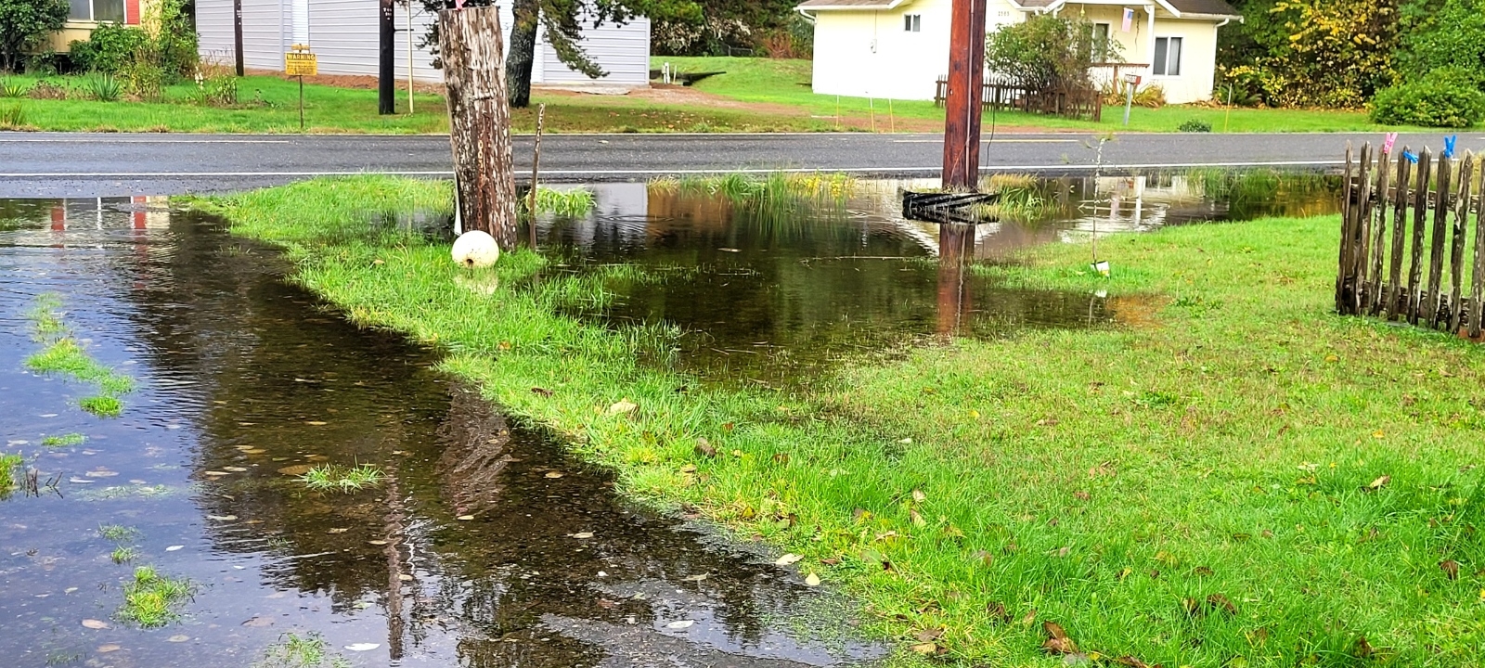
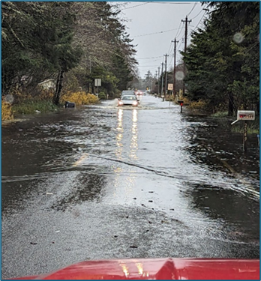
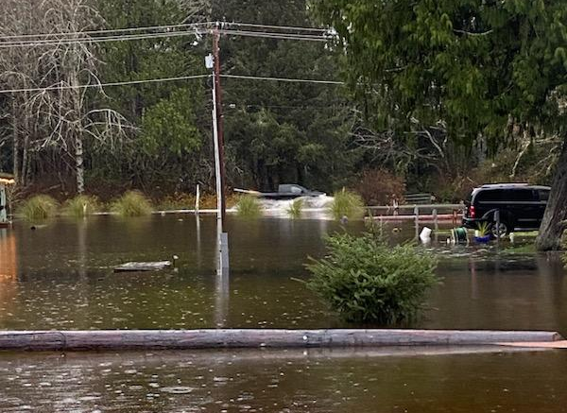
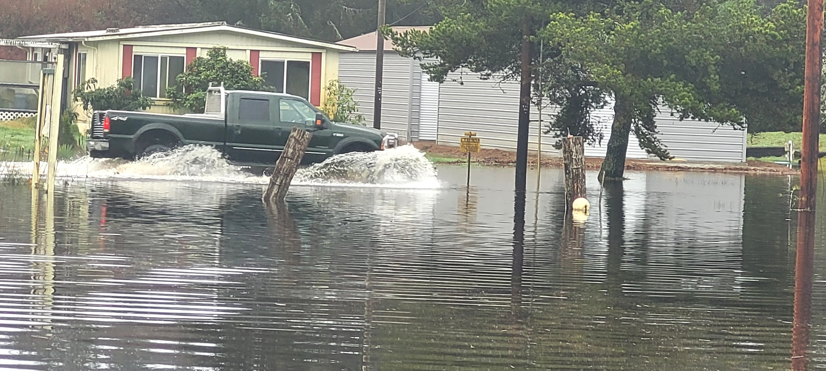
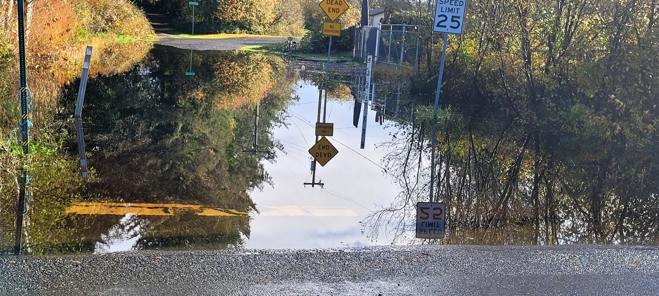
2009 UW study -- Razor clamming positively impacts Grays Harbor, Paciﬁc counties.
Average spent per party/per trip = $357 [$521 today]
Total spent 2007-08 = $24.4M [$35.6M today]
Local jobs impact = 404 FTE
Labor income = $12.6M [$18.3M today]
11-11-2023
12/05/2023
12-05-2023
12-10-2023
11-16-2023

Slide 3
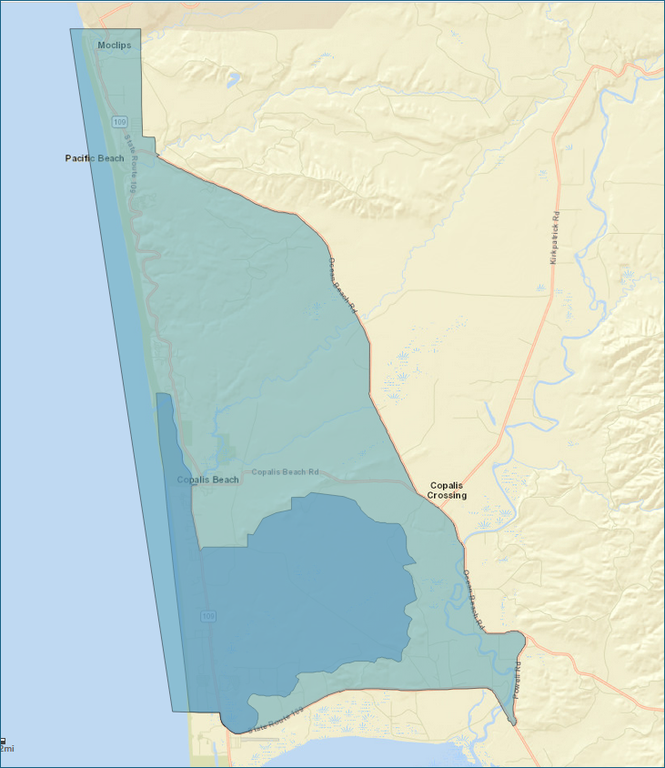
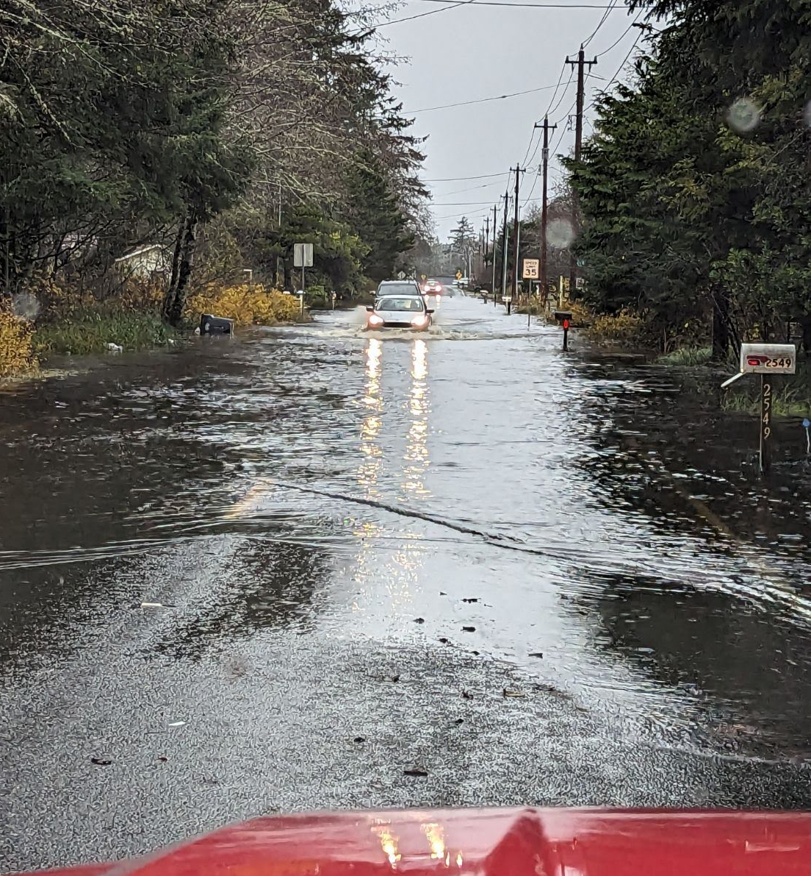
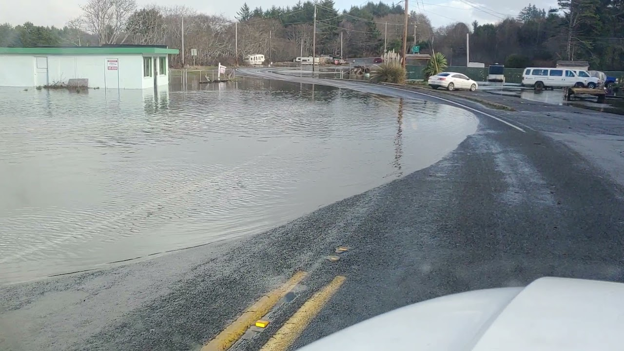
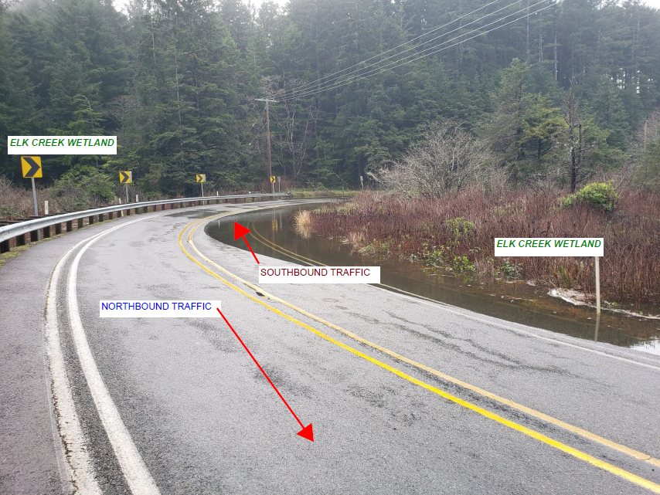
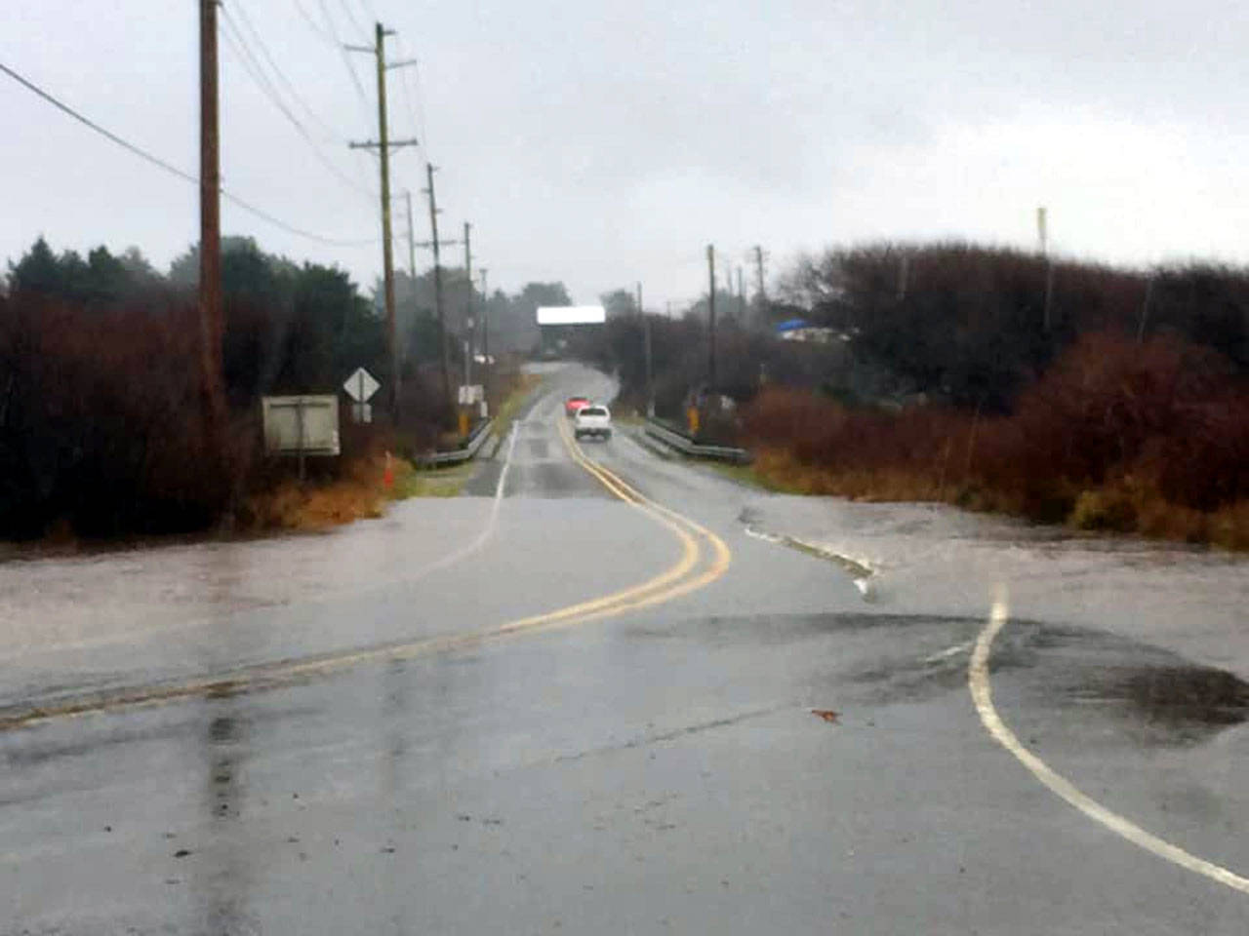
Problem Statement . . . .
“Connor Creek watershed (Ocean City) presents a chronic, complex, and historically unaddressed flooding problem adversely affecting North Beach residents, visitors, businesses, and emergency responders alike that has steadily gotten worse since about 1987, serves as a microcosm of flooding issues up and down North Beach, warrants immediate and significant action, and -- in its solutions -- serves as a model for others.”
NBFCZD established 6-25-2024
Ocean City Drainage District to be established 8-**-2024
Ocean City, 12-05-2023
Copalis, 1-3-2022
Elk Creek, 3-25-2024
Moclips, 1-4-2021

Slide 4
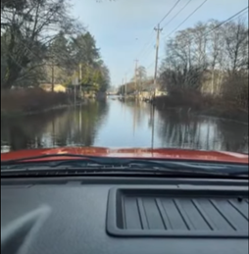
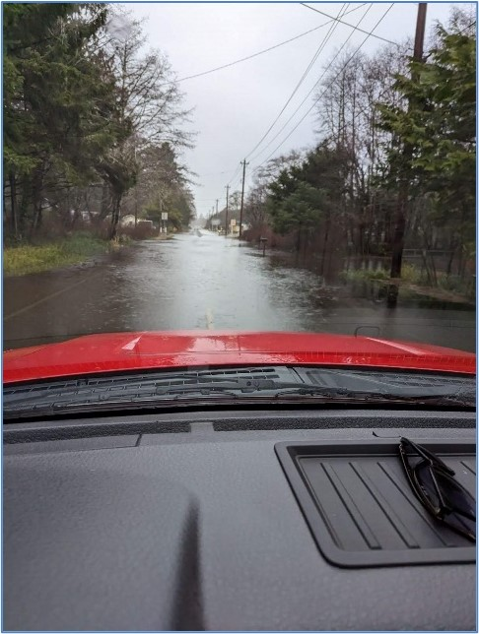
Phase II – “Implement Drainage Improvements” 2024/25, SUPPLEMENTAL .09 REQUEST
2. Install Gages (one rain, one stream) | $48K
3. Implement Drainage Improvements (culverts, derelict bridges, beavers) | $150K
4. Manage, Coordinate, Oversee, Implement Project | $48K
Total --> | $246K
For 2024-25 flood season: Clear drainage obstructions, improve flow. Install gages to monitor conditions, results. Establish Ocean City Drainage District to maintain improvements.
Off-cycle funding is needed to: Sync culvert clearing with WSDOT’s fall 2024 ditch clearing activities. Develop baseline data to measure, monitor drainage improvement results. Demonstrate “skin-in-the-game” for Phase III request (State Capital Budget $). By implementing North Beach Flood Control Project (GHC Economic Development Plan), and addressing flooding hindering Hidden Coast Scenic Byway Plan, RV parks, motels, campgrounds, and local businesses can stay open longer for clammers, vacationers, and recreationalists to come, stay, and spend.
Phase I – “Reconnaissance”
2023/24, COMPLETED
1. Project Scoping, Structuring | $25K
Total --> | $25K
Developed governance, administrative structure. Established North Beach Flood Control Zone District (NBFCZD). Completed drainage assessments (Connor Creek, SR109).
Phase III – “Comprehensive Flood Planning” 2025/26, FUTURE REQUEST
5. Develop NBFCZD Plan | TBD
6. Implement Additional Drainage Improvements | TBD
7. Manage, Oversee, Coordinate, Implement Project | TBD
Total --> | ~$650K
Develop “comprehensive plan of development for flood control” (RCW 86.15.110).
1/03/2021
12/27/2022
12/05/2023
?? ??
**/**/2024

