Slide 1
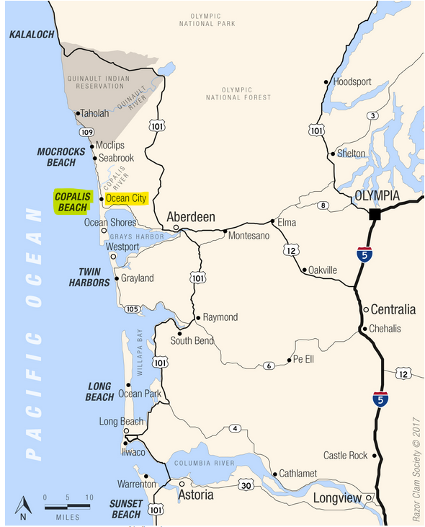
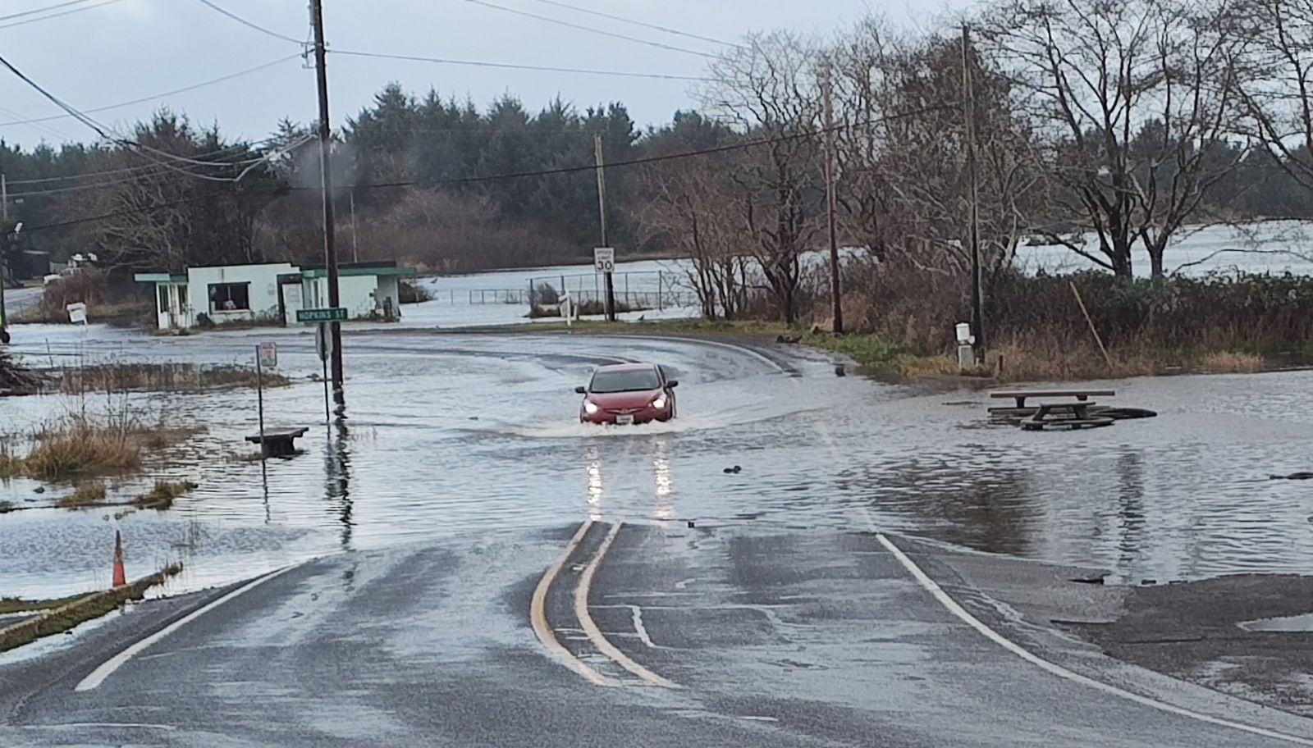


North Beach/Ocean City Flood Control
Problems Solutions Needs Opportunities
Rep. Adam Bernbaum
12-19-2024
12-15-2024

Slide 2
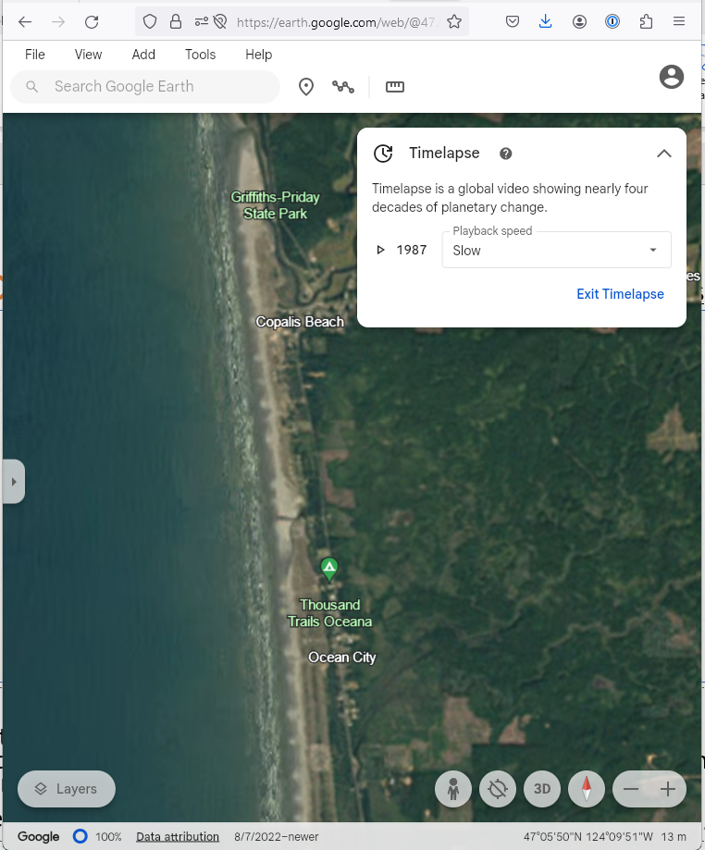
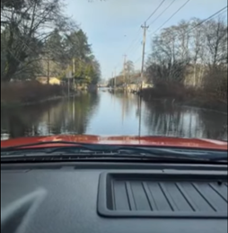
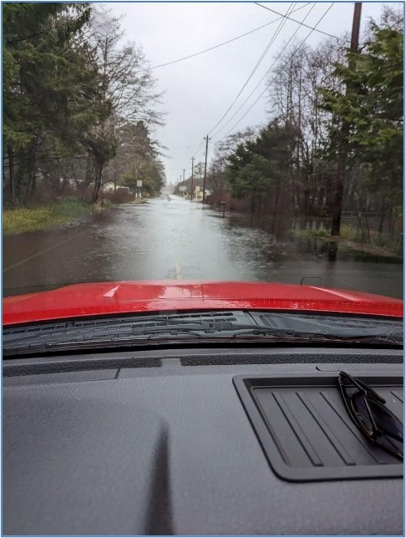
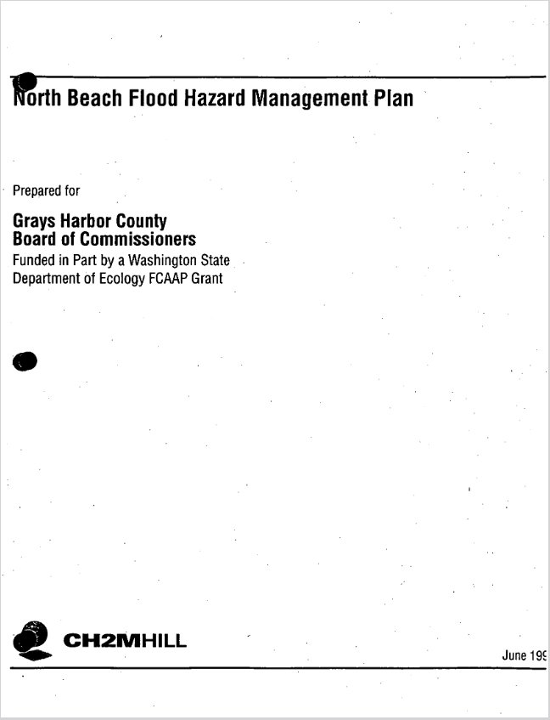
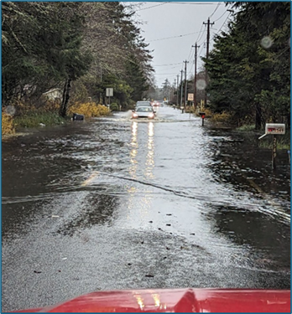
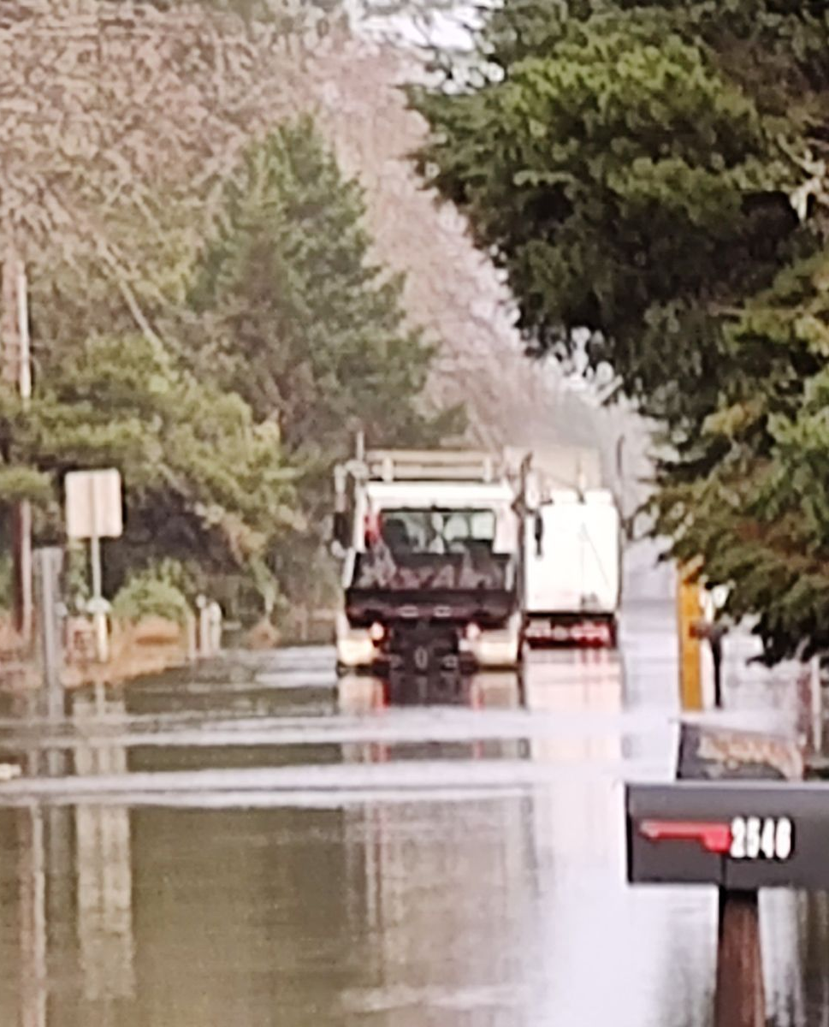

Problems
Coast is changing.
Flooding is chronic (and worsening).
Out-of-date plans are out-of-sync with future needs.
1/03/2021
12/27/2022
June 1999
12/05/2023
12/18/2024
June 2011
Activate timelapse here.

Slide 3
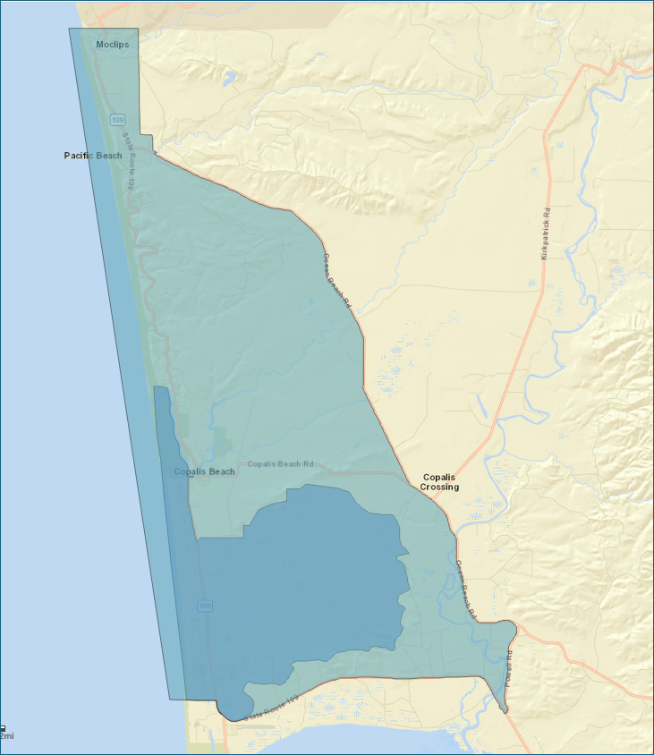
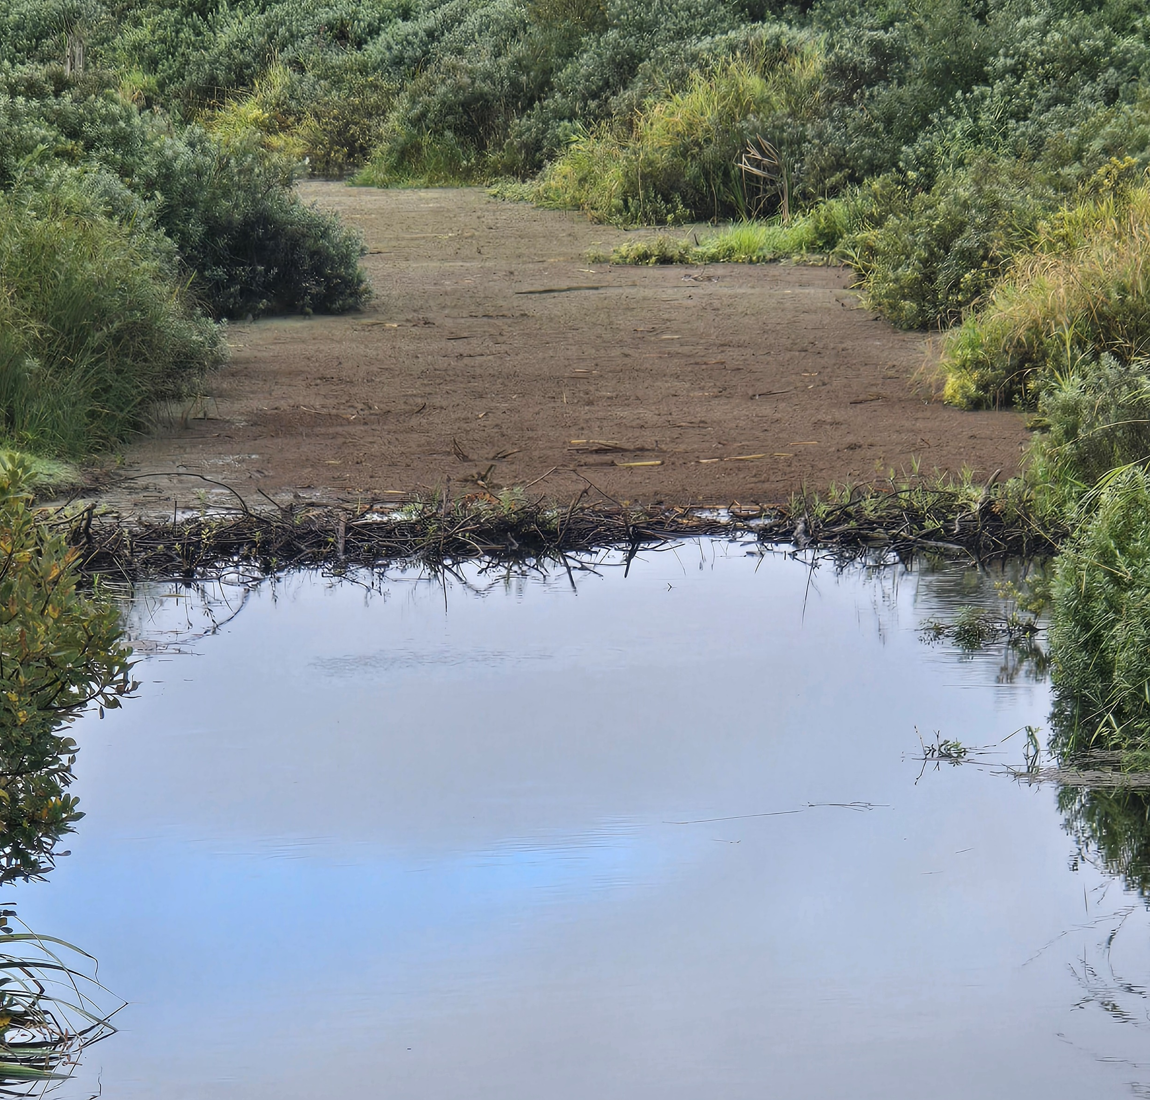
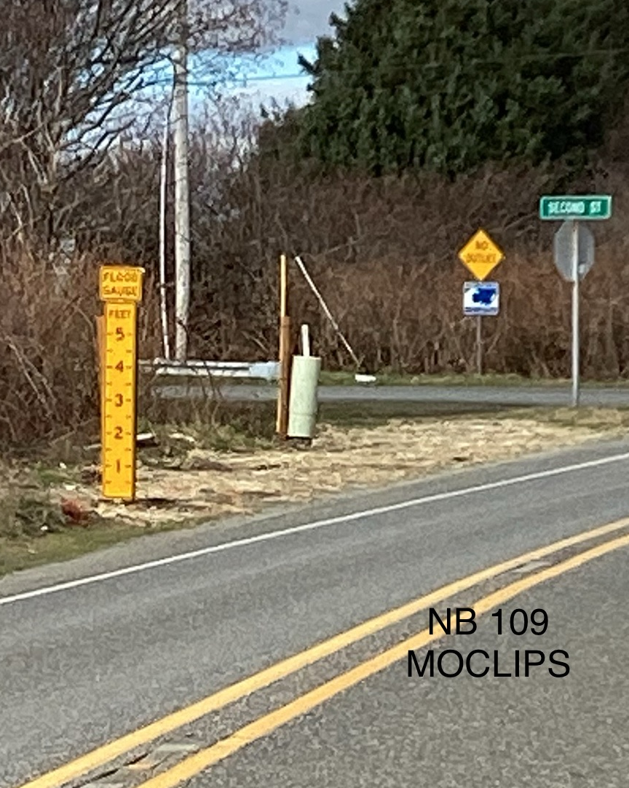
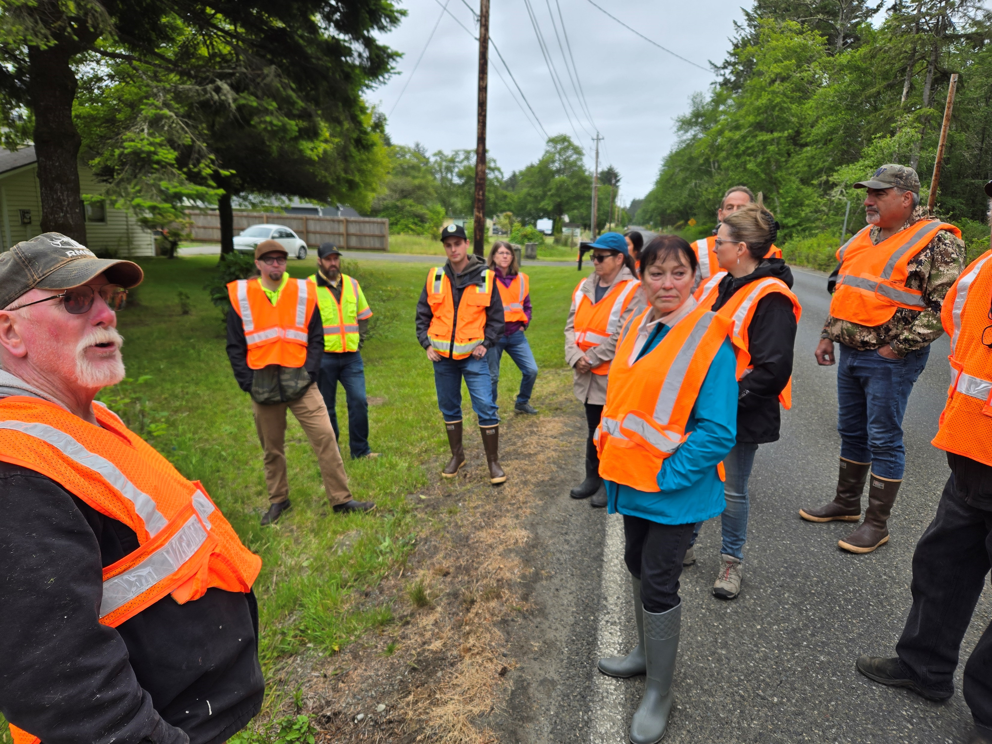
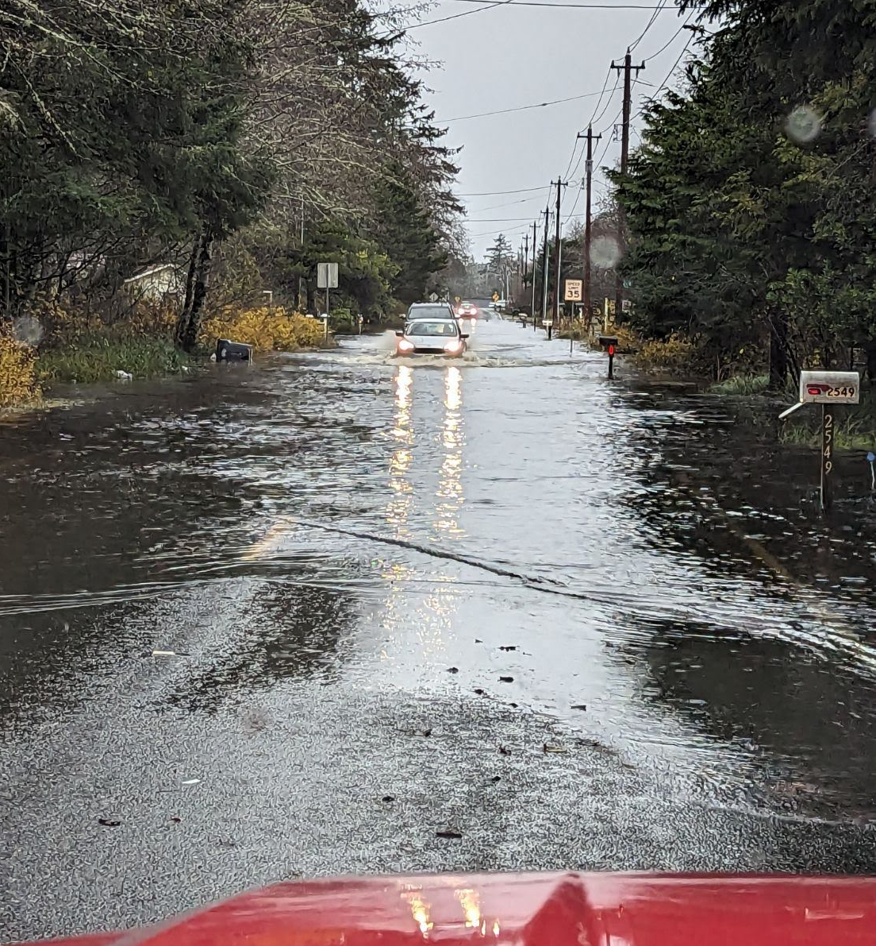
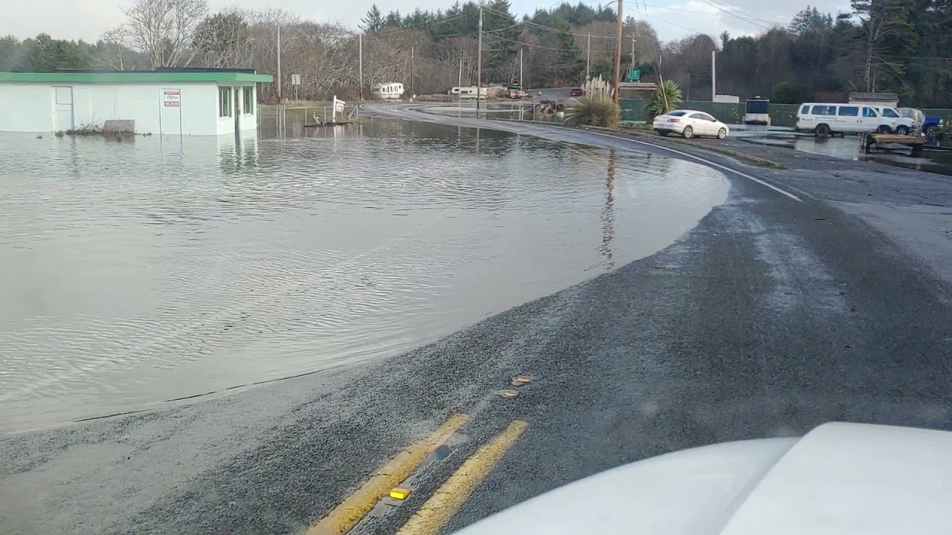
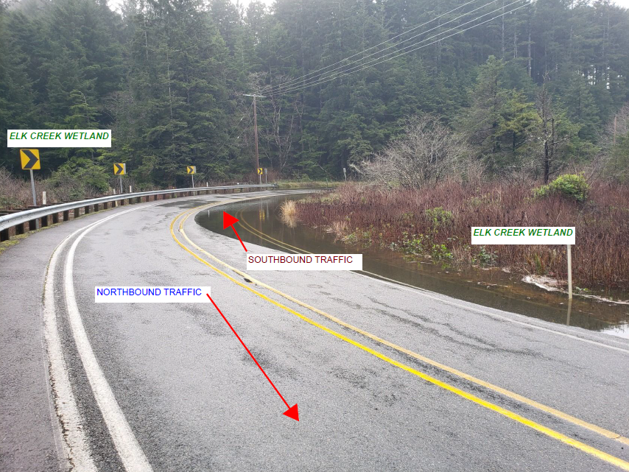
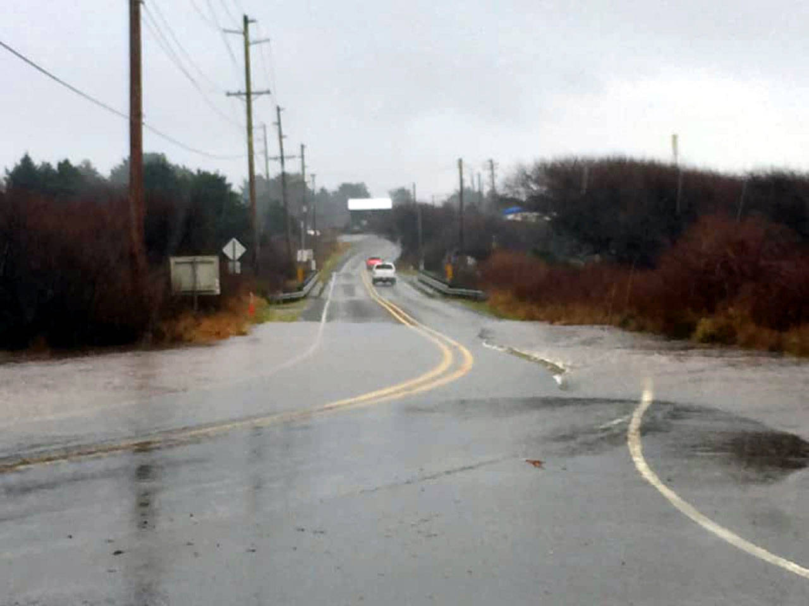


Every-other-month community meetings
☑ ☑ ☑
Rural county 0.09 economic development $$ (RCW 82.14.370)
Solutions
“REGIONAL PLANNING” through county-led, established NBFCZD
6-25-2024
“FLOOD PROJECTS”
Through locally-led drainage districts (Ocean City Drainage District to be established 2025)
Ocean City, 12-05-2023
Copalis, 1-3-2022
Elk Creek, 3-25-2024
Moclips, 1-4-2021

Slide 4
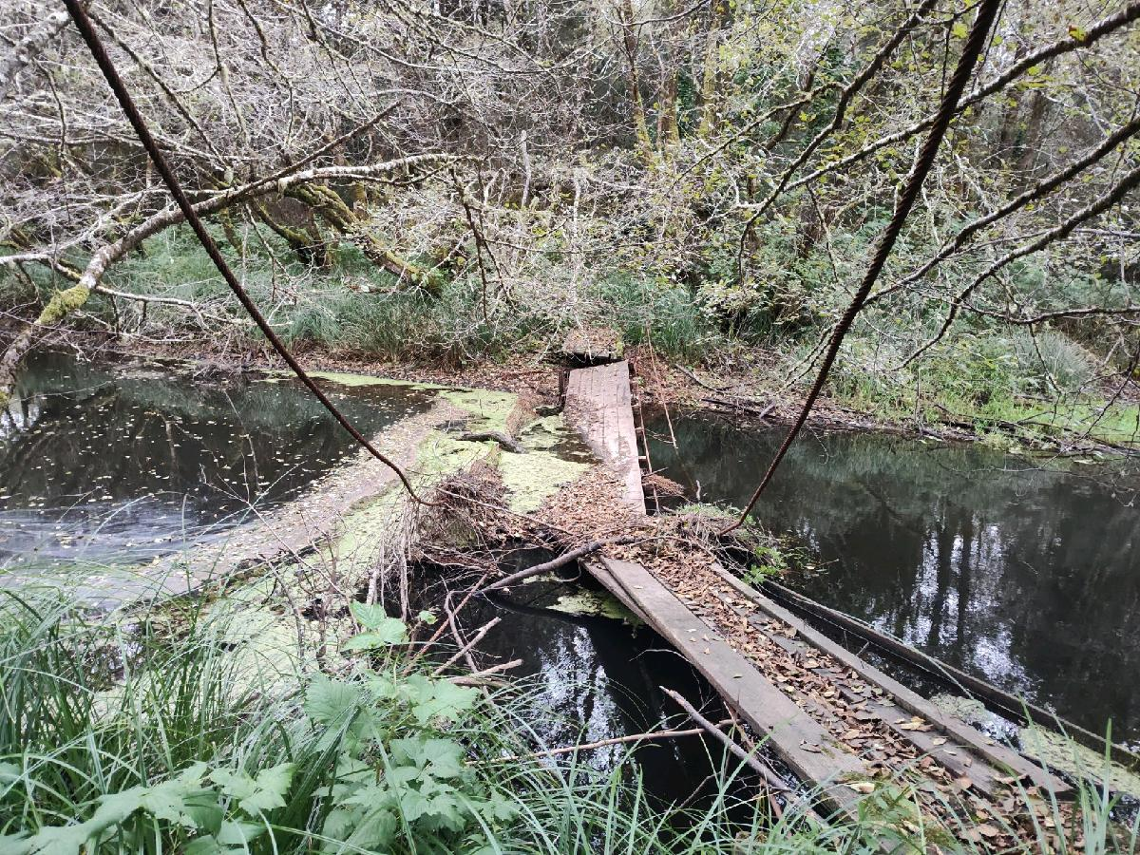
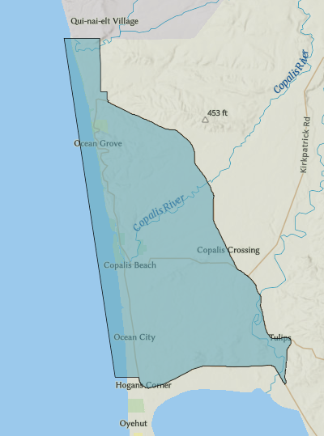
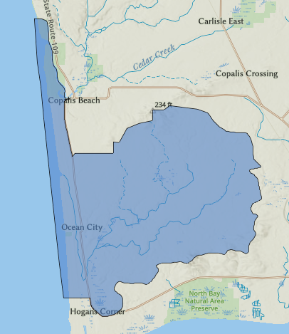
Needs
NBFCZD – Capital Budget $$ to develop “comprehensive plan of development for flood control” (RCW 86.15.110)
  ○ Coastal change ○ Housing needs
  ○ Climate change ○ Emergency response needs
  ○ Demographic changes ○ Economic drivers/opportunities
  ○ Natural resource needs ○ Flood response capital priorities
Ocean City Drainage District – Capital Budget $$ to develop a comprehensive drainage plan
  Elevations ○ Property acquisitions
  Capital priorities ○ Deferred maintenance
  Drainage pathways/volumes
  Maintenance rate structure
North Beach Flood Control Zone District
Comprehensive Plan of Development
Guiding Tomorrow’s North Beach Future
December 2026
Ocean City Drainage District
Comprehensive Drainage Plan
Guiding Tomorrow’s North Beach Future
December 2026

Slide 5
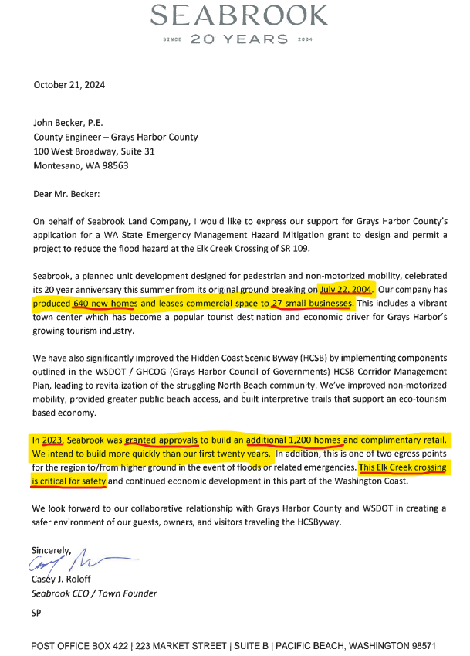
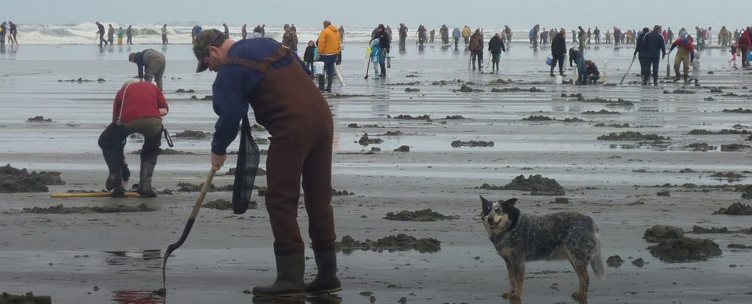
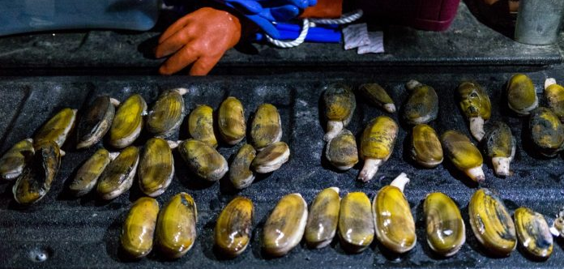
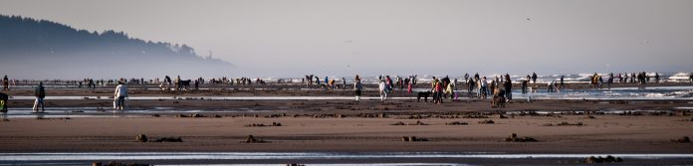
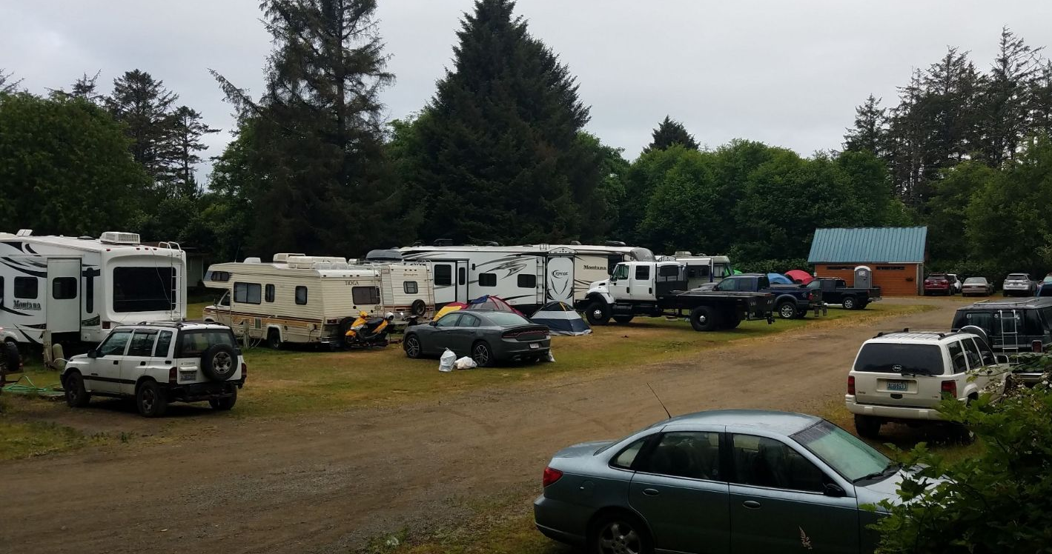
Opportunities
2009 UW study -- Razor clamming positively impacts Grays Harbor, Paciﬁc counties.
Average spent per party/per trip = $357 [$521 today]
Total spent 2007-08 = $24.4M [$35.6M today]
Local jobs impact = 404 FTE
Labor income = $12.6M [$18.3M today]

Slide 6

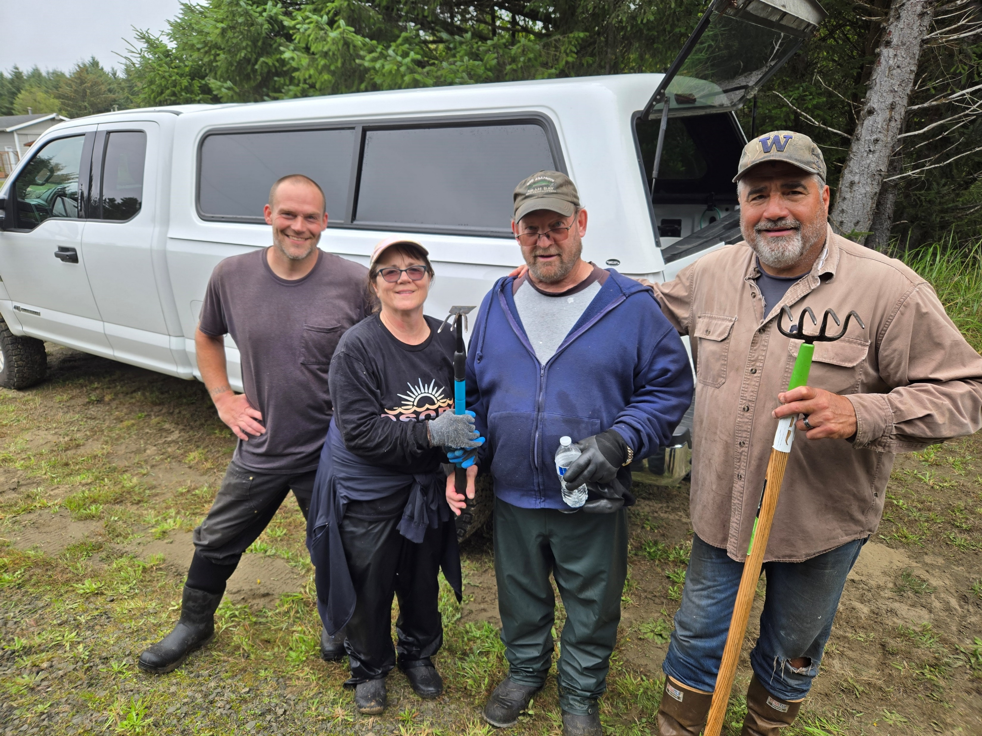




Partners!
-- Implementation Team --
Gary Clarke
Michelle Wiley
Stan Sturgeon
Stan Hutton
Vicki Hutton
-- Implementation Partners --
WSDOT (Brent Schiller, Tricia Sorensen, Bill Scott, Shannon Buchanan)
GHC (John Becker, Tom Gray, Dan Ehreth, Tim Triesch, Jane Hewitt, Jon Beltran, Wendy Chatham, Vickie Raines)
WDFW (Brandon Carmon, Amy Spoon)
GHCD (Nate Jackson, David Marcell)
UW Sea Grant (Sanpisa Sritrairat)
WEMD (Ellen Chappelka, Nicole Canning)
Sea View Estates (Jon Schleiger, Piper Henry)
Seabrook (Stephen Poulakos, Sam Nielson, Casey Roloff)
-- Beaver Dam Notchers --
Luke Crooks
Vicki Hutton
Stan Hutton
John Reimer

Slide 7
Questions/Discussion/Next Steps?
Vickie Raines
Grays Harbor County
Commissioner, District III
360/590-4100
vraines@graysharbor.us
John Becker
Grays Harbor County
County Engineer
360/581-6001
jbecker@graysharbor.us
Scott Boettcher
SBGH-Partners
North Beach Flood Project Lead
360/480-6600
scottb@sbgh-partners.com
Next Community Meeting:
1/16/20254 (or 1/23/2025)
6:00 – 7:30 PM
Ocean Shores Outdoor Recreation Club
“On average, coastal areas in Washington state are expected to see between 10 and 32 inches (more than two and a half feet) of sea level rise by the year 2100, relative to 2000.”
UW Climate Impacts Group
“Just took these pictures, DOT has closed the road down by Luke's place. As you see in the pictures people are ignoring the signs, at least some are.” Text, Stan Sturgeon, 12/18/2024, 9:45 AM
“over 1 foot of water in Ocean City flood zone”
Text, Jon Schleiger, 12/18/2024, 6:21 AM

