Slide 1
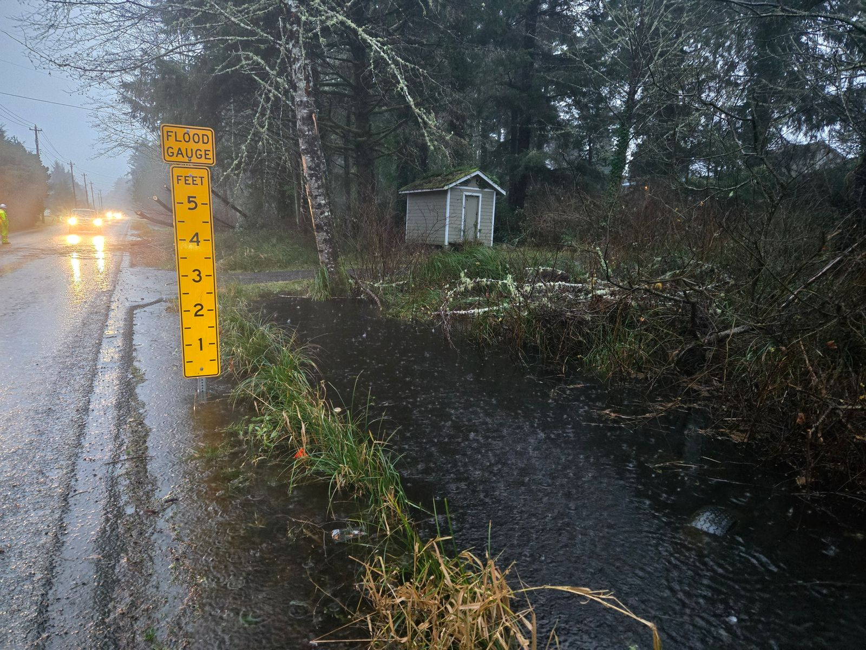
North Beach Flood Project
Proposed Ocean City Drainage District
Grays Harbor County
1-27-2025
← 12/17/2024

Slide 2
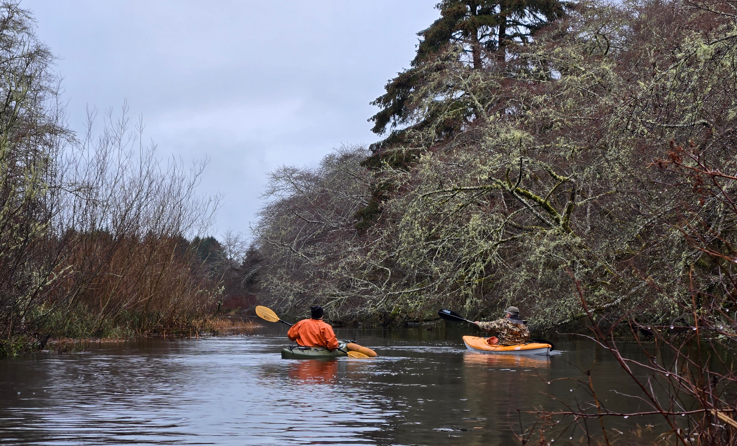
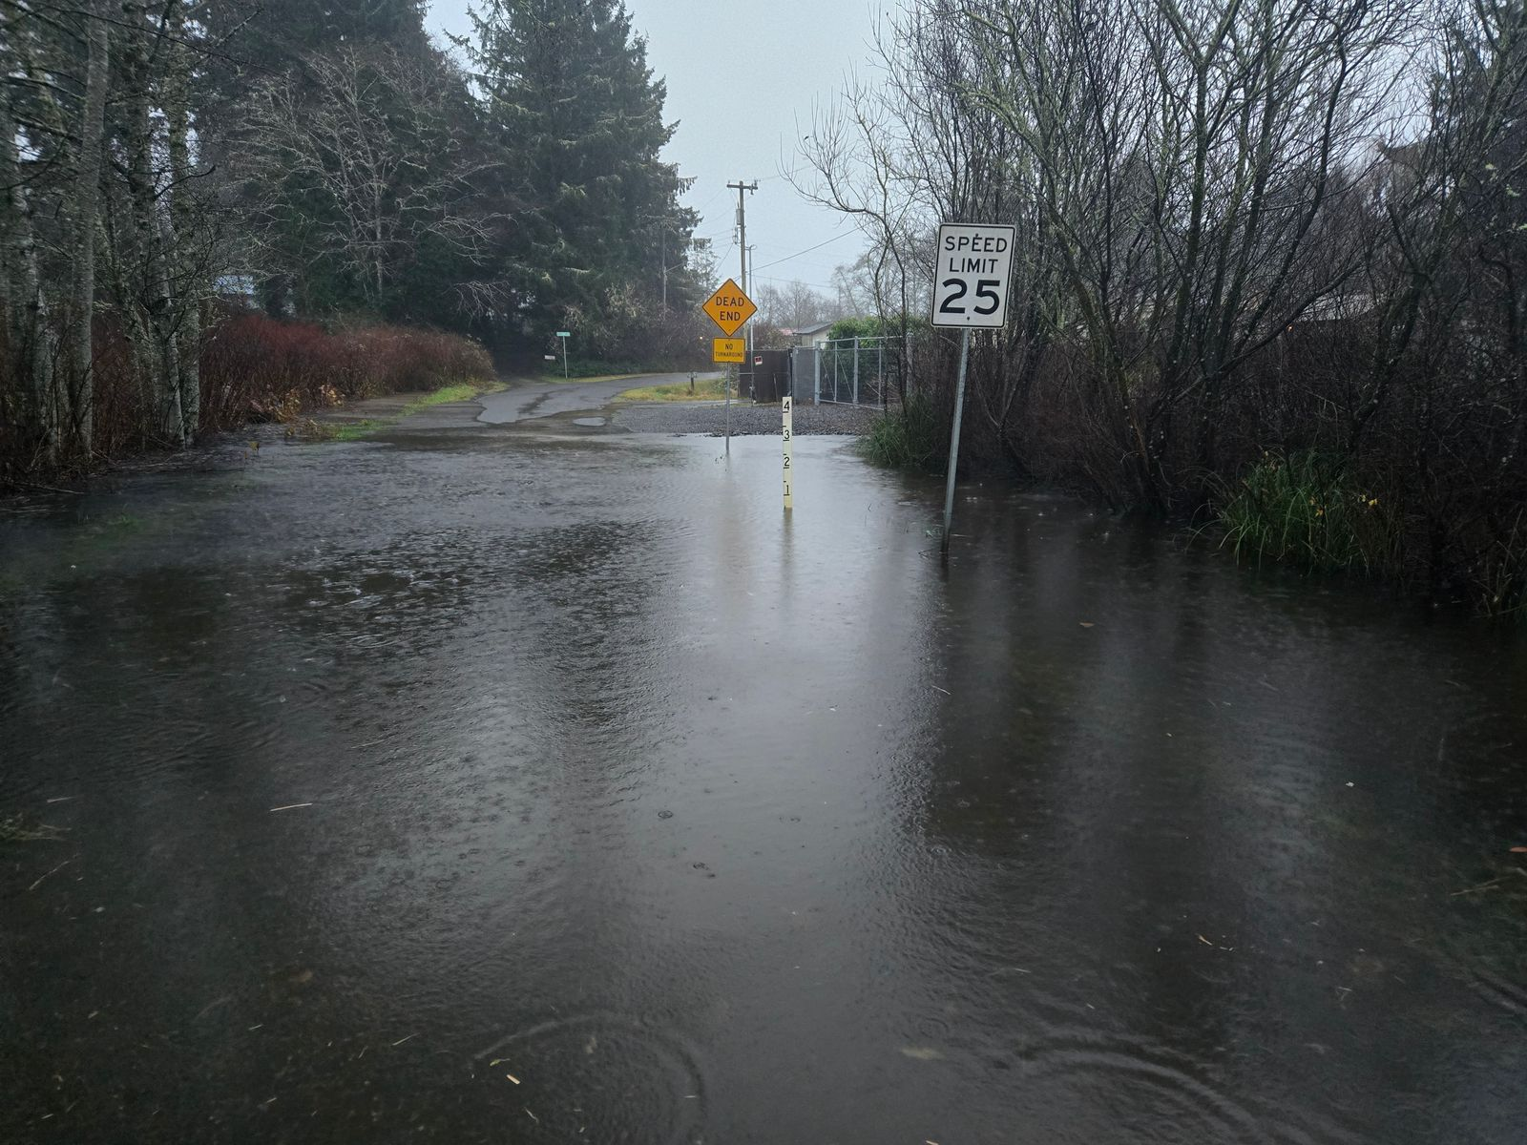
Topics
What is the Proposed Ocean City Drainage District?
Why is it Needed?
What is the Need/Opportunity from TESC?
← 12/26/2024
← 12/17/2024

Slide 3
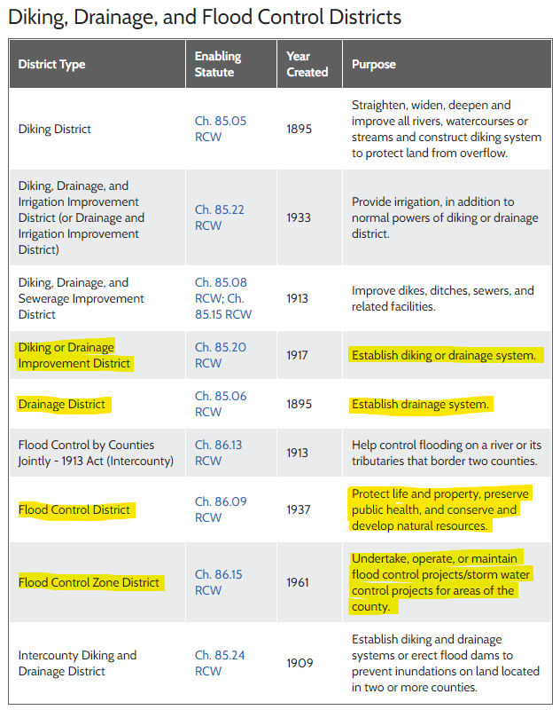
1. What is the Proposed Ocean City Drainage District?
RCW 85.05
RCW 85.06
RCW 85.08
RCW 85.15
RCW 85.20
RCW 85.22
RCW 85.24
RCW 86.09
RCW 86.13
RCW 86.15
Focus = Local flood control implementation, maintenance.
Lead = Flood Control District (RCW 86.09).
Creation = RCW 85.38 (Special District Creation and Operation).
Model = Grays Harbor Drainage District # 1 (Grayland)

Slide 4
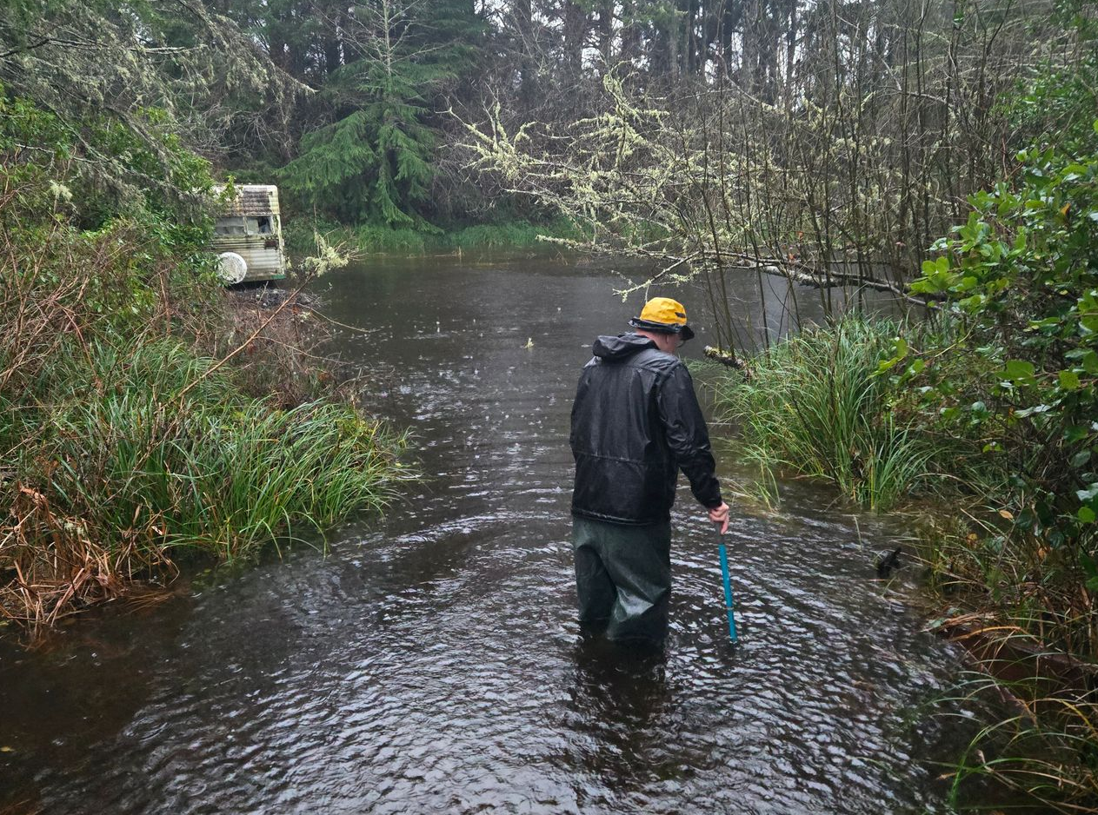
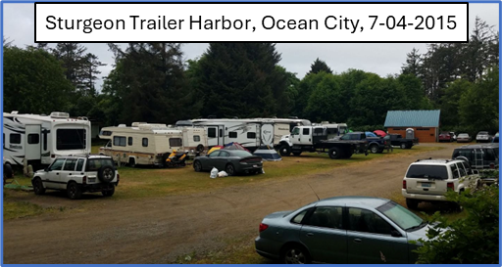
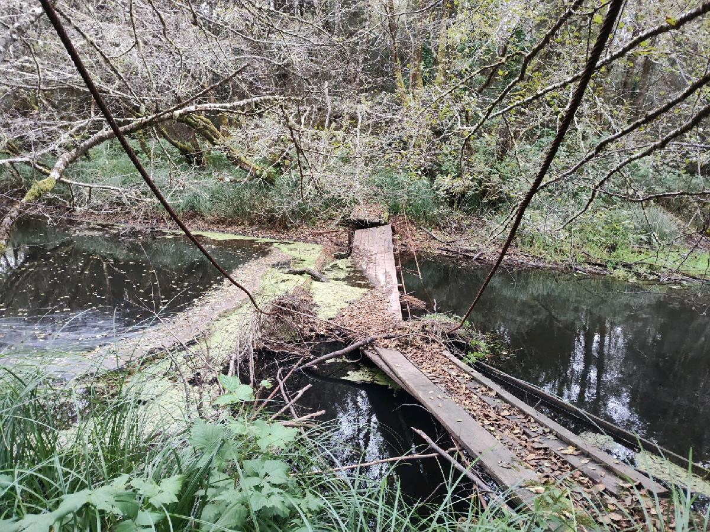
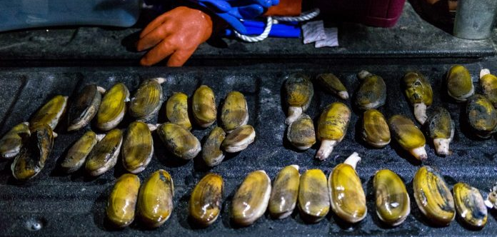
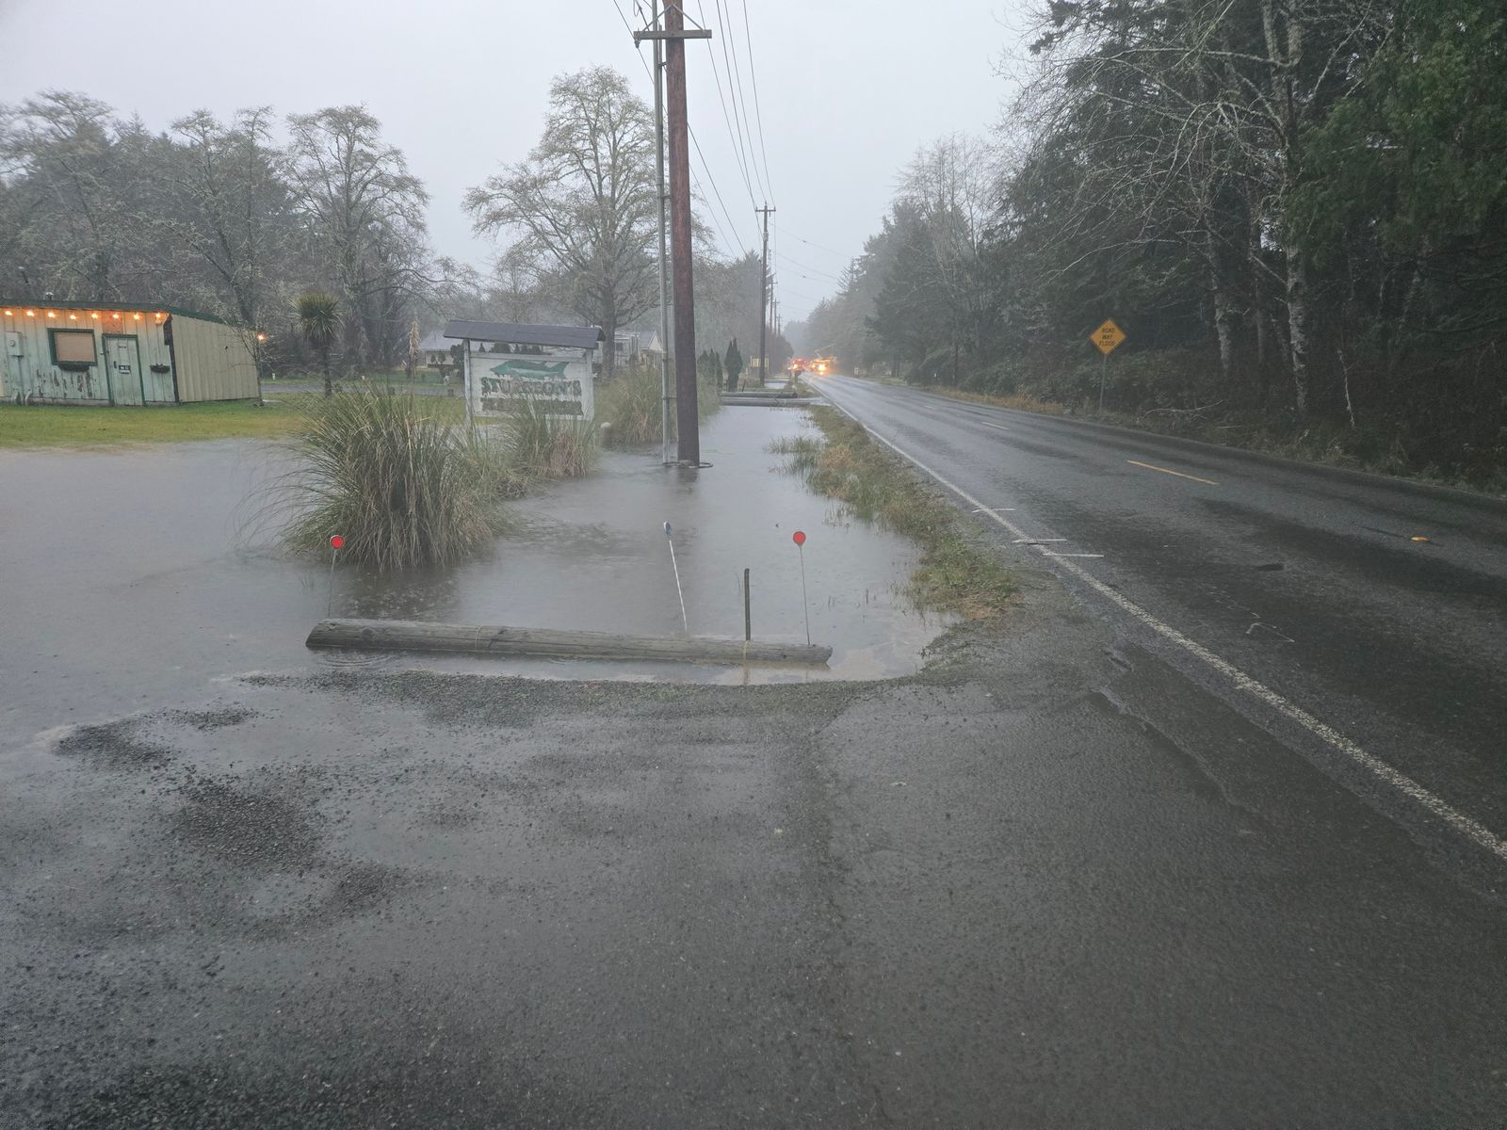
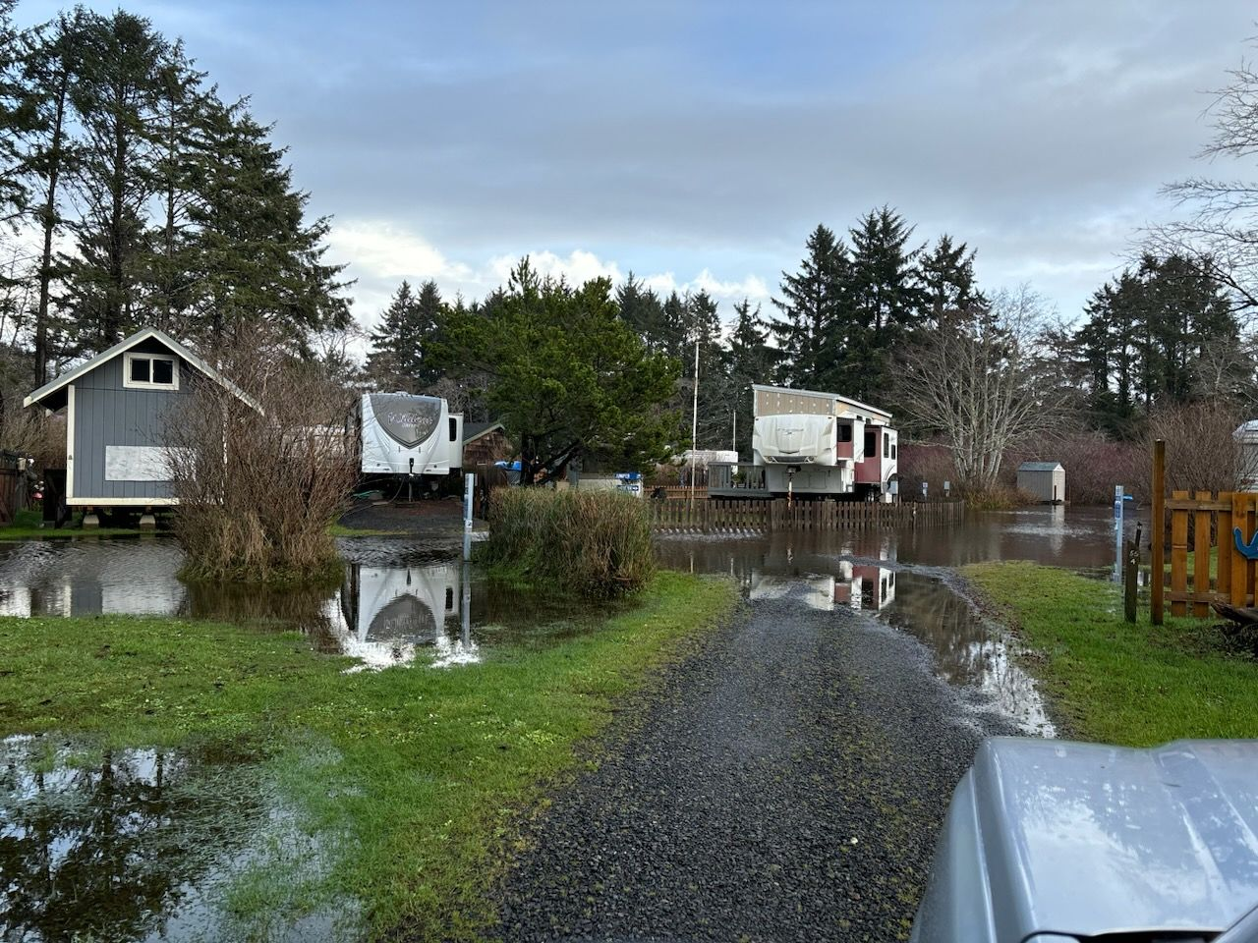
2. Why is it Needed?
Flooding
12/17/2024
← 12/17/2024
12/26/2024 →

Slide 5
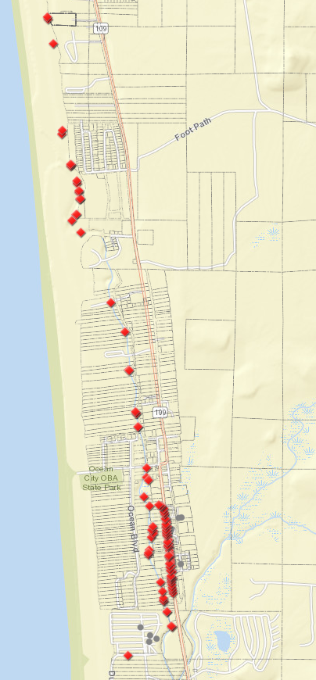
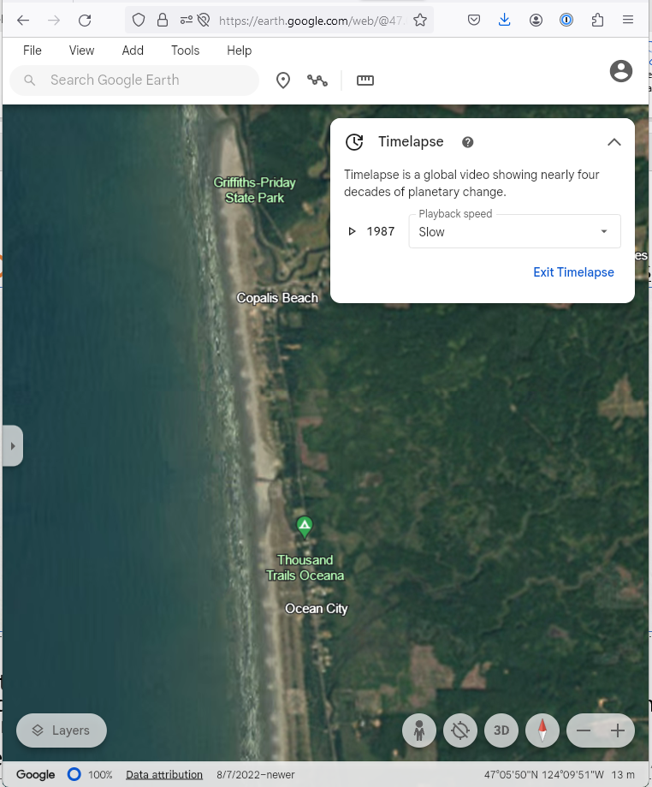
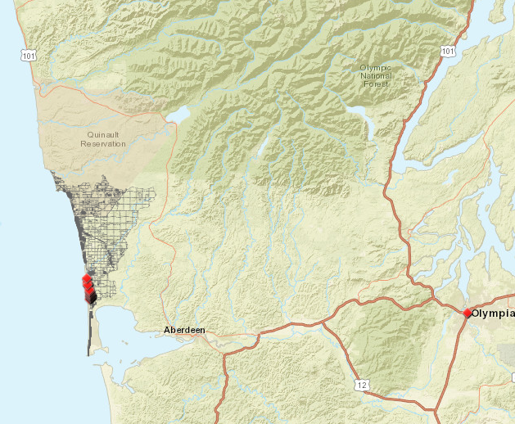
2. Why is it Needed?
Coastal Change
Activate timelapse here.
See webmap here.

Slide 6
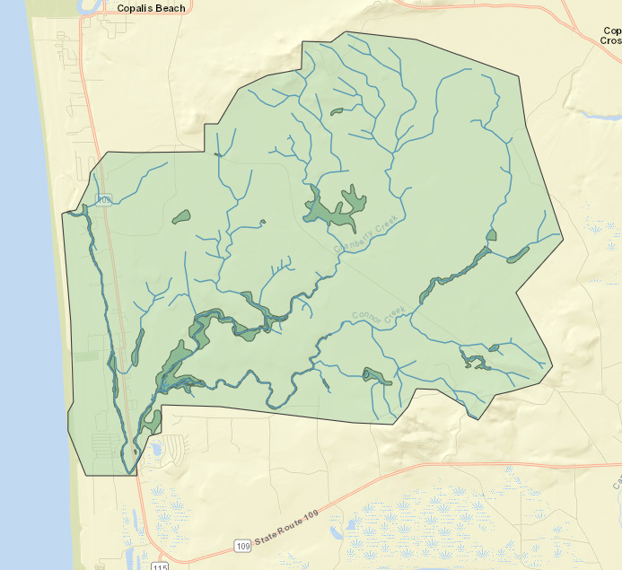
2. Why is it Needed?
Goals
Uplands: Slow, moderate, and/or reduce/redirect flow.
SR109 Corridor: Improve conveyance, evacuation (via public parcels, ROW).
Through the Dunes: Reinstate high-flow, overflow.
Mitigation Site: Enhance wetland water storage (hotter summers).
King Tides: Evacuate high-flows at historic overflow points.

Slide 7
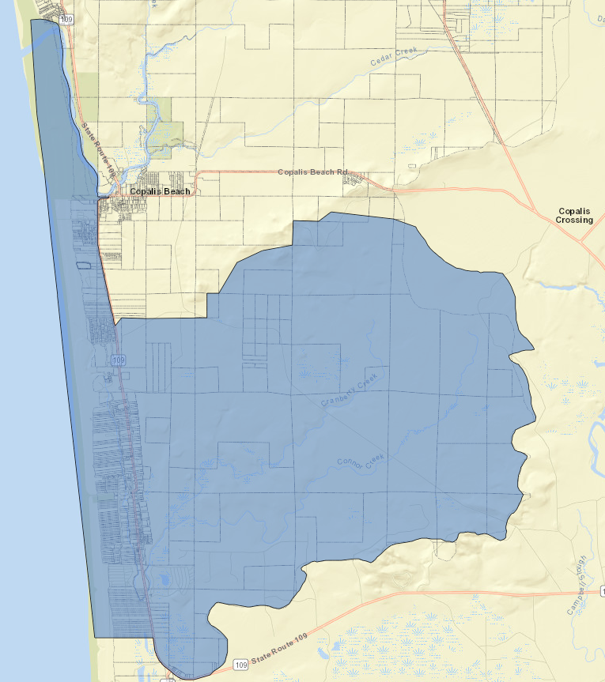
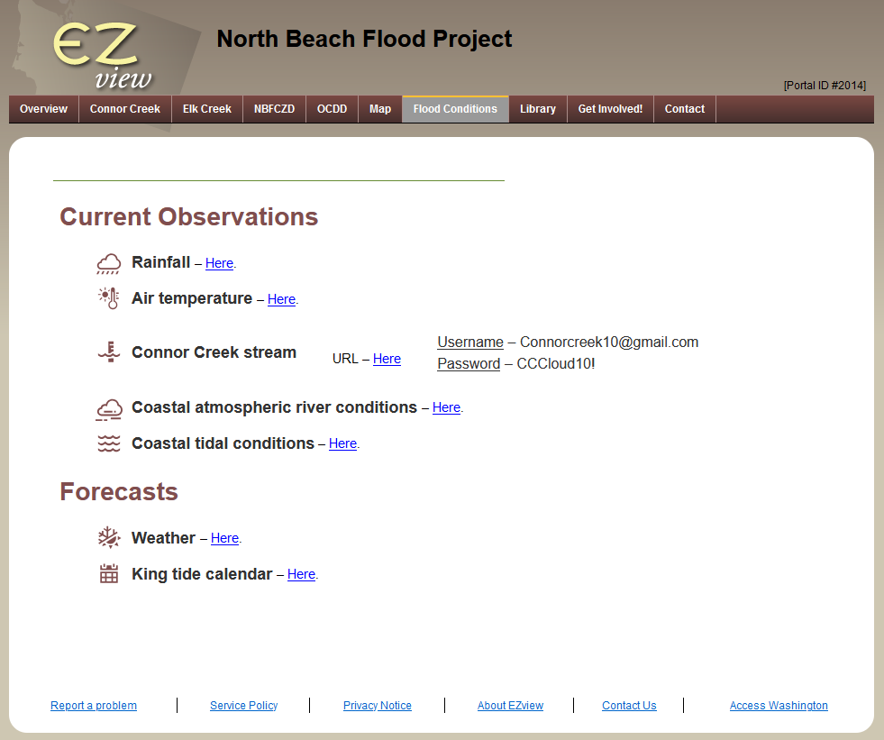
3. What is the Need/Opportunity from TESC?
Need #1 – StoryMap Substantiating Need for Drainage District
Define Boundaries
Correlate Data
Here

Slide 8
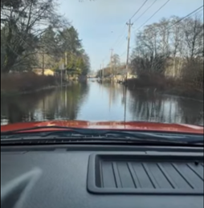
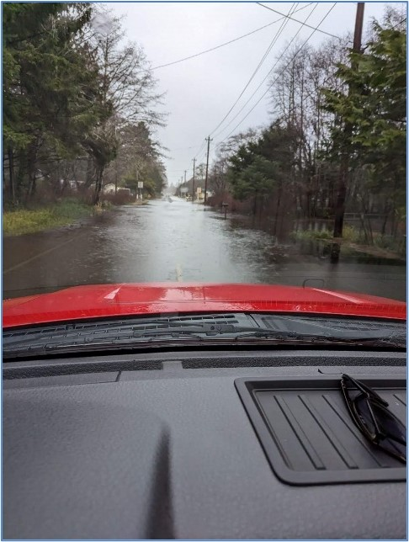
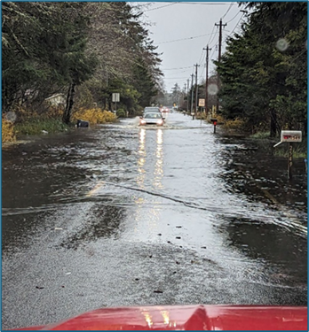
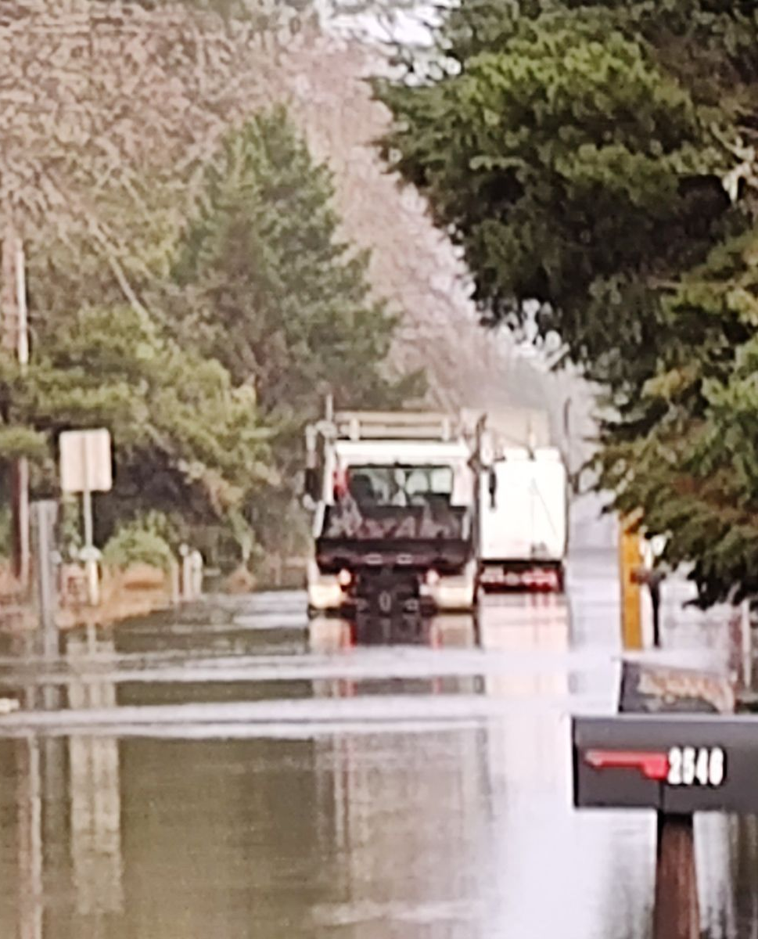
3. What is the Need/Opportunity from TESC?
Need #1 – StoryMap Substantiating Need for Drainage District
Document Flood Frequency
Survey/Document Opinions
Frequency/scale of flooding
Impacts of flooding
Formation of a Drainage District
Taxation
1/03/2021
12/27/2022
12/05/2023
12/18/2024

Slide 9
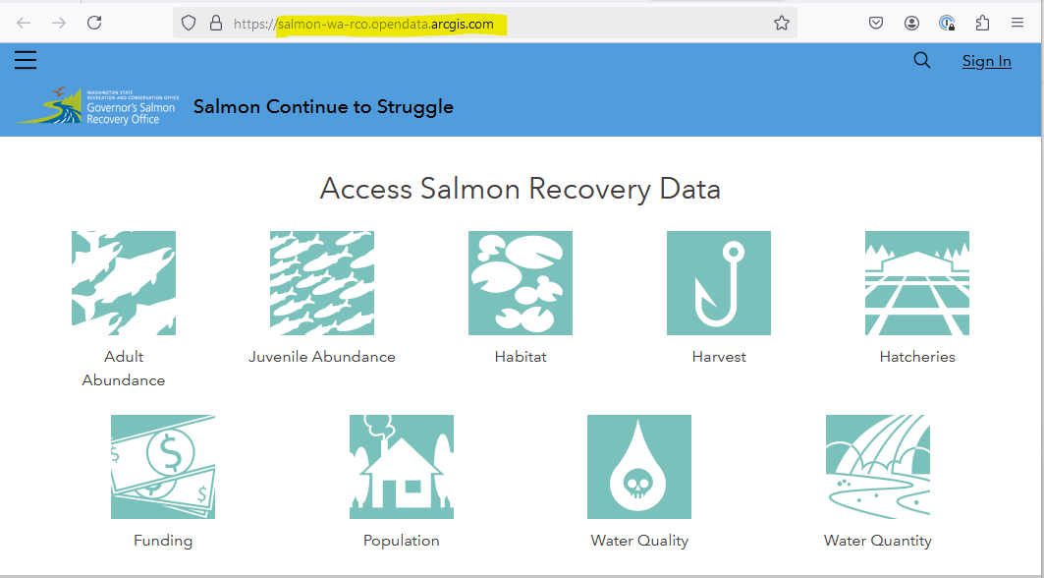
3. What is the Need/Opportunity from TESC?
Need #2 – Architect North Beach GIS Repository/Portal
Open Data
Drone
Lidar
Wetland/Water
Parcels
Land Use
Change Analyses
Etc.
Here

Slide 10
Questions/Discussion?
Scott Boettcher
SBGH-Partners
360/480-6600
scottb@sbgh-partners.com
Robin Vance
MES Graduate
239/849-3649
robinvance10@gmail.com
← 12/26/2024
← 12/17/2024

