Slide 1
Chehalis River Basin
Overview of Work Program and Issues
July 24, 2013
WA State Department of Ecology

Slide 2
Today’s Presentation
Share perspectives
Encourage discussion
Key messages we’d like to leave you with . . .
  Broad agreement -- For the first time in a century there is broad agreement across the Basin on next steps to reduce flood damage and enhance salmon runs in the Basin.
  Basin-wide strategy -- A Basin-wide strategy is needed to protect communities along the river and enhance aquatic species.
  Collaboration of Governor’s Chehalis Basin Work Group, Chehalis River Basin Flood Authority and WA State Agencies – Together, a galvanizing force for action!

Slide 3
Governor’s Chehalis Basin Work Group
Appointed by Gov. Gregoire (2012); Re-confirmed by Gov. Inslee (2013)
Developed Next Steps Framework, $28.2 capital budget request (2013-15)
Looking Forward → Tasked by Gov. Inslee to oversee implementation of 2013-15 budget, recommend next steps by December 2014 for: Water retention; I-5; Other basin improvements; Aquatic species enhancement.
Members are:
  David Burnett (Chairman Chehalis Tribe)
  Karen Valenzuela (Thurston County Commissioner, Vice-Chair Flood Authority)
  Vickie Raines (Mayor Cosmopolis, Chair Flood Authority)
  J Vander Stoep (Private Attorney, Pe Ell Alternate Flood Authority)
  Jay Gordon (President Washington Dairy Federation and Chehalis Farmer)
  Sandi Triggs (Capital Budget Advisor to Governor)
  Keith Phillips (Governor’s Energy and Environment Advisor)

Slide 4
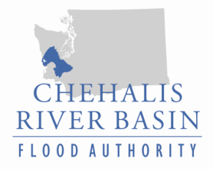
  Chehalis River Basin Flood Authority
Formed in 2008
Formal body focused on: (1) flood hazard mitigation throughout the Basin; and (2) decision-making that is . . . .
  informed by science.
  protective of Basin residents/communities.
  environmentally appropriate.
Basin jurisdictions represented
  Grays Harbor County
  Lewis County
  Thurston County
  City of Aberdeen
  City of Centralia
  City of Chehalis
  City of Cosmopolis
  City of Montesano
  City of Napavine
  City of Oakville
  Town of Pe Ell
  Town of Bucoda

Slide 5
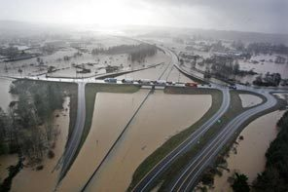
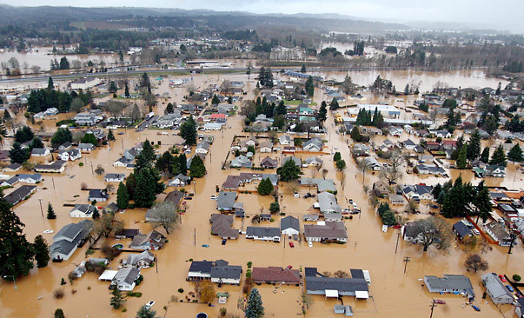
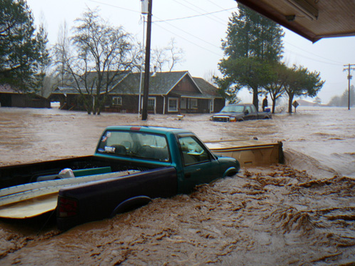
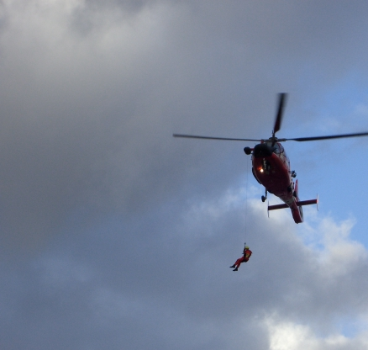
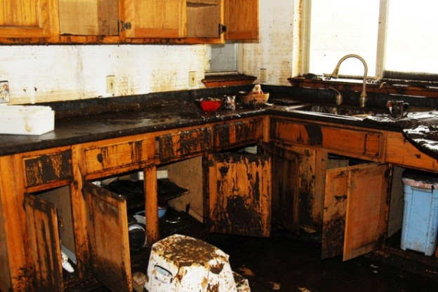
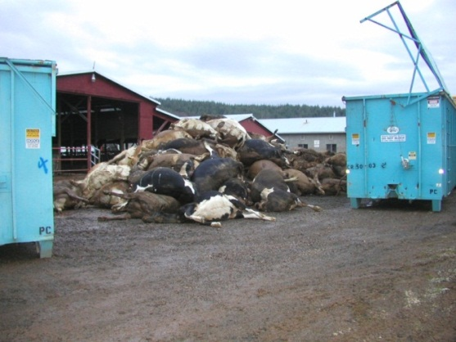
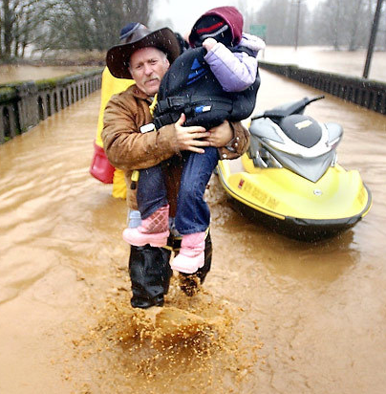
  Background
2007 Flood -- $938M Basin-wide damage, $300M lost economic activity (WA)
Exit 77 (I-5) in Chehalis
STEVE RINGMAN / SEATTLE TIMES
City of Centralia
STEVE RINGMAN / SEATTLE TIMES
Photos Source: LEWIS COUNTY,
DIVISION OF EMERGENCY MANAGEMENT

Slide 6
  Background
Ranked high flow events (1932 - 2012) . . .
  I-5 closed 1990, 1996, 2007, 2009
  Five largest events since 1986 -- Frequent floods are getting worse and damage is increasing . . .
  Chart -- Chehalis River Flow Rates near Grand Mound (cubic ft./sec.)

Slide 7
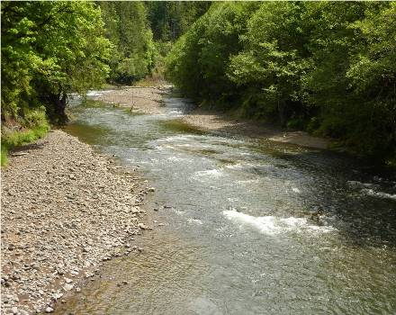
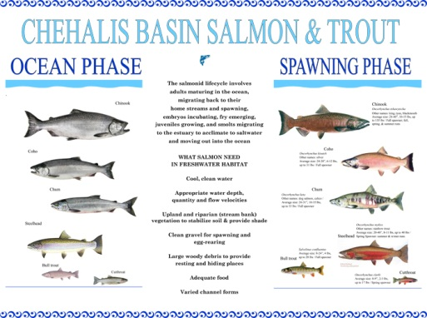
  Background
Chehalis is the second largest river basin in the state, rich in natural resources . . .
Populations are 15-25% of historic levels
TMDL for the basin (http://www.ecy.wa.gov/programs/wq/tmdl/ChehalisRvrTMDLSummary.html)
Upper Chehalis (5/31/2010)
JAMES E. WILCOX / WILD GAME FISH CONSERVATION INTERNATIONAL
www.chehalisbasinpartnership.org

Slide 8
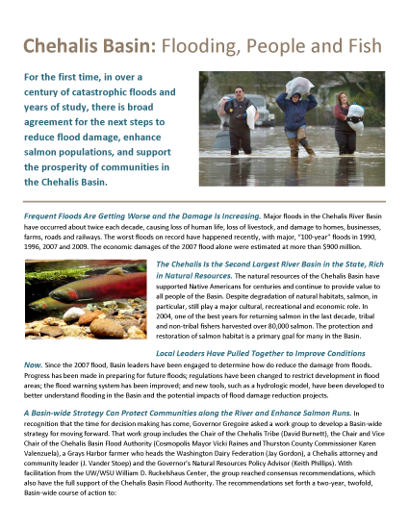
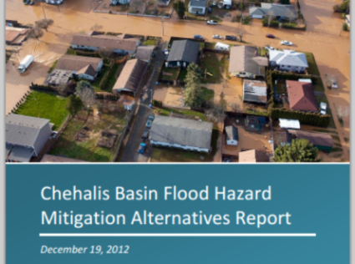
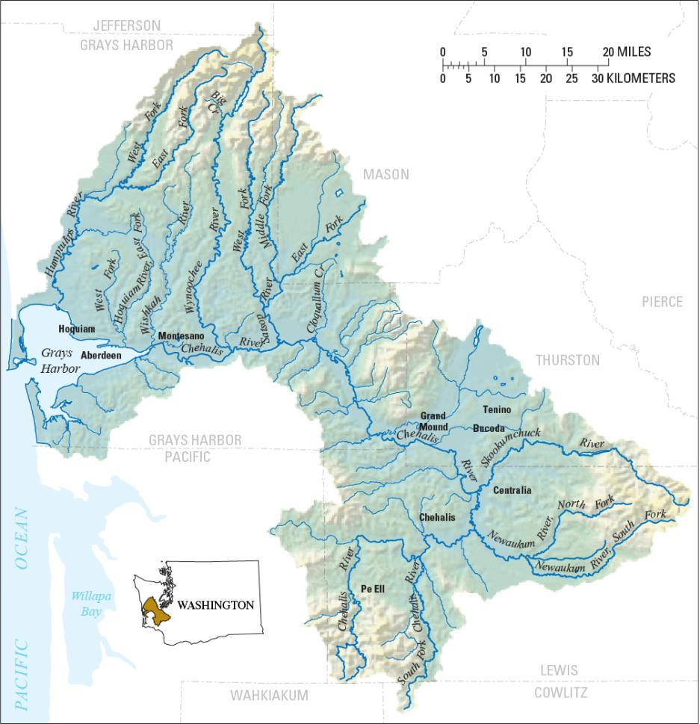
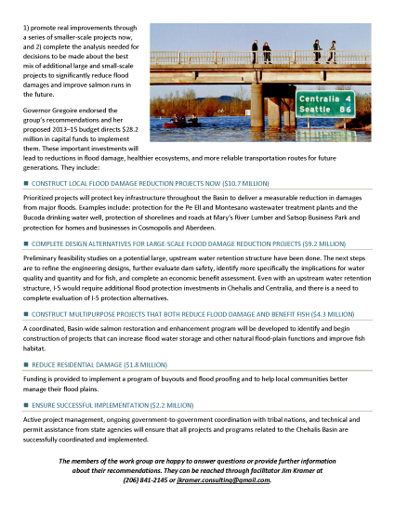
  Need -- Strategy, Action, Tools . . .
Strategy = Basin-wide Solution
Significant reduction in flood damage and enhancement of aquatic resources.
Solving one’s problems doesn’t increase another’s.
Maintain focus in five areas:
  major capital projects.
  localized projects.
  land use management.
  aquatic species and habitat enhancements.
  flood warning, emergency response.
William D. Ruckelshaus Center

Slide 9
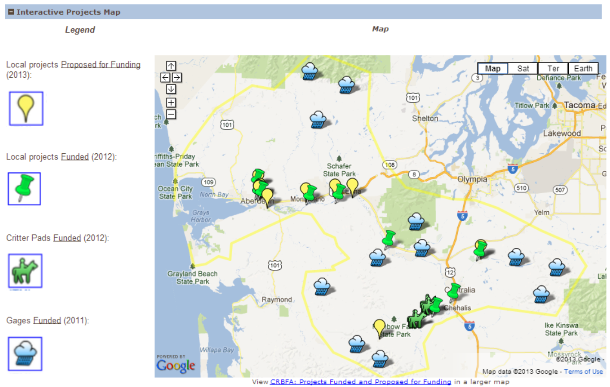
  Action – Capital Projects (2012, 2013)
2012 Capital Budget:
$5.0M – Local projects.
2013 Capital Budget:
$9.2M -- Design evaluations by 2014 for Upper Basin dam (~$5.6M) and I-5 protection (~$3.4M).
$15.1M -- Local projects and Fish and habitat enhancements.
$1.8M -- Local programs (buyouts, flood proofing, home elevations).
$2.2M – Implementation capacity, technical experts.
http://www.ezview.wa.gov/pr/site/alias__1492/34489/projects.aspx#map

Slide 10
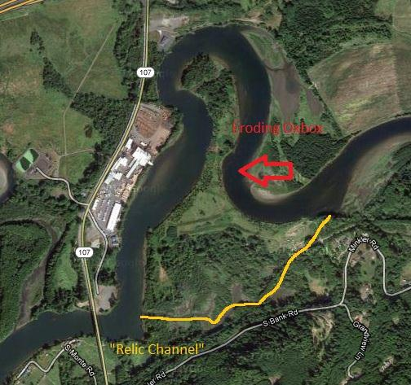
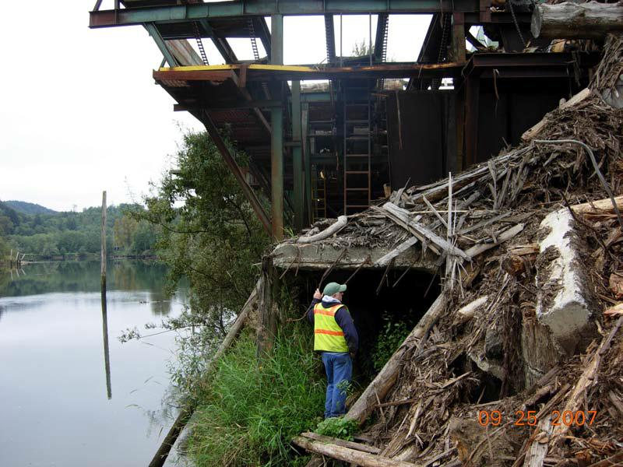
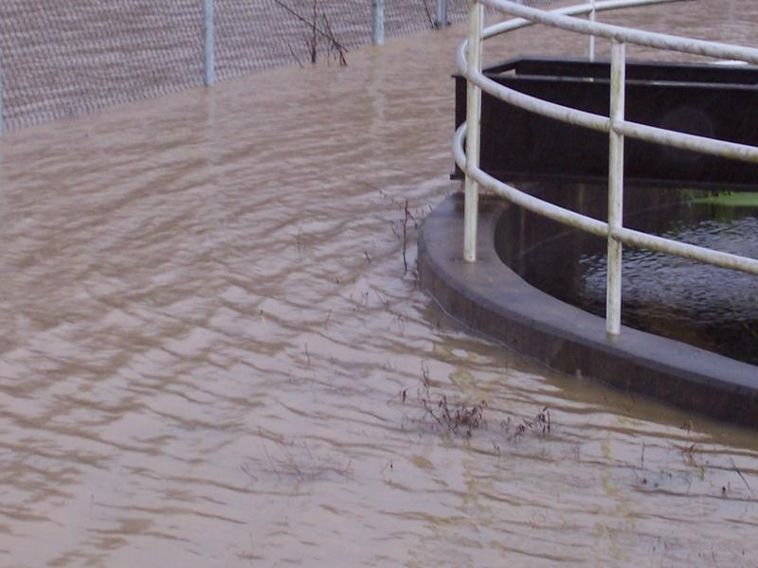
  Example Project – City of Montesano
Revetment to Protect Montesano Road, Adjacent Facilities
  Mary’s River Lumber = 120 family wage jobs.
  State Highway (SR 107) = At risk of damage.
  Montesano STP = Risk of overtopping.
  Solutions and Alternative = Balance time, cost, results.
  Project website.

Slide 11
  Local Projects --
Sponsor | Projects (and web content) | 2012 Allocated | 2013 Budgeted
1. Aberdeen | Burger King Trail/Dike | $ 24,600 | $ 140,000
2. Aberdeen | Dike Bank of Wishkah North of Highway | $ 47,000 | $ 270,000
3. Aberdeen | Market Street Dike | $ - | $ 670,000
4. Aberdeen | Southside Dike/Levee Certification | $ 50,000 | $ -
5. Bucoda | Bucoda Levee | $ 42,000 | $ 305,000
6. Chehalis Tribe | Flood Gage Station | $ 50,000 | $ -
7. Chehalis Tribe | Sickman-Ford Overflow Bridge Project | $ 2,075,000 | $ -
8. Cosmopolis | Mill Creek Dam Improvements | $ - | $ 2,250,000
9. Grays Harbor County | Elma-Porter Flood Mitigation Project | $ - | $ 584,000
10. Grays Harbor County | Satsop River Floodplain Restoration | $ 50,000 | $ 510,000
11. Grays Harbor County | Wishkah Road Flood Levee | $ 125,000 | $ 2,642,000
12. Lewis County | Adna Levee | $ 244,145 | $ -
13. Lewis County | Airport Levee (Phase I) | $ 1,239,829 | $ -
14. Montesano | Revetment for Montesano Rd., Sewage Treatment Plant, Mary’s River Lumber | $ 102,426 | $ 2,000,000
15. Pe Ell | Wastewater Treatment Plant Flood Prevention Dike | $ - | $ 521,000
16. WA Cons. Comm. | Critter Pads and Evacuation Routes | $ 500,000 | $ 850,000
17. ??? | Restoration -- Allen Creek | $ - | $ 990,000
18. ??? | Restoration -- Oxbow Reconnect at RM 78 | $ - | $ 861,000
19. ??? | Restoration -- Oxbow Lake Reconnect | $ - | $ 1,149,000
20. ??? | Restoration -- Basin-wide Salmon Recovery Strategy | $ - | $ 1,350,000
Total = |  | $ 4,550,000 | $ 15,092,000

Slide 12
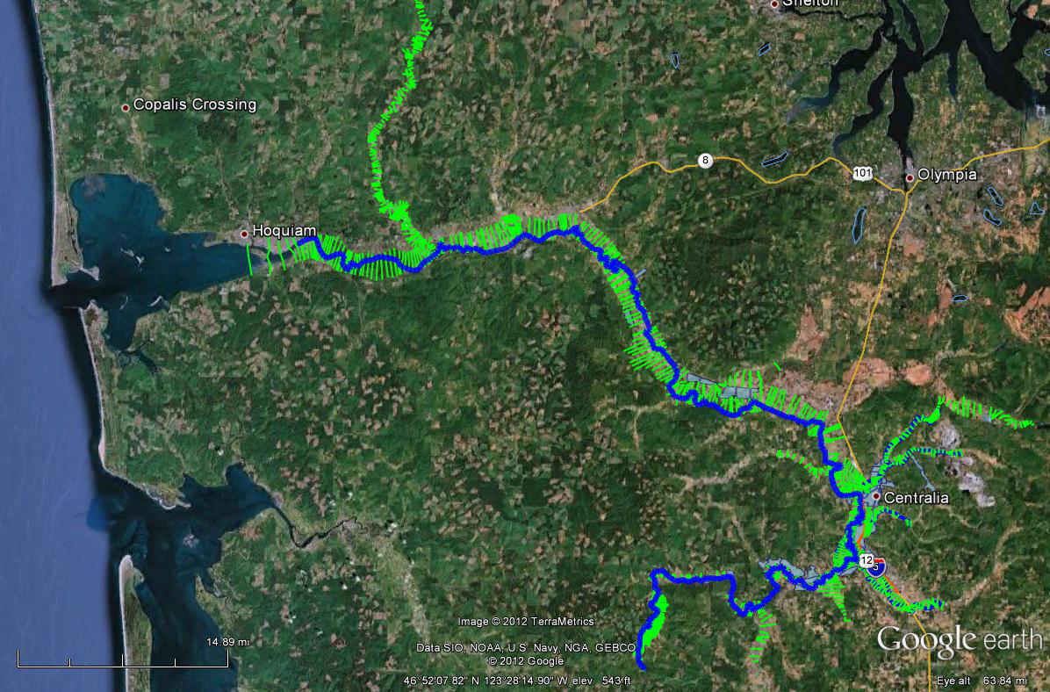
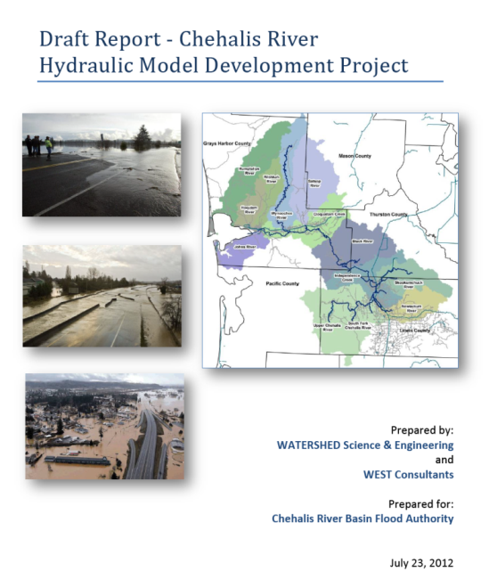
  Key Tool to Understanding How the Basin Functions – “Chehalis River Hydraulic Model”
Science-based model to inform decision-makers on hydraulic effects of potential flood relief options (at basin-wide and localized scales).
Covers mouth of Chehalis River upstream to Pe Ell (108 miles).

Slide 13

Work Program Elements
Collection of aquatic species, water quality and hydrologic data.
Model analyses of flood mitigation projects, fish, wildlife, water quality, sediment, streamflow and flooding.
Technical Committees.
Technical, Policy and Public Workshops.
Consultant/agency report -- September 1, 2014.
Recommendation -- November 2014.

Slide 14
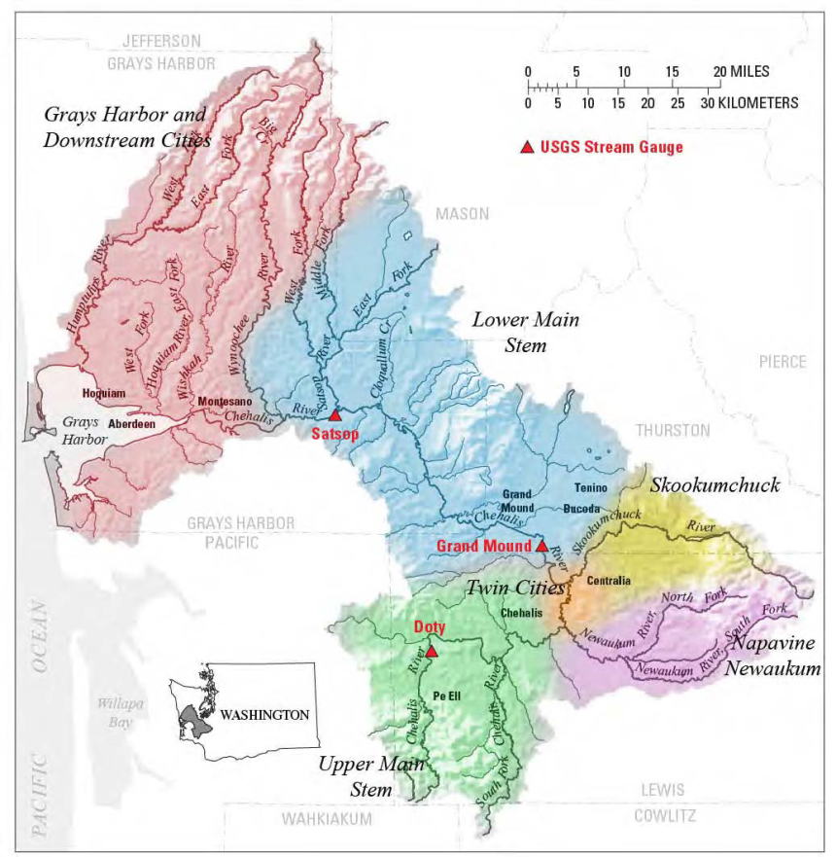
Key Issues
Increasing the data and understanding of the Basin ecological and physical functions.
Assessing the feasibility of water retention, I-5 alternatives, suite of smaller projects.
Striving for consistency and improving floodplain management across the Basin.
Creating an aquatic species enhancement strategy and set of actions.
Developing the long term strategy, specific actions, costs and funding.
Gaining broad support for implementation.

Slide 15


Needs from Ecology
Partner to improve understanding of the Basin.
Participation in technical and policy work.
Help build broad support for long-term strategy to reduce flood damage and enhance ecological functions.
Support implementation of capital projects.

Slide 16

Discussion
Questions about budget and work program.
Key issues, questions, interests.
Communication.
Strategies and ideas to stay connected.

Slide 17
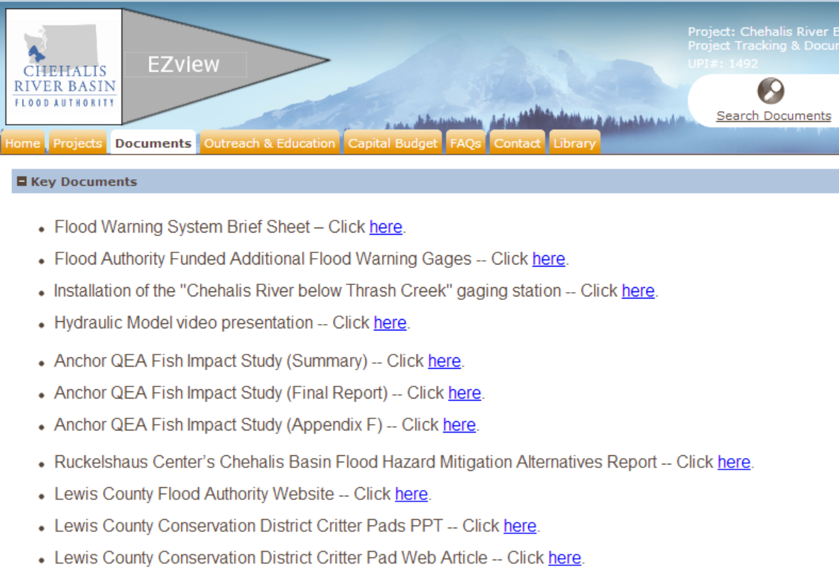
  Resources, Additional Information
www.ezview.wa.gov

Slide 18
  Thank You!
Governor’s Chehalis Basin Work Group
Chehalis River Basin Flood Authority
Staff contacts . . .
Jim Kramer, Facilitator
Governor’s Chehalis Basin Work Group
Chehalis River Basin Flood Authority
206/841-2145
jkramer.consulting@gmail.com
Scott Boettcher, Staff
Chehalis River Basin Flood Authority
360/480-6600
scottb@sbgh-partners.com

