Slide 1
Lewis County Conservation District
Critter Pads!!!!!!!!!!!!!!!!!!!!

Slide 2
Critter Pads in Washington
Critter Pads started in King County in the 1990’s
One dairy farmer has used his pad three times
The Lewis County Conservation District has constructed three pads
Two more are planned. The District is researching a source of fill

Slide 3
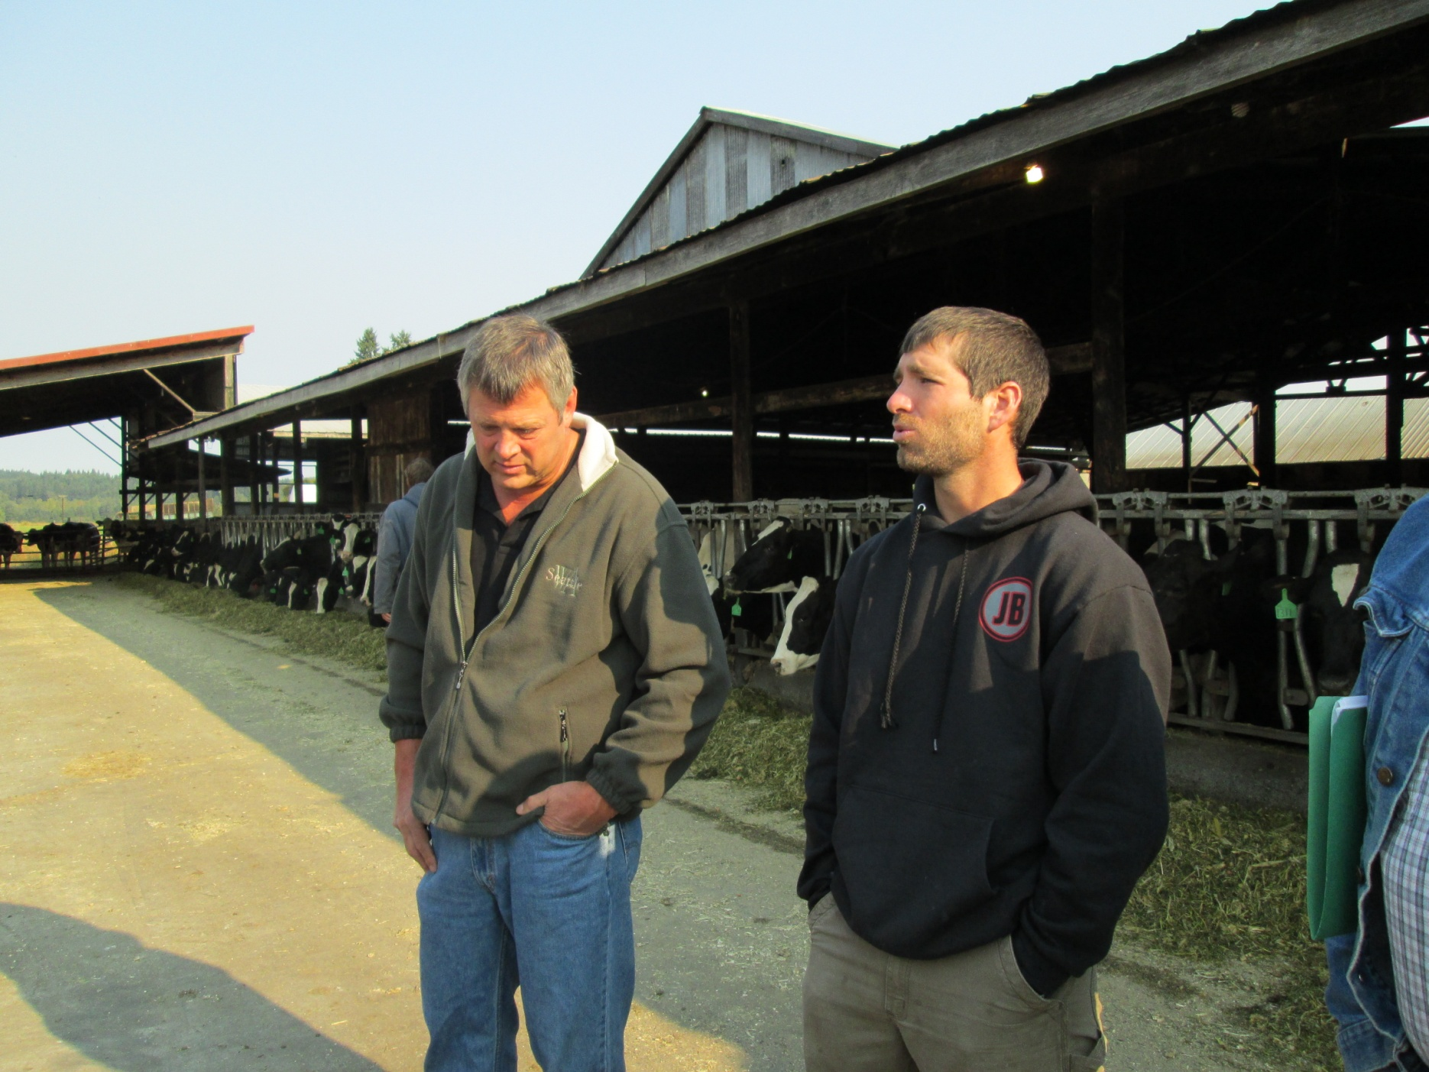
Meeting with Contractors

Slide 4
Starting Brunoff Critter Pad

Slide 5
Getting Taller

Slide 6
Finished Brunoff Pad

Slide 7
Larson Critter Pad

Slide 8
Gregory Critter Pad

Slide 9
Questions?

