Slide 1
Chehalis River Basin Flood Authority
Education and Outreach Subcommittee
Actions and Activities Benefiting the Basin
6:00 p.m., February 25, 2013
City of Chehalis
City Council

Slide 2
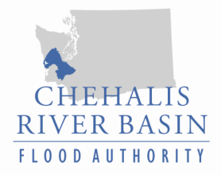
Today’s Presentation
Raise awareness
Encourage discussion
Key messages we’d like to leave you with . . .
  Broad agreement -- For the first time in a century there is broad agreement on the next steps to reduce flood damage and enhance salmon runs in the Basin.
  Basin-wide strategy -- A Basin-wide strategy can protect communities along the river and enhance salmon runs.
  Flood Authority – Positioned to continue to be a galvanizing force in the Basin for implementation of tools and projects.
Discussion

Slide 3
  Chehalis River Basin Flood Authority
Formed in 2008
Formal body focused on (1) flood hazard mitigation throughout the Basin and (2) decisions that would be . . .
  informed by science
  protective of Basin residents/communities
  environmentally appropriate
Basin jurisdictions represented
  Grays Harbor County
  Lewis County
  Thurston County
  City of Aberdeen
  City of Centralia
  City of Chehalis
  City of Cosmopolis
  City of Montesano
  City of Napavine
  City of Oakville
  Town of Pe Ell
  Town of Bucoda

Slide 4
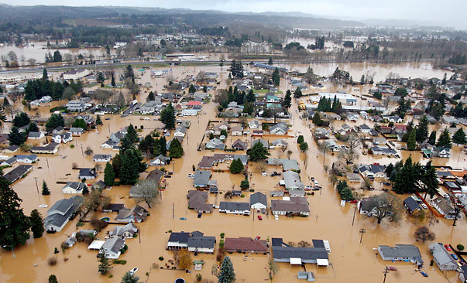
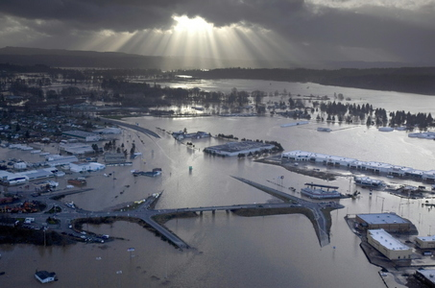
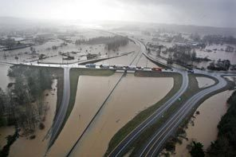
  Background
2007 Flood -- $938 million in damage (Basin-wide)
City of Centralia
STEVE RINGMAN / SEATTLE TIMES
City of Chehalis
BRUCE ELY / THE OREGONIAN
Exit 77 (I-5) in Chehalis
STEVE RINGMAN / SEATTLE TIMES

Slide 5
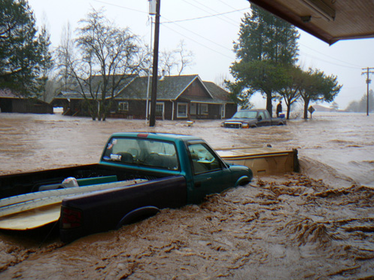
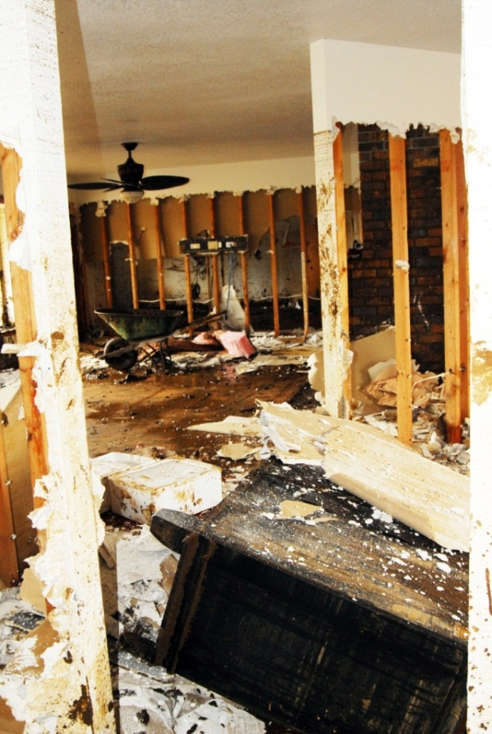
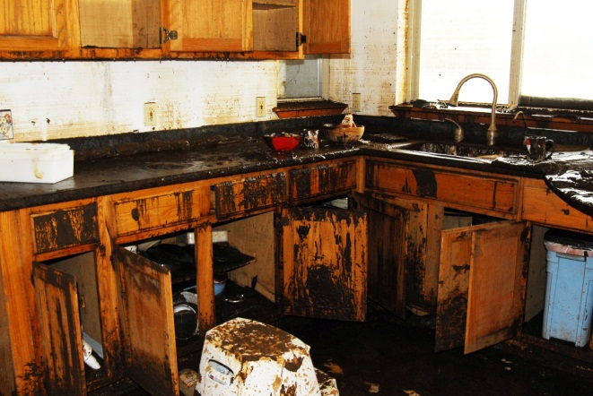
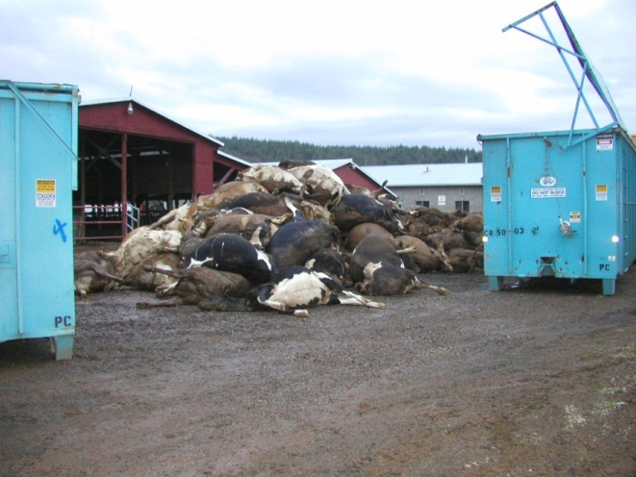
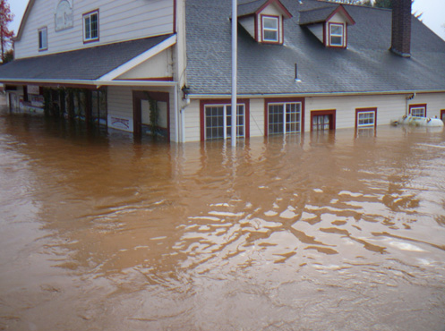
  Background
2007 Flood -- $300 million in lost economic activity (Washington State)
Photos Source: Lewis County,
Division of Emergency Management

Slide 6
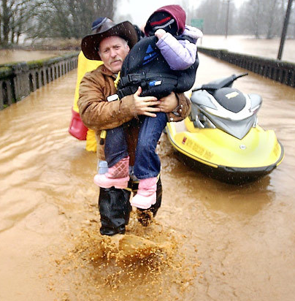
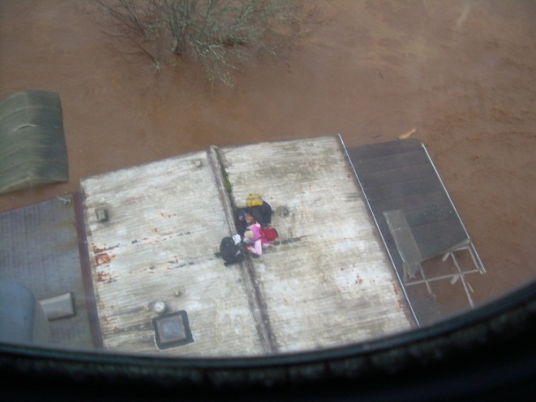
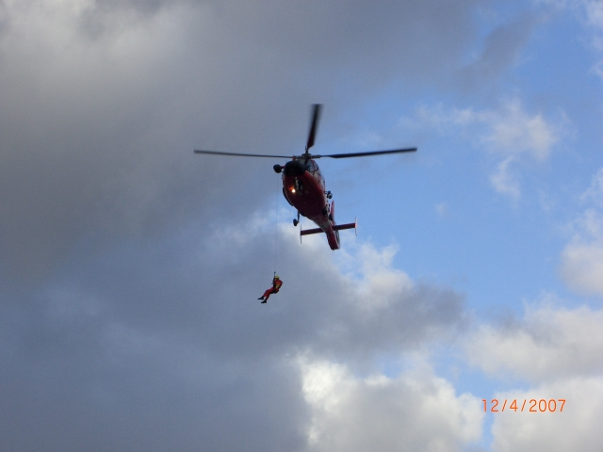
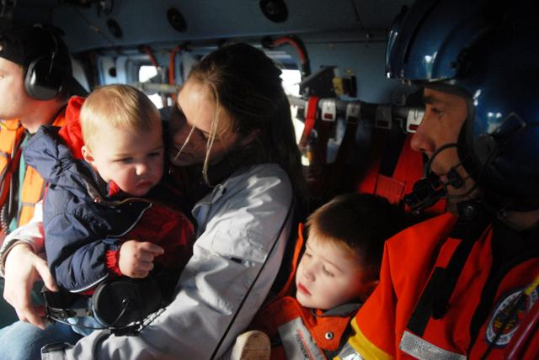
  Background
2007 Flood – Immense impact on the lives of victims, responders alike
Photos Source: Lewis County,
Division of Emergency Management

Slide 7
  Background
Ranked high flow events (1932 - 2012) . . .
  I-5 closed 1990, 1996, 2007, 2009
  Five largest events since 1986 -- Frequent Floods are getting worse and damage is increasing . . .
  Chart -- Chehalis River Flow Rates near Grand Mound (cubic ft./sec.)

Slide 8
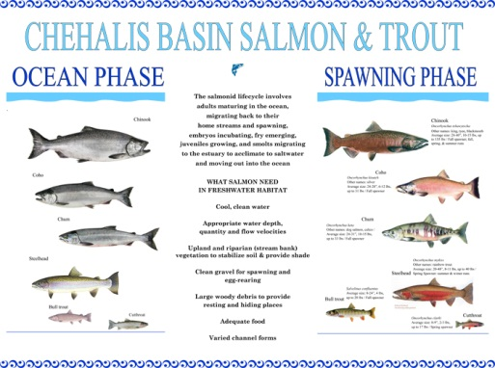
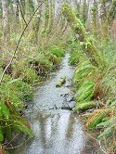
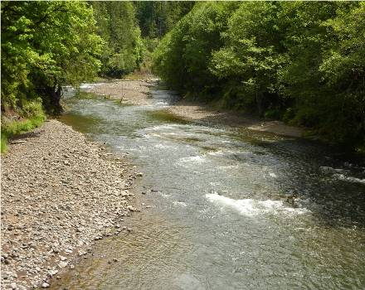
  Background
Chehalis is the second largest river basin in the state, rich in natural resources . . .

Slide 9
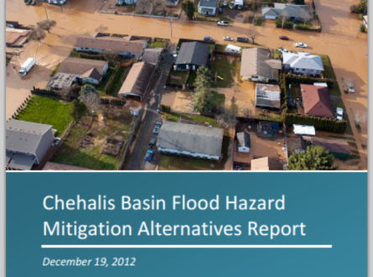
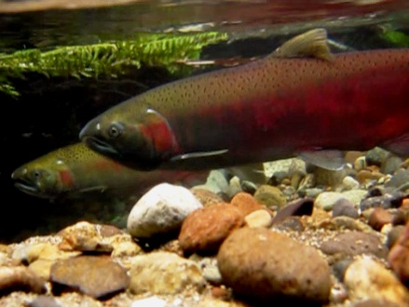
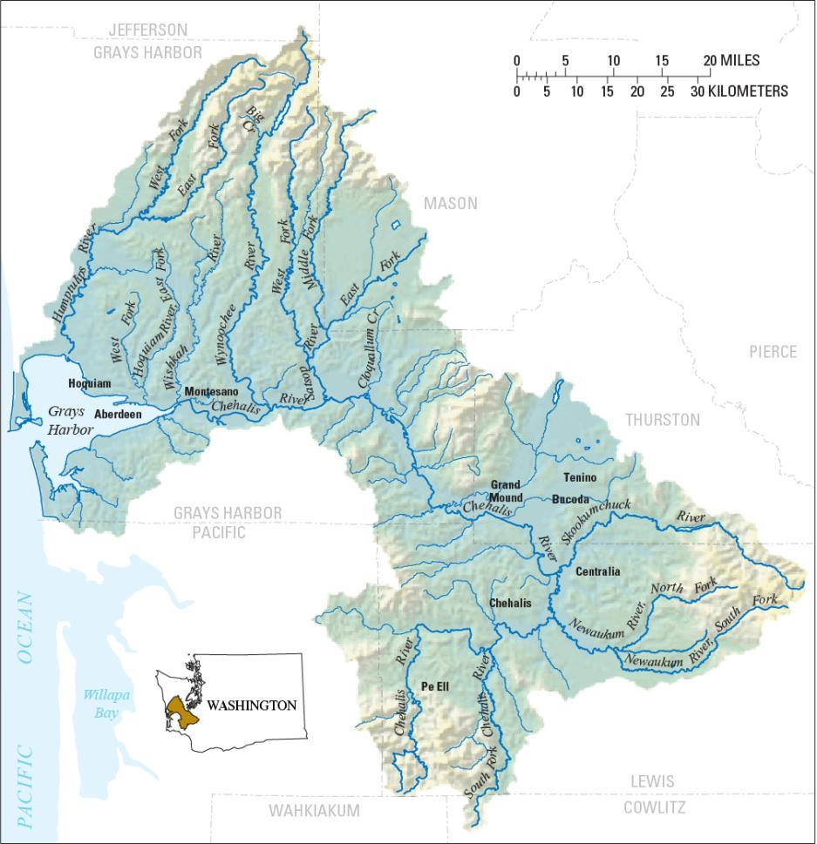
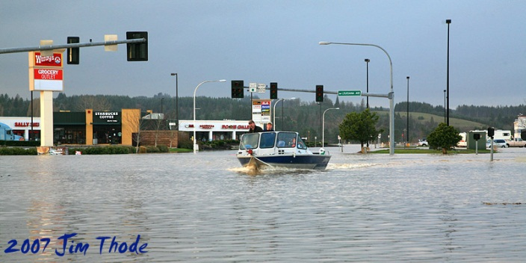
  Need -- Strategy, Tools, Action. . .
Strategy = Basin-wide Solution
Significant reduction of flood damage.
Solving one area’s problems doesn’t increase problems for others.
Maintain focus in five areas:
  major capital projects
  localized projects
  land use management
  environmental enhancements
  flood warning and emergency response
William D. Ruckelshaus Center

Slide 10
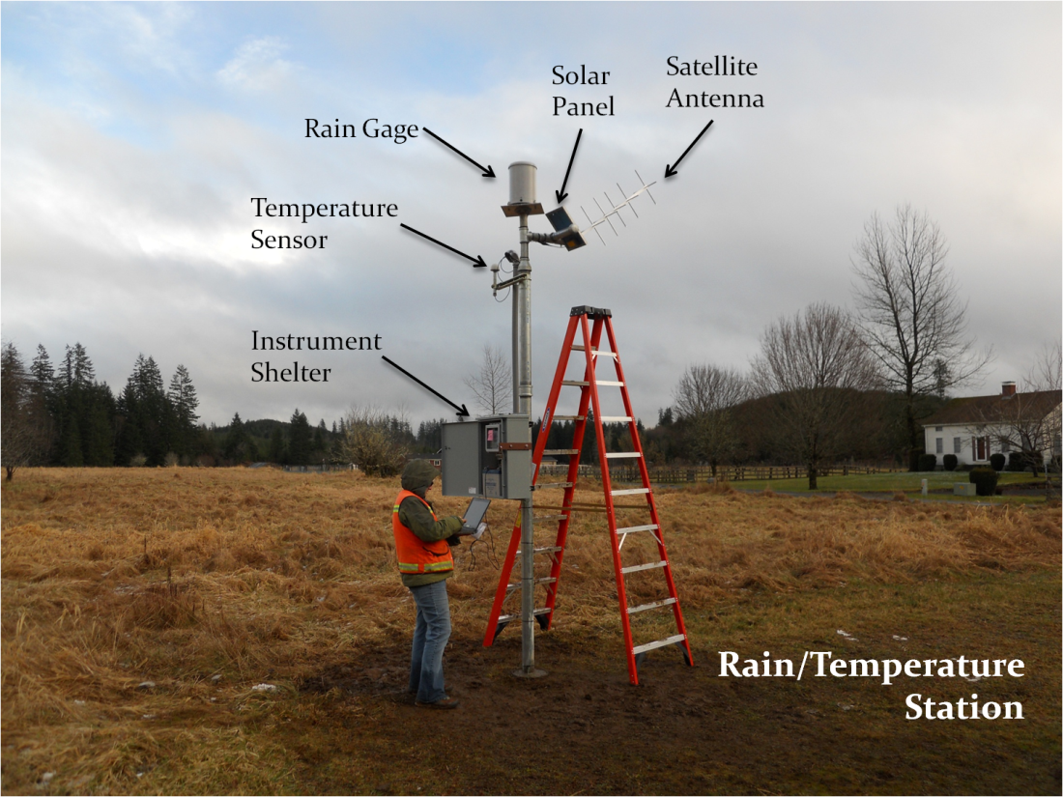
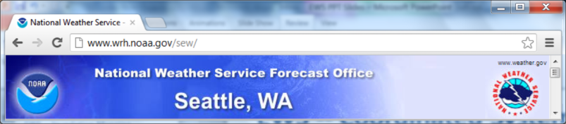
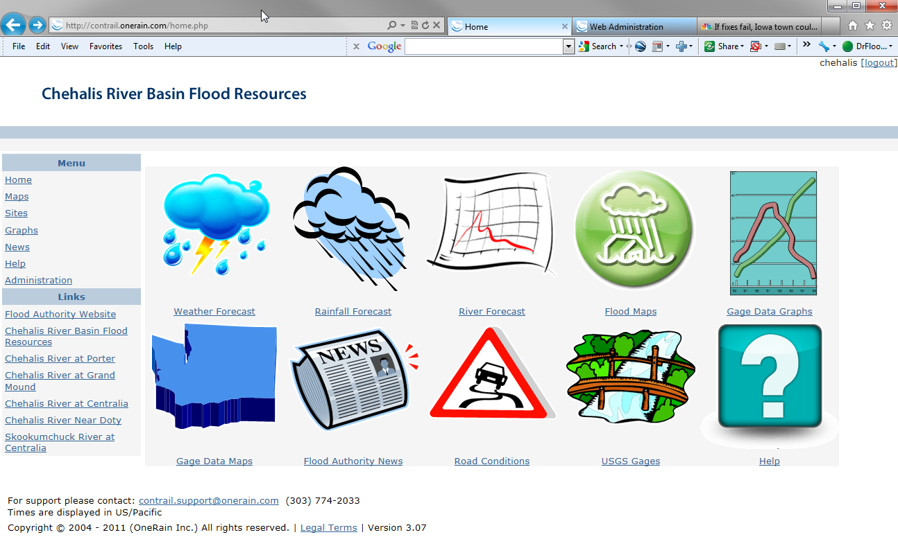
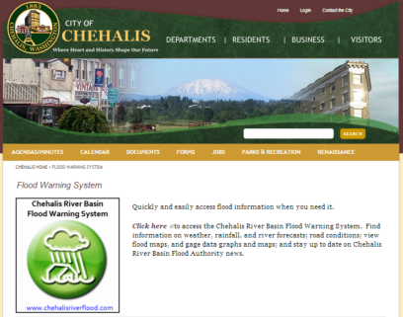
  Tools -- Flood Warning System
www.chehalisriverflood.com
Front-facing website.
Back-end data collection, data synchronization system.
Improves forecasting and early-warning.

Slide 11
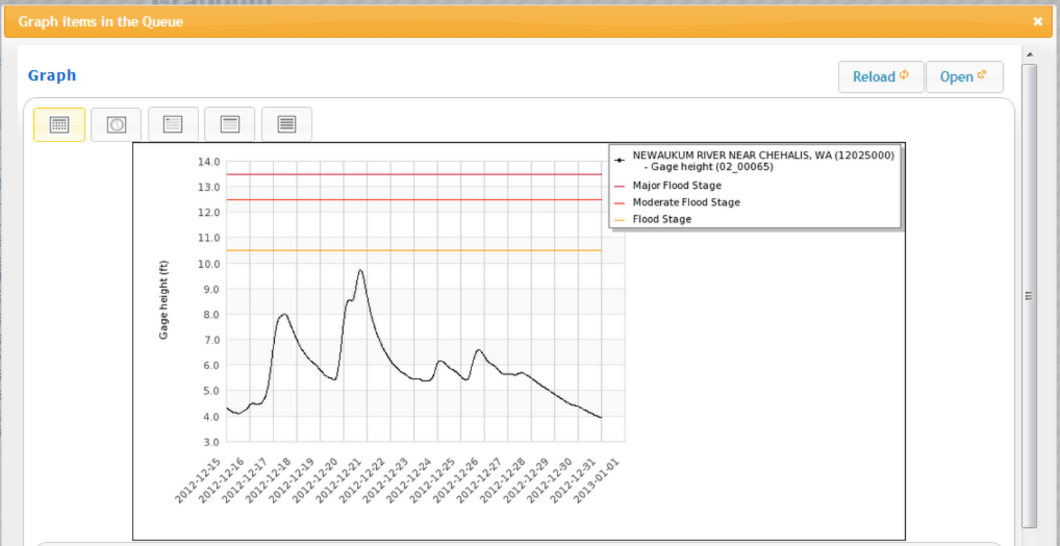
  Tools -- Flood Warning System
Localized tracking, forecasting . . .
www.chehalisriverflood.com

Slide 12
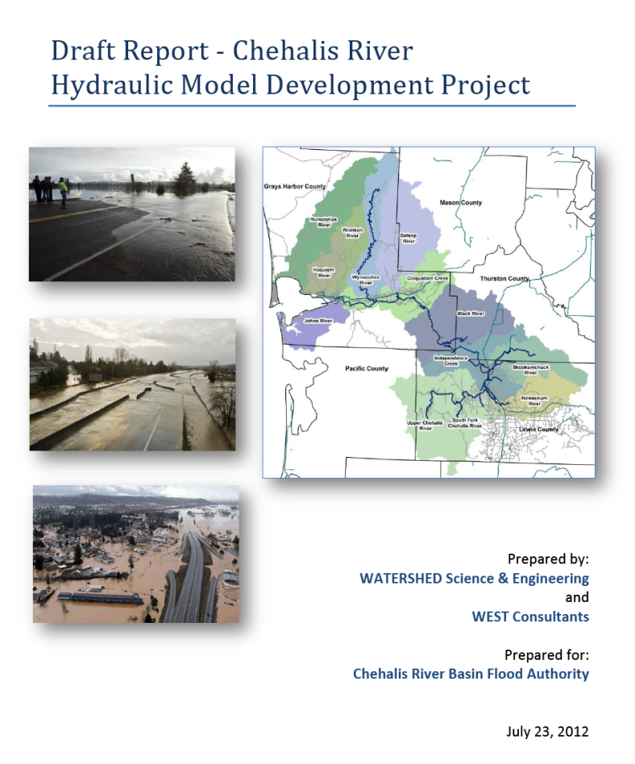
  Tools -- Hydraulic Analysis Model
Science-based model to inform decision-makers on the hydraulic effects of potential flood relief alternatives (at basin-wide and localized scales).
25 potential flood relief projects or project combinations were analyzed/evaluated with the model.
Covers mouth of the Chehalis River upstream to Pe Ell (108 miles).

Slide 13
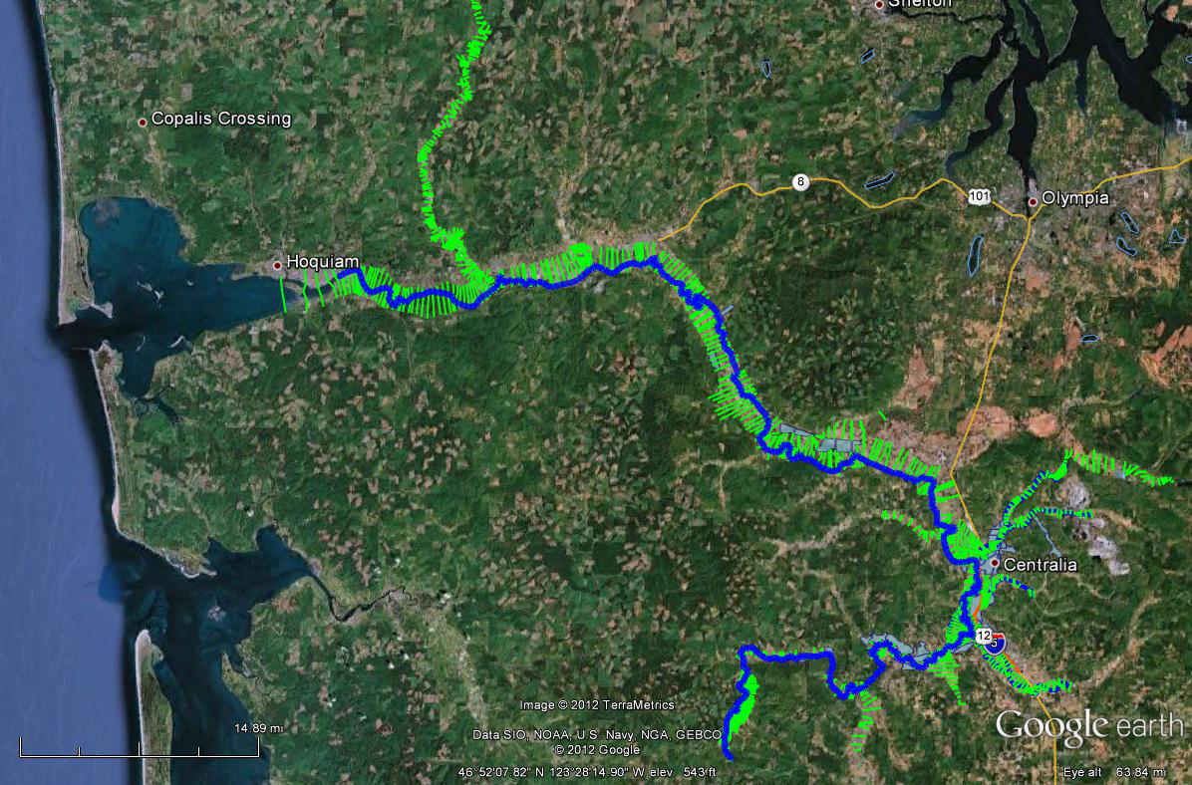
  Tools -- Hydraulic Analysis Model
Now have analytic ability to understand potential project effects, downstream and up.

Slide 14
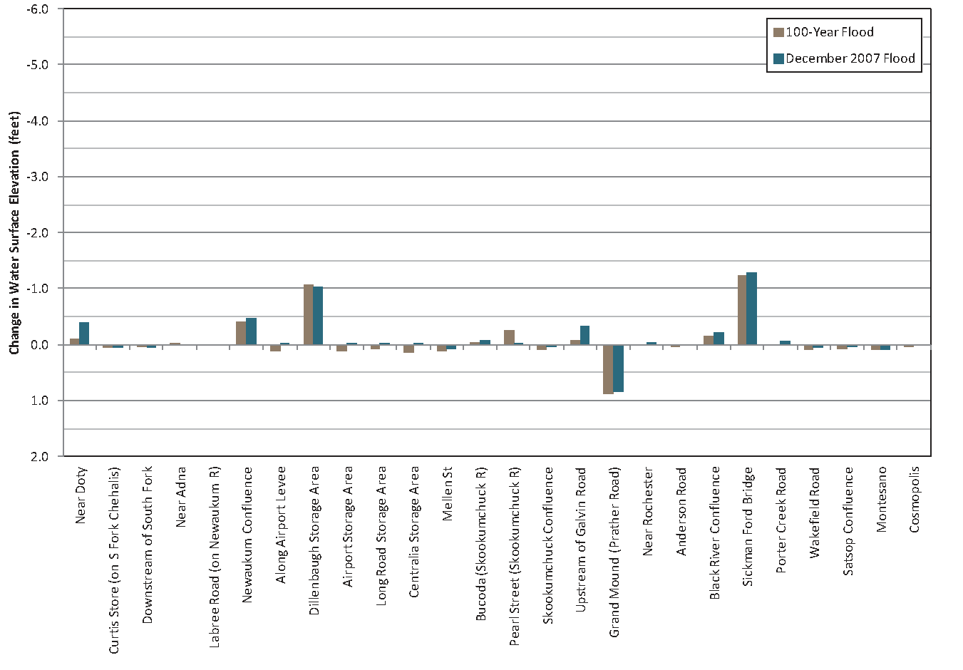
  Tools -- Hydraulic Analysis Model
Example: Basin-wide effects analysis (Chehalis Basin Flood Hazard Mitigation Alternatives Report 12/2012)
Table 6 (pg.80) -- “Removal of all Bridges, Approach Fills”

Slide 15
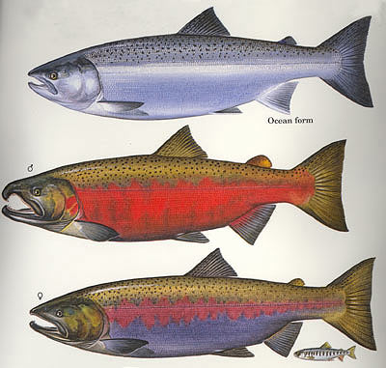
  Tools -- Fish Studies
Two significant fish studies conducted in Upper Basin (WRIA 23).
  Analyze effect of dam alternatives on Spring Chinook, Steelhead and Coho.
  Prioritize potential fish habitat enhancement opportunities.
Initial and preliminary projections . . .
Species | Multi-Purpose Dam | Flood Control-Only Dam | Fish Habitat Enhancement Measures
Spring Chinook | 20%  | 4%  | likely same as Coho
Steelhead | 7%  | 11%  | likely same as Coho
Coho | 1%  | 1%  | 4-5% 

Slide 16
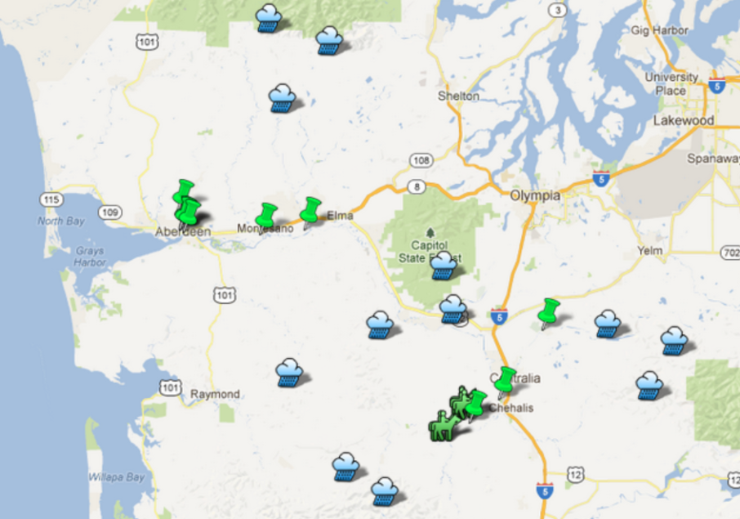
  Action -- 2012 Jobs Now Act Projects
$5,000,000 provided under 2012 Jobs Now Act.
  $1,875,000 -- Repair/modification of levees and dikes.
  $2,075,000 -- Modification of Sickman Ford bridge, and floodplain culverts.
  $50,000 -- Installation/calibration of rain gauge on Chehalis reservation.
  $500,000 -- Construction of evacuation routes and critter pads.
  $500,000 -- Improvements to areas affected by Satsop river.
Half the funds allocated to date.
  Adna
  Aberdeen
  Bucoda
  Chehalis- Centralia Airport
See http://goo.gl/maps/v7vO3.
  Grays Harbor County
  Montesano
  WA Conservation Commission

Slide 17
  Action -- 2013 Proposed State Capital
  Budget
Governor workgroup convened to develop prioritized list of projects for 2013 state capital budget based on Basin-wide solution.
  Chehalis Tribe
  Chehalis Flood Authority
  Washington Dairy Federation
  Governor’s staff
Proposed budget . . .
  Construct local flood damage reduction projects now ($10.7 million)
  Complete design alternatives for large-scale flood damage reduction projects ($9.2 million):
    Upper basin water retention-engineering and design
    I-5 protection options
  Construct multipurpose projects that reduce flood damage and benefit fish ($4.3 million)
  Reduce residential damage ($1.8 million)
  Ensure successful implementation ($2.2 million)

Slide 18
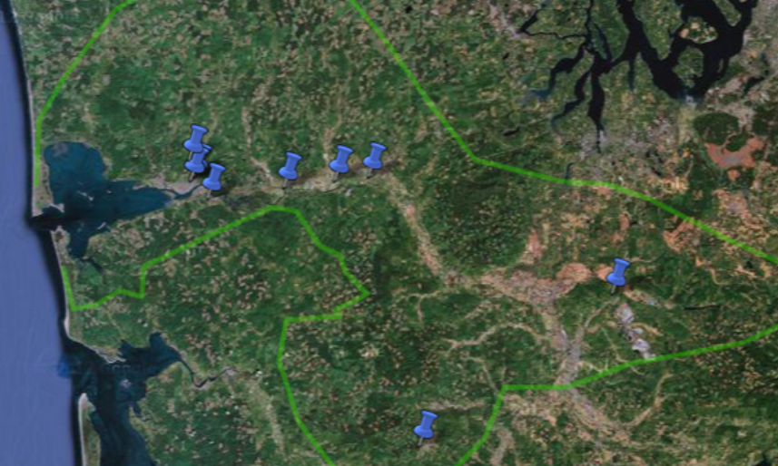
  Action -- 2013 Proposed State Capital
  Budget
Proposed budget ($10.7 million for local projects) . . .
http://goo.gl/maps/gWob9

Slide 19
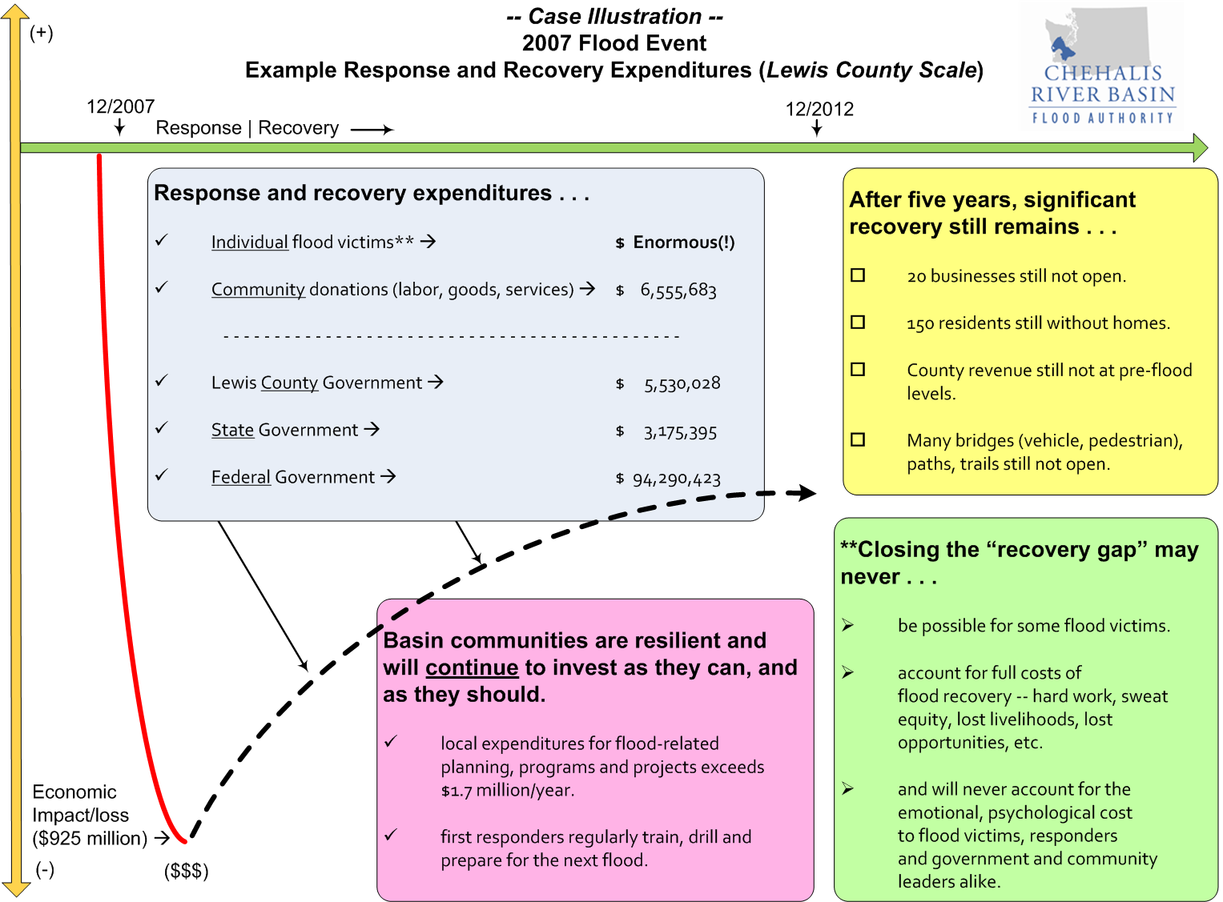
  Action -- 2013 Proposed State Capital
  Budget
Local contribution . . .

Slide 20
  Looking Ahead . . .
Continue to focus on local small/mid-scale projects (like was done in 2012 with Jobs Now Act projects).
Major projects:
  Upper Basin Dam – Evaluate design alternatives to determine permit feasibility, engineering safety and mitigation requirements by December 2014.
  I-5, Airport, Twin Cities – Conduct design and engineering analysis on four protection alternatives.
Continue to improve existing tools (usability improvements to Flood Warning System).
Continue to be a galvanizing force for the Basin.

Slide 21
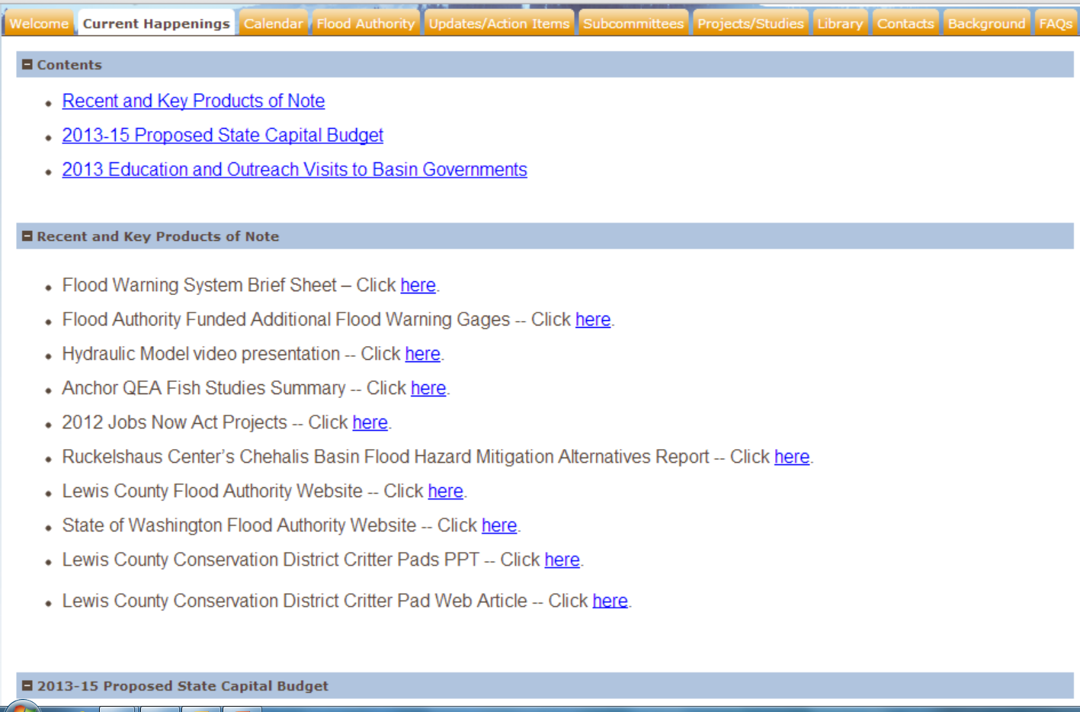
  Resources, Additional Information
Visit Flood Authority Web Library (here or via www.ezview.wa.gov) . . .

Slide 22

  Questions? Perspectives? Input?

Slide 23
  Thank You!
Vickie Raines, Chair
Chehalis Basin Flood Authority
360/590-4100
vraines@cosmopolis.us.com
Edna Fund, Chair
Education and Outreach Subcommmittee (Flood Authority)
360/269-7515
Edna.Fund@lewiscountywa.gov
Karen Valenzuela, Vice-Chair
Chehalis Basin Flood Authority
(360) 786-5440
ValenzK@co.thurston.wa.us
Scott Boettcher, Staff
Chehalis Basin Flood Authority
360/480-6600
scottb@sbgh-partners.com
Arnold Haberstroh, Chehalis Rep.
Chehalis Basin Flood Authority
(360) 262-3634
agttt@comcast.net

