Slide 1
Chehalis River Basin Flood Authority
Community Outreach and Education Subcommittee
Actions and Activities Benefiting the Basin
7:00 a.m., July 11, 2013
Lewis County EDC

Slide 2
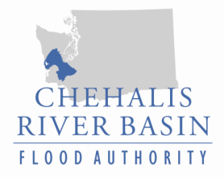
Today’s Presentation
Raise awareness
Encourage discussion
Key messages we’d like to leave you with . . .
  Broad agreement -- For the first time in a century there is broad agreement across the Basin on next steps to reduce flood damage and enhance salmon runs in the Basin.
  Basin-wide strategy -- A Basin-wide strategy is needed to protect communities along the river and enhance salmon runs.
  Flood Authority -- Positioned to continue be a galvanizing force in the Basin to collaboratively implement tools and projects.
Discussion

Slide 3
  Chehalis River Basin Flood Authority
Formed in 2008
Formal body focused on: (1) flood hazard mitigation throughout the Basin; and (2) decision-making that is . . .
  informed by science.
  protective of Basin residents/communities.
  environmentally appropriate.
Basin jurisdictions represented
  Grays Harbor County
  Lewis County
  Thurston County
  City of Aberdeen
  City of Centralia
  City of Chehalis
  City of Cosmopolis
  City of Montesano
  City of Napavine
  City of Oakville
  Town of Pe Ell
  Town of Bucoda

Slide 4
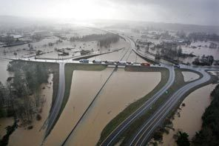
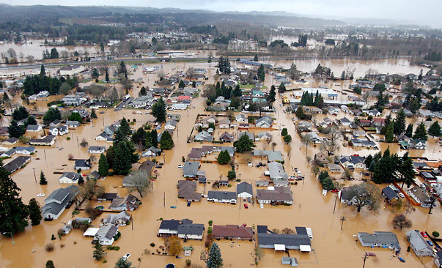
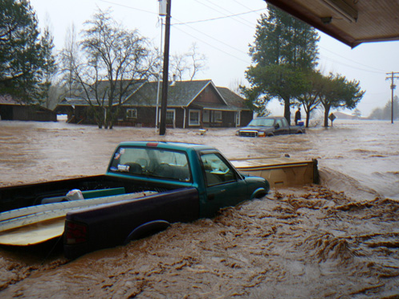
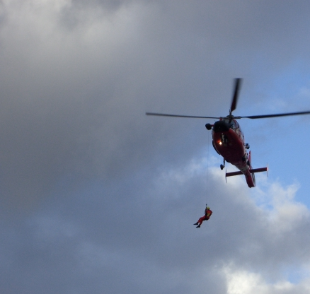
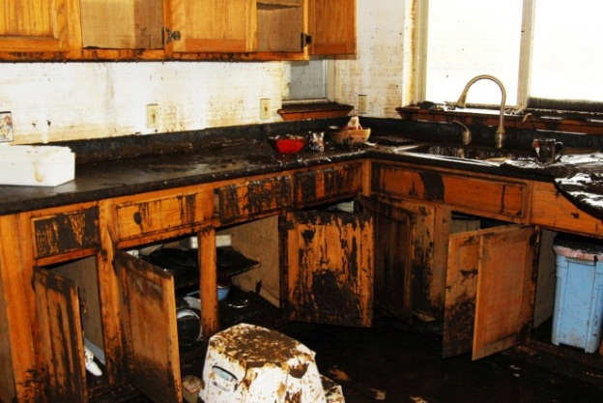
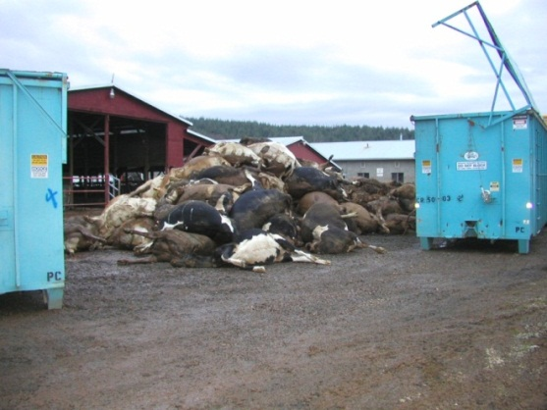
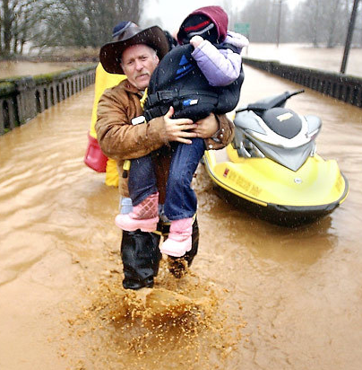
  Background
2007 Flood -- $938M Basin-wide damage, $300M lost economic activity (WA)
Exit 77 (I-5) in Chehalis
STEVE RINGMAN / SEATTLE TIMES
City of Centralia
STEVE RINGMAN / SEATTLE TIMES
Photos Source: LEWIS COUNTY,
DIVISION OF EMERGENCY MANAGEMENT

Slide 5
  Background
Ranked high flow events (1932 - 2012) . . .
  I-5 closed 1990, 1996, 2007, 2009.
  Five largest events since 1986 -- Frequent floods are getting worse and damage is increasing . . .
  Chart -- Chehalis River Flow Rates near Grand Mound (cubic ft./sec.)

Slide 6
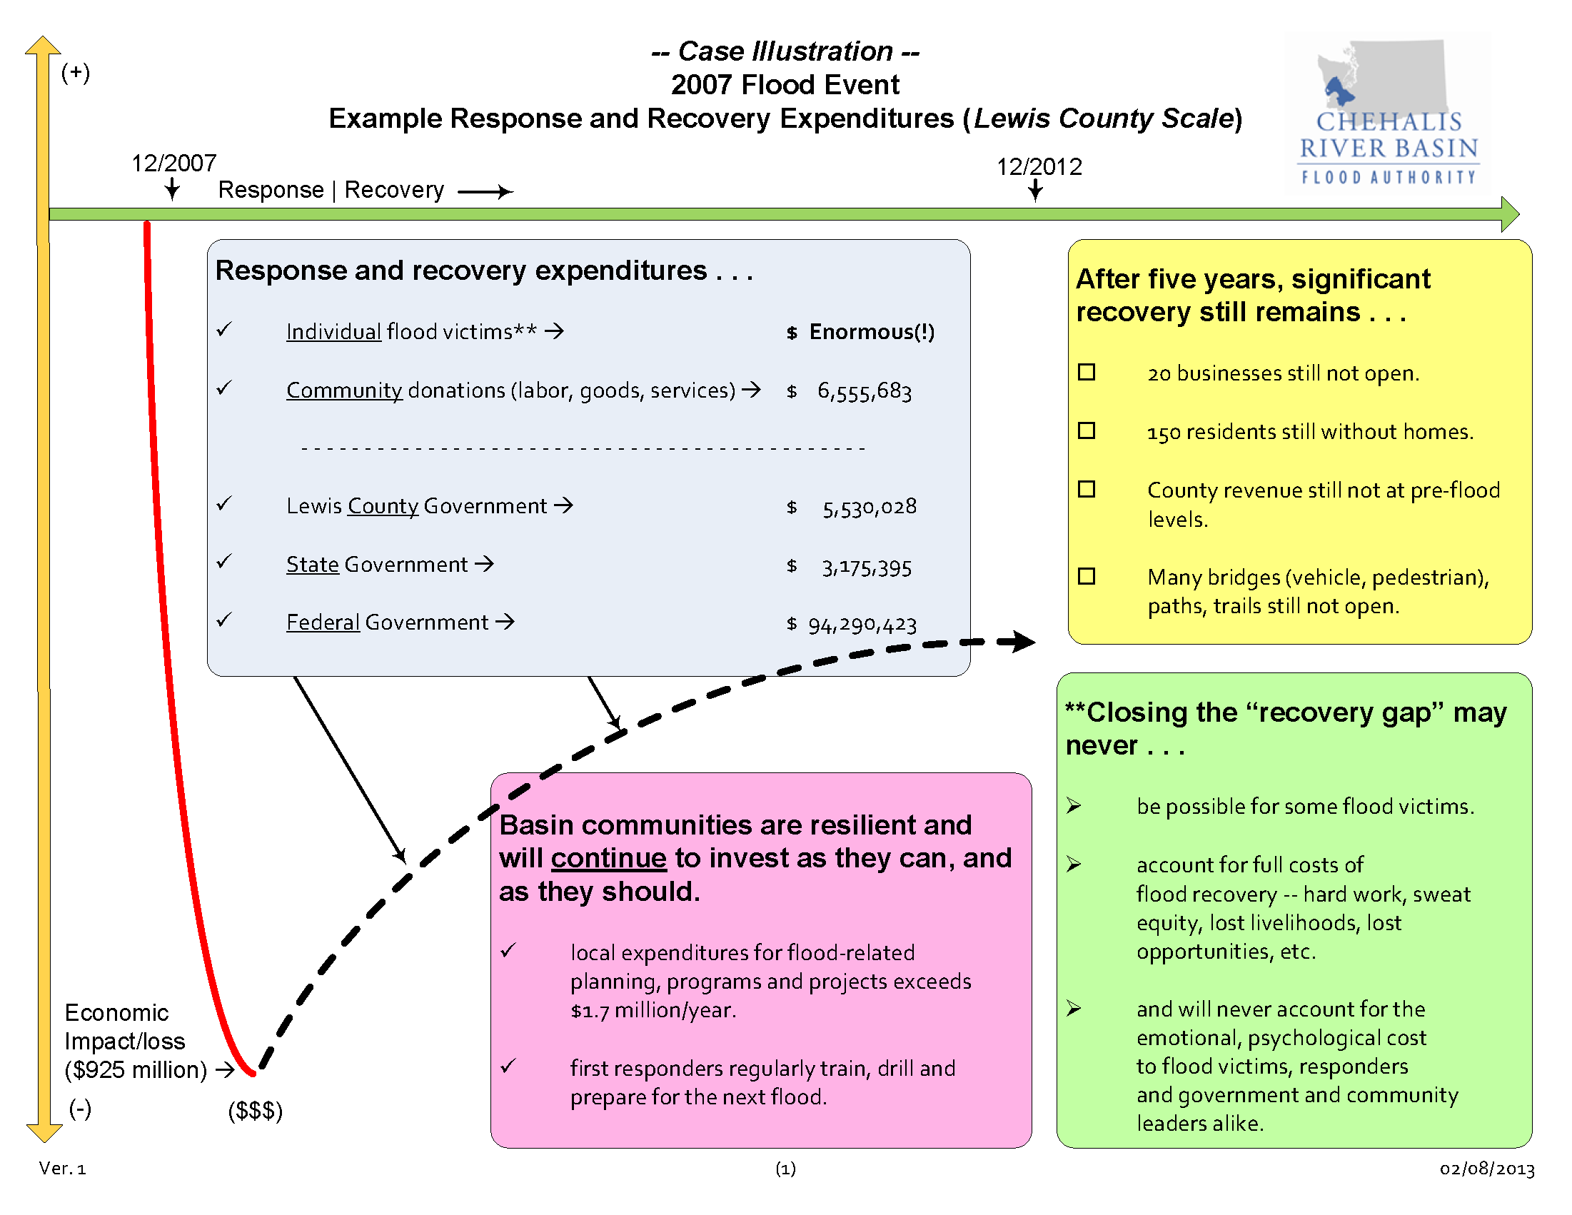
  Background
Response and recovery is expensive, takes time, and may not be fully achieved (at least on a near-term time scale) . . .

Slide 7
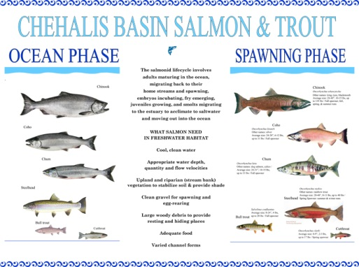
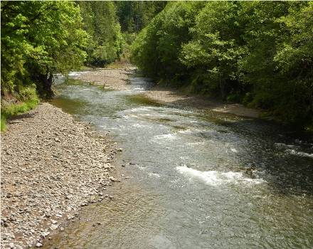
  Background
Chehalis is the second largest river basin in the state, rich in natural resources . . .
www.chehalisbasinpartnership.org
Upper Chehalis (5/31/2010)
JAMES E. WILCOX / WILD GAME FISH CONSERVATION INTERNATIONAL

Slide 8
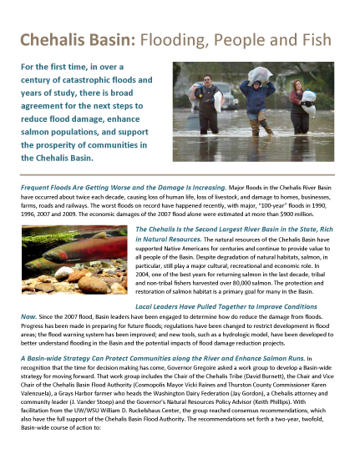
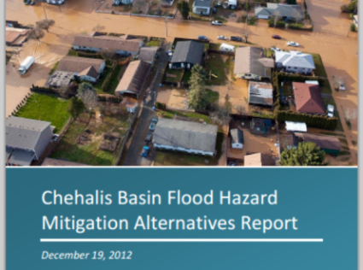
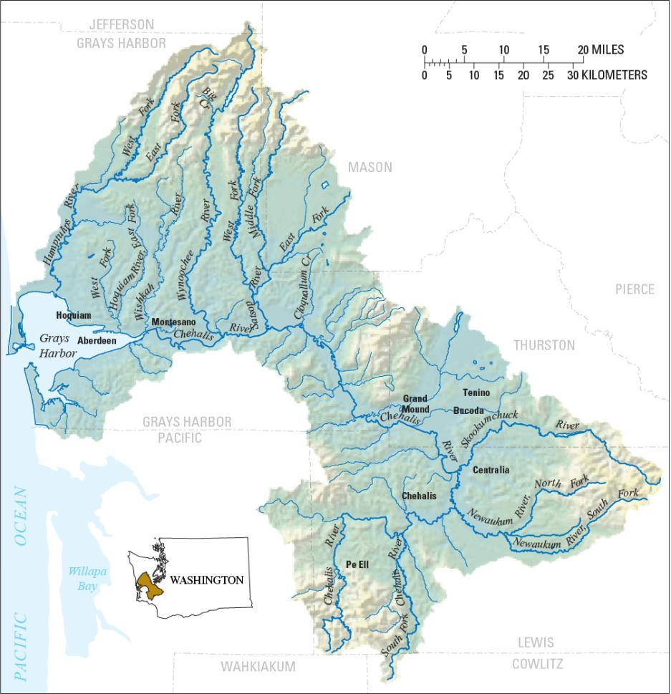
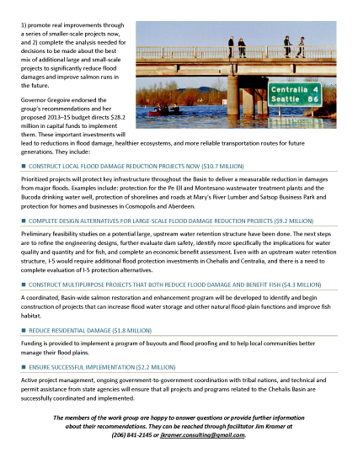
  Need -- Strategy, Action, Tools . . .
Strategy = Basin-wide Solution
Significant reduction in flood damage.
Solving one’s problems doesn’t increase another’s.
Maintain focus in five areas:
  major capital projects.
  localized projects.
  land use management.
  fish and habitat enhancements.
  flood warning, emergency response.
William D. Ruckelshaus Center

Slide 9
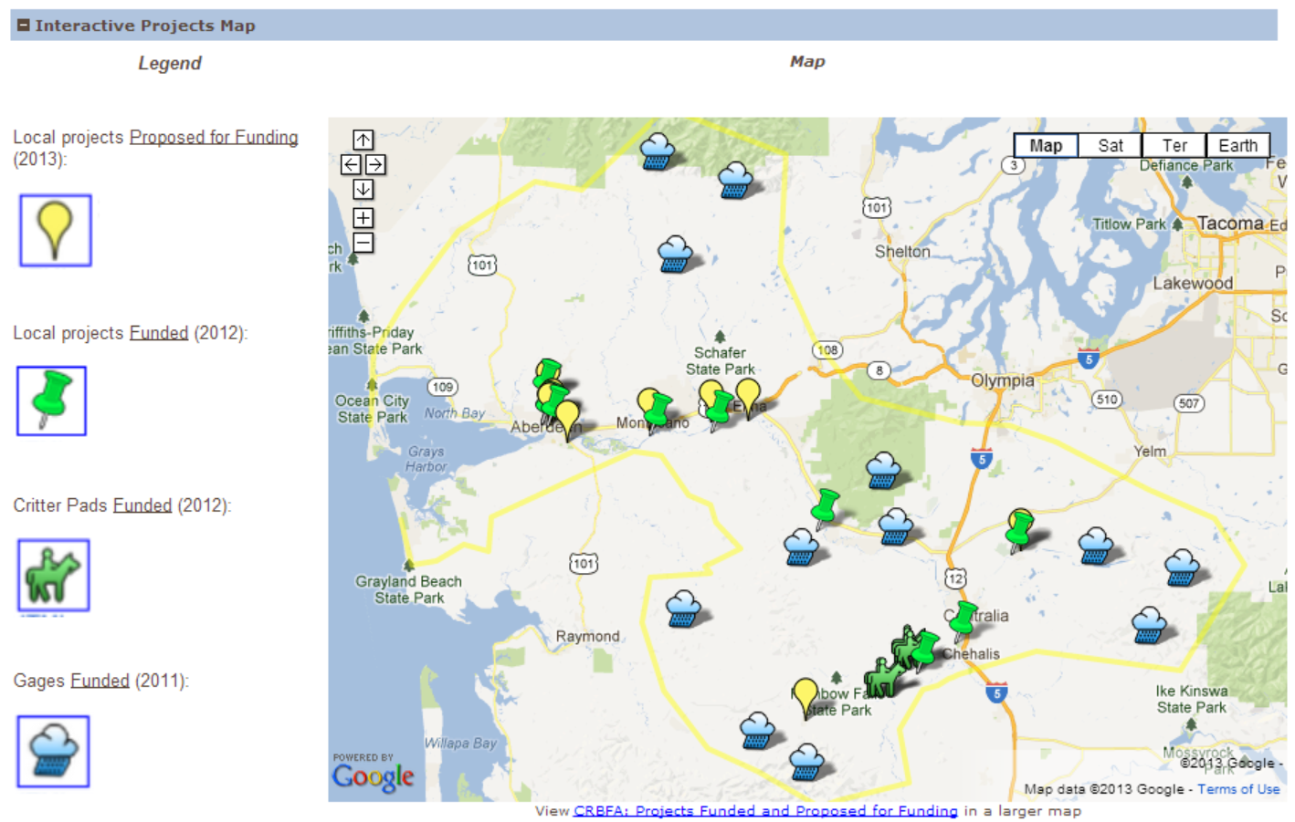
  Action – Capital Projects (2012, 2013)
2012 Capital Budget:
$5.0M – Local projects.
(Lewis County = $1,983,974)
2013 Capital Budget:
$10.7M -- Local projects.
$9.2M -- Design evaluations by 2014 for Upper Basin dam (~$5.6M) and I-5 protection (~$3.4M).
$4.3M -- Fish and habitat enhancements.
$1.8M -- Local programs (buyouts, flood proofing, home elevations).
$2.2M – Implementation capacity, technical experts.
http://www.ezview.wa.gov/pr/site/alias__1492/34489/projects.aspx#map

Slide 10
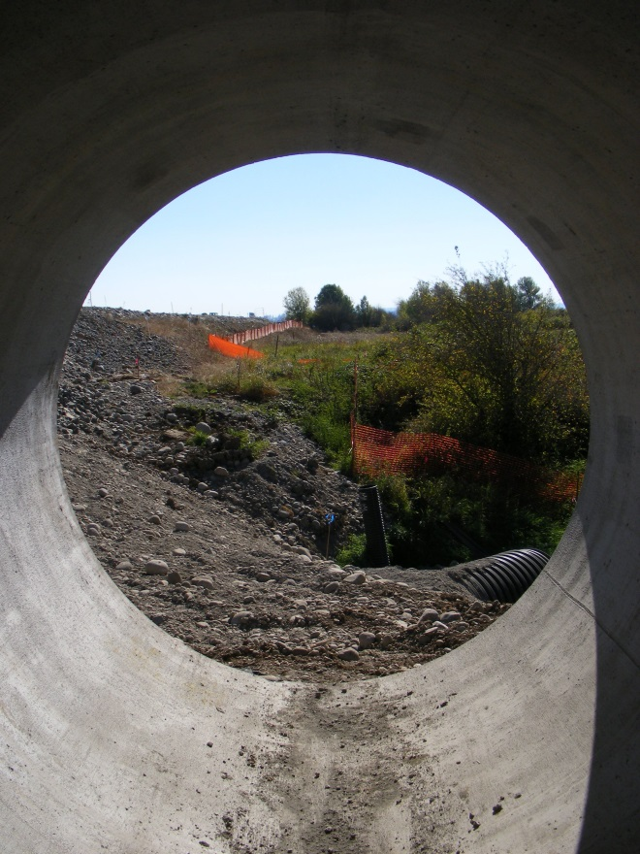
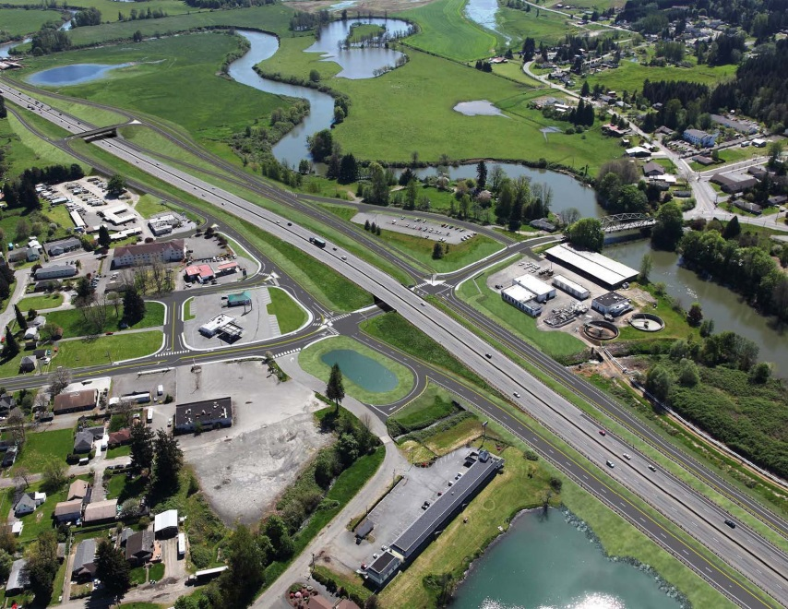
  Action – Spotlighting Other Key Projects
I-5 - Mellen Street to Blakeslee Junction
  Dedicated collector/distributor lanes to improve local mobility, enhance safety and improve access to hospital, airport, etc.
  Airport road culverts to drain flood waters away from Chamber Way.
  http://www.wsdot.wa.gov/projects/i5/mellentograndmound/phase3/
Visualization and Photo Source: WASHINGTON STATE DEPARTMENT OF TRANSPORTATION

Slide 11
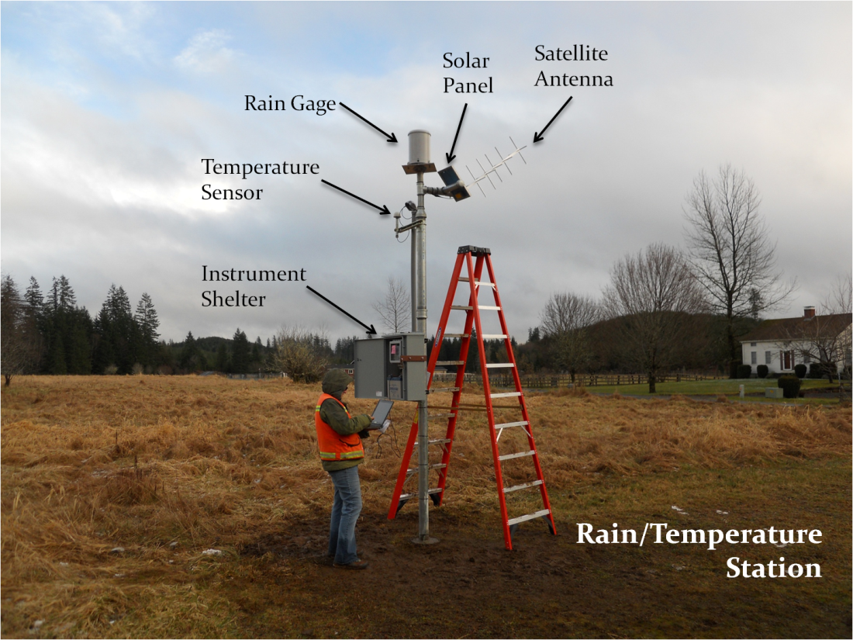

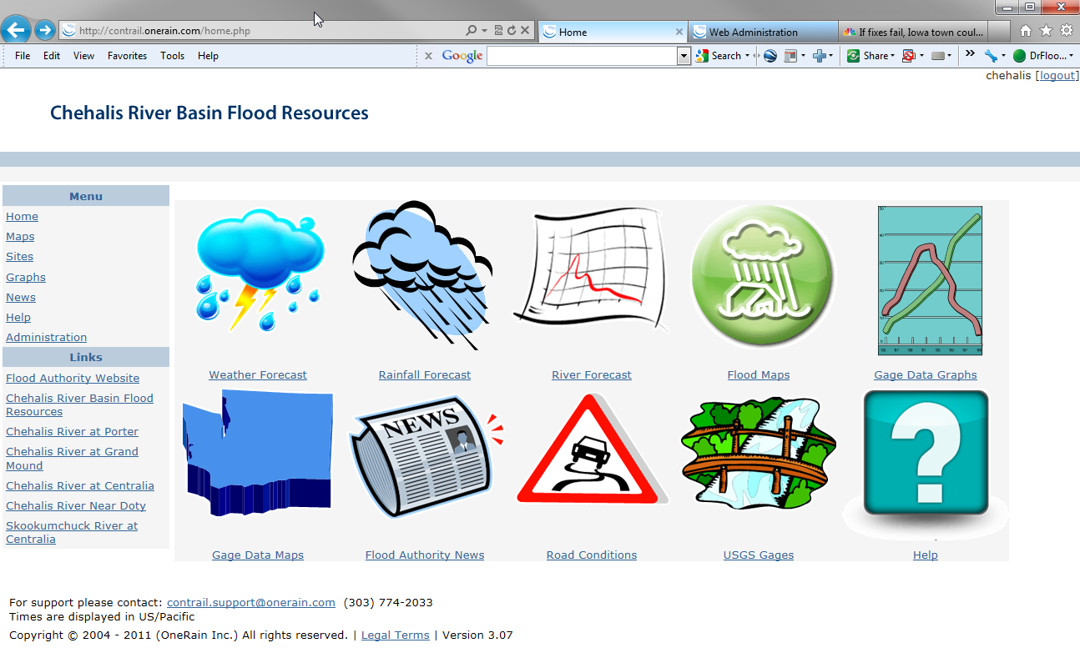
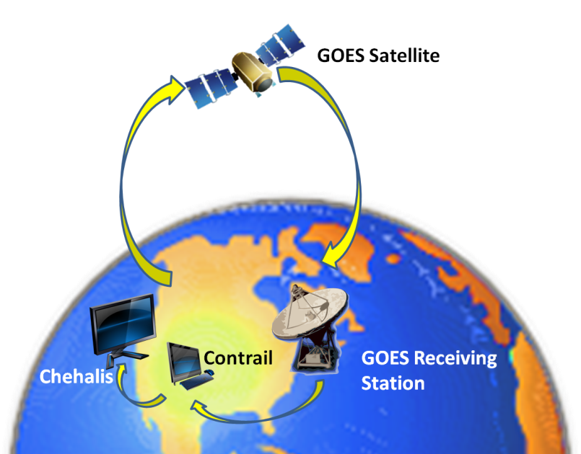
  Tools -- Flood Warning System
www.chehalisriverflood.com
Front-facing website.
Back-end data collection, data synchronization.
Improves forecasting and early-warning.

Slide 12
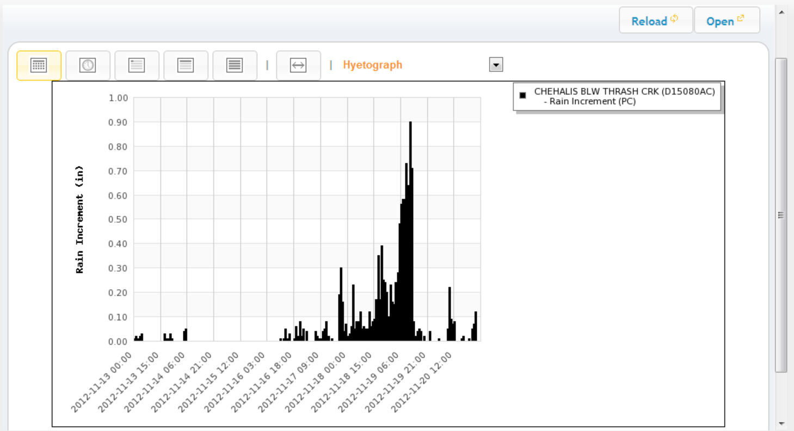
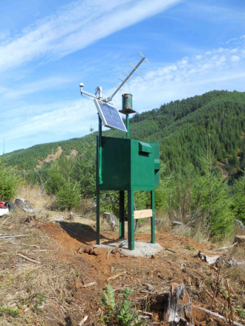
  Tools -- Flood Warning System
Localized tracking, forecasting . . .
www.chehalisriverflood.com

Slide 13
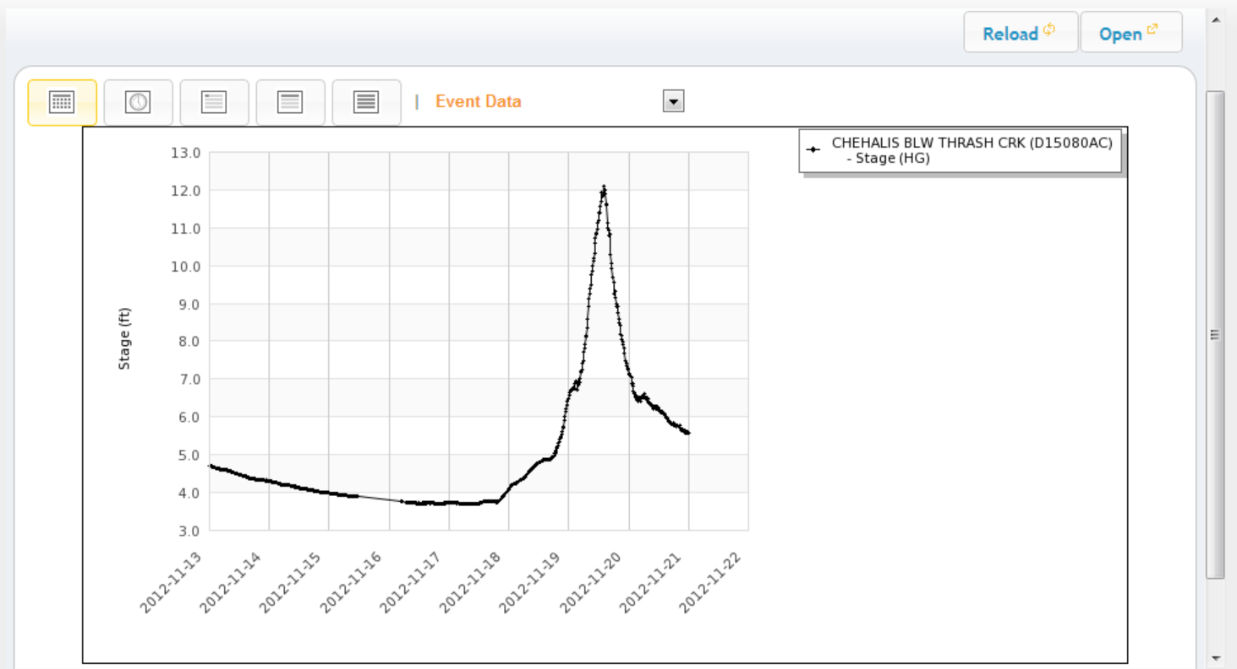
  Tools -- Flood Warning System
Localized tracking, forecasting . . .
www.chehalisriverflood.com

Slide 14
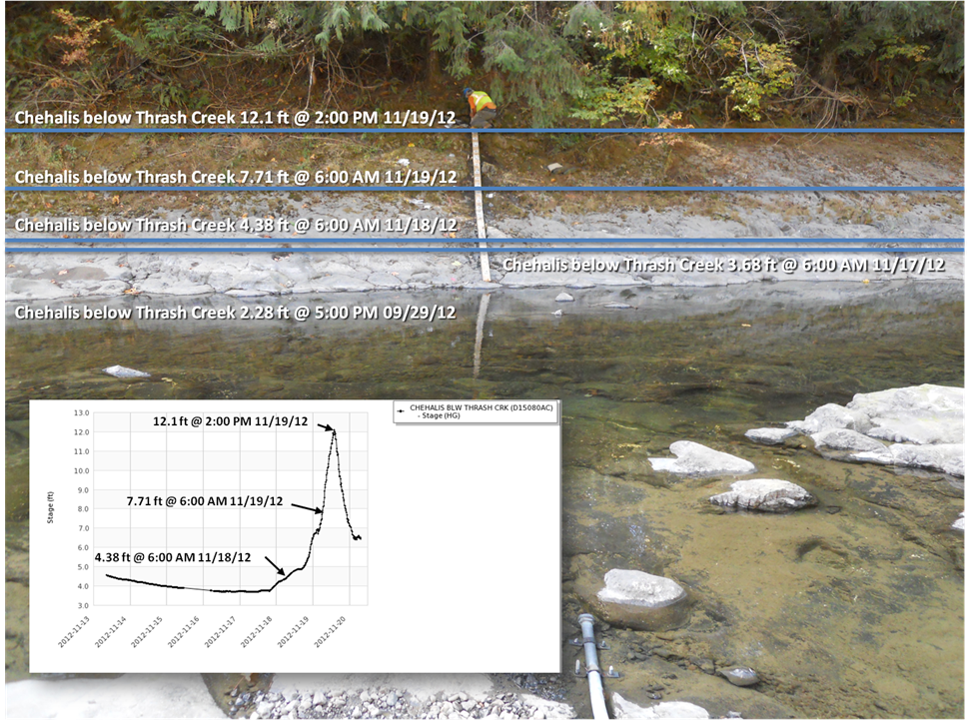
  Tools -- Flood Warning System
Localized tracking, forecasting . . .
www.chehalisriverflood.com

Slide 15
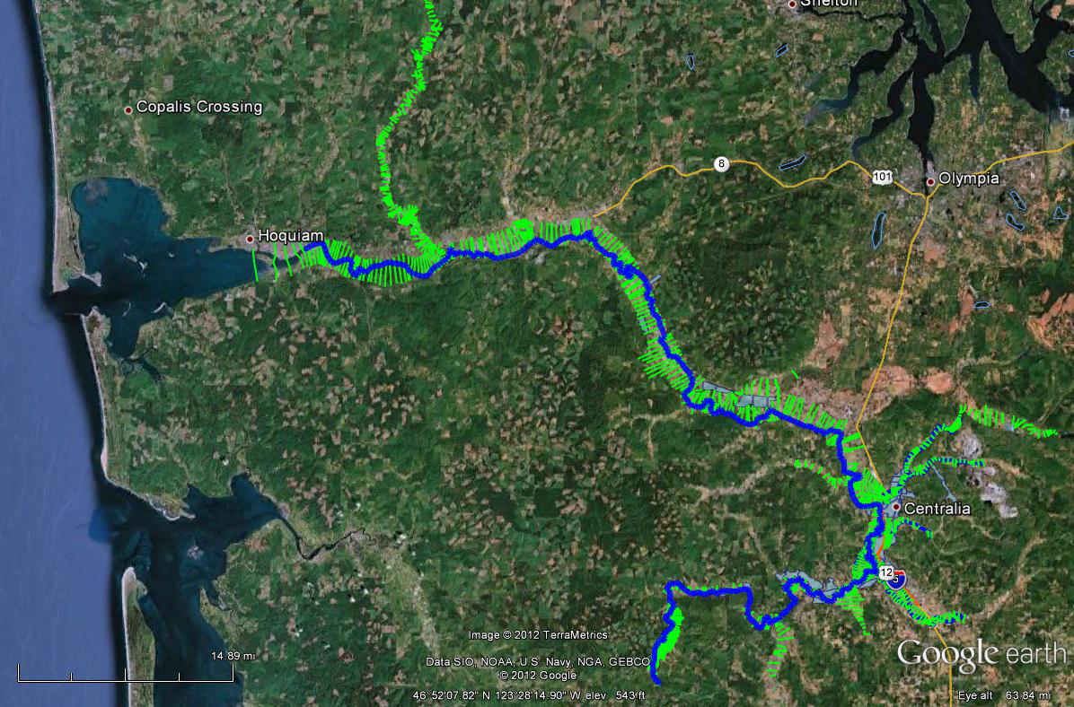
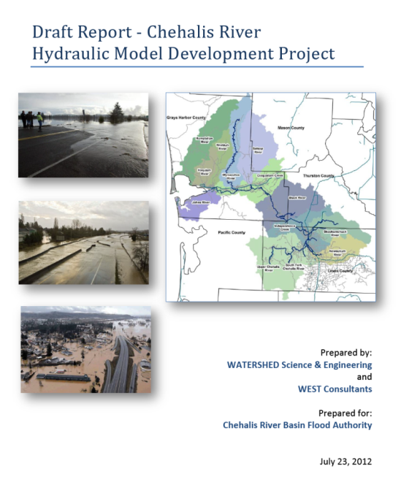
  Tools -- Hydraulic Analysis Model
Science-based model to inform decision-makers on hydraulic effects of potential flood relief options (at basin-wide and localized scales).
Covers mouth of Chehalis River upstream to Pe Ell (108 miles).

Slide 16
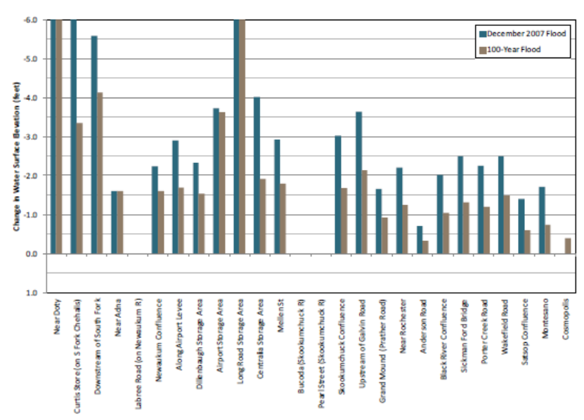
  Tools -- Hydraulic Analysis Model
Example: Basin-wide effects analysis (Chehalis Basin Flood Hazard Mitigation Alternatives Report 12/2012)
Table 1 (pg.70) -- “Mainstem Dam, Upper Chehalis”

Slide 17
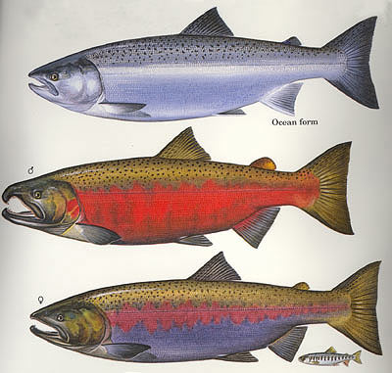
  Tools -- Fish Studies
Two significant fish studies conducted in Upper Basin (WRIA 23).
  Analyze effect of dam alternatives on Spring Chinook, Steelhead and Coho.
  Prioritize potential fish habitat enhancement opportunities.
Initial and preliminary projections . . .
Species | Multi-Purpose Dam | Flood Control-Only Dam | Fish Habitat Enhancement Measures
Spring Chinook | 20%  | 4%  | likely same as Coho
Steelhead | 7%  | 11%  | likely same as Coho
Coho | 1%  | 1%  | 4-5% 

Slide 18
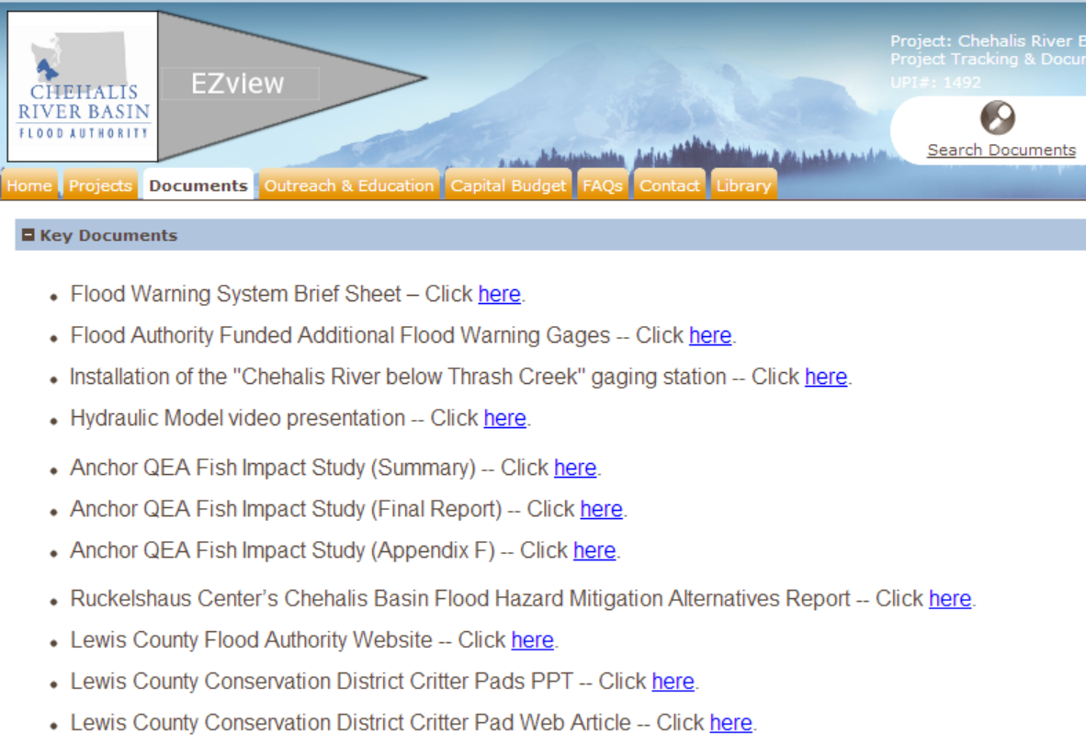
  Resources, Additional Information
Visit Flood Authority’s Project Tracking and Documentation website!
www.ezview.wa.gov

Slide 19
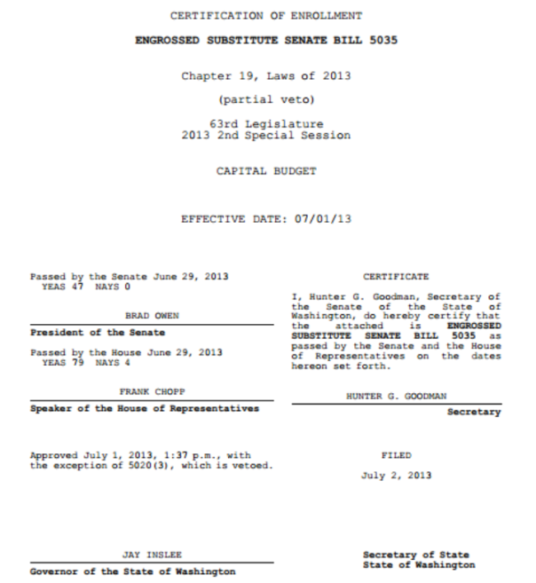
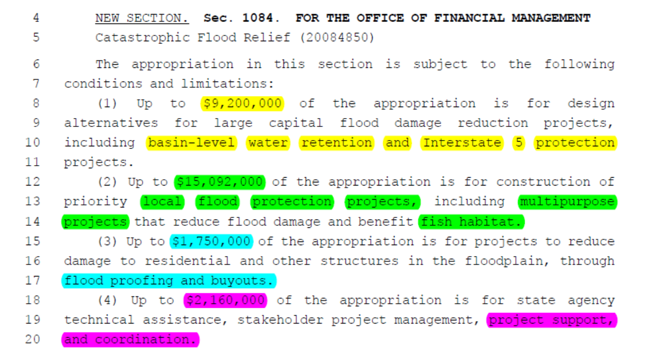
  Local Projects
2013 – 2015 Capital Budget

Slide 20
  Local Projects --
2012, 2013 Funding Breakdown
Sponsor | Project | Funded (2012) | Proposed (2013)
1. Aberdeen | Burger King Trail/Dike | $ 24,600 | $ 140,000
2. Aberdeen | Dike Bank of Wishkah North of Highway | $ 47,000 | $ 270,000
3. Aberdeen | Market Street Dike | $ - | $ 670,000
4. Aberdeen | Southside Dike/Levee Certification | $ 50,000 | $ -
5. Bucoda | Bucoda Levee | $ 42,000 | $ 305,000
6. Chehalis Tribe | Flood Gage Station | $ 50,000 | $ -
7. Chehalis Tribe | Sickman-Ford Overflow Bridge Project | $ 2,075,000 | $ -
8. Cosmopolis | Mill Creek Dam Improvements | $ - | $ 2,250,000
9. Grays Harbor County | Elma-Porter Flood Mitigation Project | $ - | $ 584,000
10. Grays Harbor County | Satsop River Floodplain Restoration | $ 50,000 | $ 510,000
11. Grays Harbor County | Wishkah Road Flood Levee | $ 125,000 | $ 2,642,000
12. Lewis County | Adna Levee | $ 244,145 | $ -
13. Lewis County | Airport Levee (Phase I) | $ 1,239,829 | $ -
14. Montesano | Revetment for Montesano Rd., Sewage Treatment Plant, Mary’s River Lumber | $ 102,426 | $ 2,000,000
15. Pe Ell | Wastewater Treatment Plant Flood Prevention Dike | $ - | $ 521,000
16. WA Cons. Comm. | Critter Pads and Evacuation Routes | $ 500,000 | $ 850,000
17. Sponsor??? | Restoration -- Allen Creek | $ - | $ 990,000
18. Sponsor??? | Restoration -- Oxbow Reconnect at RM 78 | $ - | $ 861,000
19. Sponsor??? | Restoration -- Oxbow Lake Reconnect | $ - | $ 1,149,000
20. Sponsor??? | Restoration -- Basin-wide Salmon Recovery Strategy | $ - | $ 1,350,000
Total = |  | $ 4,550,000 | $ 15,092,000

Slide 21
  Thank You!
Vickie Raines, Chair
Chehalis River Basin Flood Authority
360/590-4100
vraines@cosmopolis.us.com
Edna Fund, Chair
Community Outreach and Education Subcommmittee (Flood Authority)
360/269-7515
Edna.Fund@lewiscountywa.gov
Karen Valenzuela, Vice-Chair
Chehalis River Basin Flood Authority
360/786-5440
ValenzK@co.thurston.wa.us
Scott Boettcher, Staff
Chehalis River Basin Flood Authority
360/480-6600
scottb@sbgh-partners.com

