Slide 1
Chehalis River Basin Flood Authority
Education and Outreach Subcommittee
Actions and Activities Benefiting the Basin
7:00 p.m., February 26, 2013
City of Montesano
City Council

Slide 2

Today’s Presentation
Raise awareness
Encourage discussion
Key messages we’d like to leave you with . . .
  Broad agreement -- For the first time in a century there is broad agreement on the next steps to reduce flood damage and enhance salmon runs in the Basin.
  Basin-wide strategy -- A Basin-wide strategy can protect communities along the river and enhance salmon runs.
  Flood Authority – Positioned to continue to be a galvanizing force in the Basin for implementation of tools and projects.
Discussion

Slide 3
  Chehalis River Basin Flood Authority
Formed in 2008
Formal body focused on (1) flood hazard mitigation throughout the Basin and (2) decisions that would be . . .
  informed by science
  protective of Basin residents/communities
  environmentally appropriate
Basin jurisdictions represented
  Grays Harbor County
  Lewis County
  Thurston County
  City of Aberdeen
  City of Centralia
  City of Chehalis
  City of Cosmopolis
  City of Montesano
  City of Napavine
  City of Oakville
  Town of Pe Ell
  Town of Bucoda

Slide 4
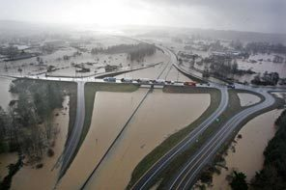
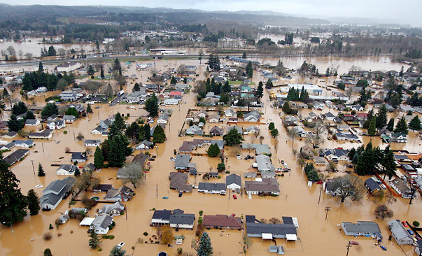
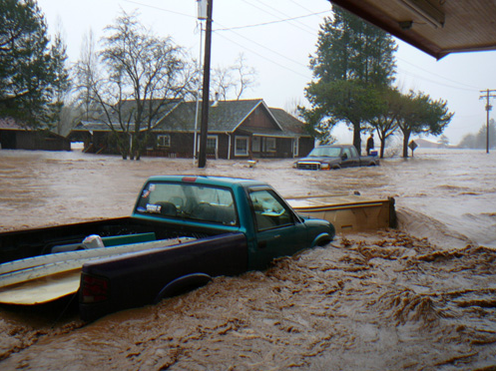
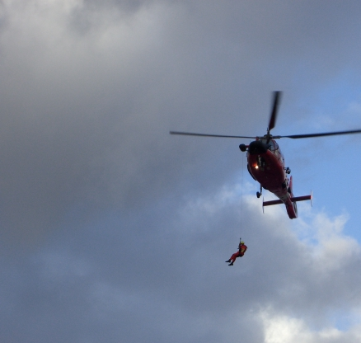
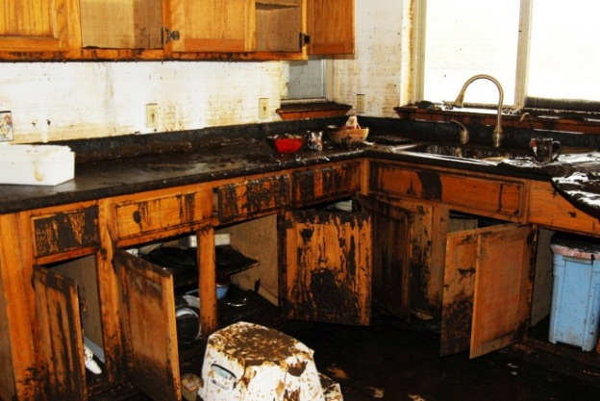
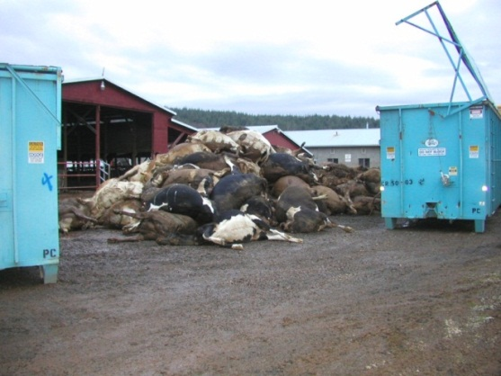
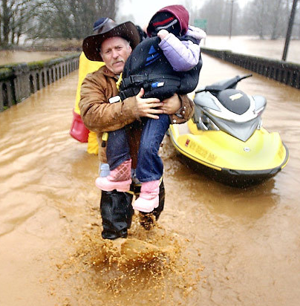
  Background
2007 Flood -- $938M Basin-wide damage, $300M lost economic activity (WA)
Exit 77 (I-5) in Chehalis
STEVE RINGMAN / SEATTLE TIMES
City of Centralia
STEVE RINGMAN / SEATTLE TIMES
Photos Source: Lewis County,
Division of Emergency Management

Slide 5
  Background
Ranked high flow events (1932 - 2012) . . .
  I-5 closed 1990, 1996, 2007, 2009
  Five largest events since 1986 -- Frequent Floods are getting worse and damage is increasing . . .
  Chart -- Chehalis River Flow Rates near Grand Mound (cubic ft./sec.)

Slide 6
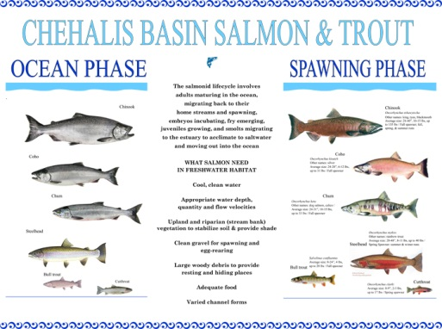
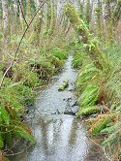
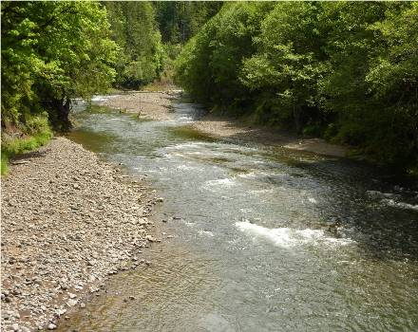
  Background
Chehalis is the second largest river basin in the state, rich in natural resources . . .

Slide 7
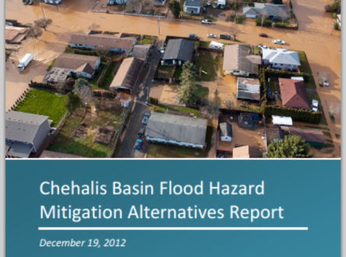
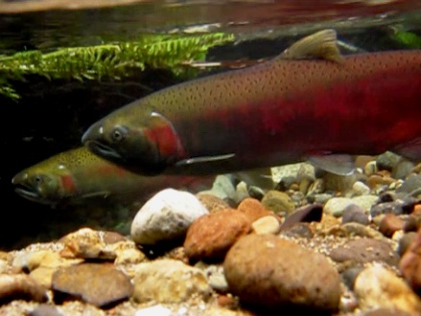
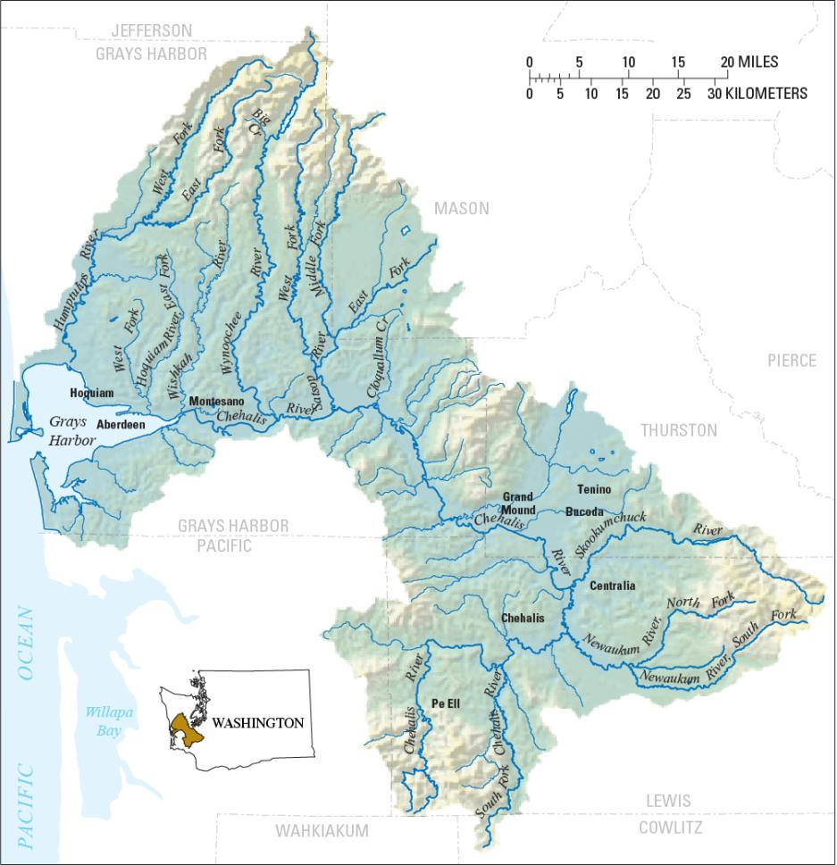
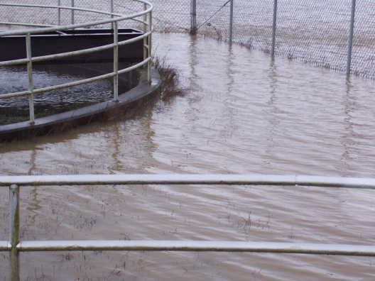
  Need -- Strategy, Tools, Action. . .
Strategy = Basin-wide Solution
Significant reduction of flood damage.
Solving one area’s problems doesn’t increase problems for others.
Maintain focus in five areas:
  major capital projects
  localized projects
  land use management
  fish and habitat enhancements
  flood warning and emergency response
William D. Ruckelshaus Center

Slide 8
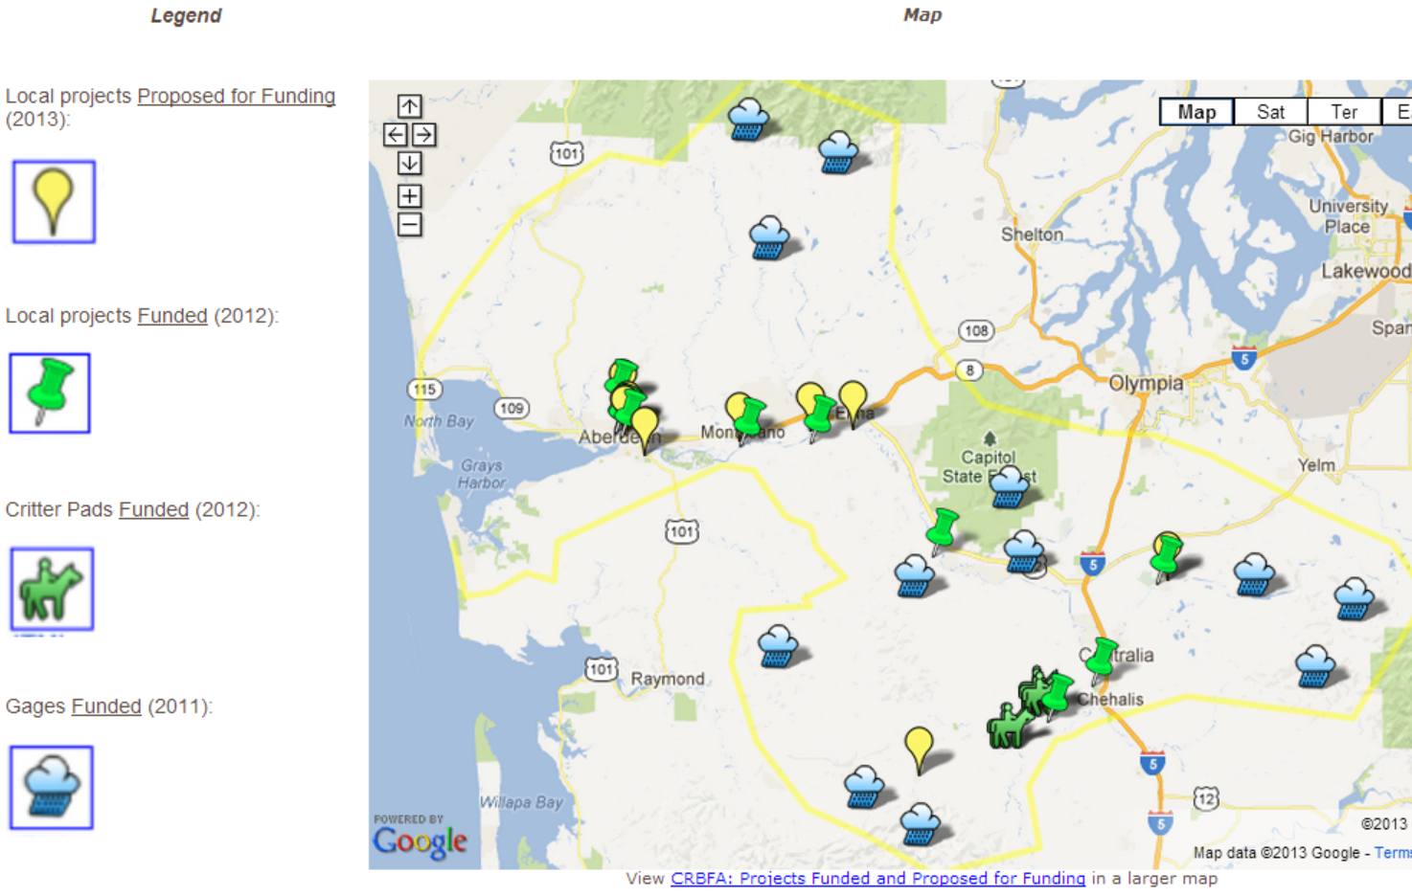
  Action – Capital Projects (2012, 2013)
2012 Capital Budget:
$5.0M – Local projects.
2013 Proposed Budget:
$10.7M -- Local projects.
$9.2M -- Design evaluations by 2014 for Upper Basin dam (~$5.6M) and I-5 protection (~$3.4M).
$4.3M -- Fish and habitat enhancements.
$1.8M -- Local programs (buyouts, flood proofing, home elevations).
$2.2M – Implementation capacity, technical experts.
(Click map to access separate map site.)
Montesano → $102,426 (2012); $2.0M (2013)

Slide 9
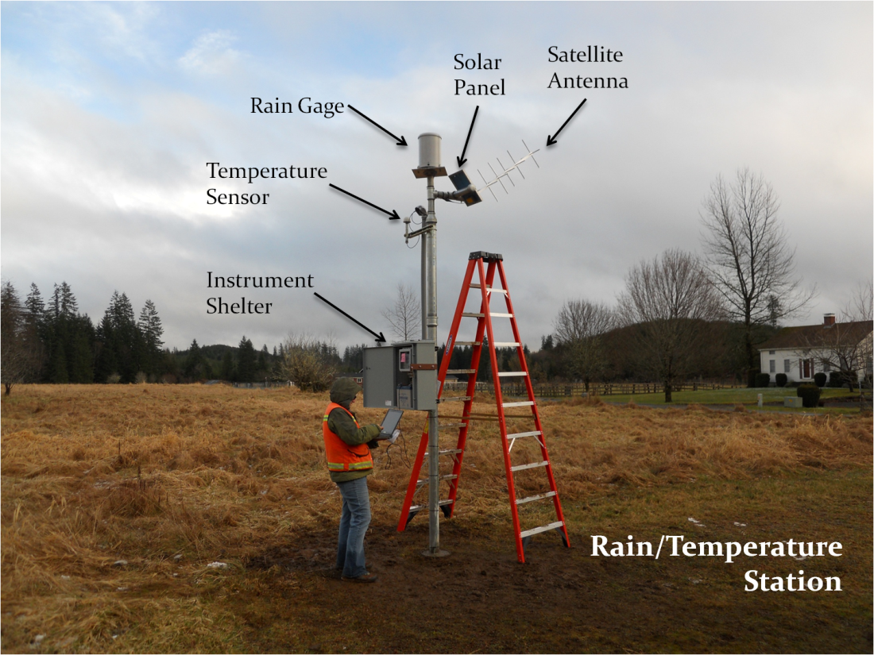
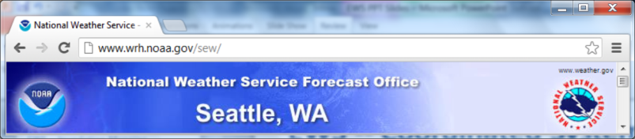
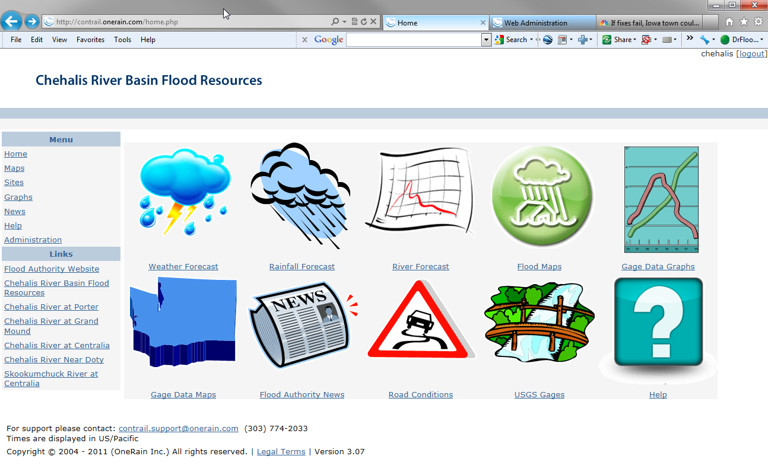
  Tools -- Flood Warning System
www.chehalisriverflood.com
Front-facing website.
Back-end data collection, data synchronization system.
Improves forecasting and early-warning.

Slide 10
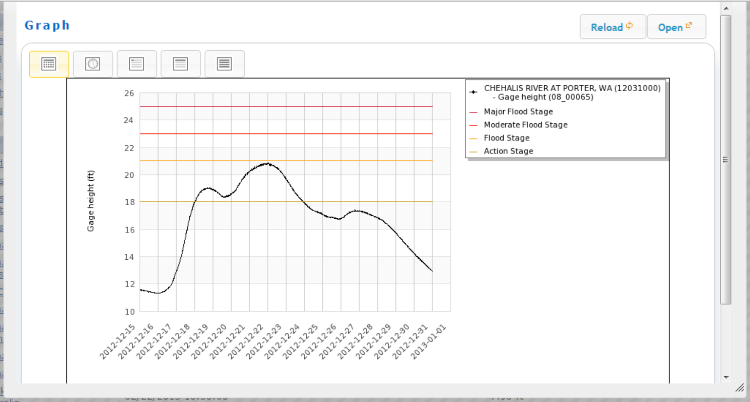
  Tools -- Flood Warning System
Localized tracking, forecasting . . .
www.chehalisriverflood.com

Slide 11
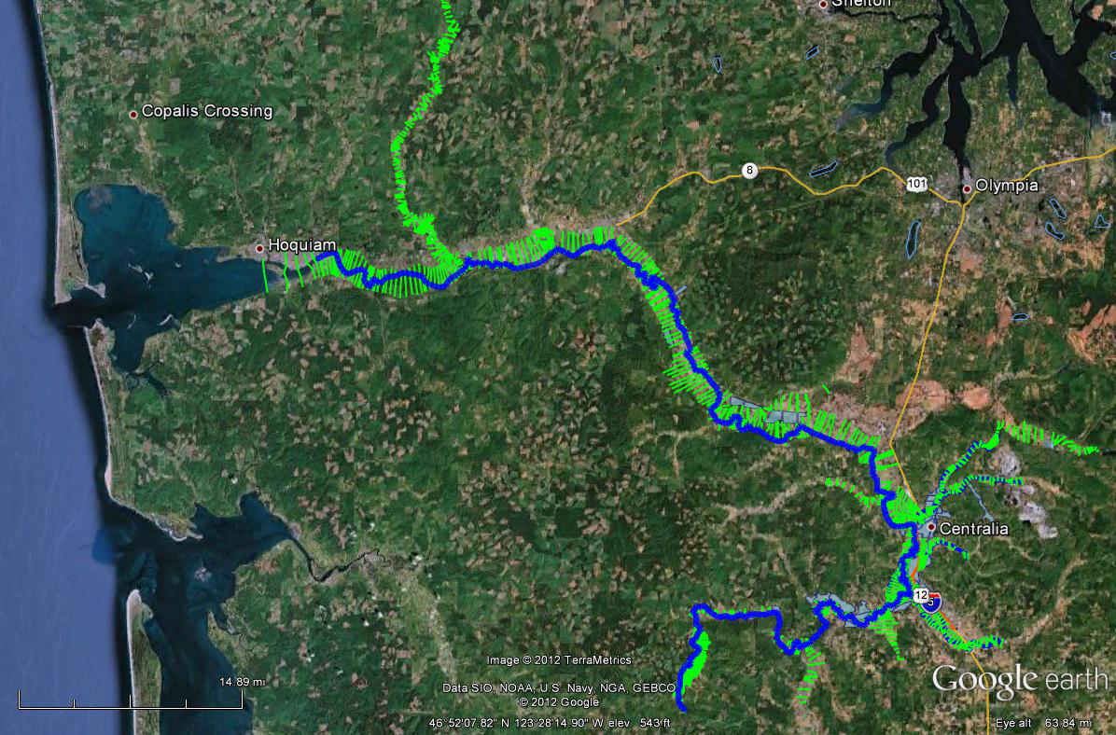
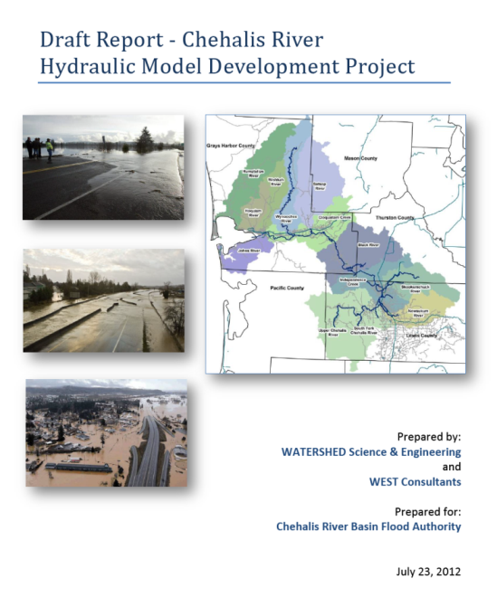
  Tools -- Hydraulic Analysis Model
Science-based model to inform decision-makers on hydraulic effects of potential flood relief options (at basin-wide and localized scales).
Covers mouth of Chehalis River upstream to Pe Ell (108 miles).

Slide 12
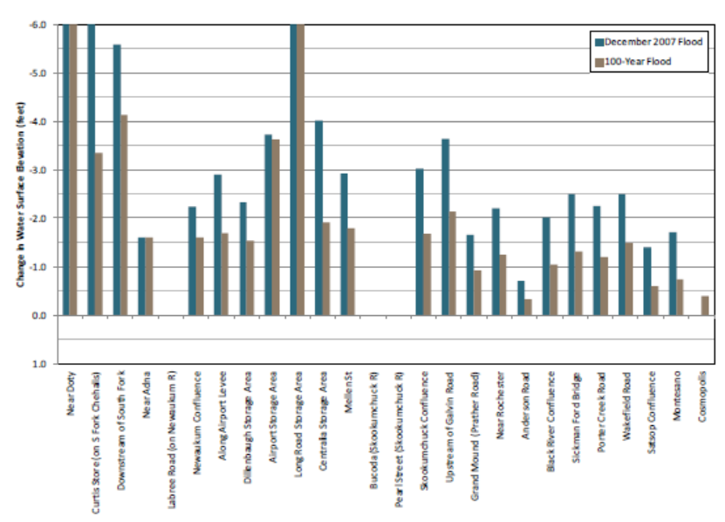
  Tools -- Hydraulic Analysis Model
Example: Basin-wide effects analysis (Chehalis Basin Flood Hazard Mitigation Alternatives Report 12/2012)
Table 1 (pg.70) -- “Mainstem Dam, Upper Chehalis”

Slide 13
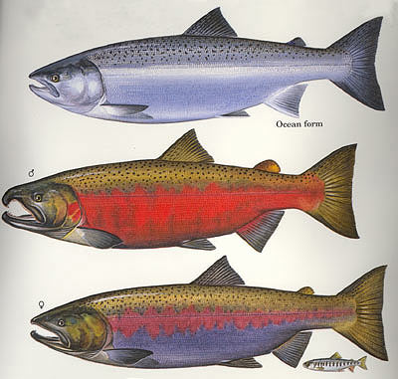
  Tools -- Fish Studies
Two significant fish studies conducted in Upper Basin (WRIA 23).
  Analyze effect of dam alternatives on Spring Chinook, Steelhead and Coho.
  Prioritize potential fish habitat enhancement opportunities.
Initial and preliminary projections . . .
Species | Multi-Purpose Dam | Flood Control-Only Dam | Fish Habitat Enhancement Measures
Spring Chinook | 20%  | 4%  | likely same as Coho
Steelhead | 7%  | 11%  | likely same as Coho
Coho | 1%  | 1%  | 4-5% 

Slide 14
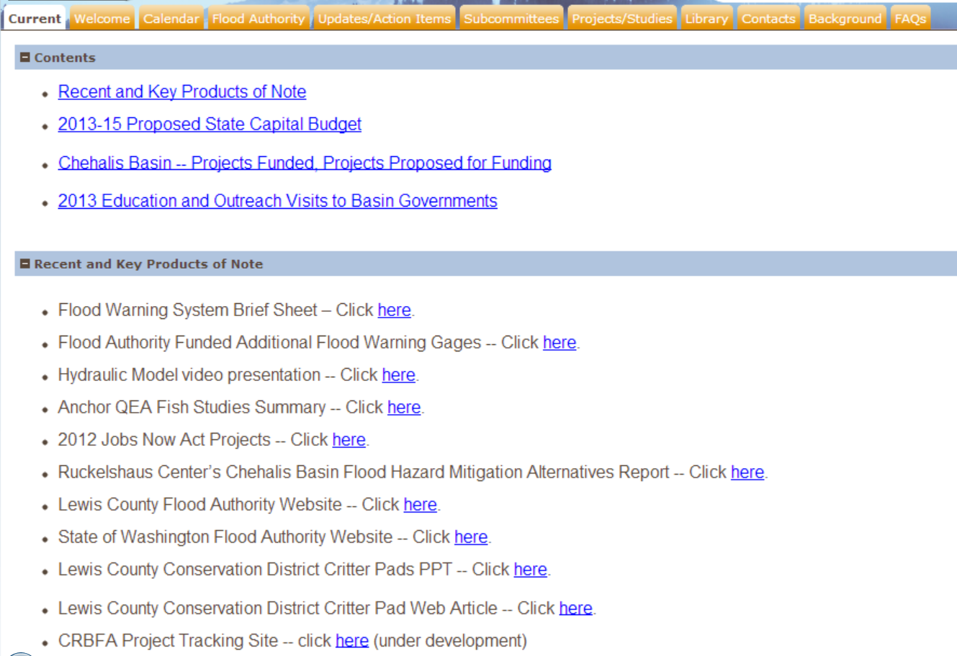
  Resources, Additional Information
Visit Flood Authority Web Library (here or via www.ezview.wa.gov) . . .

Slide 15
  Thank You!
Vickie Raines, Chair
Chehalis Basin Flood Authority
360/590-4100
vraines@cosmopolis.us.com
Edna Fund, Chair
Education and Outreach Subcommmittee (Flood Authority)
360/269-7515
Edna.Fund@lewiscountywa.gov
Karen Valenzuela, Vice-Chair
Chehalis Basin Flood Authority
360/786-5440
ValenzK@co.thurston.wa.us
Scott Boettcher, Staff
Chehalis Basin Flood Authority
360/480-6600
scottb@sbgh-partners.com
Ken Estes, Montesano Rep.
Chehalis Basin Flood Authority
360/249-3021 x-102
mayor@montesano.us

