Slide 1
Chehalis River Basin Flood Authority
Education and Outreach Subcommittee
Actions and Activities Benefiting the Basin
7:00 p.m., March 19, 2013
Pe Ell Town Council

Slide 2
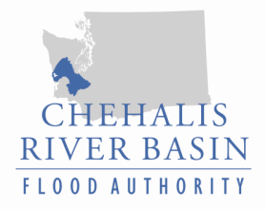
Today’s Presentation
Raise awareness
Encourage discussion
Key messages we’d like to leave you with . . .
  Broad agreement -- For the first time in a century there is broad agreement across the Basin on next steps to reduce flood damage and enhance salmon runs in the Basin.
  Basin-wide strategy -- A Basin-wide strategy is needed to protect communities along the river and enhance salmon runs.
  Flood Authority -- Positioned to continue be a galvanizing force in the Basin to collaboratively implement tools and projects.
Discussion

Slide 3
  Chehalis River Basin Flood Authority
Formed in 2008
Formal body focused on: (1) flood hazard mitigation throughout the Basin; and (2) decision-making that is . . .
  informed by science.
  protective of Basin residents/communities.
  environmentally appropriate.
Basin jurisdictions represented
  Grays Harbor County
  Lewis County
  Thurston County
  City of Aberdeen
  City of Centralia
  City of Chehalis
  City of Cosmopolis
  City of Montesano
  City of Napavine
  City of Oakville
  Town of Pe Ell
  Town of Bucoda

Slide 4
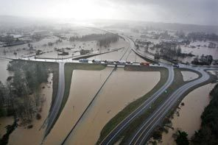
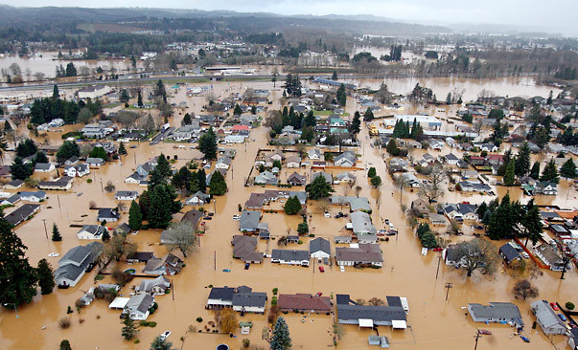
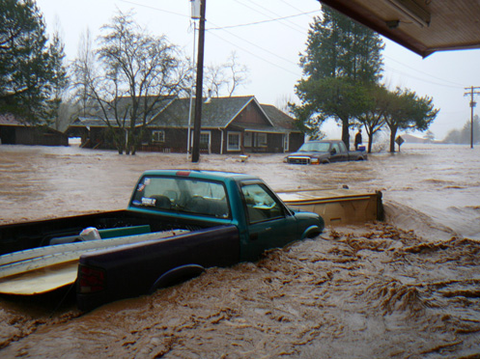
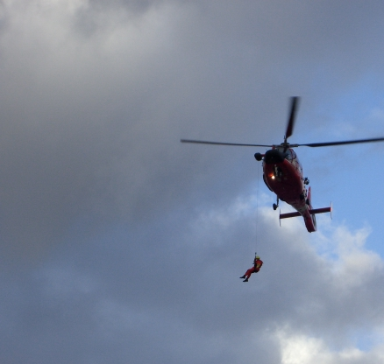
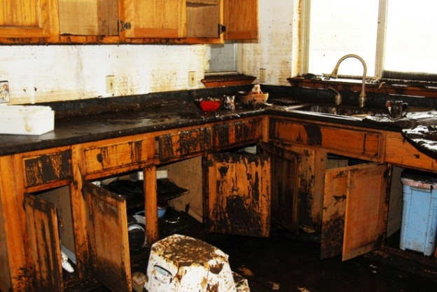
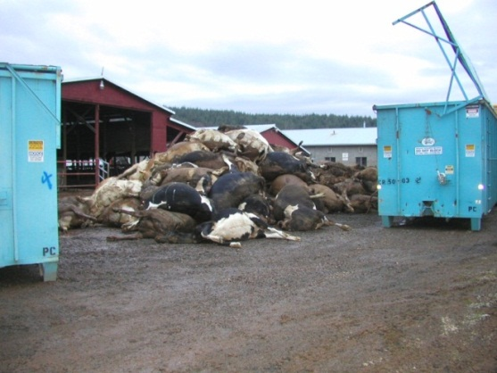
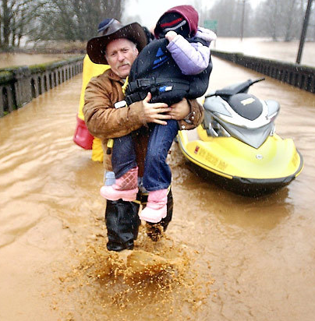
  Background
2007 Flood -- $938M Basin-wide damage, $300M lost economic activity (WA)
Exit 77 (I-5) in Chehalis
STEVE RINGMAN / SEATTLE TIMES
City of Centralia
STEVE RINGMAN / SEATTLE TIMES
Photos Source: LEWIS COUNTY,
DIVISION OF EMERGENCY MANAGEMENT

Slide 5
  Background
Ranked high flow events (1932 - 2012) . . .
  I-5 closed 1990, 1996, 2007, 2009.
  Five largest events since 1986 -- Frequent floods are getting worse and damage is increasing . . .
  Chart -- Chehalis River Flow Rates near Grand Mound (cubic ft./sec.)

Slide 6
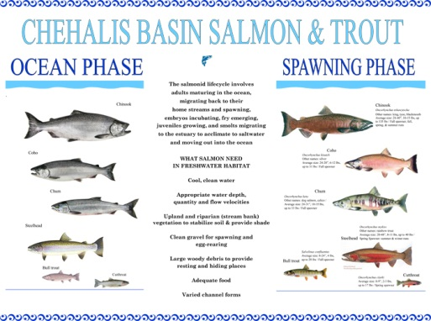
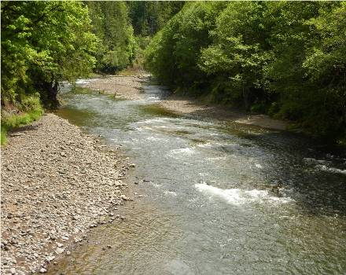
  Background
Chehalis is the second largest river basin in the state, rich in natural resources . . .
www.chehalisbasinpartnership.org
Upper Chehalis (5/31/2010)
JAMES E. WILCOX / WILD GAME FISH CONSERVATION INTERNATIONAL

Slide 7
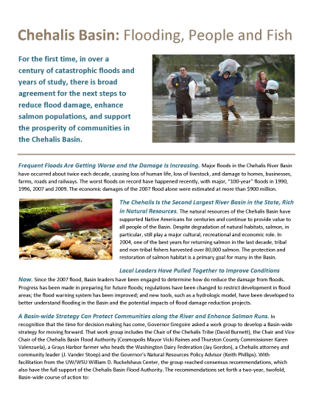
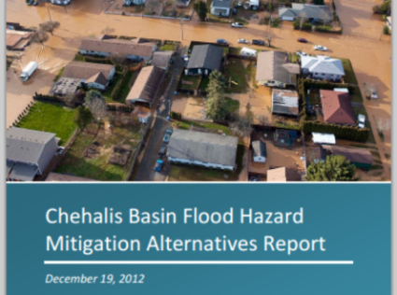
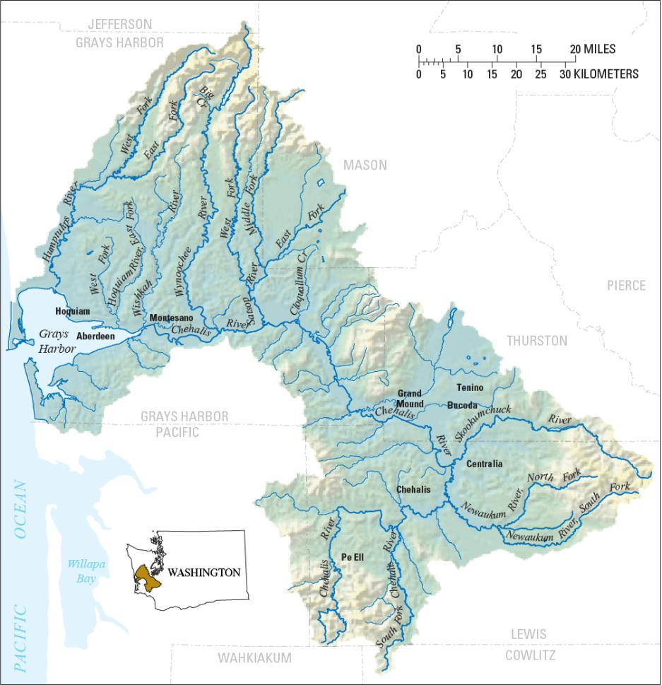
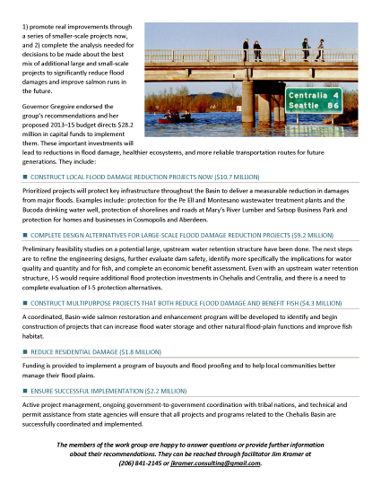
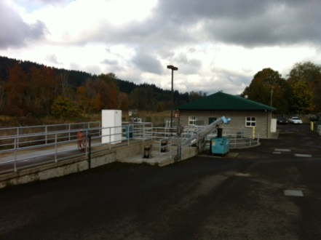
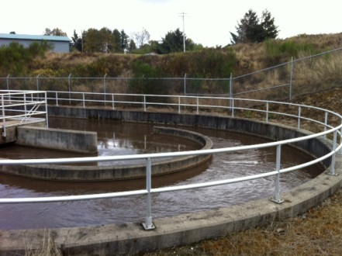
  Need -- Strategy, Action, Tools . . .
Strategy = Basin-wide Solution
Significant reduction in flood damage.
Solving one’s problems doesn’t increase another’s.
Maintain focus in five areas:
  major capital projects.
  localized projects.
  land use management.
  fish and habitat enhancements.
  flood warning, emergency response.
William D. Ruckelshaus Center
Pe Ell Treatment Plant / J. VANDER STOEP

Slide 8
  Action – Capital Projects (2012, 2013)
(Scroll down to “Chehalis Basin -- Projects Funded, Projects Proposed for Funding”)
2012 Capital Budget:
$5.0M – Local projects.
2013 Proposed Budget:
$10.7M -- Local projects.
  (Pe Ell = $521,000)
$9.2M -- Design evaluations by 2014 for Upper Basin dam (~$5.6M) and I-5 protection (~$3.4M).
$4.3M -- Fish and habitat enhancements.
$1.8M -- Local programs (buyouts, flood proofing, home elevations).
$2.2M – Implementation capacity, technical experts.

Slide 9
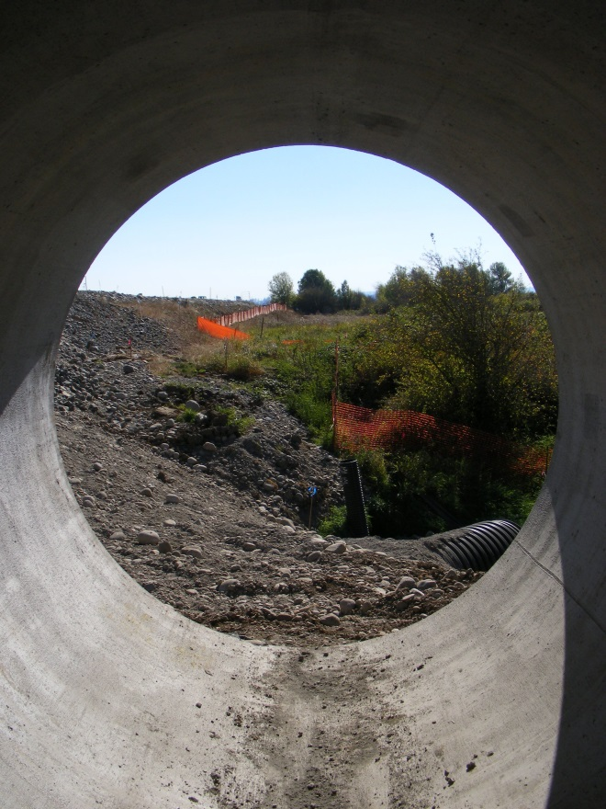
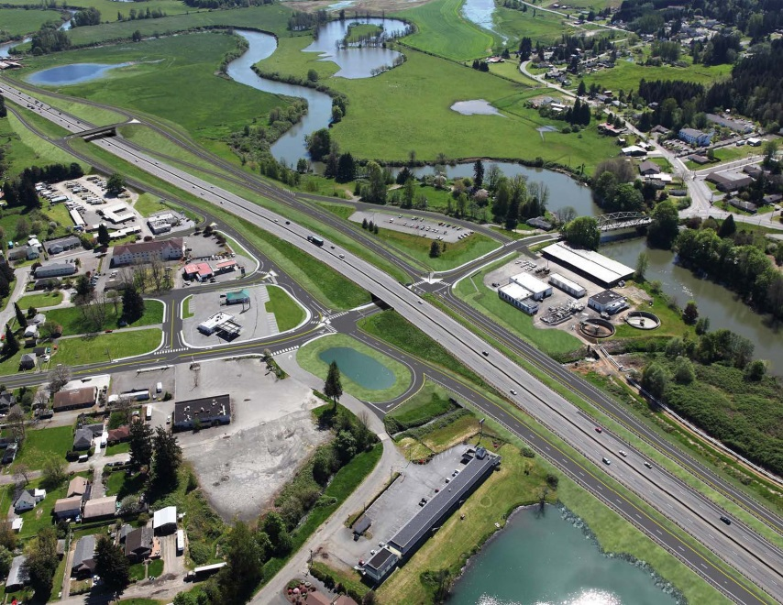
  Action – Spotlighting Other Key Projects
I-5 - Mellen Street to Blakeslee Junction
  Dedicated collector/distributor lanes to improve local mobility, enhance safety and improve access to hospital, airport, etc.
  Airport road culverts to drain flood waters away from Chamber Way.
  http://www.wsdot.wa.gov/projects/i5/mellentograndmound/phase3/
Visualization and Photo Source: WASHINGTON STATE DEPARTMENT OF TRANSPORTATION

Slide 10
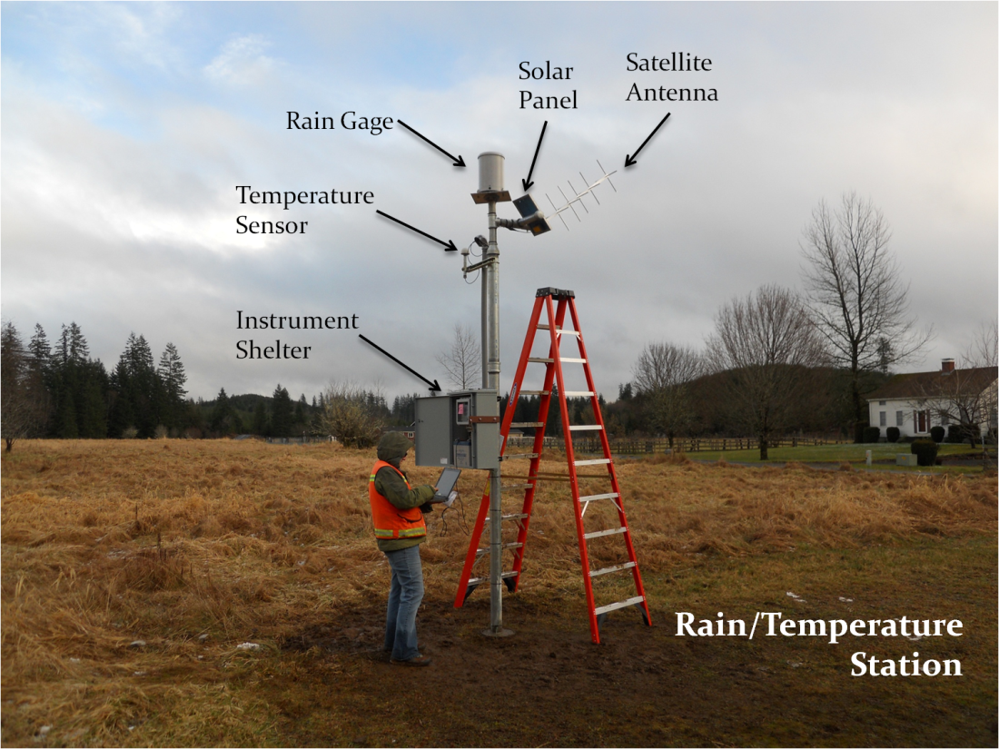
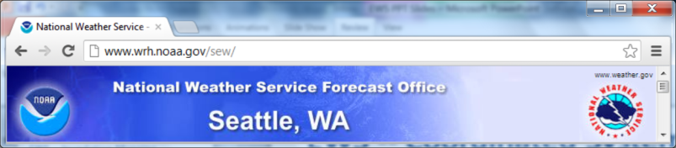
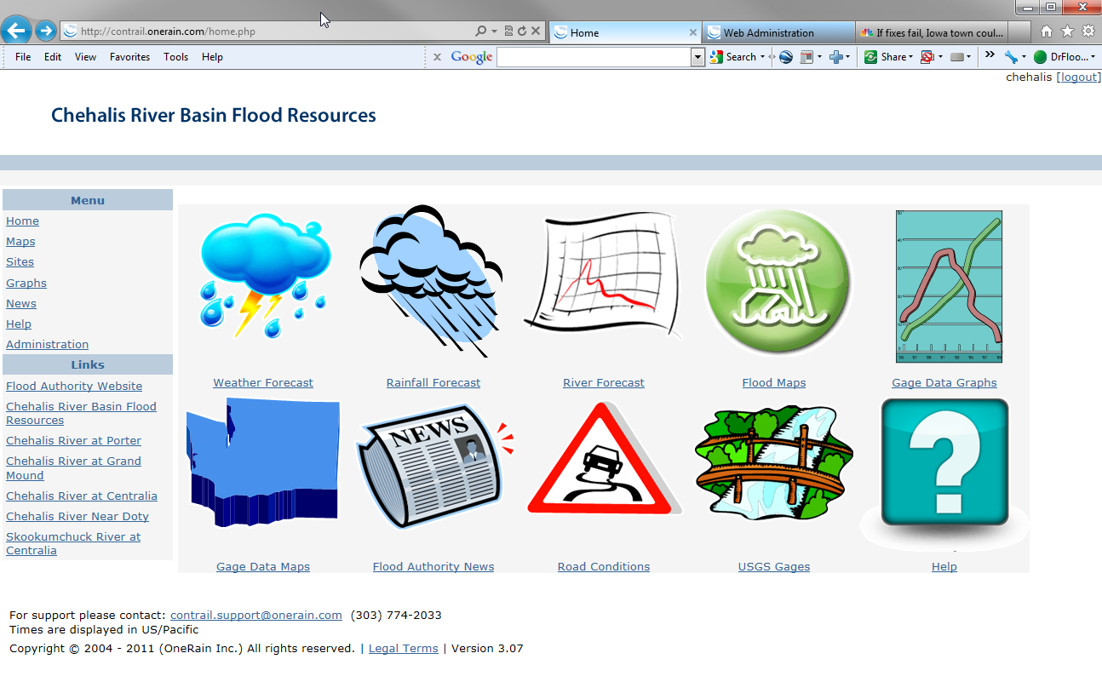
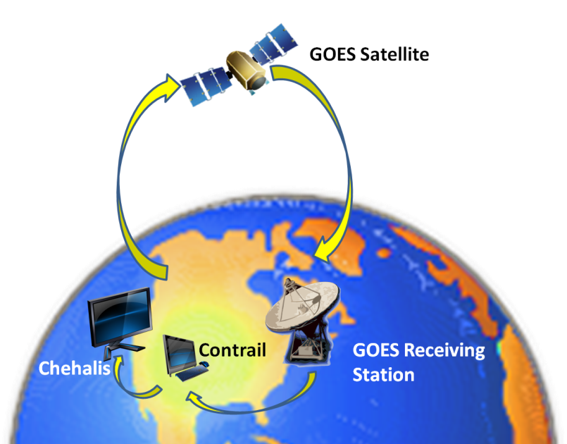
  Tools -- Flood Warning System
www.chehalisriverflood.com
Front-facing website.
Back-end data collection, data synchronization.
Improves forecasting and early-warning.

Slide 11
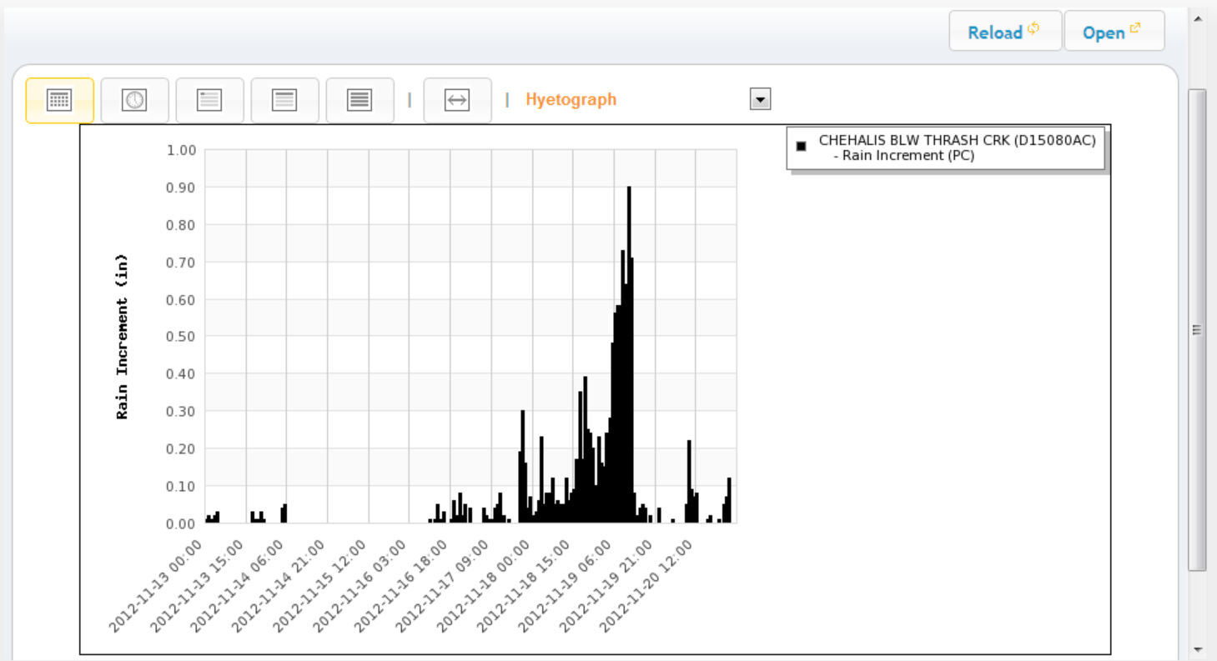
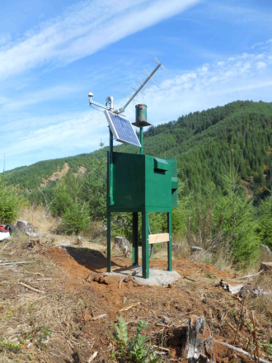
  Tools -- Flood Warning System
Localized tracking, forecasting . . .
www.chehalisriverflood.com

Slide 12
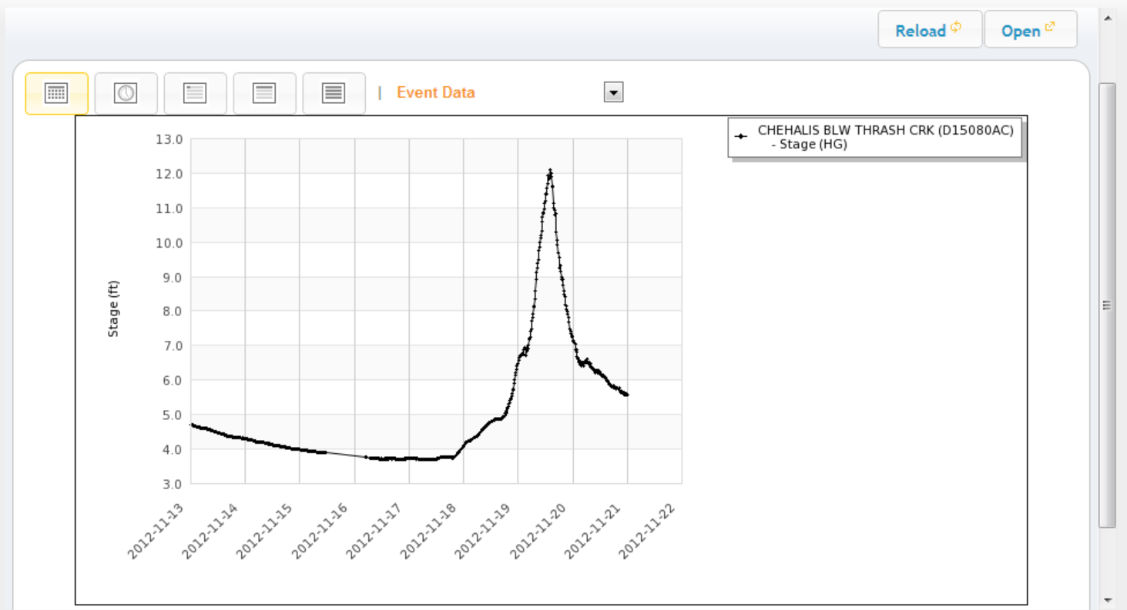
  Tools -- Flood Warning System
Localized tracking, forecasting . . .
www.chehalisriverflood.com

Slide 13
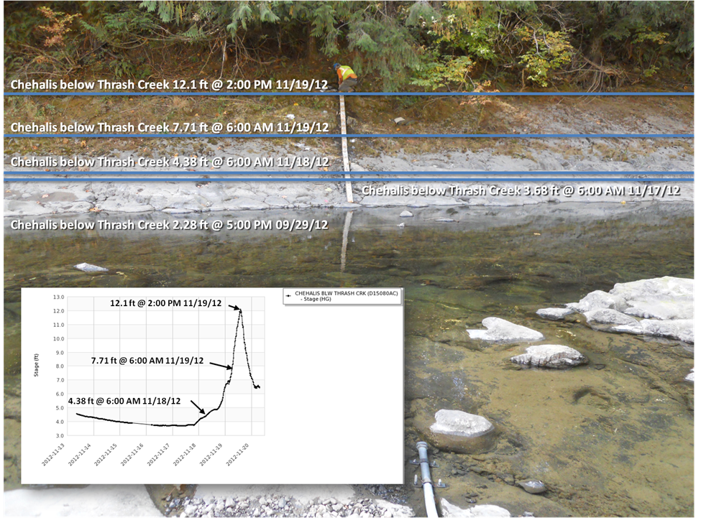
  Tools -- Flood Warning System
Localized tracking, forecasting . . .
www.chehalisriverflood.com

Slide 14
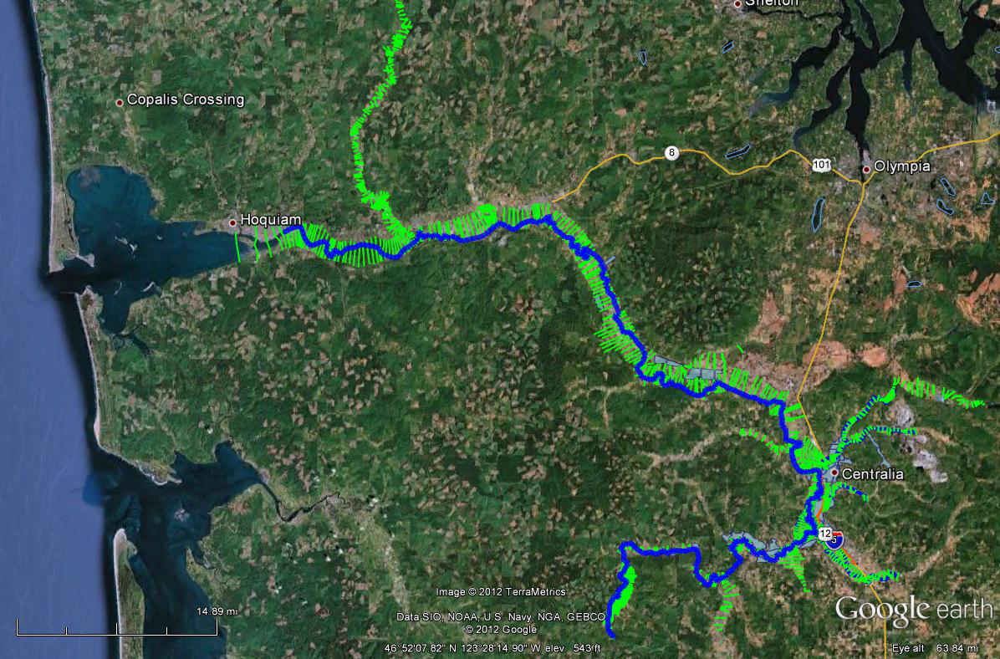
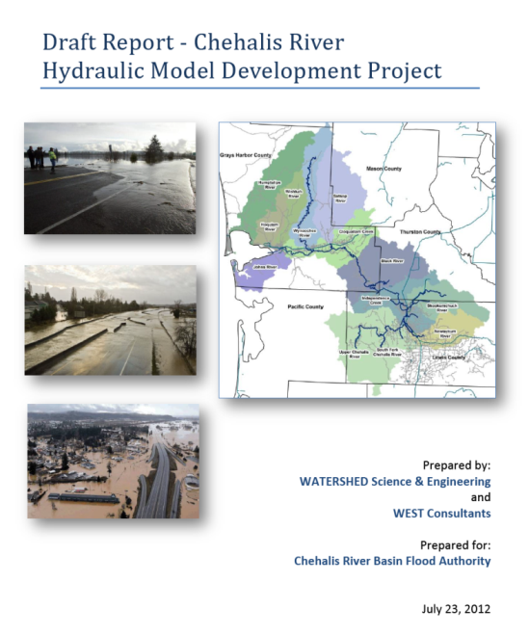
  Tools -- Hydraulic Analysis Model
Science-based model to inform decision-makers on hydraulic effects of potential flood relief options (at basin-wide and localized scales).
Covers mouth of Chehalis River upstream to Pe Ell (108 miles).

Slide 15
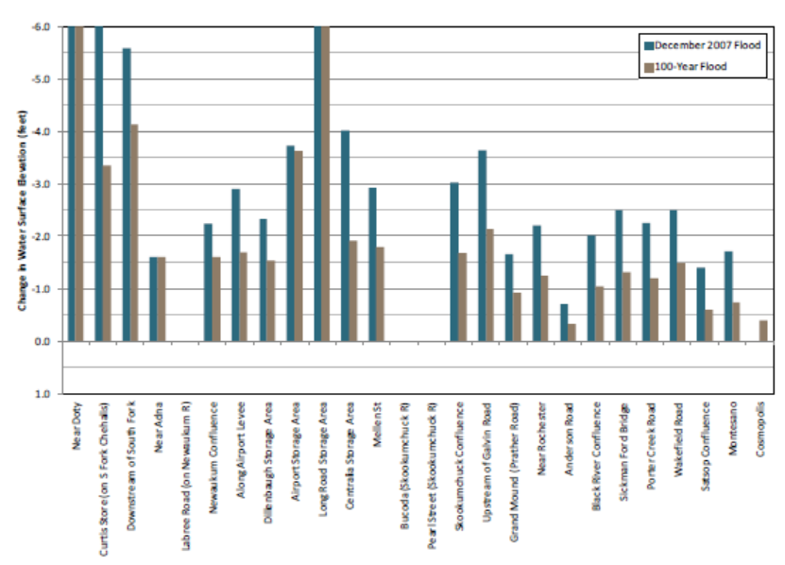
  Tools -- Hydraulic Analysis Model
Example: Basin-wide effects analysis (Chehalis Basin Flood Hazard Mitigation Alternatives Report 12/2012)
Table 1 (pg.70) -- “Mainstem Dam, Upper Chehalis”

Slide 16
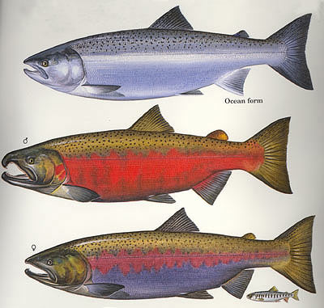
  Tools -- Fish Studies
Two significant fish studies conducted in Upper Basin (WRIA 23).
  Analyze effect of dam alternatives on Spring Chinook, Steelhead and Coho.
  Prioritize potential fish habitat enhancement opportunities.
Initial and preliminary projections . . .
Species | Multi-Purpose Dam | Flood Control-Only Dam | Fish Habitat Enhancement Measures
Spring Chinook | 20%  | 4%  | likely same as Coho
Steelhead | 7%  | 11%  | likely same as Coho
Coho | 1%  | 1%  | 4-5% 

Slide 17
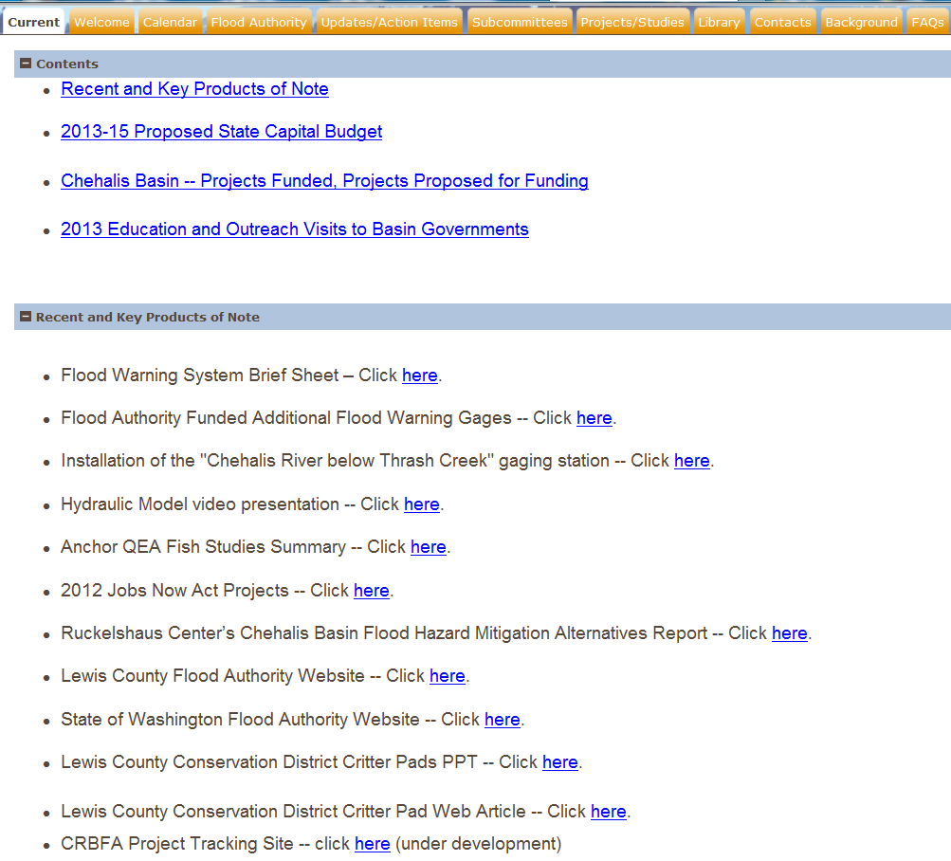
  Resources, Additional Information
Visit Flood Authority Web Library!
www.ezview.wa.gov

Slide 18
  Thank You!
Vickie Raines, Chair
Chehalis Basin Flood Authority
360/590-4100
vraines@cosmopolis.us.com
Edna Fund, Chair
Education and Outreach Subcommmittee (Flood Authority)
360/269-7515
Edna.Fund@lewiscountywa.gov
Karen Valenzuela, Vice-Chair
Chehalis Basin Flood Authority
360/786-5440
ValenzK@co.thurston.wa.us
Scott Boettcher, Staff
Chehalis Basin Flood Authority
360/480-6600
scottb@sbgh-partners.com
Dolores Lee, Pe Ell Rep.
Chehalis Basin Flood Authority
360/880-6615
rengel47@msn.com

