Slide 1

Preliminary Economic Analysis
Chehalis River Basin Flood District Formation
February 17, 2010

Slide 2
Purpose of Economic Analysis
Document the relative economic benefit from flood mitigation
Build upon prior studies and background data
  Flood damage and loss estimates
  Cost-Benefit study by EES Consulting
  Earth Economics study
  WSDOT/WSU I-5 closure study
  NFIP data
Conduct supplemental interviews
Utilize GIS and other data in the analysis
  Floodplain and Basin Area

Slide 3
Economic Benefits from Flood Mitigation
Reduced property damage
Avoided business losses
Avoided clean-up costs
Avoided transportation delays
Avoided infrastructure damage
Avoided public tax revenue losses
Avoided flood insurance loss payments
Enhanced property values
Health & safety benefits
Ecological benefits
Our Challenge:
finding consistent data to measure impacts by local jurisdiction

Slide 4
Economic “Benefit” Areas
Primarily includes:
Grays Harbor County
Lewis County
Thurston County
Chehalis Reservation
Areas of Special Concern
Floodplain Area
River Basin Area
Also: statewide benefits
Chehalis River Basin Flood District Formation

Slide 5
Overall Findings – 2007 Flood
Total economic losses from the December 2007 flood event were about $938 million
About 36% of these losses were statewide and 64% were regional
Category | Local/Regional Impact | Statewide Impact | Total
Local Business Disruption ¹ | $57,443,691 | - | $57,443,691
Property & Content Damage, Cleanup ² | $340,342,820 | - | $340,342,820
Transportation/Infra-structure Damage ³ | $86,696,488 | $23,374,900 | $110,071,388
Government Revenue Loss (tax dollars) | $70,087,199 | - | $70,087,199
Transportation Disruption ⁴ | $48,782,400 | $310,997,963 | $359,780,363
Total | $603,352,597 | $334,372,863 | $937,725,460
Notes:
¹ based on IMPLAN analysis for Lewis, Thurston, and Grays Harbor counties.
² reflects findings from Lewis County "One Year Later” report and Thurston County estimates.
³ reflects findings from Lewis County “One Year Later report.
⁴ includes findings from Lewis County “One Year Later” report and WSDOT estimates.
Compiled and adjusted to 2010 dollars by FCS GROUP, Inc.
Reflects items
1-6 from prior list of economic benefit measures
5

Slide 6
Potential Metrics for Comparing Local Economic Benefits
Should be reasonably consistent and accurate:
  Population, households and employment (US Census)
  County Assessor property valuation estimates
  Local business & economic activity
    Apply IMPLAN model to local job counts by sector
    Measure direct, indirect and induced impacts
    Economic Value added = gross domestic product that is “at risk” during a major flood event
  FEMA NFIP loss data (accurate?)
  Prior accounts of property losses (consistent?)

Slide 7
Potential Metrics for Comparing Benefits in Chehalis River Floodplain
Population and households (¹ 2000 & 2010 Census data)
Employment (² 2008 Census data)
Land Area and Assessed Values (³ local sources)
NFIP loss data (⁴ FEMA data not recommended)
Economic Value Added Per Day (⁵ IMPLAN data)
7

Slide 8
Potential Metrics for Comparing Benefits in Chehalis River Basin
Population and households (¹ 2000 & 2010 Census data)
Employment (² 2008 Census data)
Land Area and Assessed Values (³ local sources)
NFIP loss data (⁴ FEMA data not recommended)
Economic Value Added Per Day (⁵ IMPLAN data)
8

Slide 9
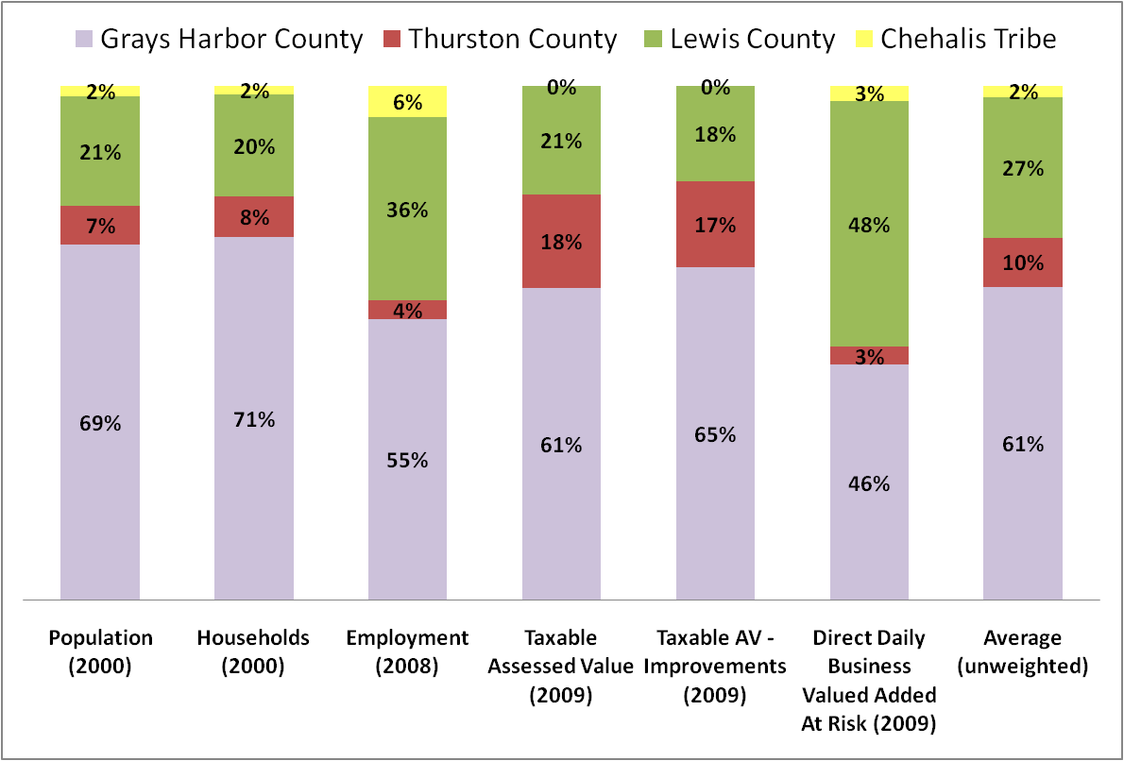
Potential Allocation of Benefits in Chehalis River Floodplain
9

Slide 10
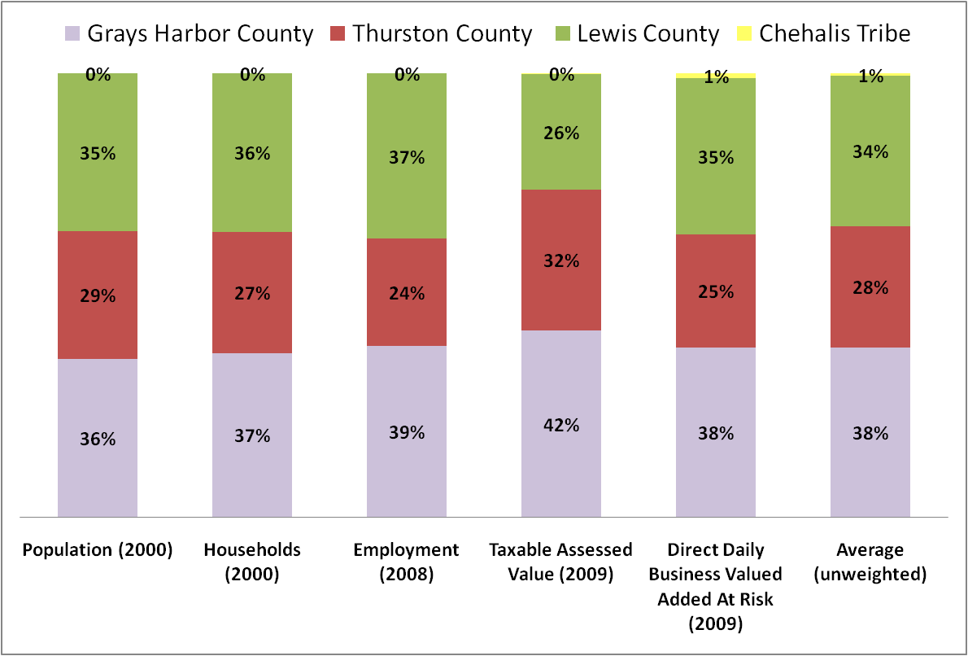
Potential Allocation of Benefits in Chehalis River Basin
10

Slide 11
Potential Construction Benefits
(per each million dollars spent on flood mitigation)
Each million in regional spending would generate:
  10.9 jobs (direct and indirect/induced impacts)
  $544,689 in labor income
  $901,676 in valued added (GDP)
  $1.4 million in economic output
Impact Type | Employment | Labor Income | Value Added | Output
Direct Impact | 6.9 | $394,890 | $660,167 | $1,000,000
Indirect Impact | 1.7 | $69,849 | $97,310 | $170,260
Induced Impact | 2.3 | $79,951 | $144,199 | $235,997
Total | 10.9 | $544,689 | $901,676 | $1,406,257
11

Slide 12
Key Questions for Today
Confirm locally preferred economic benefit metrics
Need to update findings with 2010 Census data?
Need to modify the floodplain or basin boundary assumptions?
12

